Slide 1
Mis-Information
Stocks
Justin Briley, Marc Kwiatkowski,
Nicholas Sheng, Jordan Stack
VT CS4624 Multimedia, Hypertext and Information Access
Virginia Tech, Blacksburg VA 24061
12/2/21

Slide 2
Outline
Background
System Context Diagram
Timeline
Scraper
Data Processing
Website
  Frontend
  Backend
Labelling
Lessons Learned
Future Ideas
Acknowledgements
References

Slide 3
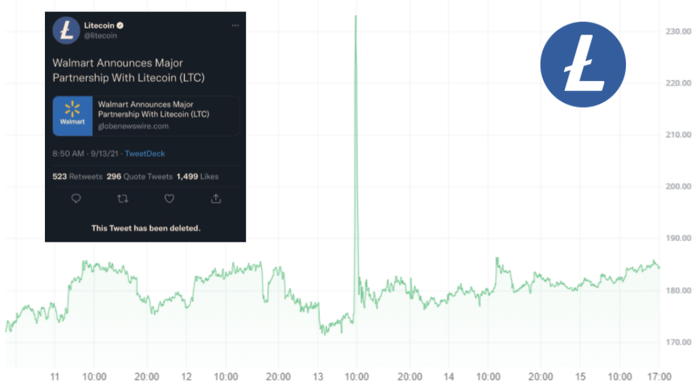
Background
Combination of two things we have interests in: the stock market and social media.
Interested in finding out if there is a way to predict stock market trends based on fake news
“Fake news articles generate about 83.4% more page views than a matched sample of legitimate articles” (https://hub.hku.hk/bitstream/10722/284479/1/Content.pdf?accept=1)

Slide 4
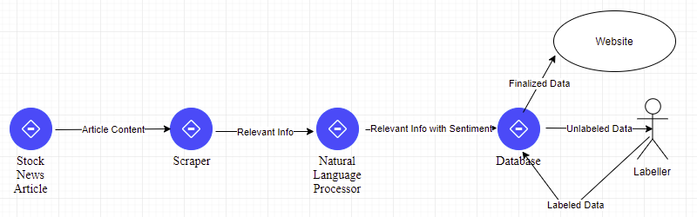
System Context Diagram

Slide 5
Timeline
9/16/21 : Presentation 1
9/24/21 : Identify sites to crawl
9/30/21 : Have web crawler working for any site/ complete wireframe
10/8/21 : Implement database and define models
10/15/21 : Build scraper for links collected
10/22/21 : Automate storage of data to database
10/29/21 : Deploy website and finish labeling data***
11/9/21 : Presentation 2 and start testing / validating
11/19/21 : Refine and streamline website design
12/7/21 : Complete code refinement and final paper

Slide 6
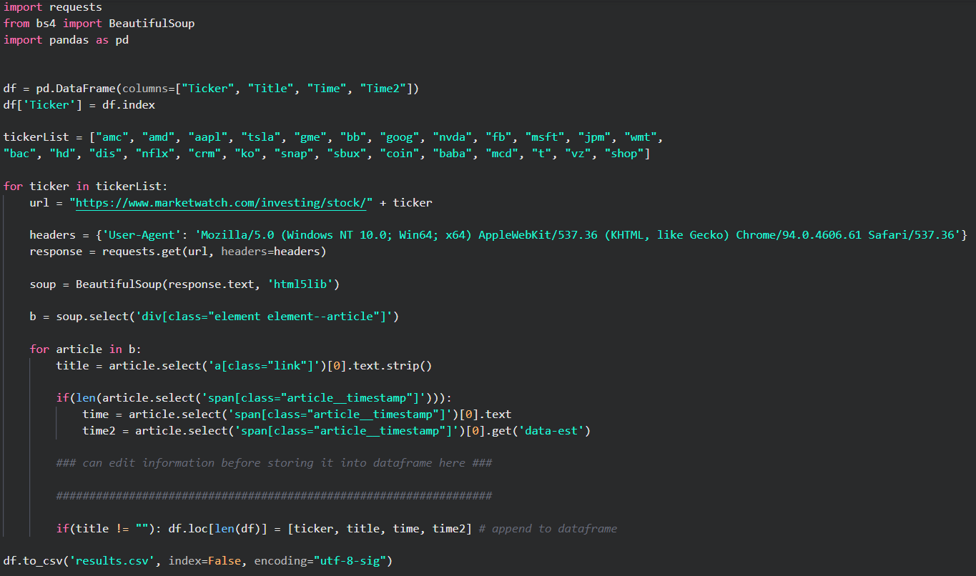
Scraper

Slide 7
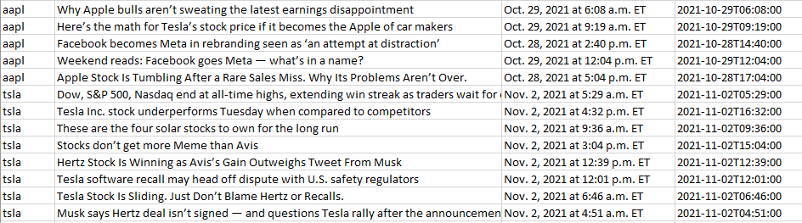
Results from Scraper

Slide 8
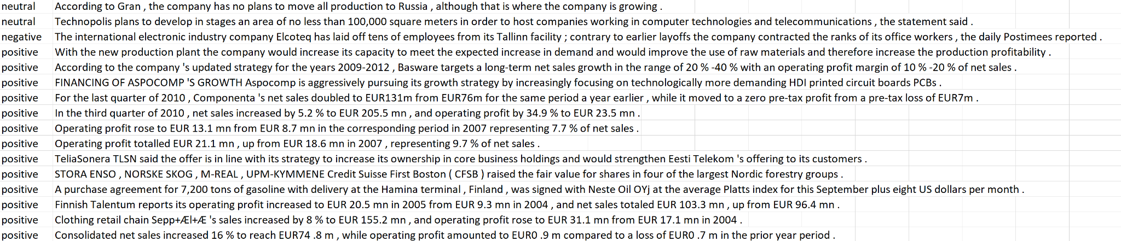
Data Processing
Misinformation
Sentiment

Slide 9
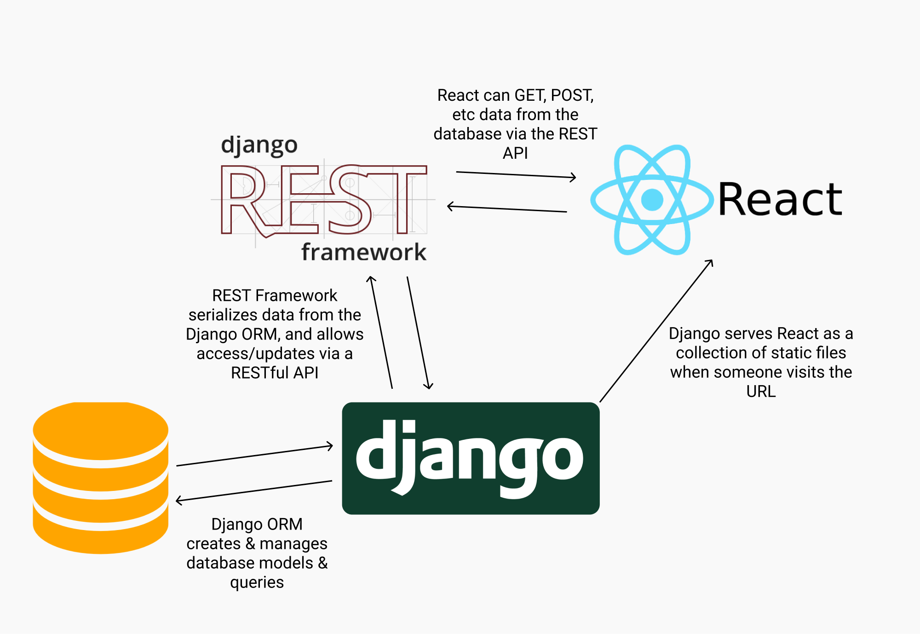
Website
Django Rest API+ React
Use Cases:
Download data
Access source code
Easier labelling
[1]

Slide 10
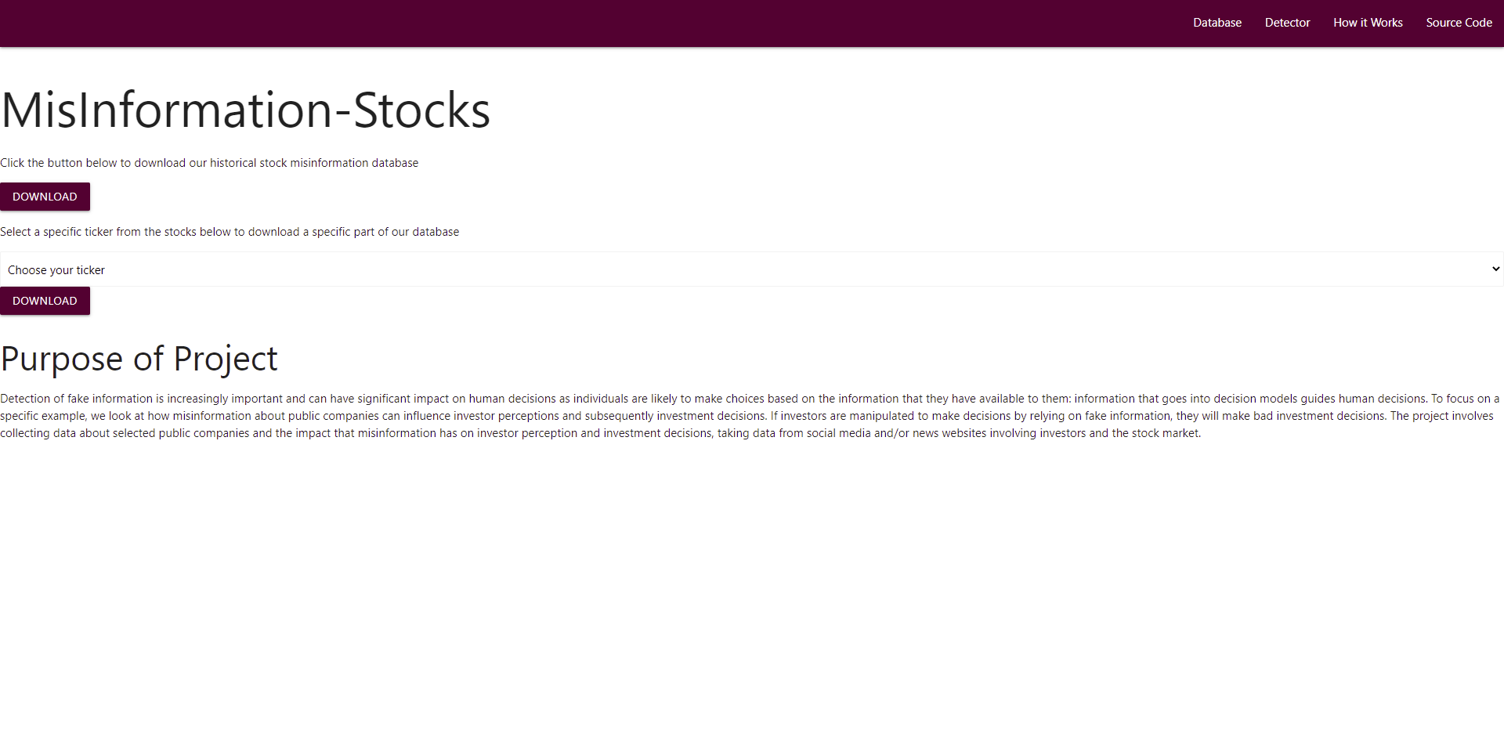
Frontend

Slide 11
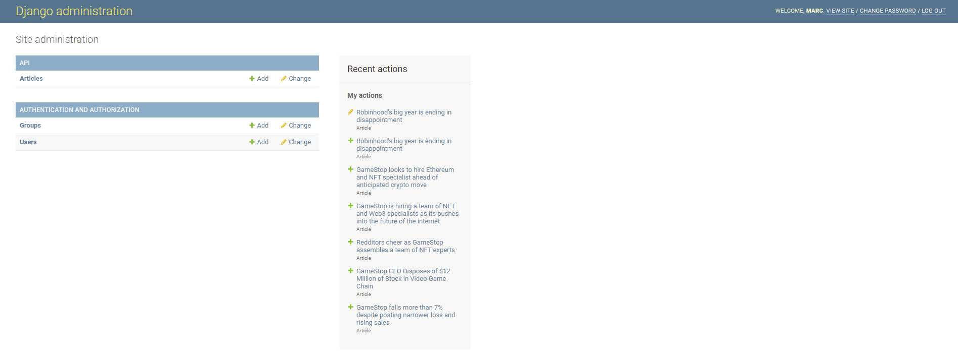
Backend

Slide 12
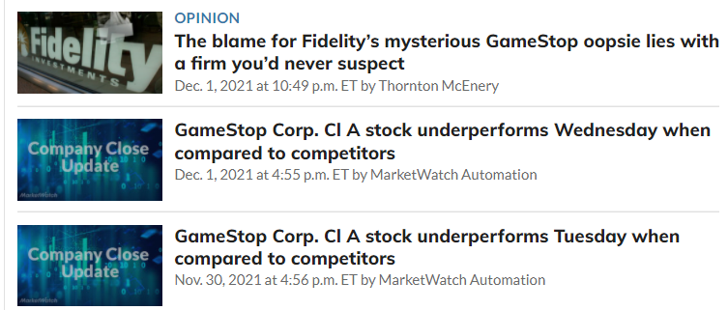
Labelling
Our final hurdle
Tedious, Time consuming
Must research every article
[3]

Slide 13

Lessons Learned
Define objectives
Narrow down scope

Slide 14
Next Steps
Real time data capture
  Able to constantly pull data from sources
  Store data efficiently
  Distinguish repeat articles
Misinformation Predictor
  Natural Language Processor
  Need a lot of training idea
Website
  Parameterized queries for CSV
  Allow anyone to submit data for review
  Show informative stock charts for desired ticker

Slide 15
Acknowledgements
Dr. Barkhi - VT KMPG Professor
Dr. Fox - VT CS4624 Professor

Slide 16
References
[1] B. Garner, “Build your first rest api with Django REST framework,” Medium, 28-Sep-2021. [Online]. Available: https://medium.com/swlh/build-your-first-REST-API-with-django-rest-framework-e394e39a482c. [Accessed: 03-Nov-2021].
[2] Sinha, A. (2020, May). Sentiment Analysis for Financial News, Version 5. Retrieved October 27, 2021 from https://www.kaggle.com/ankurzing/sentiment-analysis-for-financial-news.
[3] “GME stock price: GameStop Corp.. cl a stock quote (U.S.: NYSE),” MarketWatch. [Online]. Available: https://www.marketwatch.com/investing/stock/gme?mod=quote_search. [Accessed: 02-Dec-2021].

