Slide 1
Green Goes with Anything
Decreasing Environmental Impact of Digital Libraries at Virginia Tech
September 13, 2022
Alex Kinnaman, Digital Preservation Coordinator, alexk93@vt.edu
Alan Munshower, Digital Collections Archivist, alanmun@vt.edu

Slide 2
Introduction
Reevaluating sustainability across digital curation practices library wide
  Inter-departmental nature of digital curation and digital lifecycle
Prioritizing considerations for environmental sustainability
Investigating workflows of appraisal, digitization, fixity checking, and storage choices
Finding balance between best practices and environmental sustainability
Using K. Pendergrass et al. “Towards Environmentally Sustainable Digital Preservation” as a guide

Slide 3
Literature Review
US climate policy first emerged in early 1990’s, libraries and archives have been attentive decades prior
Early sustainability efforts in management of library and archival materials was mostly reflected in building design and construction
Proliferation of technology and digital materials has removed content managers from physical awareness of environmental impact of day-to–day work
K. Pendergrass et al. “Toward Environmentally Sustainable Digital Preservation”
  Provides framework for organizations to shift to environmentally sustainable goals
Large concern remains on the immediacy for new sustainable practices

Slide 4
Literature Review
Society of American Archivist (SAA)
  “Devise environmentally sustainable techniques for preserving collections and serving communities”
  “Developing acquisition, processing, storage, and service models—must necessarily involve an ongoing awareness of the impact of archival work on the environment”
Digital Preservation Services Collaborative (DPSC)
  Sustainability and Accountability are key values
National Archives and Records Administration of the United States (NARA)
  Climate Action Plan, with five action items
    “strengthening of NARA’s climate resilience by leveraging cloud-based solutions.”

Slide 5
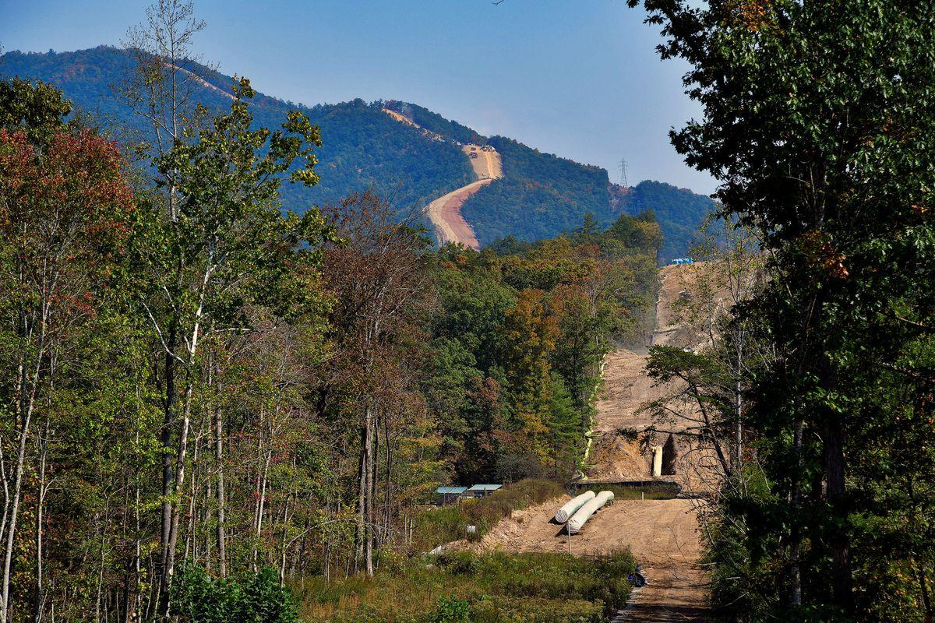
Literature Review
Library and broader institutional commitment to sustainability in mission statements and goals
State and Regional considerations - historical dependence on fossil fuels
Workers construct the Mountain Valley Pipeline near Elliston, Virginia, U.S. September 30, 2019. Picture taken September 30, 2019. REUTERS/Charles Mostoller/File Photo
Notes:
https://www.reuters.com/business/energy/equitrans-complete-us-mountain-valley-pipeline-2023-shares-soar-2022-08-02/

Slide 6
Methodology
Notes:
Methodology. [title card for next section]

Slide 7

Appraisal & Digitization
Stakeholders group reviews digitization proposals
Digital Imaging Lab creates Preservation Digital Objects to serve as surrogate of original object
  FADGI, Metamorfoze and ISO imaging guidelines
Production server and transfer of completed material to other departments managed by Digital Imaging Lab
https://makeameme.org/meme/ok-lets-digitalize

Slide 8

Power Consumption
Preservation activities consume power constantly
Storage and number of copies, fixity and fixity frequency, ingest, restoration, migration, virus checking, file format verification, access, etc
https://knowyourmeme.com/memes/darth-sidious-unlimited-power
Notes:
Like the Sith Lord, what we really want is unlimited power [in our case energy in the non-evil sense] to run all of the preservation activities we can to ensure access. All preservation activities are constantly consuming power in ongoing storage for multiple copies, fixity and fixity frequency, ingest and restoration, migration, etc etc.

Slide 9

Fixity
NDSA Fixity Survey 2017: 84.1% responded they run fixity
NDSA Fixity Survey 2021: 98% responded they run fixity
Neither NDSA nor DPC provide a best practice for frequency
Most digital preservationists in agreement that fixity is necessary for ingest and migration
Option to run fixity:
  Continuously
  Every XX days
  After any PREMIS event
  After ANY event
  Never
  Any combination, so many options
https://makeameme.org/meme/the-power-is-5b5a12
Notes:
However, knowing that we need that energy to perform these activities means we need to use it carefully, Yoda-style.
The 2017 NDSA Fixity Survey indicated that 84.1% of respondents indicated that they run fixity at some point, jumping to 98% of respondents in the 2021 Fixity Survey. It’s interesting to note that neither NDSA nor the DPC provide a single best practice for the frequency of fixity, but we all agree that fixity is absolutely necessary for ingest and migration. Without a best practice, there are many combinations of fixity frequency that can be tailored to individual needs and resources.

Slide 10
Fixity
Frequency best practices still up in the air and are based on need, resources available
Neither NDSA nor DPC provide a single best practice for frequency
Frequent/Continuous Fixity | Minimal Fixity (migration from one location to another) | Continuous Check in a Canonical Fixity Store (e.g. LOCKSS)
Faster repair | Slower notification and repair | Self-healing through multiple copies
Energy-consumptive | Intentional energy use | Low energy use/low bandwidth
Cost-prohibitive, particularly in the Cloud environment | Less costly | Requires lots of maintenance and time cost
Opens and reads the entire file | Opens and reads the entire file | Self-healing, does not need to open and read every file
Notes:
Broadly speaking, there are three types of fixity frequency that are currently used by various organizations.
Frequent or Continuous Fixity provides faster repair and faster notifications, but is highly energy-consuming and cost-prohibitive particularly if calculations are performed in the cloud. In contrast minimal fixity, e.g. only checking upon migration from one location to another, is much slower to notify and repair, but is much less energy-consumptive and at a lower cost. Both of these methods open and read the entire file to look for issues.
The third method is Continuous Checking in a Canonical Fixity Store, which is notably used by the LOCKSS system. This is a self-healing process through multiple copies that uses less energy and bandwidth for individual checks because it does not need to open and read every file. However, this method requires greater cost in time and maintenance to keep all of the caches active and updated.

Slide 11
Virginia Tech Fixity
Continuous
synced to
AWS secondary
migrated to
copied to
Local server
Staging server
AWS server
APTrust
MetaArchive
Content
ingested into either
post-digitization
Migration
Every 90 days
Migration
Every 90 days
LOCKSS
ingested into
uploads to
synced to
User
Figshare
Chronopolis
Data
Migration
Continuous
Notes:
Just to give a little context to point of fixity checks at Virginia Tech, this is a simple diagram showing the standard migrations from location to location (noted in rectangles) and the reason and/or frequency at that stage (in the grey circles). This only shows migration and doesn’t include additional preservation activities.

Slide 12
Assumptions for Calculations
Based on a study (1) examining energy measurements of standard security functions, MD4 and MD5 are the least energy-consumptive hash algorithms
Hash for a 10kb file consumed ~5mj
Hash for a 1mb file consumed 40mj
Energy consumption also dependent on energy source (coal, gas, petroleum) with coal having the highest impact at 54%; and on time of day (peak hours vs. middle of the night)
Second study (2) quality and energy efficiency in hashing algorithms of mobile devices found that ound a 29% difference in battery life between choosing the highest and least energy-consuming hash.
“Consumption increases with the size of the file”
1. R. Damasevicius , G. Ziberkas, V. Stuikys, and J. Toldinas, “Energy consumption of hash functions,” Elektronika ir Electrotechnika, vol. 18, no. 12, pp. 81-84, April 2012. https://pdfs.semanticscholar.org/7f43/7af19922bda1fe845b663290440e359d21ff.pdf
2. P. Harish, “Towards designing energy-efficient secure hashes,” University of North Florida Digital Commons Graduate Theses and Dissertations, 2015. https://digitalcommons.unf.edu/etd/598/
Notes:
For our investigation into the energy cost of fixity checking at Virginia Tech, we primarily draw from two different studies on similar previous work. The first study first tested different types of fixity and found that MD4 and MD5 are the less energy consumptive hash algorithms. They also tested various file sizes and found that “consumption increases with the size of the file” as noted in the two examples on the slide. Another concept they introduced was energy consumption is dependent on the energy source, e.g. coal, gas, petroleum) with coal being the most impactful, and on the time of day the fixity is run, e.g. during peak hours versus the middle of the night.
The second study is a little further removed from our goal in the project, but they examined the quality and energy efficiency in hashing algorithms of mobile devices found that ound a 29% difference in battery life between choosing the highest and least energy-consuming hash. This is important to note that there is a significant energy difference in using various forms of fixity checking.

Slide 13
Storage
Storage choices and number of copies intertwines directly with fixity
Robust digital preservation means distributed digital preservation storage, preferably with administrative diversity, and multiple copies
NDSA Levels of Preservation V2 recommends a minimum of 3 copies and LOCKSS maintains 5 copies
Bethany Scott at the University of Houston Libraries inventoried all of the hardware components of their access and preservation infrastructure to measure electricity usage
She concluded that focusing on ZFS fixity checking and decreasing file format resolutions would be the best way to optimize their local hardware to decrease environmental impact
Notes:
Moving on to Storage, we examined the number of copies we maintain because the number of copies directly affects the number of times fixity is calculated.
It’s been well-established that distributed digital preservation storage with administrative diversity and multiple copies is a best practice for preservation storage. NDSA currently indicates that a minimum of 3 copies is ideal and LOCKSS maintains 5 copies, previously 7 copies.
A third study we draw from was conducted by Bethany Scott at the University of Houston Libraries who inventoried all of the hardware components of their access and preservation infrastructure to measure electricity usage. She concluded that focusing on ZFS fixity checking and decreasing file format resolutions would be the best way to optimize their local hardware to decrease environmental impact. The previously discussed studies indicated that the larger files consume more energy so we know that file size affects both storage and fixity.

Slide 14
AWS Storage
VTUL is highly reliant on AWS
AWS claims to have a 72% reduction of carbon emissions from their data centers when compared to other enterprise data centers
A research team attempted to test these claims by building a dataset of CO2e emissions from AWS’s EC2 hardware to attempt to estimate the impact of EC2 hardware on carbon emissions.
  They found that it was difficult to measure the distribution of emissions over time due to the limited lifespan of a server, but ultimately produced a dataset available for revalidation and manipulation.
  Others have claimed that cloud computing and storage is significantly more energy-consuming than saving to a disk, but that any security-driven disk server will consume more energy than an energy-saving disk server
D. Bizo, “The carbon reduction opportunity of moving to Amazon Web Services,” AWS, October 2019. https://sustainability.aboutamazon.com/carbon_reduction_aws.pdf
Notes:
For this presentation, we can’t avoid discussing Virginia Tech’s reliance of AWS. AWS does claim to have a 72% reduction of carbon emissions from their data centers compared to other enterprise data centers, but in another study attempted to test these claims it was very difficult to measure the distribution of emissions over time due to the limited lifespan of a given server. It’s also interesting to note that other studies have claimed that cloud computing and storage is significantly more energy-consuming than saving to a disk, but that any security-driven disk server will consume more energy than an energy-saving disk server.

Slide 15
Limitations
Scope: Archival appraisal; digitization workflows; fixity frequency; storage options
Out of scope: All other data lifecycle activities; cloud computing actions; financial cost
Using approximate numbers based on others’ research
Highly qualitative to provide recommendations and new areas of exploration

Slide 16
Results

Slide 17
Appraisal & Digitization Methods
VTUL SCUA mission to provide materials in digital format “when possible”
Advisory Council for Digital Collections selection rubric focuses on mission-specific projects and technical details
  Could be a logical check on unsustainable digital projects in pipeline
Departmental collection digitization prioritization focuses on time/effort, access restrictions, copyright, uniqueness, etc
  Sustainability goals not a component of prioritization
  Clarify prioritization decisions when submitting proposals
Cleanup of preservation copies to reduce redundancy

Slide 18
Fixity Estimation References
mj | millijoule | One thousandth of a joule “the derived unit of energy, work and heat”
w*s | watt-second | The power of one watt sustained for one second
kWh | watt-hour | The power of one watt sustained for one hour
MT | megatonne | One million tons
CO2e | carbon dioxide equivalent | the number of metric tons of CO2 emissions with the same global warming potential as one metric ton of another greenhouse gas
Notes:
Our fixity results will be referring to several measurements so this table is only in here for future reference.

Slide 19
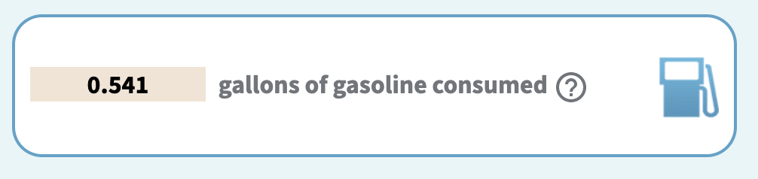
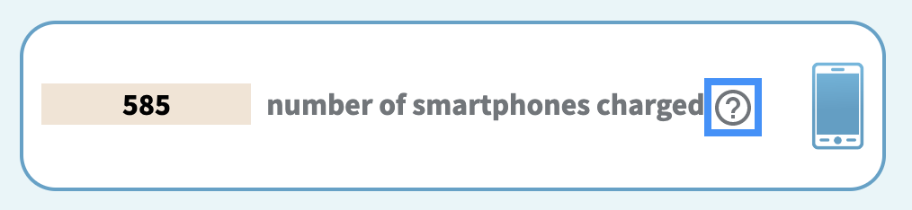
Fixity Calculations
Assuming library digital objects are of a larger size, this example is a calculation for a 1 MB file and 1 TB file with an MD5 checksum
Size | Millijoule | Wass-second | Watt-hour | Kilogram
1 MB | 40mj | 0.05 W*s | 1.111111111E-8 kW*h | --
1 TB / 1,000,000 MB | 40,000,000mj | 40,000 W*s | 11.111111 kW*h | 2.59 kg CO2e
epa.gov/energy/greenhouse-gas-equivalencies-calculator
Notes:
Our first calculation is assuming that library digital objects are of a larger size. This table shows the calculations for a 1 MB file and a 1 TB file using an MD5 checksum. A 1 MB file is very small and doesn’t have a great impact for a one-time fixity check; however, a 1 TB file or collection of files does produce a measure amount of carbon dioxide equivalent.
A neat tool on the United States Environmental Protection Agency lets you translate equivalent energy consumptions, showing that fixity on 1 TB of digital content is the equivalent to half of a gallon of gas, or 585 smart charges.

Slide 20
Fixity Estimations for Virginia Tech digital library*
*Current to March 2020
Summarizes a single fixity check for each digital object in one VTUL digital library
Storage Location | Fixity Freq. | Size in TB | Kilogram CO2e
Local high speed server | Nightly | 11 | 28.59 CO2e
Local NAS server | Nightly | 10 | 25.9 kg CO2e
AWS East Region | Every 90 days | 1 | 2.59 kg CO2e
AWS West Region | Every 90 days | .5 | 1.3 kg CO2e
APTrust | Every 90 days | 6 | 15.54 kg CO2e
MetaArchive | Every 90 days | 5 | 12.95 kg CO2e
 |  |  | 86.87 kg CO2e
Notes:
This table, which is current to March 2020, summarized a single fixity check for each digital object (on average) in only the Virginia Tech Digital Library. With an approximate 33.5 TB of content and using the previous energy calculation, a single fixity for this amount of content is 88.87 kg of carbon dioxide equivalent.

Slide 21
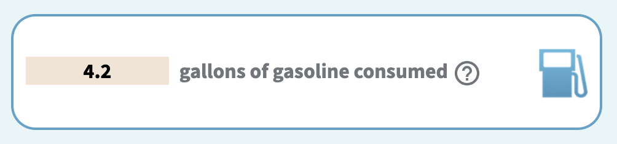

86.87 kg
CO2e
epa.gov/energy/greenhouse-gas-equivalencies-calculator
Notes:
Using the same equivalencies calculator from the EPA website, this is equivalent to 4.2 gallons of gas, or 4571 smartphone charges.

Slide 22
Fixity Results
The environmental impact of running fixity is very complicated to define
Validating these results would involve a time-intensive research study in collaboration with our IT division, vendors, and preservation vendors
  Currently no support or bandwidth to perform
If our final result of 86.87 kg CO2e for running a single fixity check on all of our approximate data is even close to accurate, this is cause for concern and an a motivation to modify workflows
Notes:
Ultimately, the environmental impact of running fixity is very complicated. These results are based on other’s research and validating even our small investigation would be a time-intensive study in collaboration with our IT division and vendors, which we currently do not have the support or bandwidth to perform.
However, if our result of 86.87 kg of carbon dioxide equivalent is anywhere near accurate, this is concerning and is clear motivation for us to begin modifying our workflows.

Slide 23
Storage Considerations
VTUL has designated 4 levels of preservation
Not all content is maintained at all levels
In terms of the number of storage locations, the levels are as follows:
  Level 0 is no preservation action taken;
  Level 1 basic preservation is 1-2 local copies, 1 cloud copy;
  Level 2 extended preservation is 2 local and 2 cloud copies;
  Level 3 Advanced preservation is 2 local copies, 2 cloud copies, and ingest into one of our two distributed storage locations, APTrust or MetaArchive
Most of our content is designated at a Level 2
Notes:
In terms of storage, VTUL has 4 levels of preservation ranging from no preservation action taken at level 0, all the way to maintaining 2 local copies, 2 cloud copies, and ingest into either APTrust or MetaArchive. Most of our content is in the middle at level 2.

Slide 24
Minimum Number of Copies
Storage Location | Medium | Geographical Location | Purpose | Minimum Number of Copies
Local NAS | Disc | Virginia | Working/staging server | 1
AWS East Region | Cloud | Virginia | Primary cloud storage | 1
AWS West Region | Cloud | Oregon | Secondary cloud storage | 1
APTrust (AWS) | Cloud | Virginia, Oregon | Preservation storage, admin. diversity | 3
MetaArchive (LOCKSS) | Various disc | Varies | Distributed preservation storage | 5
Chronopolis (Figshare) | Cloud + Disc | Virginia, Oregon, California | Figshare preservation | 1
Notes:
Within all of our storage locations, this table shows the location, medium, geographical location, purpose, and the minimum number of copies that might be maintained. We have a mix of cloud and disc storage spread throughout the United States for various purposes.

Slide 25
Lots of copies and lots of checksums do keep stuff safe, but can we articulate the value of these choices and still account for the carbon footprint?
Notes:
The big question is that lots of copies AND lots of checksums do keep stuff safe, but can we really articulate the value of these choices and still account for the carbon footprint?

Slide 26
Yes [but]
Yes we still value our digital library storage choices
Our local servers are for creating and staging content for ingest
Our AWS serves as both a backup for our disc servers as well as access and preservation for our digital library
All of our preservation options are for geographically distributed preservation storage, administrative diversity, and technology diversity
We commit to the number of copies we maintain and the storage we have chosen
But
We need transition to relying more on our appraisal system, both pre-digitization and for preservation
We need to better distribute preservation objects within our storage spaces to optimize those storage spaces
Notes:
Our conclusion is “yes, but…” We believe we are following best practices for storage choices by having our local servers, AWS servers, and preservation subscriptions for strong storage diversity. We also commit to the number of copies we maintain.
However, we need better and more selective appraisal both in pre-digitization workflows and for preservation. We also need to better distribute preservation objects in our storage spaces to better optimize those spaces and decrease reliance on any one location.

Slide 27
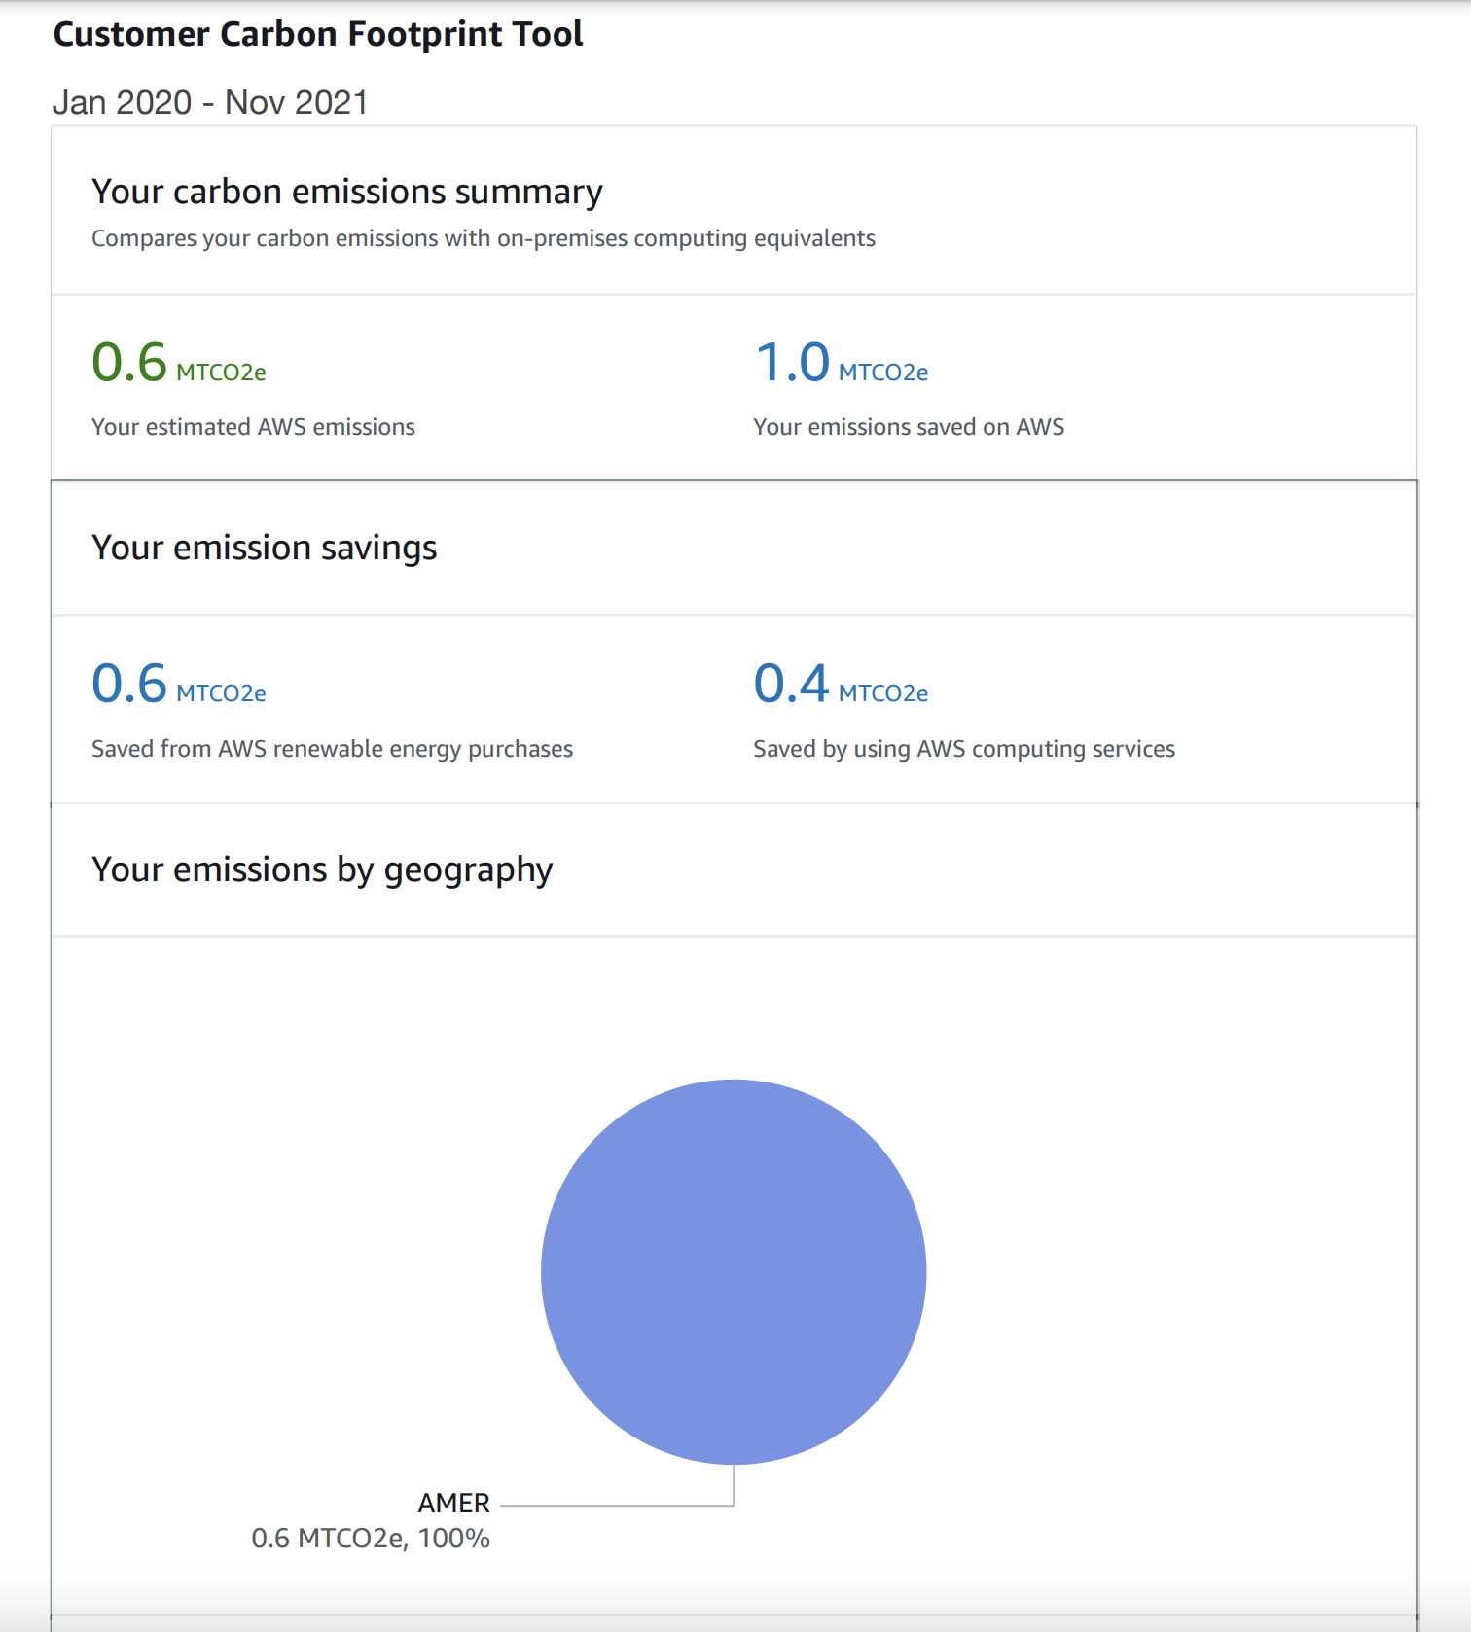
Amazon Web Services Customer Carbon Footprint Tool
New tool to track carbon emissions over time and over geographic location, specially measuring Scope 1 and Scope 2, or direct emissions and indirect emissions, of content in AWS
Notes:
One other quick thing to note is that AWS has recently released a Customer Carbon Footprint Tool to track carbon emissions or time and geographical location to measure direct and indirect emissions of content in AWS. We had to figure out how to get this and one of our amazing Systems Engineers finally got a hold of a copy of ours measuring from January 2020 to November 2021. The image on the right is the broad overview.

Slide 28
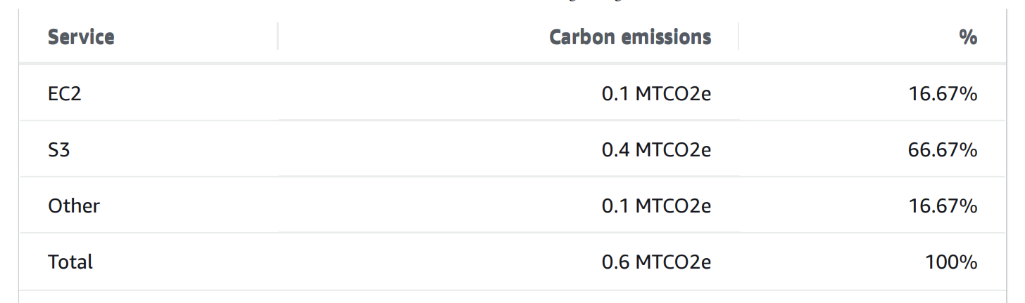
Amazon Web Services Customer Carbon Footprint Tool
We emitted 0.6 MTCO2e and AWS claims that we have saved 0.4 MT CO2e as compared to “on-premises computing equivalents”
S3 is the feature generating the most carbon emissions
As it is a new feature we are still learning how to read the information and understand the true impacts of the numbers, and we will continue to monitor it as we increase activity in AWS
Notes:
According to the breakdown from this tool, Virginia Tech emitted 0.6 megatons of carbon dioxide equivalent, and claims that we have saved 0.4 megatons by using them. S3 storage is generating the most carbon emissions.
This is a new feature and we really still don’t know what to do with it - we’re working on understanding the actual impact of these numbers and it’s something we can continue to monitor over time as we increase activity in AWS.

Slide 29
Storage Results
The environmental impact of digital library storage choice is, surprisingly, very complicated to define and is impacted by the various workflows, number of copies, distribution of copies, and independent needs of the collection
We a have not determined what Pendergrass et. al. describes as acceptable loss - the “level of acceptable loss in collection under [our] care” to make better use of what resources we do have
Appraisal at all workflow steps is key
Energy efficiency is predominantly measured by financial cost rather than environmental cost
  E.g., the AWS Carbon tool is located in the AWS Billing Console under Cost & Usage Reports, emphasizing financial cost
Notes:
As with fixity, environmental impact of digital library storage choices is also very difficult to define. We have not determined what Pendergrass et. al. describes as acceptable loss - the “level of acceptable loss in collection under [our] care” to make better use of what resources we do have, indicating improved and increased appraisal is necessary. Another aspect we found interesting to note is that energy efficiency is almost always measured by financial cost rather than by environmental cost. Libraries are businesses and energy consumption is usually conveyed in terms of money, but measuring the environmental impact would not only help us to decrease that impact, but could have a positive impact on financial costs as well.

Slide 30

The Real Result…
GIF from Bill Nye's Global Meltdown Climate Change Documentary
https://giphy.com/gifs/netflix-jay-z-xUA7b6VK1kfM5QxYNq
Notes:
Really though, the big takeaway here is best summarized by Bill Nye. We’ve got a lot of problems and they’re all DIFFICULT.

Slide 31
Recommendations
Notes:
We have several broad recommendations that we believe will move VTUL into a greener state in terms of our digital libraries and workflows.

Slide 32
Include climate considerations in appraisal of digital collection projects
The long term environmental impact of digitizing a collection should be considered alongside other factors in collection selection.
Notes:
First, we need to include climate consideration during the appraisal workflow for digital collections. Long-term impact of digitizing large collections is largely unknown and needs to be considered alongside other factors in collections selection.

Slide 33
Reduce ongoing fixity checks
We recommend reducing scheduled fixity checks of all AWS objects from every 90 days to every 120 days or possibly more
Increase spot-checking fixity from a randomly selected subset of files in each digital collection
Increase test restorations to account for the decreased fixity checking.
Notes:
Reducing ongoing fixity checks is a conversation that has been happening more and more in the digital preservation field, and after this investigation into VTUL fixity practices, we recommend reducing scheduled fixity checks in AWS from every 90 days to possibly every 120 days, as a start. To account for this, we should increase spot-checking fixity from a randomly selected subset of files in each collection, and increase test restorations to account for the decreased fixity checking.

Slide 34
Determine acceptable loss
Reducing security will reduce energy consumption
We need to determine acceptable loss for each of the storage vendors we contract with and alter our workflows with mechanisms for faster healing to compensate for any loss
Notes:
Referring back to the Pendergrass et. al. paper, we must determine our acceptable loss. Our IT Division has similar protocols in their software, and the same should be applied to our collections. Simply, reducing security (e.g. hashes) will reduce energy consumption. We need to determine acceptable loss for each of the storage vendors we contract with and alter our workflows with mechanisms for faster healing to compensate for any loss.

Slide 35
Preservation appraisal
Expand on our defined levels of preservation
Modifying them to include more direct appraisal strategies and a determination of acceptable loss for each level
Notes:
As noted in a previous slide, we must investigate stricter preservation appraisal methods by expanding on our current levels of preservation and modifying them to incorporate more direct appraisal. Shoutout to Nathan Tallman in the room for already having resources available for preservation appraisal for us to begin working on this component!

Slide 36
Revist collection policies and institutional mission
Adjusting an existing collection policy or mission to reflect a commitment to sustainably manage digital resources and guide future decision-making
This may include a goal to reduce carbon emissions from the digital library, reflecting new methods for appraisal

Slide 37
Decrease redundancy of working files
Streamlining the transfer process to minimize the multi-department storage redundancy of working files
Understanding that redundancy is a necessity, determine which stages of the collection management process should be the most secure
Schedule a process for deletion after migration and quality assurance

Slide 38
Investigate smaller object sizes
The size of a digital object directly impacts the energy consumed in running fixity, transferring between storage locations, and ongoing storage maintenance
Explore collections or data types where there are options for creating lower resolution or otherwise smaller objects

Slide 39
Sustainability commitment
As an organization, we recommend that VTUL develop a Sustainability Statement for the Digital Libraries at VTUL to scope our work and to emphasize not only the importance of but the immediate need for greener digital library curation strategies

Slide 40
Community training
The Libraries are responsible for keeping up with digital trends and practices and educating the University and larger community
Develop regular Professional Development Network training sessions on ensuring good practices in personal and professional archiving that also emphasize environmental sustainability

Slide 41
Next Steps
Notes:
All of our recommendations are broad but offer us a first step as an organization.

Slide 42
Long-Term Goals
Exploring time and money spent on all of these steps to reinforce the areas where we need improvement on multiple levels
Explore other preservation activities including migration, restoration, transfer and syncing, file format verification, alternate storage opportunities, and appraisal
Validate energy consumption numbers by collaborating with our IT Division and vendors
Notes:
In the long term, we do want to explore the time and money expended at all of these steps to really identify and reinforce areas of improvement. We also want to explore other preservation activities for energy consumption to determine what is justifiable to run more often and what should be performed sparingly. Finally, we would love to actually validate the energy consumption numbers in this investigation by collaborating with our IT Division and vendors.

Slide 43
Thank you!
Alex Kinnaman
Digital Preservation Coordinator
Virginia Tech University Libraries
alexk93@vt.edu
@alex_kinnaman
Alan Munshower
Digital Collections Archivist
Virginia Tech University Libraries
alanmun@vt.edu
Questions?
Notes:
Thank you all for listening to our talk! We would love to answer any questions you have, and our contact information is on the slide. While Alex could not join in person today, she is in the chat ready for questions!

