Slide 1
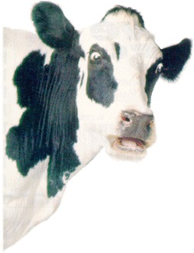
Raw Milk:
Health Craze or Just Crazy?
Dr. Andy Overbay
Teacher Recertification
July 11, 2016

Slide 2
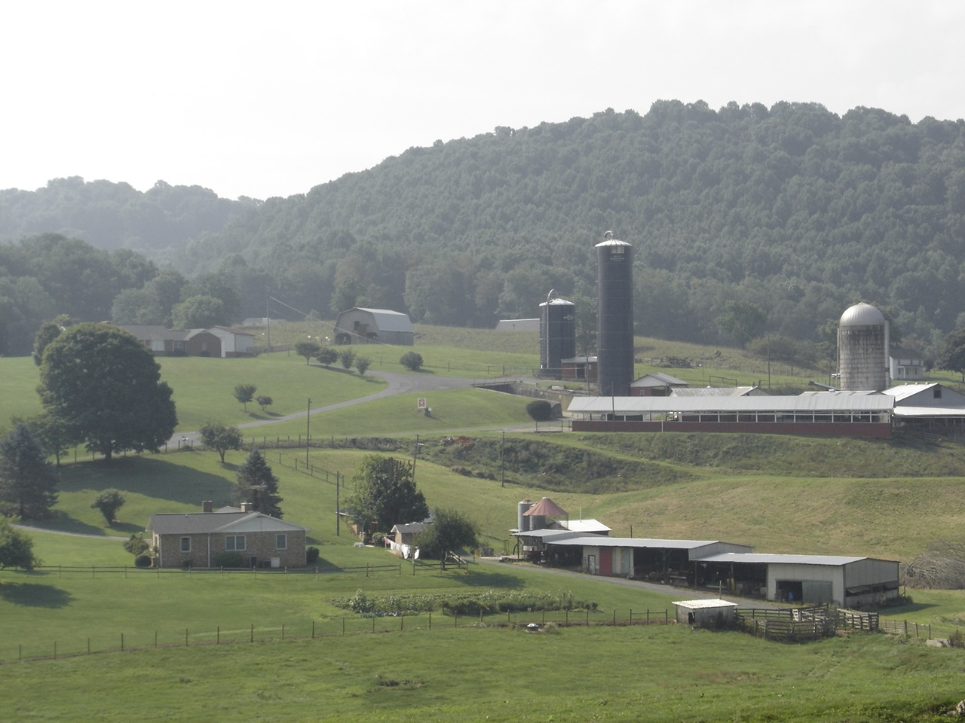
“I was raised on raw milk”

Slide 3

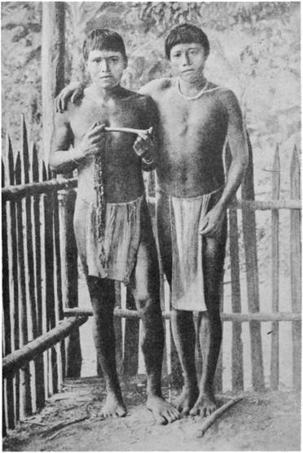
It’s a question of immunity

Slide 4
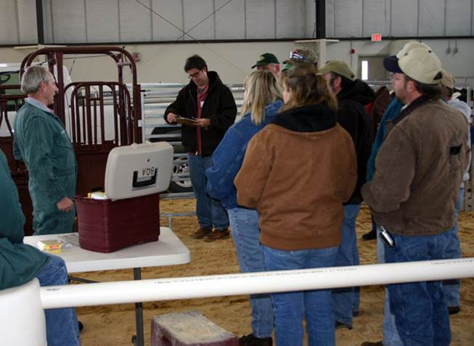
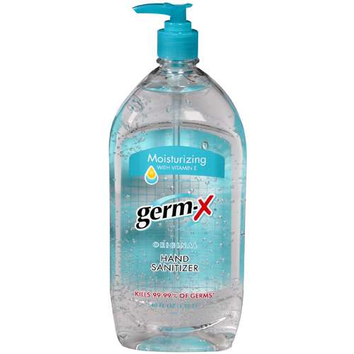
Modern Lesson on Immunity

Slide 5
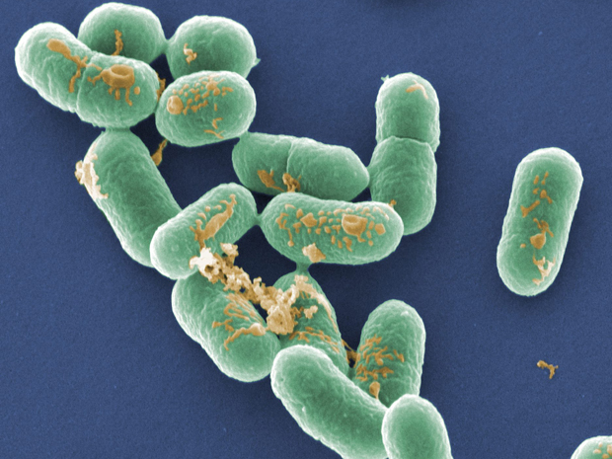
Pathogen Possibilities
E. Coli
Salmonella
Listeria
Campylobacter
Cryptosporidium
Brucellosis
Tuberculosis
Staphlococcus
Streptococcus

Slide 6
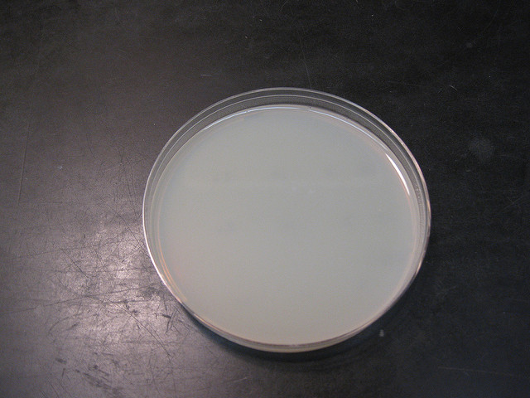
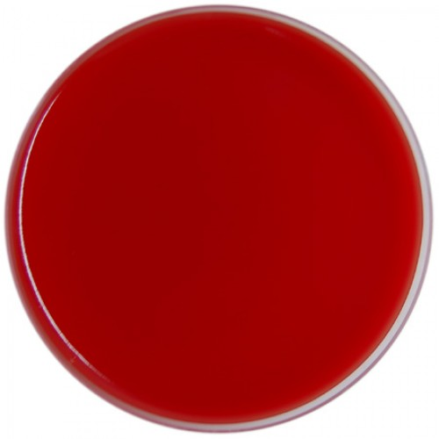
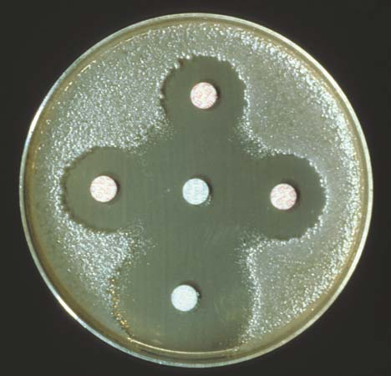
Two Agars
BLOOD
MILK

Slide 7
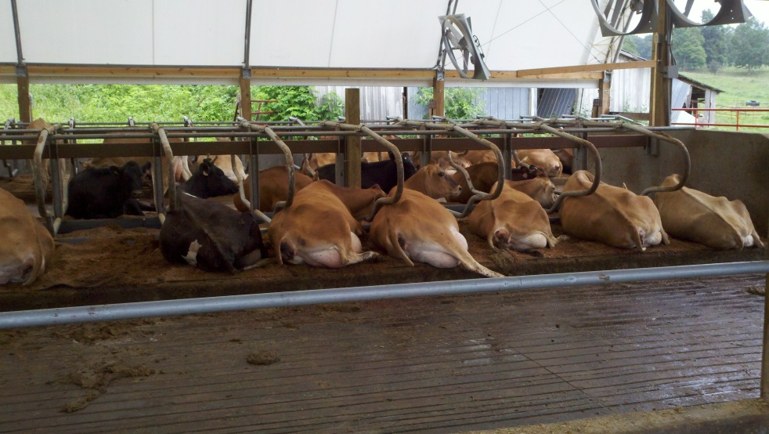
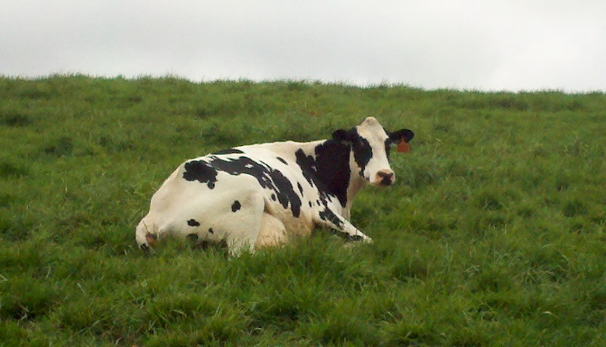
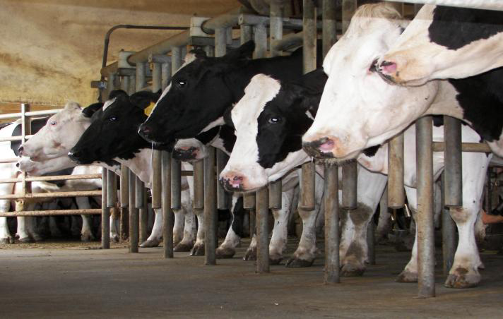
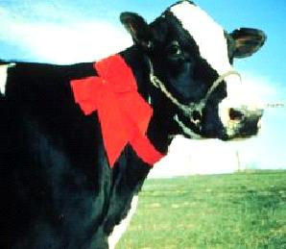
Pick out the healthiest cow

Slide 8
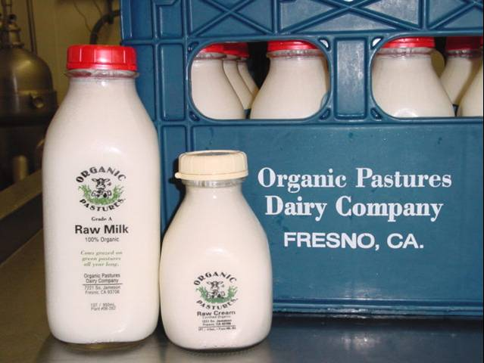
“Our farm is pathogen free!”

Slide 9
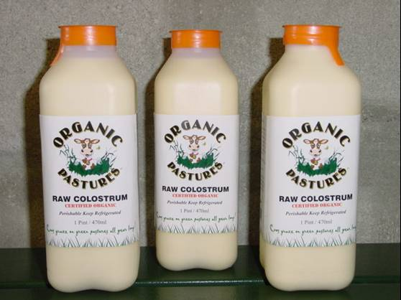

Slide 10
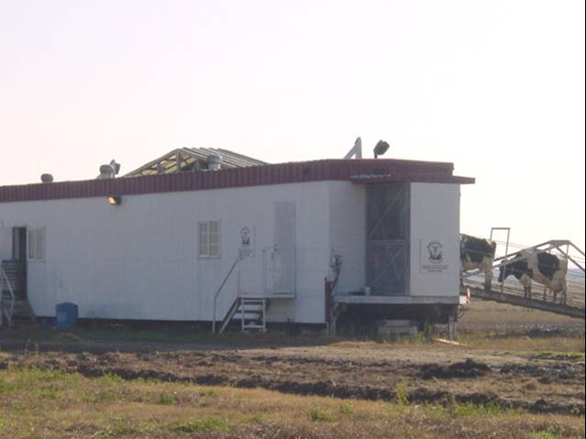
Portable Dairy

Slide 11



Barn Moving Day

Slide 12
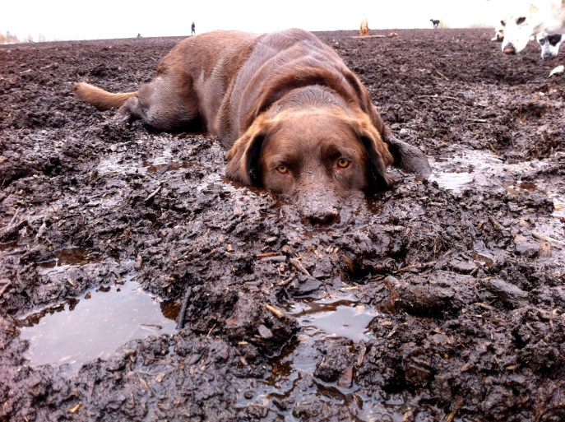
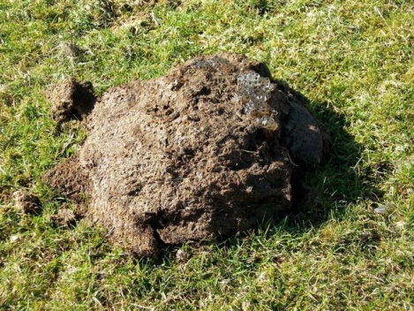
Pathogen Math
Pathogens

Slide 13
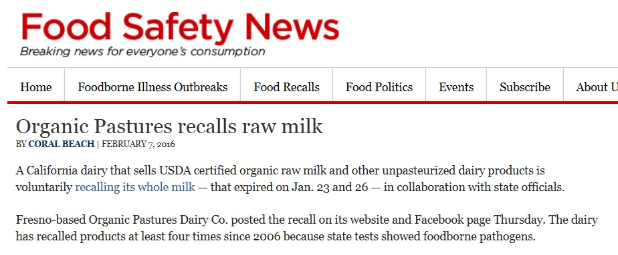
Oops?

Slide 14
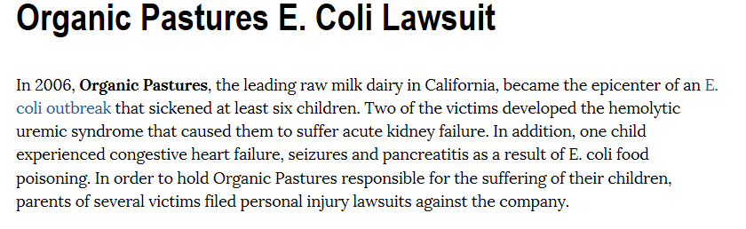
Ouch!

Slide 15
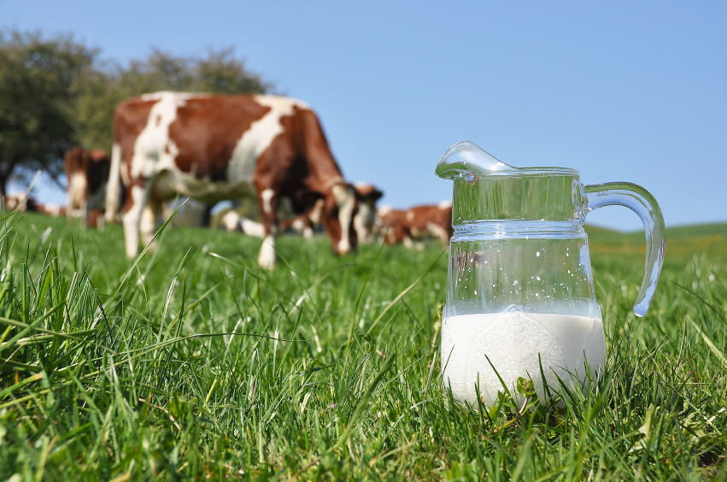
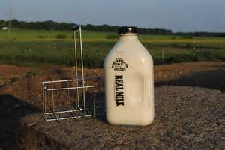
Cow Shares

Slide 16
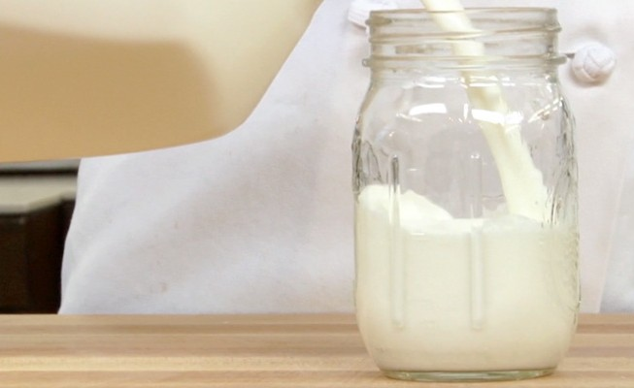
Milk in a Mason Jar

Slide 17
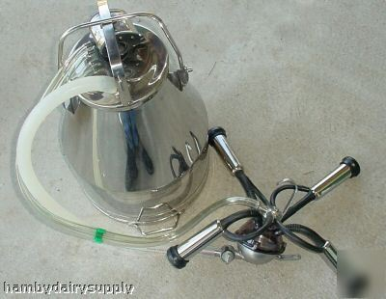

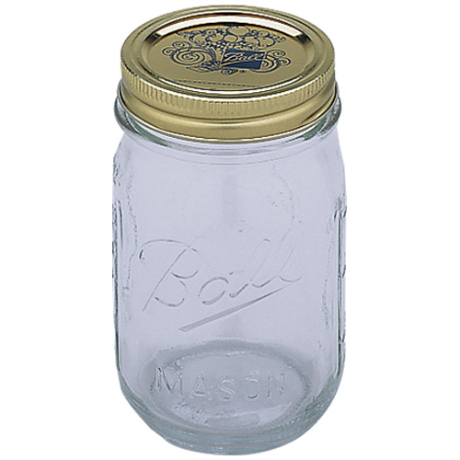
Milk Handling???

Slide 18
Glass
Is an excellent insulator
Lets UV light through
Requires sterilization

Slide 19
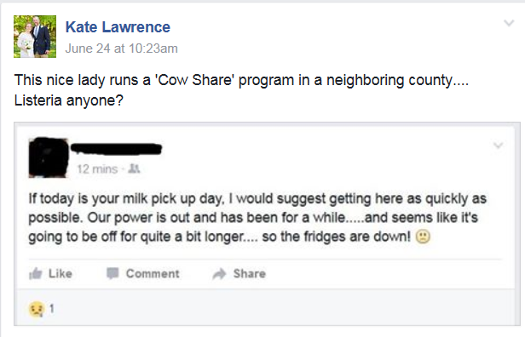
Profit over Safety

Slide 20
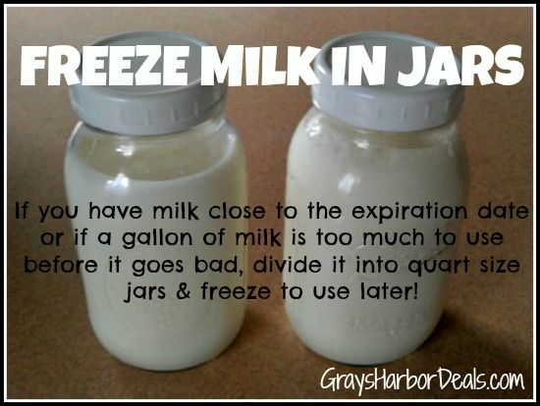
Poor Handling and Bad Advice

Slide 21
An Attack on Freedom?
Food and Drug Administration
Centers for Disease Control
American Medical Association
American Association of Pediatrics
State Departments of Public Health
Extension Nutritionists
Food Science and Technology Departments

Slide 22
CDC
"Abundant evidence has shown that raw milk serves as the source of bacteria that cause outbreaks of disease in humans: in recent years, most frequently salmonellosis and campylobacteriosis.
In the investigations of such outbreaks, the epidemiologic evidence, combined with knowledge about the occurrence of specific pathogens in cattle and the isolation of some of these pathogens from raw milk, leaves no doubt that raw milk is a vehicle for disease in humans."

Slide 23
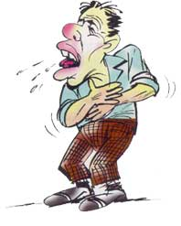
Final Thought
What’s Your Deductible?

