Slide 1
Final Presentation:
Neural Network Doc Summarization
CS4624 Multimedia, Hypertext, and Information Access
Team: Junjie Cheng
Instructor: Dr. Edward A. Fox
Virginia Tech, Blacksburg VA 24061, Apr 30th, 2018

Slide 2
Outline
Project Overview
Data Preprocess
Model Architecture
Training
Model Performance
References and Acknowledgements

Slide 3
Project Overview
Purpose: generate summarization from long document through deep learning.
Model: sequence to sequence model with RNN.
Dataset: CNN/Daily Mail news.

Slide 4
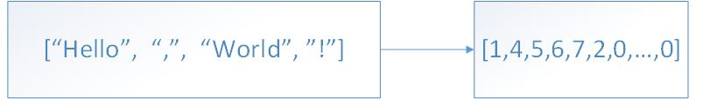
Data Preprocess
Vocab size: 50000
Input sequence max length: 400
Target sequence max length: 100
Notes:
The vocabulary size is 50000. Input sequence max length is 400 and the target sequence max length is 100. Right now, processing long sequence is still challenging for deep learning. Therefore, I pick only short articles from the dataset. After processing, the articles and the abstracts are converted to tokens like this.

Slide 5
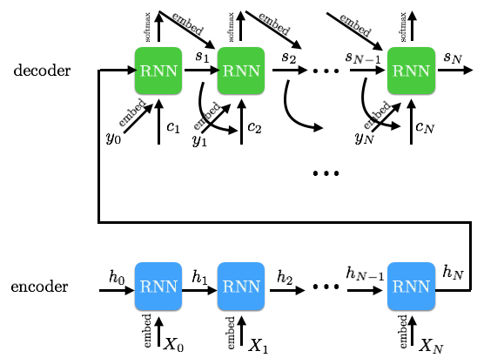
Model Architecture
Sequence to Sequence Model
Notes:
Sequence to sequence model is used for solving sequence problem. It takes a sequence as the input, and returns another sequence as the output. The sequence to sequence model contains an encoder and a decoder. The encoder converts the input sequence to the context vector, and the decoder takes the context vector as input and generate the output sequence. In this project, I used recurrent neural network as the both encoder and decoder. Next, I will introduce the technical details in the model.

Slide 6
Encoder Architecture
Encoder
Shared embedding layer
Bidirectional LSTM layer
Notes:
The encoder has only two layers. A shared embedding layer, and a bidirectional long short term memory layer. The embedding layer converts each input token to a vector. The vector represents the semantic of the token. The performance of transformation is poor at the beginning of training, but the embedding layer will learn from data. As more data are trained, the transformation will be more accurate. After the embedding layer is well trained, the relationship of two tokens can be computed by calculating the distance between two vectors. For tokens that their semantic are similar, their distance should also be similar. For example, the distance between the word “human” and “man” should be similar to the distance between “human” and “woman”.
The other layer is abidirectional LSTM layer. LSTM is a kind of RNN. It uses a logic gate to control selecting long term or short term memory from the context. It is bidirectional because it trains the input sequence from both forward and backward. In natural language, a word usually not only depends on the previous sequence, but also depends on the following sequence. The single directional RNN can only predict the next token from previous context, but the bidirectional LSTM can predict token from the whole context.

Slide 7
Encoder Workflow
Embedding layer
Embedded Input sequence
LSTM layer
Context
Last hidden vector
Last LSTM cell state
Notes:
While training, the input sequence is first embedded, then the embedded sequence will be put into the LSTM layer. The output of the LSTM layer contains a context, which includes the hidden vectors of each timestamp. The output also contains the last hidden vector and the last LSTM cell state. All of them will be used by the decoder.

Slide 8
Decoder Architecture
Decoder
Shared embedding layer
LSTM layer
MLP attention Layer
Dropout layer
Out layer
Notes:
The decoder has five layers. The first one is the shard embedding layer. This layer is shared with the encoder, because I want tokens’ semantic are same in the encoder and decoder.
The next layer is a single directional LSTM layer. Since I’m going to generate the sequence from start of a sentence, so I don’t want to use bidirectional LSTM. It will also generate from the end of the sequence.
The third layer is a MLP attention layer. This layer takes the context from encoder LSTM and the context from decoder LSTM to generate an attention applied context.
The fourth layer is dropout layer. This layer drops part of data in the context to prevent overfitting. If a model is overfitting, it will have a good performance on the training dataset, but if we use other inputs, the output will be terrible.
The last layer is the out layer. This layer is a linear transformation layer. It transforms the hidden vector to the size of the vocabulary.

Slide 9
Decoder Workflow
Embedding layer
Embedded input sequence
LSTM layer
Context
Attention layer
Attention applied context
Dropout layer
Attention applied context
Out layer
Context with vocab size
Log softmax function
Possibility of each token in the vocab

Slide 10
Training Workflow
Load data
Train model
Compute loss
Back propagation
Notes:
Training includes four steps. First, the data loader loads a batch of sequence from the dataset. They will be converted to a matrix, and put in to the model. The output of the model is the generated summary, it will be compare with the real summary by the criterion to compute the loss. According to the loss value, the optimizer will perform a back propagation to improve the accuracy of the model.
When the loop iterates through the whole dataset, we call one epoch is completed.

Slide 11
Training Architecture
Optimizer: SGD
Criterion: NLLLoss
Batch size: 3
Epoch number: 100
Loss: 6.7 → 1.4
Learning rate: 1
Hidden size: 256
Word embedding size: 128
Notes:
There are some parameters I used for training phase. The optimizer is SGD, and the criterion is NLLLoss.
Due to the limitation of memory size, I the batch size I used is 3.
The dataset is trained 100 epochs. At the end, the loss decrease from 6.7 to 1.4. This is low enough to generate reasonable sentence.
The learning rate is 1. I also applied dynamic learning rate. After each 20 epochs, the learning rate shrink to one tenth of the previous value.

Slide 12
Model Performance
Generated summary: “have beaten three of their last three league games . the <UNK> scored in the second half of the last minute . the win takes all three points to move ahead of champions league place”
Human-produced summary: “two goals from lionel messi help barcelona to a 3-1 win over almeria . kaka bags brace as real madrid coast to 3-0 victory at athletic bilbao . inter milan move up to second place in serie a with 2-0 win over chievo .”
Notes:
Because the Hackberry server has a really long queue. I have waited for 4 days to evaluate the model. And I’m still waiting now. Therefore, I used my laptop trained a very small dataset. After 100 epochs, the loss decreased to an extremely small value.
When I gives the model the sentence, it returned the expected result.

Slide 13

Acknowledgements
Client: Yufeng Ma
Mr. Ma is a PhD student at Virginia Tech. He worked as the client of this project and guided the project through all project phases.
Notes:
My client is Yufeng Ma. He is a great tutor. He taught me everything in this project. It is impossible to complete the project without his help.

Slide 14
Reference
Gokumohandas. Recurrent Neural Networks (RNN) – part 3: encoder-decoder. https://theneuralperspective.com/2016/11/20/recurrent-neural-networks-rnn-part-3- encoder-decoder/. Web. accessed: March 26, 2018.

