Slide 1
Xpantrac connection with IDEAL
Sloane Neidig, Samantha Johnson, David Cabrera, Erika Hoffman
CS 4624
3/6/2014

Slide 2
Project Specification
Short Description
  Integrating Xpantrac into the IDEAL software suite
  Applying Xpantrac to identify topics for IDEAL webpages
Primary Contact
  Seungwon Yang
Deliverable
  Xpantrac tailored for IDEAL
Notes:
Erika

Slide 3
What is Xpantrac?
Seungwon Yang’s dissertation topic
Based on Expansion-Extraction approach
Algorithm to identify topics in a given webpage
Purpose: Tag topics to easily understand document
Combines Cognitive Informatics with Information Retrieval
Currently, only running on Seungwon’s personal data set
Notes:
Sloane

Slide 4
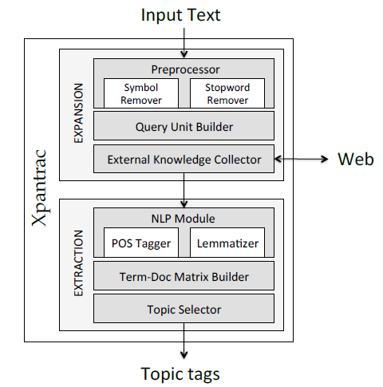
What is Xpantrac?
Notes:
Sloane

Slide 5
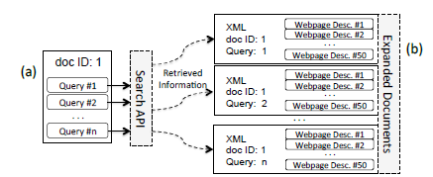
Xpantrac Algorithm Overview
A single input document is expanded to multiple expanded XML format documents
Ultimately, search API will be replaced with Apache Solr (Different project for IDEAL)
Uses Vector Space Model approach for topic identification - http://en.wikipedia.org/wiki/Vector_space_model (black box - no need to know to implement)
Notes:
Sloane
Discussion about “Document Corpus” here…
Looks up every 5 (or any number specified) RELEVANT words and expands it to multiple XML files.

Slide 6
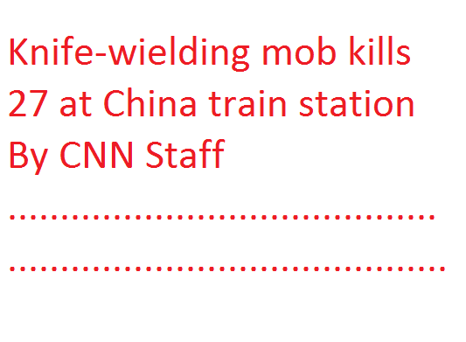
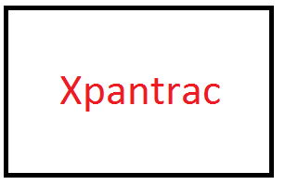
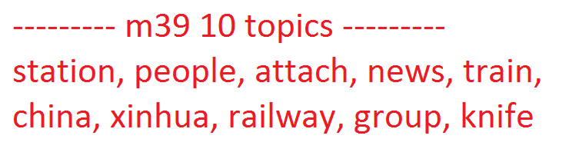

Example Input/Output
Input
Output
Notes:
Sam
Takes about 50 - 150 seconds per article right now using the Yahoo! Search API
Search API acts as “External Knowledge Collector”

Slide 7
Current Progress
Quick python script written to get html out of .warc (web archive) files
Xpantrac currently runs on local data set (50 .txt files) and gives correct output, using Yahoo Web API
  Needs to eventually use Apache Solr since that is what IDEAL uses
Started indexing .html CNN news files to SOLR/Got familiar with Solr
  Stores information like title, first 30 words, last 30 words, etc. to easily use as input for Xpantrac
Notes:
Erika

Slide 8
Use case
Librarian wants to be able to search 100 short stories for a contest by topic
He/She will upload the 100 stories using the Xpantrac UI
  Topic tags can currently be extracted from UI
Topics will then be added in the meta data of the pages on the Library website for easy searching
User of Library website can now look up a short story by topic name
Notes:
Sam

Slide 9
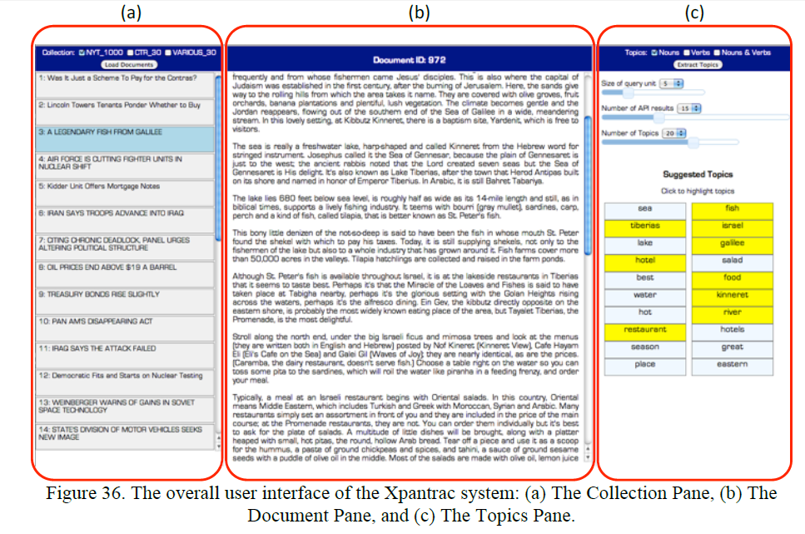
Current UI
Notes:
Sam

Slide 10
What is Apache Solr?
Solr is a popular enterprise search platform that allows you to index and search documents.
Allows for an easy creation of a search engine for websites, databases, and user provided files.
Offers features such as:
  Full Text Searching
  Rich Document Parsing and Indexing (such as Word, PDF, etc)
Notes:
David

Slide 11
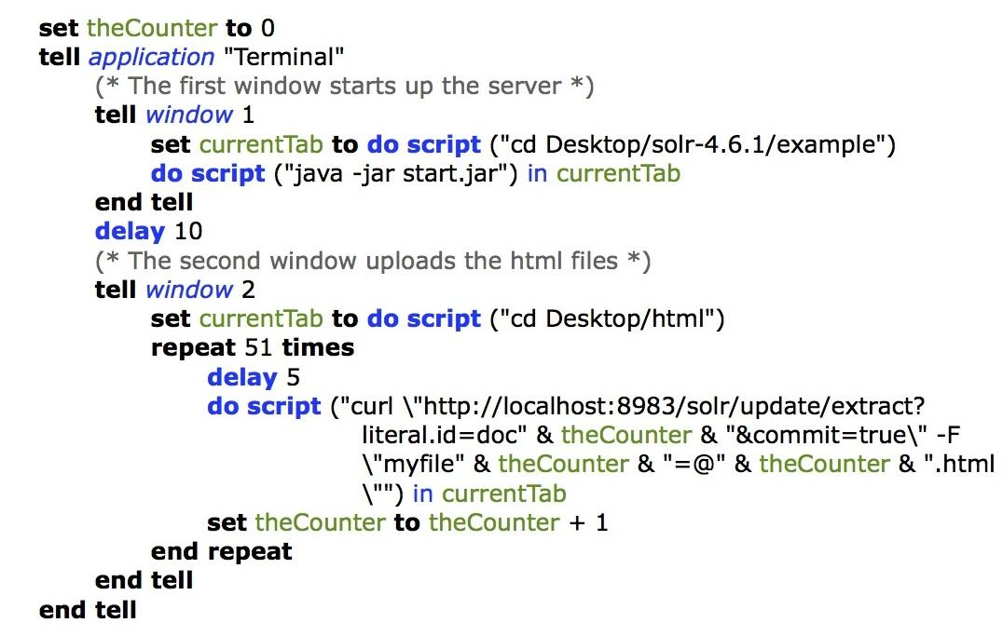
Indexing With Solr
Notes:
David: Talk about how to index and reference this

Slide 12
Querying With Solr
A SOLR API query to retrieve a text document in JSON format
  Can also use the web interface
Notes:
David

Slide 13
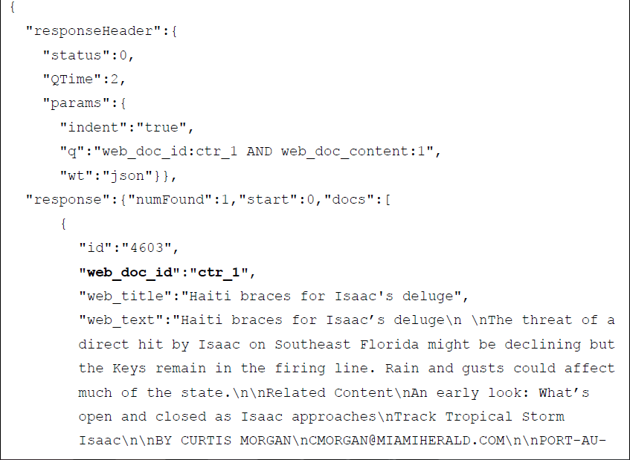
Querying Results
Resulting JSON object retrieved from SOLR query
Notes:
David

Slide 14
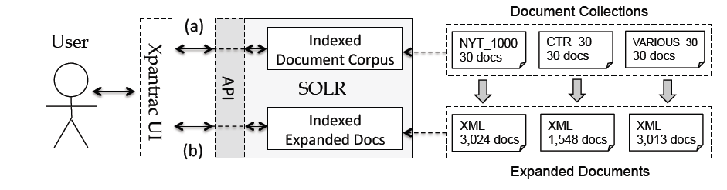
How Solr Fits Into The Puzzle
A diagram showing the indexing of documents and expanded documents using SOLR to emulate a search engine API.
Notes:
Sam
Xpantrac uses a search engine API to expand a given text document to
multiple (likely) relevant documents (i.e., merged webpage descriptions), after which they are
processed to extract topic tags.

Slide 15
Constraints of Using Xpantrac With Solr
In order to use Xpantrac with Apache Solr, two constraints must be followed
  It should index a massive number of documents, so that any documents from users could be expanded based on indexed information
  It should return the most relevant portion of the matching documents, for a query
Notes:
David

Slide 16
Deadlines
February
  1st: Determine topic, Get client approval
  15th: Discuss roles & timelines; Get instructor approval; Try out Apache Solr
March
  1st: Decompress files (with IDEALpages); Begin working with Xpantrac
  15th: Xpantrac - Begin Batch & Interactive Modes
  29th: Xpantrac - Continue Batch & Interactive Modes
Notes:
Erika

Slide 17
Deadlines
April
  12th: Stretch Goal: Tweets and Archive Files
  26th: Finalize project & prototype; Final Report
May
  1st – 6th: Final Presentation
  6th: Final Paper
Notes:
Erika

Slide 18
References
Automatic Identification of Topic Tags from Texts Based on Expansion-Extraction Approach by Yang, Seungwon, Virginia Polytechnic and State University, 2013, 230 pages. (Seungwon’s dissertation)
SOLR tutorial: https://lucene.apache.org/solr/tutorial.html

Slide 19

Questions?

