Slide 1

Chapter 5
The Intersection of Sustainable Real Estate Management and Risk Management
Unless otherwise noted, this slide deck is (c) Erin A. Hopkins.
It is released under a Creative Commons Attribution NonCommercial ShareAlike 3.0 license (CC BY NC-SA 3.0).

Slide 2
Chapter Sections
5.1 Introduction
5.2 The Risk Management Process Model
5.3 Environmental Risk Management
5.4 Social Risk Management
5.5 Governance Risk Management
5.6 Conclusion

Slide 3
Learning Objectives
Describe the risk management process model
Identify environmental risk management components
Identify social risk management components
Identify governance risk management components
Describe how ESG risk management concepts relate to sustainable property management

Slide 4
5.1 Introduction
Human condition tends to consider immediate risks more commonly than distant risks

Slide 5
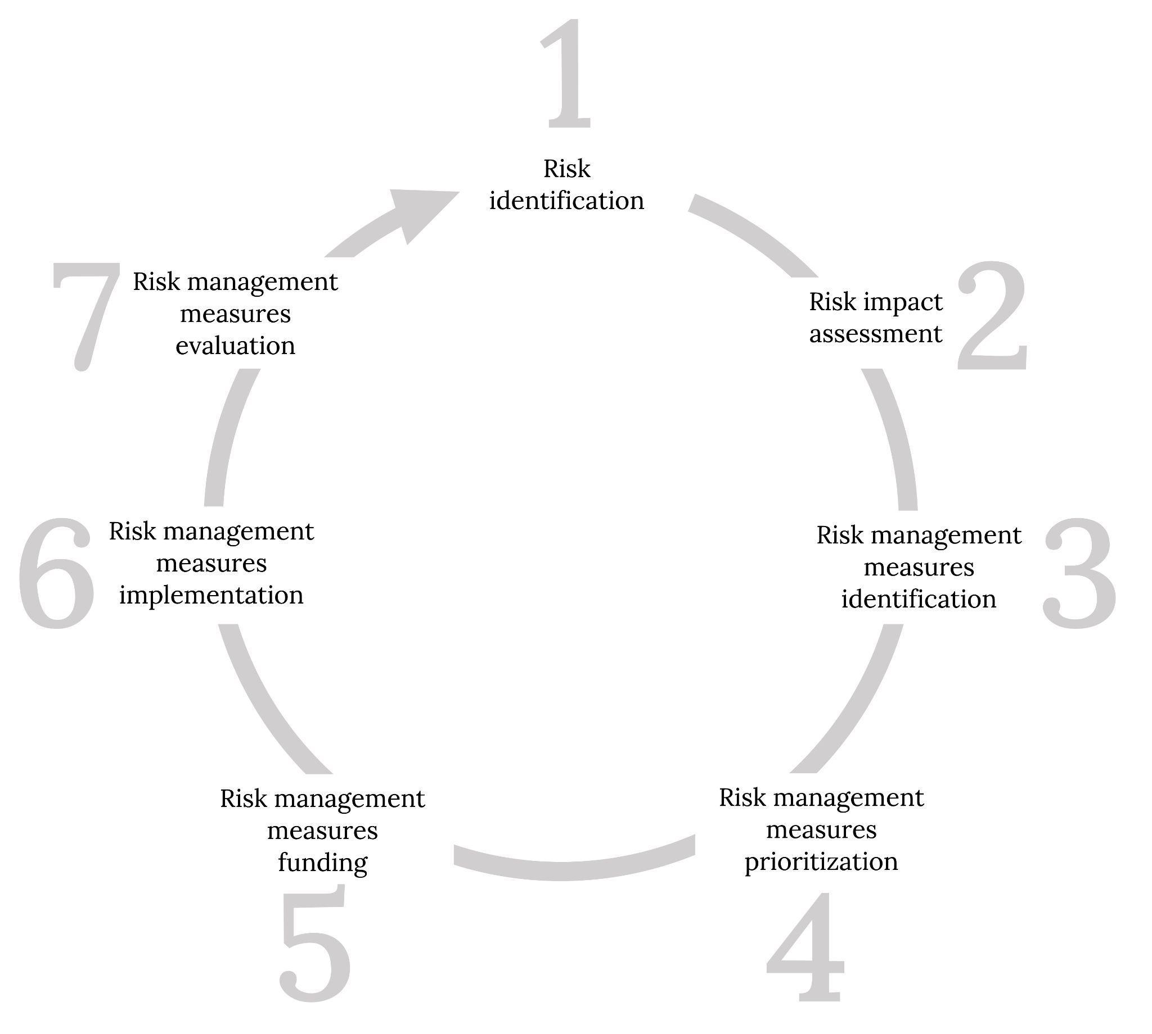
5.2 The Risk Management Process Model
Figure 5.1: Risk management process model. Kindred Grey. 2023. CC BY 4.0.

Slide 6
5.3 Environmental Risk Management
Environmental

Slide 7
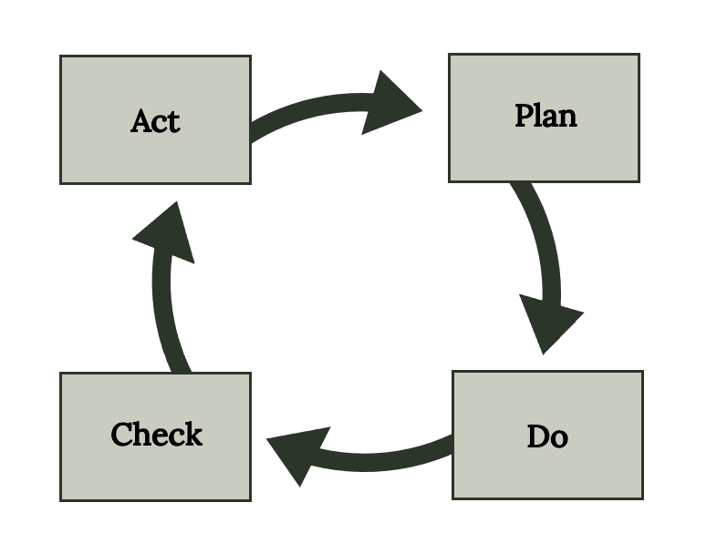
Environmental Risk Management
Climate risk management
Environmental regulation management
Resource management
Figure 5.4: EMS process model. Kindred Grey. 2023. CC BY 4.0.

Slide 8
5.4 Social Risk Management
Social

Slide 9
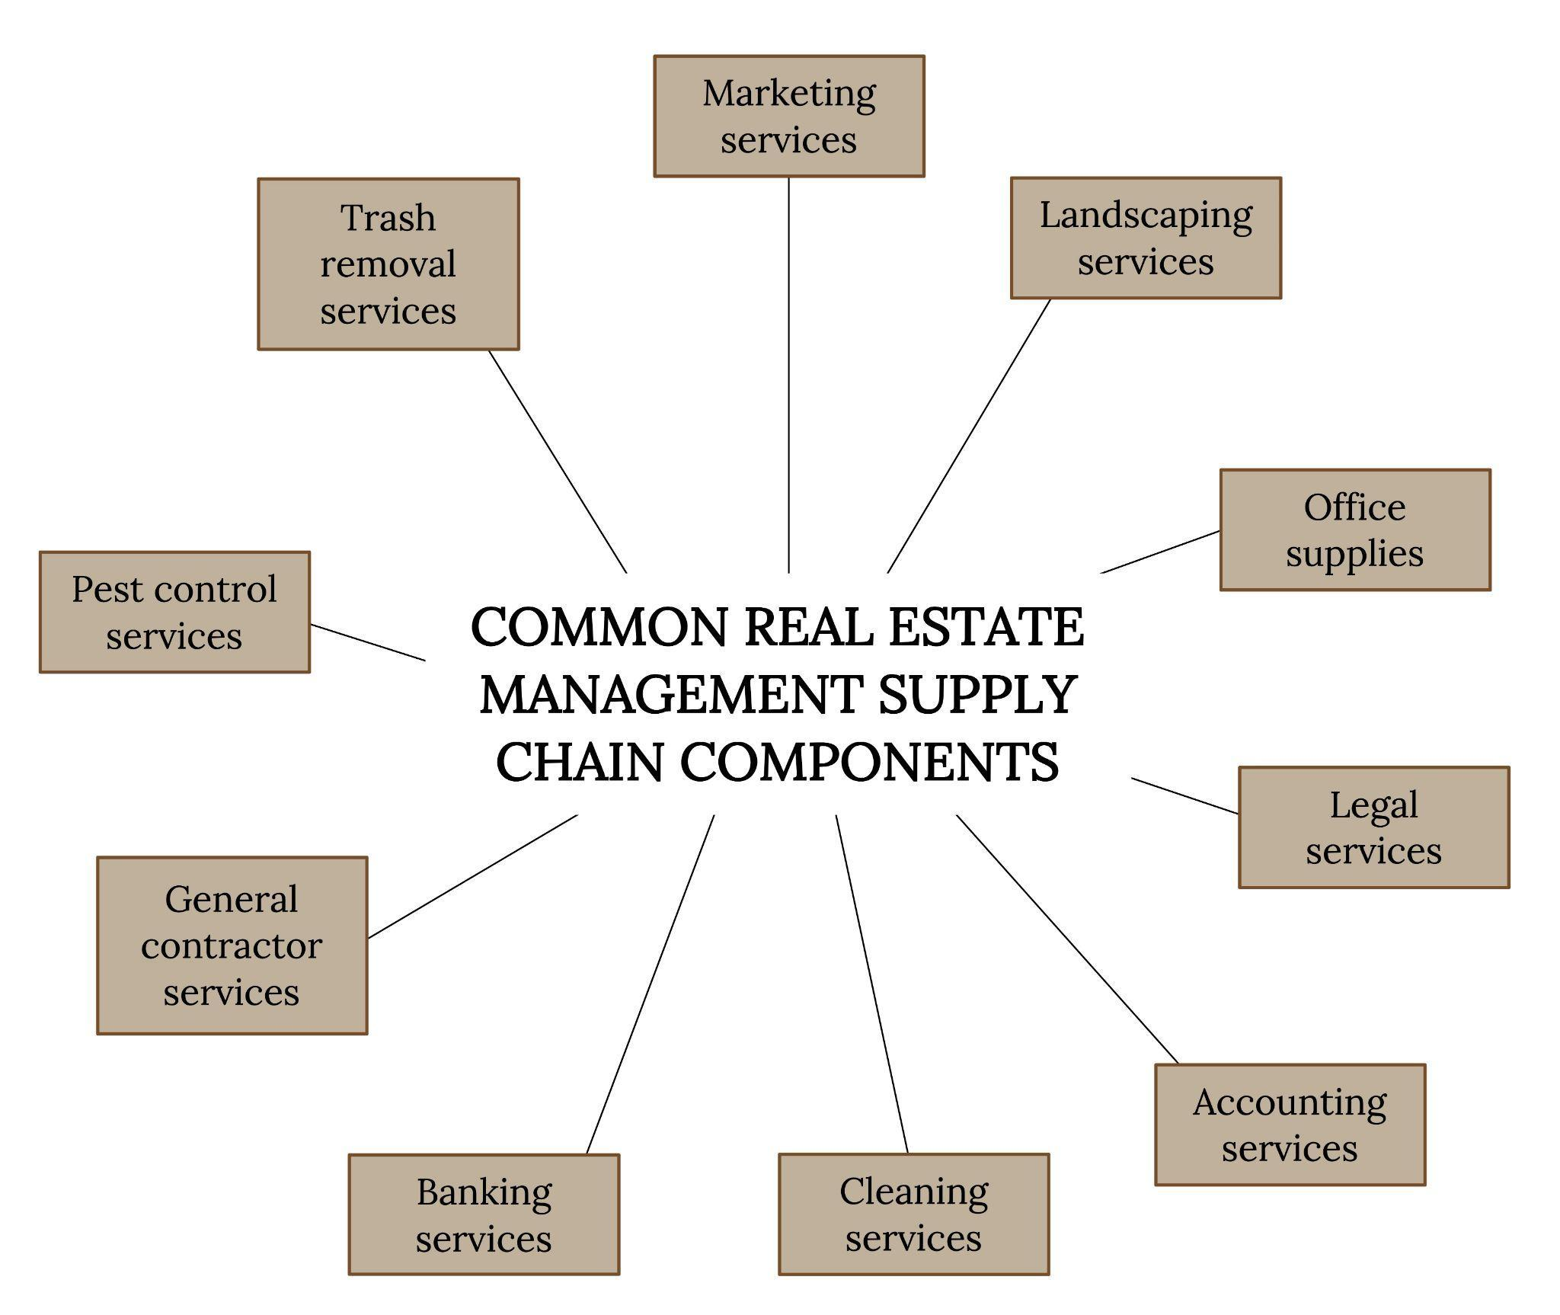
Social Risk Management
Health and safety measures
Supply chain management
Diversity and inclusion measures
Figure 5.5: Common property management supply chain components. Kindred Grey. 2023. CC BY 4.0.

Slide 10
5.5 Governance Risk Management
Governance

Slide 11
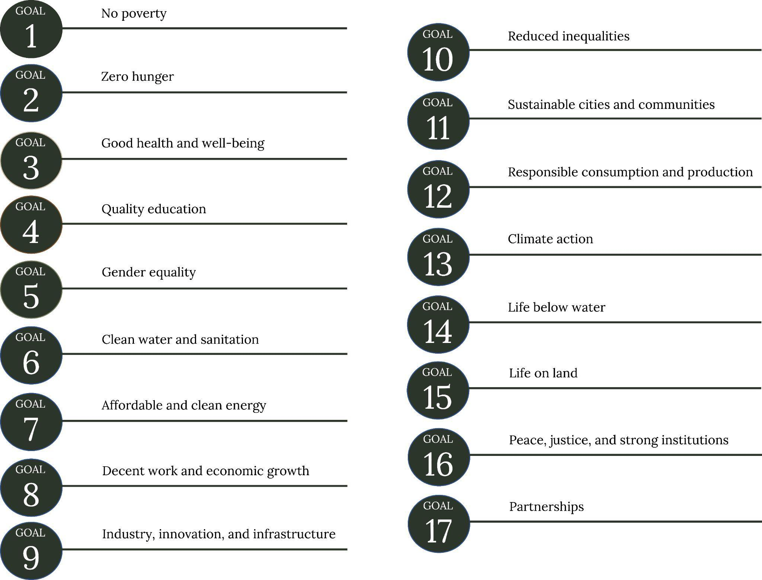
Governance Risk Management
Disclosure
Implementation Strategies
Cybersecurity
Figure 5.6: United Nations’ SDGs. Kindred Grey. 2023. CC BY 4.0. Adapted from United Nations Department of Economic and Social Affairs (https://sdgs.un.org/goals).

Slide 12
5.6 Conclusion
ESG initiatives are all interconnected and provide a holistic look at risk management
ESG initiatives can be implemented at the property, property portfolio, and organizational levels
Risk management initiatives will vary depending on the property age, location, size, condition, occupant mix, and turnover frequency

Slide 13
Chapter Activity
Refer to the UN’s website on the SDGs
https://www.un.org/sustainabledevelopment/sustainable-development-goals/
2) Choose five SDGs and explain how they can be applied to property management operations

