Slide 1
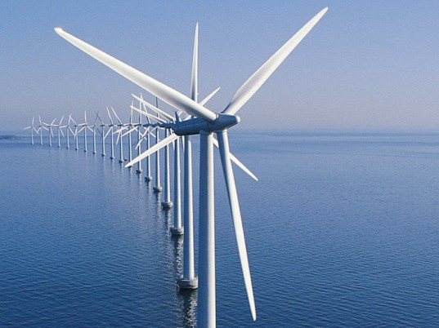
Experimental Study of Turbulence Influence on Wind Turbine Performance and Wake Recovery
Miguel Talavera
Fangjun Shu
Add image

Slide 2
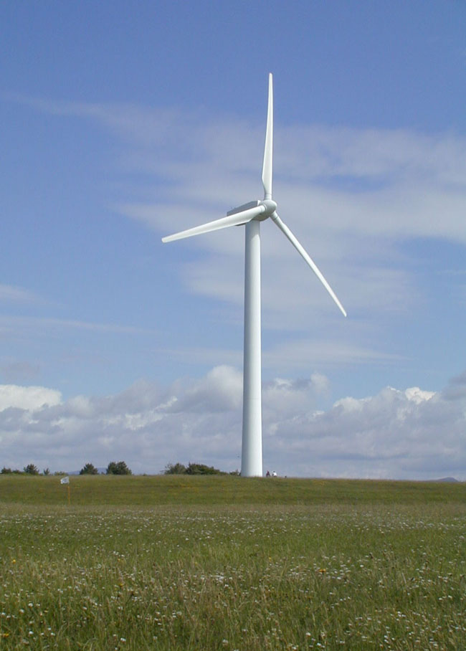
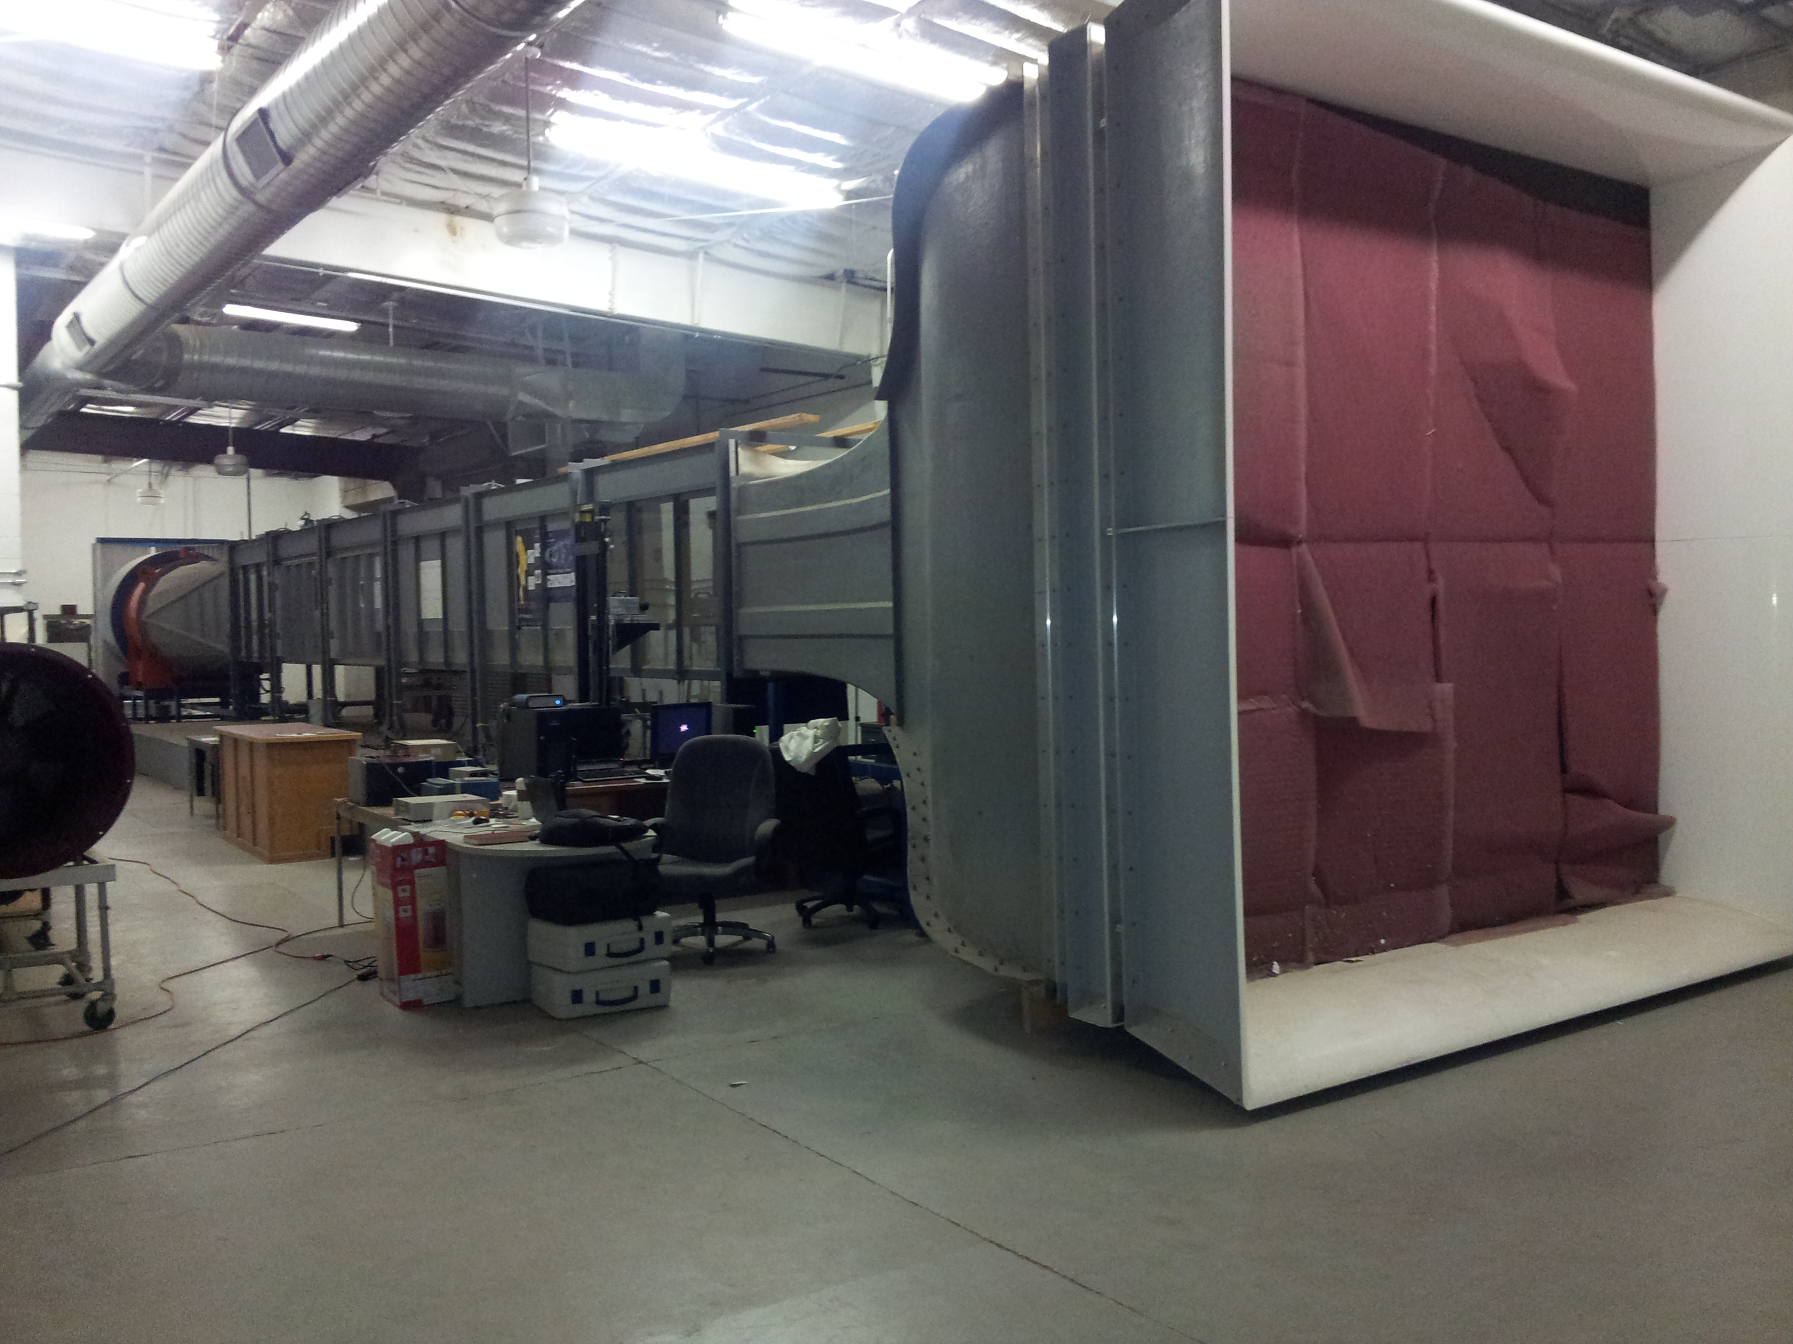
Introduction
The used of downscaled wind turbine models represents a limitation for wind tunnel testing.
vs.

Slide 3
Outline
Introduction
Problem statement
Approach
Methodology
Results
Conclusions

Slide 4
Problem statement
Unmatched Reynolds number
Flow separation
on the wind turbine blades
Slower flow recovery in the wake
Lower efficiency for downscaled wind turbines tested in wind tunnel

Slide 5
Outline
Introduction
Problem statement
Approach
Methodology
Results
Conclusions

Slide 6
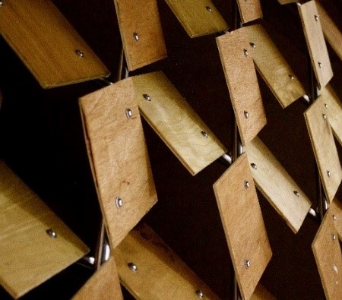
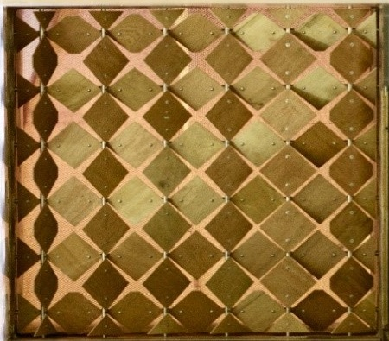
Approach
Create turbulence in the flow with the help of an active grid system installed at the beginning of the wind tunnel

Slide 7
Atmospheric Boundary Layer
Wind turbines in the field work inside the boundary layer, therefore this has to be mimic
300 m
100 m

Slide 8
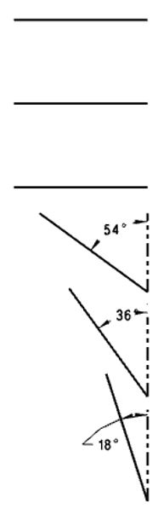
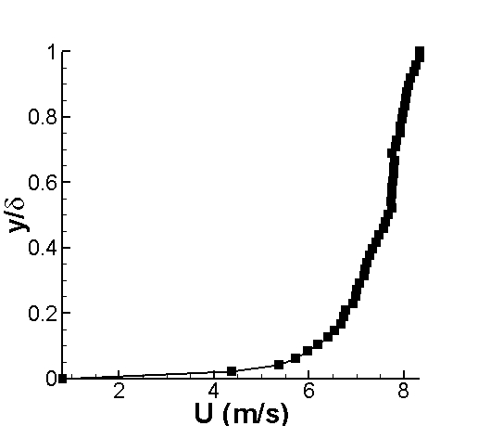
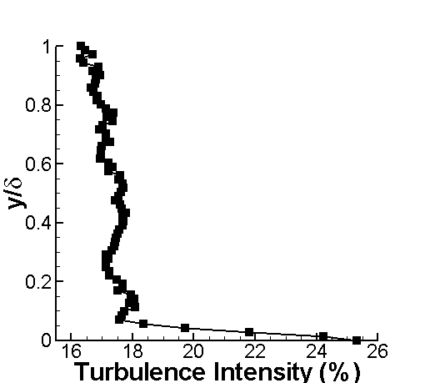
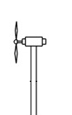
Scaled Atmospheric Boundary Layer
0.6 m
0.2 m

Slide 9
Outline
Introduction
Problem statement
Approach
Methodology
Results
Conclusions

Slide 10
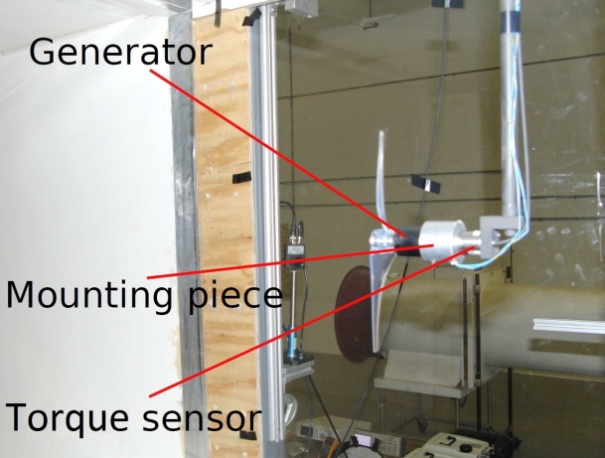
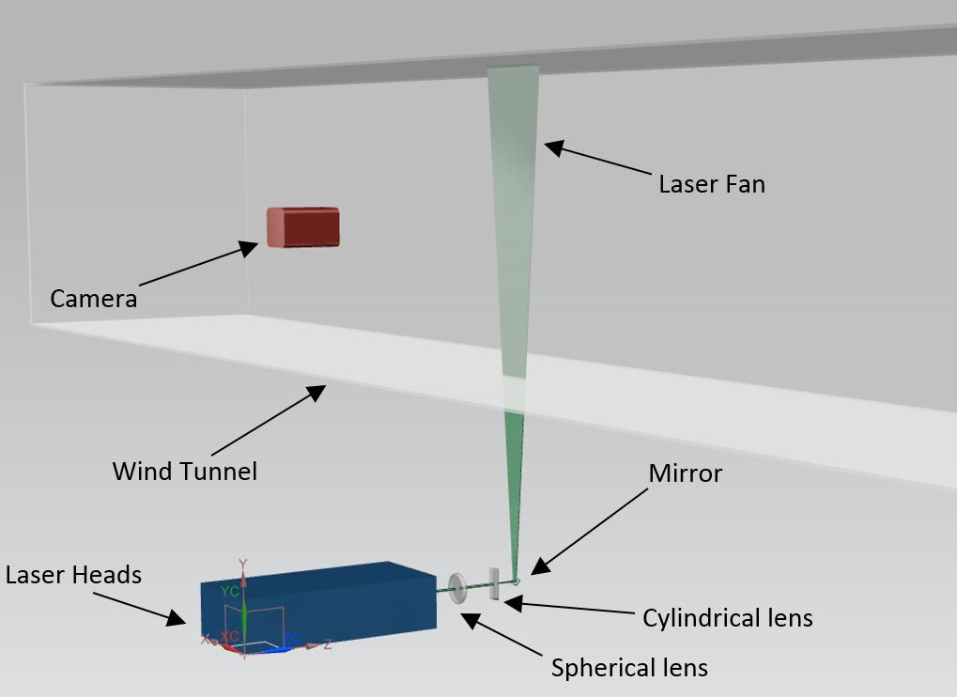
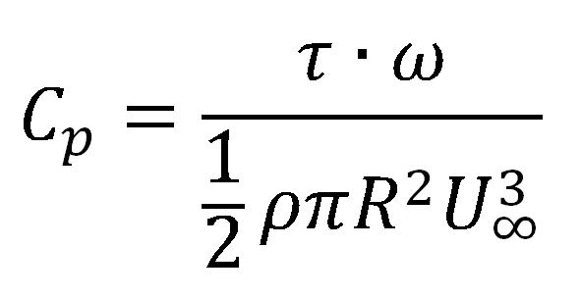
Methodology
Torque measurements to calculate the efficiency
PIV measurements to investigate the velocity profiles

Slide 11
PIV image pair example. Image A

Slide 12
PIV image pair example. Image B

Slide 13
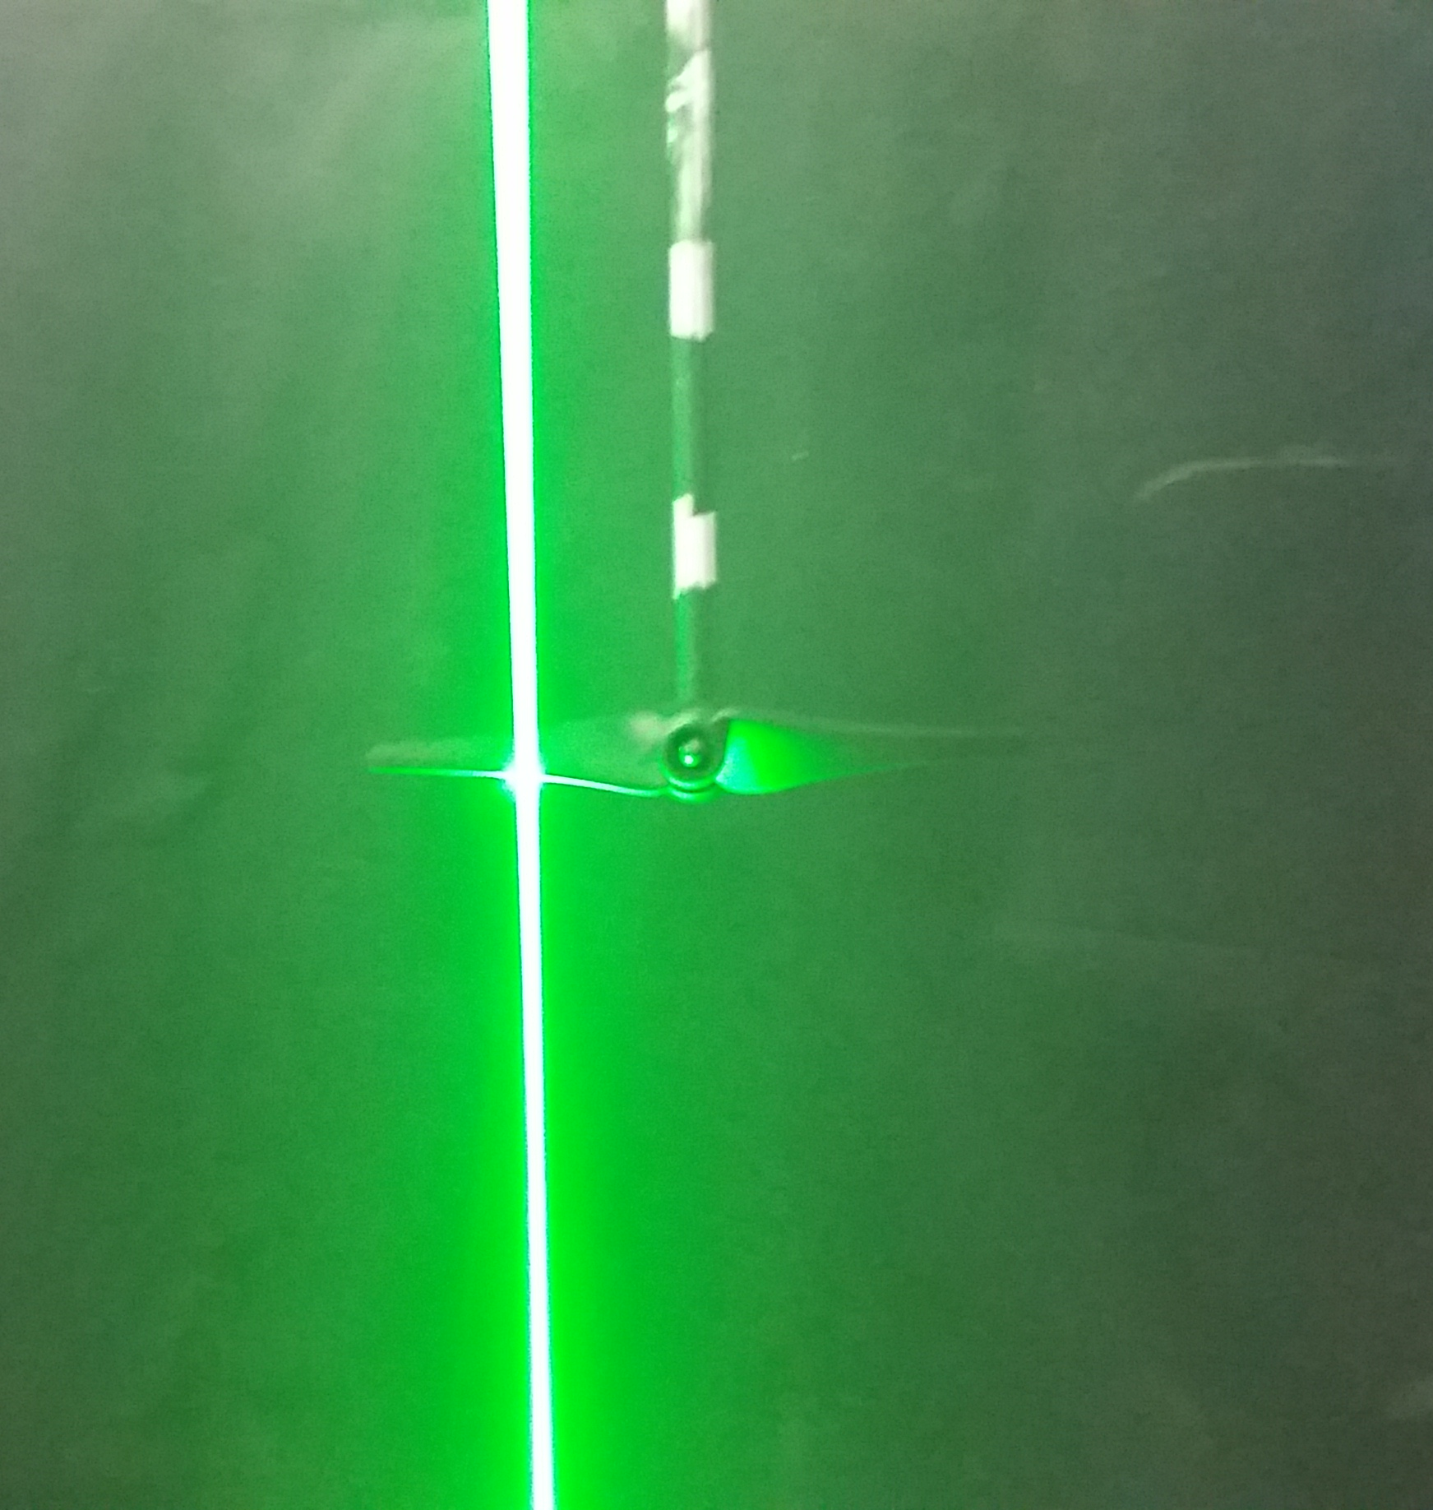
Flow separation around the wind turbine blade

Slide 14
Outline
Introduction
Problem statement
Approach
Methodology
Results
Conclusions

Slide 15
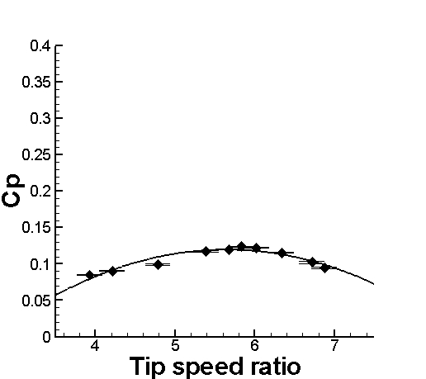
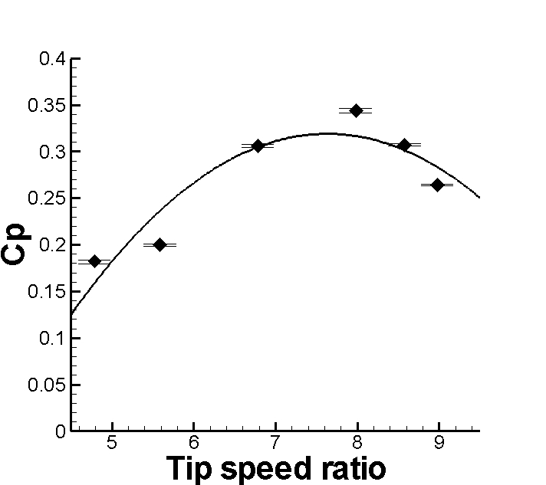
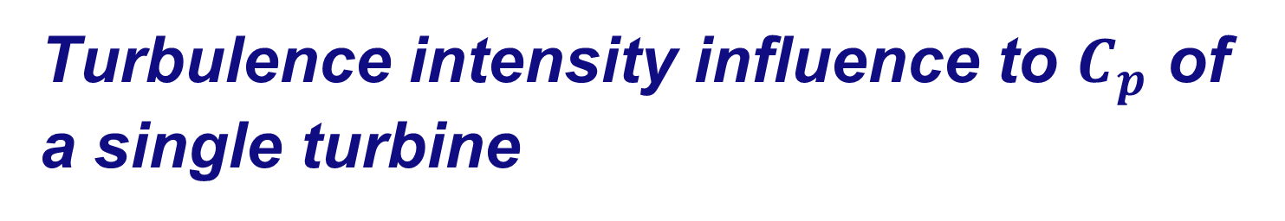
Turbulence intensity influence to $C_{p}$ of a single turbine
Laminar Inflow
Turbulent Inflow

Slide 16
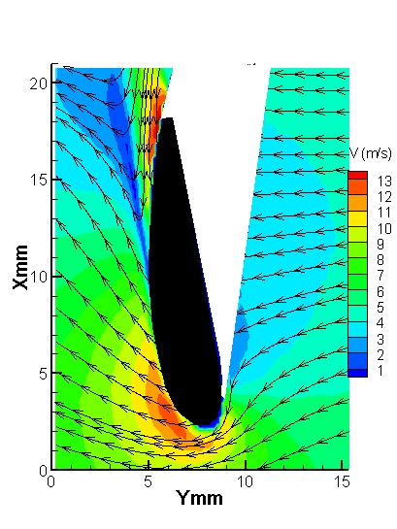
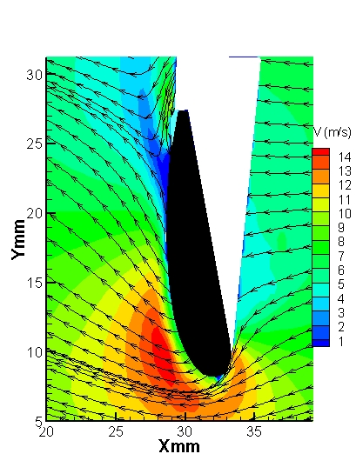
Flow separation around the wind turbine blade
Laminar Inflow
Turbulent Inflow

Slide 17
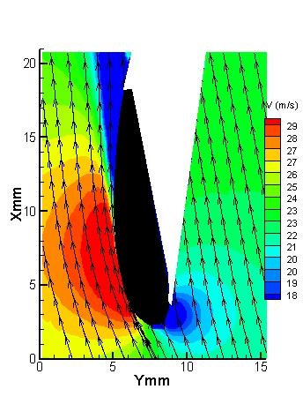
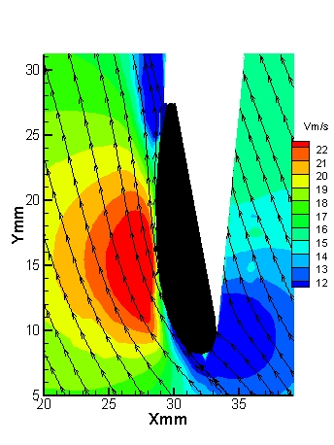
Including the relative velocity due to the angular velocity of the blade
Laminar Inflow
Turbulent Inflow

Slide 18
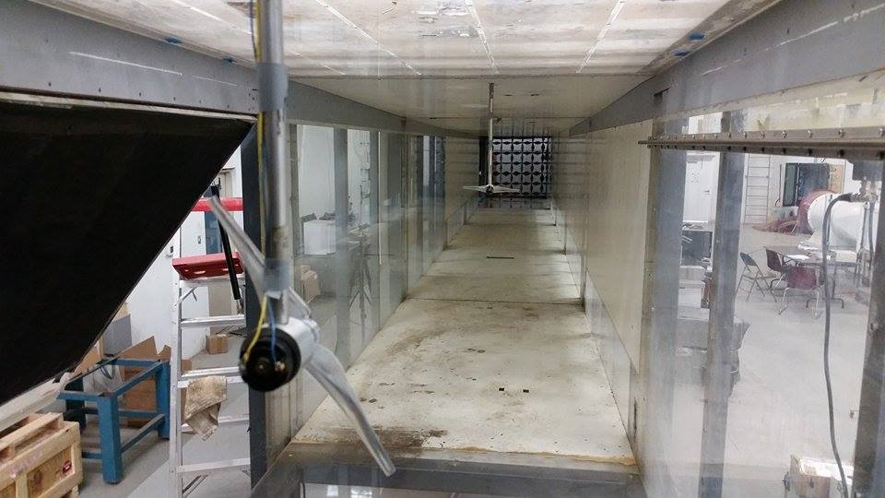
Influence of turbulence intensity to wind turbine array
Wind turbine tested

Slide 19
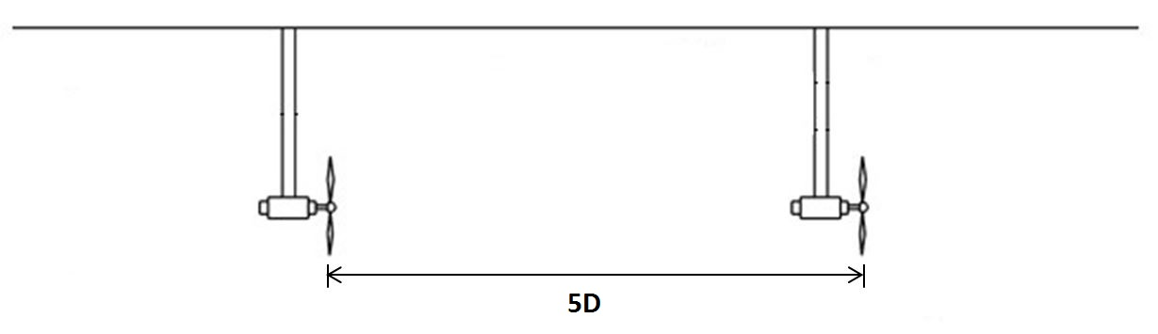
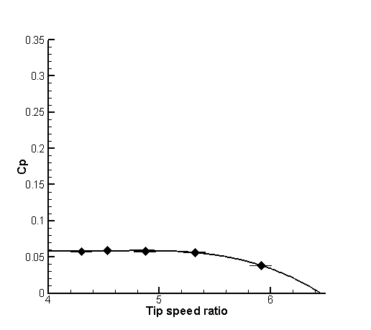
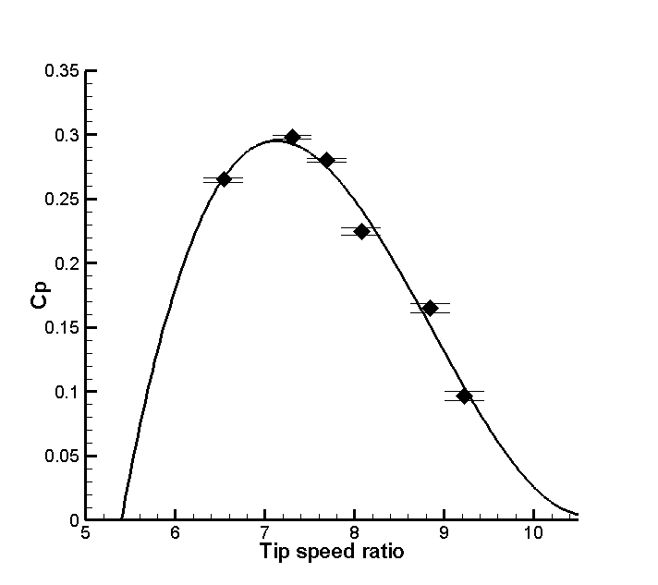
Results
Wind turbine tested
Torque measurements
5 diameters
Laminar Flow
Turbulent Flow

Slide 20
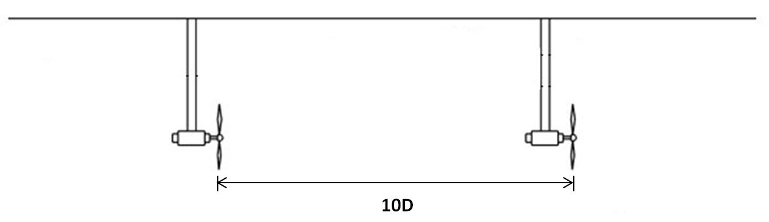
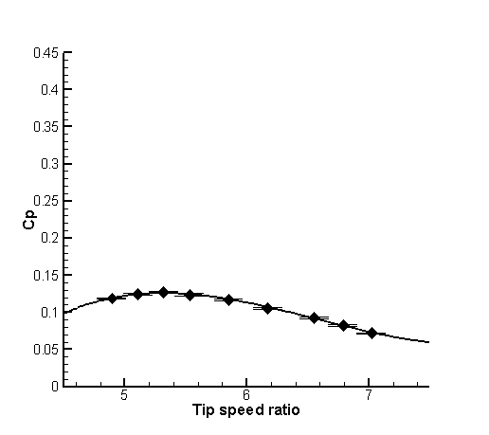
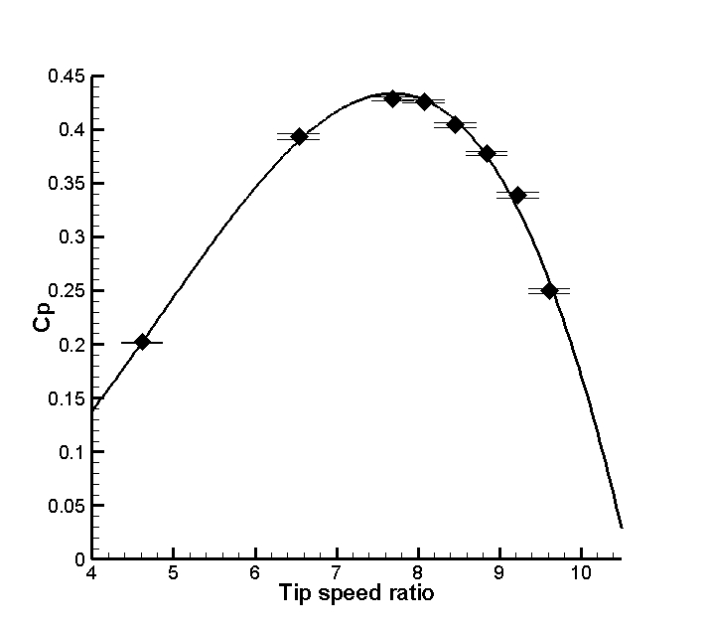
Wind turbine tested
10 diameters
Laminar Flow
Turbulent Flow

Slide 21
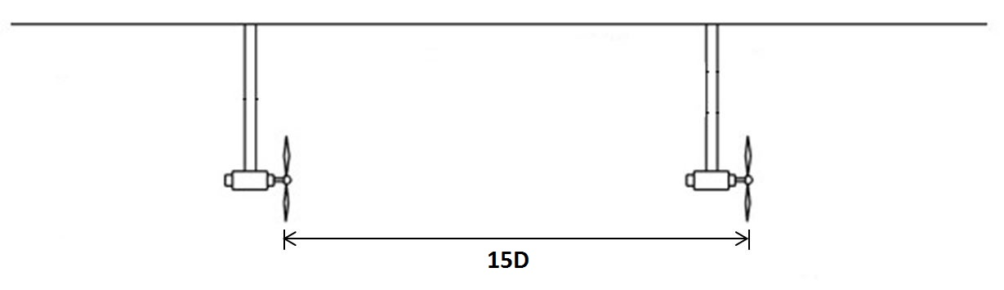
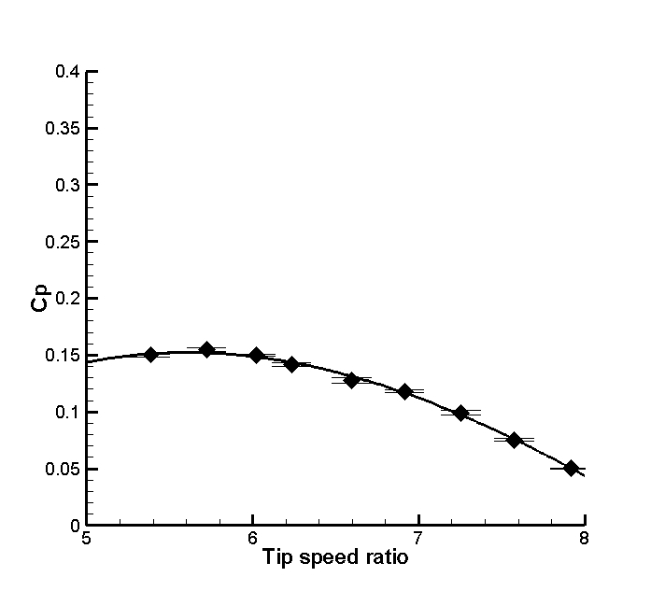
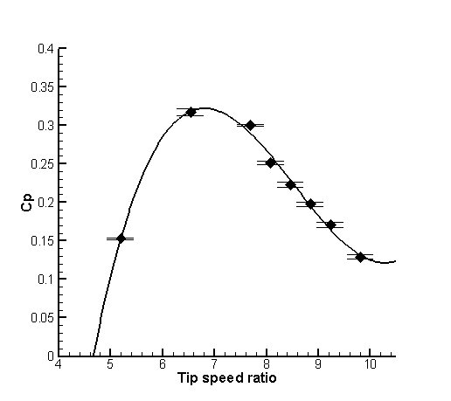
Wind turbine tested
15 diameters
Laminar Flow
Turbulent Flow

Slide 22
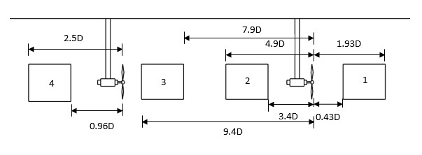
Influence of turbulence intensity to wake recovery
PIV test sections

Slide 23
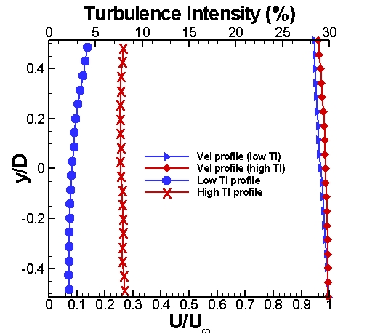
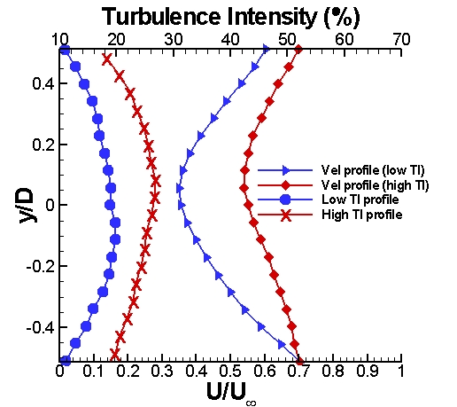
PIV Results
FWT= First Wind Turbine
SWT= Second Wind Turbine
Section 1. x/D=-0.93 to FWT
Section 2. x/D=3.65 to FWT

Slide 24
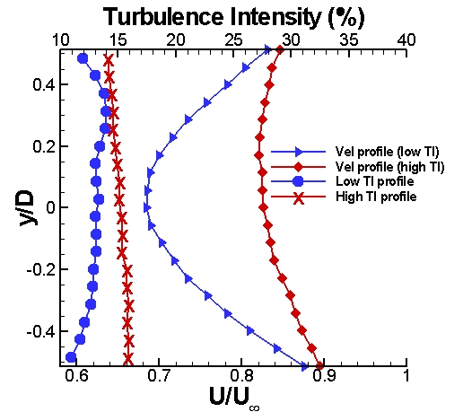
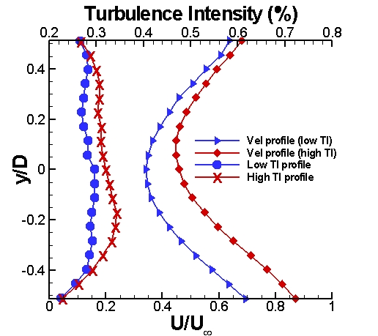
FWT= First Wind Turbine
SWT= Second Wind Turbine
Section 3. x/D=8.4 to FWT
Section 4. x/D= 1.46 to SWT

Slide 25
Outline
Introduction
Problem statement
Approach
Methodology
Results
Conclusions

Slide 26
Conclusions
Wind turbines tested in laminar wind tunnels does not mimic the field situation, since a lower performance is presented.
Wind turbines tested with turbulent inflow have a more realistic efficiency, even though the unmatched Re number.
Using of an active grid system is effective way to generate controllable turbulence intensity and get realistic wind turbine test results in wind tunnels.
Flow separation in the suction side of the wind turbine blades highly depends on the inflow turbulence intensity.
The flow recovery in the wake highly depends on the turbulence intensity.
Wind turbine performance highly depends on the flow separation of the wind turbine and the flow recovery on the wake, therefore on the turbulence intensity.

Slide 27
Questions???

