Slide 1

Discovery Teams
Image compliments of http://www.sxc.hu/
Technology

Slide 2
Team Members
Amy Arnold
Janice Chatham
Ed Lener
Heather Moorefield-Lang

Slide 3
Interviews
15 Interviews
17 males
12 Females
7 Freshmen
8 Sophomores
6 Juniors
5 Seniors
3 Graduate Students

Slide 4
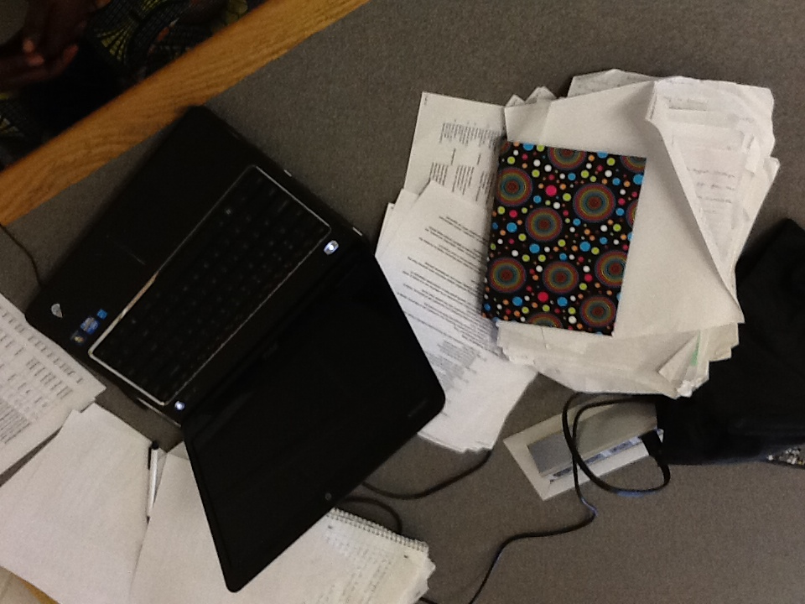

Slide 5
Represented Majors
HNFE
Accounting
Finance
Engineering
Music
Communications
Business
Biology
University Studies
Education
Horticulture
History
Economics

Slide 6
Visited Locations
1st, 2nd, and 4th floor of Library
Graduate Life Center
Math Emporium
Panera (University Blvd)
Squires
Hancock Hall

Slide 7
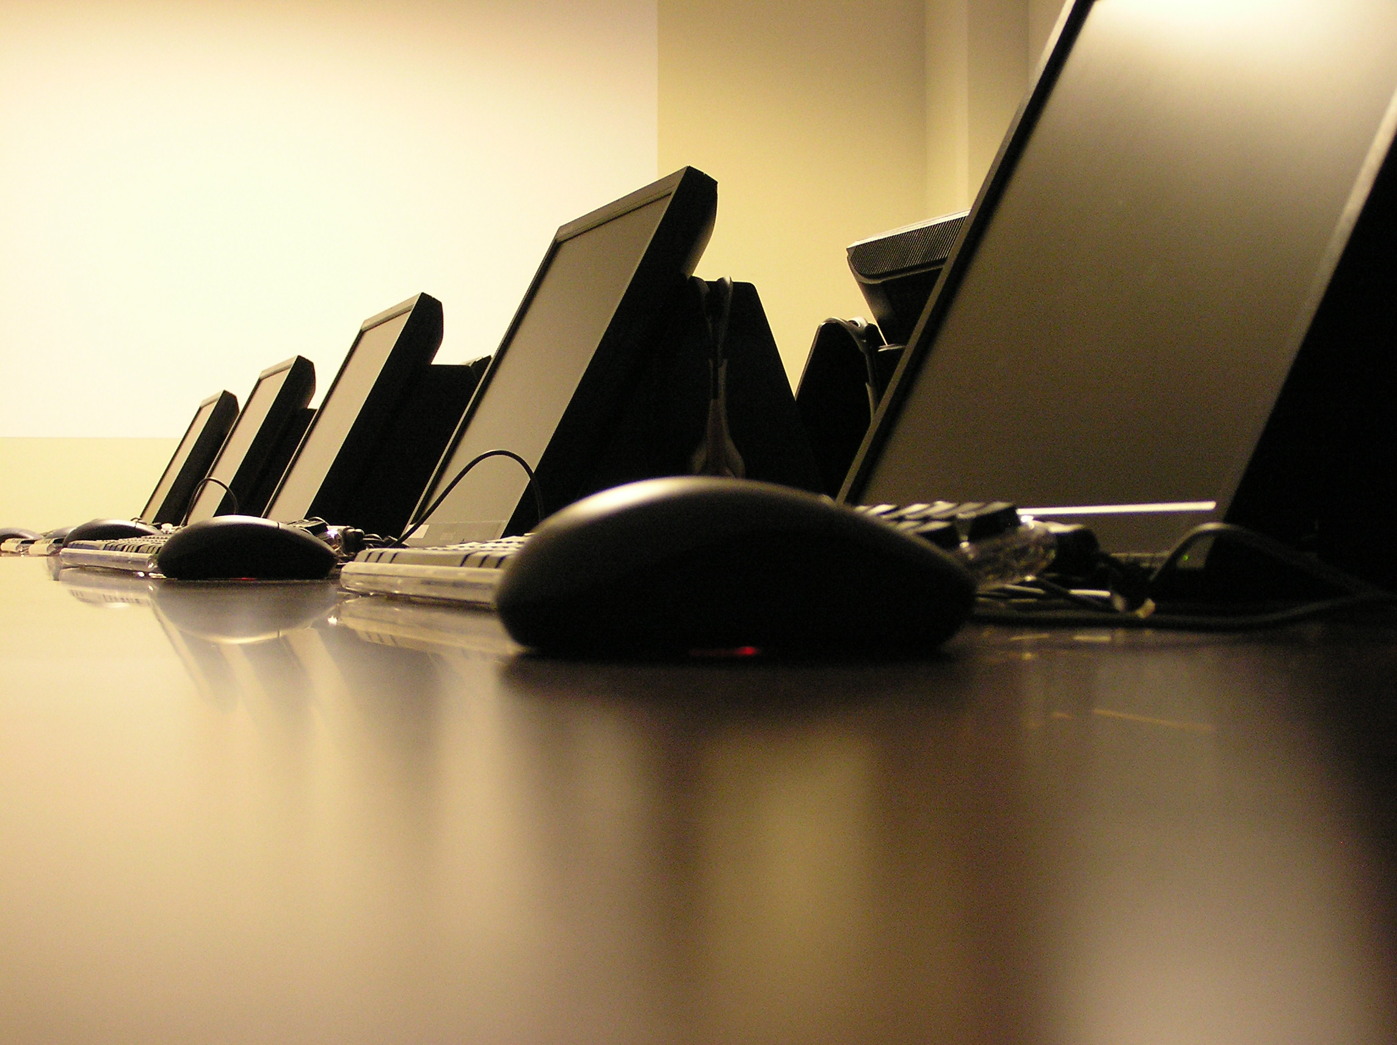
Image compliments of http://www.sxc.hu/

Slide 8
Technology being Used by Students
Laptops
iPods, iPhone
Calculators
Scholar
Google Docs
Power Point
Prezi
Excel
Notes on Tablet PC
International Phonetic Alphabet
Skype
Email
Web Browers
MS Onenote
MS Word
AutoCad
Matlab
iMovie
XD Camera
You Tube

Slide 9
Student’s Work Process
“We basically just bounce ideas off of one another, affirming what the other has answered, or what the other is doing for this class assignment.”
We are working on a project. We just talk about what needs to be done and then divide up the tasks. As we work on it in the library, we ask each other questions whenever we're confused about something. If we don't finish the project before we're ready to go home, we do the rest of it at home.

Slide 10
Work Process cont.
Reading lecture notes online
Textbooks for course
Reviewing paper class notes
Working through problems on paper
Pulling in data from other resources as needed.
We talk back and forth, studying socially. Occasionally, they work in the library but the male says, “the wifi blows.”
One student usually studies in Squires because of its proximity to practice rooms and the fact that there are couches upstairs where other music majors nap

Slide 11
Why do you use this space?: Library
Easy access, central location
Big tables that can seat up to 4 people so group can work together
Electrical outlets
This space has worked well, plugs, tv, quiet even though it's a noisy floor. Blocks out all sound.
Space works well. Can park and spread out. There is room to move, enough room.

Slide 12
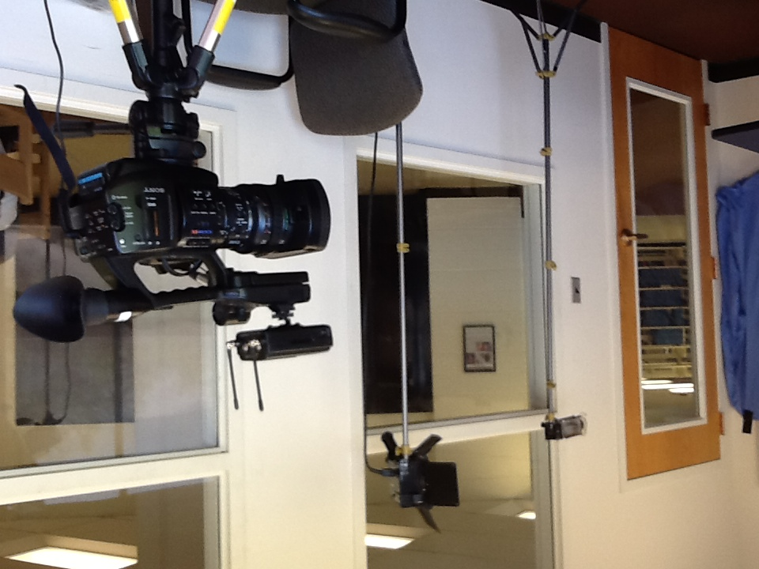

Slide 13
Why do you use this Space?: Squires
Works well if not crowded
Right near Music department, close proximity
It’s near the recital salon

Slide 14
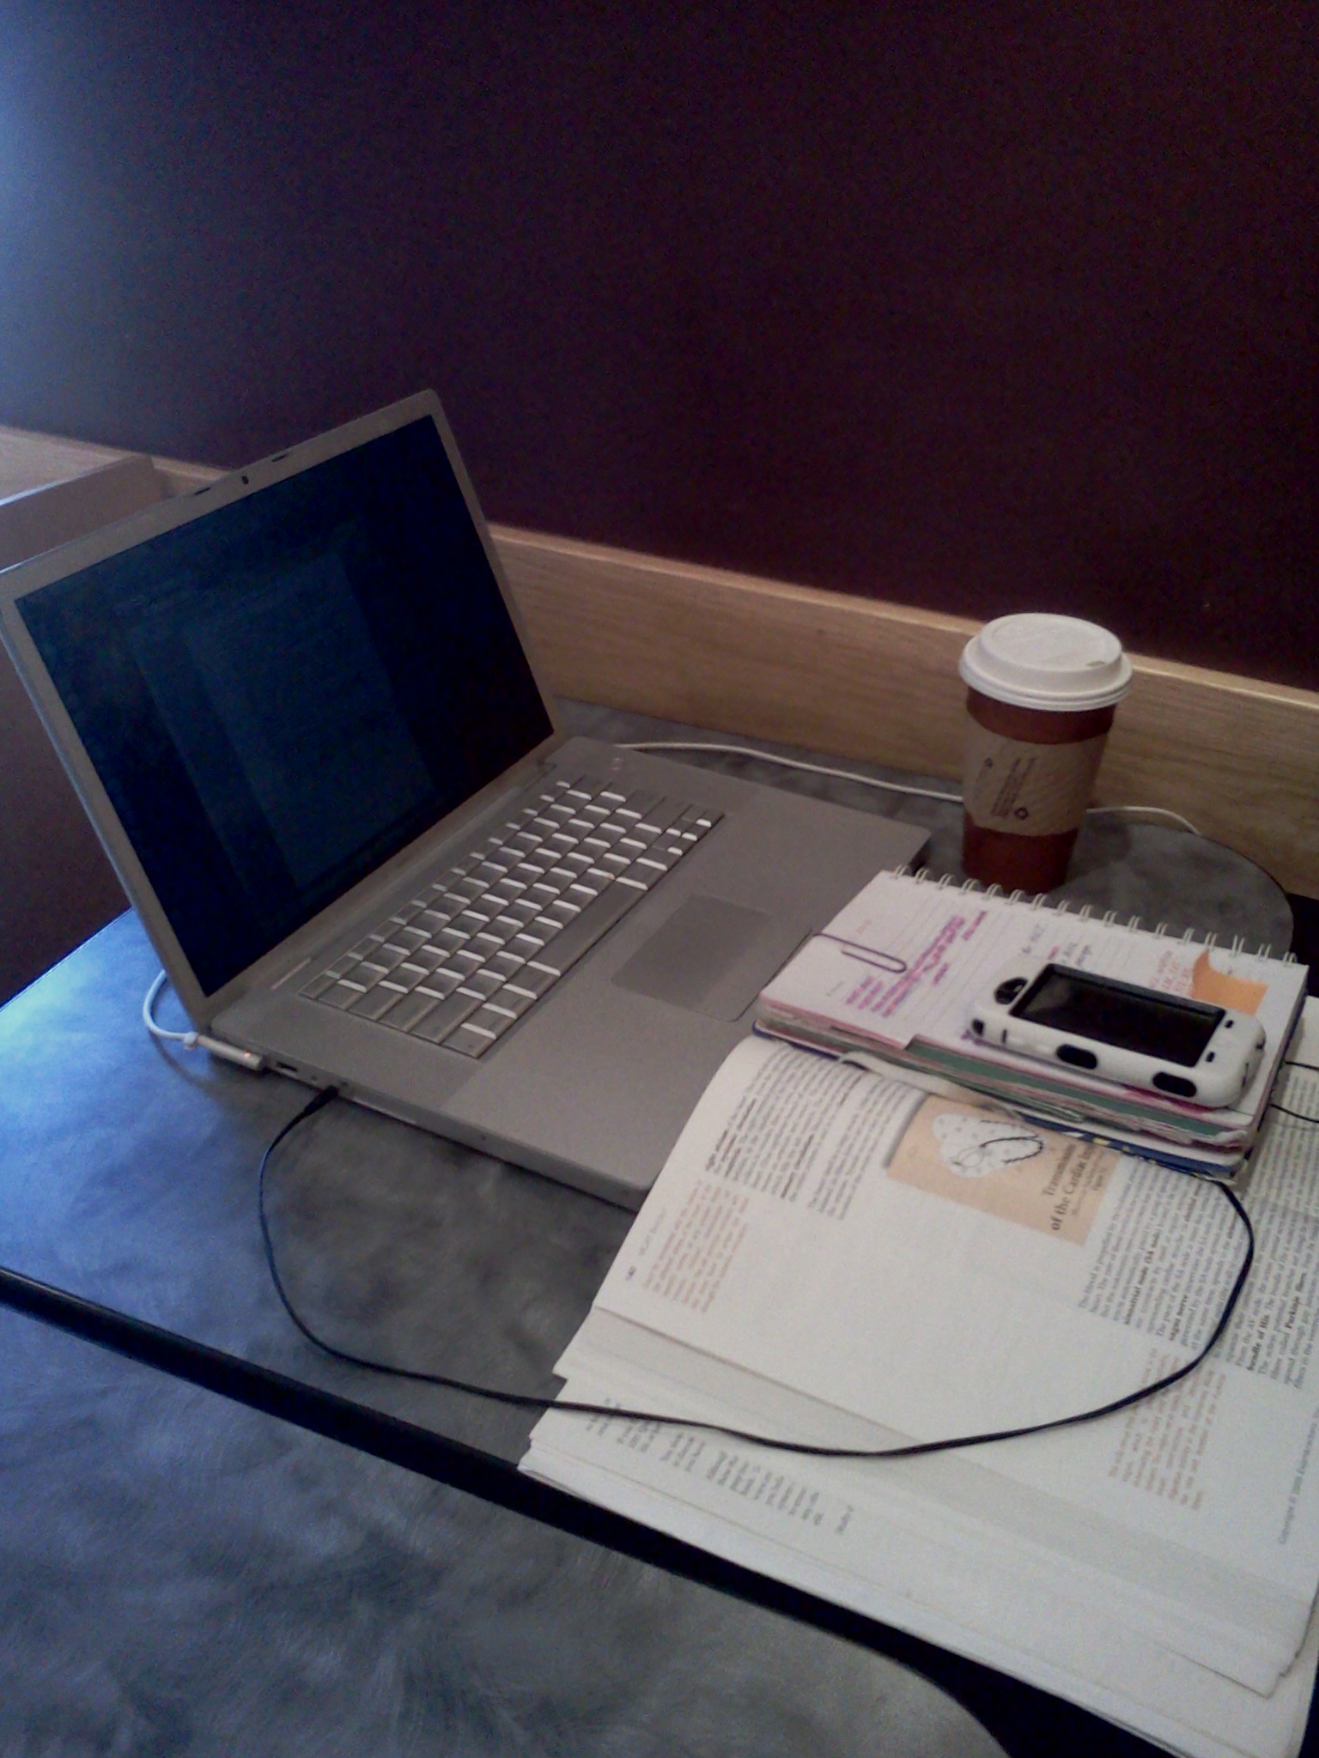

Slide 15
Why Do you Use this Space: Math Empo
Likes the sound of the water fall as it is peaceful and relaxing
Study in the University Mall because it is a convenient location as they had to come to the Empo

Slide 16
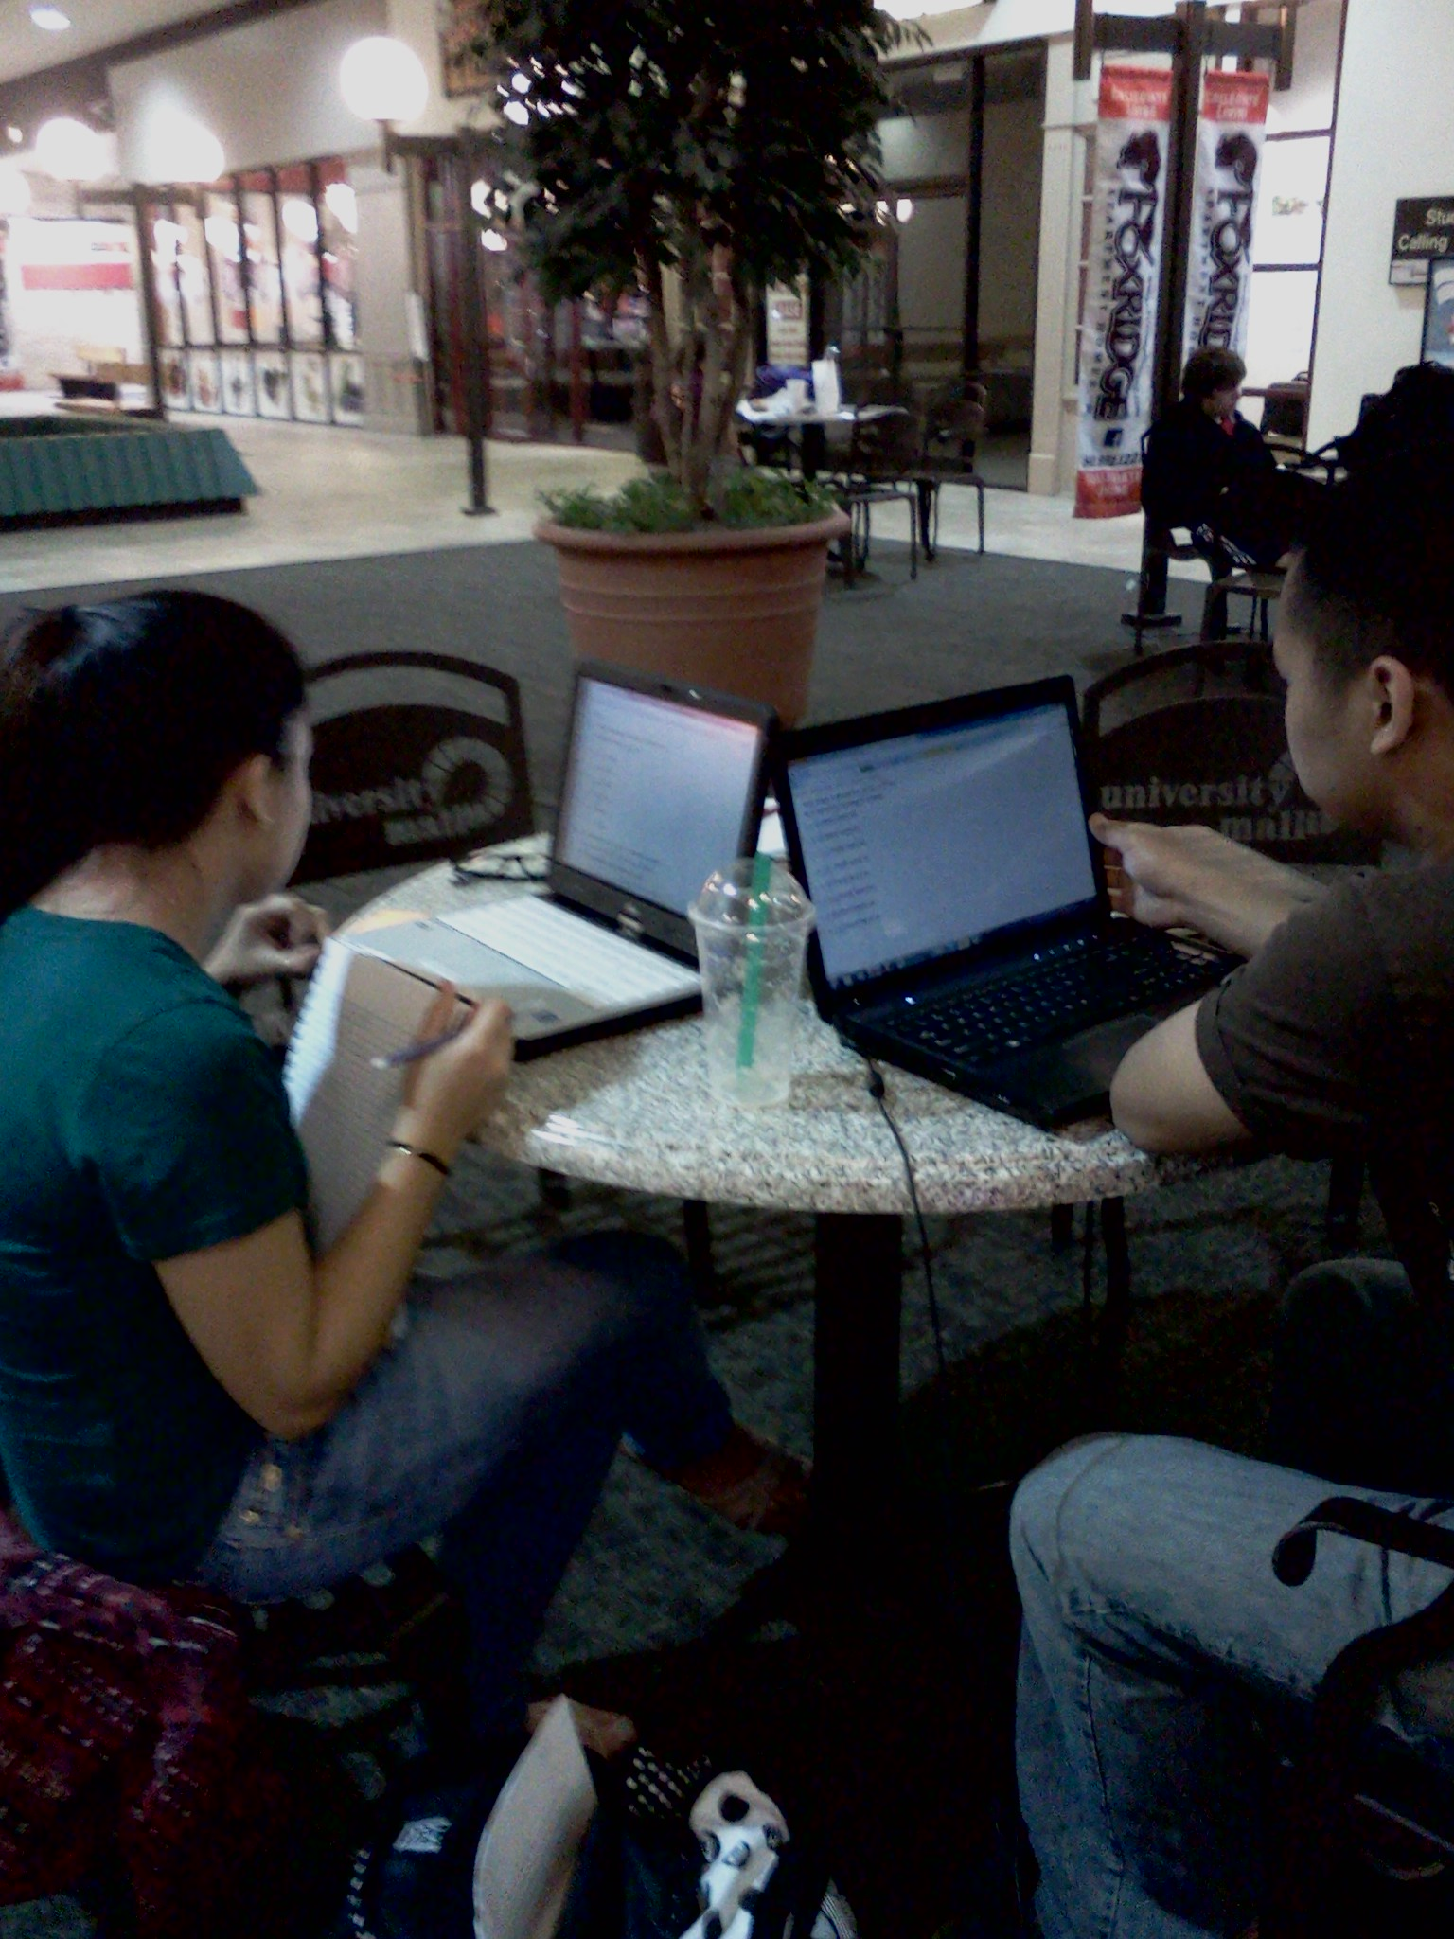

Slide 17
Alternative Locations
Home
Graduate Study Lounge at the Library for solo work
GreenBerrys for group work
GLC lounge, good lighting, peaceful and comfortable
Torg Bridge and Torgersen
Math Empo

Slide 18
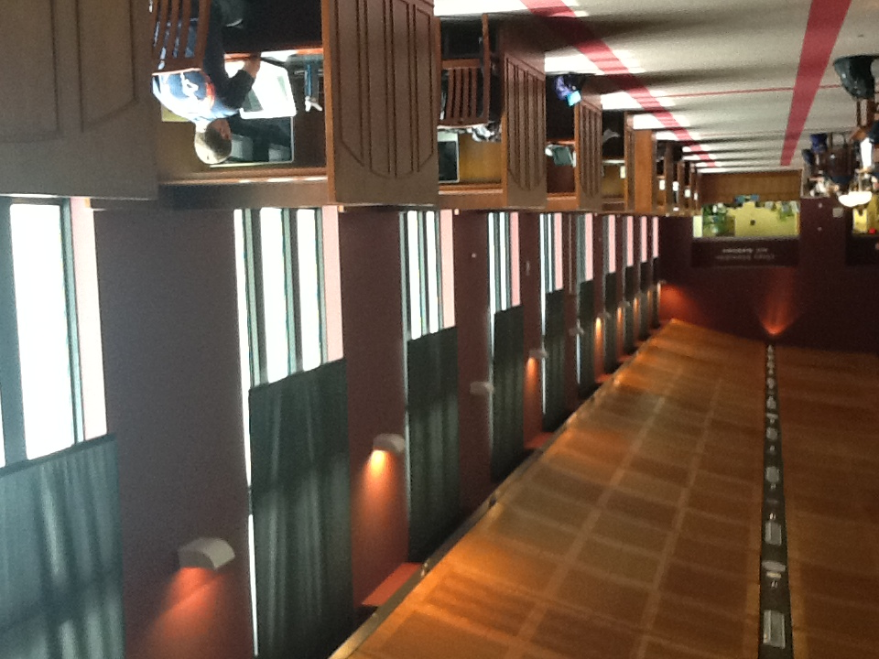

Slide 19
Alternative Locations, cont.
Practice rooms (Music Students)
Dorm Rooms
Lee Hall
Deetz Coffee House
Quiet floors in library
Group study floors in library
Aerospace ENGR lounge in Randolph Hall

Slide 20
What is Appealing about this Space?: Library
Table Space
Outlets
Natural Light
Tables with outlets built in
Can spread materials out on one plane (Engineer Student)
Can spread out
People nearby to watch your materials
Quiet spaces on group study floors
Close proximity to shelves and other materials

Slide 21
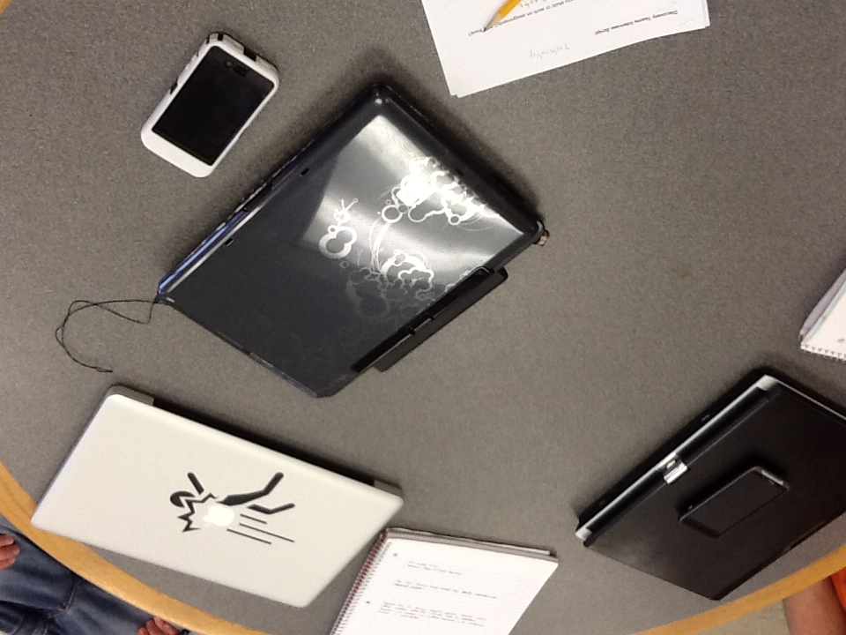

Slide 22
What is Appealing about this Space?: Squires
The chairs are comfortable, the tables are smaller, and the space is quieter—even with collaborators. One guy says, “I like the fact that it is a little more closed off and more private than the open study areas within the library.” Also, the proximity of ABP (Au Bon Pain) makes it a convenient place.
Right near Music department, close proximity

Slide 23
What is Appealing about this place?: Math Empo
Finds the University Mall an appealing study environment because she enjoys the traffic passing by…so she does not have to focus solely on her work.
University Mall made it an appealing study environment they stated because it was quiet and relaxing.

Slide 24
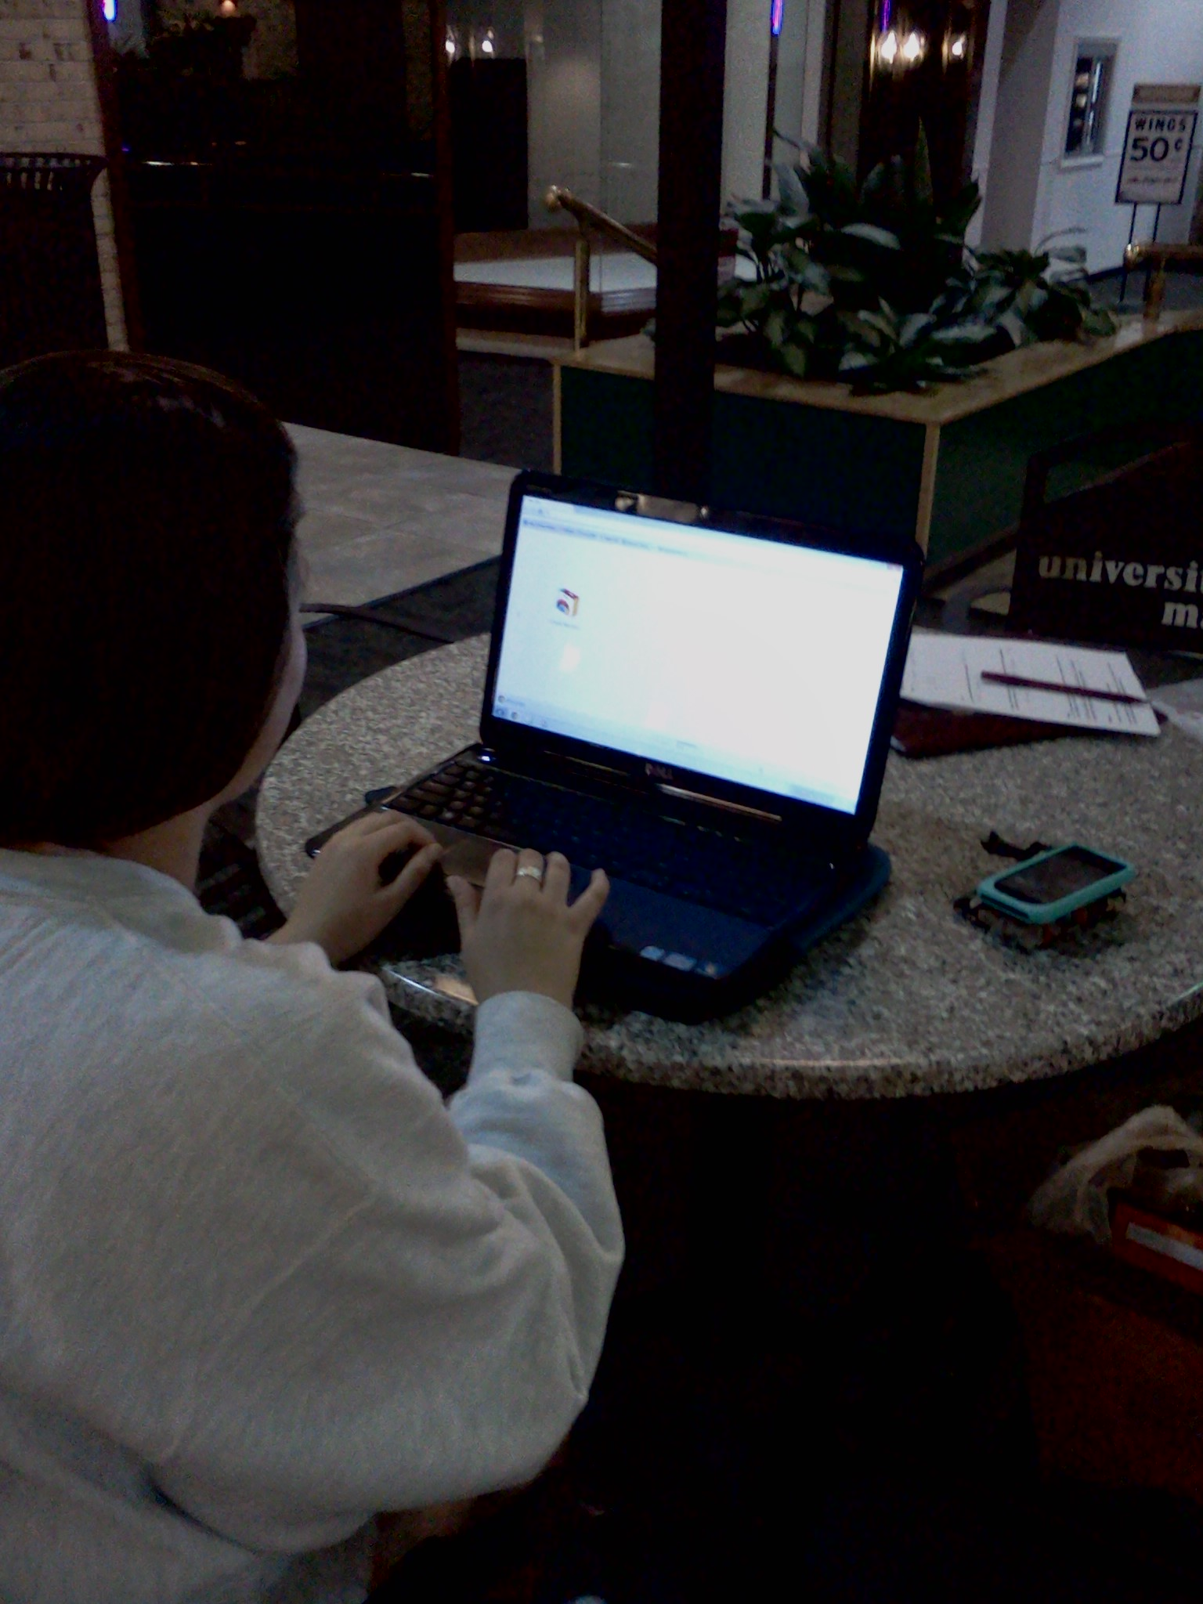

Slide 25
Possible Improvements: Library
Not as many tables as needed
More tables with outlets
Space to have two computers, like in Math Emporium or Torgersen Bridge
Only groups should be allowed to use tables.
Have “patrolling lions” to take care of individuals alone at a table. (And yes they meant real lions)

Slide 26
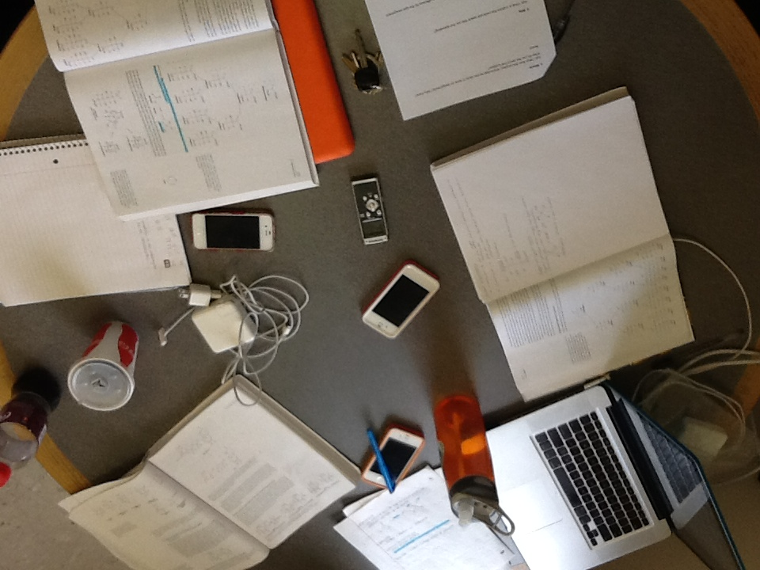

Slide 27
Improvements: Library cont.
More desktop computers on the quiet end of the 4th floor, there are only two and they are normally full
More access to power
Fix the windows/blinds in the group study rooms

Slide 28
Improvements: Squires
More space to sit/collaborate, as it's generally pretty crowded here.”
Wireless router upgrade
More chairs, we move them around a lot and often need to sit on floor
Less foot traffic
If the outlets in Squires were closer to the seating area and upstairs, it would help. Also, more couches / mainly more comfortable seating would be desirable.

Slide 29
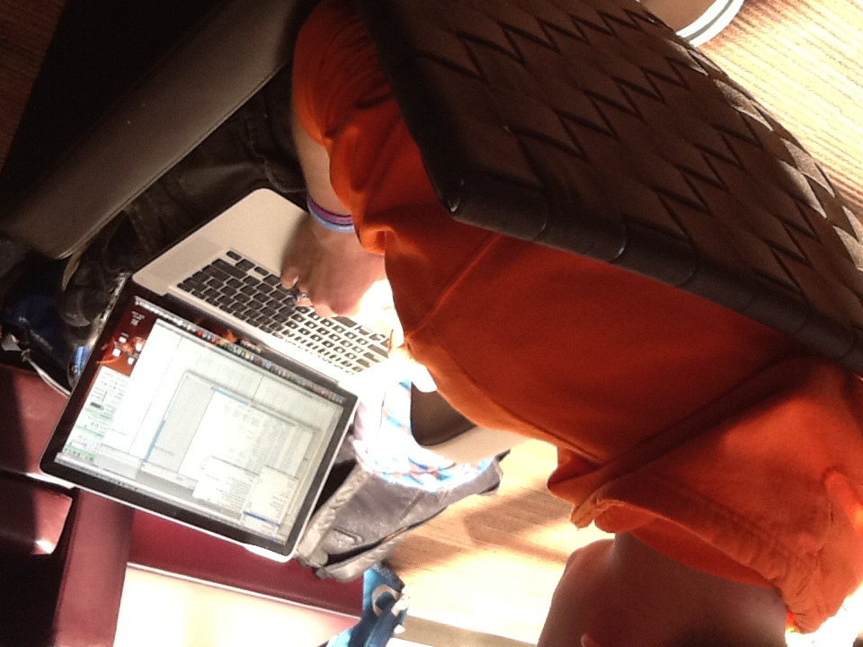

Slide 30
Improvements: Math Empo
More comfortable chairs would improve the space as the table and chairs that are currently there are more for outside use.
More tables in the common area of the mall would make the space more effective as the tables are small and if just one person is at the table, the entire table is occupied.

Slide 31
A few interesting quotes
When I ask about Torgersen, they both say it is too crowded. The male answers, “it [Torgersen] reminds me of Hogwarts and claims that it is too “Harry Potter-ish.”
Male asks, “Are you a librarian?” I respond, “No, I am a doctoral student in IDT.” He continues with, “Can I tell you something? I have a hard time finding books and have had bad service at the library.” I ask more questions, to see who / where he is seeking help. He explains that the desk, “not the one where you checkout but the other one, on the first floor.” He continues, that when he asks for help in locating a certain book that the librarians aren’t helpful. The female encourages him to ask the people (student workers) that are shelving. She say, “look for the people with headphones; they know where things are.”

Slide 32
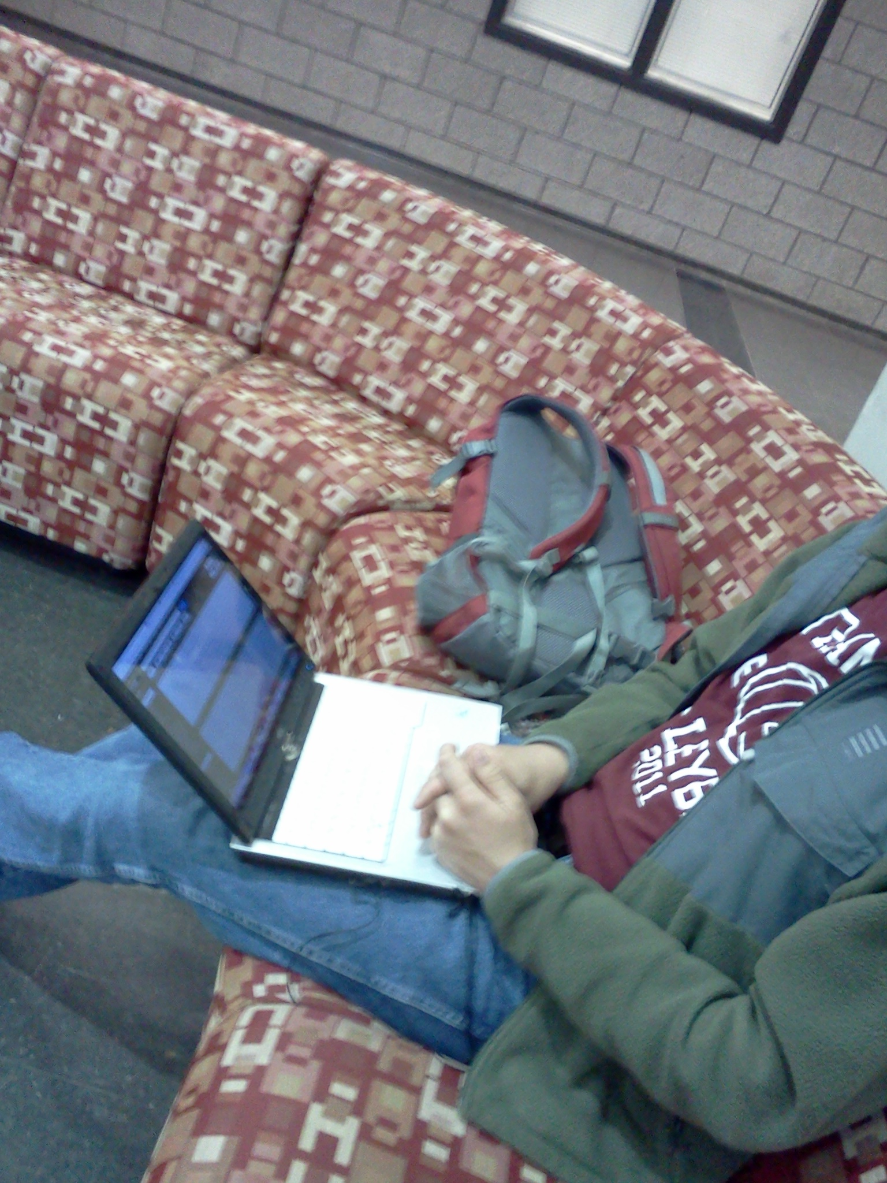

Slide 33
Conclusion: Themes
Students tend to use a space for these main reasons
Proximity
Convenience
Peers/Friends and space to work with them
Good internet connection
Space to work, move, sit
Comfort
Options. Students like to have them

