Slide 1
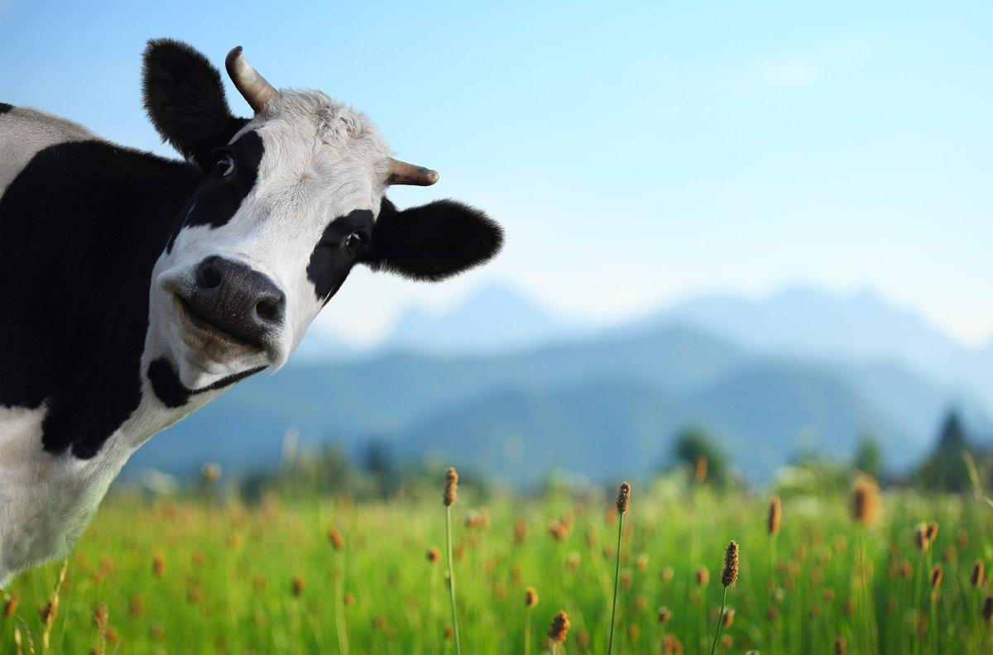
Project: Dairy Feeding Framework
Team: Kevin Kapros, Dwarakh Nayam, Ger Vue, Evan Webb, Mike Silvasy, Oli Stein
Course: CS 4624: Multimedia, Hypertext, and Information Access
Instructor: Dr. Edward A. Fox
Location: Virginia Tech, Blacksburg VA 24061
Date: 04/22/2021
Image: https://www.chicagoparent.com/learn/milking/
Notes:
https://lucid.app/lucidchart/bcb22e03-45d2-4bdc-aa2c-2c7097bd787a/edit?shared=true&page=0_0#

Slide 2

Outline
Brief Description
Current Progress
Future Plan/Finishing Up
Acknowledgement

Slide 3

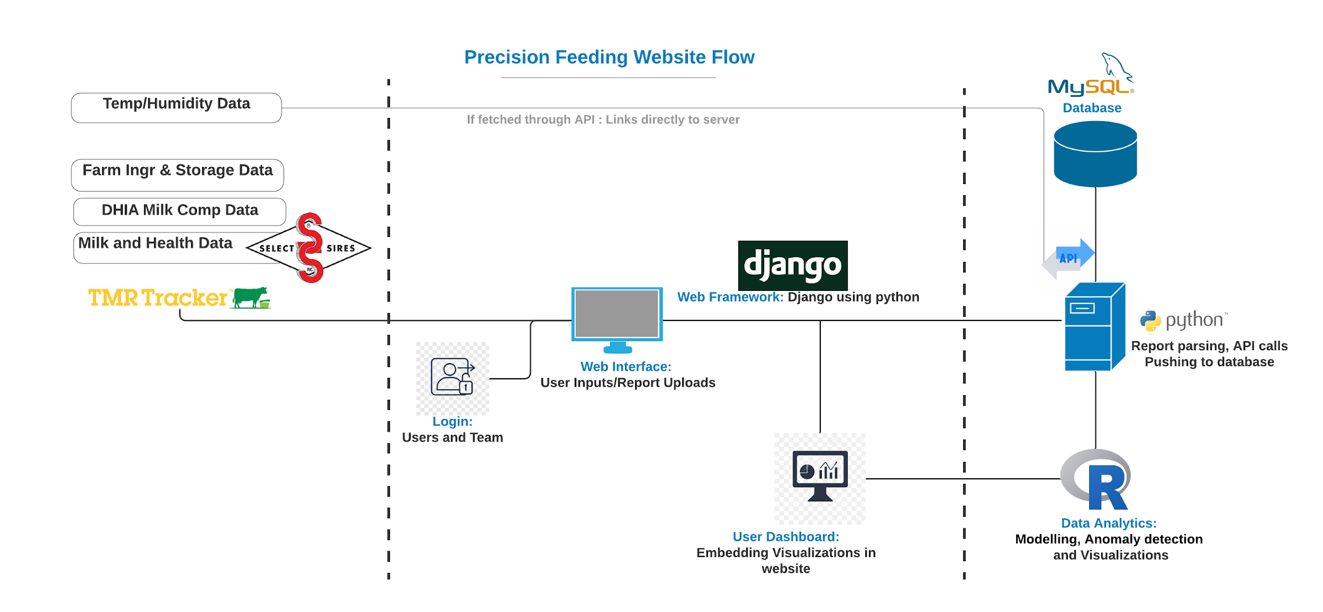
Precision Feeding Overview
Provide easy-to-use framework for dairy nutritionists to adjust individual cow diets for efficient milk production
INPUT
INTERFACE
BACKEND
Notes:
Kevin
https://www.flaticon.com/svg/vstatic/svg/2395/2395765.svg?token=exp=1612891328~hmac=7ec78423b43049cab21f11e379822ed0

Slide 4
Current Progress
Notes:
Mike

Slide 5
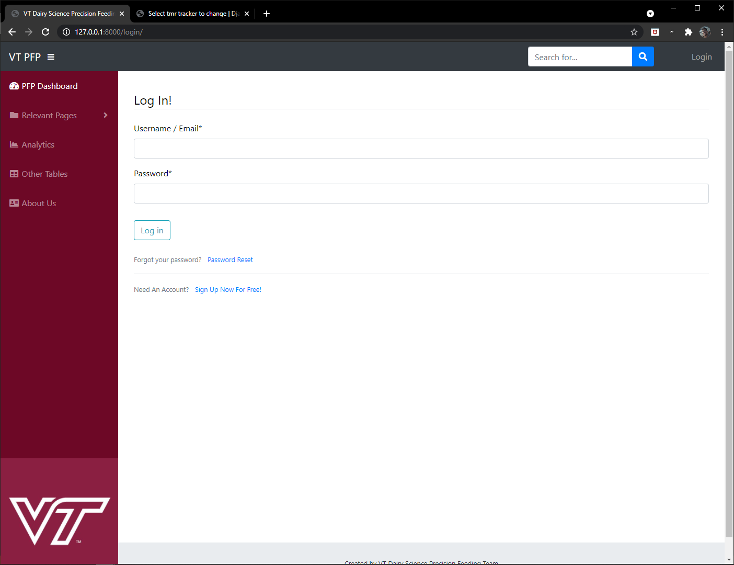
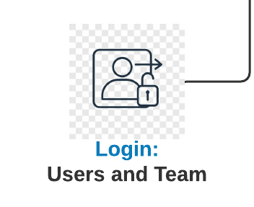
User Login
Login/Create Account
Email verification for account creation
Notes:
Mike

Slide 6
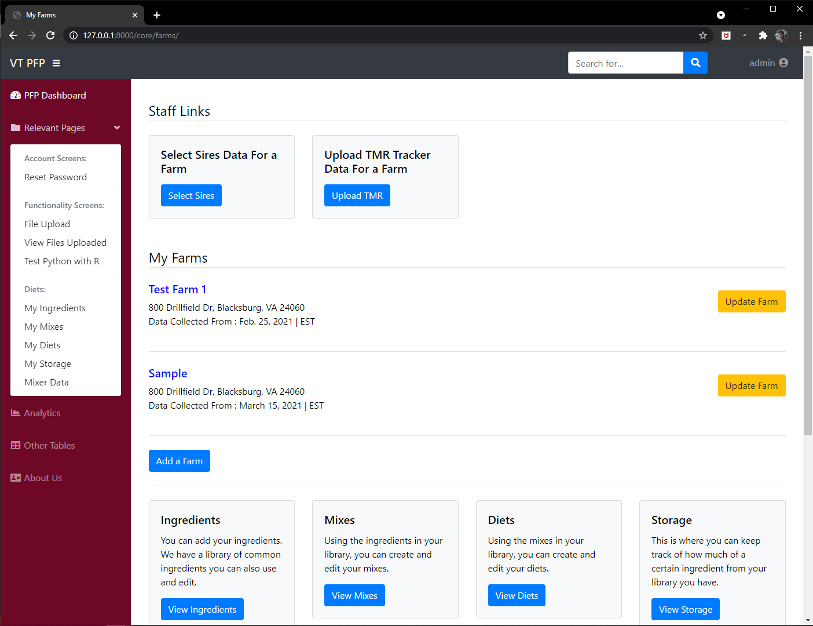
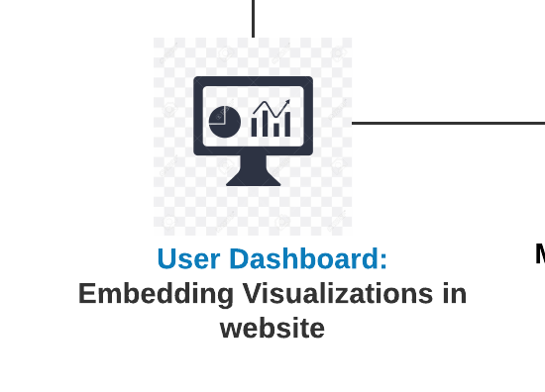
User Dashboard
Able to view/add farms to their profile
(Admin only) able to import Select Sires and TMR data
Left panel: multi-tab for specific selections
Notes:
Mike

Slide 7
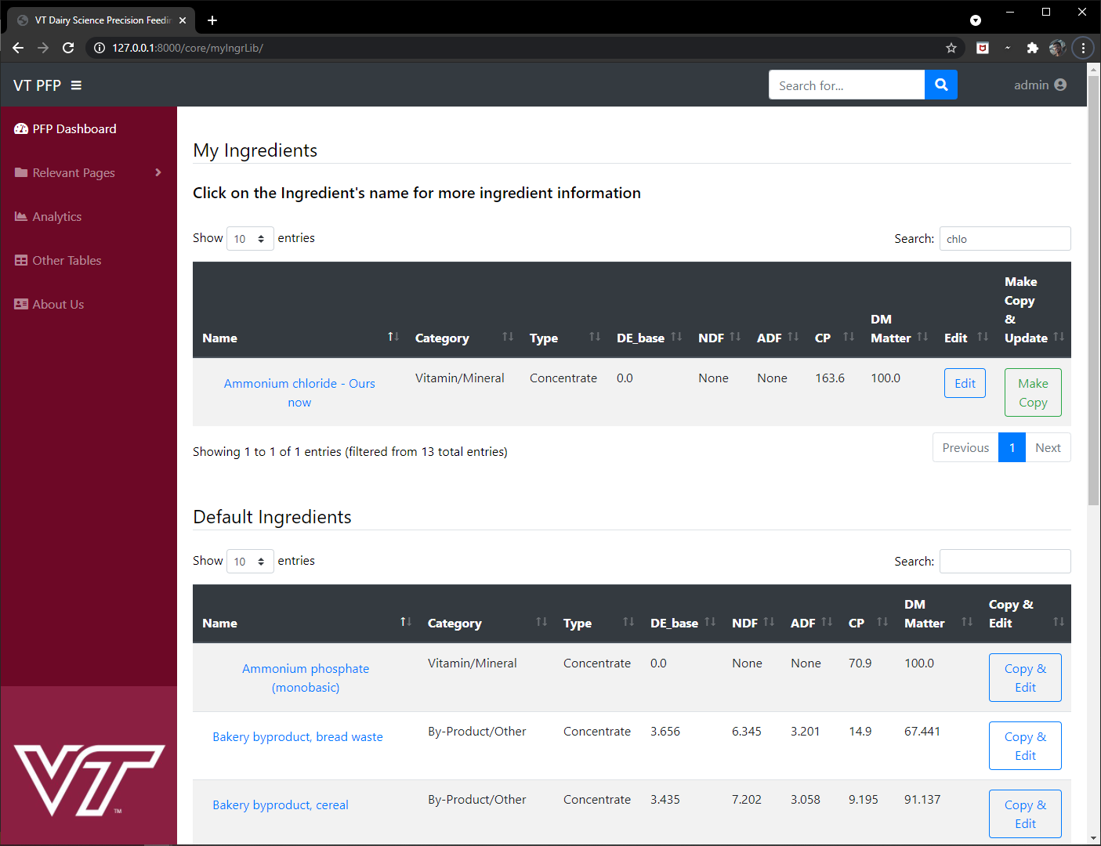
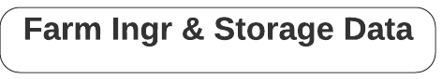
User Ingredients
Able to see list of default ingredients
Able to copy and edit default ingredients
Able to edit or copy custom ingredients
Notes:
Mike

Slide 8
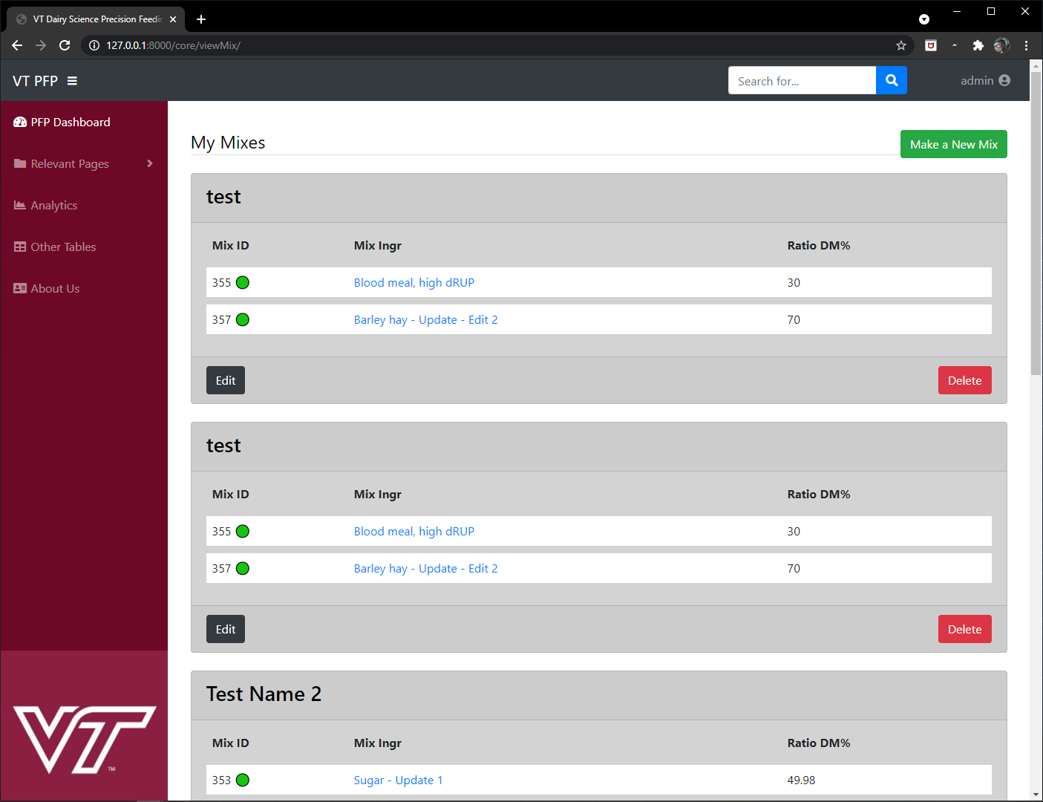

User Mixes
Able to view all ingredients mixes
Can edit/delete mixes
Can create a new mix
Notes:
Mike

Slide 9
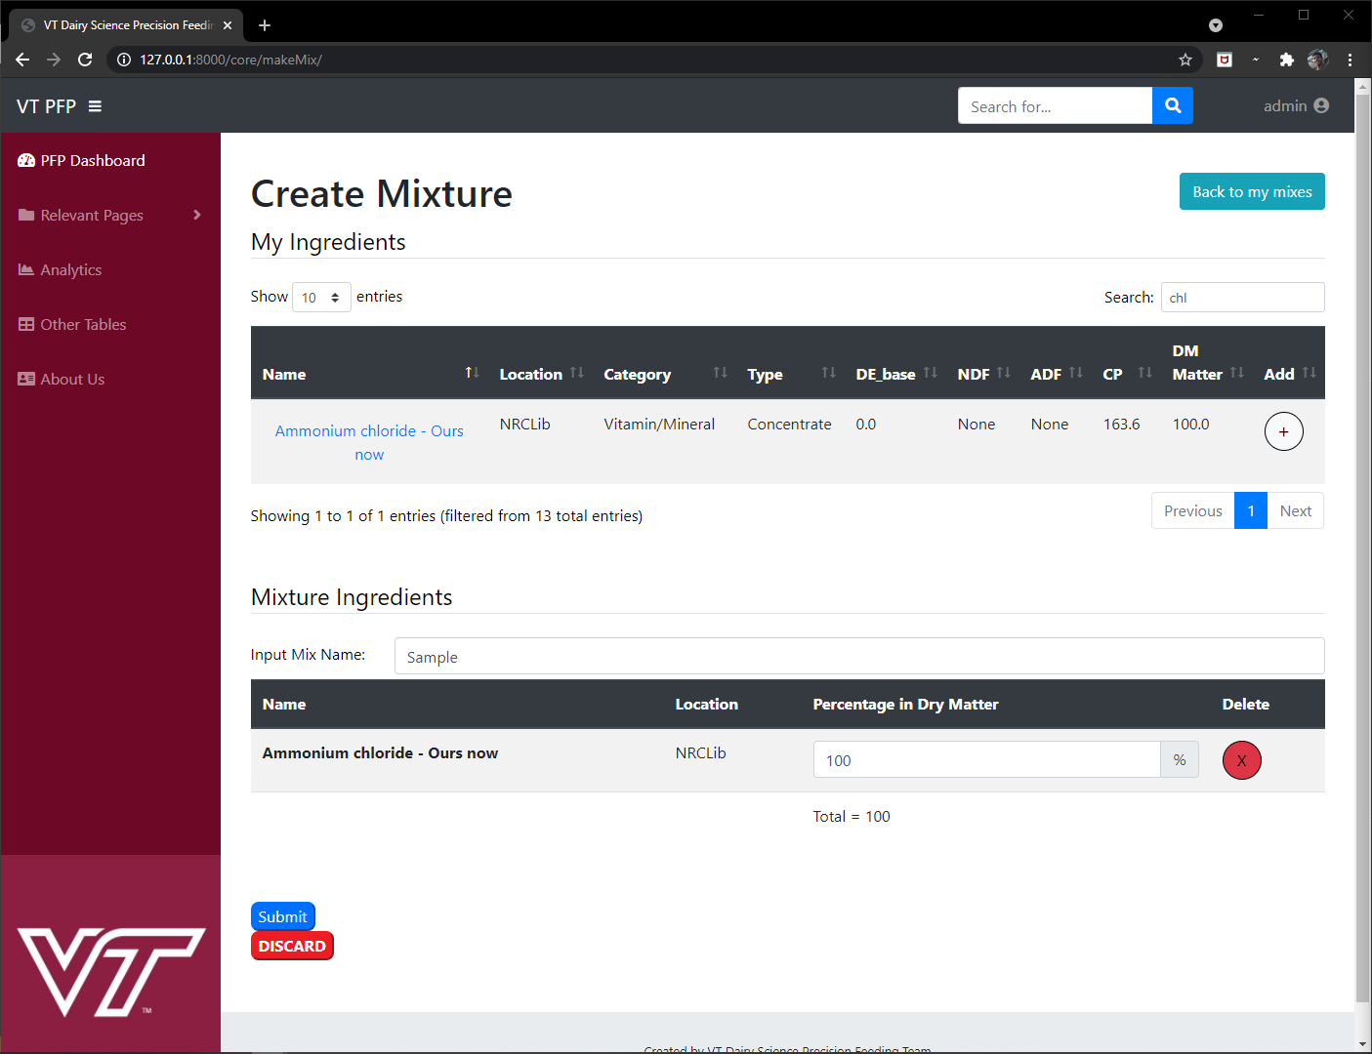
User Mixes (Create)
Select ingredients for mixture
Set a name for mixture
Set ingredients ratio based on dry matter
Ratio must total to 100% otherwise creation fails
Notes:
Evan

Slide 10
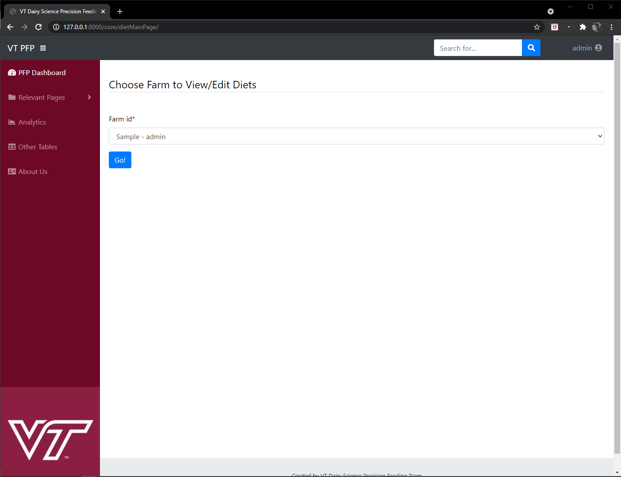
User Diets
Must select a farm to view/edit diets
List of user’s Farms
Notes:
Evan

Slide 11
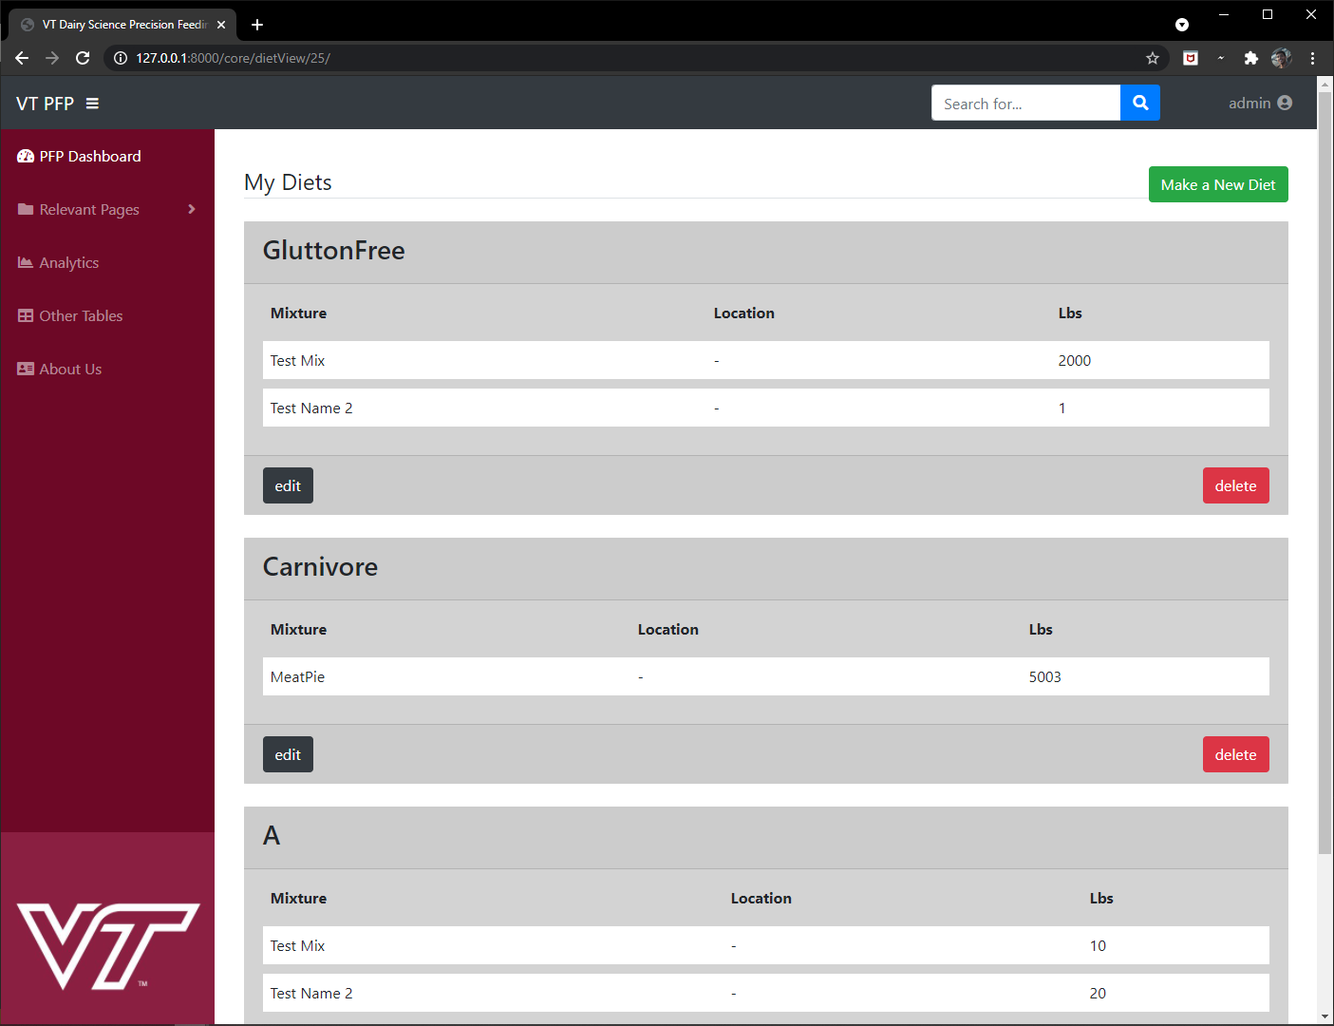
User Diets
Able to view all diets specific to selected farm
Can edit/delete diet
Can create new diet
Notes:
Evan

Slide 12
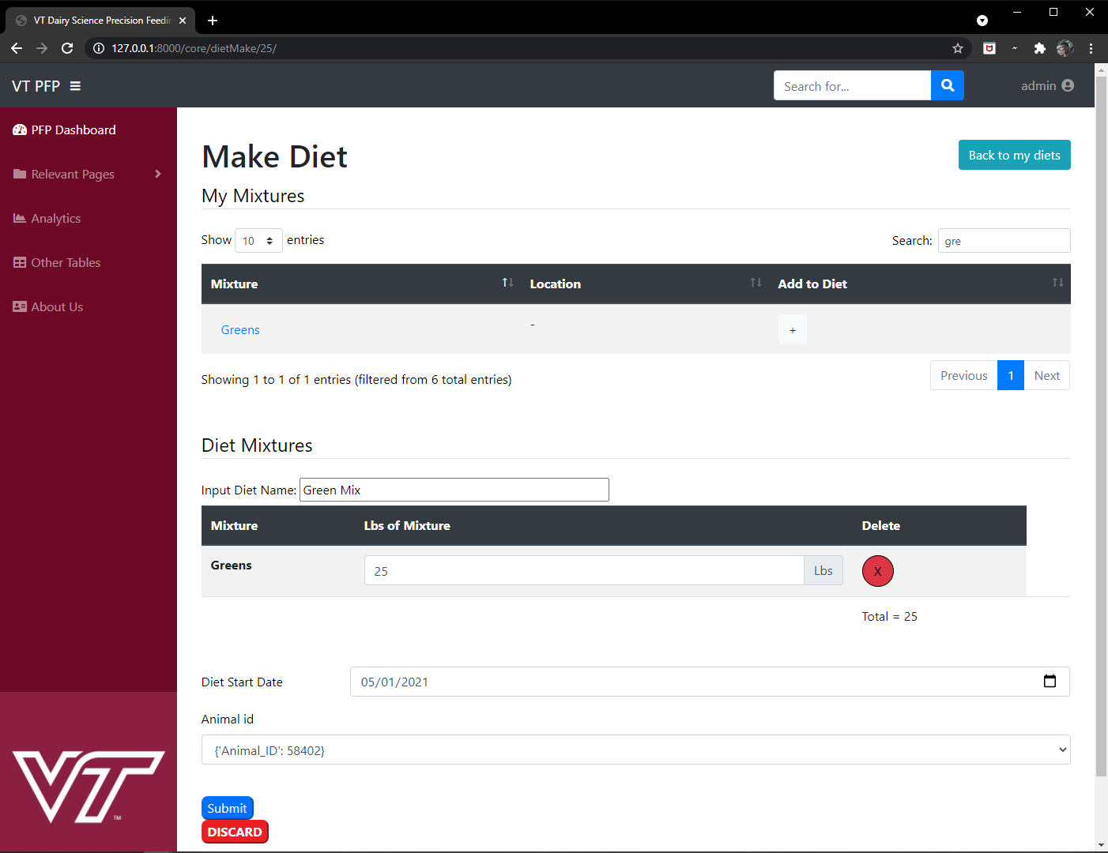
User Diets
Select ingredients mixture for diet
Set a name for diet
Set mixture weight in pounds
Set date when diet given
Select animal/pen where diet was used
Notes:
Evan

Slide 13
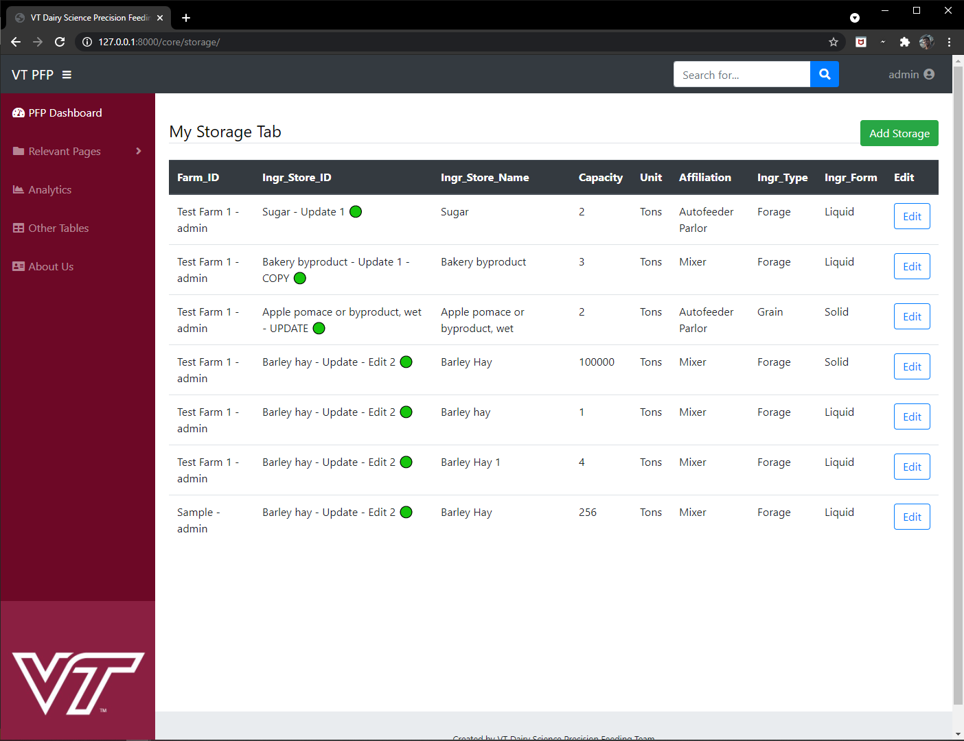
Ingredients Storage
View storage unit of all ingredients and its location
Can add/edit storage
Notes:
Evan

Slide 14
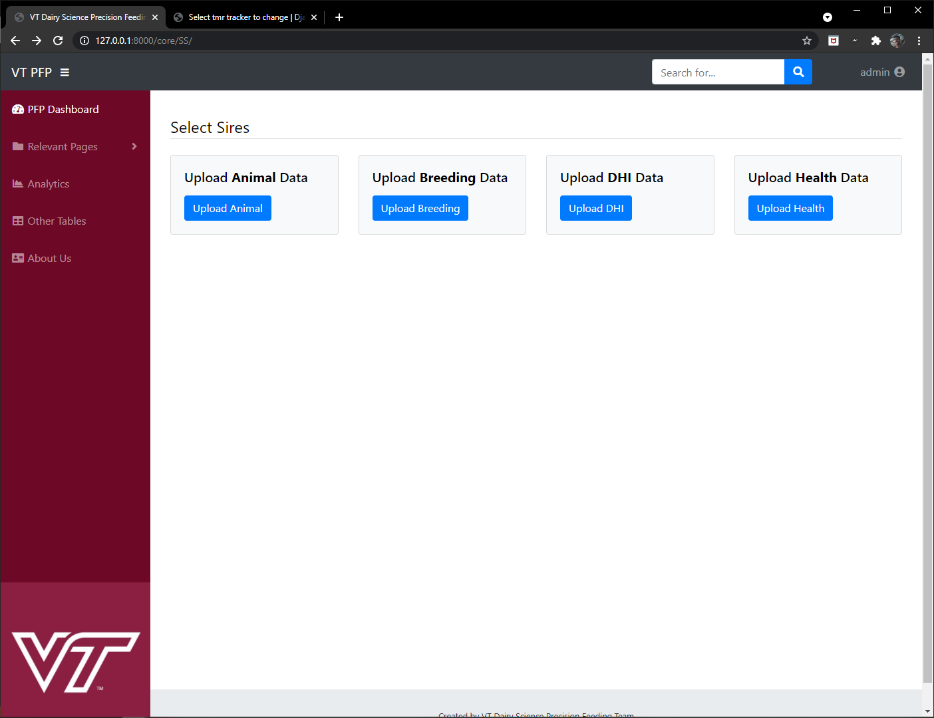

Select Sires
Admin Privilege Only
Upload Select Sires data to database
Notes:
Ger

Slide 15
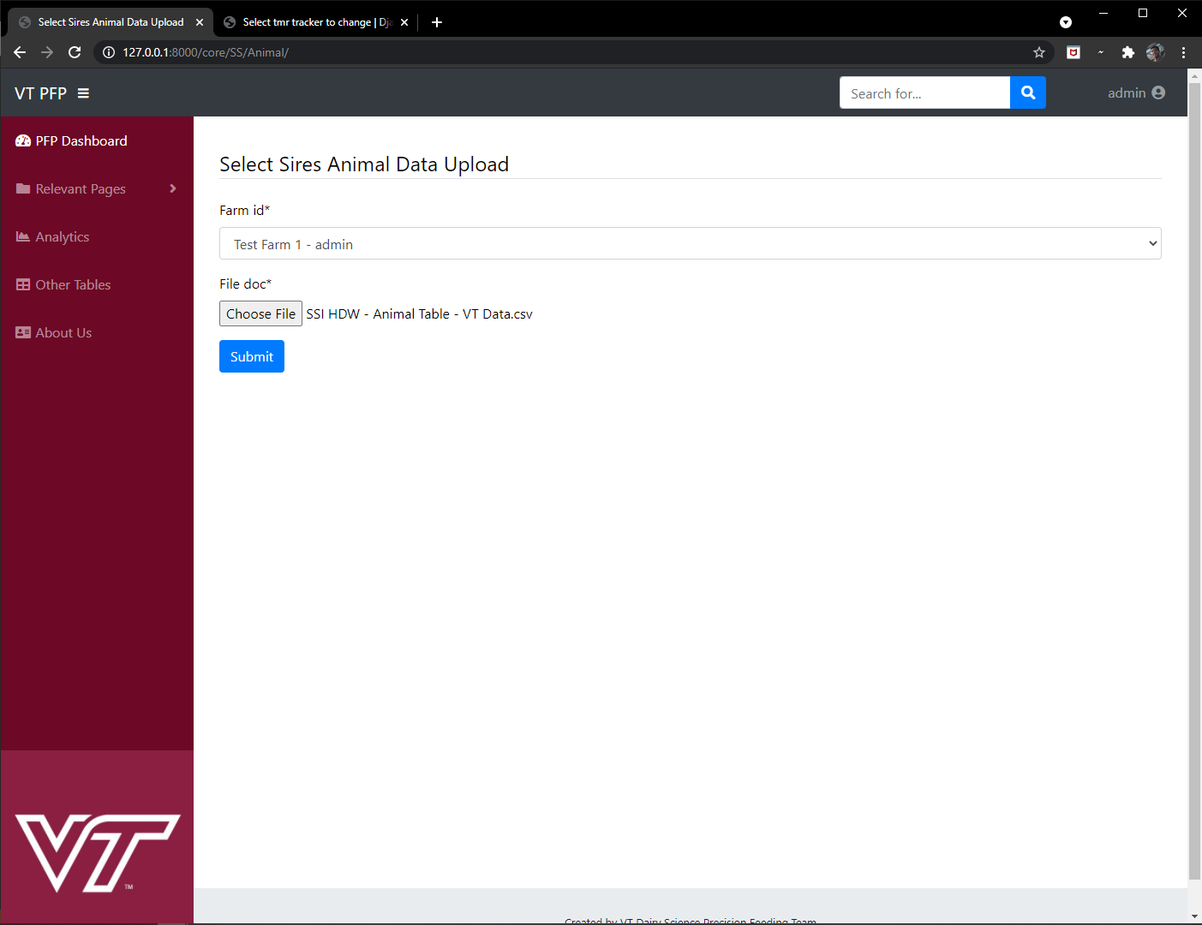

Select Sires (Animal Example)
Upload correct data obtained from Select Sires
Notes:
Ger

Slide 16
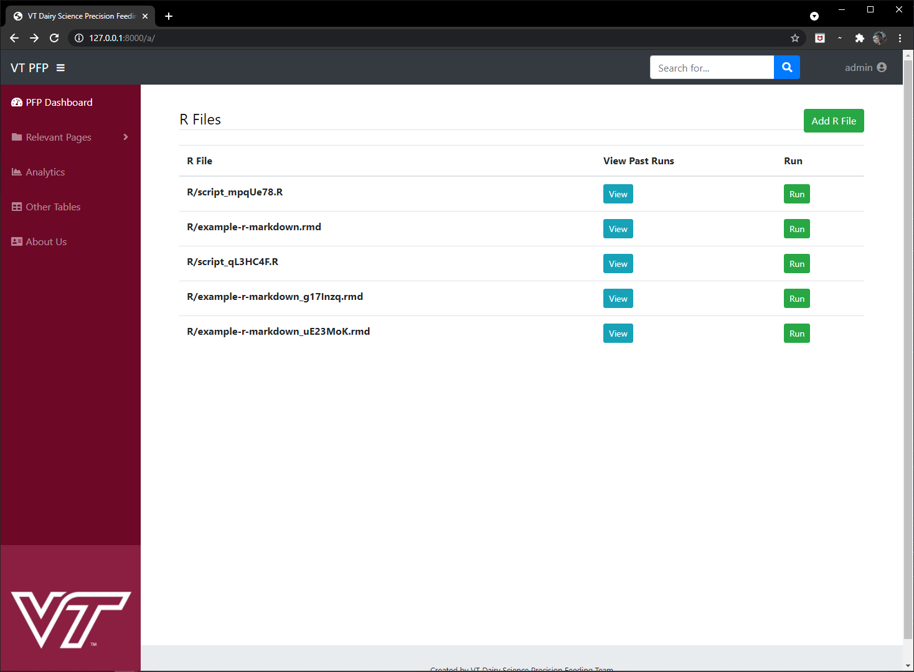

Analytics with R
Notes:
Oli

Slide 17

Analytics with R
Runs R Analysis/Report
Notes:
Oli

Slide 18
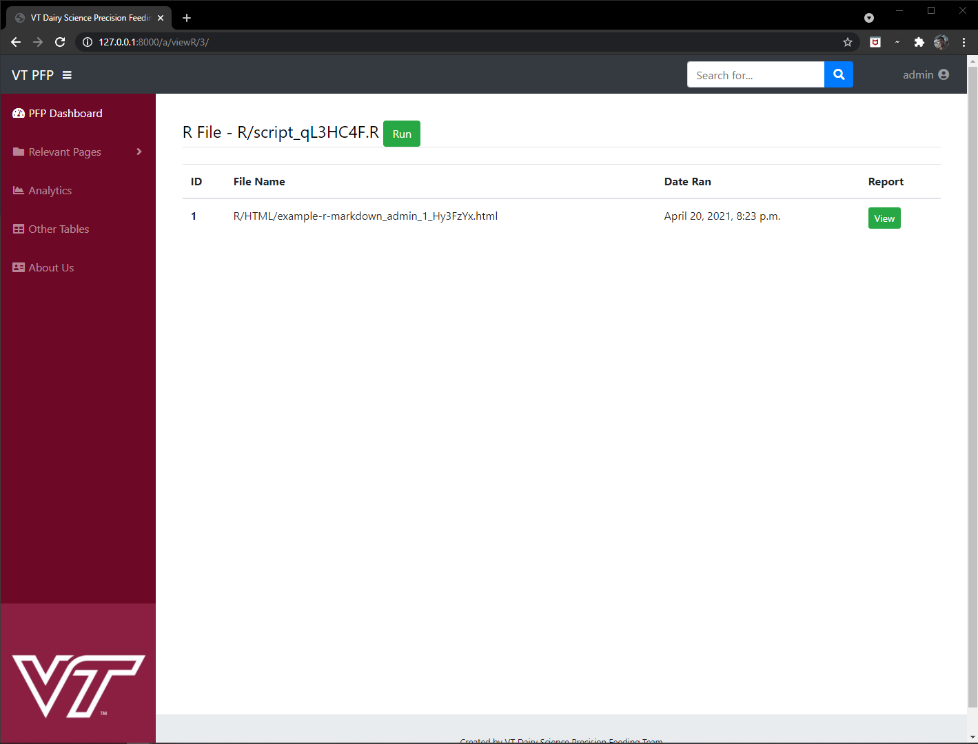
Analytics with R
View Analysis/Report
Notes:
Oli

Slide 19
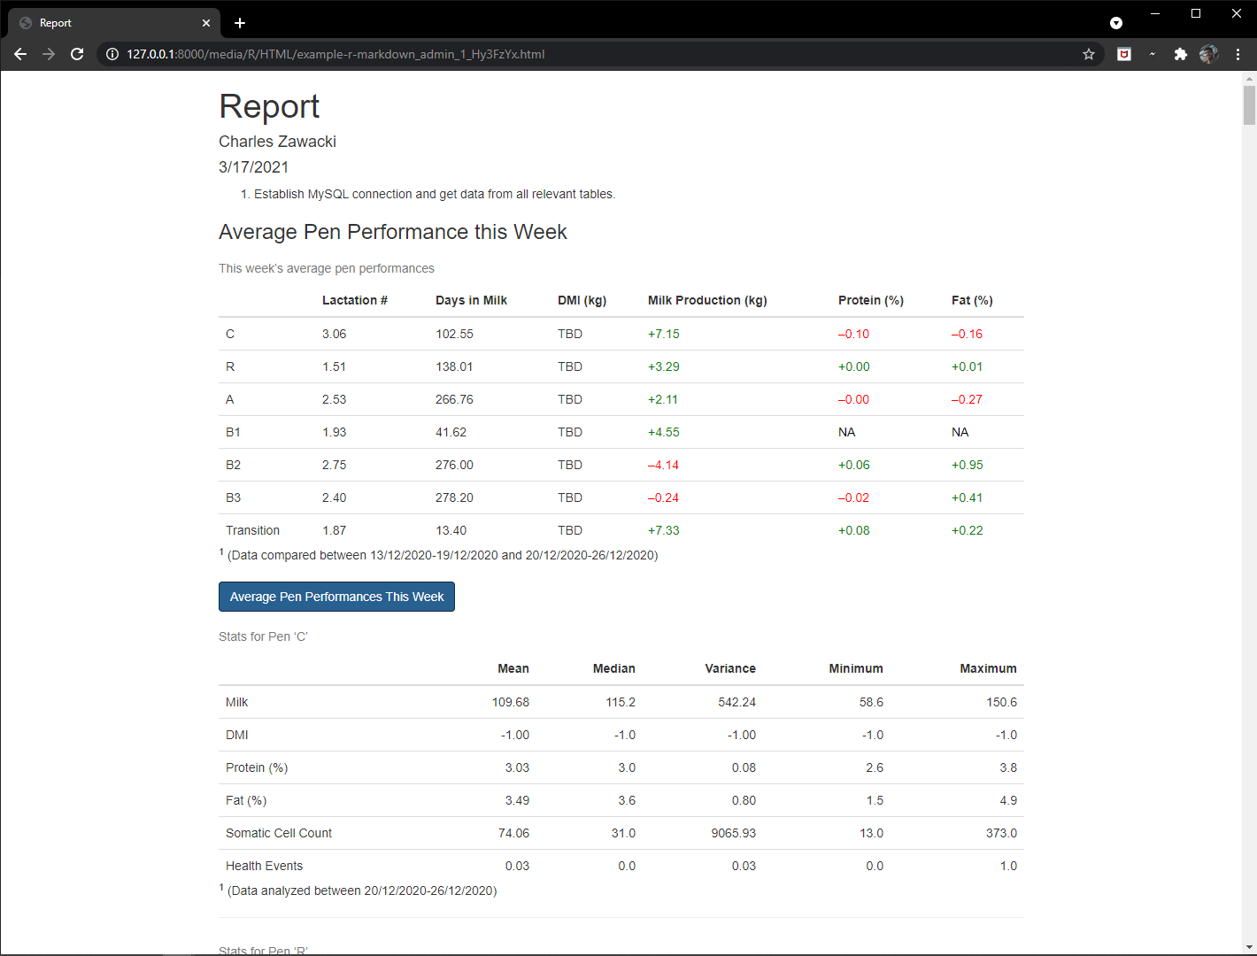
Analytics with R
Notes:
Oli

Slide 20
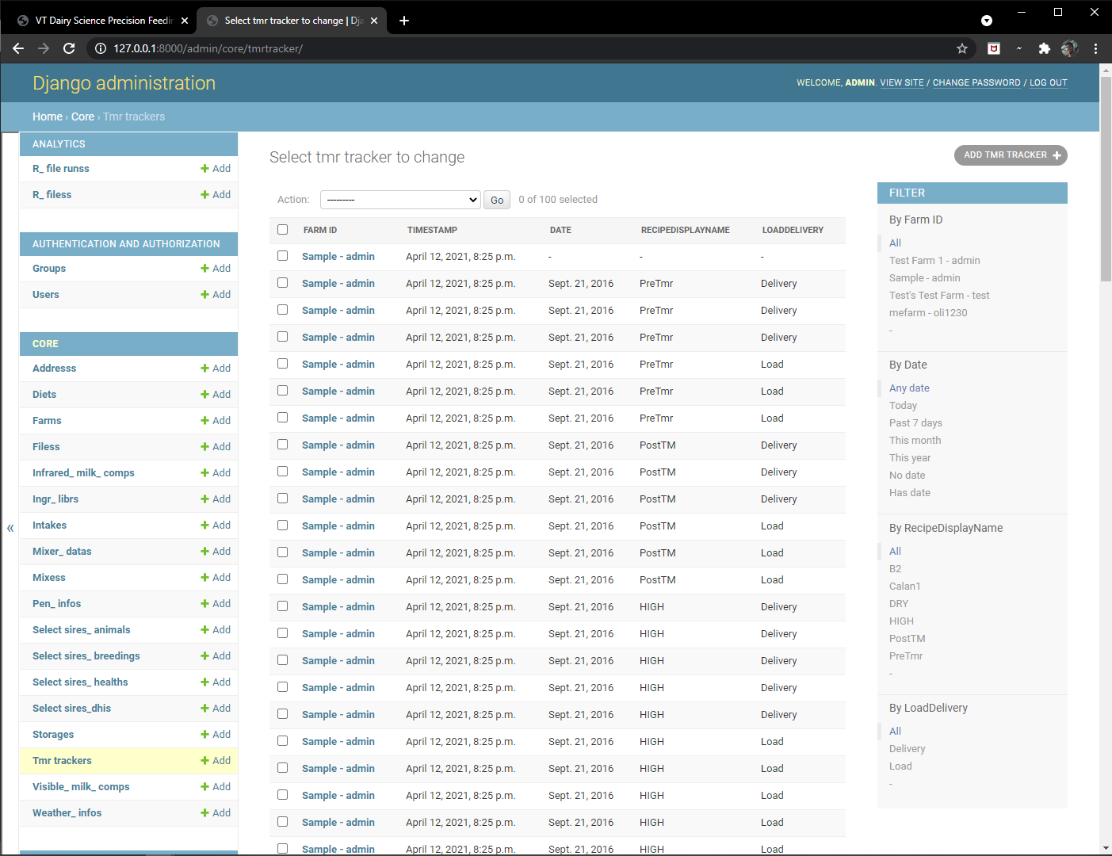

Admin Page
Holds all the data uploaded or fetched
Admin can view data tables and users accounts
Notes:
Ger

Slide 21

Finishing Up
04/16
04/23
04/30
R Connection Setup for Analytics
Testing Functionality & Visualization
Complete Docker Website Setup
Notes:
Ger
https://www.flaticon.com/svg/vstatic/svg/3652/3652191.svg?token=exp=1612982860~hmac=c5e4cdb3a26aa200a695bc78dc74fd15
Python ==(rpy2)==> R ===> R (Markdown) ===> HTML Render ===> Save file path in DB ==> Show our clients those report

Slide 22
Project Acknowledgement
Clients:
Mark Hanigan
Department of Dairy Science, Professor
mhanigan@vt.edu
Leticia M. Campos
Department of Dairy Science, Phd. Student
leticiamc@vt.edu
Wu Feng
Department of Computer Science, Professor
wfeng@vt.edu
Research Assistants:
Sonal Jha
Graduate Research Assistant
Charles Zawacki
Undergraduate Research Assistant
Yanlin Du
Undergraduate Research Assistant
Notes:
Ger
https://www.flaticon.com/svg/vstatic/svg/1198/1198355.svg?token=exp=1612891903~hmac=dd15d7be78e227b93df356d6921fcdf4
Special thanks to our clients Dairy Science Professor Mark Hanigan and CS Professor Wu Feng. We are open to any questions or comments. Thank you!
Citations:
https://www.selectsires.com/
Cow Images:
https://www.chicagoparent.com/learn/milking/
https://www.flaticon.com/svg/vstatic/svg/2395/2395765.svg?token=exp=1612891328~hmac=7ec78423b43049cab21f11e379822ed0
https://www.flaticon.com/svg/vstatic/svg/2230/2230283.svg?token=exp=1612891328~hmac=7aa6f4a21c44951c9cdeb92bb558baea
https://www.flaticon.com/svg/vstatic/svg/2194/2194839.svg?token=exp=1612891472~hmac=90fcd9e678b715d5ceca35f207bb5278
https://www.flaticon.com/svg/vstatic/svg/616/616528.svg?token=exp=1612891832~hmac=0c5fcacc9c28a834ab73d801af89cc65
Dairy:
https://www.flaticon.com/svg/vstatic/svg/1198/1198355.svg?token=exp=1612891903~hmac=dd15d7be78e227b93df356d6921fcdf4
Calendar:
https://www.flaticon.com/svg/vstatic/svg/3652/3652191.svg?token=exp=1612982860~hmac=c5e4cdb3a26aa200a695bc78dc74fd15

Slide 23
References
Citations:
https://www.selectsires.com/
Images:
https://www.chicagoparent.com/learn/milking/
https://www.flaticon.com/free-icon/cow_2395765?term=cow&page=1&position=4&page=1&position=4&related_id=2395765&origin=search
https://www.flaticon.com/svg/vstatic/svg/2395/2395765.svg?token=exp=1612891328~hmac=7ec78423b43049cab21f11e379822ed0
https://www.flaticon.com/svg/vstatic/svg/2230/2230283.svg?token=exp=1612891328~hmac=7aa6f4a21c44951c9cdeb92bb558baea
https://www.flaticon.com/svg/vstatic/svg/2194/2194839.svg?token=exp=1612891472~hmac=90fcd9e678b715d5ceca35f207bb5278
https://www.flaticon.com/svg/vstatic/svg/616/616528.svg?token=exp=1612891832~hmac=0c5fcacc9c28a834ab73d801af89cc65
https://www.flaticon.com/svg/vstatic/svg/3652/3652191.svg?token=exp=1612982860~hmac=c5e4cdb3a26aa200a695bc78dc74fd15
Notes:
Ger
https://www.flaticon.com/svg/vstatic/svg/1198/1198355.svg?token=exp=1612891903~hmac=dd15d7be78e227b93df356d6921fcdf4
Special thanks to our clients Dairy Science Professor Mark Hanigan and CS Professor Wu Feng. We are open to any questions or comments. Thank you!
Citations:
https://www.selectsires.com/
Cow Images:
https://www.chicagoparent.com/learn/milking/
https://www.flaticon.com/svg/vstatic/svg/2395/2395765.svg?token=exp=1612891328~hmac=7ec78423b43049cab21f11e379822ed0
https://www.flaticon.com/svg/vstatic/svg/2230/2230283.svg?token=exp=1612891328~hmac=7aa6f4a21c44951c9cdeb92bb558baea
https://www.flaticon.com/svg/vstatic/svg/2194/2194839.svg?token=exp=1612891472~hmac=90fcd9e678b715d5ceca35f207bb5278
https://www.flaticon.com/svg/vstatic/svg/616/616528.svg?token=exp=1612891832~hmac=0c5fcacc9c28a834ab73d801af89cc65
Dairy:
https://www.flaticon.com/svg/vstatic/svg/1198/1198355.svg?token=exp=1612891903~hmac=dd15d7be78e227b93df356d6921fcdf4
Calendar:
https://www.flaticon.com/svg/vstatic/svg/3652/3652191.svg?token=exp=1612982860~hmac=c5e4cdb3a26aa200a695bc78dc74fd15

