Slide 1


Chapter 8
Formulate Business-Level Strategy
Strategic Management
MGT 4394
Notes:
These slides serve as a study guide for “Chapter 8: Formulate Business-Level Strategy” in Strategic Management and Case Analysis: An Integrated Approach ©Lori Anderson, Dirk Buengel, and Joseph J. Simpson, which is provided at https://doi.org/10.21061/strategicmanagementandcaseanalysis under an open license, Creative Commons BY NC-SA 4.0. The slides are also provided at https://hdl.handle.net/10919/138831 under the same open license, Creative Commons BY NC-SA 4.0.
Note to Instructors: These study guides are intended to be a concise and comprehensive accompaniment that follows the logic of the textbook. Our intention is to support you in your instruction and is based on our experience that it can be easier and quicker to remove slides you do not want to include than to create additional slides.

Slide 2

Study Guide
These slides serve as a study guide for “Chapter 8: Formulate Business-Level Strategy” in Strategic Management and Case Analysis: An Integrated Approach by Lori Anderson, Dirk Buengel, and Joseph J. Simpson, which is provided under an open license, Creative Commons BY NC-SA 4.0. The slides are also provided under the same open license, Creative Commons BY NC-SA 4.0.
Notes:
Note to students: These study guides are intended to be a concise and comprehensive accompaniment that follows the logic of the textbook and may support your learning, mastery, and application of these concepts. They are are intended to supplement, not replace, your review of the textbook and any other sound study strategies you have made, such as taking notes to support your most effective learning.

Slide 3
Learning Objectives, 1 of 2
After engaging with this chapter, you will understand and be able to apply the following concepts.
Business-level strategy
Strategic market position (cost leadership and differentiation)
Strategic market size (focused and broad)
Six business-level strategies
Focused cost leadership
Broad cost leadership
Focused differentiation
Upon completion of this chapter, you will be equipped to analyze a firm’s business-level strategy.

Slide 4
Learning Objectives, 2 of 2
After engaging with this chapter, you will understand and be able to apply the following concepts.
Broad differentiation
Best-cost strategy
Blue ocean strategy
Stuck in the middle
Limitation of business-level strategies
Why business-level strategy is important to business graduates
Upon completion of this chapter, you will be equipped to analyze a firm’s business-level strategy.

Slide 5
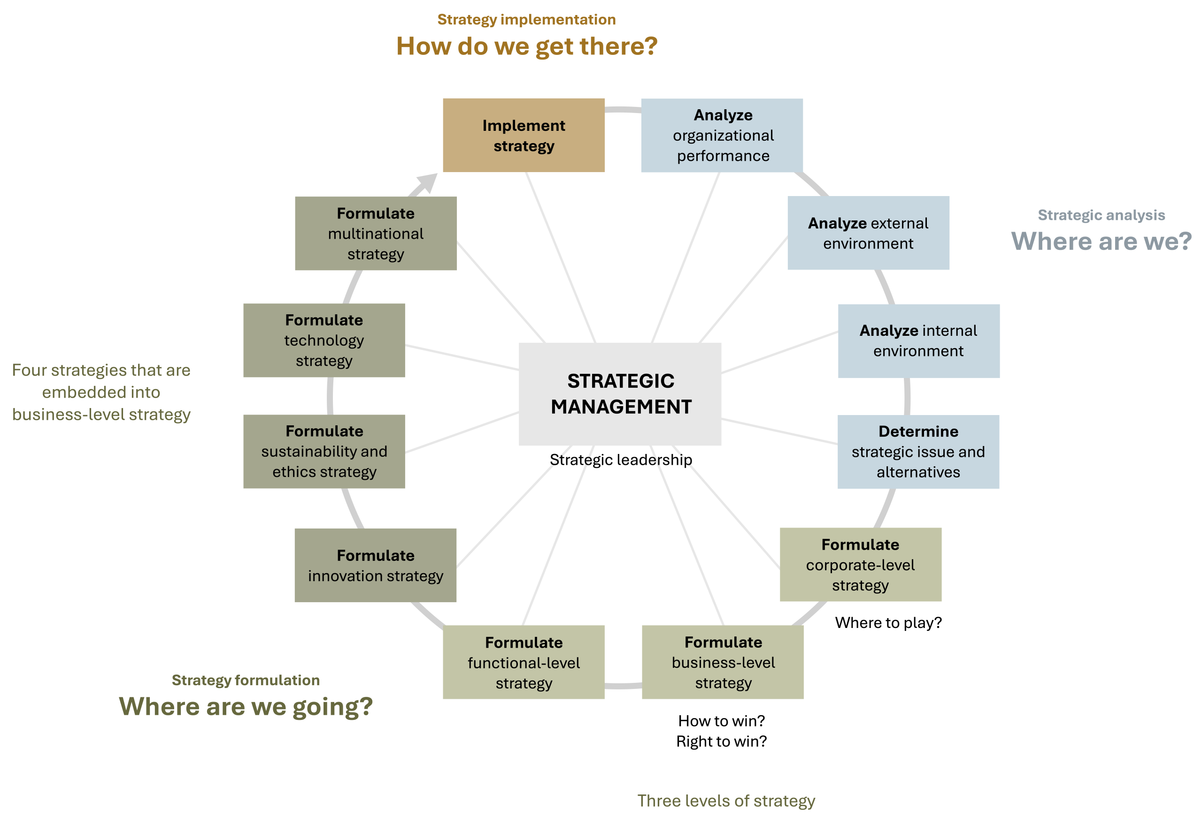
Business-Level Strategy in the AFI Framework
Figure 1.3: The analysis, formulation, implementation (AFI) framework [Kindred Grey. 2025. CC BY-NC-SA]

Slide 6
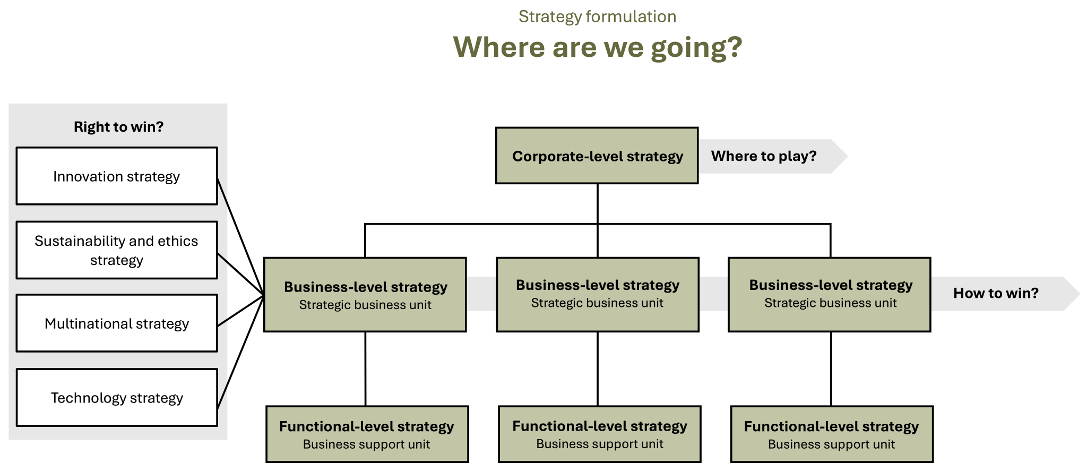
Business-Level Strategy in Strategy Formulation
Figure 1.5: Strategy formulation [Kindred Grey. 2025. CC BY-NC-SA]

Slide 7
Strategy Formulation: Where Are We Going?
Strategic management’s foundations rest in three essential questions that align with the three stages of strategic management:
Strategic analysis: Where are we?
Strategy formulation: Where are we going?
Strategy Implementation: How are we going to get there?
Like all strategy formulation, business-level strategy addresses the question of where a firm is going.

Slide 8
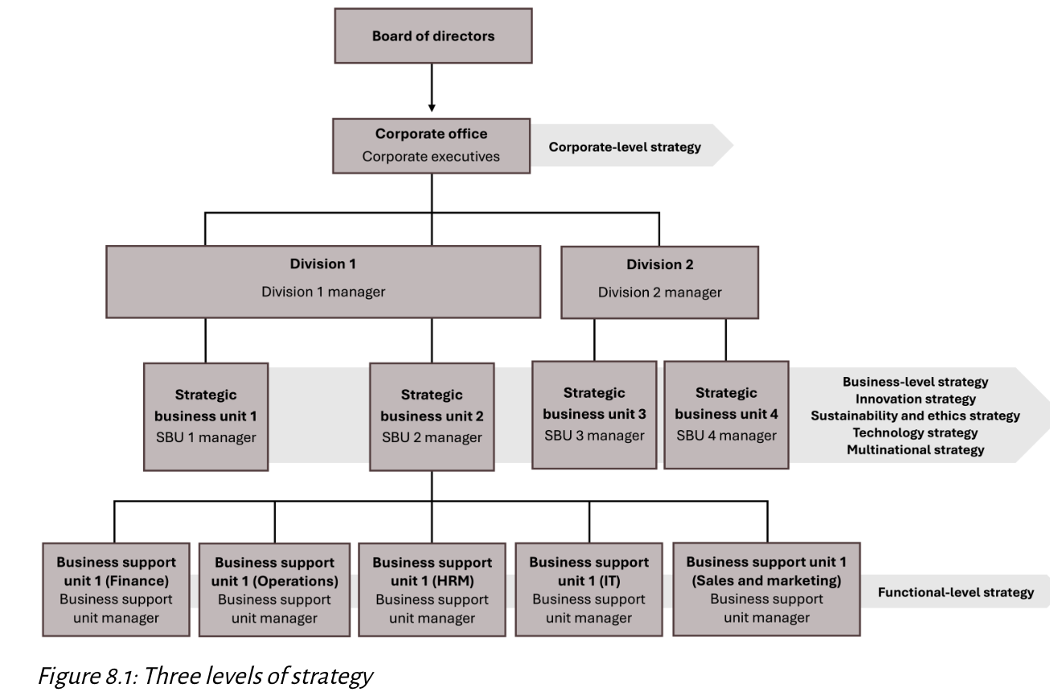
The Three Levels of Strategy, 1 of 2
There are three levels of strategy in an organization.
corporate-level
business-level
functional-level
Strategy is formulated at all three levels.
[Kindred Grey. 2025. CC BY-NC-SA.]

Slide 9
The Three Levels of Strategy, 2 of 2
Corporate-level strategy: Companywide strategy
What industries to compete in
What stage in the value chain to compete
Where geographically to compete.
Business-level strategy: Strategy of a strategic business unit
Strategic market position
Strategic market size
Functional-level strategy: How support functions (HR, IT, etc.) enable strategy.

Slide 10
Strategic Business Unit, 1 of 2
A strategic business unit is a fully functional unit of a business that has its own vision and direction and may be part of a larger organizational unit like a division. It may be based on markets served, products offered, or regions served.
Each strategic business unit has its own vision and direction that it pursues through one business-level strategy.

Slide 11
Strategic Business Unit, 2 of 2
Smaller firms that have only one strategic business unit have only one business-level strategy.
In large companies with more than one strategic business unit, different strategic business units may have different business-level strategies.
Therefore, large corporations that have more than one strategic business unit potentially have multiple business-level strategies.

Slide 12
Business-Level Strategy: How to Win?, 1 of 2
Strategy can be described as a firm’s answer to three critical strategic questions that every organization needs to answer.
Corporate-level strategy: Where to play?
Business-level strategy: How to win?
Strategies embedded into business-level strategies: Right to win?
Innovation strategy
Sustainability and ethics strategy
Technology strategy
Multinational strategy

Slide 13
Business-Level Strategy: How to Win?, 2 of 2
How a firm wins in its chosen markets is largely driven by the firm’s ability to develop a winning strategy around its resources, capabilities, and core competencies that are superior to those of its competitors and that will create value for the firm’s customers.
Overall, the “How to win?” question addresses the firm’s search for a sustainable competitive advantage.

Slide 14
Strategy: Outside-In Perspective
When strategic management leaders and managers formulate strategy, they focus on an outside-in perspective.
All successful strategies are driven by outside-in perspectives, including corporate-level and business-level strategy as well as the strategies embedded in business-level strategies, such as innovation, sustainability and ethics, technology, and multinational strategies.

Slide 15
VUCA
This means that companies need to carefully monitor their external environment, analyzing trends and developing strategies that are forward-looking.
Firms must navigate an external environment that is volatile, uncertain, complex, and ambiguous (VUCA), where change and disruption have become the new normal.

Slide 16
Business-Level Strategy
Both corporate-level strategy and business-level strategy focus on the markets and market segments in which a firm competes.
Corporate-level strategy is broader in focus, aimed at creating synergy across businesses and industries.
Business-level strategy is narrower in focus. Business-level strategy is the strategy of a strategic business unit.

Slide 17
Business-Level Strategy, 2 of 4
A business-level strategy is a general way of positioning a company within an industry for gaining a competitive advantage by defining how a firm competes head-to-head against similar products and services in its market and market segments.
In contrast, corporate-level strategy considers what industries and markets a firm should operate in and how to create synergy between them.
Both focus on markets and market segments, but the focus is different.
It is important the business-level strategy is congruent with and supports corporate-level strategy.

Slide 18
Business-Level Strategy, 3 of 4
Determining a firm’s business-level strategy involves making decisions about how to best serve specific groups of customers, address their unique needs, and provide solutions that stand out from competitors.
At its core, business-level strategy is about identifying who the firm will serve, what needs it will meet, and how it will go about satisfying those needs in a way that delivers value.

Slide 19
Business-Level Strategy, 4 of 4
Business-level strategy begins by exploring:
Who Are Our Customers?
What Customer Needs Do We Meet?
How Do We Satisfy Customer Needs?

Slide 20
Business-Level Strategy Framework, 1 of 2
Firms formulate business-level strategies by making critical decisions on two fundamental dimensions.
The first of these decisions is defining the firm’s strategic market position.
The second decision that firms make concerns the company’s strategic market size.
Both dimensions require a thorough understanding of the firm’s customers, and both dimensions address which customers are being targeted.
These decisions combine to create business-level strategies.

Slide 21
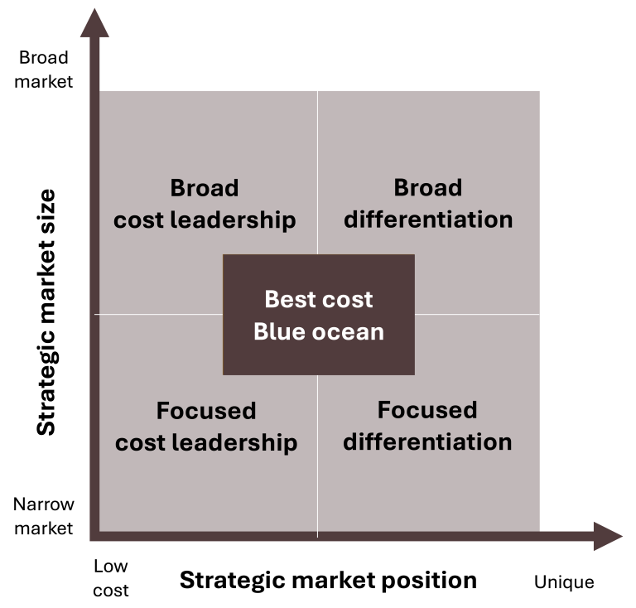
Business-Level Strategy Framework, 2 of 2
Figure 8.2: Business-level strategy framework [Kindred Grey. 2025. CC BY-NC-SA.]

Slide 22
Strategic Market Position: Cost Leadership and Differentiation
The first critical strategic decision in defining the firm’s business-level strategy is deciding its strategic market position.
The strategic market position addresses how the firm distinguishes itself in its chosen market and market segments, either through addressing consumer preferences for low-cost alternatives or by addressing consumer preferences for luxury items.
Strategic market position is sometimes referred to as the source of competitive advantage or as just strategic position.

Slide 23
Strategic Market Position: Cost Leadership, 1 of 2
When a firm distinguishes itself in the market by responding to consumer preferences for low-cost alternatives, the company competes primarily by being the lowest-cost producer or provider in its chosen market.
The goal is to offer products or services that are of an equal or similar value to competitors’ products or services at a lower price than them.
This is called a cost leadership approach, and it appeals to cost-conscious customers.

Slide 24
Strategic Market Position: Cost Leadership, 2 of 2
For example, Walmart strategically positions itself in the market by using a cost leadership strategic market position.
It has mastered this position by streamlining its supply chains and keeping operating costs low to offer lower prices than competitors.
The key to success in cost leadership is maintaining cost advantages without sacrificing quality, which can erode the firm’s competitive position if not carefully managed.

Slide 25
Strategic Market Position: Differentiation
When a firm distinguishes itself in the market by responding to consumer preferences for luxury items, the company competes primarily by offering products or services that are perceived as unique or superior by customers.
This is referred to as a differentiation approach.
For example, Apple exemplifies the differentiation approach to strategic market position by offering cutting-edge technology, superior design, and a strong brand identity.

Slide 26
Strategic Market Size: Broad and Focused, 1 of 2
The second critical decision that firms make when deciding their business-level strategy concerns the company’s strategic market size.
Like the firm’s strategic market position, a company’s strategic market size is also a decision based on the firm’s customers.
The strategic market size defines whether the firm will target a broad market, serving many customer segments, or a narrow market, focusing on a specific niche market segment.

Slide 27
Strategic Market Size: Broad and Focused, 2 of 2
If the approach is broad, the target market is broad, meaning most people within that industry buy the product or service.
If the approach is focused, the target market is narrow, and the product or service is not meant for most people in the industry.
Sometimes strategic market size is referred to as scope of operations or competitive scope.

Slide 28
Strategic Market Size: Broad, 1 of 2
A broad approach to strategic market size targets large markets, typically encompassing a wide range of customer groups.
These strategies aim to appeal to as many customers as possible by offering products or services designed to meet diverse customer needs and preferences.
By leveraging economies of scale and broad market reach, firms employing this approach seek to dominate their industry and build a strong competitive position.

Slide 29
Strategic Market Size: Broad, 2 of 2
Broad approaches are often associated with significant operational scale, extensive distribution networks, and the ability to serve a diverse customer base efficiently.
The goal of a broad strategic market size is to achieve widespread market penetration and long-term sustainability by serving the needs of a diverse customer base.
For example, Walmart targets in a broad strategic market. Its products appeal to a large and diverse customer base.

Slide 30
Strategic Market Size: Focused, 1 of 3
A focused approach to strategic market size targets specific niche markets segments.
Focused strategic market segments allow firms to understand and cater to the specific needs of a niche market segment, fostering customer loyalty by offering tailored products or services that meet the unique demands of their target market segment.
By concentrating on a narrow market segment, firms that follow a focused approach can reduce direct competition, but the small size of the niche market segment limits long-term growth opportunities and may constrain economies of scale.

Slide 31
Strategic Market Size: Focused, 2 of 3
Focused strategic market segments are highly vulnerable to changes in customer preferences and can be threatened by larger competitors entering the niche market segment, leveraging their resources and scales to replicate or surpass the focused firm’s offerings.
Focused approaches allow firms to serve niche market segments with precision and build customer loyalty, but they also come with risks, such as limited market size, vulnerability to market shifts, and the threat of competition from larger rivals.

Slide 32
Strategic Market Size: Focused, 3 of 3
Firms pursuing focused strategic market segment must stay vigilant in maintaining their unique value proposition while being prepared to adapt to changes in their niche market segment.
For example, Apple follows a focused approach to strategic market size. They serve a market segment that is interested in high quality products with the latest technology.

Slide 33
Six Business-Level Strategies
These two dimensions
strategic market position: cost leadership and differentiation
strategic market size: broad and focused
dynamically interact to suggest six business-level strategies:
broad cost leadership
focused cost leadership
broad differentiation
focused differentiation
best-cost strategy
blue ocean strategy
Each offers distinct paths to achieving competitive advantage.

Slide 34
Broad Cost Leadership, 1 of 2
A broad cost leadership strategy is a business-level strategy that combines a broad strategic market size and a cost leadership strategic market position.
The firm distinguishes itself in the market by responding to consumer preferences for low-cost alternatives and competes primarily by being the lowest-cost producer in its industry. This is the cost leadership element of the company’s business-level strategy.
The company is also targeting a broad market, meaning most people within that industry buy the product or service.
The firm’s strategic market position is cost leadership, and its strategic market size is broad.

Slide 35
Broad Cost Leadership, 2 of 2
Walmart is an excellent example of a company following a broad cost leadership strategy by streamlining their supply chains and keeping operating costs low to offer lower prices than competitors.
Walmart uses its massive supplier network and distribution capabilities to offer low prices to a broad market, securing its leadership in cost-effective retail.
Walmart focuses on selling products of an equal or similar quality than its competitors at a lower cost, and most people in the market shop at Walmart.

Slide 36
Focused Cost Leadership, 1 of 2
Firms that pursue a focused cost leadership strategy target a narrow market segment that prefers low-cost products.
The firm distinguishes itself in the market by responding to consumer preferences for low-cost alternatives and competes primarily by being the lowest-cost producer in its industry, appealing to cost-conscious customers. This is the cost leadership element of the company’s business-level strategy.
The company is also following a focused strategy, which means the company is concentrating on a target market segment that is a narrow, niche market and that the product or service is not meant for most people in the industry.
The firm’s strategic market position is cost leadership, and its strategic market size is focused.

Slide 37
Focused Cost Leadership, 2 of 2
Dollar General, for instance, employs a focused cost leadership strategy by targeting rural and small-town customers with low-cost, basic goods.
Dollar General’s business model is built around keeping operational costs low, including a focus on smaller store footprints and private-label goods, which helps reduce purchasing and distribution costs.
By focusing on price-sensitive customers in underserved areas, Dollar General effectively captures a niche market segment that is less competitive than the broader retail market dominated by companies like Walmart.

Slide 38
Broad Differentiation, 1 of 2
Firms that pursue a broad differentiation strategy target a broad market and customers who want a quality product.
A firm distinguishes itself in the market by responding to consumer preferences, typically for luxury items.
A company using such a strategy competes primarily by offering products or services that are perceived as unique or superior by customers. This is the differentiation element of the business-level strategy.
If the company is also following a broad strategy, this means it is concentrating on a target market that is broad, meaning most people within that industry buy the product or service.
The firm’s strategic market position is differentiation, and its strategic market size is broad.

Slide 39
Broad Differentiation, 2 of 2
An example of a firm that follows a broad differentiation strategy is Marriott International, which differentiates itself through a wide range of premium accommodations and customer service, catering to both business and leisure travelers worldwide.

Slide 40
Focused Differentiation, 1 of 2
A firm that pursues a focused differentiation strategy targets a narrow, niche market segment and offers quality products.
The firm distinguishes itself in the market by responding to consumer preferences for luxury items, offering products or services that are perceived as unique or superior by customers.
The company concentrates on a niche target market, and the product or service is not meant for most people in the industry.
The firm’s strategic market position is differentiation, and its strategic market size is focused.

Slide 41
Focused Differentiation, 2 of 2
One of the most prominent examples of a focused differentiation strategy is Tesla, which has redefined the automotive industry by offering electric vehicles (EVs) that combine luxury, sustainability, and advanced technology.
Tesla’s vehicles stand out for their long-range electric powertrains, high performance, and innovative software features, including autonomous driving capabilities.
Beyond the product itself, Tesla has differentiated its brand by providing over-the-air software updates that continually enhance the functionality and performance of its cars, allowing customers to experience new features long after their initial purchases.

Slide 42
Best-Cost Strategy, 1 of 2
There are two business-level strategies that rely on combining a cost leadership approach and a differentiation approach.
The first is a best-cost strategy, a hybrid approach that combines elements of both cost leadership and differentiation in an existing market or market segment.
A best-cost strategy allows firms to offer products or services with superior features at lower prices than competitors.
This strategy seeks to deliver more value to customers by providing high quality while keeping costs lower than rivals who offer similar levels of quality.

Slide 43
Best-Cost Strategy, 2 of 2
By offering both superior quality and competitive pricing, firms employing this strategy can attract both price-conscious consumers and those who are willing to pay a bit more for added value.
This dual appeal allows companies to capture market share from both low-cost competitors and premium brands.

Slide 44
Best-Cost Strategy
Toyota uses a best-cost strategy with its Lexus brand, offering luxury features at lower prices than traditional luxury automakers like Mercedes-Benz or BMW.
Toyota achieves this balance by leveraging its efficient manufacturing processes and economies of scale, keeping costs low while maintaining high quality in its Lexus line.
Lexus appeals to customers who may not be able to afford more luxury vehicles or who choose not to spend their money on more expensive automobiles from a value perspective but who still want a little luxury at a reasonable price.

Slide 45
Blue Ocean Strategy, 1 of 2
Some firms find it difficult to strictly adhere to either a cost leadership or differentiation strategy, as market conditions often require a blend of cost control and differentiation.
Firms that choose a best-cost strategy combine cost leadership and differentiation in existing markets.
Other companies are bold, creating a completely new market using a blue ocean strategy, which is also a combination of cost leadership and differentiation but with the distinction of market creation.

Slide 46
Blue Ocean Strategy, 2 of 2
The core goals of the blue ocean strategy are to create uncontested market space and ideally make competition irrelevant.
By doing so, blue ocean strategy breaks the paradigm that business is a zero-sum game in which a company can only increase its business at the expense of its competitors.

Slide 47
Value Curves, 1 of 4
The value curve is a two-dimensional graph that shows the principal buying factors on the X-axis and the service level on the Y-axis.
The X-axis depicts the competing factors that are the main factors that a customer considers in a buying decision in the specific industry. Typical principal buying factors are price, innovation, reliability, customer service, supply security, global availability, and sustainability of the offered product and service, among others. These principal buying factors are specific to the industry in which the business operates.
The Y-axis depicts the service level offered per principal buying factor, ranked from low to high (for example, on a scale from 0 – 5 or 0 – 10).

Slide 48
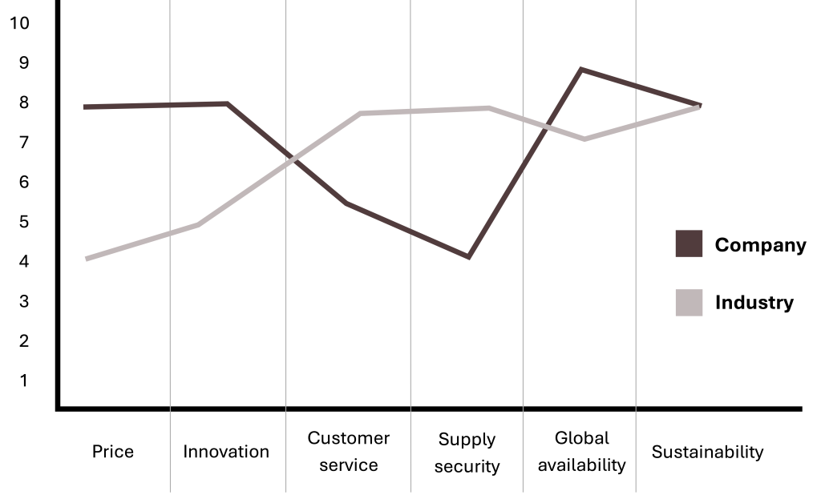
Value Curves, 2 of 4
Using this concept, the organization creates two different value curves. The industry as-is curve depicts the current profile of offerings. Additionally, the company depicts its current value curve for its business.
Figure 8.13: Value curve [Kindred Grey. 2025. CC BY-NC-SA]

Slide 49
Value Curves, 3 of 4
Lastly, the organization identifies a blue ocean market space by purposefully and intentionally diverting from the as-is industry value curve.
The logic of this move is that the organization deliberately does not want to offer the same level of the same principal buying factors, which would lead to the classic red ocean play.
Based on the as-is industry curve and the current value curve of the organization, a blue ocean can be identified by raising the service level of certain principal buying factors, reducing the service level, eliminating certain product and service elements, and creating new product and service factors.

Slide 50
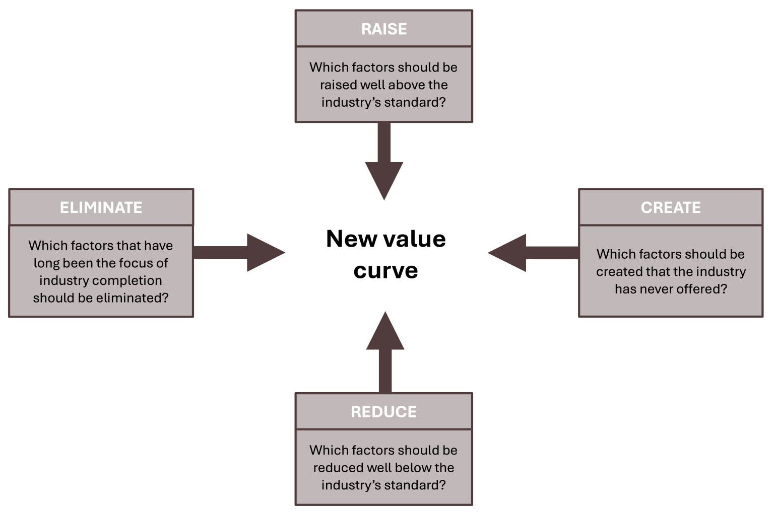
Value Curves, 4 of 4
Through this process, the organization purposefully creates a new value curve that deviates from the as-is industry curve.
This blue ocean move means that the business is not operating anymore in the same market space, as it has created a differentiated offering that ideally creates a new blue ocean space.
Figure 8.14: Creating a blue ocean value curve [Kindred Grey. 2025. CC BY-NC-SA. Adapted from Article title – DOI link (CC BY-NC-SA 4.0)]

Slide 51
Value Innovation, 1 of 4
The organization that uses this approach lowers its costs by eliminating or reducing factors that the industry takes for granted and that are the industry’s current standard.
At the same time, the business also increases perceived consumer benefits by raising and creating factors well above the industry’s standard or by offering completely new factors that the industry has never offered.
This simultaneous reduction of costs and creation of new benefits supports the value innovation at the core of blue ocean strategy as a combination of differentiation and cost leadership strategies.

Slide 52
Value Innovation, 2 of 4
Value innovation places equal emphasis on value and innovation.
It is a new way of thinking about and executing strategy that results in the creation of a blue ocean.
The creation of blue oceans allows driving costs down while simultaneously driving value up for buyers.

Slide 53
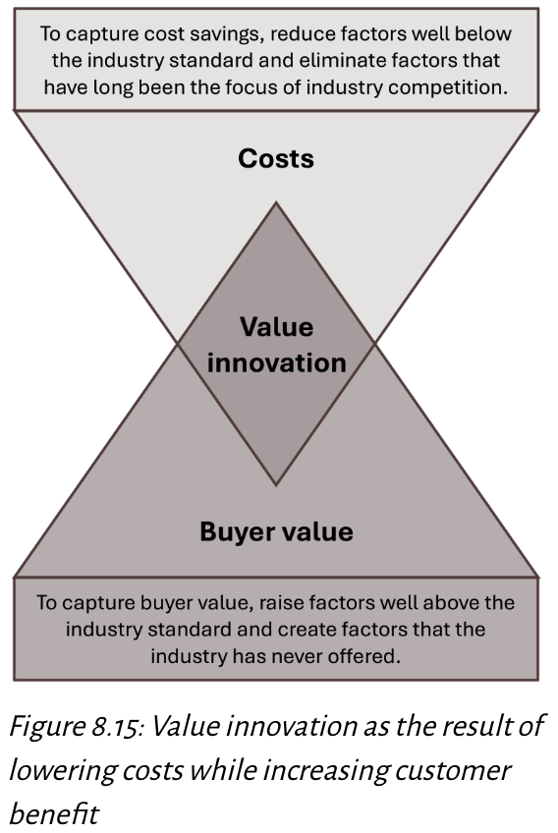
Value Innovation, 3 of 4
⚓ Core Actions:
Create uncontested market space.
Make competition irrelevant.
Generate new demand.
Break value/cost trade-off.
💎 Value Innovation: Lower costs by removing non-essential factors while raising buyer value with new offerings.
Adapted under fair use from https://barnabythinks.wordpress.com/2018/12/02/blue-ocean-strategy-kim-mauborgne/
Notes:
Core Actions
Create uncontested market space - Avoid saturated, hyper-competitive markets.
Make competition irrelevant - Redefine the playing field.
Generate new demand - Target customers not currently served.
Break value/cost trade-off - Deliver higher value and lower cost simultaneously.
Value Innovation
Definition: Achieving lower costs by removing non-essential features while raising buyer value with new offerings.
Goal: Offer customers a compelling reason to switch while spending less to provide it.

Slide 54
Value Innovation, 4 of 4
Examples
🎭 Cirque du Soleil – Eliminated costly animal acts (reduced costs), raised production quality, and created a unique blend of theater + circus, attracting new audiences and redefining live entertainment.
🛋 IKEA – Removed traditional in-store sales assistance (lowered costs), raised product design quality, and created a self-service model, delivering stylish furniture at affordable prices while appealing to both budget-conscious and design-focused customers.

Slide 55
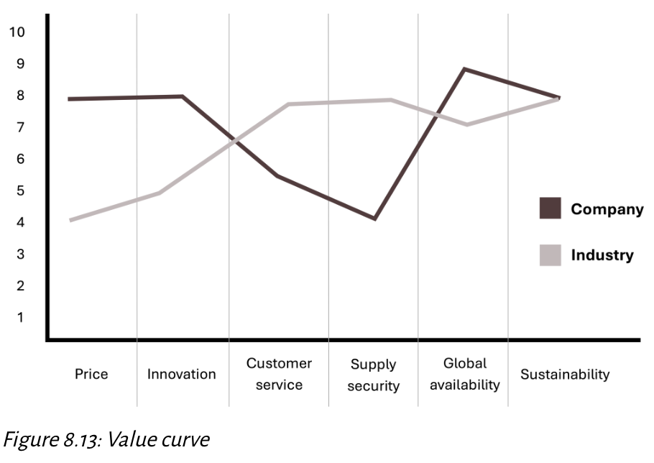
Value Curves Innovation; check Your Knowledge So Far
🎯 Purpose: Visualize differences between company offerings and industry norms.
↔️ X-axis: Principal buying factors
↕️ Y-axis: Service level (low to high)
🌊 Blue Ocean Move: Deviate intentionally from industry curve to stand out
[Kindred Grey. 2025. CC BY-NC-SA]
🗑️ Eliminate: Remove outdated industry standards
📉 Reduce: Cut features below industry level to save costs
📈 Raise: Increase value on factors that matter most to customers
💡 Create: Offer completely new elements competitors lack

Slide 56
Stuck in the Middle, 1 of 3
Companies that attempt to combine cost leadership and differentiation strategies and fail to balance the tensions inherent in cost leadership and differentiation may end up being stuck in the middle, unable to compete on price with low-cost leaders or on quality with premium brands.
This is a risk for companies following a best-cost strategy, which focuses on existing markets or market segments.
It is also a risk for firms that are attempting to create entirely new markets by following a blue ocean strategy.

Slide 57
Stuck in the Middle, 2 of 3
If a firm attempts to cut costs too aggressively, it may erode the value of its differentiated features, causing customers to perceive the product as inferior.
Conversely, if the firm invests too heavily in enhancing product features without controlling costs, it may not be able to offer competitive pricing, limiting its appeal to price-sensitive consumers.
When firms are stuck in the middle, they are left without a clear competitive advantage.
These firms cannot compete on price with low-cost leaders, nor can they offer unique enough products or services to justify premium pricing.

Slide 58
Stuck in the Middle, 3 of 3
A company that recently became stuck in the middle is Bed Bath & Beyond, which filed for bankruptcy in 2023.
Bed Bath & Beyond was once a dominant player in the home goods market, but over time, the company failed to clearly define its competitive strategy.
It was unable to effectively compete with low-cost giants like Walmart and Amazon, who offered similar products at lower prices.
At the same time, the company did not differentiate itself enough in terms of customer experience, product offerings, or convenience to maintain its status as a go-to destination for home goods.

Slide 59
Limitations of Business-Level Strategies
Limitations:
📏 Overly simplistic → Does not capture the complexity of real-world competition
🌀 Easy to imitate → Cost or differentiation advantages can be quickly copied by competitors
⚖️ Risk of “Stuck in the Middle” → Hybrid approaches like best-cost can dilute focus
⏳ Static nature → Strategies may lose relevance as industries evolve
🔄 Changing environment → Shifting customer preferences & tech advancements require constant adaptation
💡 Key Takeaway: Business-level strategies are useful frameworks, but in practice, they must evolve to keep pace with changing markets and competitive pressures. Firms must remain agile and ready to adjust.
Notes:
This slide focuses on the drawbacks and challenges companies face when relying solely on business-level strategies.
Overly simplistic – While these strategies are useful frameworks, they often don’t capture the complexity of actual market competition, where multiple factors interact in unpredictable ways.
Easy to imitate – Any cost advantage or differentiation can be copied quickly by competitors, eroding the company’s unique position.
Risk of “Stuck in the Middle” – Hybrid strategies like best-cost risk losing focus, meaning the firm might fail to lead in either cost or uniqueness.
Static nature – Strategies that worked before may lose relevance as industries evolve, competitors innovate, and customer needs shift.
Changing environment – With technology advancements and changing customer preferences, firms must adapt continuously to stay competitive.
Key takeaway: While business-level strategies are valuable for guidance, they must evolve with the market. Static or poorly adapted strategies risk becoming outdated. Successful firms stay agile, innovative, and ready to adjust their approach as competitive pressures change.

Slide 60
Analyze Business-Level Strategy
6. As appropriate to the case, analyze strategies: Corporate-level, business-level, innovation, sustainability and ethics, technology, and multinational strategies.
Use strategic management analytical frameworks to analyze, interpret, and evaluate strategies.
Ensure line of sight and congruence within analysis of each strategy.
Notes:
This slide focuses on the drawbacks and challenges companies face when relying solely on business-level strategies.
Overly simplistic – While these strategies are useful frameworks, they often don’t capture the complexity of actual market competition, where multiple factors interact in unpredictable ways.
Easy to imitate – Any cost advantage or differentiation can be copied quickly by competitors, eroding the company’s unique position.
Risk of “Stuck in the Middle” – Hybrid strategies like best-cost risk losing focus, meaning the firm might fail to lead in either cost or uniqueness.
Static nature – Strategies that worked before may lose relevance as industries evolve, competitors innovate, and customer needs shift.
Changing environment – With technology advancements and changing customer preferences, firms must adapt continuously to stay competitive.
Key takeaway: While business-level strategies are valuable for guidance, they must evolve with the market. Static or poorly adapted strategies risk becoming outdated. Successful firms stay agile, innovative, and ready to adjust their approach as competitive pressures change.

Slide 61
Why Business-Level Strategy Is Important to Business Graduates
📊 Data-Driven Support → Business graduates often provide data analysis to help divisional managers choose strategies (cost leadership, differentiation, best-cost, blue ocean)
🏢 Large Companies → Support unit managers collaborate with strategic business unit leaders across marketing, accounting, HR, and IT
🚀 Smaller Companies & Startups → Direct involvement in business-level strategy decisions from day one
💼 Consulting Roles → Requires high competence in strategy to align consulting recommendations with a firm’s market approach
🧭 Entrepreneurship → Understanding business-level strategy is key to knowing how to compete and grow in chosen markets
💡 Key Takeaway:
Business-level strategy knowledge enables graduates to influence decision-making, align functional activities with competitive goals, and help organizations succeed in their markets
Notes:
This slide highlights why understanding business-level strategy is critical for graduates entering different business roles.
Data-Driven Support 📊 – Many graduates start in roles where they analyze data to guide managers in choosing between strategies like cost leadership, differentiation, best-cost, or blue ocean. Your ability to interpret data directly influences strategic decisions.
Large Companies 🏢 – In big organizations, graduates often work cross-functionally, supporting marketing, finance, HR, and IT while helping align department actions with the company’s overall strategic goals.
Smaller Companies & Startups 🚀 – In smaller organizations, you’re often involved in strategic decisions from day one, which means you directly influence the company’s competitive positioning.
Consulting Roles 💼 – Consulting demands high-level strategic thinking to ensure recommendations fit the client’s market and business goals. A solid understanding of business-level strategy makes you credible and effective.
Entrepreneurship 🎯 – For entrepreneurs, knowing how to position your business in the market, compete effectively, and adapt to changes is essential for survival and growth.
Key takeaway: A strong grasp of business-level strategy helps graduates influence decisions, align operations with strategy, and drive organizational success; whether working in corporate roles, consulting, startups, or running their own ventures.

Slide 62
Demonstrate Your Knowledge, Skills, and Competence (1 of 2)
Use these questions to test your knowledge of the chapter.
Describe business level strategy. Describe a strategic business unit (SBU) and the relationship between a SBU and business level strategy. What questions does business level strategy answer? How does it relate to a VUCA environment? What is the role of synergy in corporate level strategy? What is the primary focus of business level strategy?
Explain the difference between corporate level strategy and business level strategy.
Describe the role customer analysis plays in business level strategy. What key questions do leaders and managers ask about customers to support business level strategy?
Explain the two dimensions in the business level strategy framework.

Slide 63
Demonstrate Your Knowledge, Skills, and Competence (2 of 2)
Describe in detail cost leadership and differentiation. What are the advantages and disadvantages of each. Give examples.
Discuss in detail focused and broad approaches. What are the advantages and disadvantages of each. Give examples.
Describe the key features of the six business level strategies. Give examples.
Describe a blue ocean strategy. Explain the idea of value curves and how this relates to blue ocean strategy.
Explain stuck in the middle and why firms should try and avoid this.
Describe how competence with business level strategy is relevant and important to you.
You are now skilled at analyzing a company’s business-level strategy. Congratulations!

