Slide 1
Hodgepodge or Showcase? An IR Assessment Strategy
Gail McMillan, Director, Scholarly Communication

Slide 2
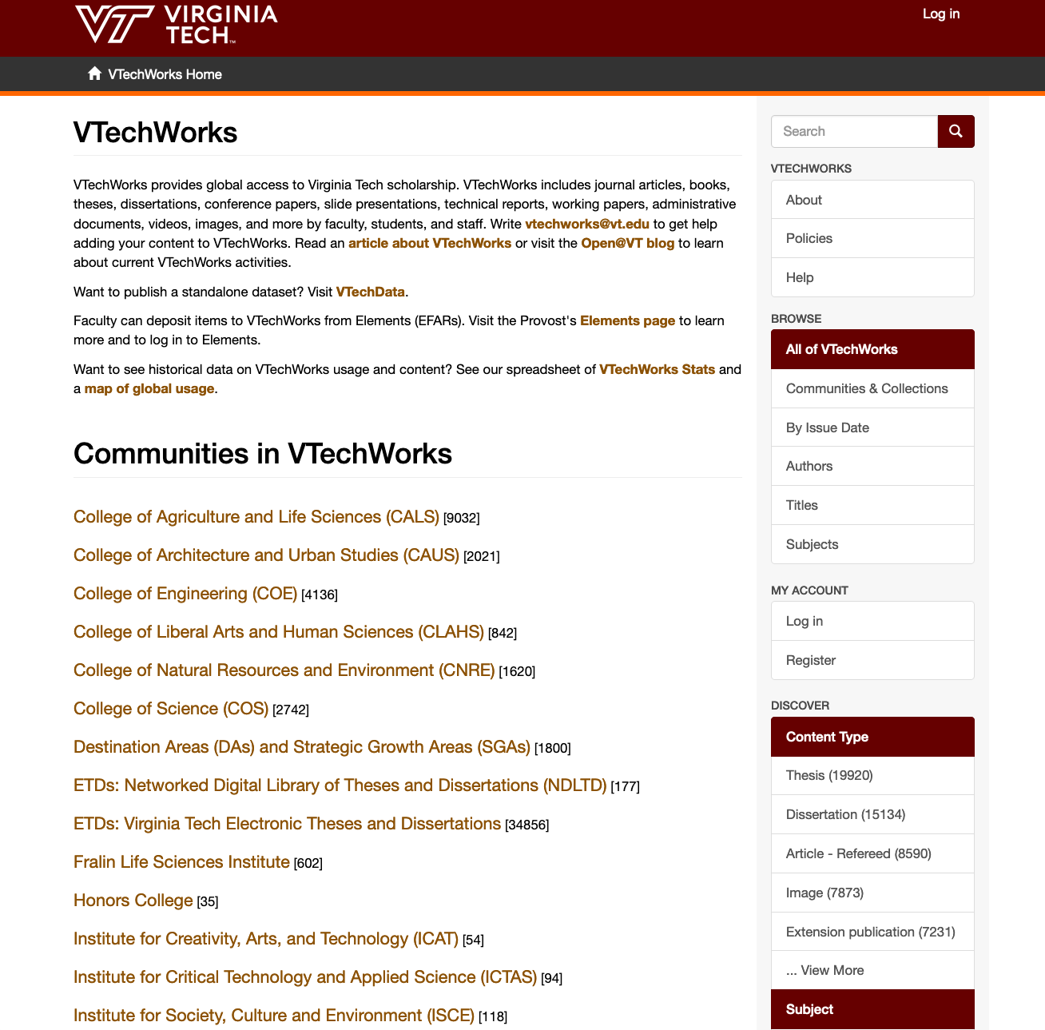
https://vtechworks.lib.vt.edu

Slide 3
VTechWorks: Collection Development
Virginia Tech Community deposit by choice or by edict
VT Faculty: Elements, SWORD
VT Students: ETDs, course projects
VT Publishing: open articles, journals, textbooks, books
VTechWorks Staff: randomly, systematically
Non-VT deposits

Slide 4
IR Assessment Strategy
Identify one or more microcosms
Develop vocabularies for each
Search IR, record hits, turn numbers into percentages
Search institution, record hits, turn numbers into percentages
Compare percentages
Determine what is an acceptable level of difference

Slide 5
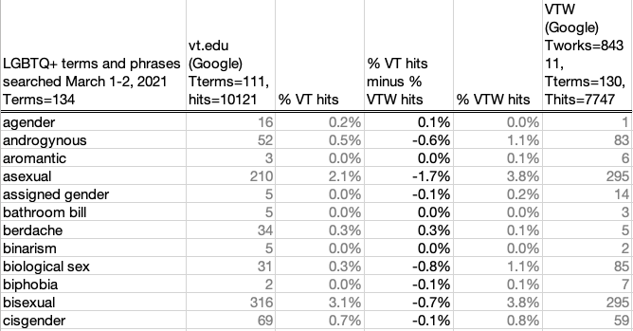
Sample Spreadsheet

Slide 6
While I was at it
Who’s using these terms and phrases?
Graduate students: 34,550 ETDs
Faculty: 5,350 published articles, presentations
660 articles supported by subvention fund for OA APCs
2400 articles from SWORD, journals published at VT, etc.
2290 works deposited from Elements’ FARS

Slide 7
Google and DSpace Search Strategies
Google
“term” site:vt.edu -site:vtechworks.lib.vt.edu -site:scholar.lib.vt.edu -site:thesis.lib.vt.edu
“term” site:vtechworks.lib.vt.edu
VTechWorks/DSpace
VTechWorks https://vtechworks.lib.vt.edu/
ETDs https://vtechworks.lib.vt.edu/handle/10919/5534
Faculty Publications combines these three collections:
OASF https://vtechworks.lib.vt.edu/handle/10919/71752
SWORD+ https://vtechworks.lib.vt.edu/handle/10919/8195
Elements https://vtechworks.lib.vt.edu/handle/10919/70873

Slide 8
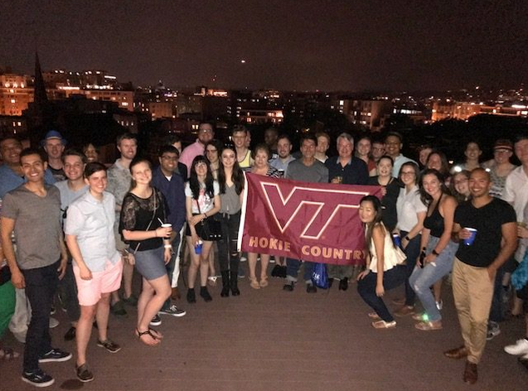
https://www.alumni.vt.edu/groups/multicultural/alumni-societies/ex-lapide.html

Slide 9

Does VTechWorks accurately reflect VT?
% difference, VT - VTechWorks | LGBTQ+
<1% | 88%
<2% | 97%
https://ccc.vt.edu/index/lgbtq.html

Slide 10
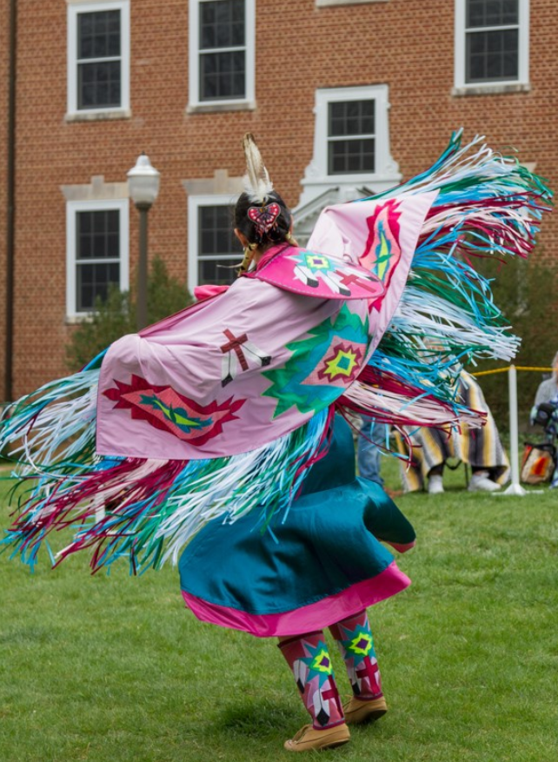
https://ccc.vt.edu/index/aiicc/

Slide 11

Does VTechWorks accurately reflect VT?
% difference, VT - VTechWorks | Indigenous People
<1% | 85%
<2% | 95%
https://ccc.vt.edu/calendar/Indigenous_Peoples_Day.html

Slide 12
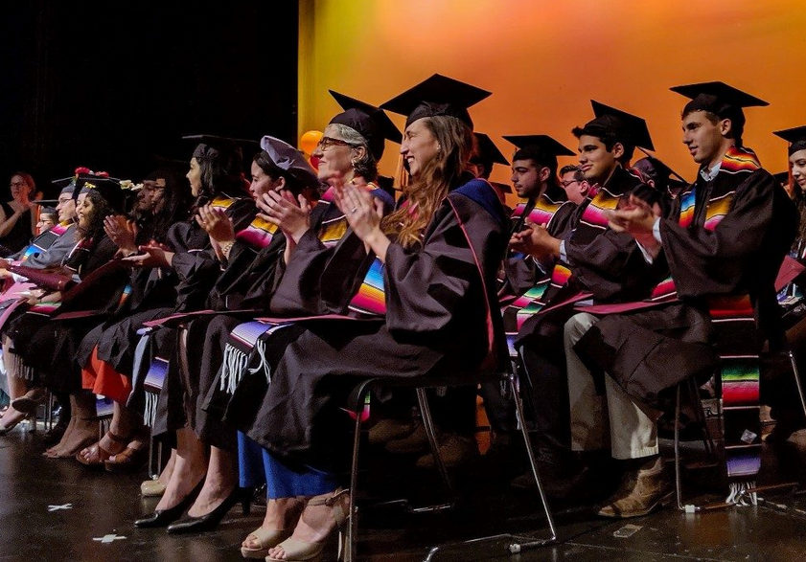
https://ccc.vt.edu/calendar/ceremonies.html

Slide 13

Does VTechWorks accurately reflect VT?
% difference, VT - VTechWorks | Latinx
<1% | 76%
<2% | 94%
https://ccc.vt.edu/index/el_centro.html

Slide 14
Does VTechWorks accurately reflect VT?

Slide 15
Gail McMillan gailmac@vt.edu
Have I suggested an appropriate way to evaluate institutional repositories?
What percentage of match would determine that the IR appropriately reflects its host institution?
What other microcosms might we study? Perhaps veterans, immigrants, others?
Are you interested in doing a similar study of your IR and sharing your results?
THANK YOU!

