Slide 1
Search ETD Elements
Michael Sun, Hamza Iqbal, Marcus Huynh, Josh Hester, Jiwon Kim
CS4624: Multimedia/Hypertext Capstone, Mohamed Farag
Virginia Tech, Blacksburg, VA 24061, 3/25/2025
Notes:
Marcus

Slide 2
Outline
Project Recap
Technical Stack
Updates
Live Demo
Final Touches
Challenges
Lessons Learned
Future Work
Client & References
Notes:
Marcus

Slide 3
Project Recap
What are ETDs?
  Electronic Theses and Dissertations (ETDs) are long research documents consisting of metadata, figures, tables, captions, abstracts, and chapters.
Our system allows users to search for ETDs from a 500k+ document database.
Notes:
Marcus

Slide 4
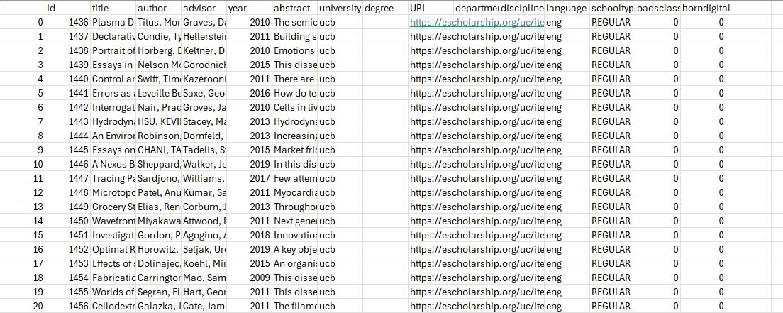
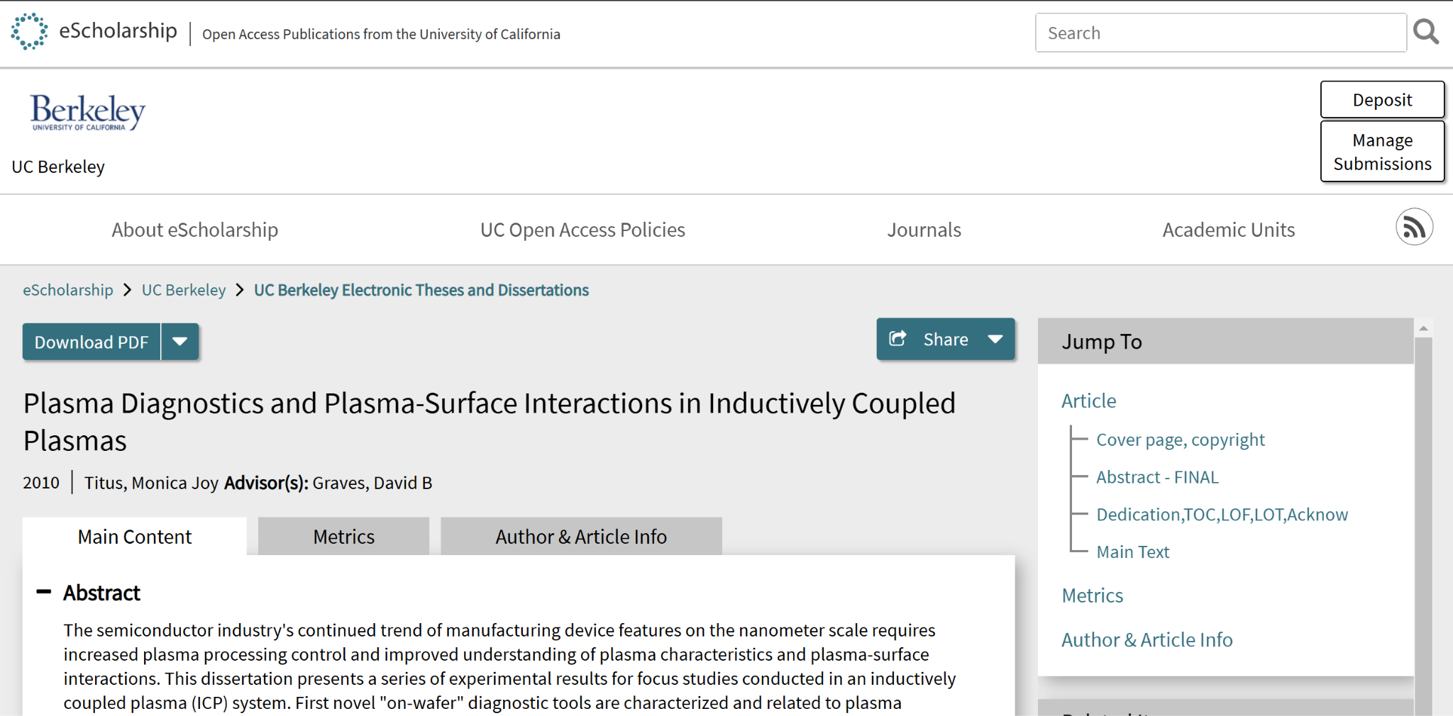
ETD Metadata Example
ETD sample metadata
Example ETD with id: 1436
Notes:
Marcus

Slide 5
Project Recap (cont.)
The Problem:
  The current system only supports indexing and searching ETD metadata, with no figure/table caption support
  Large volumes of ETD data (500k+) leads to slow indexing and searching
Our Goal:
  Enable fine-grained search by indexing figure/captions
  Optimize indexing/searching speeds
  System improvements (security, frontend updates, etc.)
Notes:
Marcus

Slide 6





Technical Stack
User
Search
Backend
Search Engine/ Database
Frontend
Notes:
Jiwon

Slide 7
Updates - General
Since the last presentation, we’ve completed the following:
Successfully indexed figure & table captions
Updated the front-end UI to support caption searching
Deployed application to the cloud (endeavor Kubernetes cluster)
Enabled security for our Elasticsearch database
Created a single docker deployment and repo that contains both the backend and frontend
Notes:
Marcus

Slide 8
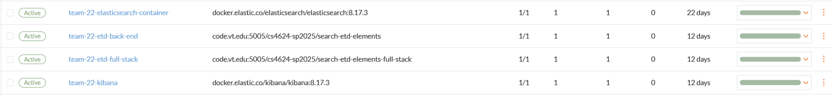
Updates - Cloud Deployment
Currently have 4 deployments on the cloud (endeavor Kubernetes cluster): Elasticsearch instance, back-end application, full-stack application (back-end + front-end), and Kibana
Plan to remove back-end deployment and only have the full-stack deployment by the end of the semester
Notes:
Michael

Slide 9
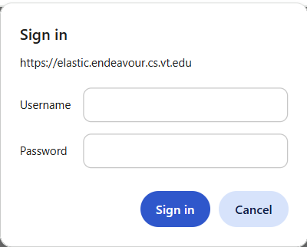
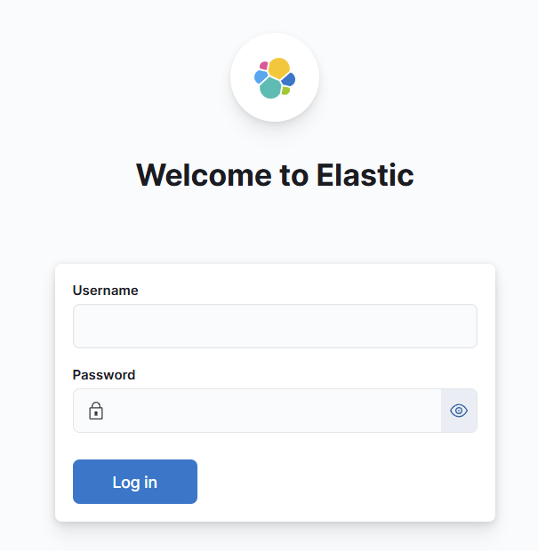
Updates - Security
As mentioned earlier, security variable was enabled in the Elasticsearch deployment configuration in the cloud (endeavor Kubernetes cluster)
This requires the correct username and password for the back-end and Kibana to access the Elasticsearch instance:
Elasticsearch Ingress
Kibana Ingress
Notes:
Michael

Slide 10
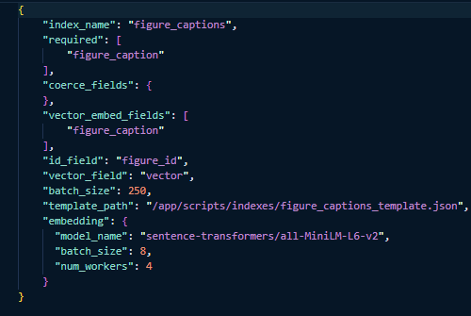
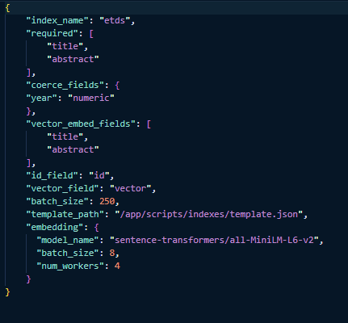
Updates - Figure/Table Caption Indexing
Added new dynamic indexing script that can index both figure/table captions and ETDs depending on the config
Command:
python index_locally.py --csv {path to csv} --config {path to config}
Captions config
ETDs config
Notes:
Hamza

Slide 11
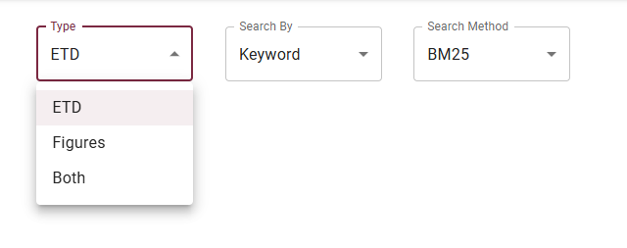
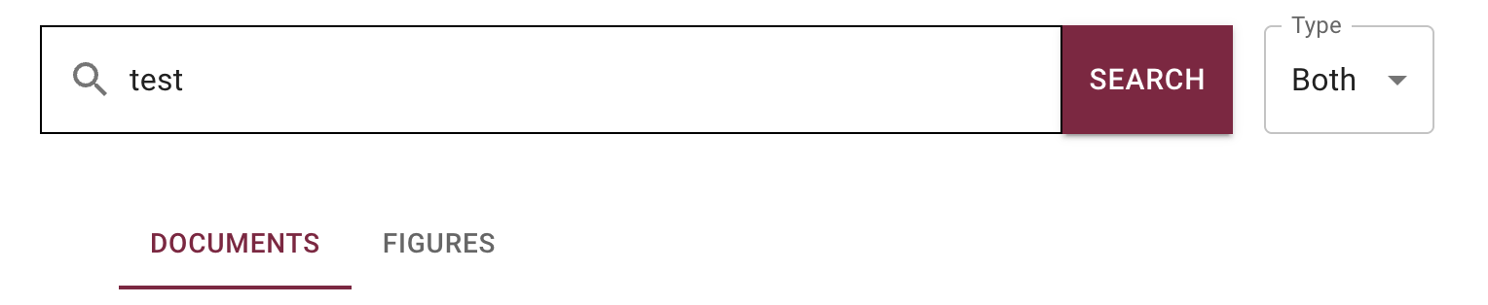
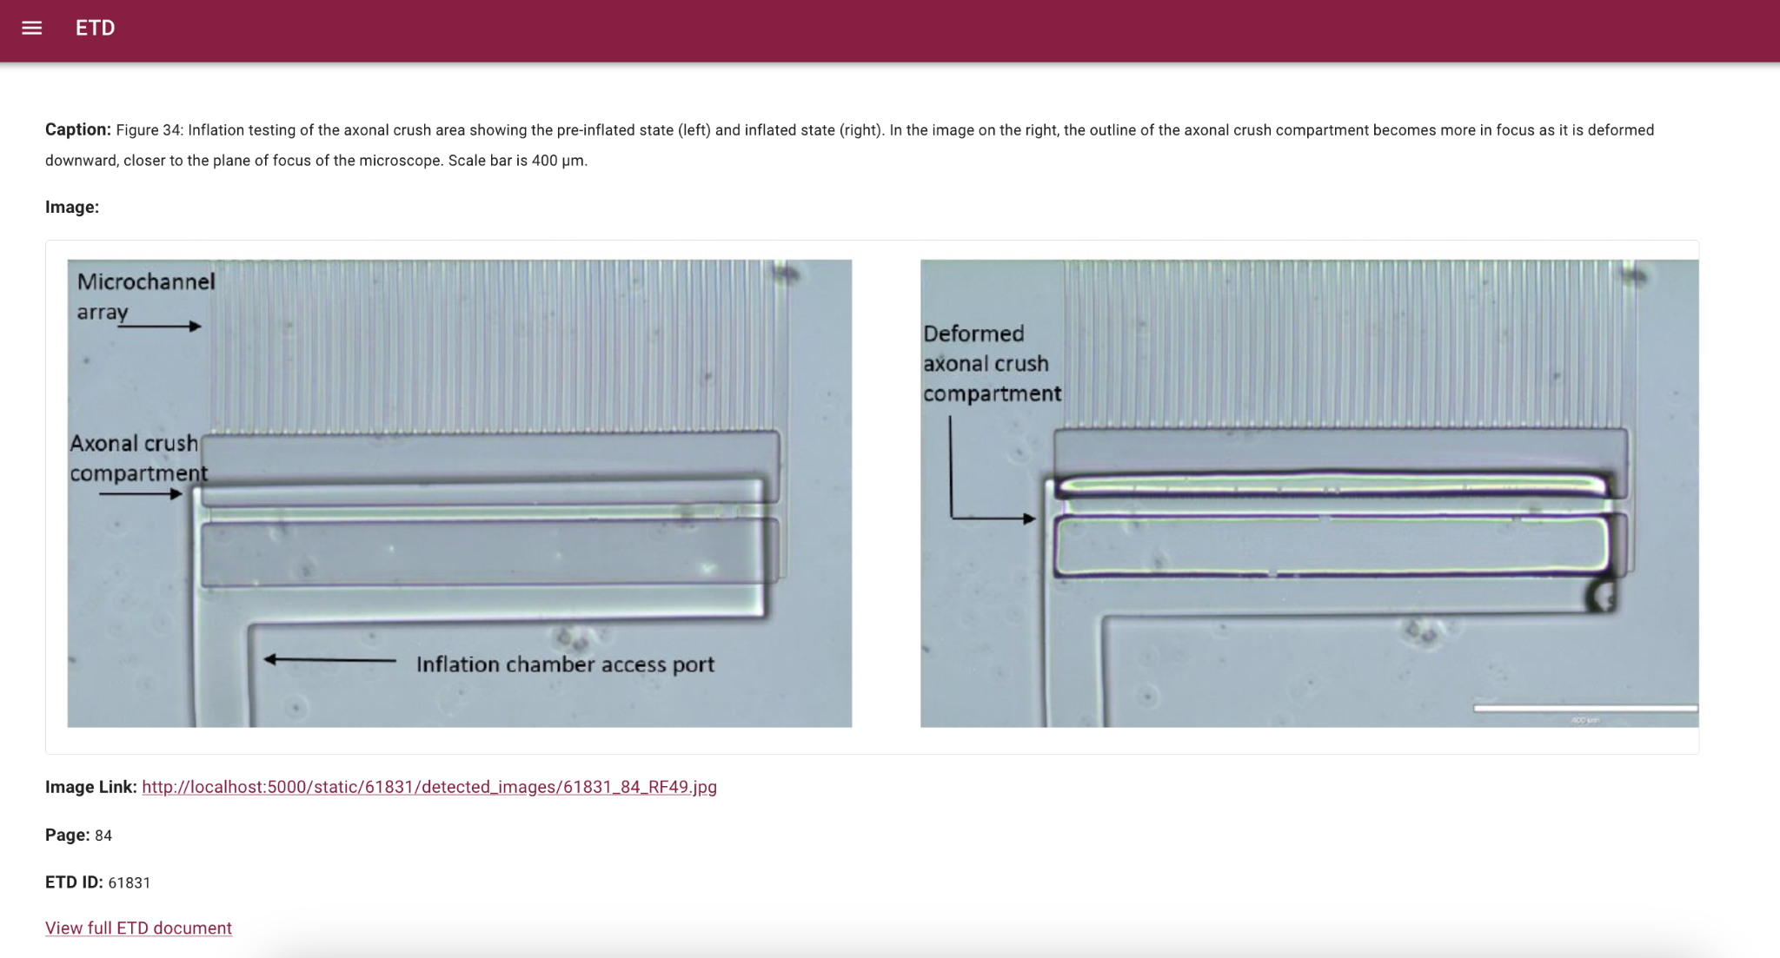
Updates - Frontend
Added new dropdown menu to search for either ETDs, figures/caption, or both
Added separate tabs for documents and figures when searching for both
Added a new figure page with the informations of the figure
Notes:
Jiwon

Slide 12
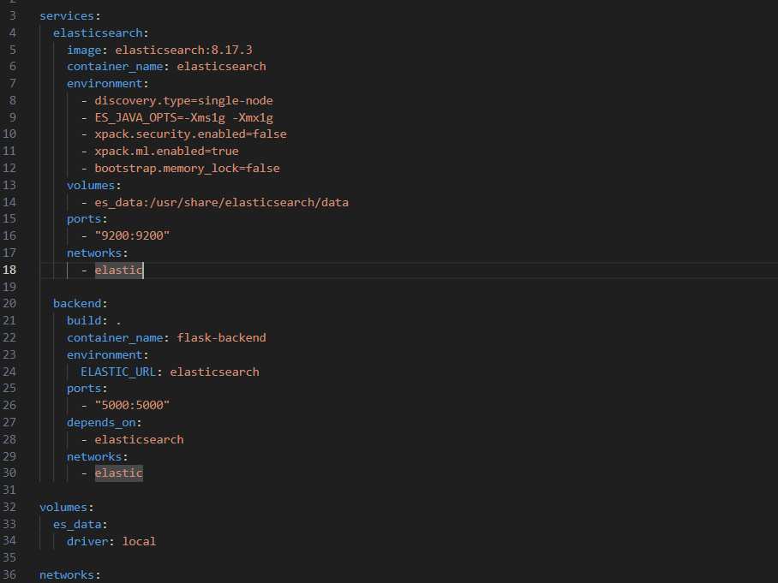
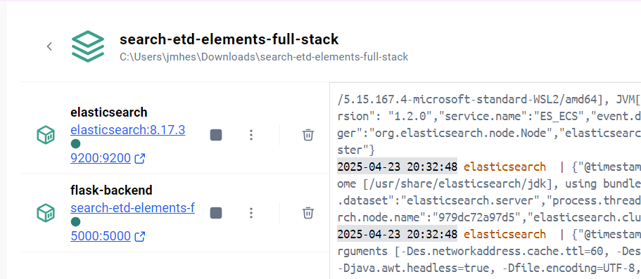
Updates - Combined Stack
Unified all components in one Docker container for simplicity
Built and launched the system with docker compose build and up -d
Exposed frontend and backend ports in docker-compose.yml for full access
Notes:
Josh

Slide 13
Final Touches
Before submitting to VTechWorks, we are still working on:
Making the front-end of the full-stack deployment accessible on the cloud (endeavor Kubernetes cluster)
Setting up a persistent volume for the Elasticsearch data
Potentially implementing an API indexing endpoint for external indexing
Notes:
Michael

Slide 14
Challenges
Some challenges we faced:
Merging frontend, backend, and Elasticsearch into one container
Configuring deployments on the cloud
Frontend not syncing with backend responses in regards to differentiating between figures and documents
Understanding the previous team’s work, design choices, and overall structure
Notes:
Josh

Slide 15
Lessons Learned
Importance of developer manual. This needs to be thoroughly documented.
How helpful it is to use all available resources provided especially the previous project reports
How consistently meeting with the client can keep you on track and can prevent misunderstandings
Notes:
Josh

Slide 16
Future Work
Reintegrate original front-end; Many features were removed to simplify testing
Add the images of the corresponding ETDs already indexed
Re-implement user login and authentication
Conduct user and client testing to gauge how user friendly the system is
Notes:
Josh

Slide 17
Acknowledgement, Client, and References
Client: Satvik Chekuri
Background: Ph.D Candidate in Computer Science @Virginia Tech
References:
2023 project report: https://vtechworks.lib.vt.edu/items/f2da817d-1823-4858-a0e3-321393505f62
2022 project report: https://vtechworks.lib.vt.edu/items/bd55af72-9916-4b4b-ac57-fa922d1524c6
2019 project report: https://vtechworks.lib.vt.edu/items/77a8e36d-b699-4cac-828c-d5fadf016ff9
Notes:
Josh

