Slide 1
Blacksburg to Guatemala Archive
Arth Joshi, Ankit Agarwal, John Crowson
Spring 2015 CS 4624 Professor Edward Fox
Virginia Tech Computer Science
Blacksburg, VA 24060 USA

Slide 2
Client
Kimberley Homer
Delegate, Christ Church, Blacksburg
homerk@vt.edu
(540) 231-9521
222 Price Street, Blacksburg VA 24060 USA

Slide 3
Background & Impact
Visited Sister Parish in January 2015
Medium for continued connection
Pictures, stories, ceremonies, recipes
Make information widely available
Design template for other Sister Parish cultural exchanges
Notes:
taht was hilarious

Slide 4
Deliverables
Well designed website
Supports stories in English and Spanish
Multimedia Support
Website should be Searchable

Slide 5
Implementation
Ease of Use
Multi-lingual support
Search
Categories
WordPress
Customized Theme

Slide 6


Slide 7
Demo
https://blacksburg2guatemala.wordpress.com

Slide 8
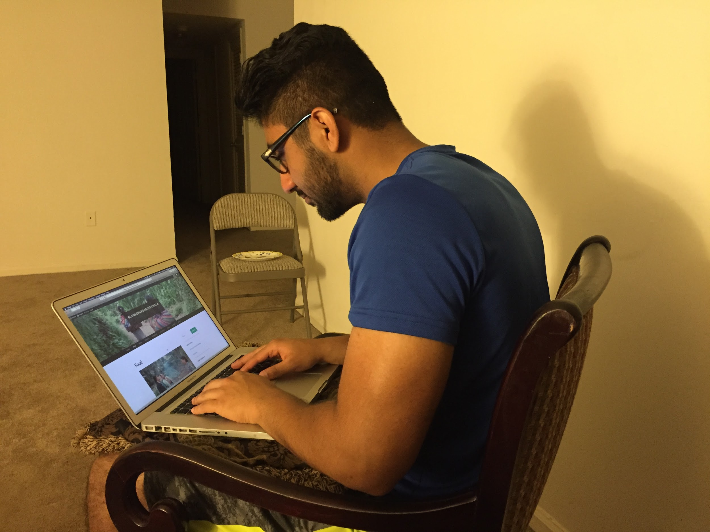
Testing

