Slide 1
CS6604 Digital Libraries
Social Communities Knowledge Management: Social Interactome
Final Term Project Presentation
Presenter
Prashant Chandrasekar
{peecee}@vt.edu
Instructor
Dr. Edward A. Fox
Virginia Polytechnic Institute and State University
Blacksburg, VA, 24061
May 2, 2017

Slide 2
Acknowledgements
Dr. Edward A. Fox
Global events team
Social Interactome team
  The Social Interactome of Recovery: Social Media as Therapy Development (NIH Grant 1R01DA039456-01)
Xuan Zhang and Yufeng Ma
Mostafa Mohammed

Slide 3
Outline
Background
  Social network community; Social Interactome
  Data
Challenges
Goal
Approaches
Network Classification
Learning via Markov Logic Networks
Future Work

Slide 4
Background: Social Interactome (SI)
Social Interactome
  NIH-funded project conducted by a team of researchers
  Study the community of people, who are recovering from addiction
  Study their interactions in an online social network, built to provide support and management of their recovery
The project is broken down into set of “test vs. control” experiments with variables defined:
  Duration of study
  Number of participants required
  Avenue of recruitment
  Null and alternative hypotheses

Slide 5
Background: SI Setup
The project is broken down into a set of clinical trials. For each clinical trial:
  The team decides on a set of null and alternative hypotheses and the duration of the trial
  Recruits participants for the trial
  Organizes the participants into one of two (or more) 128-node social network
  Participants interact with the website and their assigned friends
Two 16-week clinical trials have been completed.
Along with a set of smaller scaled trials executed via Amazon Mturk

Slide 6
Background: SI Participant Info
Participants
Demographic
Relapse
Primary Addiction
Addiction Severity Index
Social Connected Scale
Adult Social Network Index
DSM-V
Big 5 Personalities
Recovery Capital Scale
Secondary Addiction
Assessment Recovery Capital
Minute Discounting
Religious Commitment Inventory
Recovery Participation Scale
Family Info
Family's history with addiction
Past Social network experience
...
  Collected from 19,070 questions
  ~10 psychology-based measures
16 surveys

Slide 7
Background:SI Website Use Data
Participants
TES Modules/ TES scores
News Stories
Success Stories
Unpaid Assessments
Video Meetings
Private Messages
Response From Admin Posts
Posts/Likes
/Shares
/Comments
Pictures/Links Uploads

Slide 8
Overall Challenges
How do you organize the data?
How do you validate/clean the data?
What do you analyze first? And in what order do you go about it?
How do you make sense of the data?
How to interpret psychology-related measures?
Big goal: How to streamline the entire process from data collection to analyses to presentation such that it is reproducible and extensible?

Slide 9
Goal
Goal: Investigate/explore ways to model the data and recommend an approach.
Approaches to understand the data
  Frequency Distributions / Histograms
  Time series
  Checking for correlations
  Comparing means and standard deviations
    t-tests
  Statistical modeling

Slide 10
Approaches
Statistical Modeling
  What do we model?
    Substance relapse
    Engagement/Change in engagement
    Change in psychology-related measures
    Change in behavior
    Homophily
    Friendship or Trust
  Factors
    Classification: What would be the predictor variables? Response variables?
    PGMs: Directed or Undirected? What would be the factors?

Slide 11
Approaches
Classification
  Network-Classification using NetKit-SRL (Statistical Relational Learning)¹ [Focus of the presentation]
Learning using Markov Logic Networks²
1 Sofus A. Macskassy , Foster Provost. "Classification in Networked Data: A toolkit and a univariate case study," Journal of Machine Learning, 8(May):935-983, 2007.
2 Domingos, Pedro and Richardson, Matthew (2007). Markov Logic: A Unifying Framework for Statistical Relational Learning. In L. Getoor and B. Taskar (eds.), Introduction to Statistical Relational Learning (pp. 339-371), 2007. Cambridge, MA: MIT Press.

Slide 12
Network Classification
Idea: Taking advantage of relational information in addition to attribute information for entity classification. Example: Networked data.
Focuses on within-network classification
Networks of web pages, research papers, social networks, etc.
Netkit-SRL: Toolkit developed to employ statistical relational learning and inference

Slide 13
Network Classification
Netkit-SRL
  Network learning toolkit for classification and inference
  Developed by Dr. Macskassy & Dr. Provost
  Has 3 components
    Non-relational model
    Relational model
    Collective inference
  Specific Outcomes:
    Maximize P(x|G^{K}), where x are labels to be estimated and G^{K} is everything known in the network
    Estimating joint distribution over the labels
  Input:
    Graph with edges describing relationships and attributes of nodes

Slide 14
Network Classification
Netkit-SRL Components
 | Purpose | Approaches
Local (Non-relational) Classifier | Returns a model which uses only attributes of a node to estimate its class label. | 1) Uniform prior; 2) Class-prior
Relational Classifier | Returns a model which uses not only the local attributes of a node but also attributes of related nodes, including their (estimated) class membership. | 1) Weighted-vote relational neighbor; 2) Class-distributional relational neighbor; 3) Network-only multinomial Bayes classifier with Markov Random Field estimation
Collective Inference | This module applies collective inference in order to (approximately) maximize the joint probability of the labels of all nodes in the graph whose labels were initially unknown. | 1) Relaxation labeling; 2) Iterative classification; 3) Gibb’s sampling

Slide 15
Network Classification
Possible instantiations
Author | Non-relational Classifier | Relational Classifier | Collective Inference
Chakrabarti et al. (1998)¹ | Naïve Bayes classifier | Naïve Bayes Markov Random Field | Relaxation labeling
Lu & Getoor (2003)² | Logistic regression | Logistic regression | Iterative classification
Macskassy & Provost (2003)³ | Classes priors | Majority vote of neighboring classes | Relaxation labeling
[1] Chakrabarti, S., Dom, B., & Indyk, P. (1998). Enhanced Hypertext Categorization Using Hyperlinks. Proceedings of the ACM SIGMOD International Conference on Management of Data (pp. 307–318).
[2] Lu, Q., & Getoor, L. (2003). Link-Based Classification. International Conference on Machine Learning, ICML-2003 (pp. 496–503).
[3] Macskassy, S. A., & Provost, F. (2003). A Simple Relational Classifier. Proceedings of the Second Workshop on Multi-Relational Data Mining (MRDM-2003) at KDD-2003 (pp. 64–76).

Slide 16
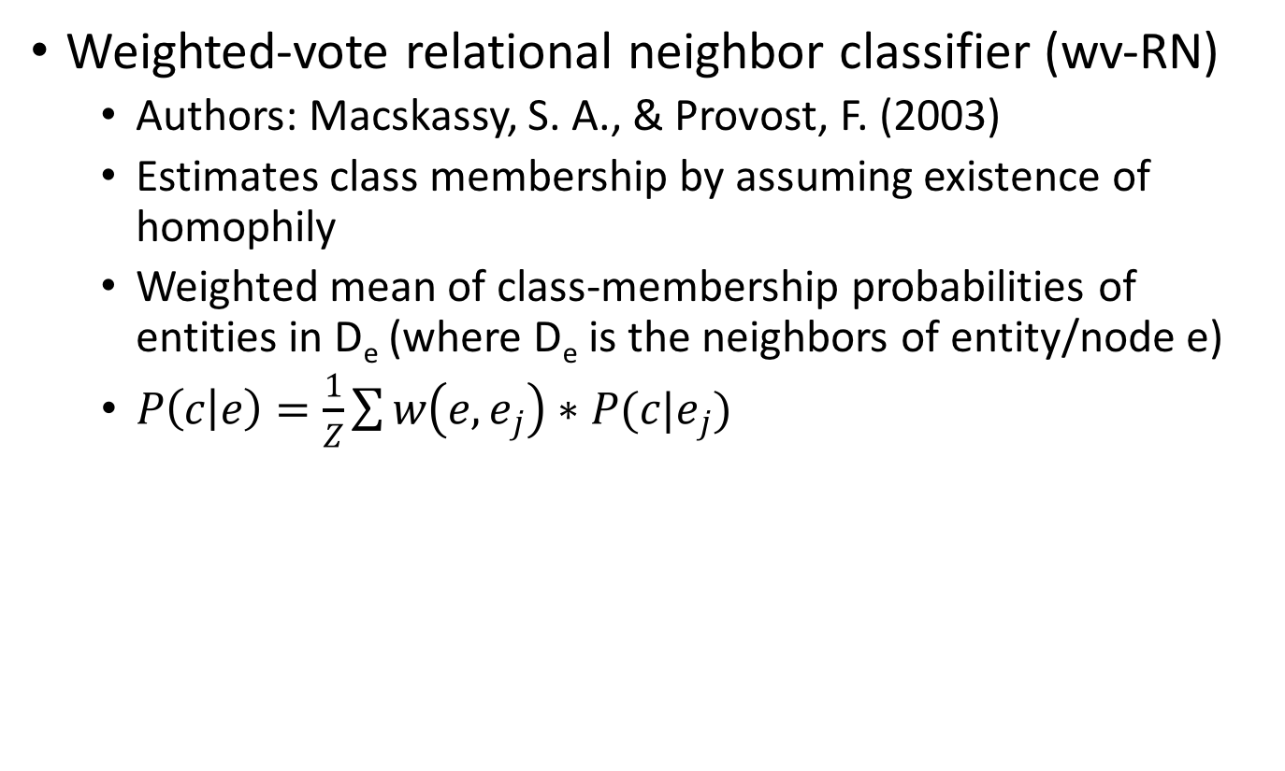
Network Classification
Weighted-vote relational neighbor classifier (wv-RN)
  Authors: Macskassy, S. A., & Provost, F. (2003)
  Estimates class membership by assuming existence of homophily
  Weighted mean of class-membership probabilities of entities in D_{e} (where D_{e} is the neighbors of entity/node e)
  $P\left(c | e\right)=\frac{1}{Z}\sum{w\left(e, e_{j}\right)∗P(c|e_{j})}$

Slide 17
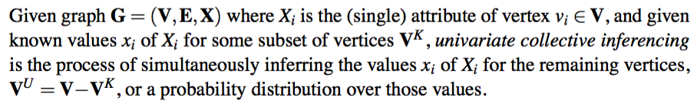
Network Classification
Collective Inference using Relaxation Labeling
Definition of collective inference:
Similar but different to Gibbs sampling in that:
  Keeps track of class probability estimates for X^{U}
  Instead of updating the graph one node at a time, updates class probabilities of all vertices, at iteration t+1, based on estimations from step t.

Slide 18
Network Classification: Experiment
Experiment
  Rationale: Participants who are “homopholous” (who have shared background in common), have common interests.
  Hypothesis: Given a set of common interests, between pairs of participants, one can predict the homophily-measures with good accuracy.
  Input graph
    Nodes: Participants
    Attributes: Addiction, Education, Income
    Edges: Edge weight is the number of news stories + success stories + educational modules that both nodes (connected via the edge) have viewed in common.
    Predicted attribute: Addiction

Slide 19
Network Classification: Experiment Config
Possible Experiment configurations
  Non-relational classifier: None
  Relational classifier: (Options)
    Weighted Vote Relational Neighbor
    Class-Distributional Relational Neighbor
  Collective inference: (Options)
    Relaxation labeling
    Gibbs sampling
    Iterative classification
  Data: Nodes and edges extracted from experiment 1 replicate 2 (E1R2) participant interactions.
  Goal: Predict 1) Primary Addiction (given graph); 2) Education (given graph); 3) Income bracket (given graph)

Slide 20
Network Classification: Experiment
E1R2 data statistics
  # of nodes: 256; # of edges: 436

Slide 21
Network Classification: Experiment
Experiment E1R2 data statistics
  Edge weight breakdown

Slide 22
Network Classification: Experiment Results
Network classification framework results (various experiment configurations given as row/column names) (Metric: Accuracy)
  Goal: Predict “Primary Addiction” of participants
Relational Classifier/Collective Inference methods | Relaxation Labeling | Gibbs Sampling | Iterative Classification
Weighted Vote Relational Neighbor (wvRN) | 0.36601 | 0.37908 | 0.39216
Class-Distributional Relational Neighbor | 0.15686 | 0.22222 | 0.18954

Slide 23
Network Classification: Experiment Results
Predicted Response/Class = Primary Addiction
Configuration: wvRN with relaxation labeling
Confusion Matrix

Slide 24
Network Classification: Experiment Results
Predicted Response/Class = Education
Configuration: wvRN with relaxation labeling
Confusion Matrix

Slide 25
Network Classification: Experiment Results
Predicted Response/Class = Income
Configuration: wvRN with relaxation labeling
Confusion Matrix

Slide 26
Network Classification: Experiment Conclusion
Conclusion
  The highest accuracy for all experiment configurations for predicting primary addiction as shown in slide 22, is 0.392
  The confusion matrix for predicting each of primary addiction, education and income shows more details on the accuracy of predicting each class.
  The accuracy is low.
  This is probably due to the fact that our experiment configuration does NOT include a non-relational component.
  Furthermore, our graph edges, and attributes have only 1-3 fields. The graph needs to be more dense with a lot more information to be used for network-based inference.

Slide 27
Network Classification: Next Steps
Possible extensions of the work:
  Build graph with different representation of edges
  Construct more attributes of the node for non-relational (local) classifier step
  Try experiments with priors learnt from various traditional classification models.
Problem/Challenge
  Extension or further work is open-ended.
  Part of doctoral work: Build a logical flowchart of inquiries/hypotheses.
  The logical flowchart of inquiries can be used and called upon based on user’s line of inquiry.

Slide 28
Learning via Markov Logic Networks
A Markov Logic Network (MLN) is a set of pairs (F, w) where
  F is a formula in first-order logic
  w is a real number
Together with a set of constants, it defines a Markov network with
  One node for each grounding of each predicate in the MLN
  One feature for each grounding of each formula F in the MLN, with the corresponding weight w
*Slide source: http://www.cs.washington.edu/homes/pedrod/psrai.ppt

Slide 29
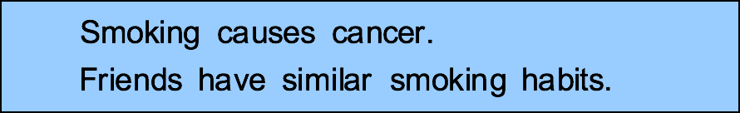
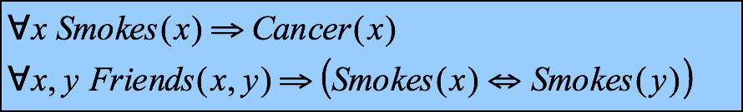
Learning via Markov Logic Networks
Two constants: Anna (A) and Bob (B)
Smokes(A)
Smokes(B)
Cancer(A)
Cancer(B)
*Slide source: http://www.cs.washington.edu/homes/pedrod/psrai.ppt

Slide 30
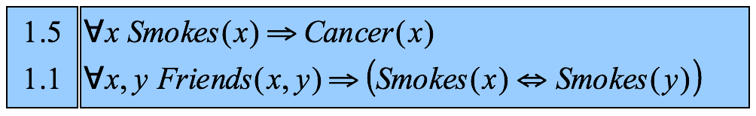
Learning via Markov Logic Networks
Friends(A,B)
Friends(A,A)
Smokes(A)
Smokes(B)
Friends(B,B)
Cancer(A)
Cancer(B)
Friends(B,A)
*Slide source: http://www.cs.washington.edu/homes/pedrod/psrai.ppt

Slide 31
Learning via Markov Logic Networks
Friends(A,B)
Friends(A,A)
Smokes(A)
Smokes(B)
Friends(B,B)
Cancer(A)
Cancer(B)
Friends(B,A)
*Slide source: http://www.cs.washington.edu/homes/pedrod/psrai.ppt

Slide 32
Learning via Markov Logic Networks
Friends(A,B)
Friends(A,A)
Smokes(A)
Smokes(B)
Friends(B,B)
Cancer(A)
Cancer(B)
Friends(B,A)
Probability of a world x:
Weight of formula i
No. of true groundings of formula i in x
*Slide source: http://www.cs.washington.edu/homes/pedrod/psrai.ppt

Slide 33
Learning via Markov Logic Networks
Tasks/Applications
Basics
Logistic regression
Hypertext classification
Information retrieval
Entity resolution
Hidden Markov models
Information extraction
Statistical parsing
Semantic processing
Bayesian networks
Relational models
Robot mapping
Planning and MDPs
Practical tips
*Slide source: http://www.cs.washington.edu/homes/pedrod/psrai.ppt

Slide 34
Future work
Next steps
  Extract more attributes for each participant
  Compiledifferent ways to represent edge weight
  Build local classifier and testing results for Netkit-SRL
  Use Alchemy to represent data using Markov Logic networks.

Slide 35
Questions?

Slide 36
Network Classification
Other works
  Inductive logic programming
  Markov random fields
  Conditional random fields
  Probabilistic relational models
  Relational Bayesian networks
  Relational dependency networks
  Relational Markov networks

