Slide 1
Disability on Campus
Guest Speaker: Dr. Marisa Fisher
Respondents: Dr. Carolyn Shivers, Martina Svyantek, Liz Spingola

Slide 2
Claiming Disability within higher education
Martina Svyantek
November 30, 2017

Slide 3
Quick note on language
Identity-first: “disabled student”
Person-first: “student with a disability”
Why I use ID-1st: can’t forget/misplace disability even if someone can “pass”
Notes:
Language choices
Passing – invisible disabilities

Slide 4
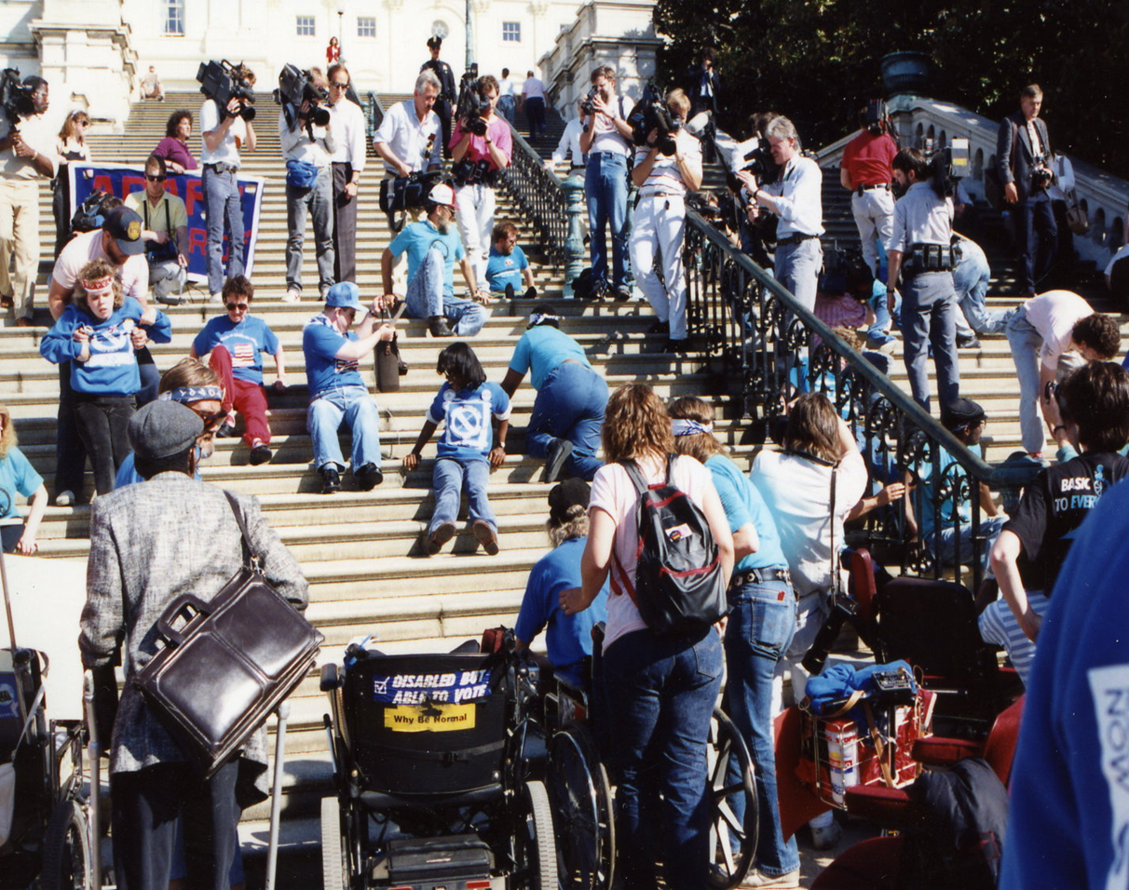
Disability history and the ADA
Capitol Crawl – 1990
  Activists
ADA passed, and now covers, among other things…
  Education, transportation, employment
2010 US Census Data
  19% of the population

Slide 5
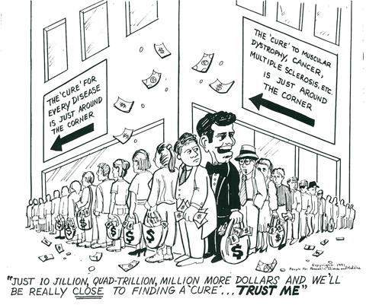
Tropes
PITY

Slide 6
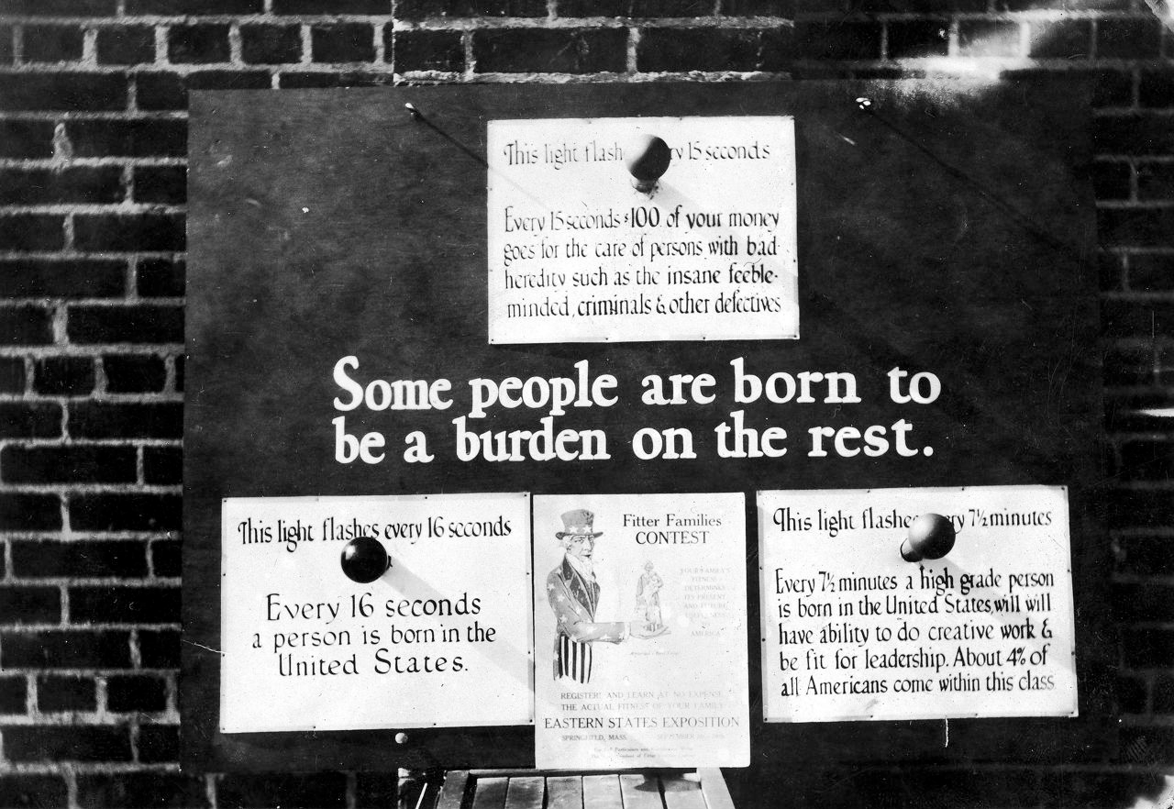
Tropes - Burden
Notes:
http://www.forbes.com/sites/techonomy/2014/11/08/could-genomics-revive-the-eugenics-movement/#bd3b2773712d
Every 15 seconds, $100s of your money goes for the care of persons with bad heredity such as the insane, feeble-minded, criminals, and other defectives
Every 71 minutes a high grade person is born in the United States who will have the ability to do creative work and be fit for leadership. About 4% of all Americans come within this class

Slide 7

Tropes - overcoming
Notes:
Commodifying disability
If they can, so must we all.
Ignores privileges…..

Slide 8

Tropes - inspiration
Notes:
http://criptiques.com/2015/05/15/criptiques-t-shirt-takeover/
Criptiques – can buy shirt for $17 until Sunday!

Slide 9
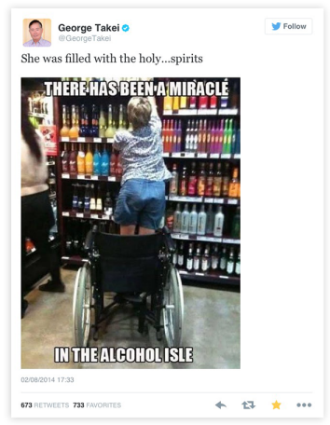
Tropes: Fraud

Slide 10
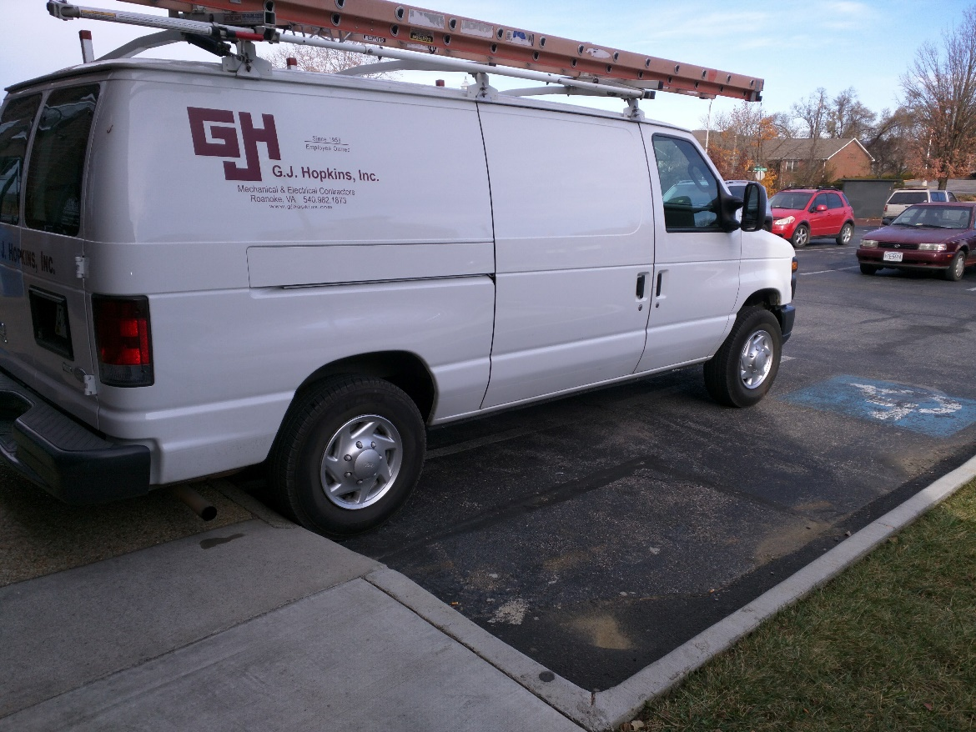
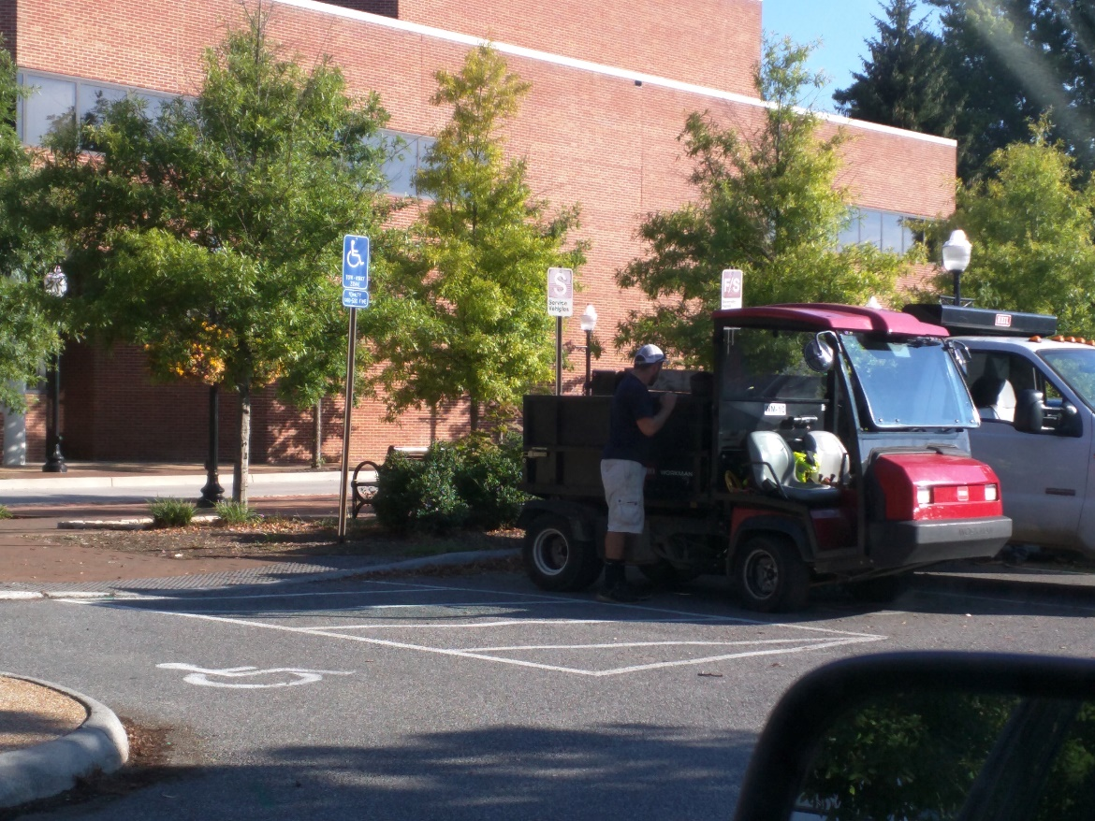
Service vehicles illegally parked

Slide 11
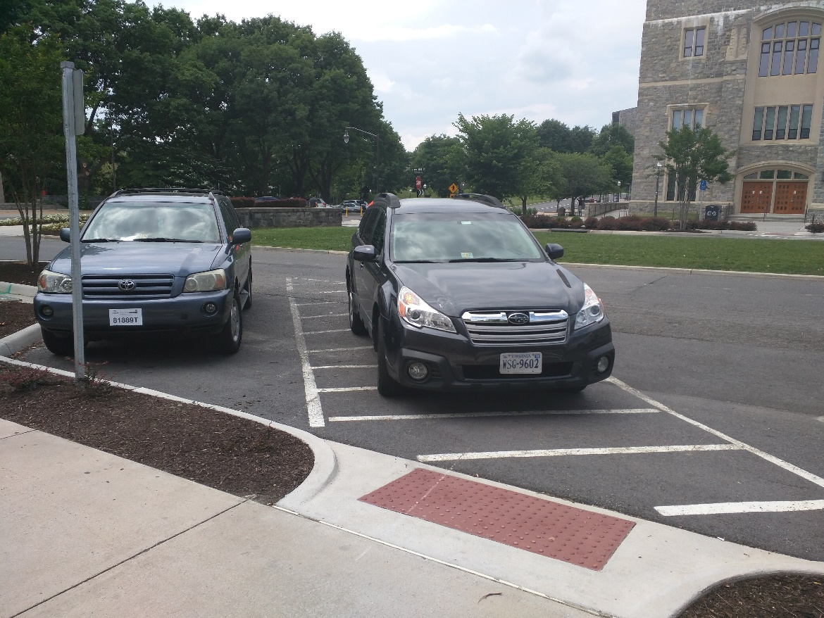
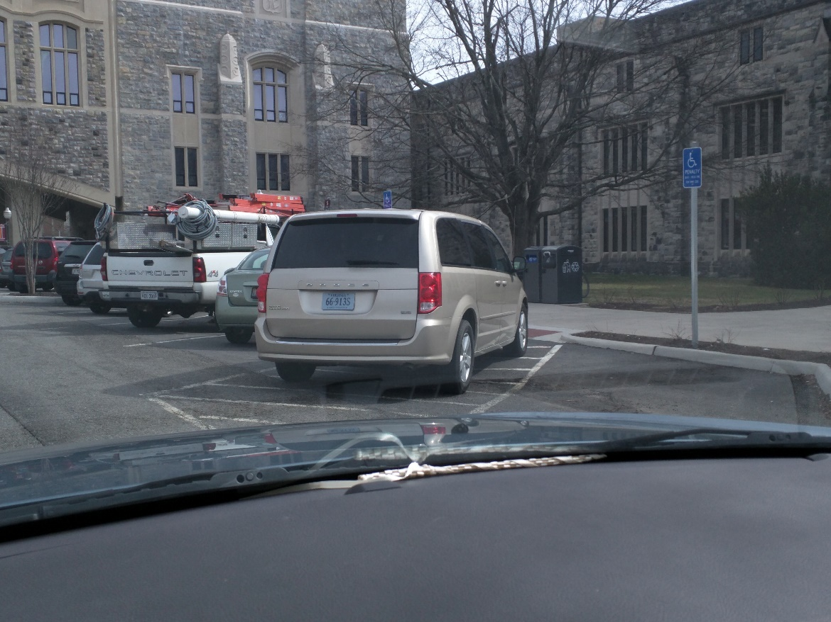
Parking in the “Free Space”

Slide 12
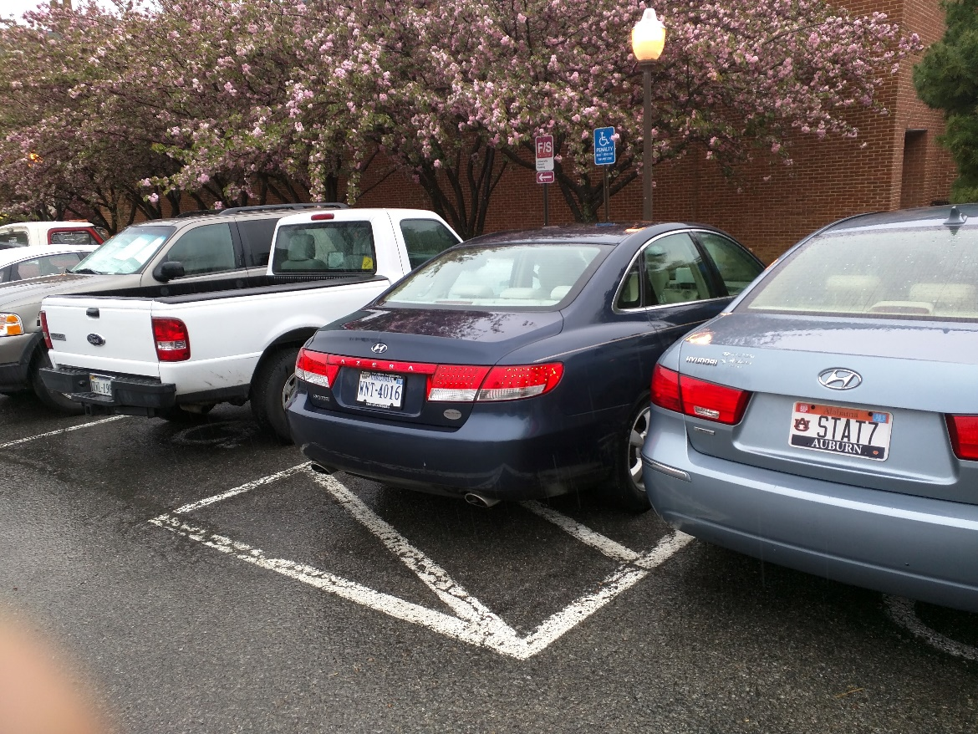
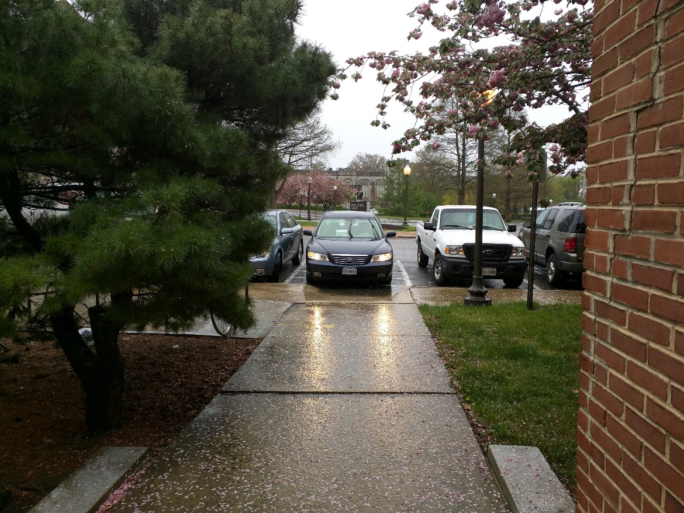
Parking Ethics, Continued

Slide 13
Claiming disability
VT services for students with disabilities

Slide 14
Diversity and Disability
“So often disability is spoken in terms of legal compliance, they invite ADA and SSD to the table, without having any real honest-to-god disabled people. That’s not representing us — that minimal legal compliance is not inclusion.”
Notes:
Quote from Fall 2015, Dr. Shew
Emphasis added
http://www.collegiatetimes.com/news/disability-alliance-fights-to-end-ableism/article_999c7986-5d8f-11e5-a70f-037cebed2593.html

Slide 15
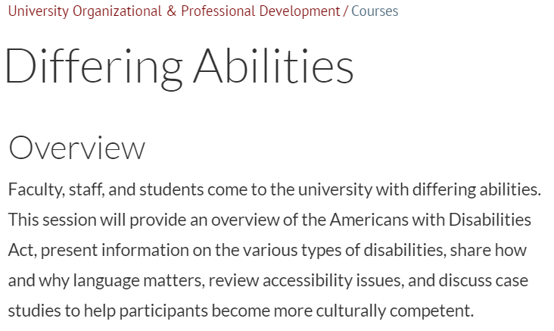
Professional development

Slide 16
#Saytheword
Institutional stigma around “Disability”
Being told to “pass” whenever possible
Linguistic gymnastics performed to avoid “Disability”
  But “language matters”

Slide 17


Slide 18
Registering with SSD
Services for Students with Disabilities (SSD) is here to serve students who have or think they may have disabilities. The department provides numerous accommodations, services, and resources for students with disabilities and temporary injuries or illnesses.
The first step to receiving accommodations is to register with SSD. This section of the site provides useful information on disability documentation, how to receive accommodations, how to advocate for yourself, and frequently asked questions.
Accommodations are given on a case-by-case basis depending on a student’s disabilities.

Slide 19
The necessity of documentation
Documentation is necessary to establish the presence of a disability and the need for accommodations. As relevant to the disability, the documentation should include the following nine elements…..
  ADA: An individual with a disability is defined by the ADA as a person who has a physical or mental impairment that substantially limits one or more major life activities, a person who has a history or record of such an impairment, or a person who is perceived by others as having such an impairment.
    (eating, breathing, caring for oneself, working, walking, etc.), OR. a person with a record of such an impairment (even if that record is inaccurate)

Slide 20
Part 1
A diagnostic statement identifying the disability, date of the most current diagnostic evaluation, and the date of the original diagnosis

Slide 21
Part 2
A description of the diagnostic tests, methods, and/or criteria used, including specific test results (including standardized testing scores) and the examiner's narrative.

Slide 22
Part 3
A description of the current functional impact of the disability. This may be in the form of an examiner's narrative, and/or an interview, but must have a rational relationship to diagnostic assessments. For learning disabilities, current documentation is defined using adult norms.

Slide 23
Part 4
A statement indicating treatments, medications, or assistive devices/services currently prescribed or in use, with a description of the mediating effects and potential side effects from such treatments.

Slide 24
Part 5
A description of the expected progression or stability of the impact of the disability over time, particularly the next five years.

Slide 25
Part 6
A history of previous accommodations and their impact.

Slide 26
Digital Accessibility and Non-Apparent Disabilities

Slide 27
Hello and welcome!
How about this?
How about this?
Notes:
Who can read this?

Slide 28

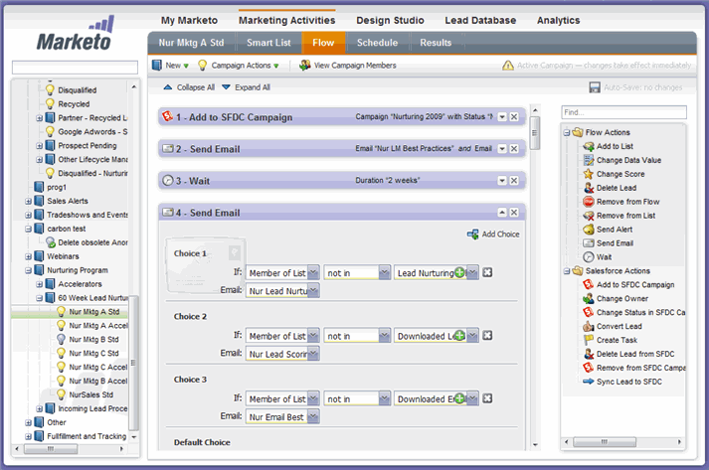

Slide 29
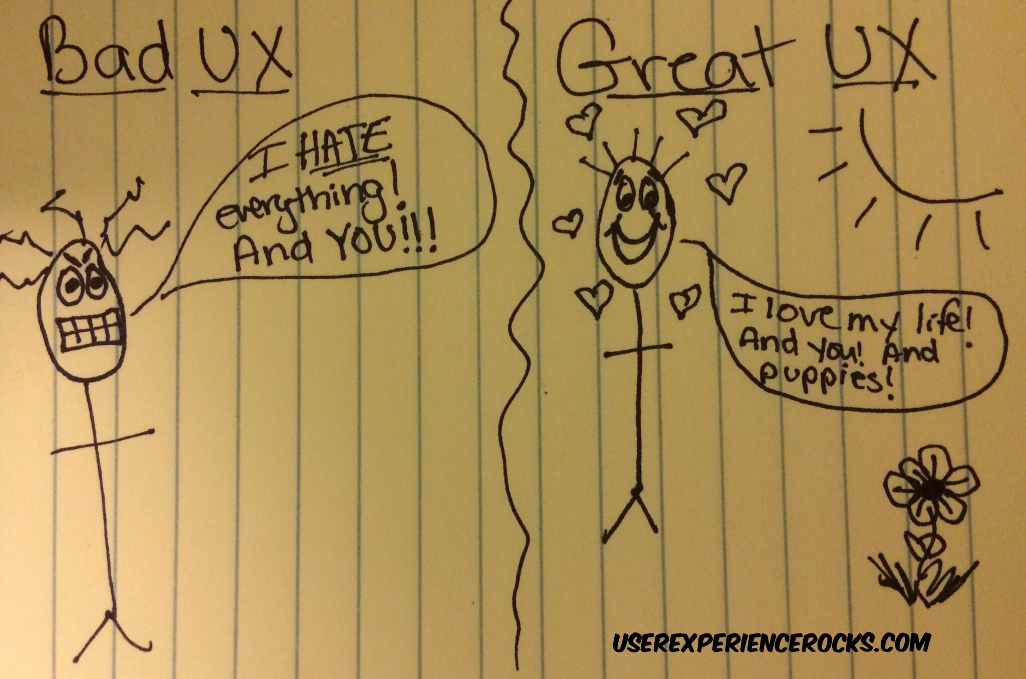

Slide 30
Flexible and Fluid Aspect of Disability and Disability Identity
A person can become disabled and non disabled
A disabled person may not identify with a disability
Not all disabilities are labeled disabilities
Not all disabilities are apparent

Slide 31
Technology and Disability
Is disability really something necessary to be “fixed”?
  Why strive for a “superiorly functioning” human?
What is the advantages and disadvantages to technologies adapting the physical and cognitive human aspects?
How does this affect the construction and identity of disability?
What is Tech’s role within this situation and what should their role be?

Slide 32
The Classroom and Beyond

Slide 33
Considerations for Instructors
Breadth of disability
  Physical disability
    Mobility impairments
    Hearing or vision impairments
  Learning disability
  Psychiatric disability
    Anxiety
    Depression
Notes:
Note – many of these disabilities can be, as Martina mentioned, invisible, which increases the likelihood that an instructor will believe a student. Many students are hesitant to ask for accommodations for fear of being seen as dumb or unworthy of being at university. Students who were unable to navigate the legal requirements for SSD might be even less likely to ask for the accommodations they need.

Slide 34
Considerations for Instructors
How to implement universal design and/or accommodations without “easing” requirements?
  Many existing courses/materials are not accessible
  Closed captioning, recording, and visual descriptions take time
Universities need institution-wide supports so that accommodations are consistent
Notes:
Sadly, the technological factors that Liz talked about don’t just exist – someone has to make them! And the instructors in the room know that a) we might not know or have the information to make materials cully accessible and b) we’re not exactly swimming in time! Of course, this isn’t an excuse for inaccessibility. We need to do better, both individually and at an institutional level.

Slide 35
Considerations for the Campus Community
College is more than just classes!
  Time management
  Daily living skills
  Socialization
Potential barriers to success for students with physical, learning, or psychiatric disabilities

Slide 36
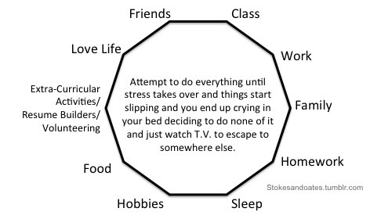

Slide 37
Who’s Missing?
Amid discussions of inclusion in higher education, individuals with intellectual disabilities (ID) are often left out
  Significant limitations in both intellectual functioning (IQ<75) and activities of daily living
Higher ed not available through traditional application and admittance processes
Notes:
What are ADLs? Well, the very things from the previous slide that require personal management!

Slide 38
Including Students with Intellectual and Developmental Disabilities in Higher Education…
It’s About More than Just Academics
Marisa H. Fisher, PhD, BCBA-D
Michigan State University
Virginia Tech Nov 30 2017

Slide 39
Current Landscape for Adults with IDD
Education
  Lowest percentage of postsecondary enrollment of any category of disabilities
  23% of high school students with IDD go on to attend a two-year or four-year college

Slide 40
Current Landscape for Adults with IDD
Employment
  Majority of adults with IDD are either unemployed or underemployed, despite their ability, desire, and willingness to work in the community (ARC, 2015)
  Compared to 68.6% of those without disabilities, 19.9% of people with IDD are employed
  In 2011, 81% of people with IDD were served in facility-based and non-work settings
Notes:
Worse for those with moderate to severe forms of ID

Slide 41
Current Landscape for Adults with IDD
Social
  The U.S. cost over the lifespan is about $2.4 million for a person with IDD vs. $1.4 for those without (Buescher et al., 2014)
  Significant number of young adults with ID are not living independently in the community
    60%-80% live in their family home (Braddock et al., 2001; Gray et al., 2014)
  Loneliness, segregation, and social isolation
    Few have any form of organized daytime social activity
    social networks of people with ID are relatively small and mostly consist of other people with ID (Gray et al., 2014; Verdonschot et al., 2009)

Slide 42
Why College?
Higher education leads to personal and financial benefits
  Opportunities for employment
  Opportunities for social inclusion
  Opportunities for independence
  …it’s about more than just academics

Slide 43
Higher Education Opportunities Act
The Higher Education Opportunities Act of 2008
  new provisions aimed at increasing access to higher education for youth and adults with intellectual disability
Supported to take inclusive college classes, obtain career experiences through internships, and access integrated paid employment
Provides opportunities for financial support to prospective students through eligibility for student grants (e.g., Federal Pell Grants) and work-study opportunities

Slide 44
What is Post-Secondary Education?
Educational opportunities after high school
Includes technical schools, colleges, and universities
  community or technical colleges, small liberal arts colleges, and large research universities
Campuses serve as a backdrop for practicing skills of autonomy
  Mini cities with their own community
Currently there are 268 options in the US

Slide 45
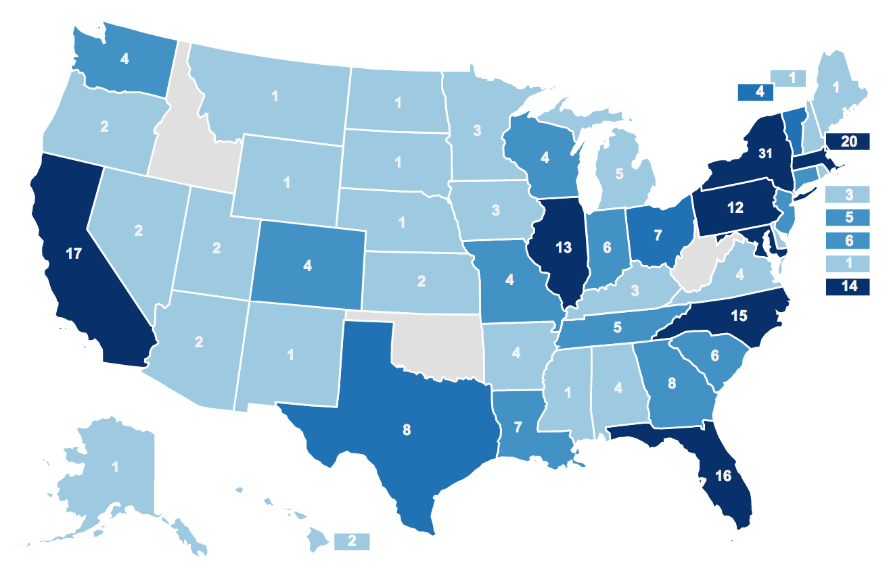

Think College
https://thinkcollege.net/

Slide 46

PSE Models
Substantively separate model
  Courses and social activities are on campus, but are not included in traditional college courses
Mixed or hybrid model
  Inclusive academic coursework and social activities, and also separate academic or life skill support as necessary
Inclusive, individualized support model
  Activities and coursework all take place in inclusive settings
  (Plotner & Marshall, 2015)

Slide 47
Post-Secondary Education Services
Program vs. Services
  Program is a Place (somewhere you go)
  Services are Supports (something you use to live the life you want)
Set of inclusive services & supports provided to individuals with intellectual disability in an inclusive college setting
  Students receive support to successfully participate and make progress in traditional college classes (alongside typical peers)
    Classes align with a career path, area of interest, or university requirement
  Students receive support in transition classes related to the domains of transition
    Career development, independent and daily living, community participation, self-advocacy and autonomy

Slide 48
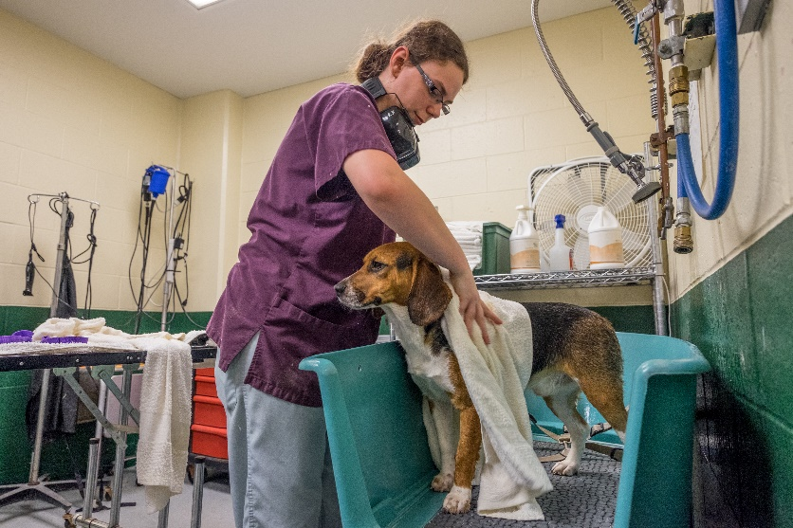
It’s not just about academics…
Vocational Training
  Internships to build resume
  Able to leverage the specific courses they take related to specific career path to obtain a job
  Ability to earn an income to either replace or supplement SSI
  Skills transferable to any place they want to live

Slide 49
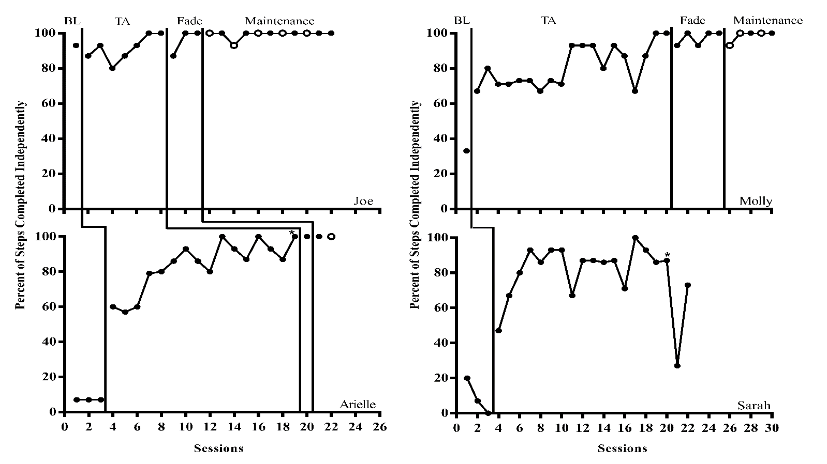
It’s not just about academics
Independence
  Community Navigation
  Community Safety
  Laundry, hygiene
  Cooking

Slide 50
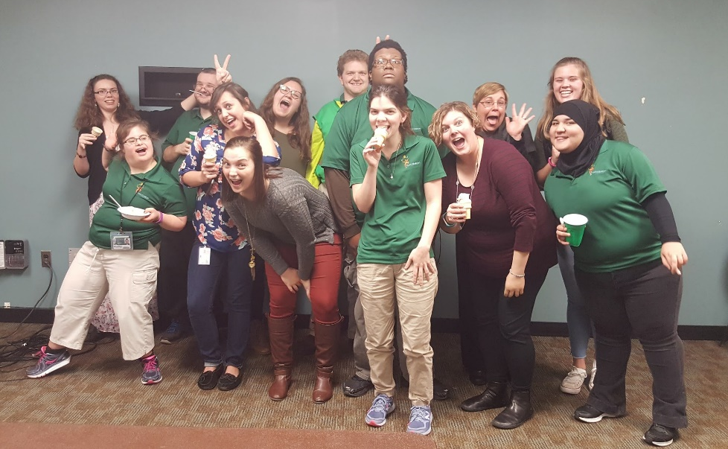
It’s not just about academics…
Inclusion
  Social contact can change attitudes and promote prosocial behavior toward individuals with IDD
  Peer Mentoring
  Natural Supports in Internship Settings

Slide 51
Which brings me back to employment
The lack of employment opportunities is partially attributed to negative societal attitudes toward hiring people with IDD
Employers’ perceptions and attitudes have the greatest impact on ability to secure and maintain employment (Smart, 2008).
Employer concerns related to hiring
  (1) concerns about coworkers’ and customers’ attitudes and stereotypes toward employees with IDD
  (2) concerns that people with IDD lack the necessary qualifications to perform the job (Bruyere, 2016; Burke et al., 2013)

Slide 52
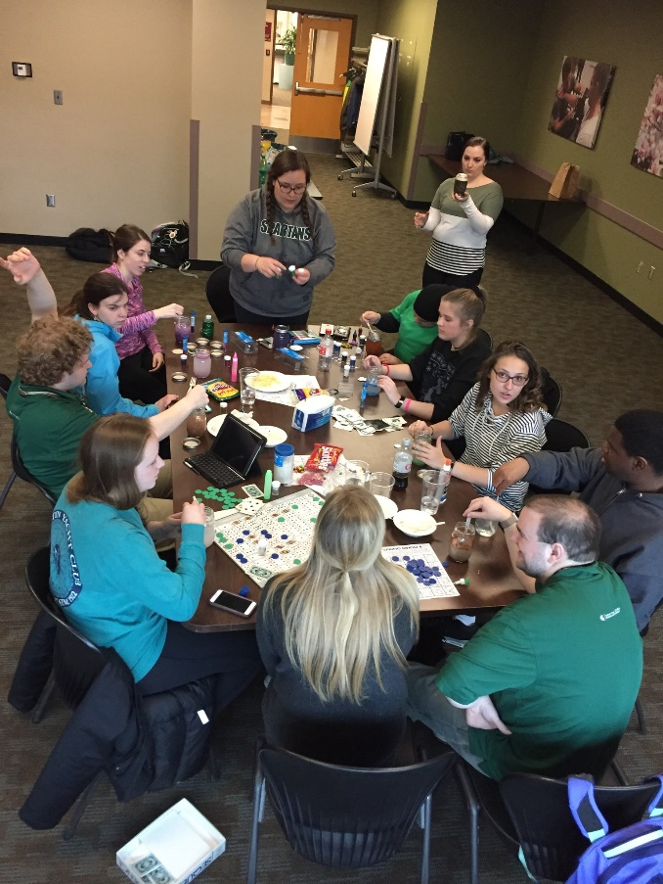
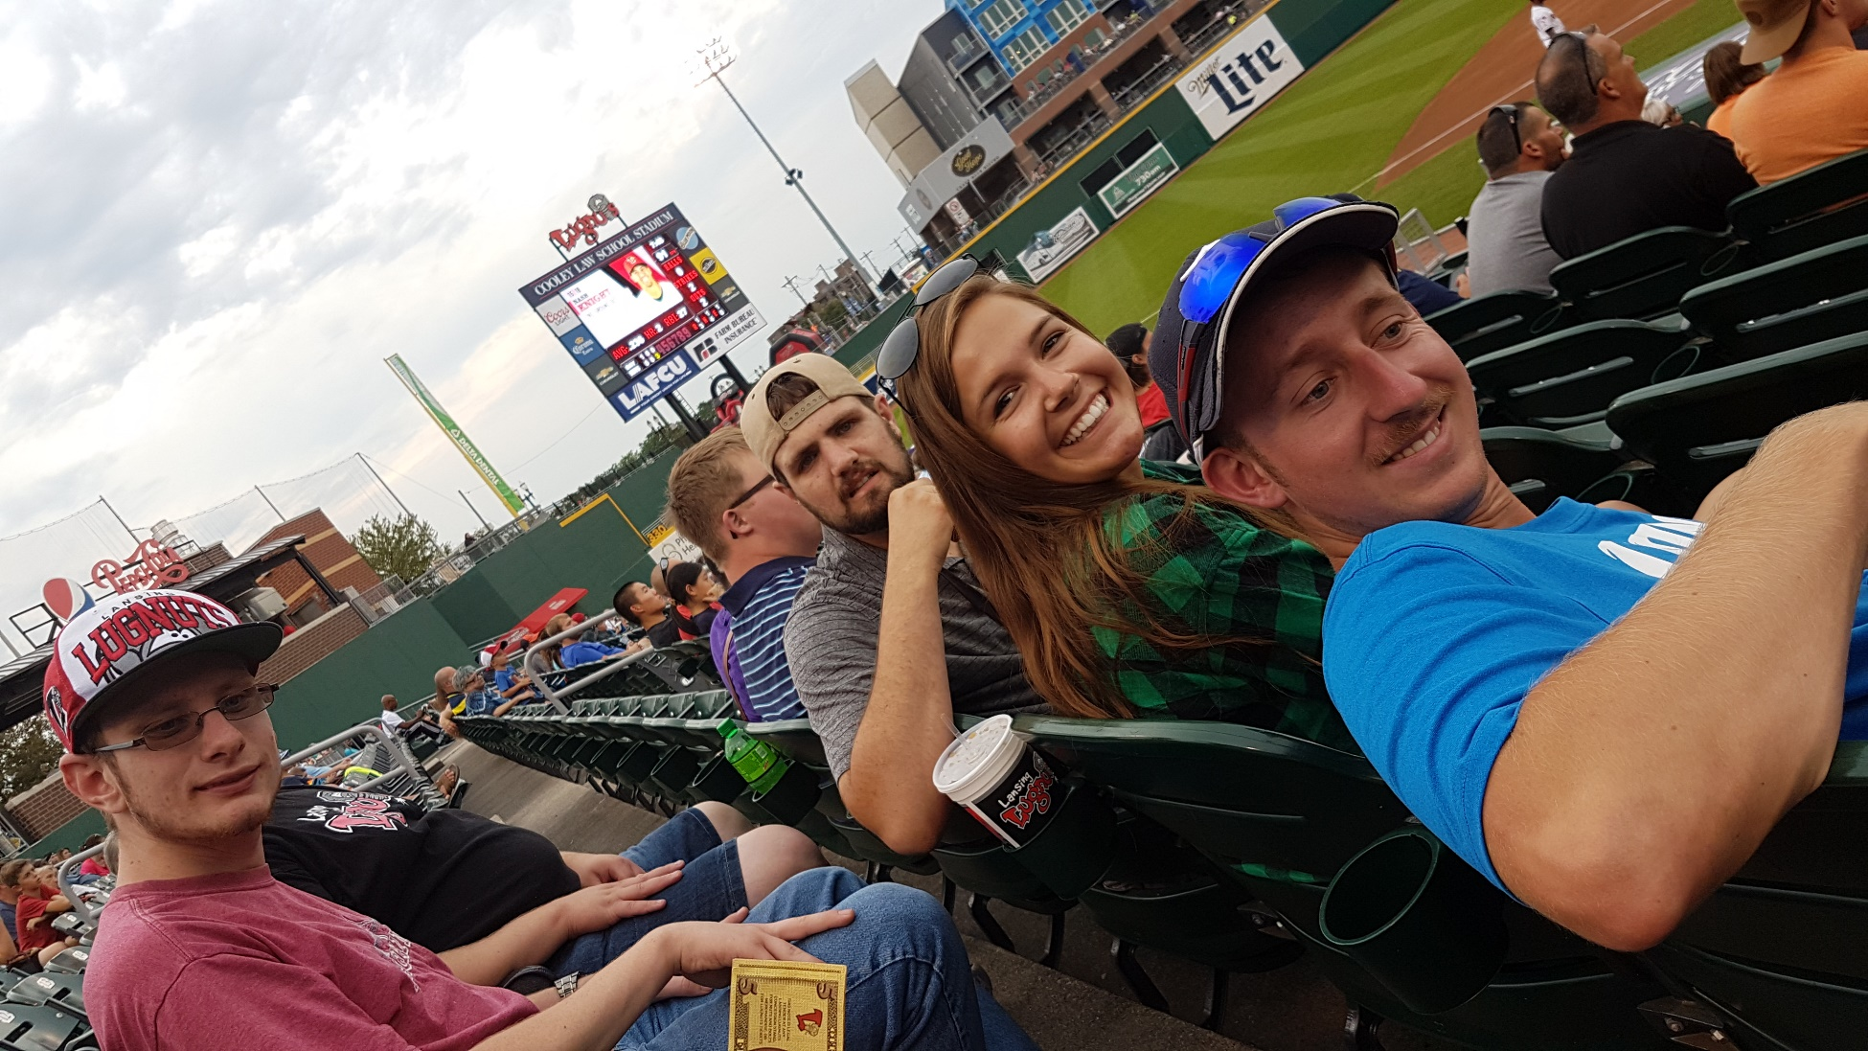
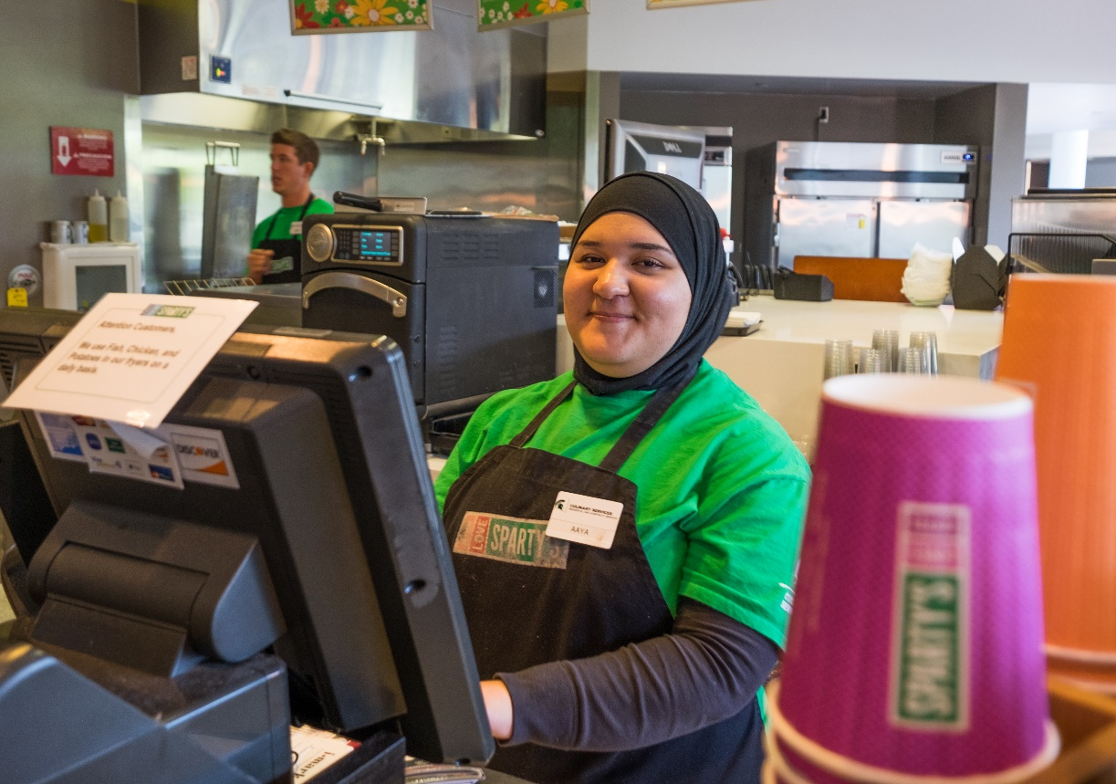
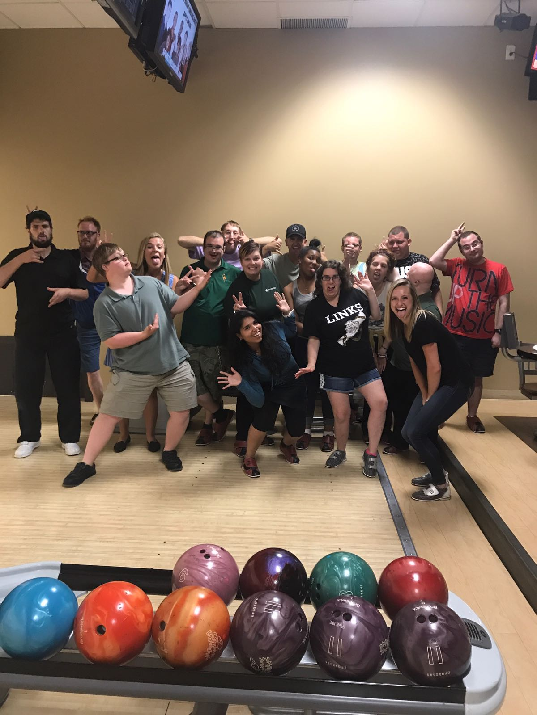
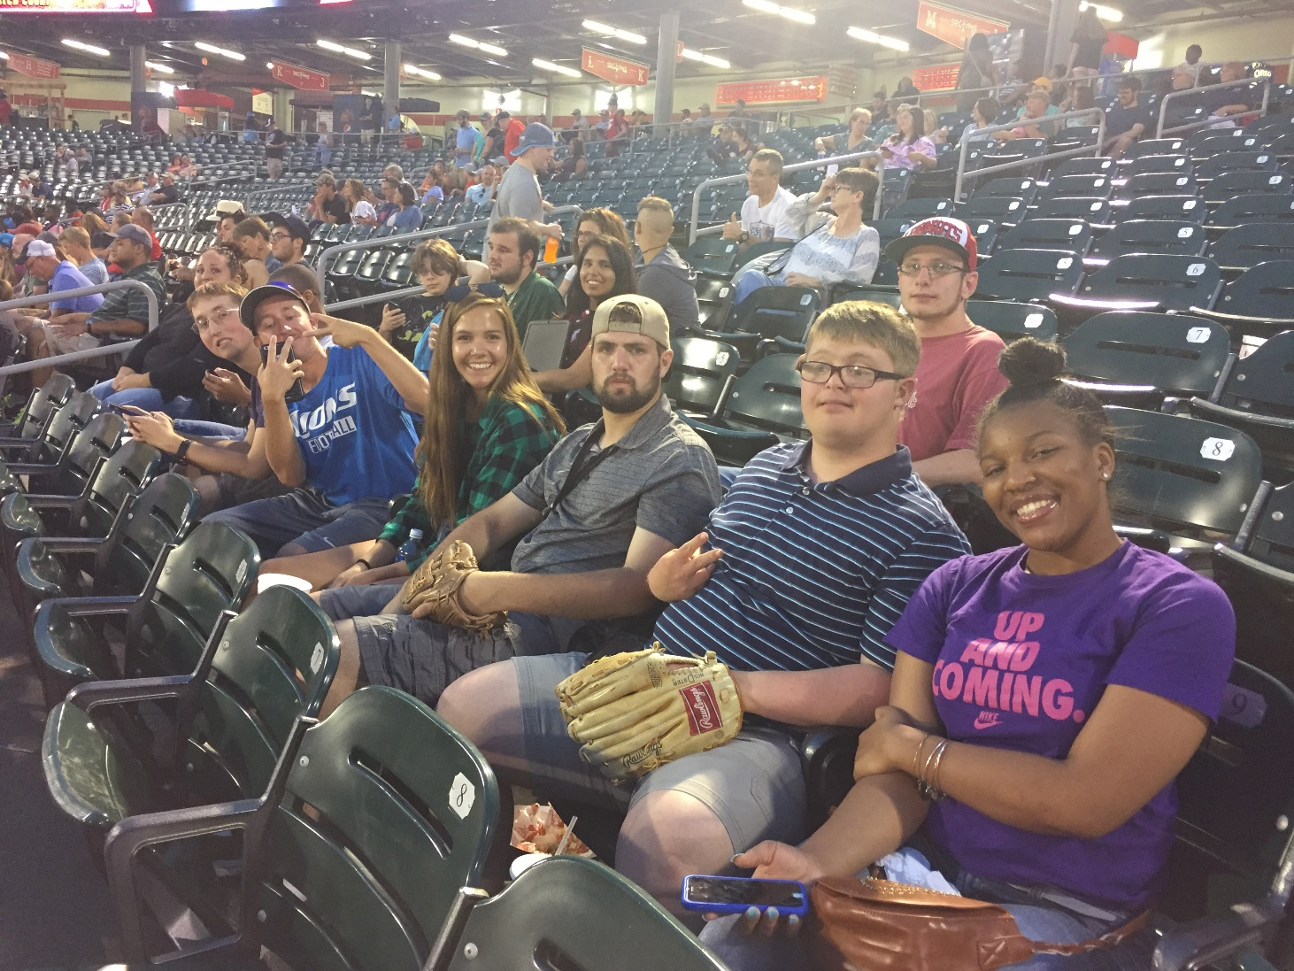
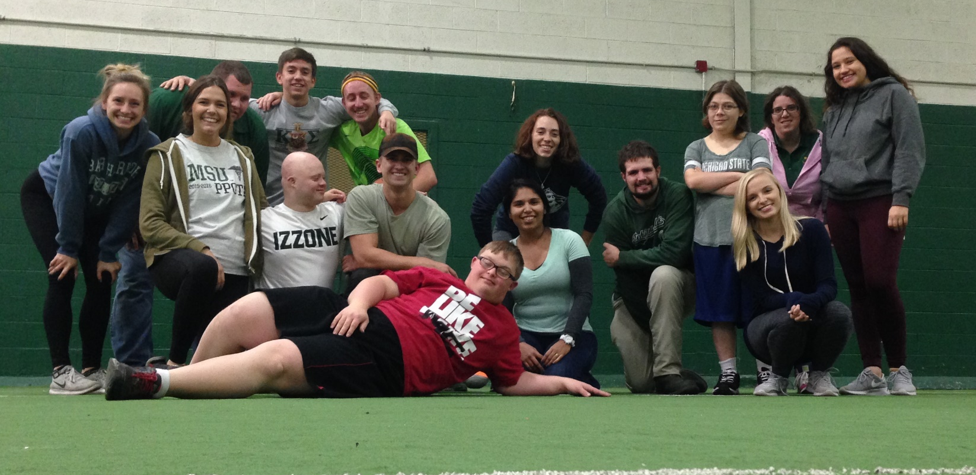
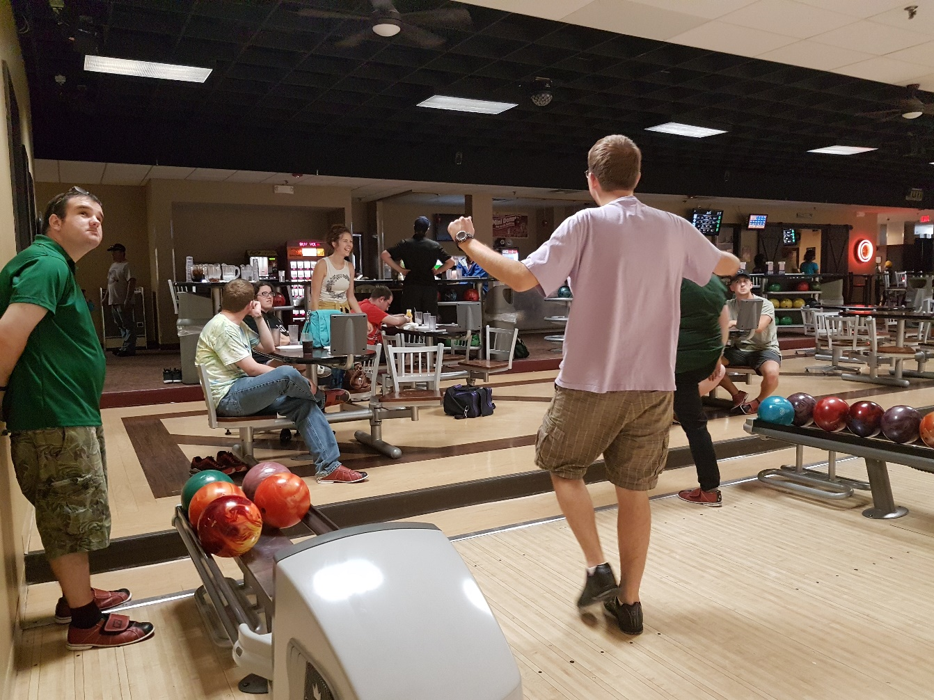
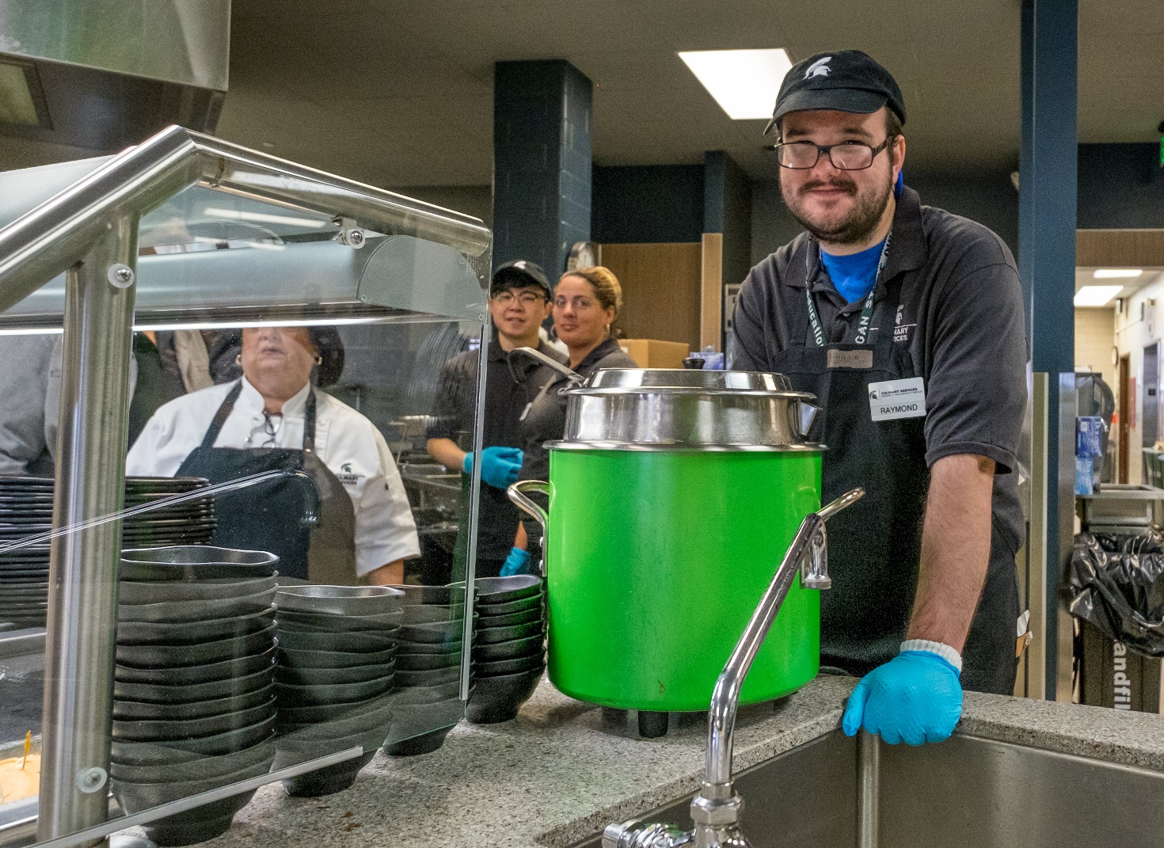
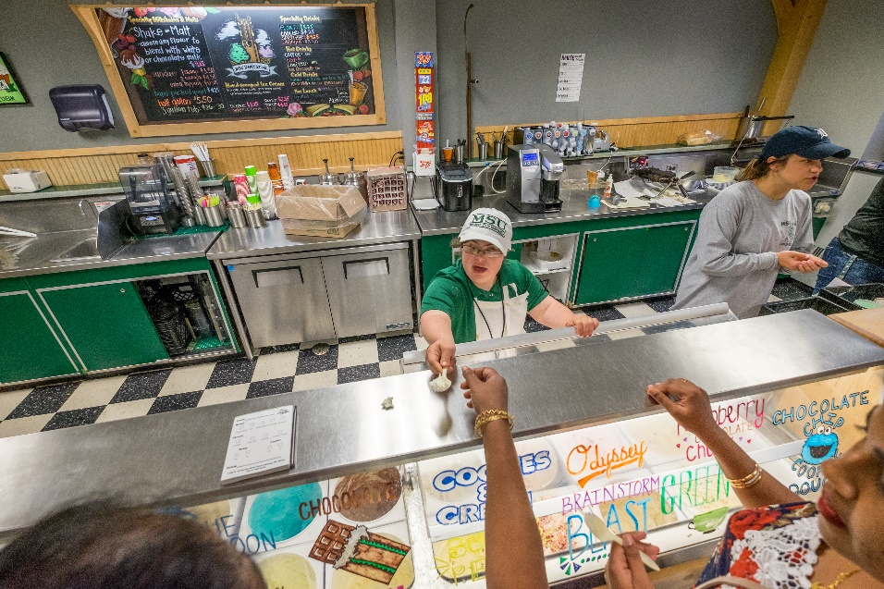
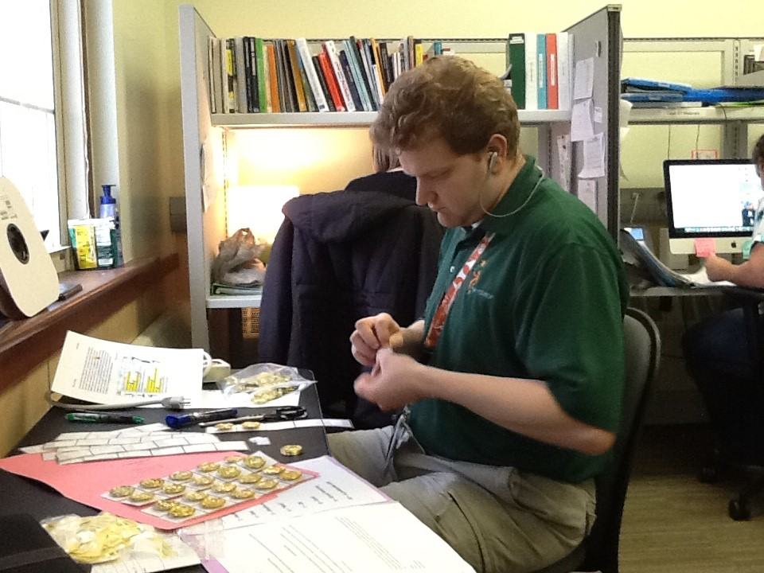
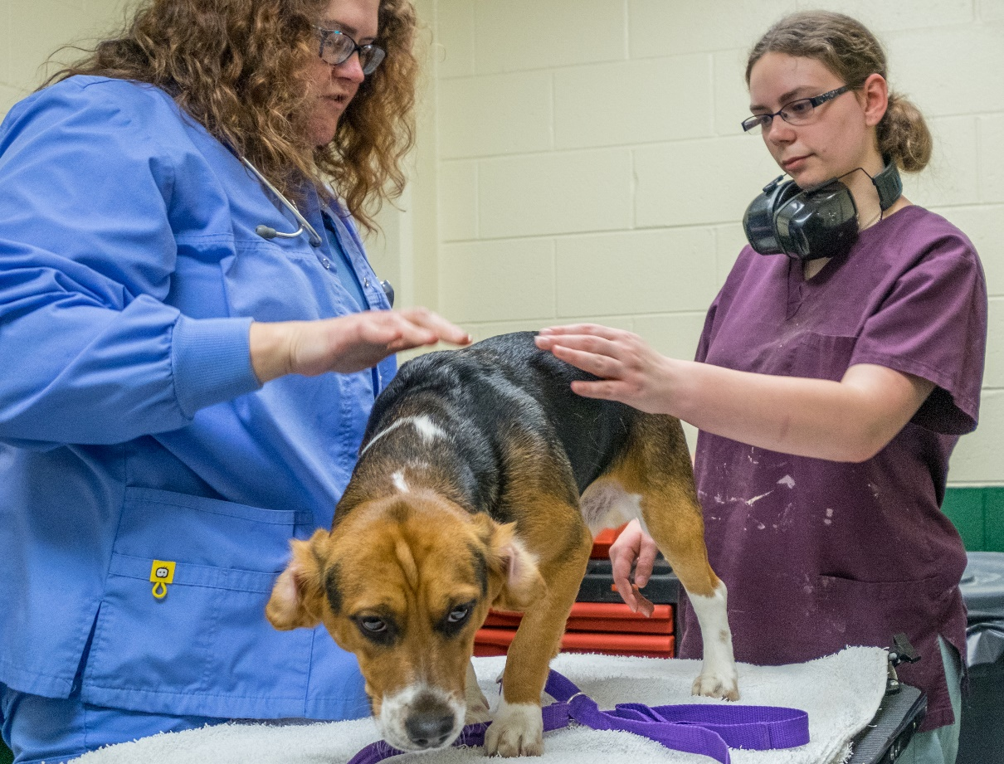
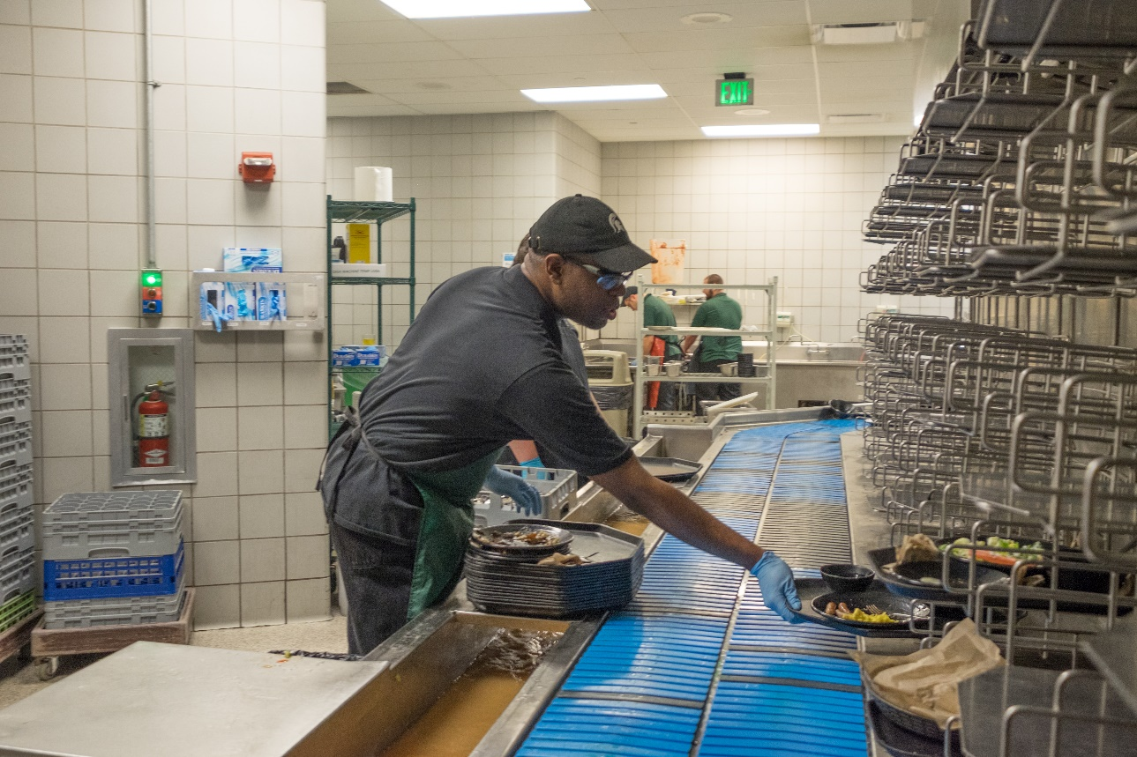
We Can Address Both

Slide 53
But It’s Not Always So Easy

Slide 54
Title IX
Prohibits sex discrimination in educational institutions that receive federal funding
Broad scope covering sexual harassment and sexual violence.
Schools are legally required to respond and remedy hostile educational environments
Failure to do so is a violation that means a school could risk losing its federal funding

Slide 55
Case Study
1st year of new residential post-secondary education program for students with IDD
Young woman with Williams Syndrome
At the start of fall semester, “Victim” said that he and “Accused” met and had a lengthy (30 min) conversation. They lived in the same hall and moved in about the same time. “Victim” was aware that she was a special needs student and he knew that after this first conversation she was then “always looking for him” and asking other people about him

Slide 56
Details of the Case
“Victim” said there were times he would see “Accused” at dining hall and she would move to sit by him for lunch…at one point in the first month or two of the semester, he told her that he had a girlfriend, even though that was not true. He thought that telling her his girlfriend didn’t like him talking to other girls would make her stop looking for him, asking about him, and trying to find him in the dining hall.
He said she did not stop and he felt weird and uncomfortable a lot.
He didn’t want to be mean and felt bad…he just wanted her to leave him alone
In late fall, he said he was more forceful with telling her “you really need to stop, stop asking about me, stop sitting with me, stop waiting for me at my door.”

Slide 57
Details of the Case
When asked if this changed anything, “Victim” reported “no change”
Mentioned that she did stop talking to him after he told her he had a girlfriend
She would be there but wouldn’t talk to him

Slide 58
Allegation 1
Stalking. Repeated conduct which would cause a reasonable person to fear for his/her safety or to alter his/her activities in response to the repeated conduct. Such repeated conduct may include, but is not limited to, any of the following:
  following, approaching, contacting, or placing under surveillance a person, a member of that person's family, or close acquaintance, whether or not conversation ensues

Slide 59
Allegation 2
Harassment. Any verbal, visual, written or physical conduct that is sufficiently severe, persistent or pervasive that it adversely affects, or has the purpose or logical consequence of interfering with an individual's education or creates an intimidating, hostile or offensive environment including but not limited to:
  a. Sexual Harassment, which includes, but is not limited to non-consensual verbal or physical conduct related to sex which unreasonably interferes with an individual's work or educational performance or creates an intimidating, hostile, or offensive work, educational, or social environment; or is a violation of an individual's privacy;
  b. Bias-Related Harassment, which includes harassment of a person or group because of factors such as race, ethnicity, religion, gender, sexual orientation, age, creed, national origin, disability, political affiliation or veteran status.

Slide 60
“Responsive Actions”
Program Instructors were made aware “Victim” lived in the same residence hall as “Accused” early in the fall semester. “Accused” discussed with both “instructors” wanting to talk with “Victim” frequently. She stated to them that she and he had a conversation during move in.
Instructors discussed wanting to reach out to “Victim” during the first two months of fall to discuss “Accused” interest with her. Instructor reached out to “Victim” at one point during fall to discuss “Accused” interest in him to better understand how the behavior was impacting him and to offer support. “Victim” declined an invitation to speak with Instructor and never returned contact.

Slide 61
“Responsive Actions”
“Program Teacher” began to teach a formal curriculum to “Accused” around appropriate social behavior in the spring
“Teacher” stated she and “Accused” watched the movie “Mike’s Crush” (a video used with curriculum to understand high school relationships for youth with autism and ID) “probably 30 times” and discussed right behavior compared to wrong behavior
They “analyzed, picked apart and talked about the behavior in the film.”

Slide 62
“Responsive Actions”
Teacher discussed repeated conversations in class and outside of class regarding appropriate behavior with “Accused”
Teacher stated “repetitious interventions” did not work; observed no change in “Accused” behavior
Teacher determined “Accused” is “really intelligent” and is in need of a more restrictive environment in order for her to be more successful as a student
  Teacher stated the Post-Secondary Education Program did not provide constant one-on-one support to students
  Program only provided natural supports (other students, volunteers, mentors for lunch)

Slide 63
The Defense
People with WS are typically overly friendly, very talkative, and have a very strong desire to please others
Limited cognitive ability in reasoning may inhibit their ability to fully consider the implications of their actions.
“Accused”, like many individuals with WS, demonstrates significant difficulties in both verbal and nonverbal reasoning, has difficulty picking up on social cues, and can have difficulties monitoring her social behavior

Slide 64
The Defense
Her conversational language skills, often displayed in the form of what others might call ‘small talk’ suggest to others that she is capable of understanding complex information that is actually very difficult for her to cognitively assess
Even though individuals with WS can and often do present themselves in initial social interactions in very positive ways, they often follow up these preliminary social interactions with behaviors that can confuse or concern others-such as repeated attempts to interact with them and misunderstandings about feelings or intentions

Slide 65
The Defense
Manifestation of the Disability
  Allegations are consistent with the behavioral phenotype of WS
  Following, approaching, and contacting people who may not wish to be contacted is consistent with the manifestation of WS in an individual who is not able to fully consider the implications of their actions due their limited general cognitive ability.
  Individuals with WS have difficulty picking up on social cues, and have difficulty monitoring their social behavior to comply with social norms.
    May be physically over-demonstrative or seek attention and affection in a context that others may find uncomfortable
    Can lack the ability to discriminate between appropriate and inappropriate sexual behaviors, which is a common problem for individuals with various intellectual disabilities.

Slide 66
The Defense
Protections under Section 504 and the ADA
  Section 504 prohibits discrimination on the basis of disability in any program or activity receiving federal financial assistance
  Section 504 and the ADA require that “College” make reasonable accommodations and modifications for students with disabilities when necessary to allow them to access their programs and activities
Based on the fact that the Post-Secondary Education Program clearly knew that “Accused” had a disability, as she was in their program, they failed to take appropriate steps to accommodate her needs.
  The Post-Secondary Education Program was contacted on multiple occasions by “Accused’s Mother” and other service providers to discuss “Accused’s” accommodation needs, yet there was undue delay in responding to all of those needs and ultimately were not provided

Slide 67
The Verdict
Guilty
Permanent Record
Removed from Program

Slide 68
Discussion
Thoughts
Questions
Comments
Ideas

