Slide 1
Max Video Tutorials
CS 4624
Virginia Tech
Blacksburg, VA 24061
Instructor: Dr. Edward A. Fox
Client: Dr. Charles Nichols
Team: Tyler DeYoung, Amanda Kahn, Deepika Darivemula, John Russell

Slide 2
Project Overview
Computer Music and Multimedia class: MUS 3654
Max Video Tutorials
Max Basics (7:09)
Timing in Max (6:00)
The Coll Object (6:32)
Quad-speaker Spatialization (6:05)
Audio Modulation (4:42)
Audio Synthesis (3:11)

Slide 3
Requirements
Content
  Mirrors Max manual: https://docs.cycling74.com/max7
Video
  DISIS lab using Quicktime: 1080p
  Raw output of video will be a .MOV file
Audio: Built in iMac microphone
Maintenance
  Client will receive raw unedited videos and iMovie project files
  YouTube annotations for minor edits

Slide 4
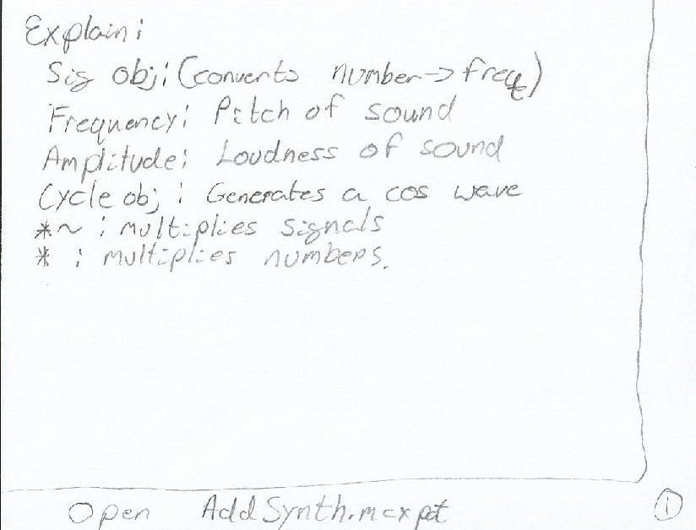
Outline: Additive Synthesis Video
Explain signal
  Convert numbers to audio signals
Explain frequency
  The number of cycles per a unit of time
Explain amplitude
  The height of the sound wave
Explain cycle
  Generate periodic wave.
...

Slide 5
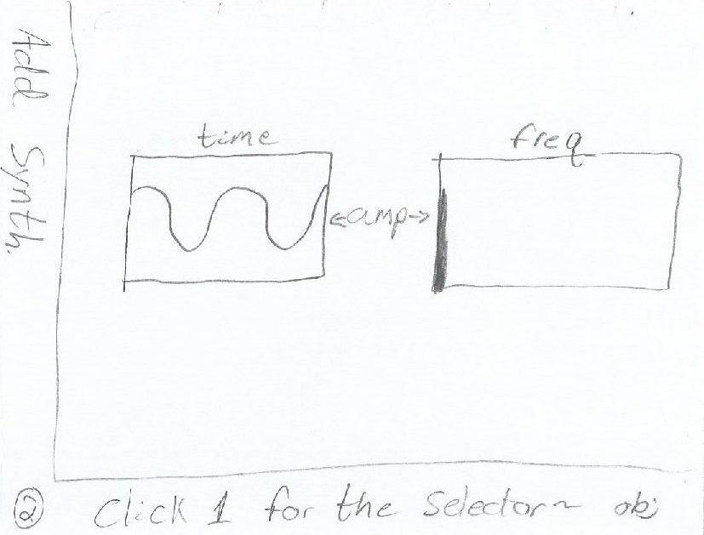
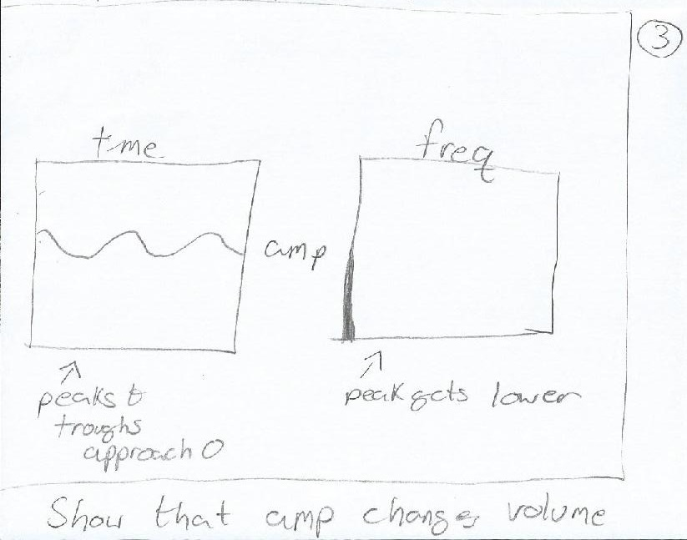
Outline Continued
6. Using a dac, show an ‘A’ at 440hz using intbox -> sig -> cycle | 7. Show that changes in amplitude change ‘volume’

Slide 6
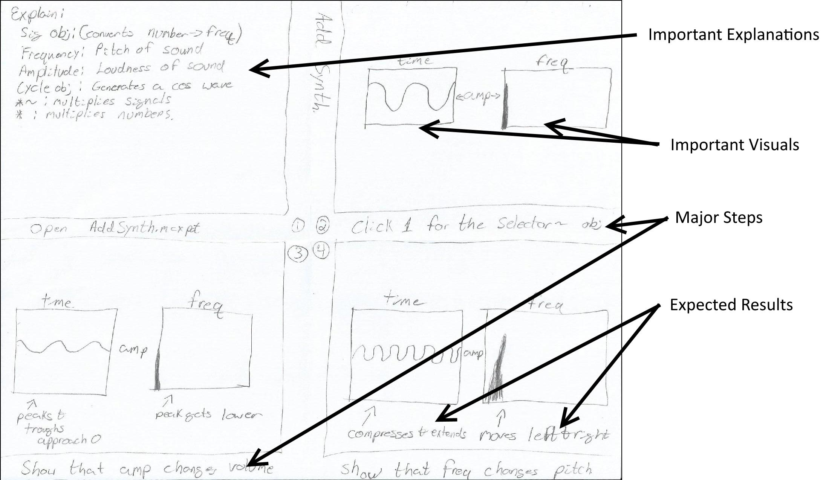
Design: Video
Storyboards were made as a rough outline of the visual scenes displayed in the video. They also cemented the order of the scenes. The image to the left displays one of the six storyboards created for the Max Basics tutorial.

Slide 7
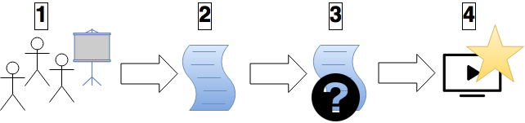
Testing Process
Show the videos to several testers with varying experience with Max
Fill out rating chart and write comments
Analyze feedback to determine the success of our videos
Identify improvements that could be made

Slide 8
Problems and Lessons
Lessons learned from trial and error during production of first video
Using general, rather than detailed, script outlines
Narrator must speak slowly
Using the internal microphone on the iMac
Adding pauses in audio to make editing more efficient

Slide 9
Sample from Additive Synthesis Video
https://youtu.be/fms4jU_tlN0
Notes:
https://youtu.be/fms4jU_tlN0

Slide 10
