Slide 1
Prince Edward 4-H InnoVAtive Leadership Academy
Jennifer Bowen
Extension Agent, 4-H
Then: Prince Edward County
Now: Mecklenburg County

Slide 2

The Idea
It all started with Dr. Martha Walker…

Slide 3
Merging and Adapting
InnoVAtive Leadership: Launching Tomorrow’s Leaders (for teens)
+
InnoVAtive Leadership: Building Community Connections (for community leaders, includes local/state govt. component)
=
4-H InnoVAtive Leadership Academy

Slide 4
The Format
Date | Time | Location | Agenda
January 26 | 5:30 – 7:30 p.m. | Prince Edward Extension Office | Classroom Session 1: Intro to Leadership and Community Issues
February 9 | 7:00 p.m. | Prince Edward County Courthouse | Board of Supervisors Meeting
February 16 | Tba | Richmond, VA | 4-H Day at the Capitol
February 29 | 5:30 – 7:30 p.m. | Prince Edward Extension Office | Classroom Session 2: Effective Communication
March 9 | Tba | Prince Edward County School Board Office | School Board Meeting
March 22 | 5:30 – 7:30 p.m. | Prince Edward Extension Office | Classroom Session 3: Community Profile and Planning
March 30 (Optional Event) | Tba | R. R. Moton Museum | Teen Leadership and Communication Conference
April 4 | 5:30 – 7:30 p.m. | Prince Edward Extension Office | Classroom Session 4: Teamwork
April 12 | 5:30 – 7:30 p.m. | Prince Edward Extension Office | Classroom Session 5: Group Issue Presentation Prep
April 21 | 5:30 p.m. | Prince Edward Extension Office | Group Presentations and Graduation
Notes:
4 Classroom sessions
BOS Meeting
SB Meeting
Participation in the Teen Leadership and Communication Conference over Spring Break
1 work session
Graduation/Presentations

Slide 5
The Audience
High School Students
Application Process
  3 most important qualities of a leader
  Most important issue facing youth in our community today

Slide 6

The Carrot
FREE
Dinner and a polo provided
Looks GREAT on a college app!

Slide 7
The Group
Nine high school students
  1 home-schooled
  3 Fuqua students (1 exchange from Ghana)
  5 PECHS students
  6 “usuals”
  3 new to 4-H

Slide 8
Classroom 1: Leadership
Positive/Negative Qualities of a Leader
Leadership Trait Questionnaire
Number 1 quality you see in yourself
Number 1 quality others see in you
Leadership Styles

Slide 9
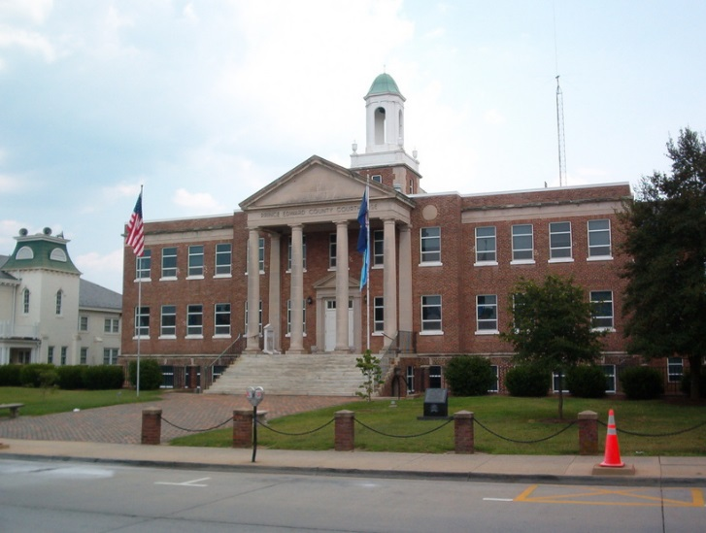
BOS Meeting
Leadership Traits/Styles Observed
Community Issues Discussed
Questions from the group –
Role of the County Administrator
Parliamentary Procedure

Slide 10
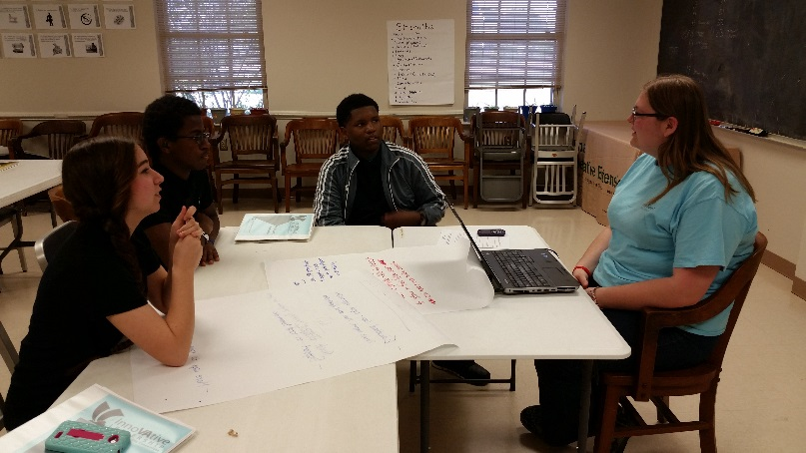
Classroom 2: Communication
“Capture” card game – no talking, each team has a different set of rules, players rotate
Communication = 5% words, 30% tone, 65% non-verbal
Effective/Ineffective Communication Strategies

Slide 11

School Board Meeting
Leadership Styles
Community Issues
Examples of Effective/Ineffective Communication
  Discussion – Student liaison to the School Board
  Observation – “Everything seems to be about money.”

Slide 12
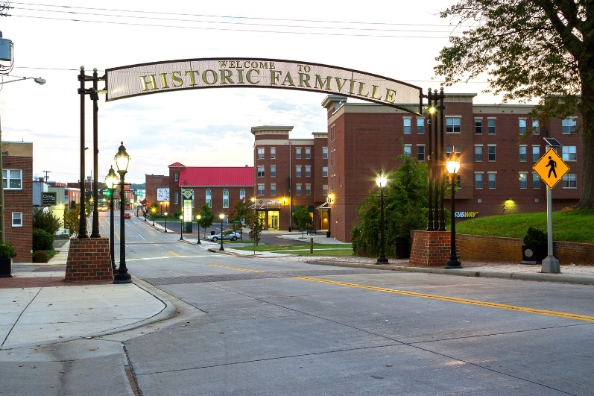
Classroom 3 – Our Community
Review of Community Profile (sent in advance)
Beginning of SWOT Analysis
Homework: Interview 3 people in the community about issues facing youth

Slide 13
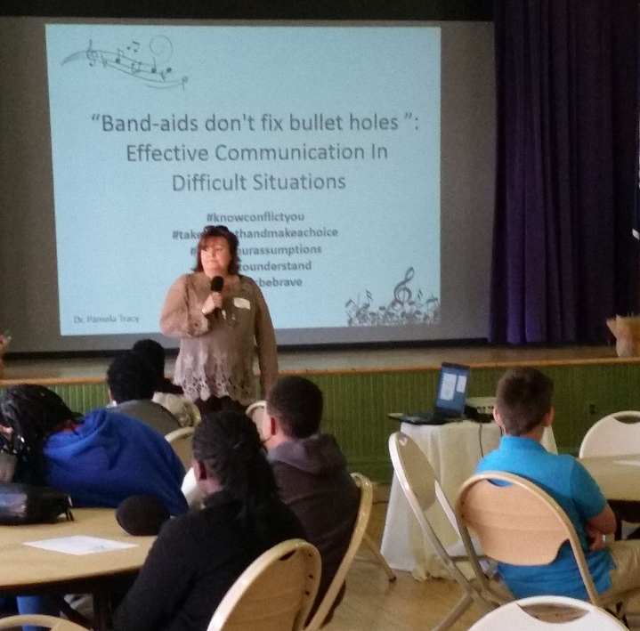
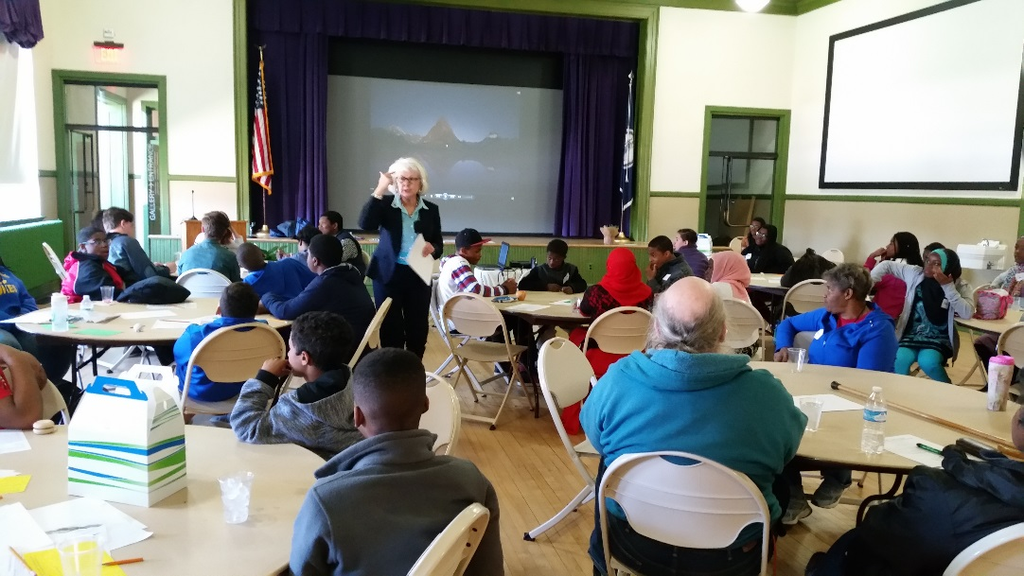
Teen Leadership & Communication Seminar
One-day program over Spring Break held at the Moton Museum in conjunction with Cumberland 4-H
Keynote Speakers – Dr. Pam Tracey, Longwood University and Dr. Martha Walker

Slide 14
Classroom 4: Introduction of the Team Problem

Slide 15
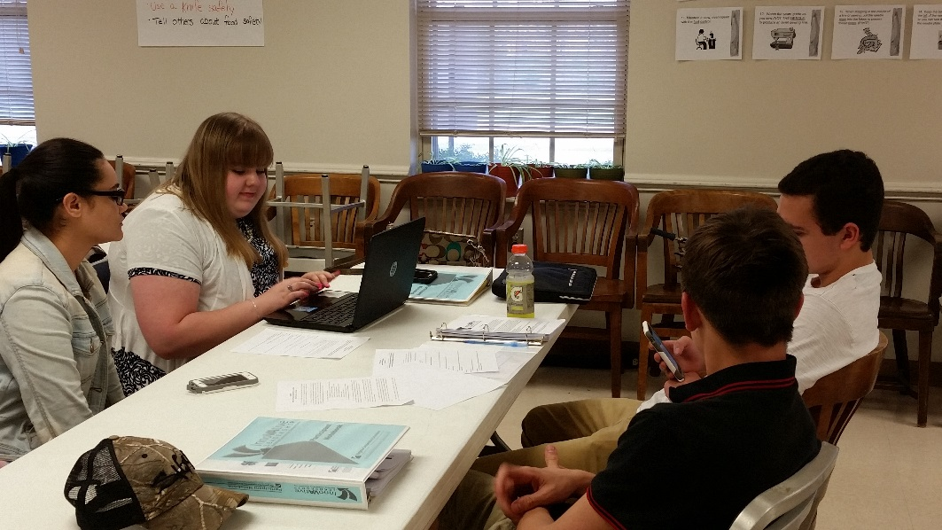
Work Session
Putting it all together
Options and Ownership – group decided that they could accomplish more in smaller groups and broke themselves into 2 teams

Slide 16
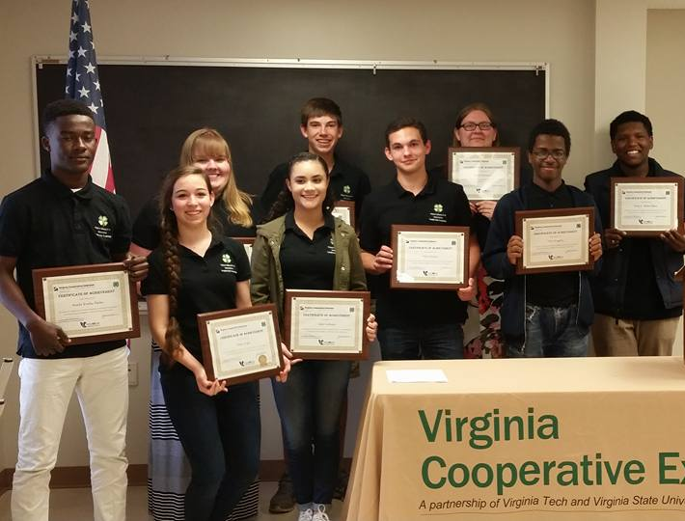
Graduation
Welcome and Overview
Public Presentations –
Invitations to parents, staff, ELC, and local government
Awards

Slide 17
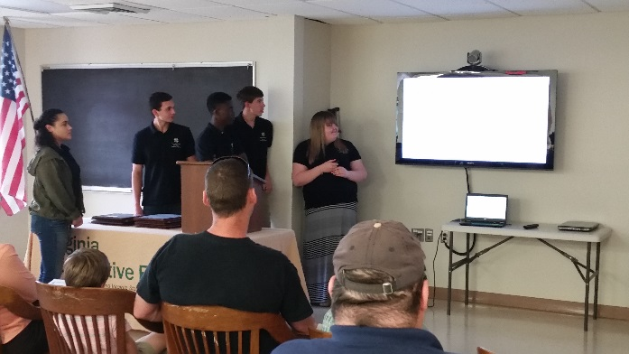
Group A
Issues:
Economic depression in Prince Edward County compared to demographics from the state of Virginia and the United States as a whole
Lack of motivation for education
Lack of incentive for county residents to work in the county
Strategies:
Increase the minimum wage
Tax cuts for small businesses
Increase career/economic education for teens

Slide 18
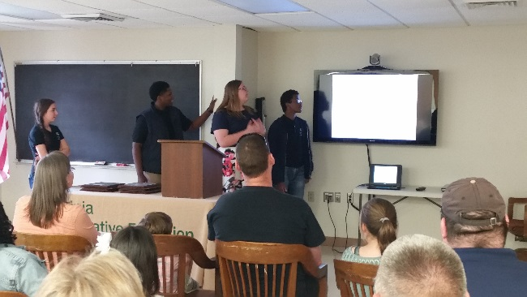
Group B
Issues:
Lack of job training for teens
Farmville/Prince Edward viewed as economically depressed
Lack of larger businesses to increase tax base
Strategies:
Seek funding from business partners for job training programs
Improve community image with additional local festivals and events
Get youth involved in local government

Slide 19
Evaluation
Eight out of nine participants (89%) stated that they better understood their personal leadership strengths and areas where they wanted to improve.
78% gained a better understanding of the elements of communication: words, tone, and non-verbal.
89% better understood the use of statistical data to help identify trends and potential issues facing the community.
Six participants indicated that they improved their teamwork skills and their ability to work together to prioritize issues and develop vision and mission statements.
One participant wrote, “I believe the most valuable component was seeing local government at work and analyzing the process.”
78% feeling better equipped to lead the teams and organizations in which they are a member.

Slide 20
The Future
Continuation of program using graduates as “mentors”
Expansion to At-Risk population
Hurdle = Funding for “the carrot”

