Slide 1


5-10-2019
Louisiana French
Joe Chu
Will Duong
Abhi Oddula
Rahul Ramakrishna
Saharsh Shrivastava
CS 4624 - Multimedia, Hypertext, and Information Access
Instructor: Dr. Fox
Virginia Tech, Blacksburg VA 24061

Slide 2
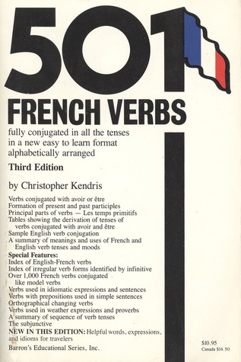

Outline
Project Recap
Final Project Design
Deliverable
Future Plans
Lessons Learned

Slide 3
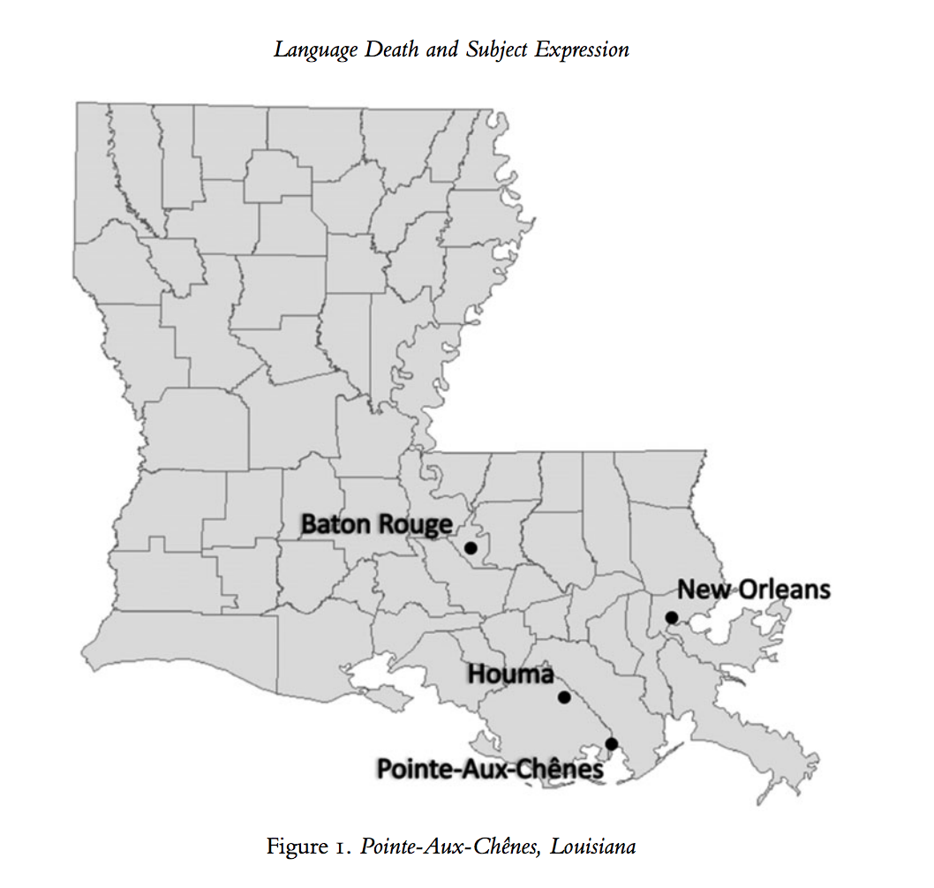
Project Recap
Who are our clients?
Louisiana French Project
Deliverable

Slide 4
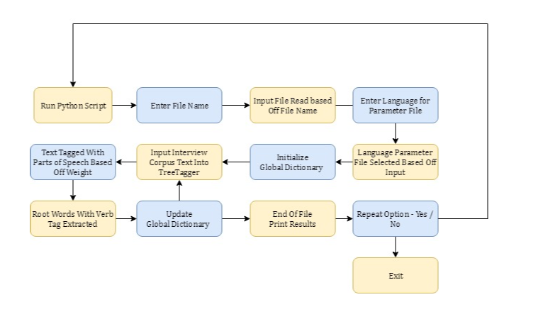
Final Project Design
Notes:
So last time we showed you how the tree tagger worked and what the results are

Slide 5
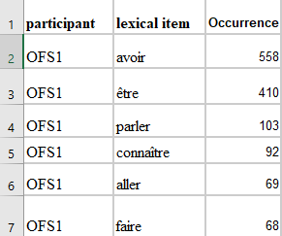
Deliverable
Cleaned Text Files
Results
Verb Frequency in Excel Sheet
User Manual
Notes:
Nom = noun

Slide 6


Future Plans
Annotated Texts with Perl file
Sort Frequencies of Valid Words
Manually Annotate Parts-of-speech tags and Lemmas
New Lexicon File
Notes:
Nom = noun

Slide 7

Lessons Learned
Ask for Help!
Goals Change
Time Constraints

Slide 8
Acknowledgements
Clients
Dr. Katie Carmichael - Department of English
Dr. Aarnes Gudmestad - Department of Modern and Classical Languages and Literatures
Professors
Dr. Helmut Schmid - Center for Information and Language Processing
Dr. Edward Fox - Department of Computer Science

Slide 9

Questions?

