Slide 1
sharkPulseApps
Mia Hagood, Anhtuan Vuong Tran, Patrick Warner
CS4624: Multimedia, Hypertext, and Information Access
Dr. Edward Fox
Virginia Tech, Blacksburg VA 24061
May 5, 2024

Slide 2
Outline
01
02
03
04
05
06
REQUIREMENTS
FRONT END
PROBLEM
& CLIENTS
BACK END
TESTING & CHALLENGES
LESSONS & FUTURE WORK

Slide 3

Problem
Data deficient shark populations
Difficulty classifying and determining conservation status
Notes:
Web scraping and

Slide 4

Clients
Jeremy Jenrette – Graduate Research Assistant
Francesco Ferretti – Assistant Professor
Department of Fish and Wildlife Conservation

Slide 5
Requirements
ORIGINAL | STRETCH
General UI Improvements Data-Informed Visuals PHP Scripting Elementor Module Cron Job Automation | Global Affiliate Map Taxonomical Accuracy Table Improve Picture Submission

Slide 6
Work Completed
FRONT END
BACK END
COURSEWORK
Dynamic Visualizations
Global Affiliates Map
UI Improvements
PHP Scripting
RShiny Leaflet Map
DB Changes
Presentations
Final Report Draft
VTechWorks Submission

Slide 7
FRONT END

Slide 8
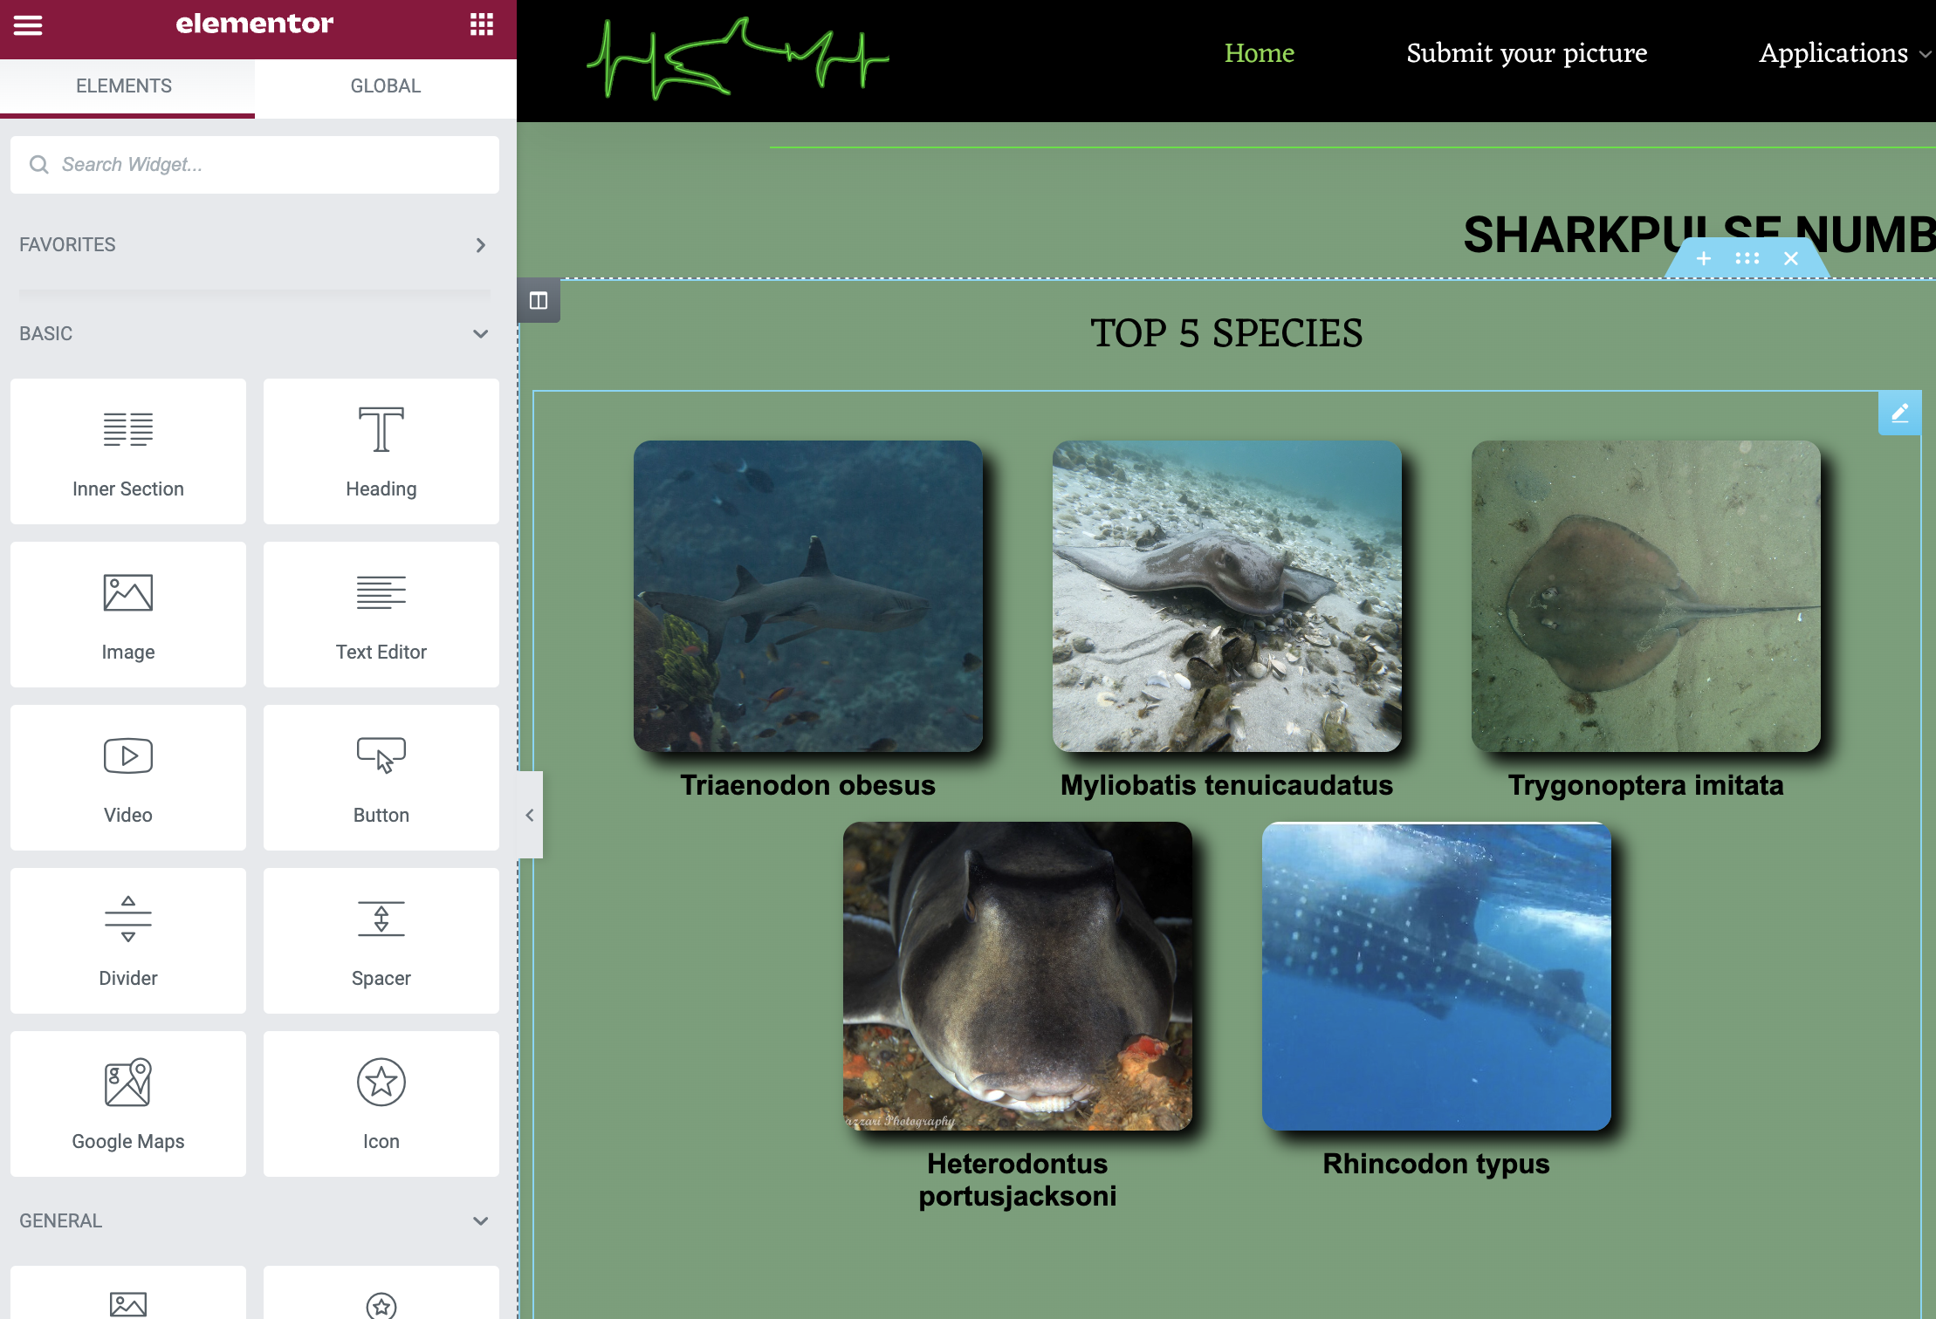
Elementor

Slide 9
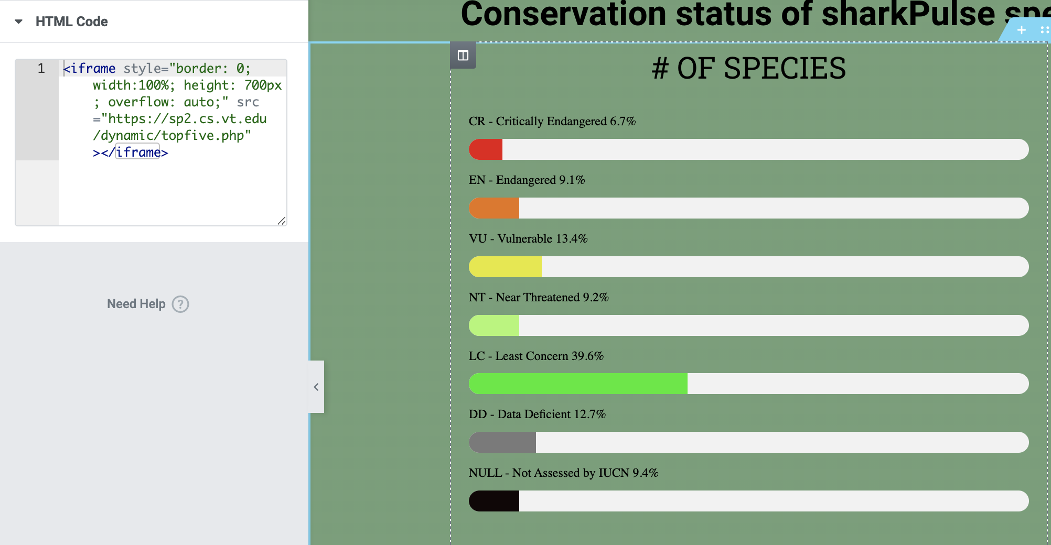
Injecting PHP

Slide 10
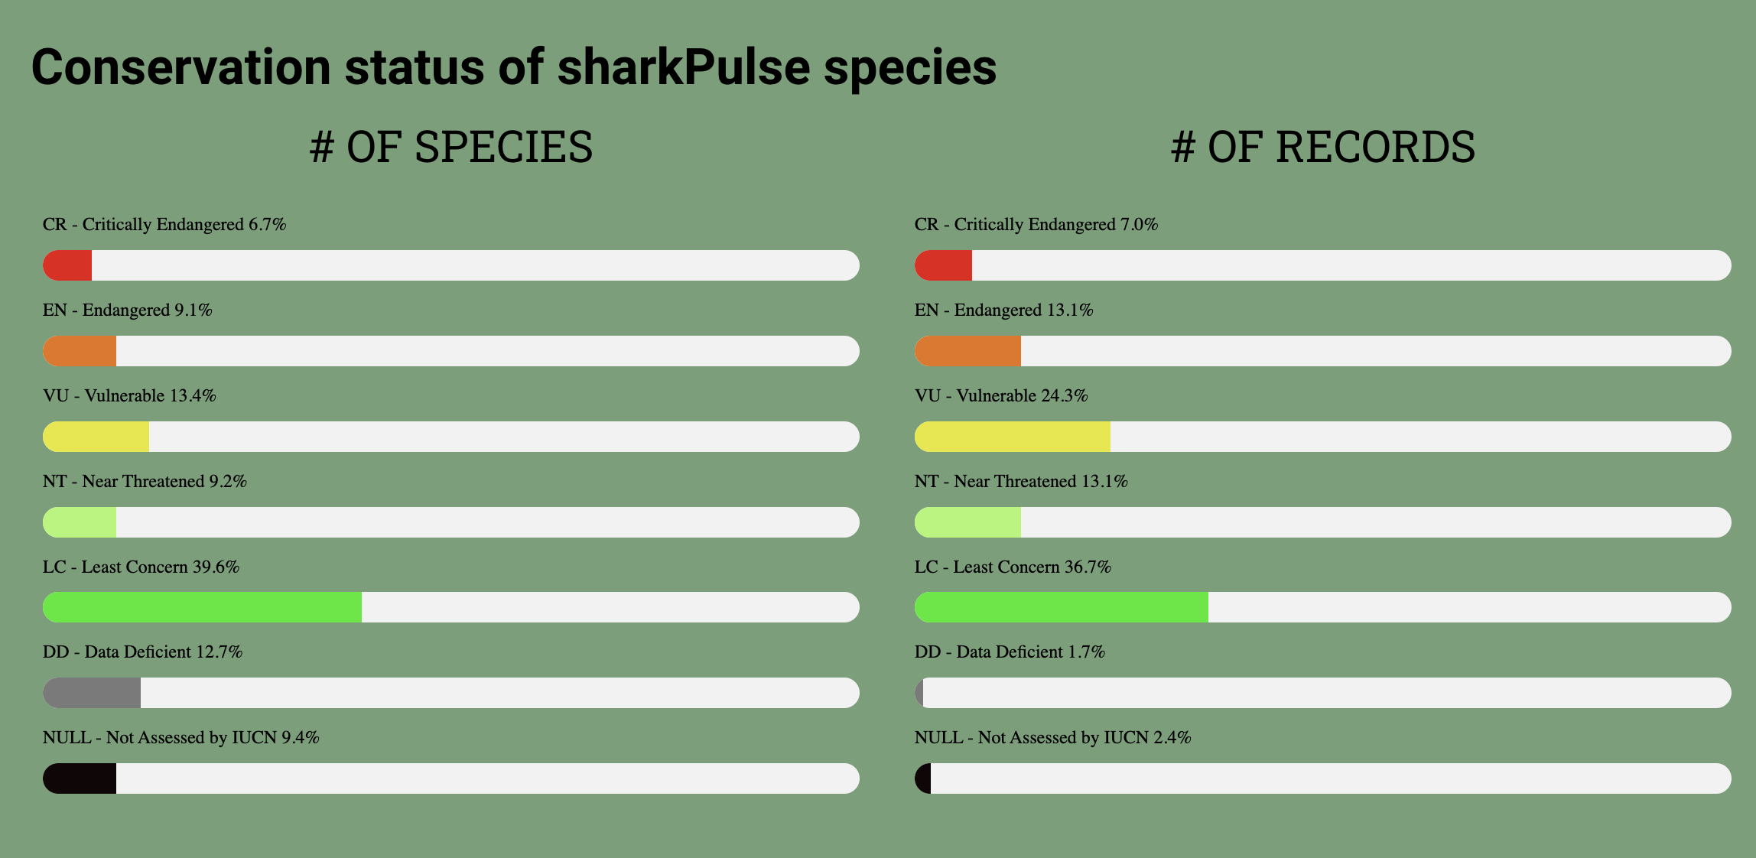
Species Coverage

Slide 11
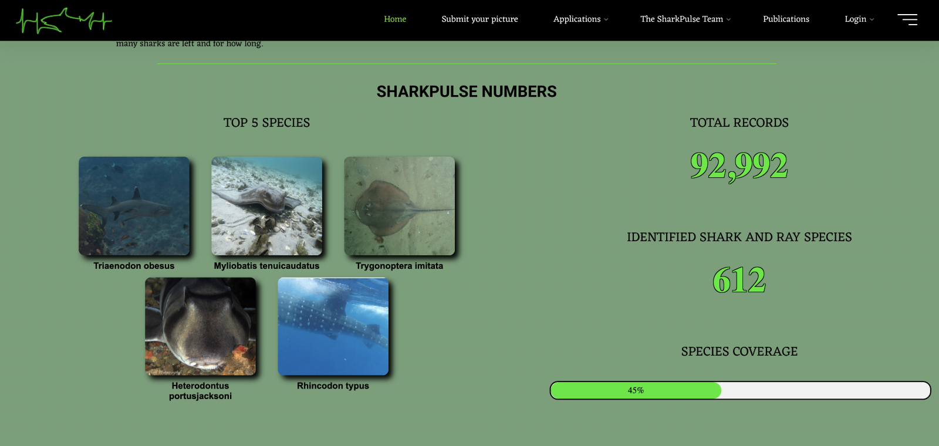
sharkPulse Numbers

Slide 12
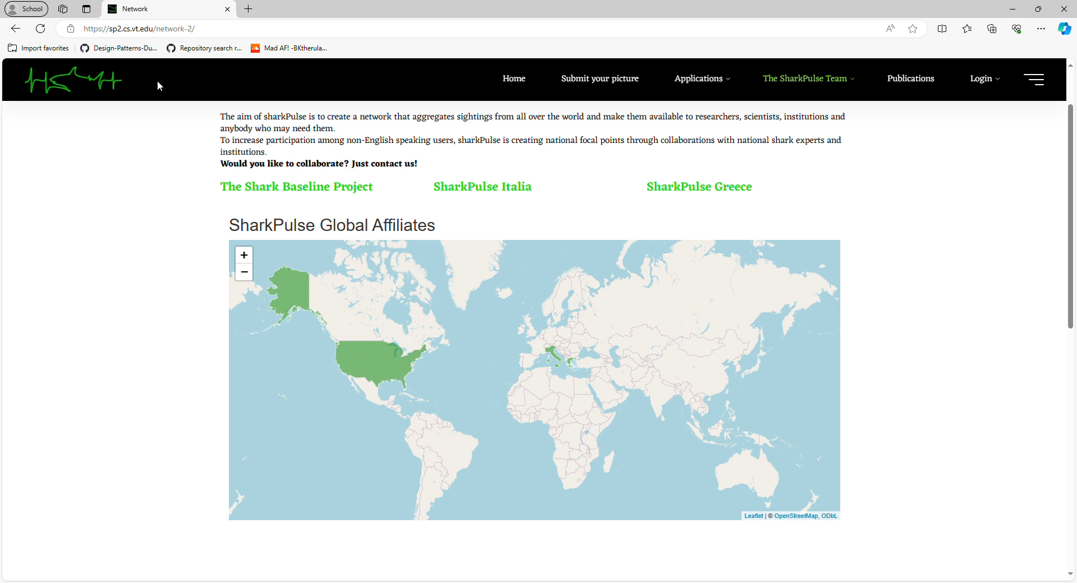
Global Affiliate Map
Notes:
This was apart of our stretch goals and the Group made this page that shows the partners of shark pulse across the globe
The map is a leaflet map for the UI and the interactions between the front end and back end are facilitated via an R-Shiny app.

Slide 13
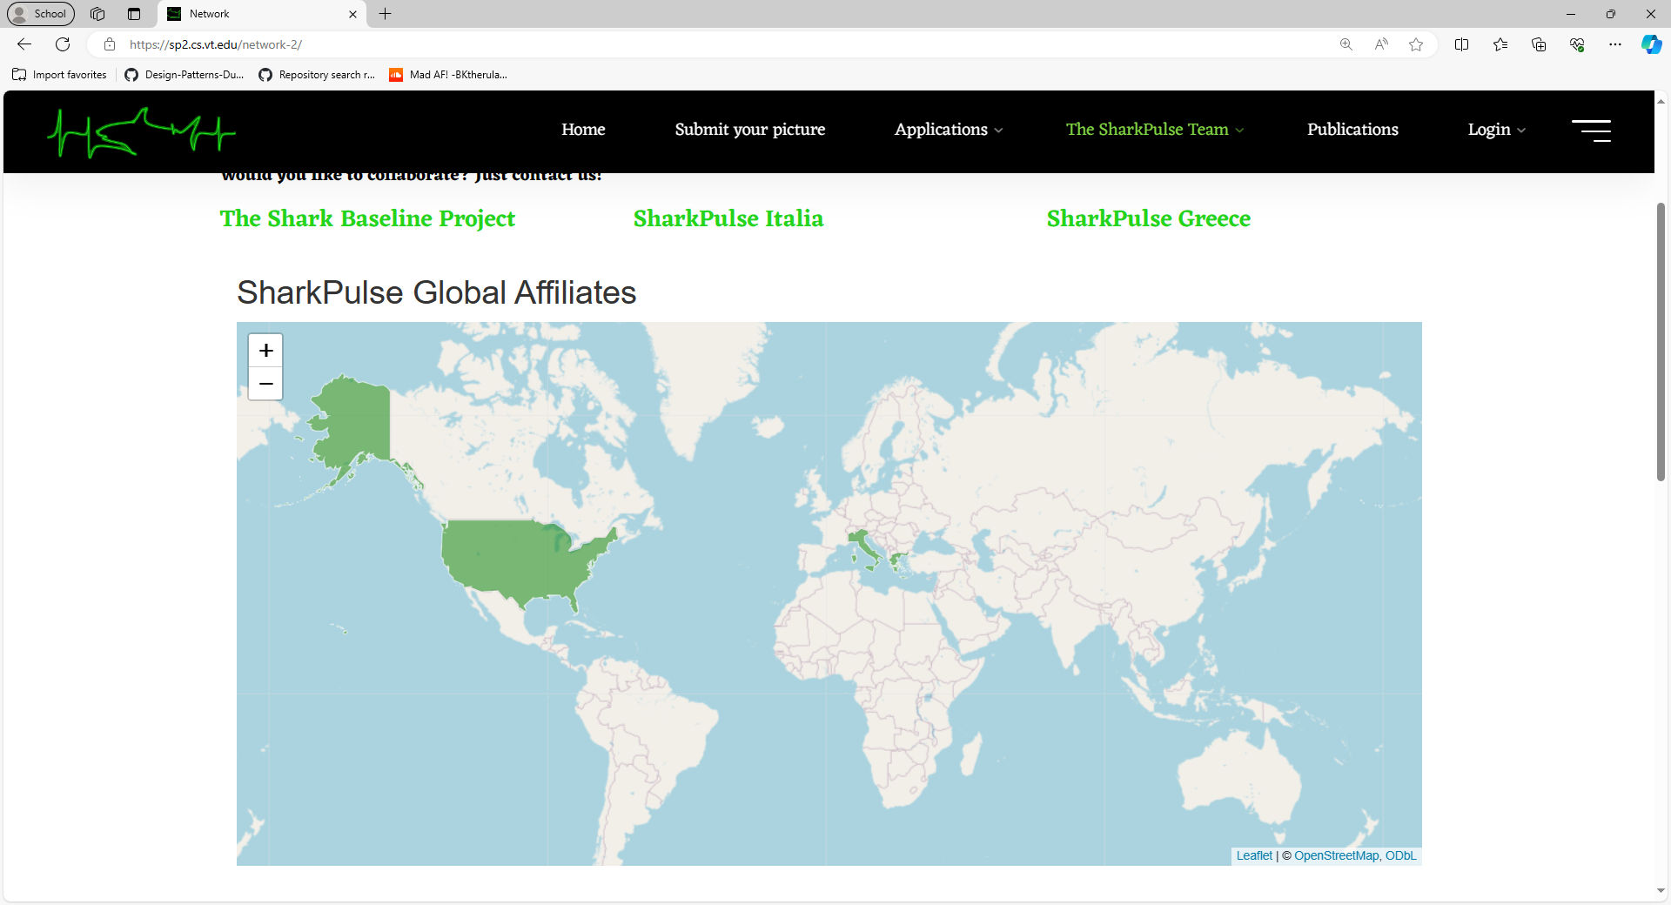
Global Affiliate Map
Notes:
This was apart of our stretch goals and the Group made this page that shows the partners of shark pulse across the globe
The map is a leaflet map for the UI and the interactions between the front end and back end are facilitated via an R-Shiny app.

Slide 14
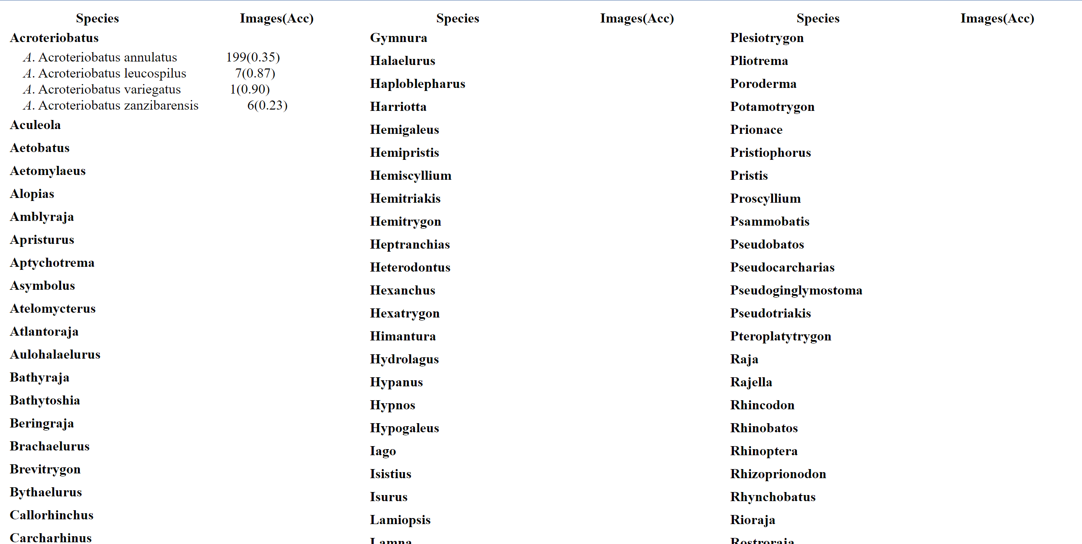
Taxonomical Accuracy Table

Slide 15
BACK END

Slide 16
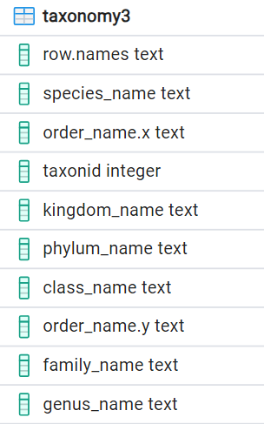
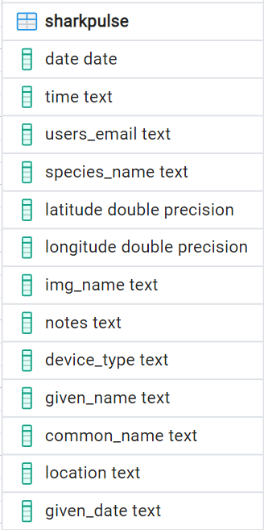
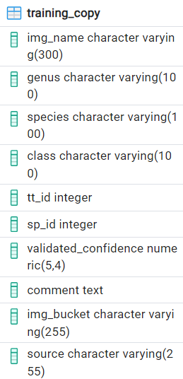
Database

Slide 17
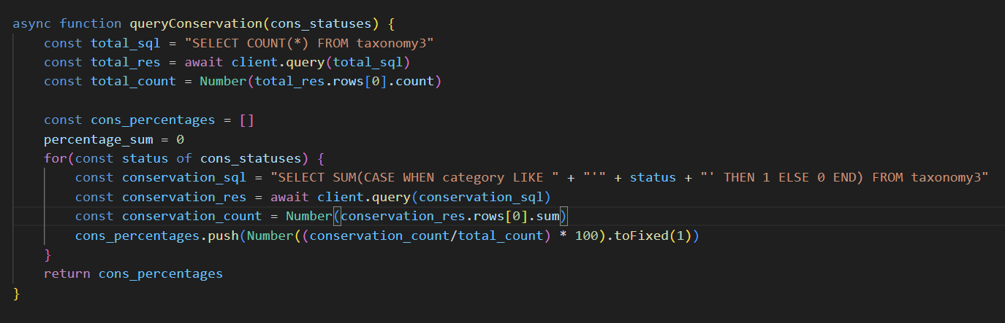
Querying the Database

Slide 18
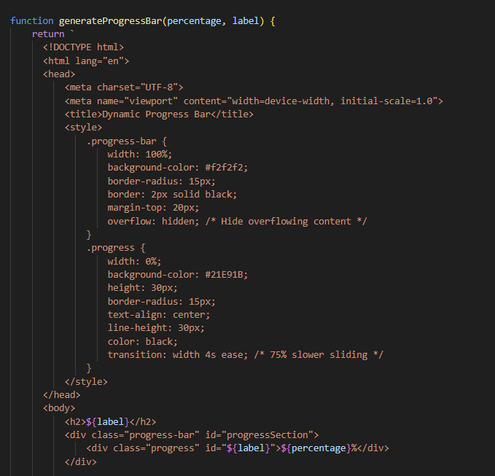
Visuals Scripting

Slide 19
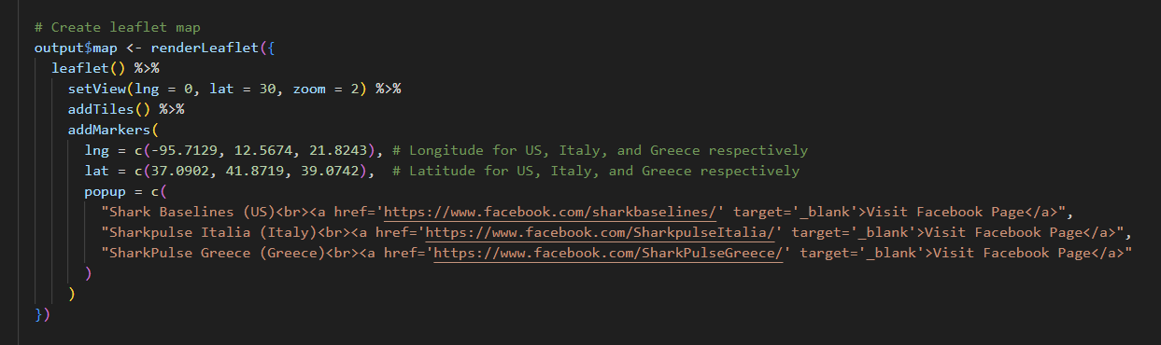
RShiny App

Slide 20
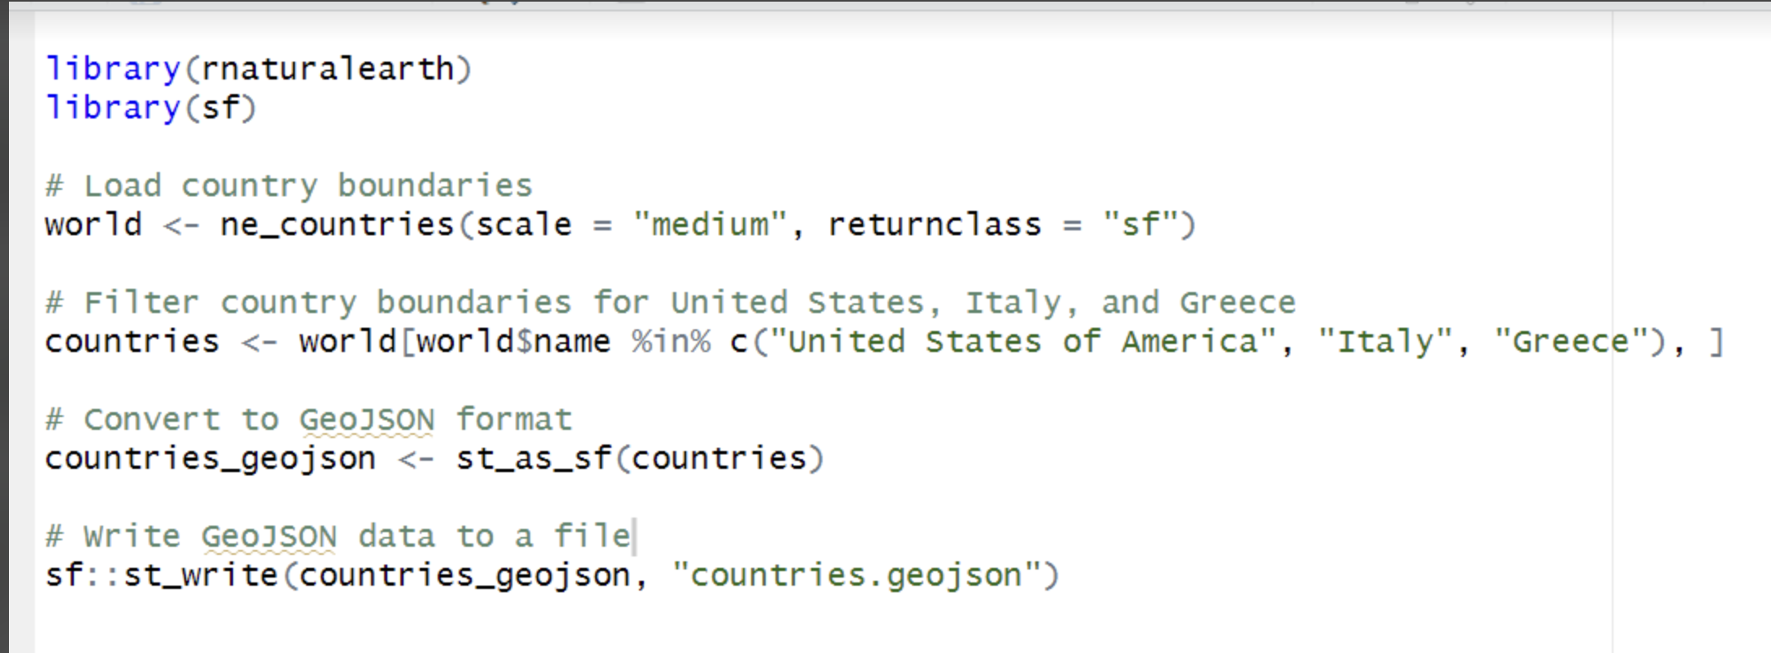
GeoJSON Data

Slide 21
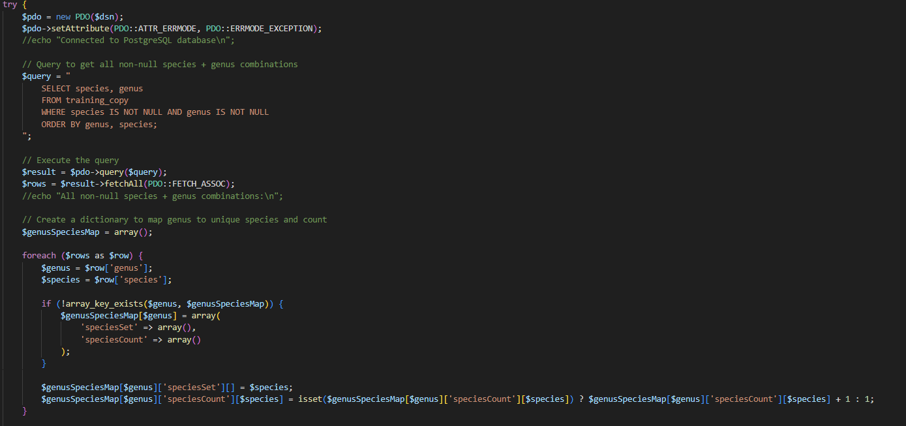
Taxonomical Accuracy Query

Slide 22
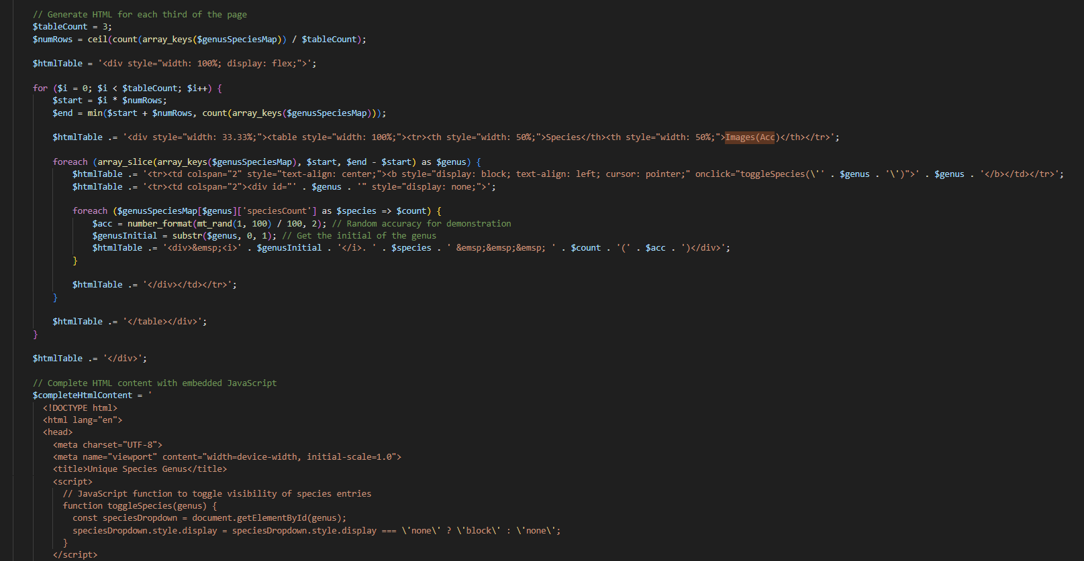
Taxonomical Accuracy Visual

Slide 23
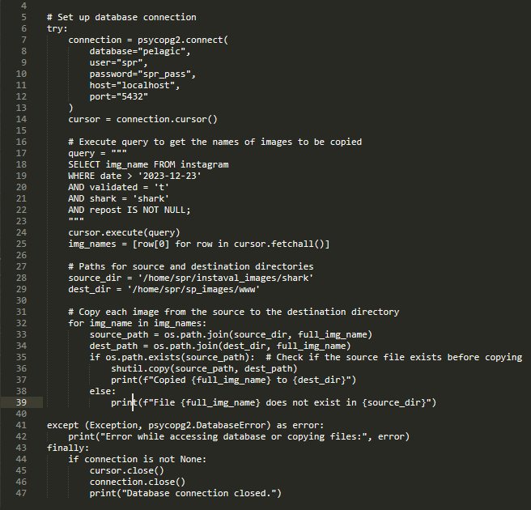
File Extension Script
Adds appropriate extensions to images
Filters out duplicates extension tag
Notes:
Adds appropriate extensions to images that come into the database
Makes sures duplicates extension tags aren’t added to the website

Slide 24
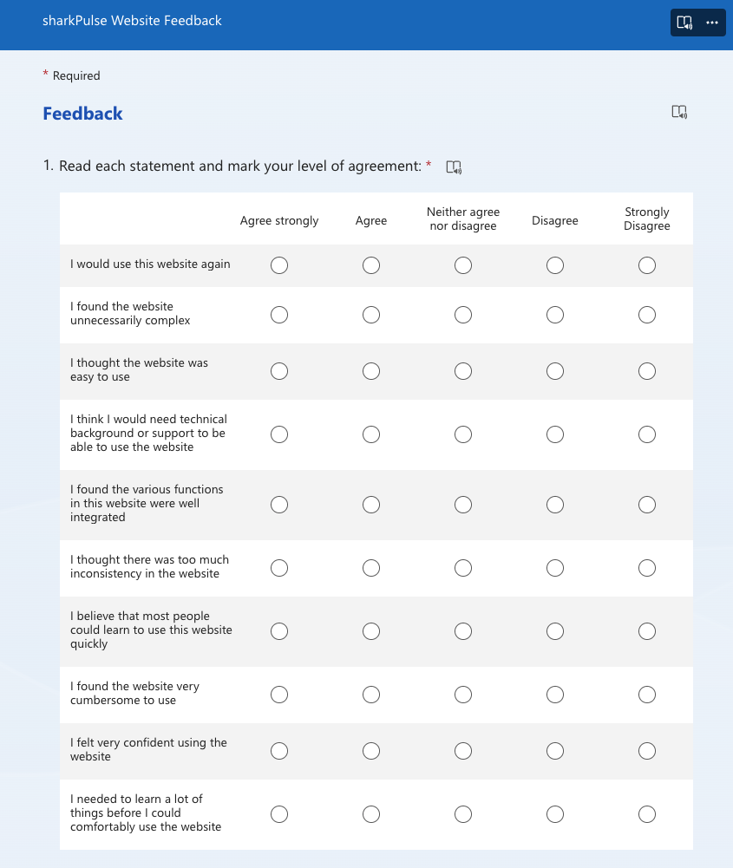
Testing
Local testing
Evaluations from clients
User experience survey
Notes:
As the team developed the scripts, local testing and evaluation of accuracy was conducted by comparing the visualization outputs with the current website’s visualizations and talking to the clients over what they preferred.
We did this saving drafts in the Elementor module in WordPress before publishing any new final visualization to the sharkPulse website
Once we felt like we were done with enough work on the website we created this survey to get feedback from more users of the website
The survey is modeled off the System Usability Scale (SUS), which is a standardized 10-item questionnaire presented in a Likert scale format where participants can indicate how strongly they agree with statements and questions are phrased to alternate between positive and negative statements

Slide 25
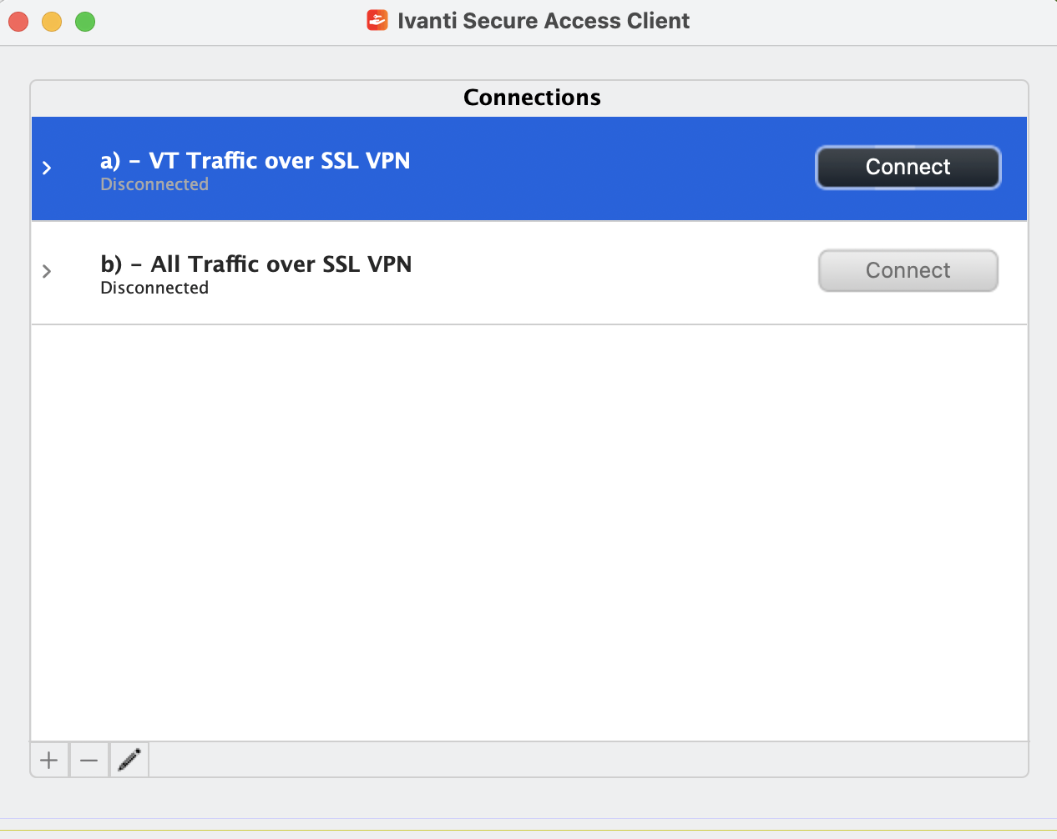
Challenges
VPN issues
RShiny and Elementor
Integrating visuals
Notes:
Establishing a connection to this server also required connection to the Virginia Tech eduroam network, so the team needed to set up VPN access using the VT Pulse Secure App (also known as the Ivanti Secure Access Client).
The team ran into difficulty getting the PHP script to cooperate with the Elementor module and inject the data visualization properly.

Slide 26

Lessons Learned
Learned how to use RShiny and Elementor
Applying agile methodology
Learned lots about sharks!

Slide 27
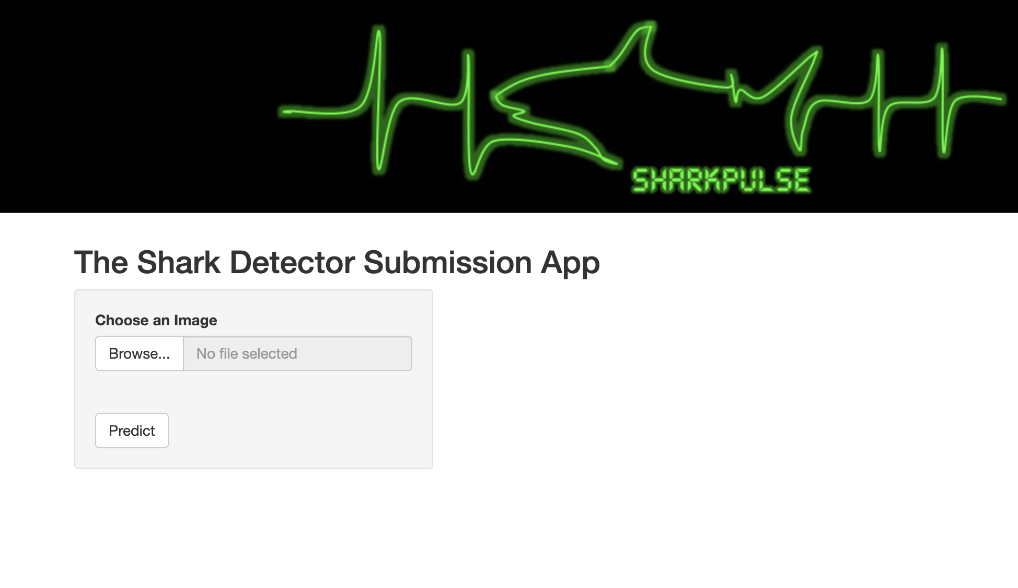
Future Work
Disseminate Feedback Survey
Picture Submission Page
Inject Taxonomy Table
Notes:
Picture submission page – improve loading time, adding features such as cropping as the image comes in
Taxonomy Table into site/ database created not on website

Slide 28
ACKNOWLEDGEMENTS
Professor Francesco Ferretti
Jeremy Jenrette
Professor Dr. Edward Fox
GTA Satvik Chekuri
Fish and Wildlife Conservation

Slide 29
References
Betteridge, K. (2024). What Every UXC Client Should Know about SUS Scores. Bentley University. Retrieved
April 16, 2024, from https://www.bentley.edu/centers/user-experience-center/what-every-client-should-
know-about-sus-scores
sharkPulse. (2024) Retrieved April 23, 2024, from https://sp2.cs.vt.edu/

Slide 30
THANK YOU!
QUESTIONS?

