Slide 1
Trail Study
Kevin Cianfarini, Shane Davies, Marshall Hansen, Andrew Eason
…
CS4624: Multimedia, Hypertext, and Information Access
Instructor: Dr. Edward A. Fox
Virginia Tech, Blacksburg, 24061
4/24/2018

Slide 2
Outline
Project Overview
Testing/Assessment
Deliverables
  App Backend
  App Frontend
  Statistics
Accomplishments
Lessons Learned
Future Ideas
Acknowledgements

Slide 3
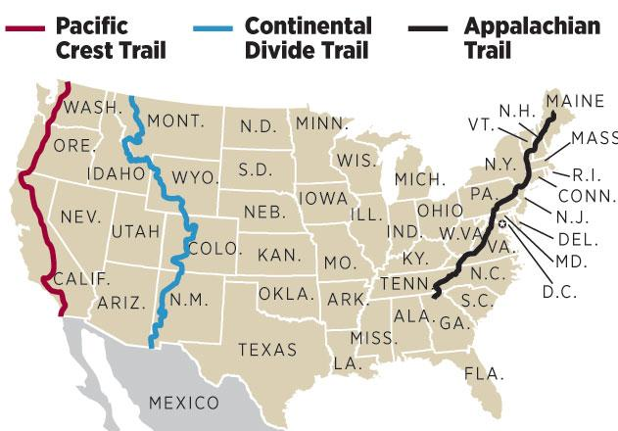
Project Overview
Client: Master’s Student, Abigail Bartolome
  Writing thesis on trail culture/trends
  Focusing mainly on Triple Crown Trails
Impact
  Allows her to search through exponentially more resources
  Saves her time
  Specific searching through tags
Quinn, Molly. media.spokesman.com

Slide 4
Testing/Assessment
Manually tested sources list
  Python script to test website compatibility
Cross referenced frontend output with expected values from database
Frequent updates with client

Slide 5
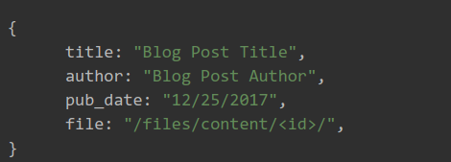
Deliverables: App Backend
Built with Django, Django Rest Framework
  Separate concerns between UI and business logic
Simple REST API for the UI to interact with
Updateable with Django management commands
Management command to export to CSV file

Slide 6
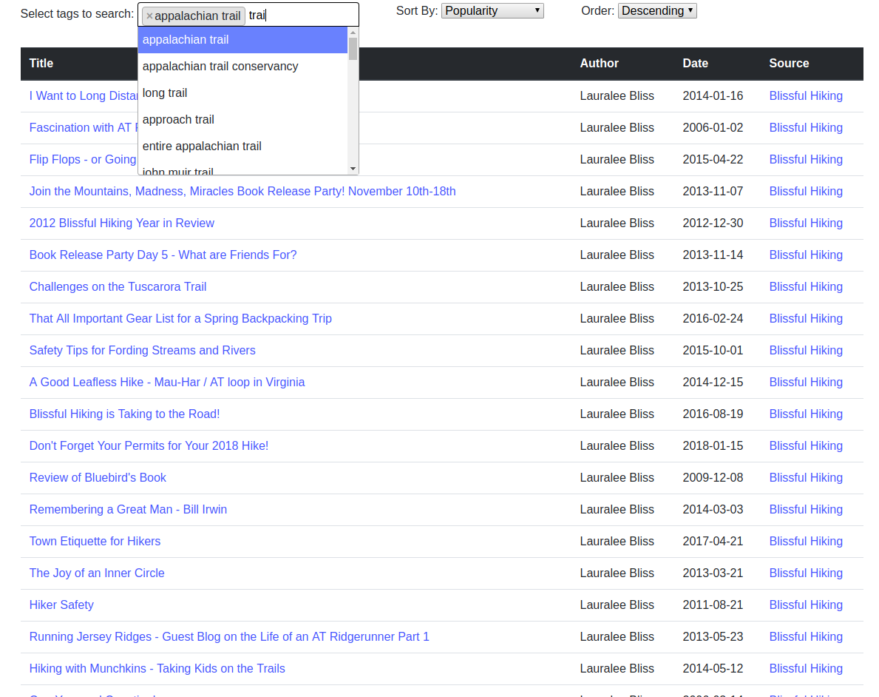
Deliverables: App Frontend
Able to search blog database by generated tags
Table of resulting blogs
  Sortable by different meta-data
  Links to view and source
  Displays date and author
Select2 Dropdown ₅
Bootstrap CSS ₆

Slide 7
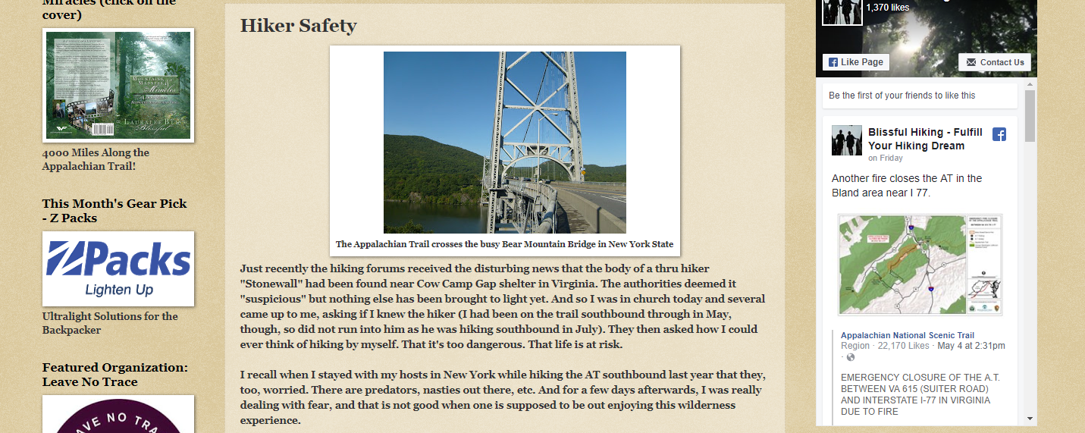
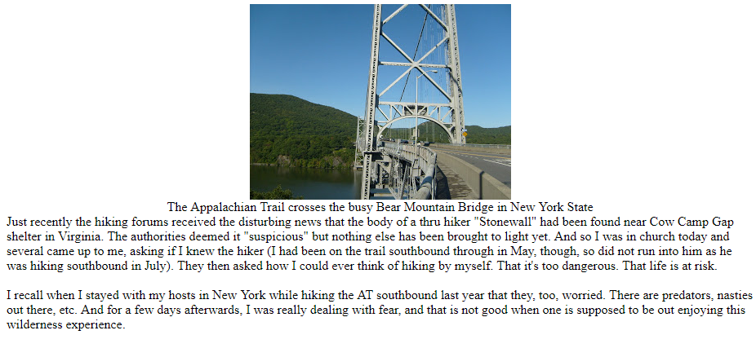
Example Scraped Post
Data saved into database...
title | author | pub_date | source | body
Hiker Safety | Lauralee Bliss | 2011-08-21 | blissfulhiking.blogspot.com/2011/08/hiking-and-safety.html | <html>...</html>
Original Post
Our Scraped Post

Slide 8
Deliverable Statistics
Note: Project is updateable and more data can be added by user
Type | Total
Blog Sources | 31
Blog Posts | 3423
Searchable Tags | 87618

Slide 9
Accomplishments
Scrape content out of most WordPress and Blogspot blogs
Keyword extraction from documents
  Fast
Simple and usable UI
Efficient and developer friendly API

Slide 10
Lessons Learned
Automated Tag generation is hard
  Different algorithms to implement:
    RAKE
    TFIDF
    Machine learning
  Similar tag output: how to coalesce similar tags?
    This is a natural language processing problem
Web Crawling is messy:
  Javascript that actively prohibits web crawlers
  Challenge to find commonalities between sites
Optimizing database interactions is key to a smooth experience

Slide 11
Future Ideas
Implement scraping for sources rather than just blog scraping
Expand scope of scrape-able blogs and forums
Create a more robust front end
Find a better tagging algorithm (requires fees)
  Natural language APIs
Statistical analysis of the results

Slide 12
Acknowledgements
Client: Abigail Bartolome
Thanks go to NSF for support by grant IIS-1619028
References
Image: http://media.spokesman.com/photos/2012/05/11/hikers-triple-crown_t620.jpg?161ad8e426d1312361ed5892fdc121cdf327258d
Django Framework: https://www.djangoproject.com/start/overview/
RAKE Algorithm: https://sujitpal.blogspot.com/2013/03/implementing-rake-algorithm-with-nltk.html
TF-IDF: https://en.wikipedia.org/wiki/Tf%E2%80%93idf
Select2 dropdown: https://select2.org/dropdown
Bootstrap CSS: https://getbootstrap.com/docs/3.3/css/

