Slide 1
Using Undergraduates to Improve the Library
Monena Hall
Rashad Assir
Virginia Tech Libraries

Slide 2
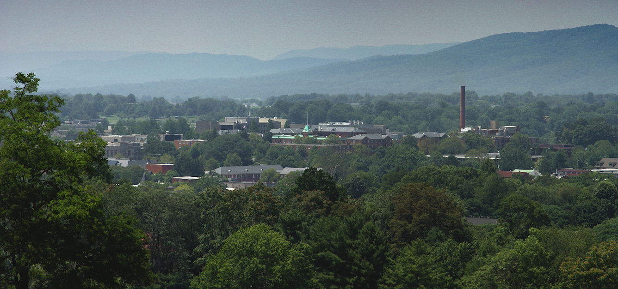
Blacksburg, VA
http://en.wikipedia.org/wiki/File:Blacksburg_VA_Summer_2008.jpg

Slide 3
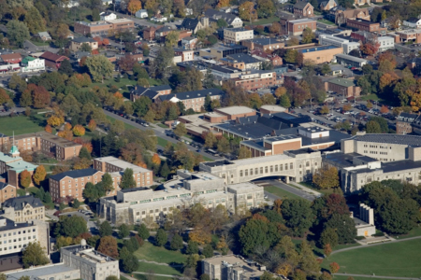
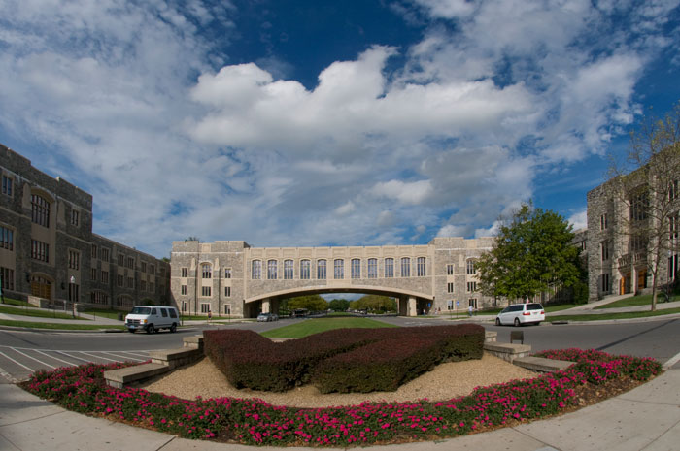
Virginia Tech
http://www.vtnews.vt.edu/photo-galleries/2011/071411-gowallatour/tour-gallery.html
http://www.mba.vt.edu/admissions/interact/on-campus/

Slide 4
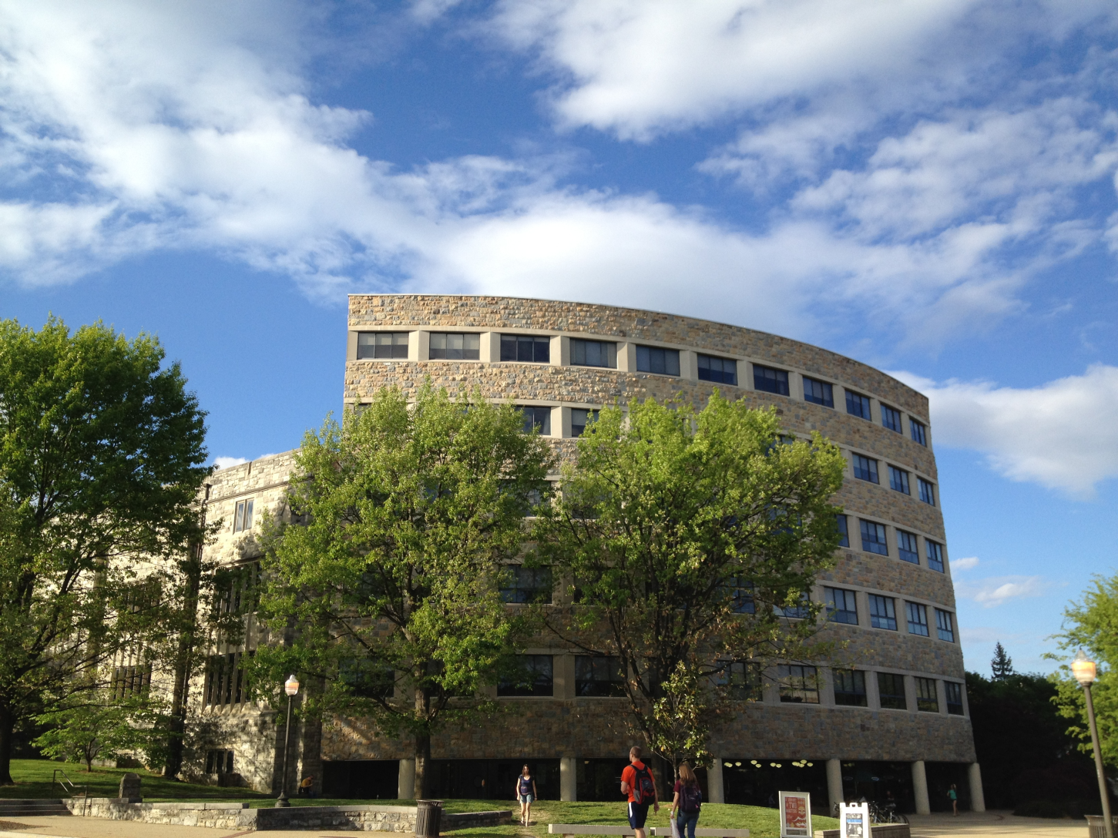
Newman Library
http://upload.wikimedia.org/wikipedia/commons/7/72/Newman_Library_Virginia_Tech.JPG

Slide 5
Peer Roving Assistants(PRA)
Purpose
Point of need service
Space observation
Interviews
**get a better understanding of what students are doing and how we can improve services!
Notes:
Explain the acronym “PRA”

Slide 6
What Does a PRA do?
Offer Assistance around the library
  Printing, scanning, copying
  Finding books
  In library “way finding”
Record Observations
  Quantitative and Qualitative
  Pictures
  Interviews

Slide 7
Why Undergrads?
Familiar faces
Ready supply
Easy to train
Gives them on-the-job experience
They can/will work hours we would rather not

Slide 8
Collection
Observation form includes:
  Group study vs. individual
  Power usage
  Use of furniture
  Use of student resources (whiteboards, public computers, study rooms)
  Additional Observations (i.e. noise level, general atmosphere, what are they doing?)

Slide 9
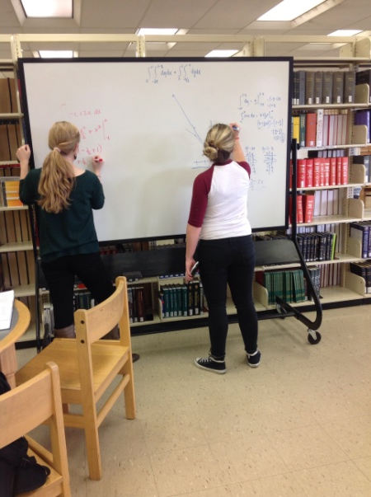
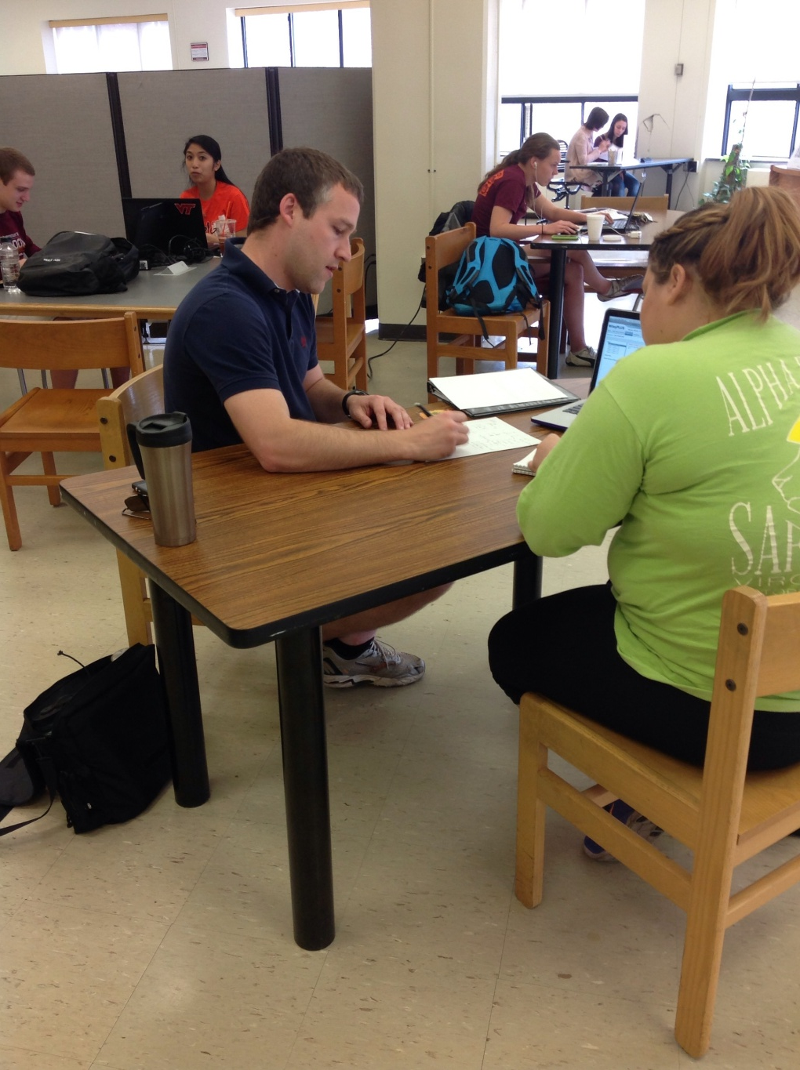
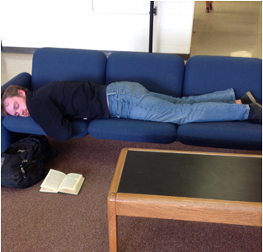

Slide 10
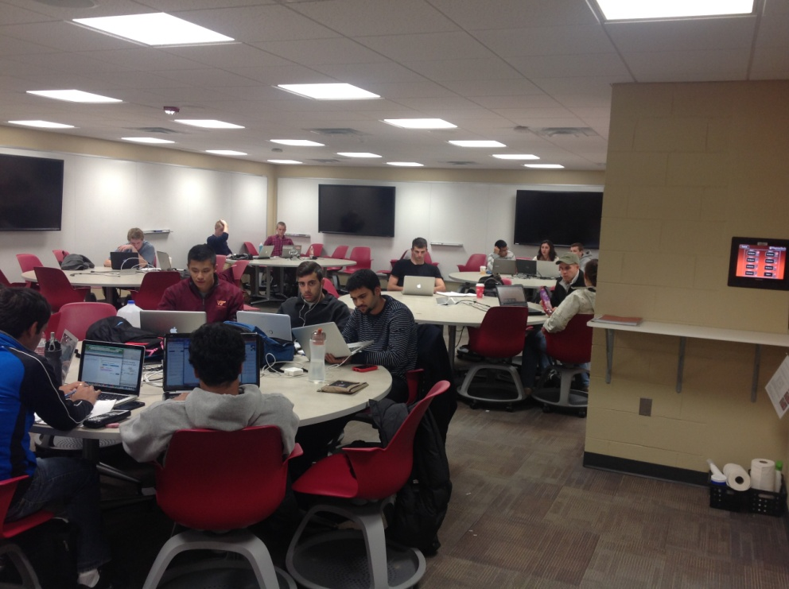
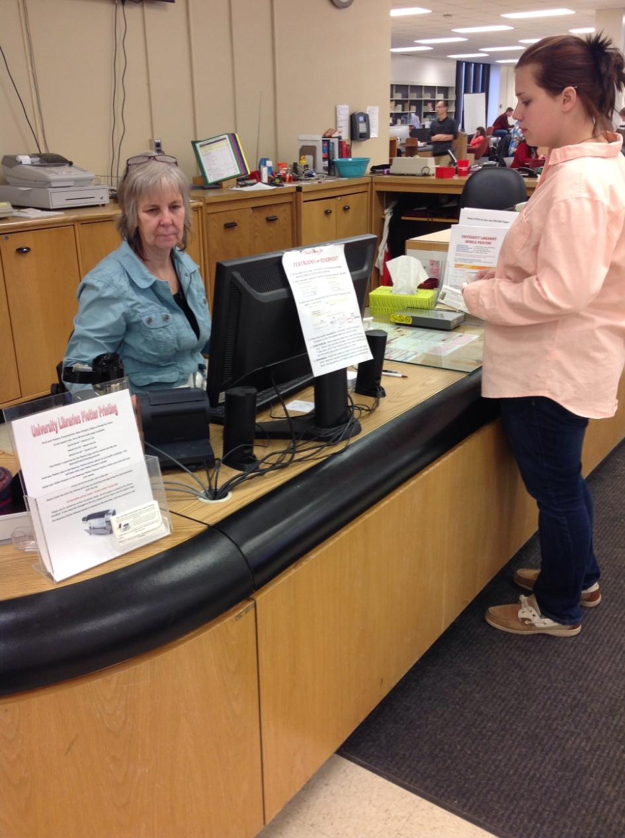
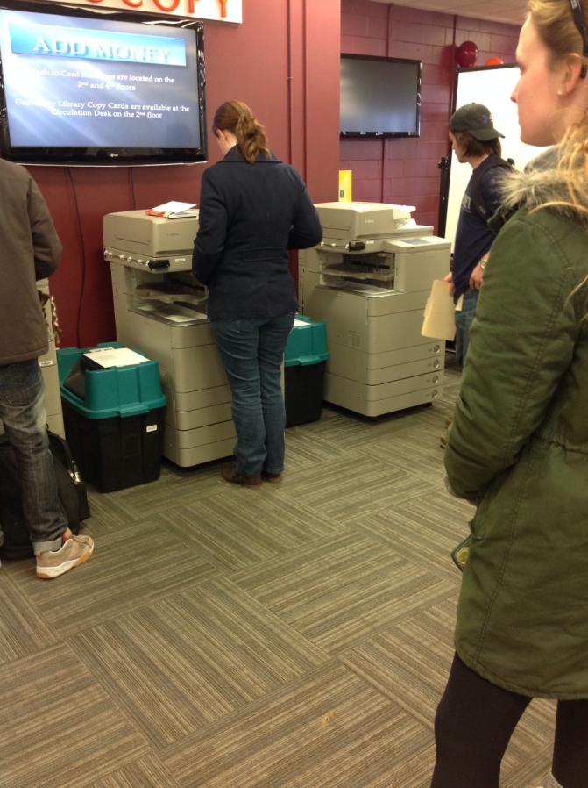

Slide 11
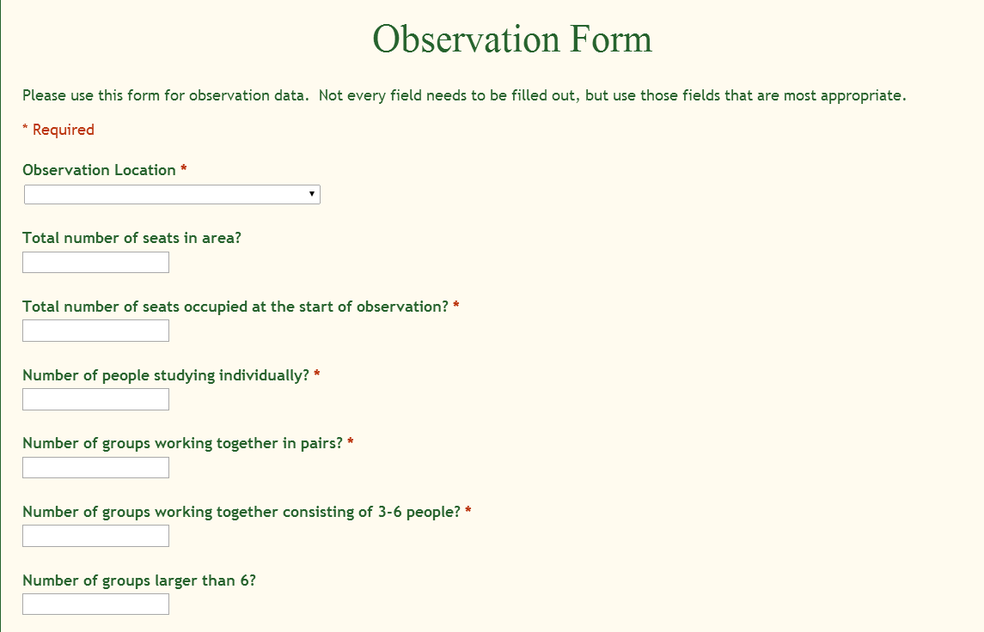

Slide 12
Interview Template
https://docs.google.com/forms/d/1vYPCspT-Uo-ilP5SKx7K5FUQrWS7-2Z7u0A-vUu3A7U/viewform?c=0&w=1

Slide 13
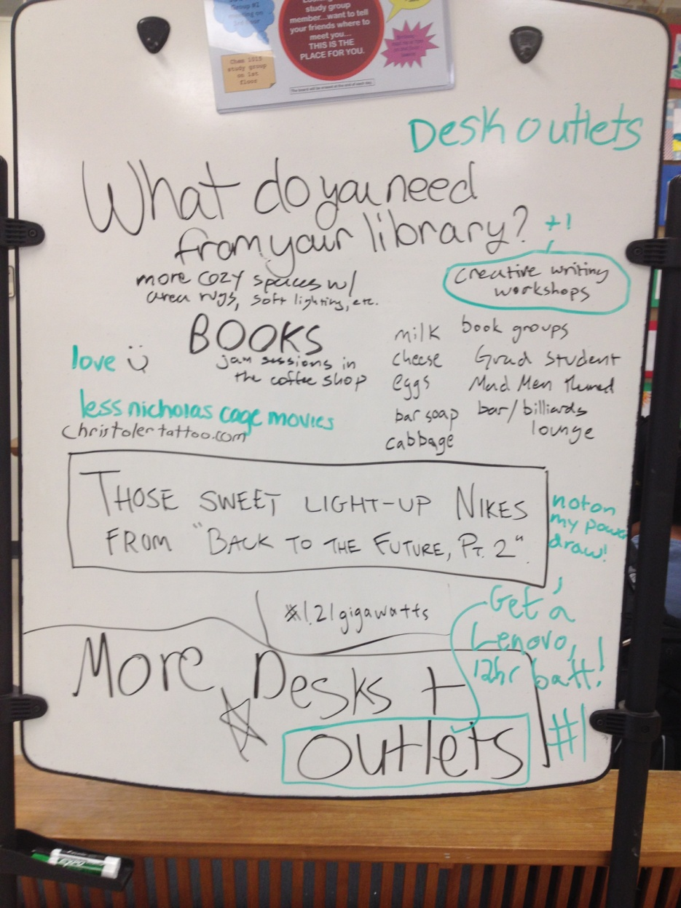
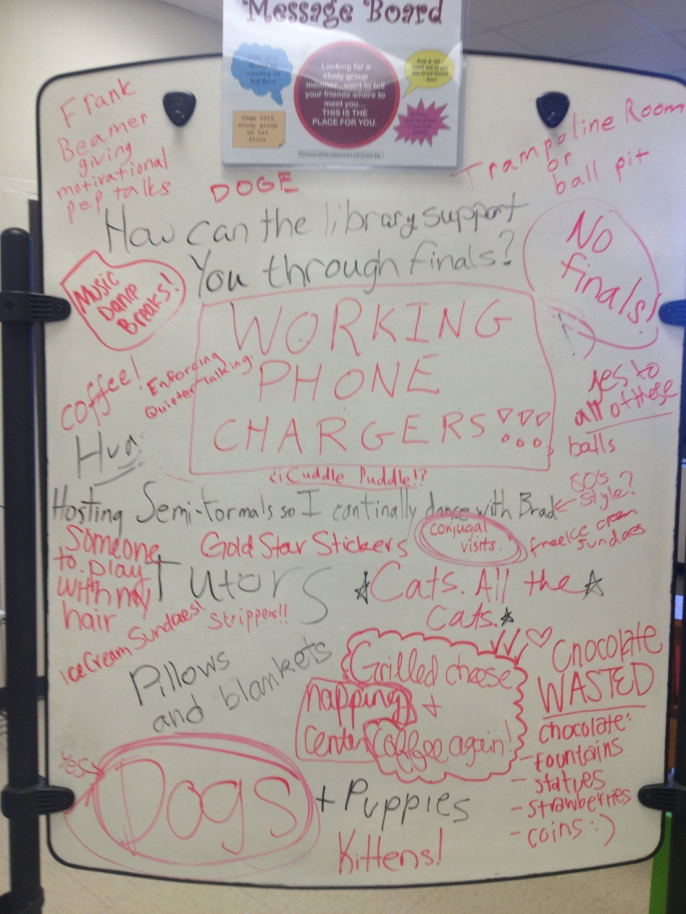
Whiteboard Initiative

Slide 14
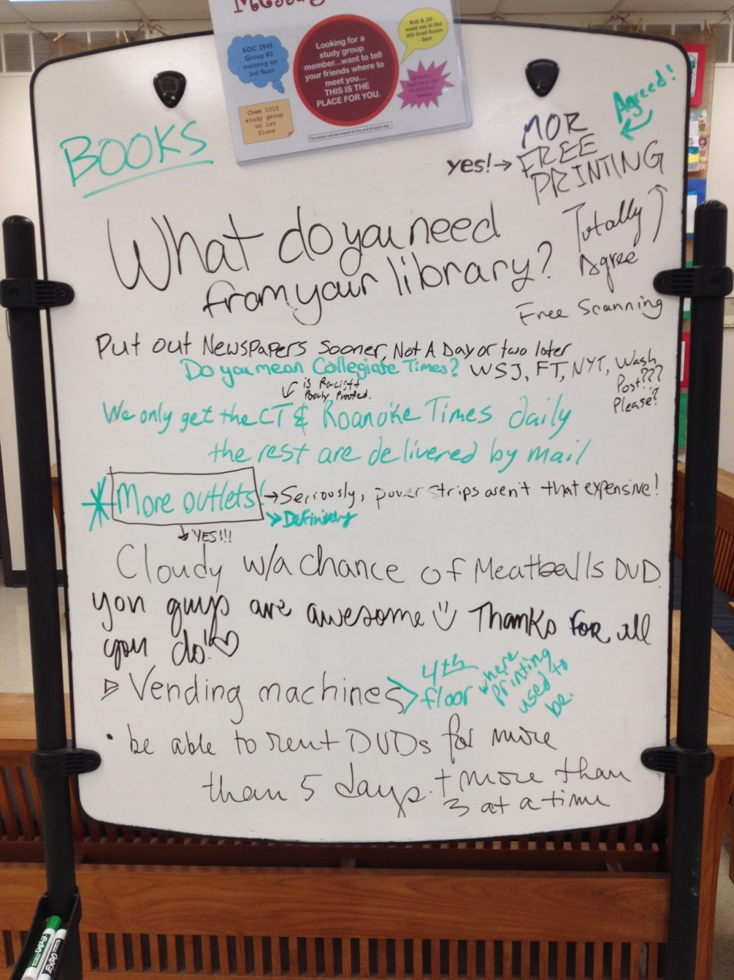
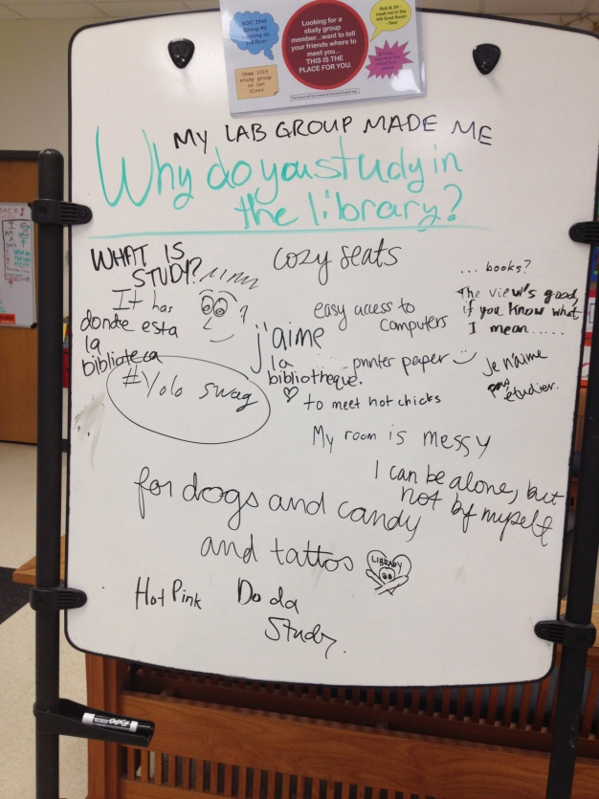
Whiteboard Initiative

Slide 15
Student Interviews
Complaints
Positive
Preferences
Constructive
Notes:
Talk about the effectiveness of having STUDENTS interview students since students are more likely to answer more honestly.

Slide 16
Interview Quotes
Constructive Feedback
“More outlets on the quiet floors”
“More space in general”
“Faster internet during peak usage”
“Better seating”
“Nicer aesthetics like a mural or nicer ceiling material “
“More green spaces in the library”
“Longer weekend hours during exam weeks”
“Better parking”
“More free coffee”
“More outlets”
“More conference rooms”
“More windows and greenery”
“Better furniture on the fourth floor”
Notes:
Talk about diversity of the responses retrieved from students, not just pertaining to academic services but rather overall services offered by newman, as well as feedback about aesthetics, acoustics,

Slide 17
Problems with collection
Division of Space
Ambiguities in the observation form
What do we want to know?
The stacks keep moving! Now what?
Where did all that furniture go?
I have 4 tests and a paper due tomorrow! There’s no way I can work!
Notes:
We moved 75 chairs and their tables from the 2nd floor to an open area of the first floor. That will definitely affect observation data for the rest of the semester. Whoops!! Students are involved in a ridiculous number of things. They are club presidents, screen play writers, tutors for other professors, and students. I try not to be an additional stressor for them, and in turn, they work hard for me. One of them dropped out of school a few weeks into the semester!

Slide 18
Solutions
Regular Meetings/Communication
Library Maps
Cutting down on ambiguous language in the forms
Being flexible – both me and my students

Slide 19
Cutting Out Ambiguities
Instead of answering:
“How many students are currently in the observation area?”
We now answer:
“How many seats are currently occupied in the observation area?”
Notes:
This clears up any ambiguities of who to include in the count. For example, should people walking through the observation area be counted?

Slide 20
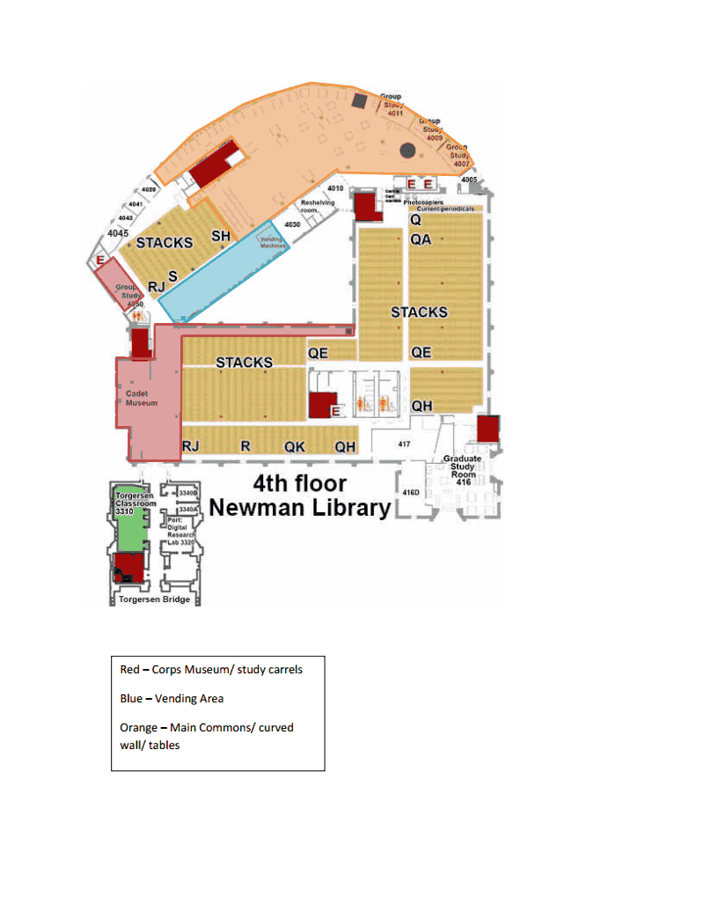
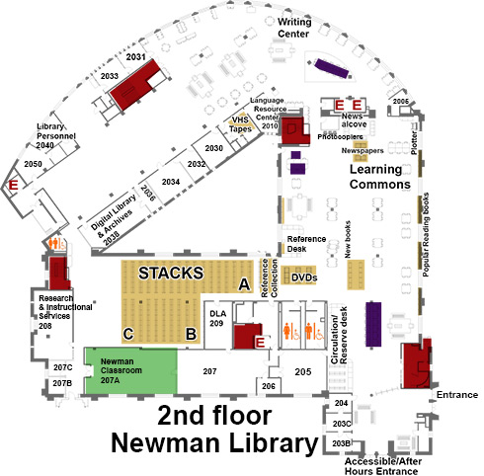
Library Maps
Notes:
Lead into the slides that are about to be displayed, how this is the only way we can display the data because of the division

Slide 21



Storage of Data
Notes:
All recorded data gets dumped into the PRA Google Drive account, including pictures, observations, interviews, etc. Data get shared with Roving team and various other library stakeholders such as Admin, Library Communications Coordinator, graphics coordinators, and webmaster

Slide 22
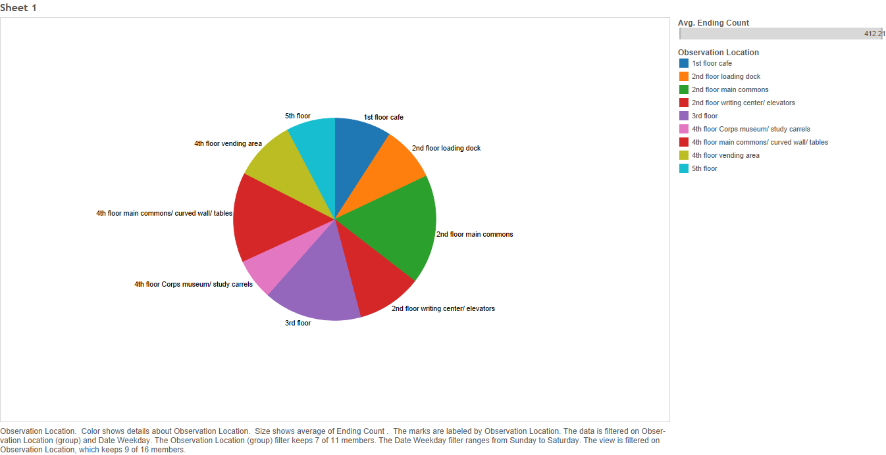
Occupancy Distribution

Slide 23
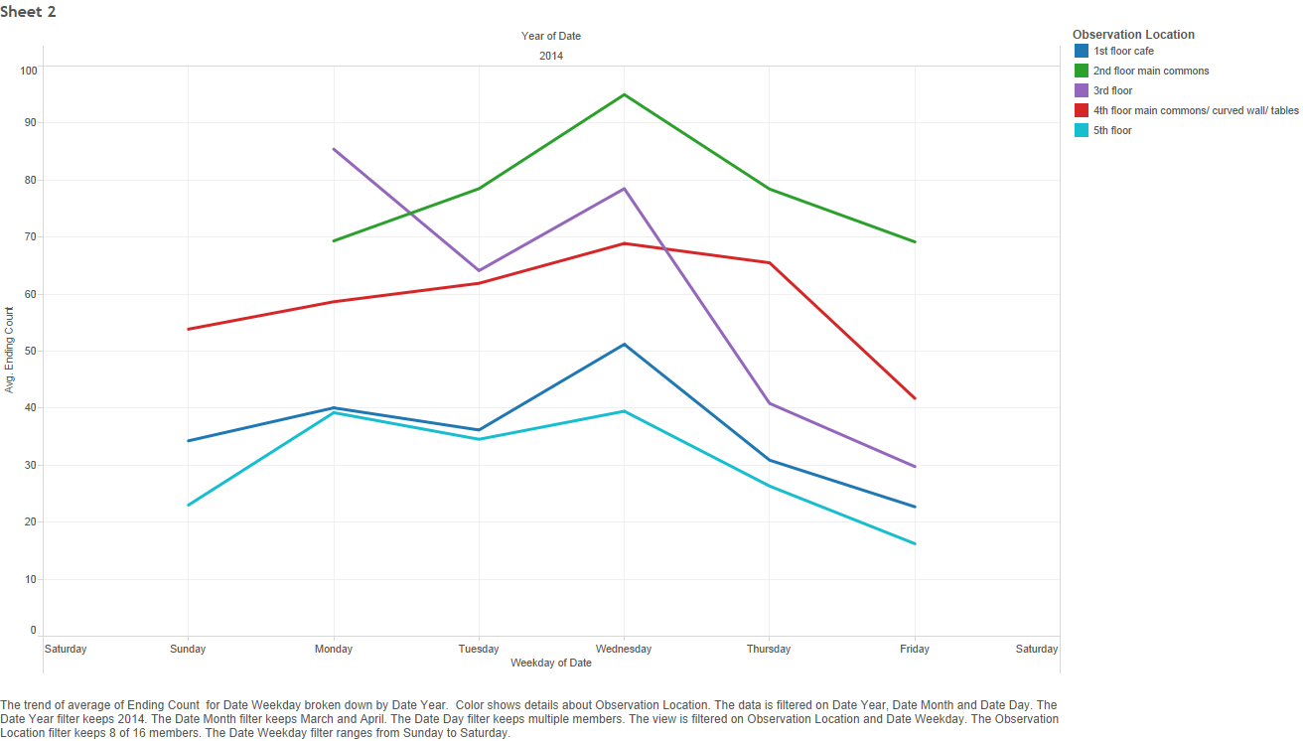
Occupancy vs. Day of Week

Slide 24
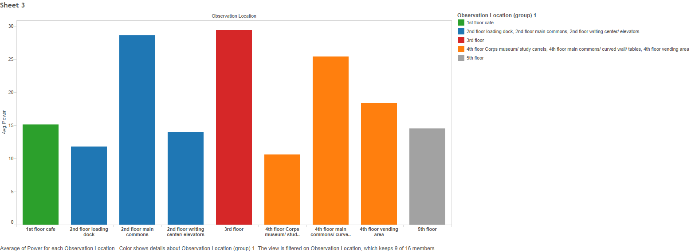
Power Usage

Slide 25
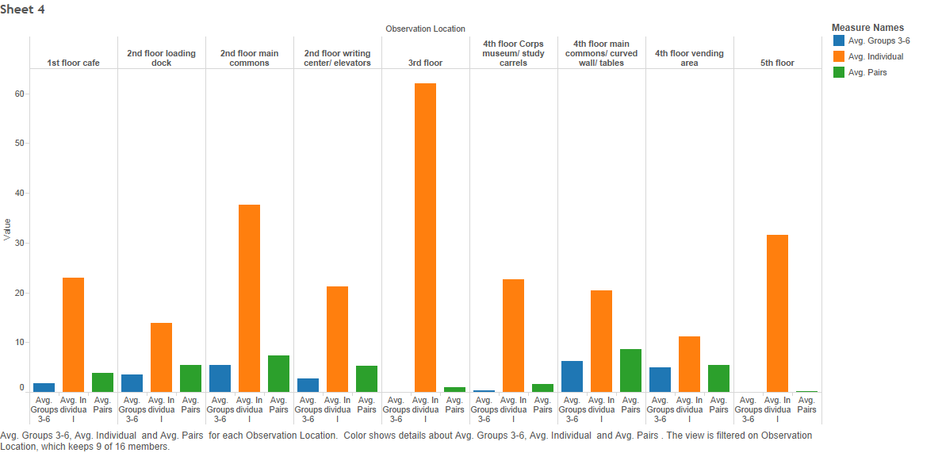
Individual vs. Group/Pair Study

Slide 26
Drawing Conclusions
Finding trends
  Noise level preference
  Group study vs. individual preference
  Effectiveness of student resources
Adapting to technological advancement
  Availability to power
  Offering loan equipment (chargers, ipads, etc)

Slide 27
Action
Bringing in the big players –
Vending machines
ATM
Power cords
Phone chargers
Notes:
Admin, department directors. ATM, power cords, chargers, other technology support

Slide 28
Future for PRA
More data → More action
Library in flux → more closely connected to other integral departments
Determine additional questions and research areas
Notes:
Talk about this being a pilot program, how we learned a lot this year alone and plan on continuing to learn. Talk about how the data becomes increasingly relevant as we continue to collect over the years to come because we can start looking at trends over a longer period of times (i.e. shift from individual to group work, increasing use of power.. )
Talk about how all the conclusions now are based off of 8 months worth of data.

Slide 29
Conclusion
Best way to improve the library?
Ask students → act on their responses
Notes:
Tie it all together, talk about our mission which is ultimately to improve the library through observation and action.

Slide 30
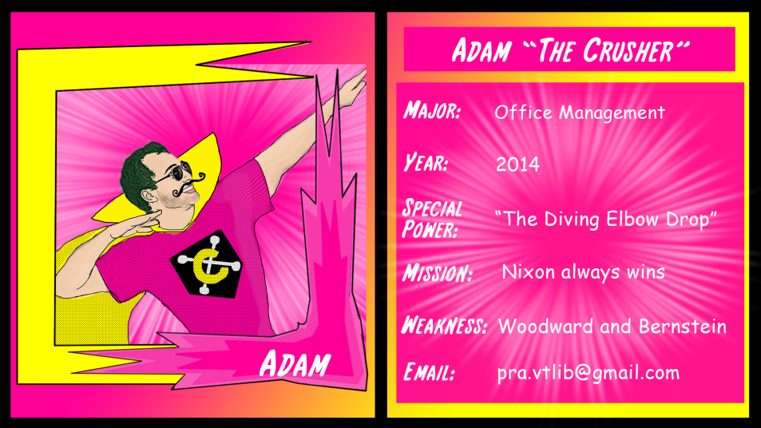
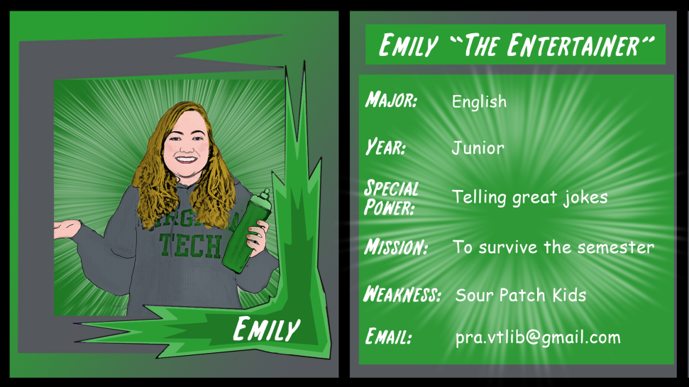
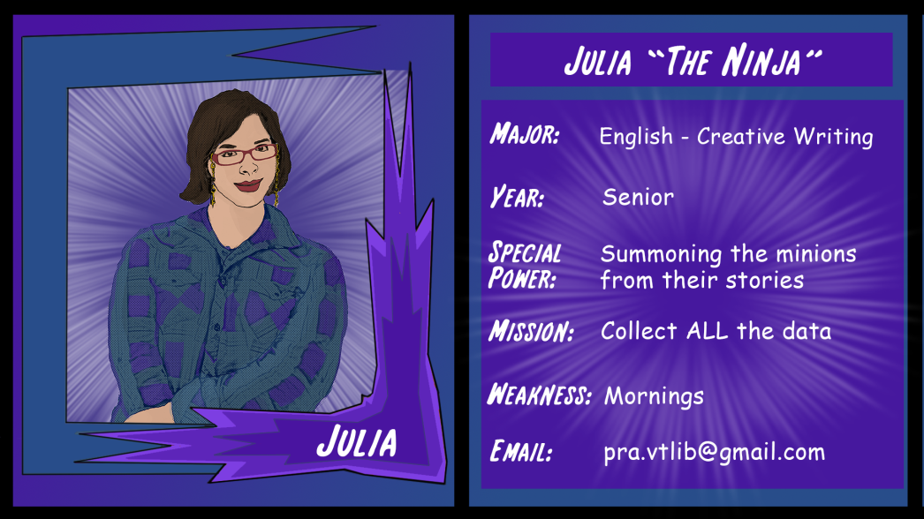
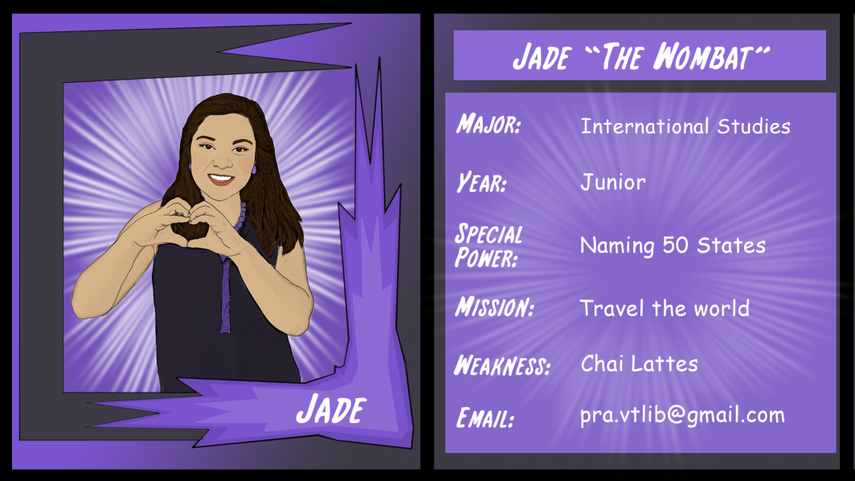
Best Student workers Ever!

Slide 31
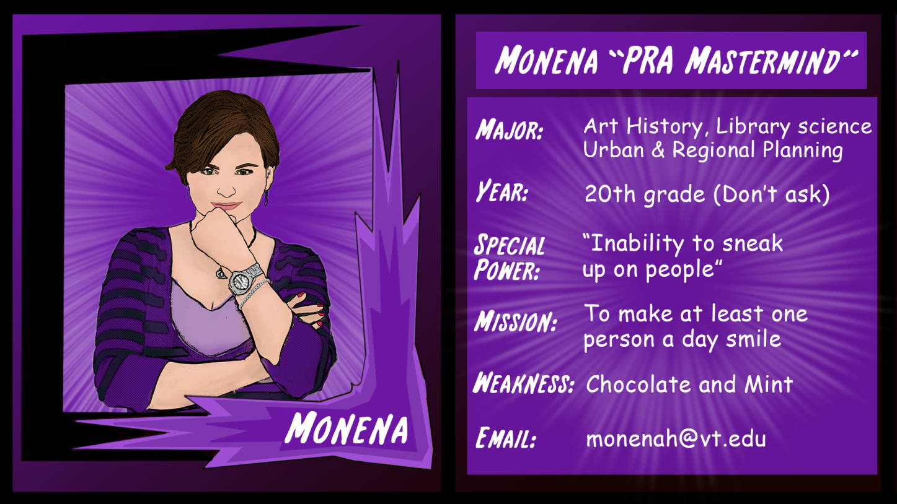

Thank you!

