Slide 1
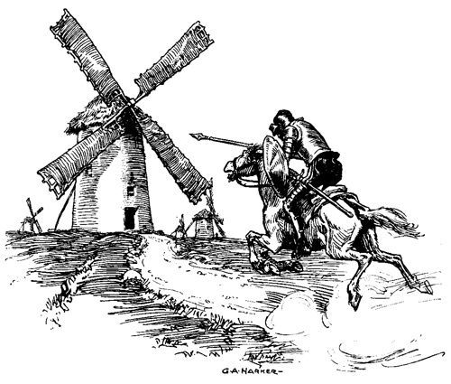
Don Quixote:
A Demonstration of Veteran Resilience in Literature
Nan Darbous Marthaller, MA
10/20/2022

Slide 2
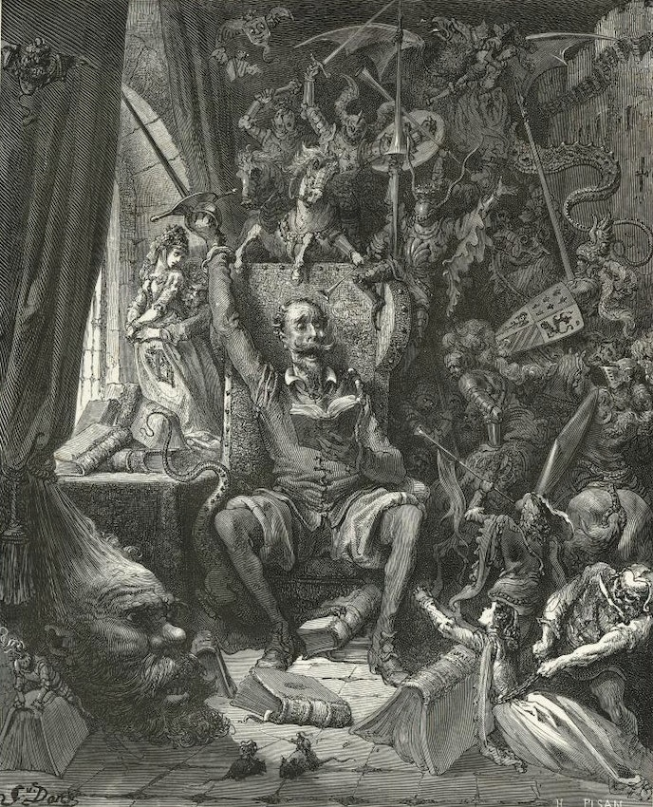
Veteran Resilience in Literature
Veteran resilience is demonstrated in the novel Don Quixote by Miguel de Cervantes who draws on his own battle and captivity experience.
Through his characters, Cervantes provides insight into what he suffered and endured.
These lived experiences give the story much deeper context than mere imagined pain or suffering.
The novel Don Quixote illustrates the desire to serve, to endure and survive, and to help others do the same.

Slide 3
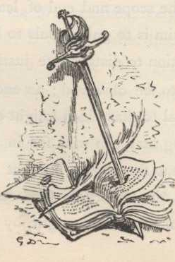
Don Quixote on Military Service
In Don Quixote, the knight-errant Quixote was provided advice from his father regarding vocation: “follow one of the paths I shall indicate . . . follow letters, another trade, and the third serve the king in the wars . . . if war does not bring much wealth it confers great distinction and fame."
(Cervantes, 1: ch. XXXIX)

Slide 4

Miguel de Cervantes Saavedra Timeline
1547 – Miguel de Cervantes was baptized at Alcalá
1571 – Served at the Battle of Lepanto; was wounded and maimed; returned to service
1575 – Captured by Barbary corsairs
1577 – Held prisoner in Algiers; tortured for trying to escape
1580 – Freed and returned to Madrid
“Penniless and maimed, he found no way of making ends meet except to re-enlist in the army” (Durant)
1584 – Married Catalina
1587 – Worked for the commissary of the army and navy; provisioned the Invincible Armada
1594 – Tax gatherer for Granada; imprisoned for 3 months for accounting issues
Remained for several years in Seville; wandered through Spain; was arrested again at Argamasilla
Began writing Don Quixote while imprisoned which was published in 1605

Slide 5
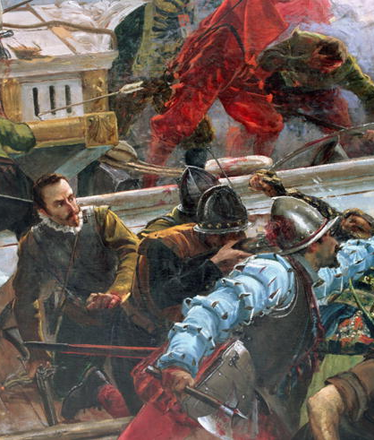
Cervantes’ Service
1571 – Sailed from Messina on the Marquesa for the Battle of Lepanto
“He received three gunshot wounds, two in the chest and another that permanently maimed his left hand. He was returned to a hospital in Messina and was paid eighty-two ducts by the Spanish government. He took part in other military actions – at Navarino, Tunis, and Goletta.” (Durant)

Slide 6
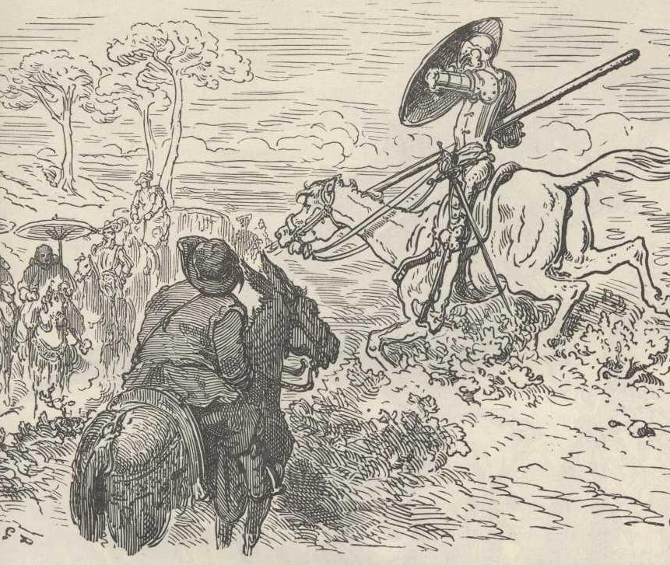
Don Quixote on Military Service
“Peace,” said Don Quixote; “where hast thou ever seen or heard that a knight-errant has been arraigned before a court of justice, however many homicides he may have committed?”
(Cervantes, 1: ch. X)

Slide 7
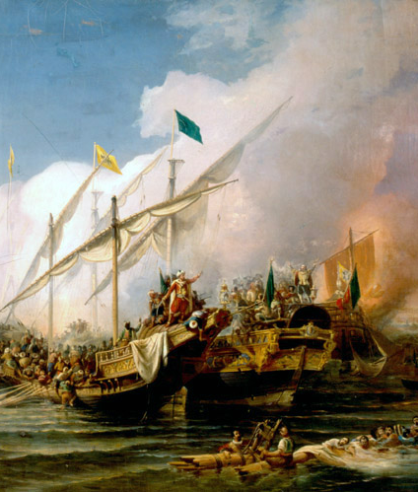
Cervantes’ Captivity
1575 – Captured by Barbary pirates while returning home from service
“On the voyage homeward he and his brother Rodrigo were captured by barbary corsairs and were sold into slavery in Algiers.” (Durant)
“His brother was released in 1577, [Cervantes] was kept in bondage for five years.” (Durant)
“Repeatedly he tried to escape, only to have the severity of his treatment increased.” (Durant)

Slide 8
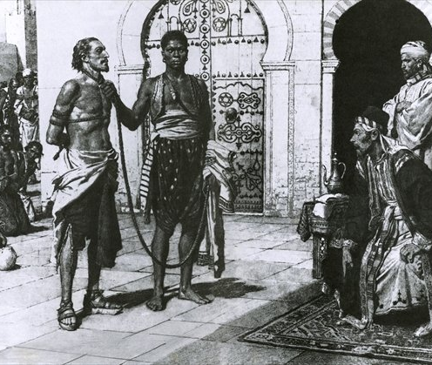
Don Quixote on Captivity
Cervantes relates in Don Quixote Book I through the memories of Quixote while he is a captive of Don Fernando, how “I was labouring at the oar without any hope of freedom” (Cervantes, 1: ch. XXXIX)
He continues by relating, “to my mind there is no happiness on earth to compare with recovering lost liberty" (1: ch. XXXIX).

Slide 9
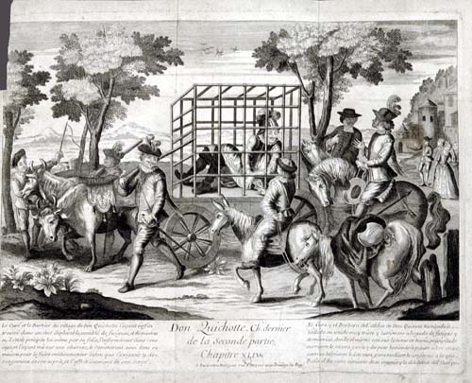
Don Quixote on Resilience
Quixote relates his tale of imprisonment, “the hope of obtaining my liberty never deserted me; and when in my plots and schemes and attempts the result did not answer my expectations, without giving way to despair I immediately began to look out for or conjure up some new hope to support me, however faint or feeble it might be.”
(Cervantes, 1: ch. XL)

Slide 10
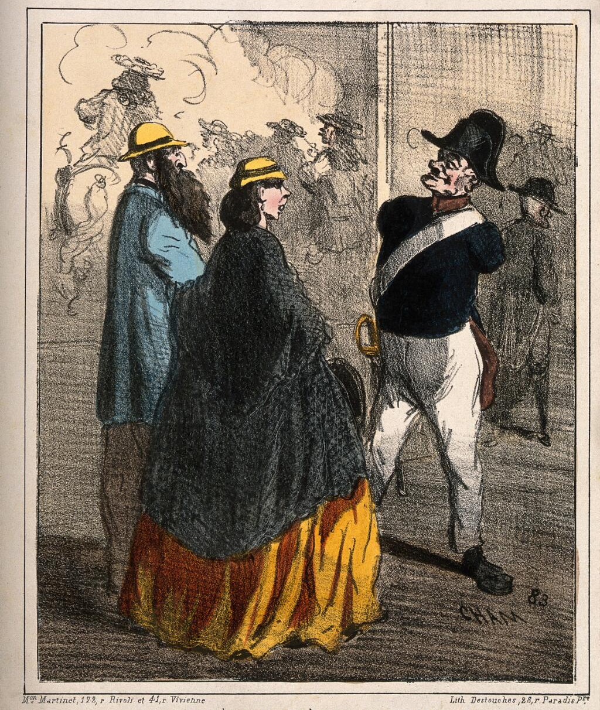
Cervantes - Veteran
1580 – Freed and returned to Madrid
“Penniless and maimed, he found no way of making ends meet except to re-enlist in the army.” (Durant)
Cervantes served Spain again and again because other opportunities were not available to a man with the use of only one arm.

Slide 11
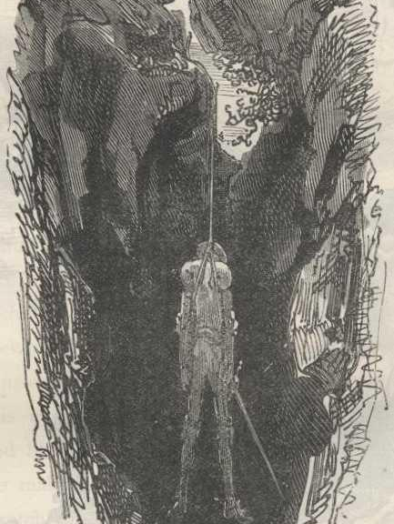
Literature and Veterans
Throughout Don Quixote, there is reference to personal distinction with military service, and it is part of the chivalric code to which Quixote (and Cervantes) adheres.
For Cervantes, the scars of battle were a testament to his service to God, his king and country and by writing Don Quixote he demonstrates his own resilience and offers it to others.
By looking closely at literature and its authors, the insight of military service can be discovered.
Examples: Socrates, Plato, Cicero, Samuel Taylor Coleridge, Friedrich Nietzsche, Erich Maria Remarque, Rod Serling, Kurt Vonnegut.

Slide 12
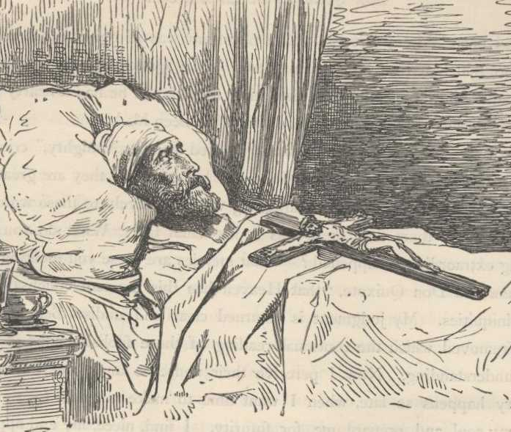
Cervantes on Don Quixote
“For me alone was Don Quixote born, and I for him; it was his to act, mine to write; we two together make but one”
(Cervantes Book II: LXXIV)

Slide 13
Cervantes and Resilience
Cervantes’ character Don Quixote “has been translated into more languages than any book except the Bible.” (Durant)
Cervantes’ Don Quixote is “the most living, the most endearing, and the best known character in all literature.” (Powys)
Cervantes established the modern novel with the writing of Don Quixote.
And, according to Durant, Cervantes “raised the new form [of fiction] to philosophy by making it reveal and illuminate the moral gamut of mankind.”

Slide 14
Works Cited
Cervantes Saavedra, Miguel de. Don Quixote. Translated by John Ormsby. 27 July 2004 [EBook #996], Produced by David Widger. gutenberg.org/ebooks/996, Kindle Version.
Cham. “An armless veteran of the Hôtel des Invalides is hired as a guide for visitors, in order that he take no money from them.” Coloured lithograph. wellcomecollection.org/works/j338gn99/items
Dore, Gustave. “Images.” The Literature Network, Jalic Inc. 2000-2022. online-literature.com/cervantes/don_quixote/1/
Durant, Will and Ariel Durant. “Chapter XI. The Golden Age of Spanish Literature: 1556-1665; II. Cervantes.” The Age of Reason Begins: The Story of Civilization, Volume VII. Simon and Schuster, New York. Kindle Version. P. 380.
Harker, G. A. “Untitled.” cpb-us-w2.wpmucdn.com/blogs.baylor.edu/dist/c/3127/files/2015/12/DQ-Screen-Shot-2015-12-04-at-4.10.29-PM-29wbxtz.png
Luna, Juan. “The Battle of Lepanto 1581.” commons.wikimedia.org/wiki/File:The_Battle_of_Lepanto_of_1571_Soldiers_detail_by_Juan_Luna.jpg
Matania, Chevalier Fortunino. “Cervantes brought before Hassan Pasha the King of Algiers.” commons.wikimedia.org/wiki/File:Cervantes_brought_before_Hassan_Pasha,_the_king_of_Algiers.jpg
Osman Nuri Pasha and Hovhannes Umed Behzad. “Barbarossa Hayreddin Pasha defeats the Holy League of Charles V under the command of Andrea Daria at the Battle of Preveza (1538).” Turkish Naval Museum, 1866. en.wikipedia.org/wiki/File:Battle_of_Preveza_(1538).jpg
Powys, J. C., Enjoyment of Literature, p. 174. As shown in The Age of Reason Begins: The Story of Civilization, Volume VII.
van Eertvelt. Andries. “The Battle of Lepanto of 1571.” Date 1640. commons.wikimedia.org/wiki/File:%27The_Battle_of_Lepanto%27,_painting_by_Andries_van_Eertvelt.jpg

