Slide 1
Blockchain
What is it and why should we care?
Notes:
Meredith:
Ok, we’re going to get started with this session, “Blockchain: What is it and why should we care?” Before we get started, I’d like to ask my fellow panelists to share a few acknowledgements:
Anthony:
Thank you. We would like to acknowledge that we are gathered today on the traditional lands of the Piscataway people.
Sharmila:
And we would also like to thank Matthew Frolick at the Library of Congress and Nicholas Connizzo at the Vermont State Archives who assisted us in preparing this presentation but were unable to join us for the session today.
Meredith:
Thank you. And thank you to everyone for joining us -- in the last session block of SAA!
We are here today because we think it’s important to learn more about this technology, become more familiar and begin to think through the implications so that we can start preparing now for how we may need to deal with Blockchain, also known as “distributed ledger technology,” so we aren’t caught off guard in the future.
I want to state at the very beginning of this panel -- none of us are blockchain experts. We are here because we think it’s important that we introduce this topic, so that we can spur discussion amongst ourselves, and encourage you to learn more about Blockchain -- how it might be useful, and how it might impact your work. However, myself and our two other panelists can’t help you set up a blockchain project. We, ourselves, have not implemented any specific projects, but we will provide an extensive list of resources at the end of our presentation that may connect you to experts in the field.

Slide 2



Panelists
Meredith Stewart
United States Digital Service
Sharmila Bhatia
National Archives and Records Administration
Anthony Wright de Hernandez
Virginia Tech
Notes:
Meredith
Now I’d like to introduce the panel:
Meredith: My name is Meredith. Currently, I’m at the U.S. Digital Service, working at the Department of Veterans Affairs, but previously I was at the National Archives and Records Administration and was exploring potential use cases and implications of Blockchain technology for the agency. Although, I don’t get to pursue Blockchain in my current projects, I’ve continued to believe we should be paying attention to the technology.
Sharmila: Sharmila is an Electronic Records Format Specialist at the National Archives at College Park. She’s worked with electronic records for over 15 years as a processing and accessioning archivist. This past year she worked with a team at NARA exploring blockchain technology and potential uses in the federal government. The team prepared a white paper for staff and will be issuing a version for the public in the coming months.
Anthony: Anthony is the Community Collections Archivist at Virginia Tech. He primarily works with traditionally marginalized communities to help improve their representation in the archival record. In that context, he is interested in the ways that technology helps these communities to document their own history and tell their own stories. Because of that interest, he works to stay abreast of the latest developments that might be useful in digital archiving such as blockchain.
All of you have probably heard about blockchain because there has been a tremendous amount of buzz in the news. And of course, the first thing that comes to mind when thinking about Blockchain is the cryptocurrency, Bitcoin.
Bitcoin is changing the nature of online financial transactions. It was invented by Satoshi Nakamoto, an unknown person (or maybe even a group) in 2009. Bitcoin was set up to provide a framework for online financial transactions. Because there is a fundamental lack of trust between users, Bitcoin created a distributed network without needing the middleman of a centralized bank to verify transactions.
For our panel today, we’ll be exploring another side to blockchain. We’ll be looking at a variety of use cases of technology -- beyond Bitcoin -- and we’ll be taking a look at the archival and records management context around the technology.
There are a variety of different perspectives right now about Blockchain -- you may be a person who thinks blockchain is good for nothing. You may be bullish and think blockchain could really help address some difficult problems. Most folks need help cutting through the buzz -- We’ve seen recently in the news articles promoting blockchain for tracking diamonds around the world or even registering new births. Whatever your perspective, we hope that you will share it during the discussion portion of this session!
Sharmila will provide us with an overview of the technology so that we can learn about what makes blockchain blockchain. We will pause after her section, so that if you have questions specific to the technology, we’ll address those before moving on to the rest of the presentation.
Next, Anthony will address why we should care about blockchain by describing how it intersects with recordkeeping and archives.
Our presentations are designed to lay the foundation so that we can have a discussion with you, the audience, in the second part of the session. We will pose four questions:
How do you think Blockchain alters what we’re already doing for digital records?
What is a digital object in a blockchain and what are its borders?
Does blockchain provide needed transparency for communities who may lack trust in institutions?
Do you believe, blockchain will reduce trust in records without the technology?

Slide 3
What is it?
Notes:
Meredith: Now, I’d like to turn it over to Sharmila.

Slide 4
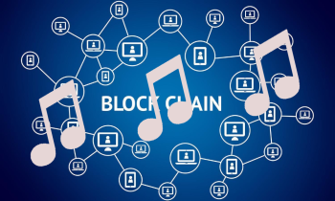
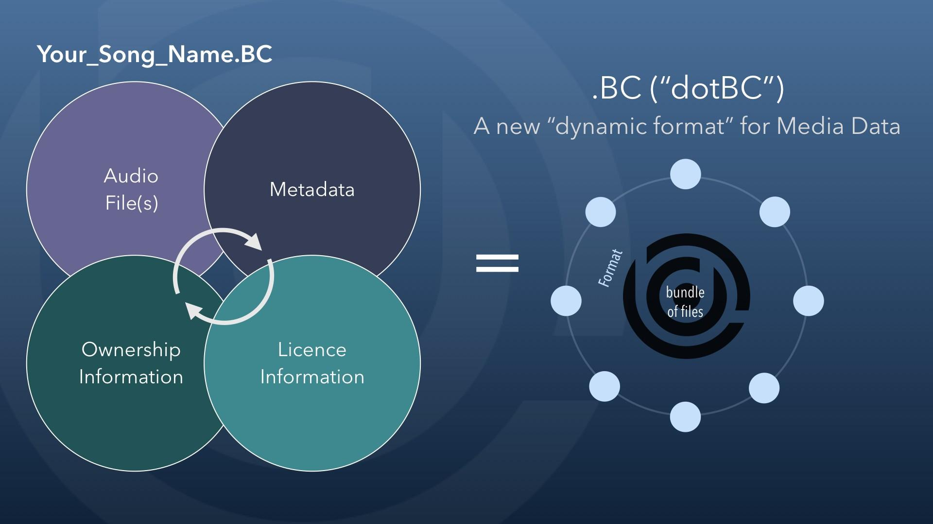

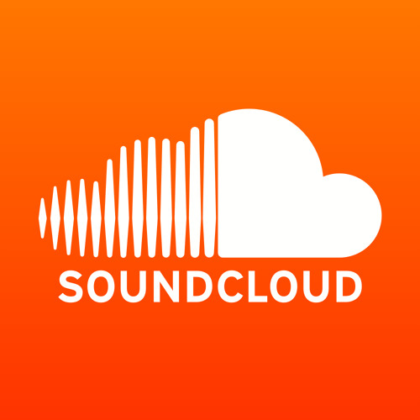
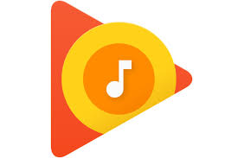
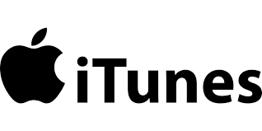


Blockchain: What is it?
Music on blockchains
Notes:
Blockchain offers a way for people to work together without using a trusted third party. At its most simple description, a Blockchain is a ledger or database that is copied between numerous parties. Updates to the database can only be made by following pre-established rules and once an update is made, it is shared with all of the parties. These trusted transactions are linked together in a chain that ensures that all parties have an accurate copy of the ledger.
I thought it would be helpful to begin with a daily life example.
Most of us have purchased or streamed digital music through a vendor. In the US, a songwriter usually receives $.09 per song sold with the distributor receiving the bulk of the revenue. If it were possible for a songwriter to place their product in a secure environment that could process payments, then songwriters could avoid the additional cost of song distribution. A blockchain would allow songwriters to place their song in an encrypted environment where listeners could buy their music directly from the songwriter. This would eliminate the need for traditional music distribution.

Slide 5
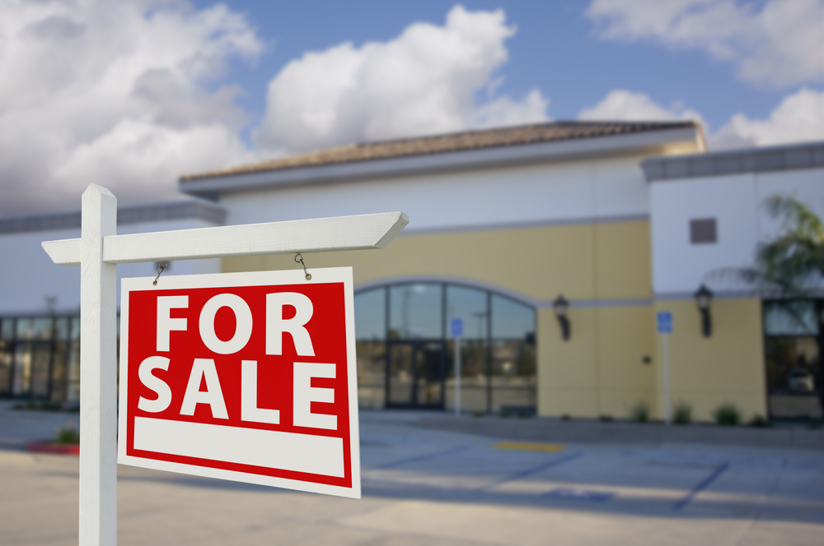
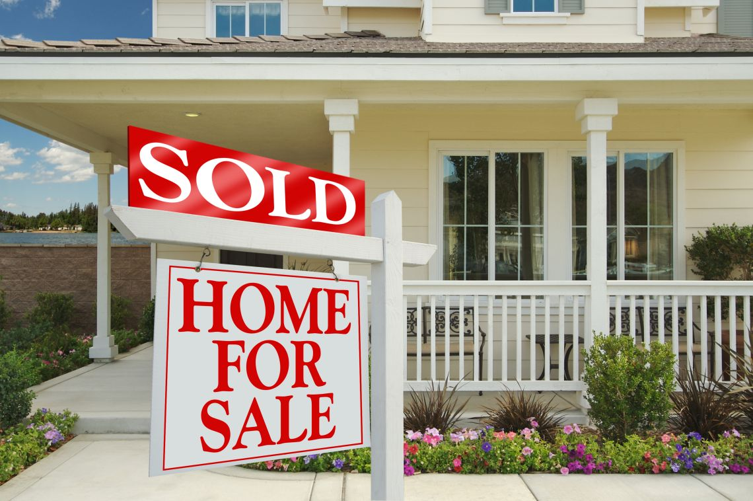
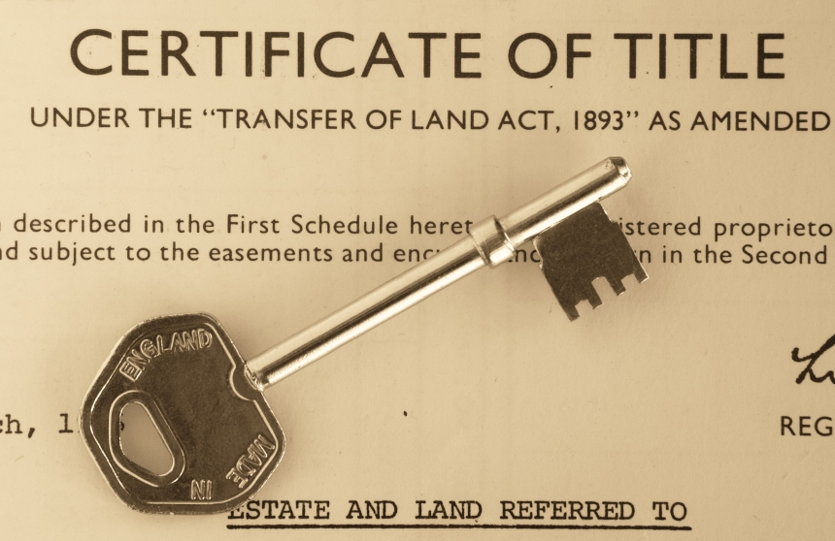
Blockchain: What is it?
Real Estate on blockchains
Notes:
Here’s another example of where blockchain may impact our lives. When a house is sold, there is often a recording fee with the county that records the transfer of ownership from one person to another. Within a blockchain, it’s possible to capture the sale and record the change of ownership at a fraction of the cost and be recorded within hours instead of months. The state of Vermont has executed one house purchase using blockchain. Recording real estate transactions may potentially impact the title insurance industry and just a few weeks ago, Washington Post had an article about about this. Potential benefits include a streamlined process, but whether it will reduce the likelihood of a forgery and thereby eliminate the need for title insurance is uncertain.

Slide 6
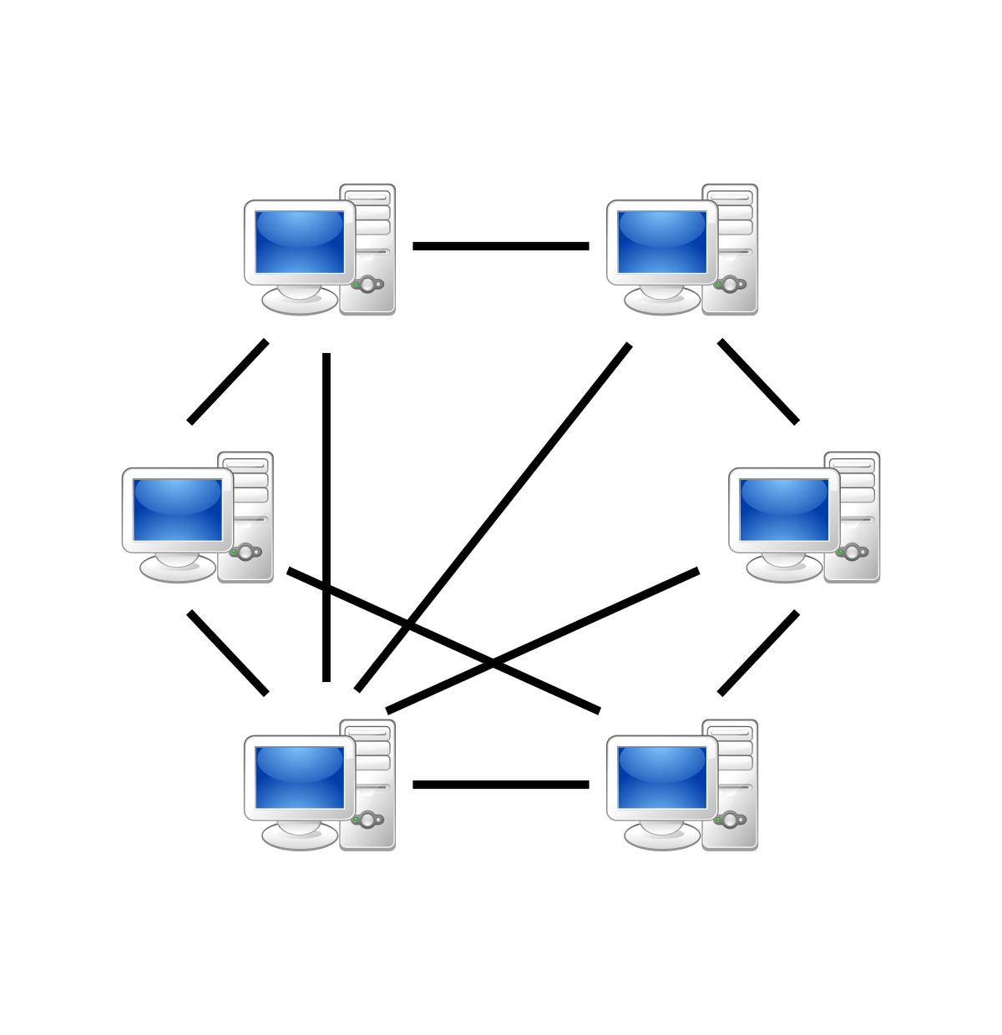
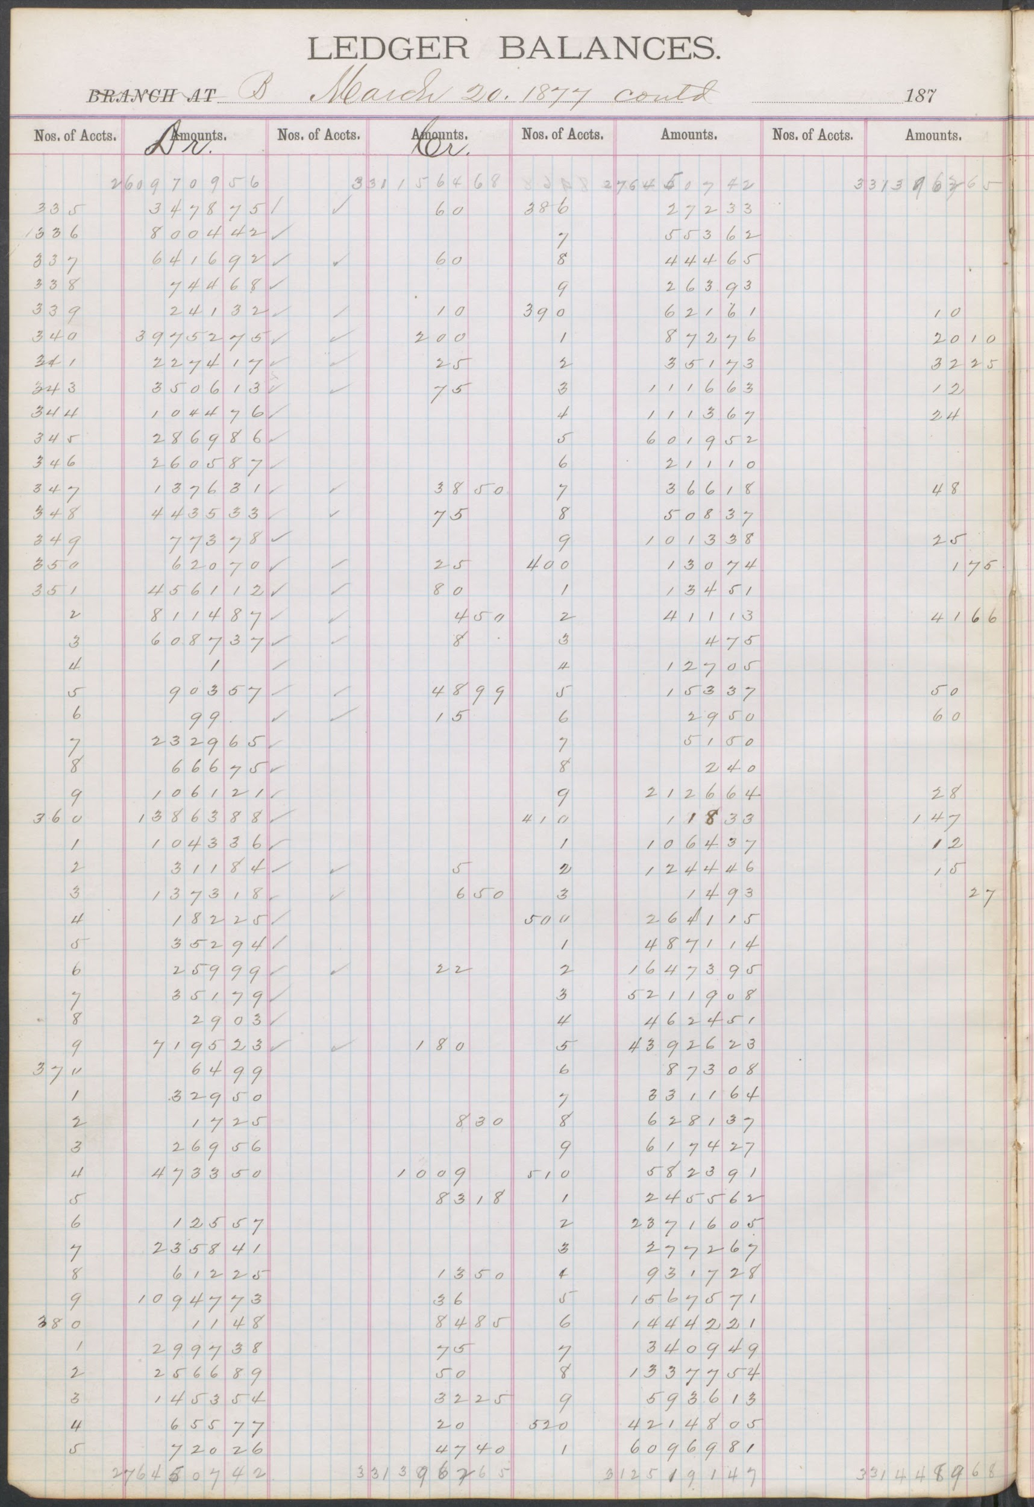
Blockchain: What is it?
Peer to Peer Network /
Distributed Ledger
Blockchain is a peer-to-peer network that timestamps transactions as a way to eliminate third party services.
Characteristics of a blockchain network, or “distributed ledger” includes:
Decentralized transaction record keeping,
Consensus or trust-based transactions, and
Tamper resistance.
Traditional Ledger
Freedman’s Saving and Trust Company. Ledger Balances - Commissioners, 1877. NARA ID 74893777.
Notes:
Blockchain is a peer-to-peer network that enables two parties to transact business. This removes the need for a third party to provide verification and trustworthiness of transactions. The blockchain network is also known as a distributed ledger. As archivists and records managers we are familiar with ledgers which are used for recordkeeping. The distributed ledger builds upon this concept and replicates the data across many nodes. This decentralized recordkeeping contains consensus or trust-based transactions and is tamper resistant.

Slide 7
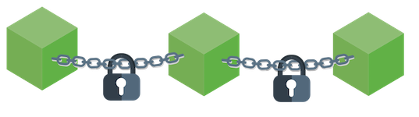
Blockchain: What is it?
Blockchains have three (3) parts
Block: A list of recorded transactions over a period of time. Transactions can represent virtually any type of activity from registering a land deed to a single purchase.
Chain: When the block reaches its maximum size of transactions, it is linked or chained to the preceding block through a hash.
Notes:
Blockchains have 3 parts.
The block contains a list of transactions over a period of time. Transactions can represent any type of activity such as registering a land deed to a single purchase. The maximum number of transactions in a block is defined by the network. For instance, on Bitcoin, the blocks are limited to 1 MB.
The chain is created when the hash value of one block is inserted into the next block. This makes a link between the new block and the previous block.

Slide 8
Blockchain: What is it?
A hash is an algorithm that takes a variable string of data and generates a fixed length value. The data about the transactions must be small so that the validity of the transaction can be quickly calculated and distributed.
Variable Text String Entry Value | Hash Value
National Archives | 6429799b9af2d91cbf915cb0290f3a50281193a977b3457d63e4541cc5788c5b
National Archives (an extra space) | d926fe7e72d09b249701dbcde2dad0ccb9b4bb653e053e461a67bbb951dcae0b
Nati0nal Archives | 5f2d570fc940d5f8de89310db43f789fdd99f51e89c021e1a50acb7a6fe2cf83
Notes:
Large amounts of data are often stored “off chain” with pointers or hashes of the data stored within the blockchain. A hash is an algorithm that takes a variable string of data and generates a fixed length value. The hash is unique and if the data is altered the resulting hash output will be different. Here we’ve generated an example using “National Archives” as the string. As you can see slight alterations generates different hashes.
If you would like to try to hash a string there are many tools available on the internet.

Slide 9
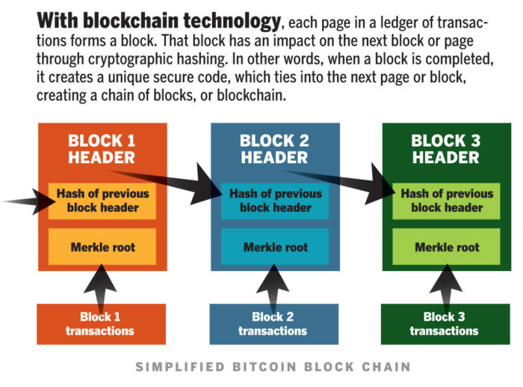
Blockchain: What is it?
Blockchain is Here to Stay, Bart Pursel
Notes:
Oftentimes, to save space, multiple hash values can be brought together and hashed again, thus creating a single hash value that represents multiple hashes. This technology is called a Merkle tree.

Slide 10
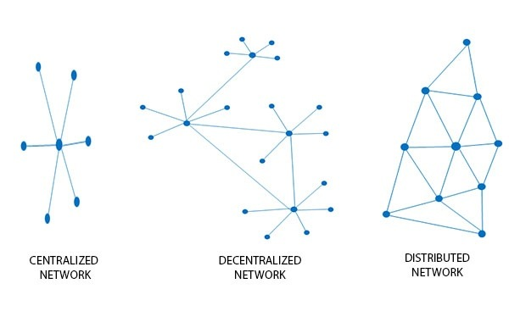
Blockchain: What is it?
3. Network: The network is made up of nodes that each contain a complete record of all transactions on a blockchain. No centralized “official copy exists and no node is “trusted more than another.
Notes:
The network infrastructure contains the complete record of all the transactions on a blockchain.
Most of us are familiar with centralized networks. Data is generally stored in one place and retrieved from a centralized place.
Distributed networks retain the same information in multiple locations.

Slide 11
Blockchain: What is it?
Types of Blockchain Networks
Public: Large network, anyone participates, generally open sourced
Permissioned: Large network, which establishes roles for users
Private: Smaller network, tightly controlled, trusted entities use it to share confidential information
PRIVATE
PERMISSIONED
PUBLIC
Notes:
The network infrastructure contains the complete record of all the transactions on a blockchain.
There are 3 types of networks:
The public network allows anyone to participate. Bitcoin is on a public network.
The permissioned network allows certains parties to participate.
The private network is usually established between trusted entities.

Slide 12
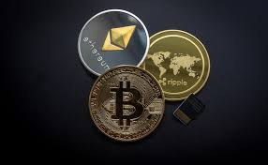
Blockchain: What is it?
Blockchain Platforms
There are a variety of blockchain platforms that can be configured in many ways to serve different purposes.
Examples of existing platforms are:
Bitcoin
Ethereum
Ripple
Hyperledger
Notes:
There are many different blockchain platforms. We’ve highlighted 4 here to illustrate the differences among them.
Bitcoin is a cryptocurrency, or digital currency, with a related open source platform. Bitcoin’s blockchain is primarily designed to support the exchange of cryptocurrency without an intermediary third party. Bitcoin assumes no trust between parties and requires numerous decentralized nodes to ensure that the blockchain has not been corrupted by malicious actors.
Whereas Bitcoin is primarily focused on the trade of its own currency, Ethereum provides an open source programming language allowing users to build applications with an integrated blockchain. Users can program executable smart contracts using the blockchain. We’ll talk a little more about smart contracts later on in the presentation. Ethereum also has a cryptocurrency known as ether.
Much like Bitcoin, Ripple is based on an open-source, which is coding that is made freely available to the public. Ripple uses a blockchain to exchange value and it has an established user-base of regional and global banks that need to transact international payments in real-time. Ripple also allows the trade of goods, property, and more broadly items of value. The Ripple cryptocurrency is known as XRP or ripples.
The Hyperledger project focuses on developing an open source and collaborative approach to distributed ledgers. By developing standards and an overall framework for blockchains, Hyperledger has gained support from organizations such as Cisco, American Express, and IBM, and is taught in some library and information science schools. Hyperledger has stated that they will never build a cryptocurrency.

Slide 13
Blockchain: What is it?
A Smart Contract is a contract that has been translated into the software language of the blockchain.
Autonomously executed by a triggering event
Transaction records are stored/shared across
the blockchain network
Notes:
A smart contract is a series of if/then statements programmed and saved on the blockchain. Once the requirements of the smart contract are met, the contract will automatically be executed and the resulting action will be stored and shared across the blockchain.
I’ve given a good bit of information about the technology. We’d love to hear any questions you may have about the technology.
Now Anthony will talk about we should care.

Slide 14
Why should we care?
How does blockchain intersect with recordkeeping and archives?
Notes:
Records exist, in part, to document our history in some fashion. They are relied upon to give us a true recording of past events, transactions, decisions, etc. So, how do we ensure accuracy? What is the provenance of the records we maintain? Blockchain provides a method for providing validation to digital records by proving they are unaltered since accession.

Slide 15
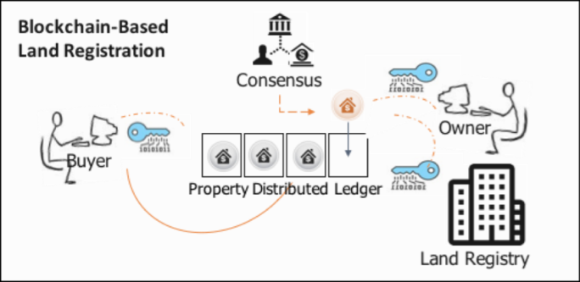
Why should we care?
Official record keeping
Data validation
Vermont Act 157 of 2016 Sec. I.1. 12 V.S.A. § 1913
Estonian E-Health Foundation
Automated record processing
Swedish land transfer pilot (Smart contracts - property/land registration)
Tokenization of assets
Brazilian land registration pilot (University of British Columbia, National Archives of Brazil)
Notes:
We’re already seeing blockchain adopted by some governmental bodies.
Vermont Act 157 of 2016 defines blockchain authentication as an acceptable method for validation of facts in official governmental business.
The government of Estonia (South of Finland, North of Latvia, and West of Russia) embraced blockchain for validation of its national healthcare data in 2016. No actual health data is copied to the blockchain (in this case the public Bitcoin blockchain). Instead, the blockchain is used to generate hashes when a record is created. Those hashes are then queried at later times to validate that no information on the health document has been changed. These health records are official government records in Estonia and rely on this technology to ensure their validity and reliability for health-related decisionmaking.
The use of smart contracts allows automation of transactional processes such as property transfers from initial listing through purchase and could even include automatic transfer of the documentation into records storage or an archives. Under development in Sweden is a system designed to improve efficiency of their land registry system. The Swedish government is working with a company called ChromaWay to develop a private blockchain-based system to handle the property transactions of their Lantmäteriet, the agency responsible for documenting land ownership. This system moves property documents forward through the ownership transfer process using smart contracts, ultimately leading to a fully executed property transfer record without the need for a government official to actively take part in the processing.
In Brazil, blockchain comes in once again with property transactions. The University of British Columbia worked with the National Archives of Brazil to test out Ubitquity’s platform to see if blockchain could improve record keeping for property transactions while complying with local laws. This was part of a larger project at UBC: “Records in the Chain” being run by Dr. Victoria Lemieux, a faculty member at the UBC iSchool.

Slide 16
Why should we care?
Validity and Trust
Project Archangel
University of Surrey Digital Ledger Technology testbed
The National Archives (United Kingdom)
Partnership with multiple archives
Provide validation and authentication for archived digital objects
Notes:
Moving to something on the archives side, Blockchain gives archivists a method for proving that the electronic archival objects we serve to patrons are identical to the objects we originally accessioned.
The University of Surrey and The National Archives of the United Kingdom are working on Project Archangel. This project involves the creation of a blockchain authentication system to ensure the validity of the digital objects held by the archives.
The network is a permissioned blockchain shared with other cultural memory institutions and used to ensure that archived digital objects are maintained in an unaltered state for future users. This effort moves beyond simple digital archiving whether on a disc or a server. It provides a method for ensuring that the information in those digital archives is provably unaltered.

Slide 17
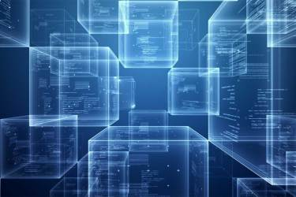
Why should we care?
“Born Blockchain”
Digital objects created with blockchain
Accessioning
Uniqueness
Forked blockchain
Future validation
Future technology needs of archives
Storage
Servers
Specialists
Notes:
Finally, we’ve all seen the term “born digital”. l recently ran across the term “born blockchain” in researching blockchain’s implications for archival practice. Essentially, this is a born digital object that has always existed within a blockchain context. So, a document tied to blockchain from its creation. This could be an Estonian medical document or a Swedish real estate document or a newly digitized object at the UK National Archives. Or, it could be any other document created and tied to the blockchain. We need to be ready to accession these objects.
When considering these objects for possible accession, are we as concerned with how unique it is? Many “born blockchain” objects could be automatically replicated on the entire blockchain. They would then be far from unique. Does that mean we ignore them? What about when the blockchain forks and some versions of the document become obsolete or unverifiable? What if the blockchain shuts down? Will the data validation remain once we’re 30 years into the future? All of these questions are still unanswered.
We may be required to set up our own internal blockchains to provide validation for our archived digital objects going forward. Whether that can be done independent of other organizations will depend on your institution. It is likely that we will need to create partnerships similar to Project Archangel at the UK National Archives to create a shared blockchain for this purpose. Or, we may need to rely on a public blockchain such as Bitcoin in a method similar to the Estonian system.
All of this directly affects the practice of records management and the work of archivists working with digital archives. It is still early days but we need to consider how to approach these documents now instead of waiting until we’re asked to take some and then have to scramble to accommodate them - or let them sit, untouched, on a disc somewhere.
Now, I’m going to turn things back over to Meredith who will lead us in some discussion.

Slide 18
What does it mean for you?
Open Discussion
Notes:
Meredith: Now the discussion portion of the session!

Slide 19
How do you think blockchain alters what we’re already doing for digital records?
Notes:
Meredith: What does this new technology mean for records managers and archivists?
Firstly, it means a lot more questions in the short term. Content creators are already using this technology for a variety of purposes. As a profession, we need to consider where the borders of a digital object using blockchain are and how we preserve a digital object separate from an active, living blockchain.
We need to consider the additional requirements our digital archiving practices will have to support these digital objects - mostly increased storage and backup requirements - but potentially significant ones if we are trying to preserve an entire blockchain.
And we will need to ensure our archivists are familiar with digital archives and capable of understanding these sorts of digital objects. As a profession, we’ll need training and we’ll likely need IT staff and other disciplines working together to preserve and access the blockchain records.
For those of you in the audience, how do you think you might encounter Blockchain technology?
And -- How do you think this might alter what we’re already doing for digital records?

Slide 20
What is a digital object in a blockchain and what are its borders?
Notes:
Anthony:
Can a “born blockchain” object be archived without also archiving the blockchain? What would archiving a blockchain look like? Does a single copy of a distributed ledger, or blockchain, become meaningless because of the lack of a method for validation of the data? So how does that affect archival practice regarding “born blockchain” objects?
If you only have one node, and you can’t query the other nodes, then does the piece you have become meaningless or suspect?
The node? the code underlying the blockchain? the records that the node points to? Depends on the situation.
If the archives takes a snapshot, but the blockchain continues,
If Bitcoin was to shutdown, what would it look like to archive bitcoin? A single copy or multiple nodes? Just the underlying code?
What kind of storage/energy consumption would be needed by the archival institution? We don’t know!

Slide 21
Does blockchain provide needed transparency for communities who may lack trust in institutions?
Will blockchain reduce trust in records without the technology?
Notes:
Sharmila
Blockchain is primarily used to validate the authenticity of a digital object. It is similar to a statement of provenance. However, the attached hash requires an active and distributed blockchain in order to confirm that validity. Do our objects become reliant on active third-party blockchains for this validation? Do we set up private blockchains? How do we provide access to users if we create private blockchains?
If we introduce or subscribe to the idea of requiring provenance or authentication for digital records, does that cause users to question born digital records that came before blockchain? Do we then need to tie all of our digital records to the blockchain?
Ensuring validity Is trust important? Providing access

Slide 22
Open Discussion

Slide 23
Resources
Introductory Articles
Gentle Introduction to Blockchain
A Brief History of Blockchain — Harvard Business Review
Technical Articles
Bitcoin: Introductory article by Satoshi Nakamoto
A World Without Middlemen — Harvard Business Review
NIST 8202 Draft Blockchain Technology Overview
Blockchain Underpinnings: Hashing
Government Blockchain Implementations
Blockchain - GSA Emerging Citizen Technology
Blockchain Technology: Opportunities and Risks (Vermont legislative report)
Blockchain in Illinois
Blockchain in Delaware
Brazil Blockchain Land Registry Case Study
Estonian eHealth and the blockchain
Land Registry in Sweden
National Association of State CIOs
World Government Summit: Blockchain
Notes:
Meredith:
I’d like to thank everyone for joining and participating in the discussion!
Although blockchain is still a developing technology, we’ve seen significant excitement from the private sector and government. We think preparation is key so that when we do encounter it, we can aren’t caught off-guard.
These resources pages have a variety of links that we’ve found helpful in preparing for this session. We’ve got intro articles, technical articles, resources focused on government implementations, smart contracts, business applications, and records management and archival implications.
We’d like to point to the General Services Administration’s Emerging Citizen Technology Office. The person who has led this effort, Justin Herman, has an Atlas that includes potential uses cases at Federal agencies, programs in action and resources. GSA is also hosting an Emerging Technology Leadership Series, which you can find on their Youtube channel. They’ve recently hosted a discussion with an overview of blockchain.

Slide 24
Resources
Smart Contracts
A gentle introduction to smart contracts
Three Common Misconceptions about Smart Contracts
Records Management and Archival Implications
Ideas on using appraisal techniques on Blockchain technology
Preserving the Archival Bond in Distributed Ledgers: Data Model and Syntax
Evaluating the Use of Blockchain in Land Transactions: An Archival Science Perspective
Blockchain and Distributed Ledgers as Trusted records keeping Systems
Trusting records: is Blockchain technology the answer?
Blog about Computational Archival Science
World’s Largest Archive Testing Blockchain for Records Management, Bitcoin News, 2018
ARCHANGEL - Trusted Archives of Digital Public Records
Blockchain Technology for Recordkeeping
A Typology of Blockchain Recordkeeping Solutions and Some Reflections on their Implications for the Future of Archival Preservation, Victoria L. Lemieux, 2017
Blockchain and U.S. State Governments: An Initial Assessment, Techtank, 2018
Business Applications
Does the future of real estate include Blockchain technology?, Washington Post, 2018

