Slide 1
Collegiate Times Grades
James O’Hara
Hang Lin
Client: Alex Koma, managing editor, Collegiate Times
Blacksburg
March 4, 2014
Virginia Tech
CS 4624

Slide 2
Outline
Overview of project
Review of deliverables completed
  Design guidelines
  Initial and final designs
  Initial prototype
What’s next?

Slide 3
Project overview
The Collegiate Times collects Virginia Tech course grades
Collated into a publicly available database
The CT recently changed web hosts and has not migrated the database
The project will create a new public home for this data

Slide 4
Market research
Interviewed employees, former users and prospective future users.
Identified a number of trends
  Mainly used by students when choosing classes to identify classes that are favorable
  Used to compare class results across semesters and years
  Can identify grading trends and patterns across courses

Slide 5
Design guidelines
Prominently display data
Must be easy to understand
Data must be sortable
Data must be paginated
Queries must be easy and productive
Must be identifiable with Collegiate Times brand

Slide 6
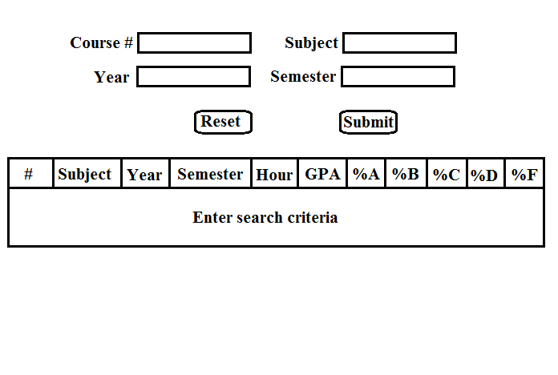
Initial design

Slide 7
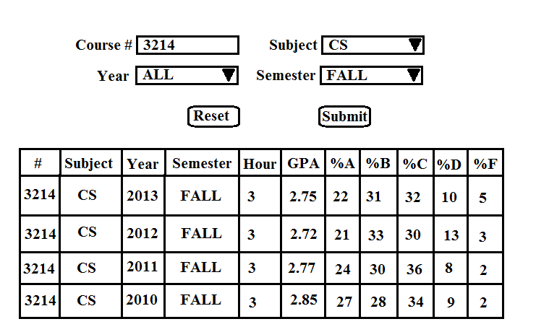
Final design

Slide 8
Initial prototype
HTML form process user request
Connects to database
Queries database with information provided by user
Outputs results into table with PHP
Formats table with Javascrpipt

Slide 9
Initial prototype
Can be viewed here: database.collegemedia.com/databases/grades/grades.html
Setbacks
  Course number and subject are ID numbers in the main table that are defined in another table
  Dynamic dropdowns not populating
  Pagination not working with variable results

Slide 10
What’s next?
Meet with client to go over changes made due to setbacks
Complete full set of webpages
  Fix bugs and formatting issues
  Close any security gaps
  Complete wrapper code that connects the page to the rest of the Collegiate Times website
Usability inspection with experts from the CT and computer science
Make changes and additions to site based on evaluation
Complete final pages that are launch-ready

