Slide 1
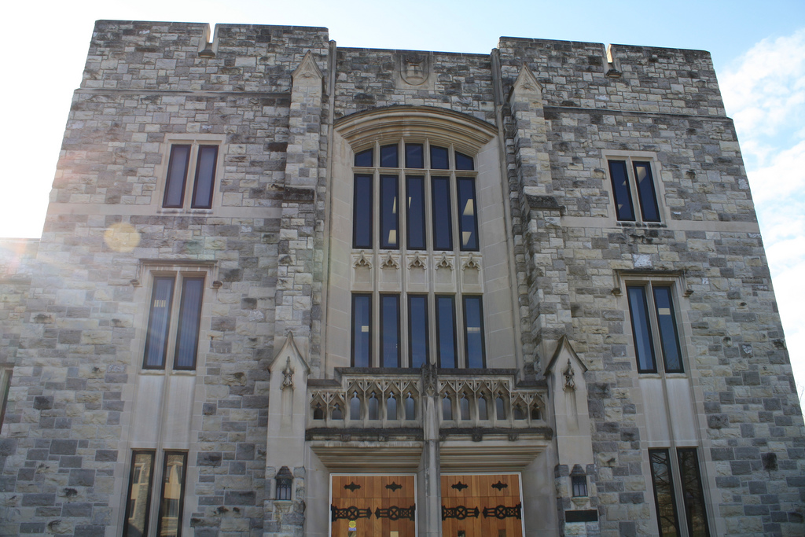
Virginia Tech
University Libraries
A LEARNING PLATFORM
(September 2012)
2nd Floor, Newman Library, Conceptual Draft #2 (short version)

Slide 2
Newman Library, Second Floor
  WHY?
  More than a renovation, we’re redefining libraries
Knowledge needs have changed and to be effective the library must adapt
Offer a comprehensive and integrated environment for academic support and skill-building
Explore and encourage new literacies and pedagogies as well as active and applied learning
Address shift from information consumption to knowledge production and sharing
Cultivate campus pride in the University Libraries

Slide 3
HIGH LEVEL CONCEPTS / METAPHORS
HOTEL LOBBY
VILLAGES
LEARNING
STUDIOS
VILLAGES
NEIGHBORHOODS
VILLAGES
KNOWLEDGE PARK
LEARNING
STUDIOS
KNOWLEDGE PARK
MARKETPLACE

Slide 4
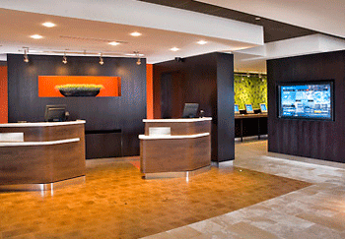
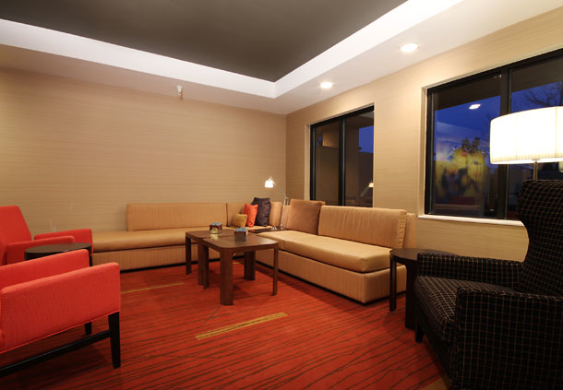
  HOTEL LOBBY
  MEET & GREET

Slide 5
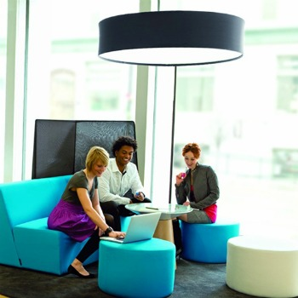
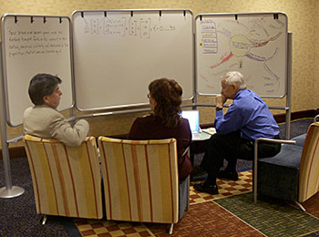
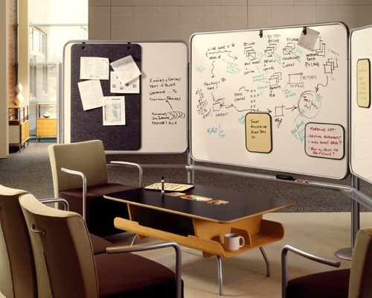
  VILLAGES
  Flexible brainstorming & sharing spaces

Slide 6
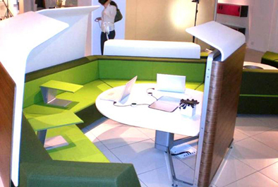
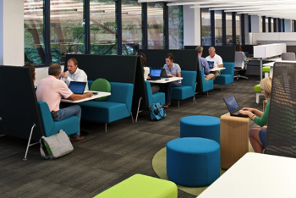
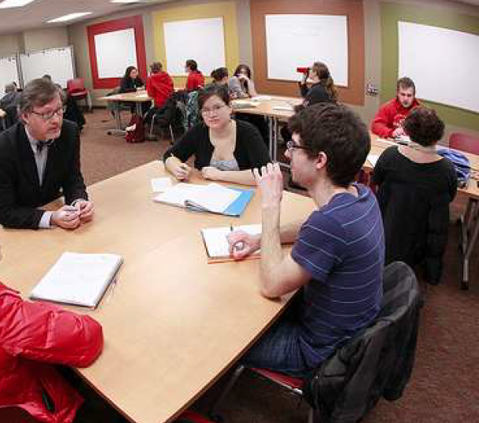
  NEIGHBORHOODS
  Open group work areas

Slide 7
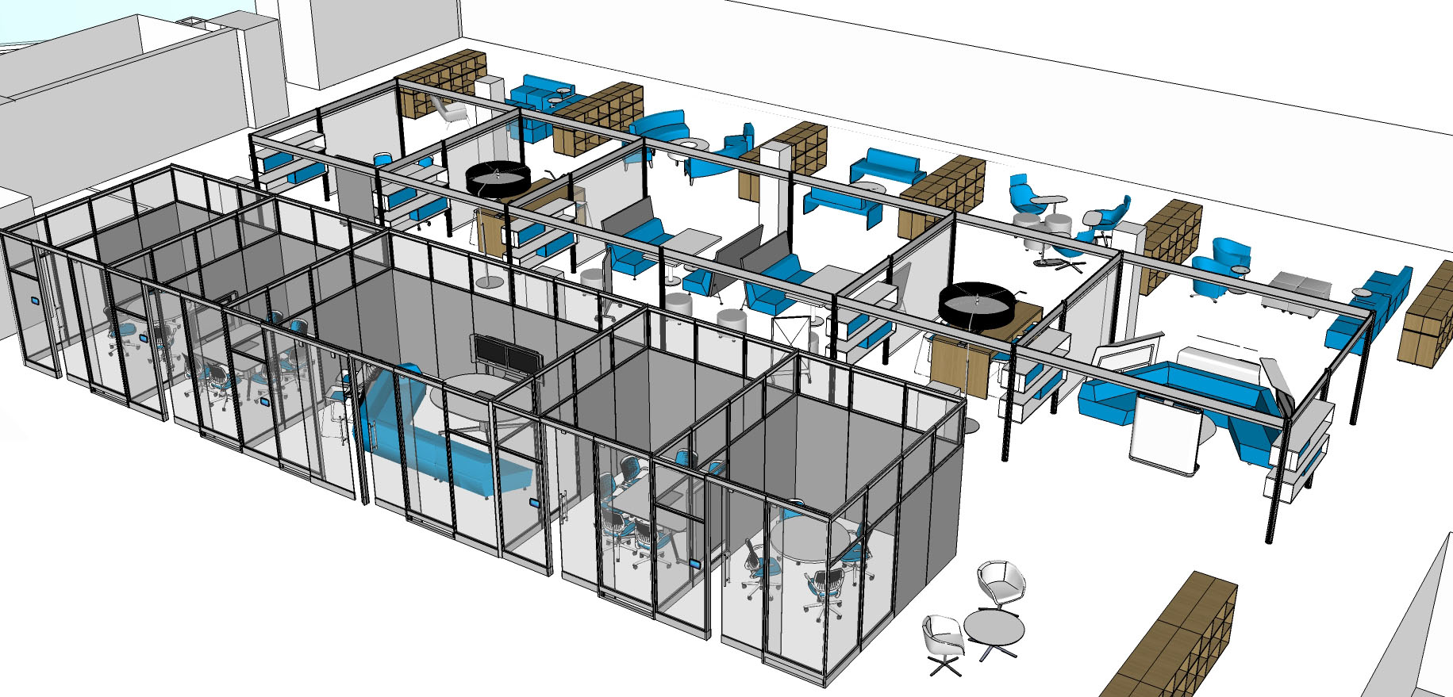
  GROUP COMMONS
  Intersection of villages & neighborhoods

Slide 8
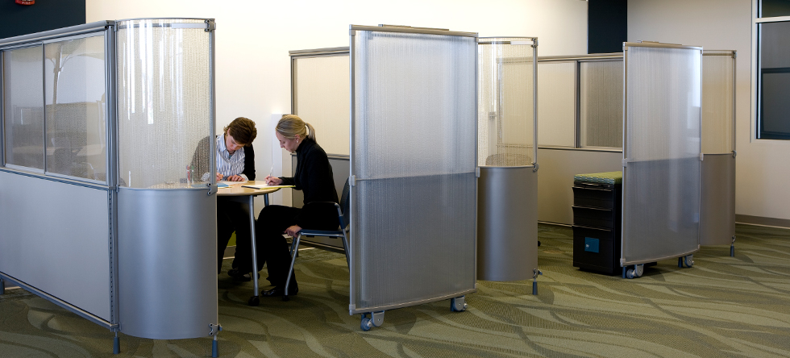
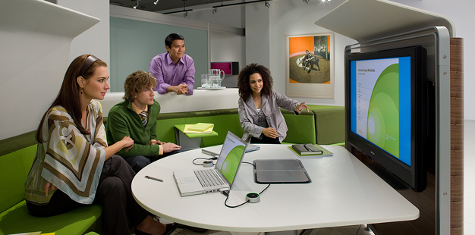
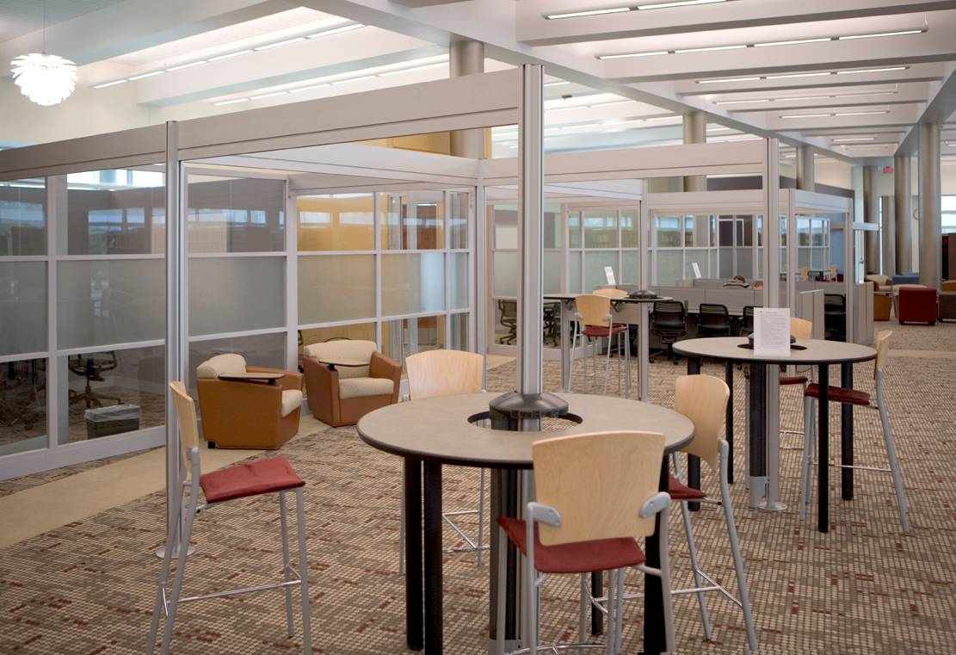
  MARKETPLACE
  Convergence of academic support
Writing Center
CommLab
Multimedia & Design
Math & Stats
Library Support
IT Support
Languages
GIS & Spatial Data

Slide 9
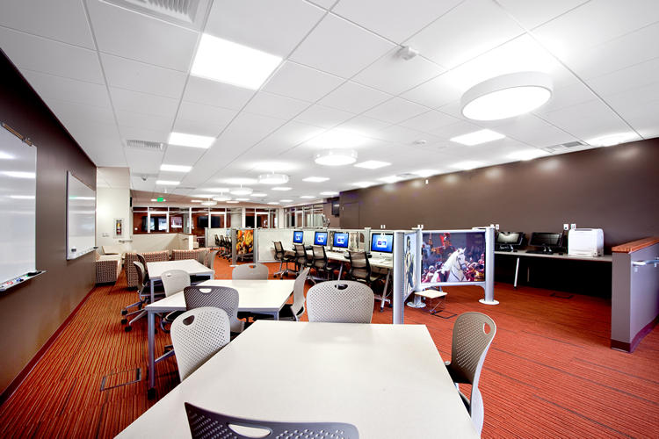
  MARKETPLACE
  Coworking environment

Slide 10
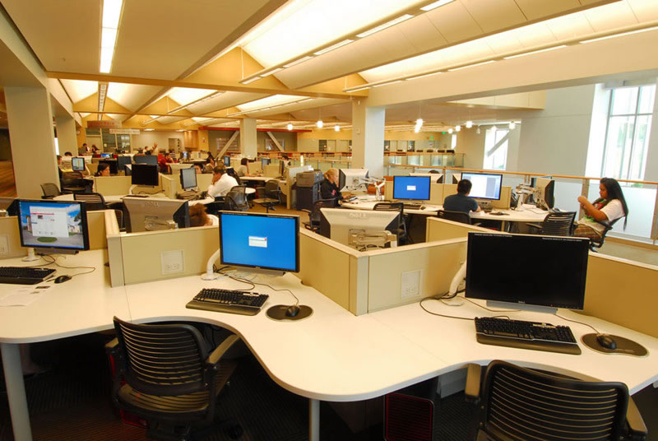
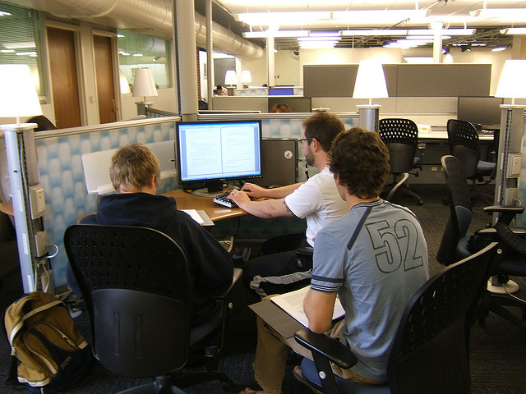
  KNOWLEDGE PARKS
  Focused areas for individuals & small groups

Slide 11
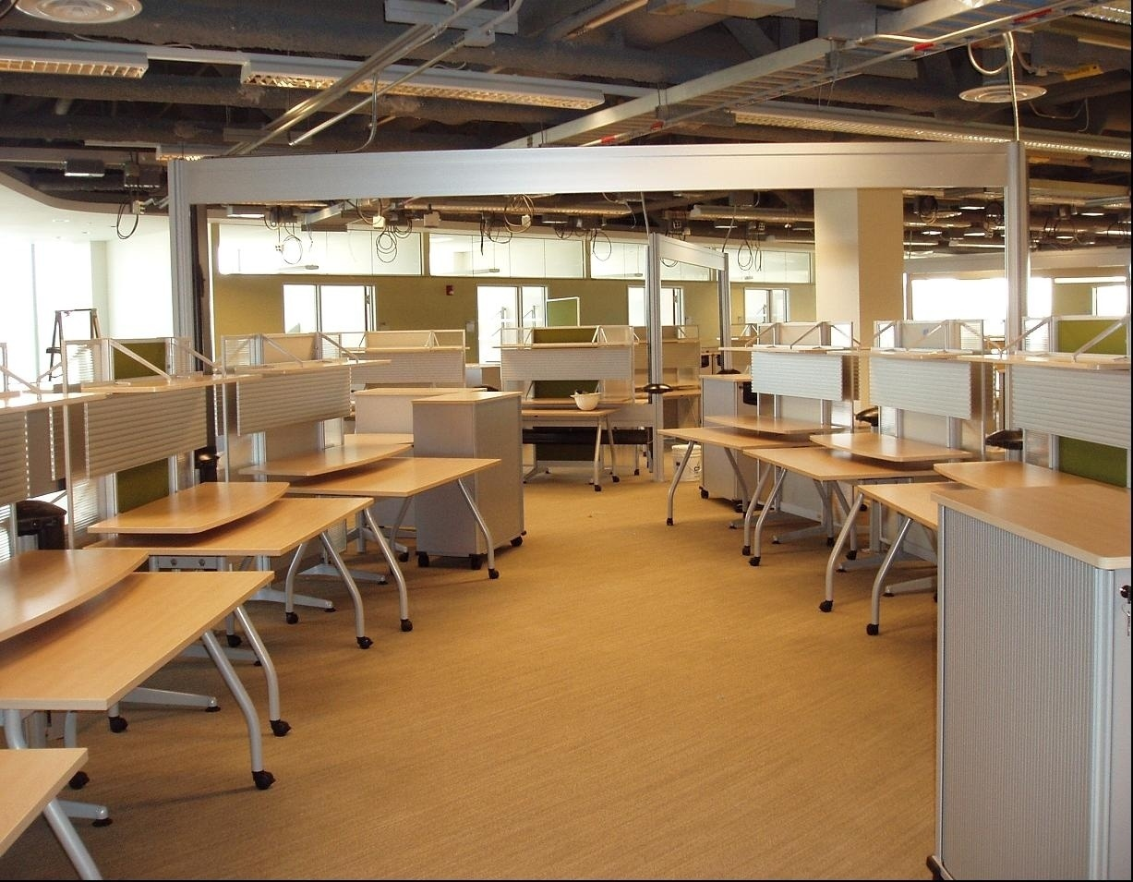
  KNOWLEDGE PARKS
  Focused areas for individuals & small groups

Slide 12
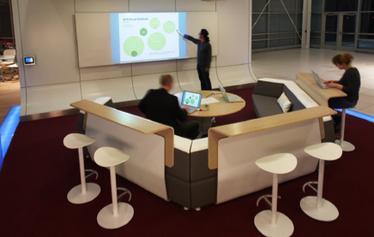
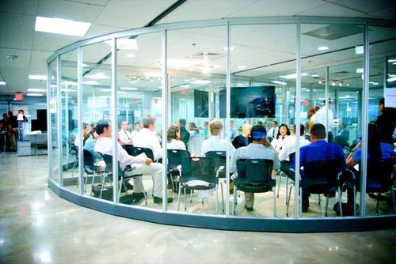
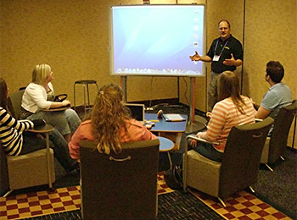
  LEARNING STUDIOS
  Reservable group spaces
Instructors
Tutors
Teaching Assistants
Librarians

Slide 13
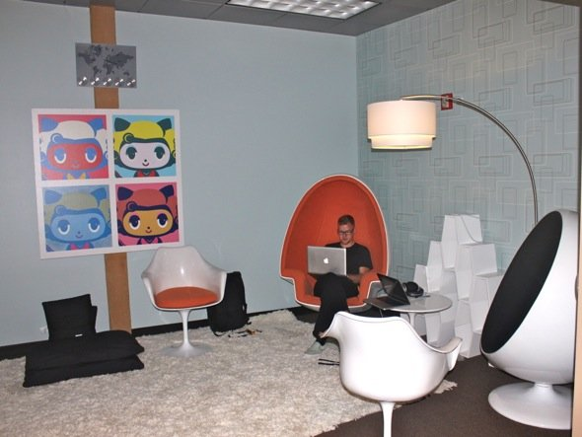
  A LEARNING PLATFORM
  Experiences & Encounters
Canvas
Stage
Gallery
Workshop
Studio
Lab
Discussion Hub
Discovery Center

Slide 14
  LIBRARY
  TRANSFORMATION
We are not just updating study space. We are reimagining and reprogramming the learning and research environment.

Slide 15
  LIBRARY
  TRANSFORMATION
For more information please visit:
www.lib.vt.edu/renovation

