Slide 1
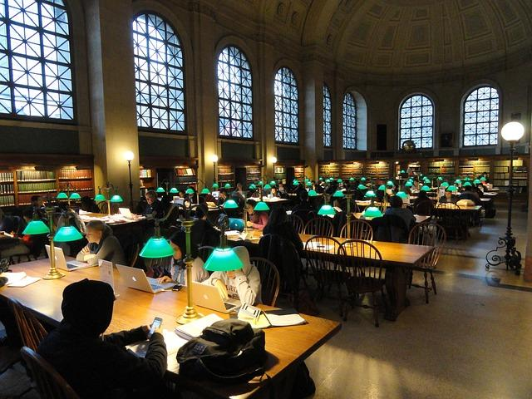

Integrating the Library into Online and Distance
Learning Environments
Ginny Pannabecker
Life Science & Scholarly Communication Librarian
Virginia Tech, University Librarires
GinnyP@vt.edu
This presentation is
licensed CC-BY 4.0

Slide 2
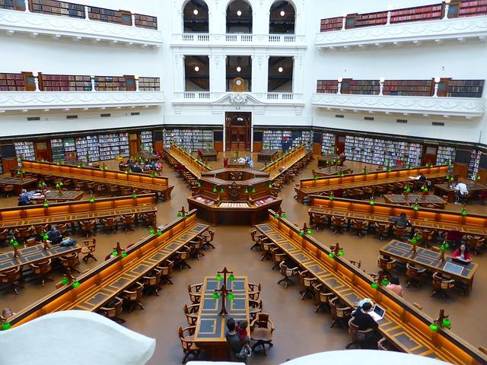
Library Roles in Distance Ed
Outreach & Placement
What’s available for learners & researchers?
Content & Copyright
What is available for teachers & trainers?
Teaching & Learning
How can content & teaching research skills be integrated within courses/programs?

Slide 3
Outreach & Placement
What is available for
distance learners & researchers?

Slide 4
In-House: Getting Started
Ask a Librarian
Chat, Email, Phone
Your resources & services
Online Learners
Skype,
Google Hangouts
Adobe Connect, Webex, Blackboard Collaborate:
online synchronous sessions with recordings.

Slide 5
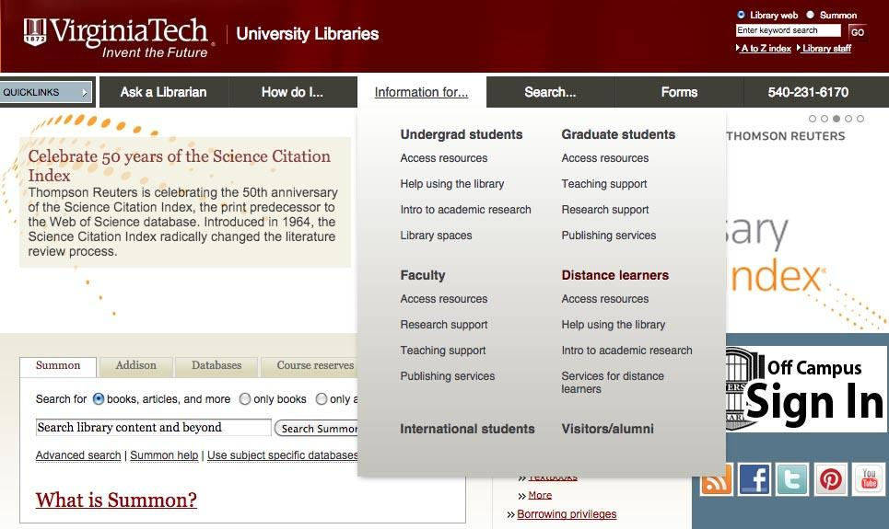
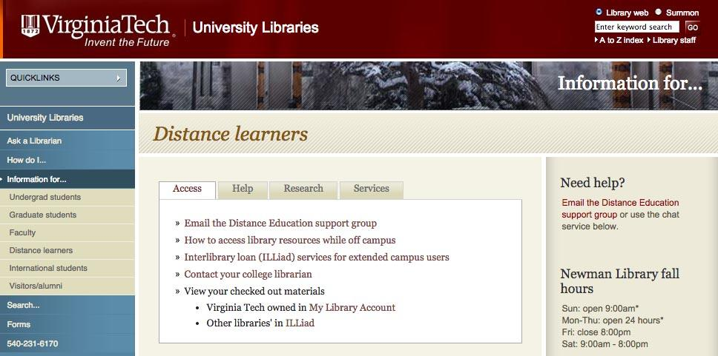
In-House: Distance Learner-Oriented Areas
Notes:
Library Orientation
-website page
-library guide
-widget / section in campus sign in platform
Even if you already have this info elsewhere, pulling together into in an area that addresses online learners can help make it obvious - it also makes it easy to provide this information quickly when asked to students, faculty, and others without having to constantly pull information together from separate areas.
Online and Distance-learner oriented discoverable information and assistance
Ask for feedback from online learners & others who connect with the library online
Program and course specific
Conversations w/faculty individually, then with program directors, connect with online program heads, connect with instructional designers
Library information
Libraries in th

Slide 6
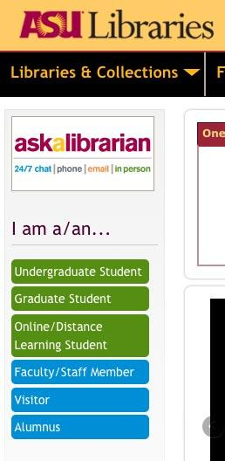
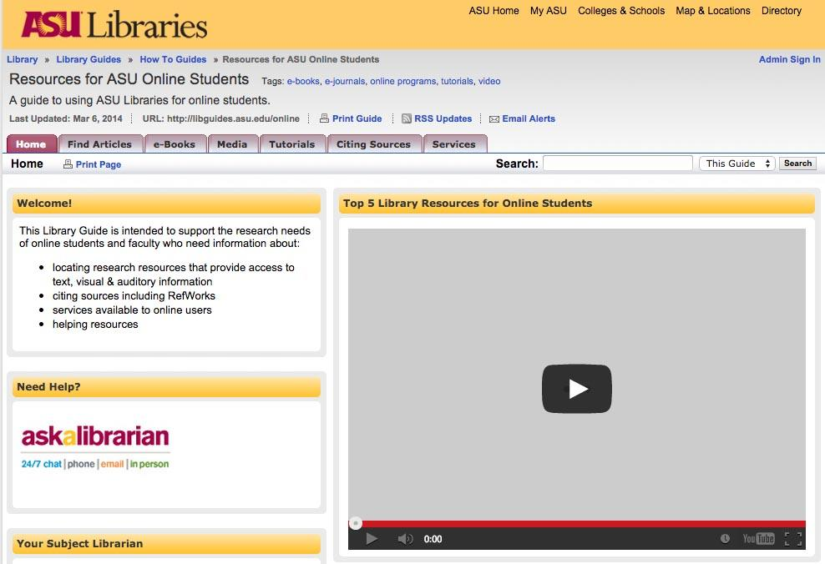
In-House: Distance Learner-Oriented Areas
Notes:
Library Orientation
-website page
-library guide
-widget / section in campus sign in platform
Even if you already have this info elsewhere, pulling together into in an area that addresses online learners can help make it obvious - it also makes it easy to provide this information quickly when asked to students, faculty, and others without having to constantly pull information together from separate areas.
Online and Distance-learner oriented discoverable information and assistance
Ask for feedback from online learners & others who connect with the library online
Program and course specific
Conversations w/faculty individually, then with program directors, connect with online program heads, connect with instructional designers
Library information
Libraries in th

Slide 7
Institution / Programmatic Roles:
Getting Started
Librarians to Institutional Technology Offices & Planners
How can we include a path to Library Resources & Services?
Your website & resources
Online Learners
Librarians to Online program staff, faculty, planners, and admins
How can we support you and your students?
Library integrated in online learning environments
Librarians to Teaching Support & Instructional Designers
We want to partner with you!
Notes:
Online and Distance-learner oriented discoverable information and assistance
Program and course specific
Conversations w/faculty individually, then with program directors, connect with online program heads, connect with instructional designers

Slide 8
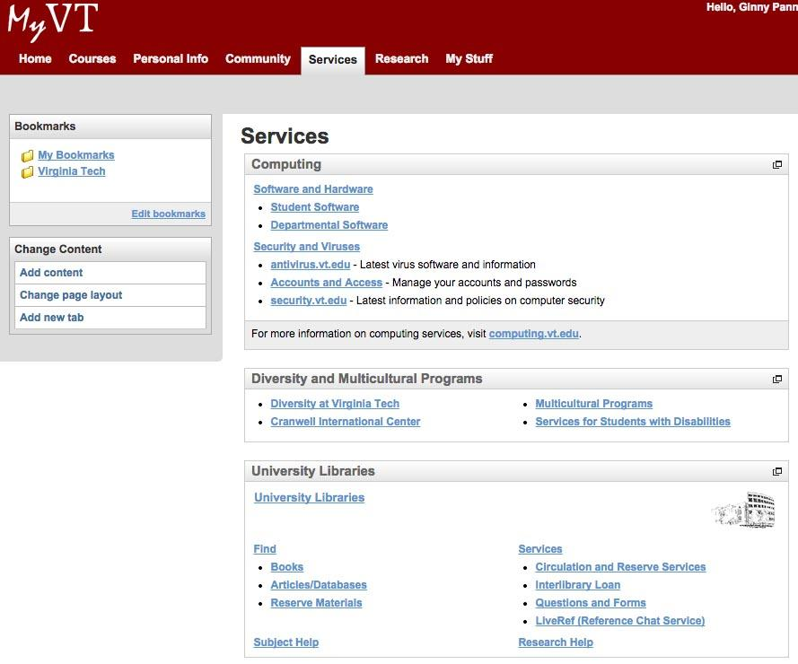
Institutional Pathways to
Library Resources & Services

Slide 9
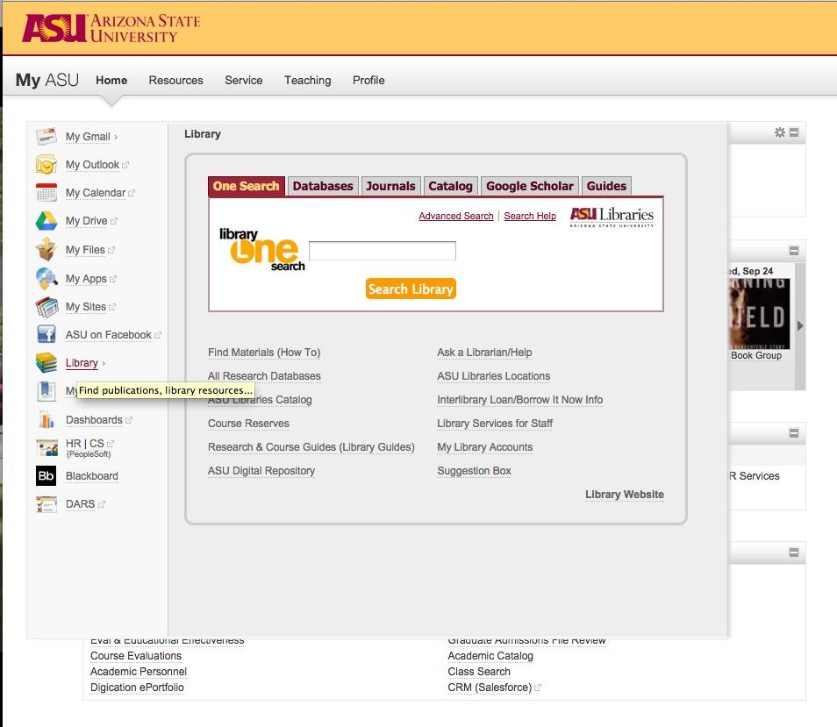
Institutional Pathways to
Library Resources & Services

Slide 10
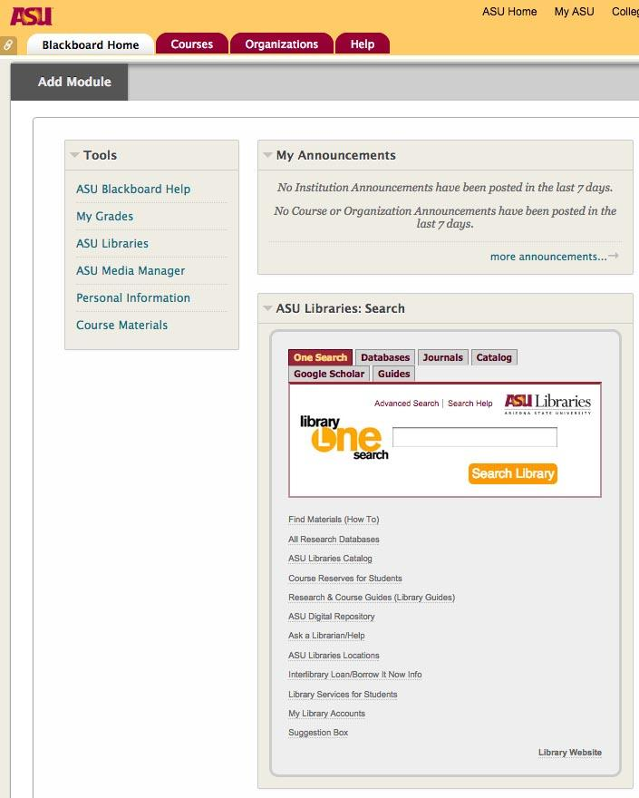
Institutional
Pathways
Library
Resources & Services in
Course Management Systems

Slide 11
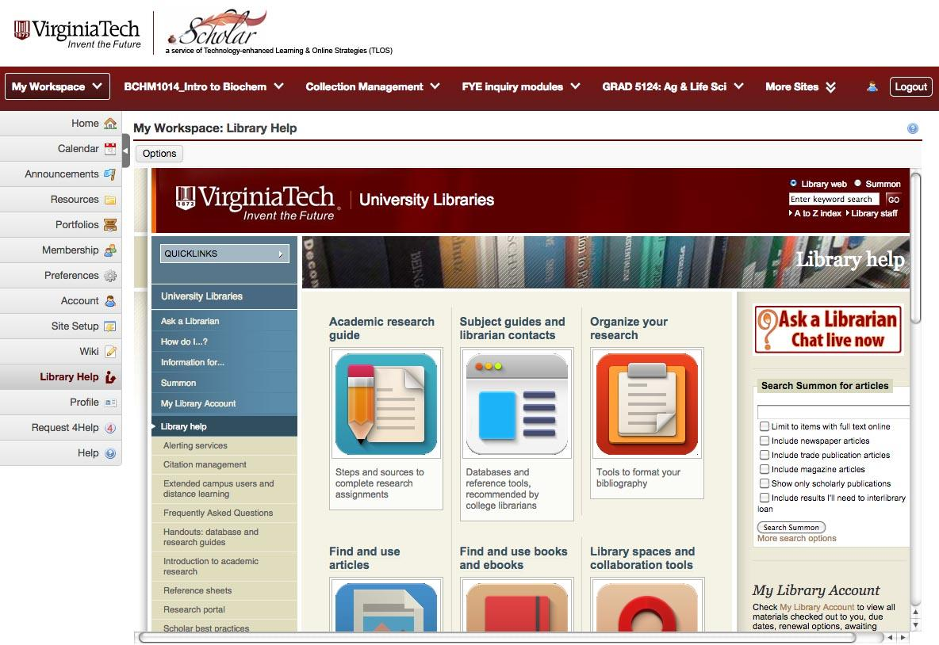
Institutional Pathways
Course Management Systems

Slide 12
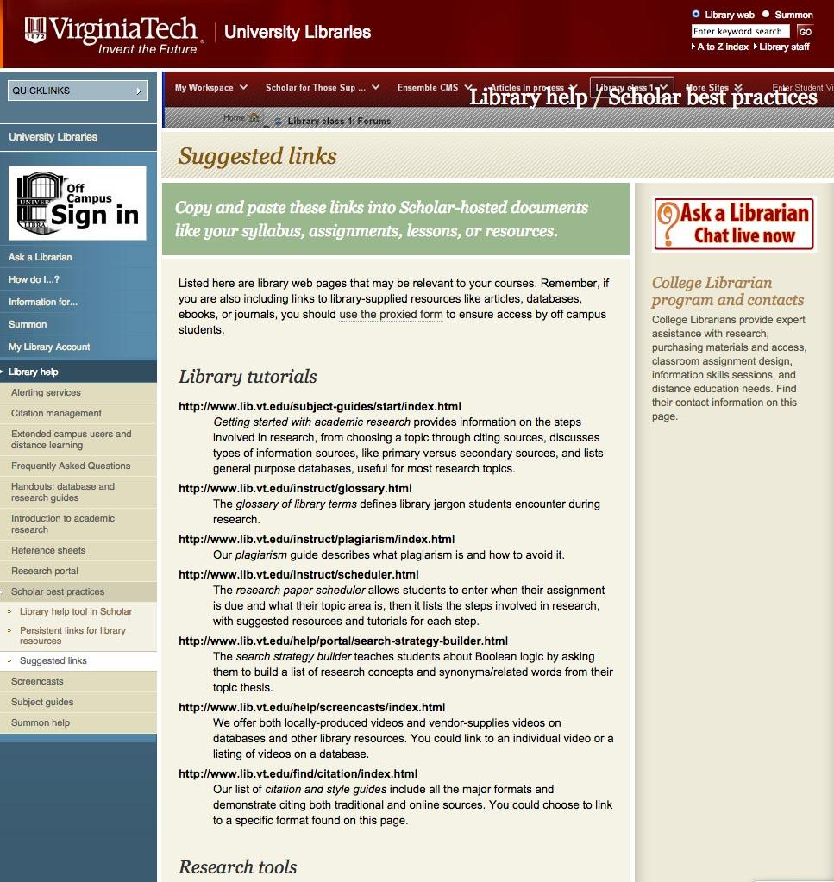
Tutorials
Notes:
stand alone - user paced
credit system: badges are an option; certificate; quiz
guide on the side
videos
interactive
Online workshop - how to session
Great resource
Specific focus
Library research skills
Resource-specific
website
library guide

Slide 13
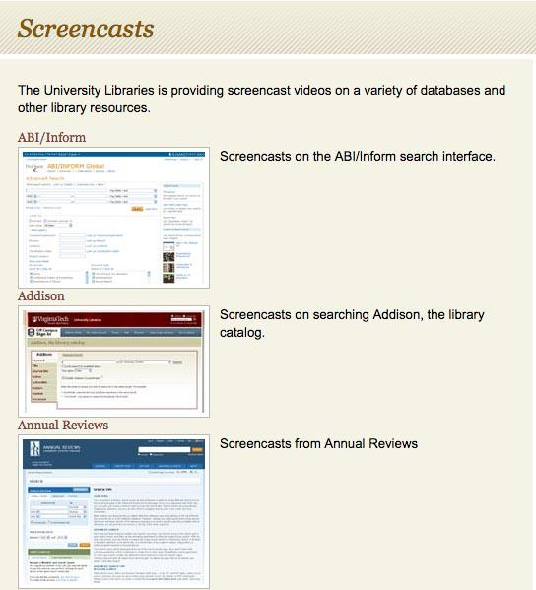
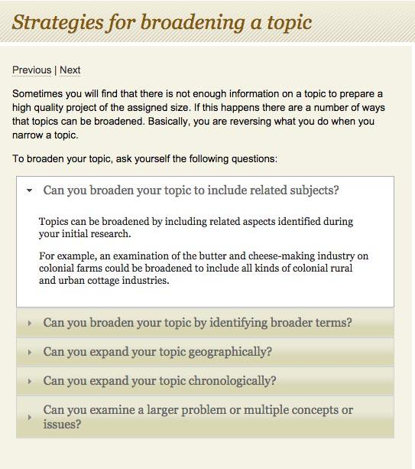
Tutorials
Notes:
stand alone - user paced
credit system: badges are an option; certificate; quiz
guide on the side
videos
interactive
Online workshop - how to session
Great resource
Specific focus
Library research skills
Resource-specific
website
library guide

Slide 14
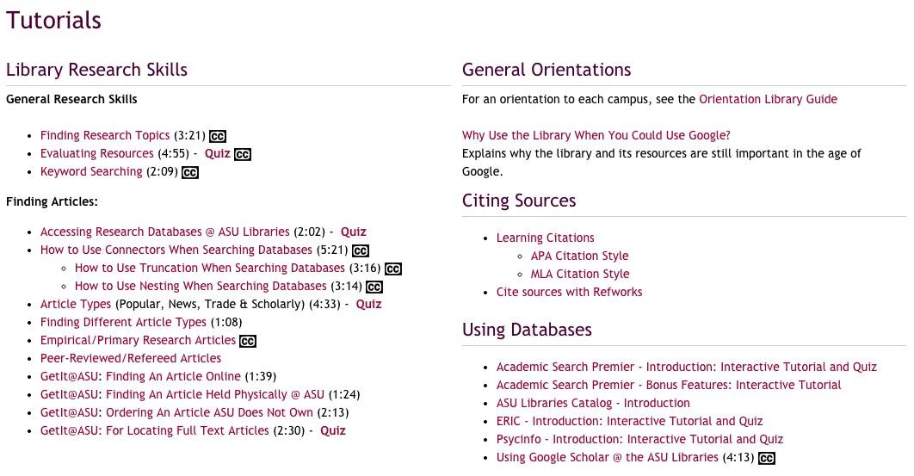
Tutorials
Notes:
stand alone - user paced
credit system: badges are an option; certificate; quiz
guide on the side
videos
interactive
Online workshop - how to session
Great resource
Specific focus
Library research skills
Resource-specific
website
library guide

Slide 15
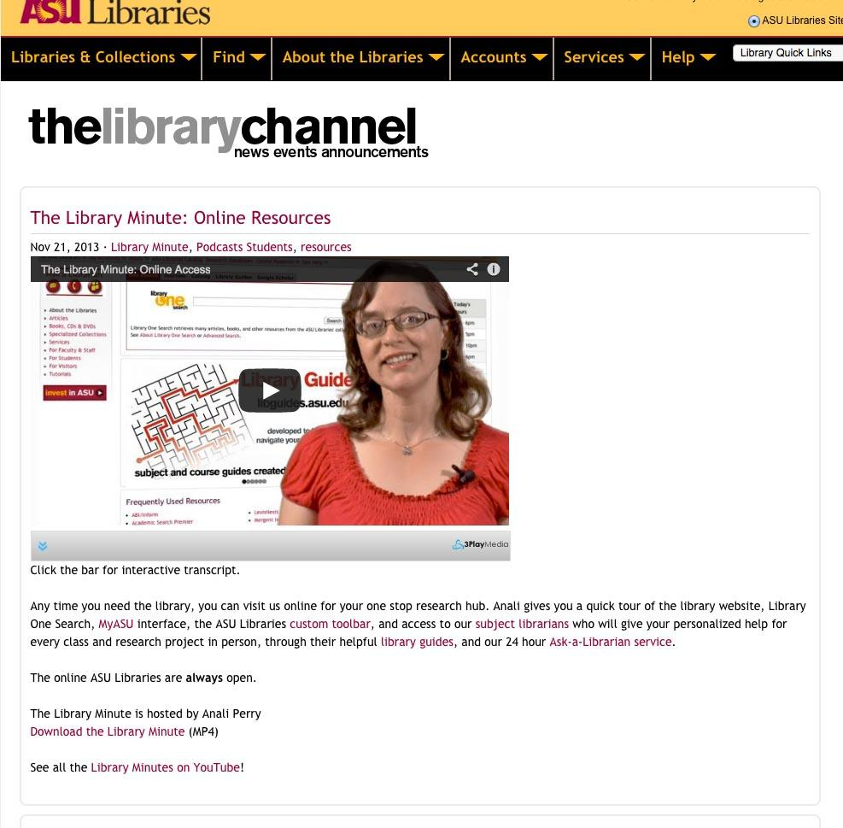
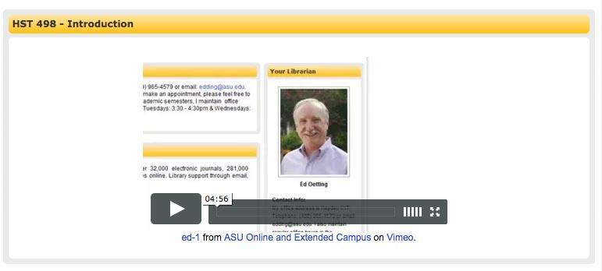
Tutorials
Notes:
stand alone - user paced
credit system: badges are an option; certificate; quiz
guide on the side
videos
interactive
Online workshop - how to session
Great resource
Specific focus
Library research skills
Resource-specific
website
library guide

Slide 16
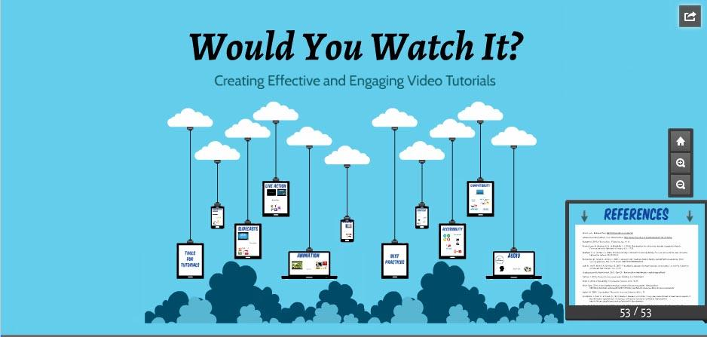
Tutorials: webinar recommendation
Blended Librarians Online Learning Community hosted this useful overview of tutorial creation tools and best practices by Nicole Martin and Ross Martin - Prezi version available.

Slide 17
Content & Copyright
What is available for teachers & trainers?

Slide 18
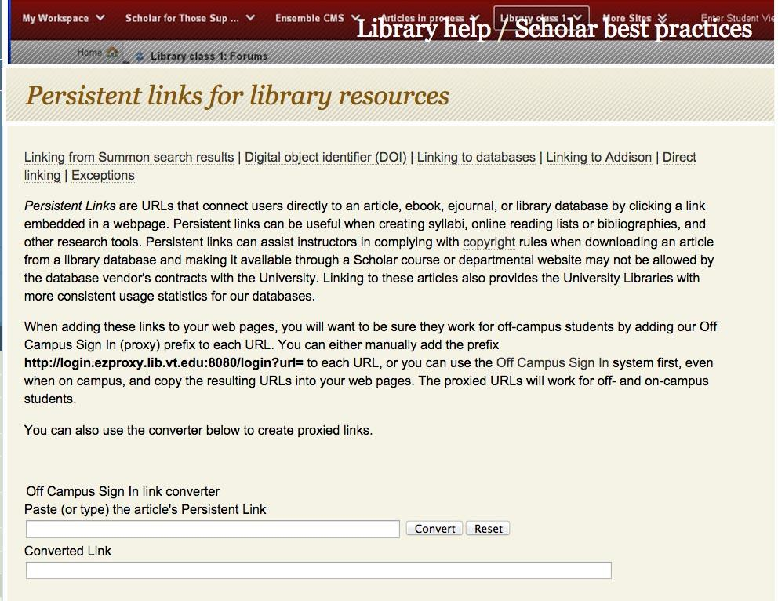
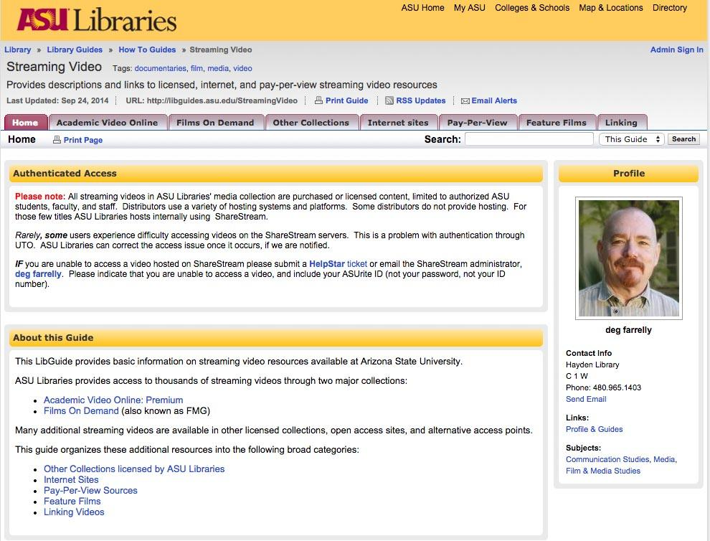
Content Sources: Library Resources
Notes:
library resources
http://www.lib.vt.edu/help/scholar/suggested-links.html
http://www.lib.vt.edu/help/scholar/persistentlinks.html
Online-useful content - videos (FMG, JOVE, Alexander Street Press…)
copyright
LINKING! B/c licensed!
support faculty / trainers
library resources / open resources

Slide 19

Copyright
Best Practices:
Institutional and Library Copyright guidelines for teaching and education
Copyright for Instructors information
Copyright guidelines and restrictions statements in online course sites
Notes:
Best practices: include a statement in each online course syllabus, with every item posted using Teach Act, Education, or Fair Use exemptions.
Library and institutional statements on copyright guidelines are also one way to improve your institution’s compliance with copyright law and add to the Fair Use side of the equation when making judgments.
https://www.lib.vt.edu/circ-reserve/reserve-instructors/reserve-copyright.html
http://scholar.lib.vt.edu/copyright/cprtinstructors.html
http://www.vt.edu/about/acceptable-use.html

Slide 20
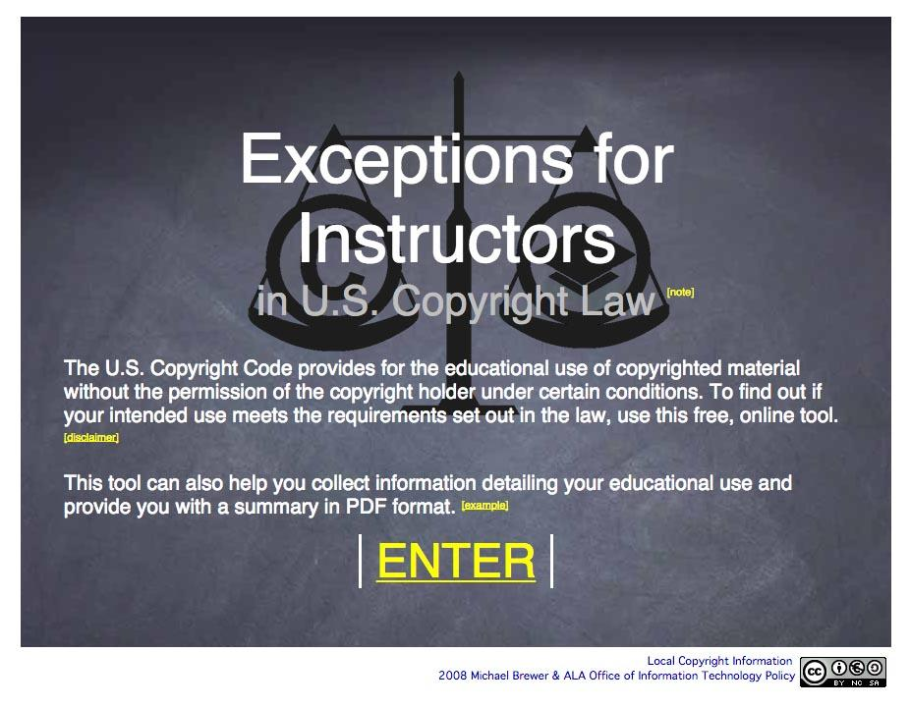
Copyright
Great, interactive tool to weigh educational use:

Slide 21
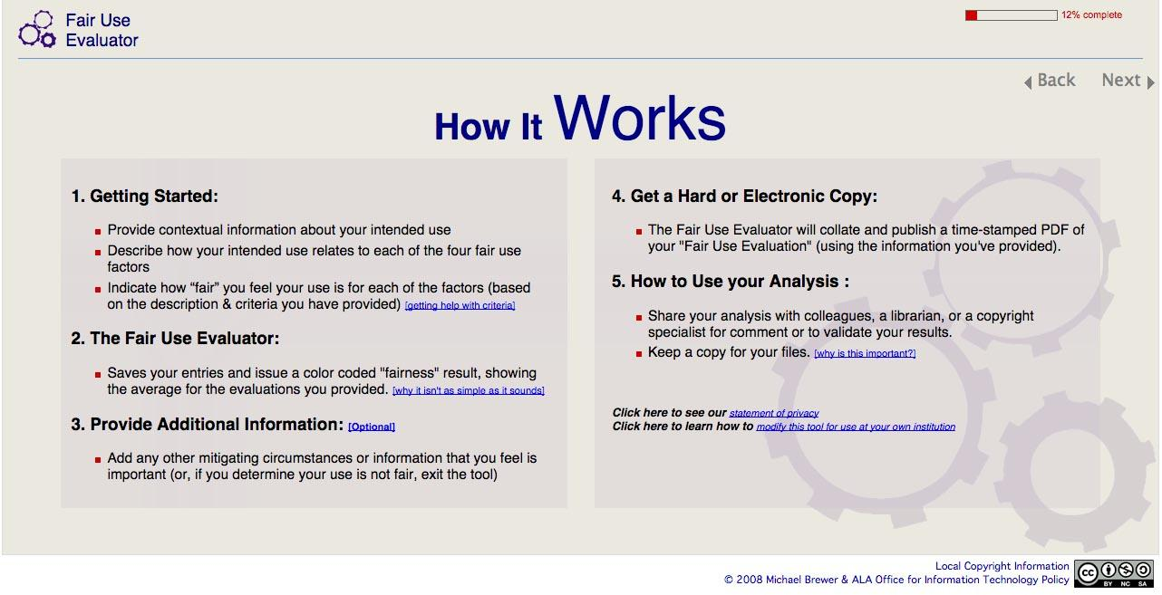
Copyright
Interactive tool to weigh fair use:

Slide 22
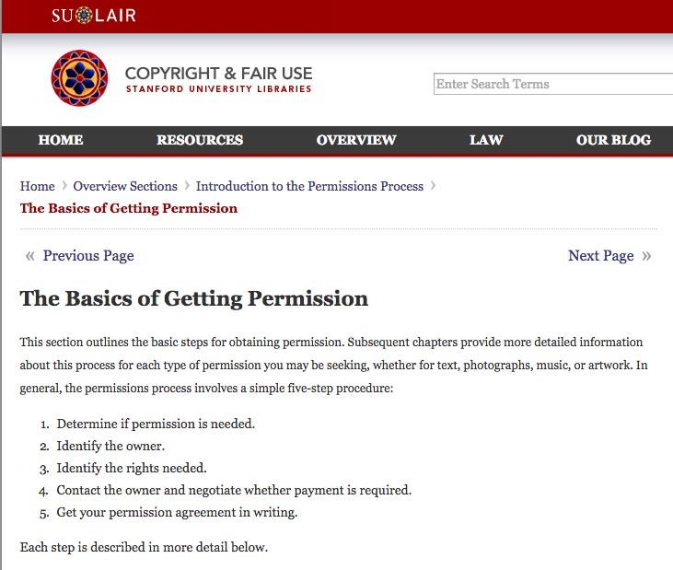
Copyright
The Basics of Getting Permission
- Stanford University Libraries

Slide 23

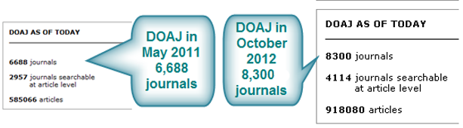


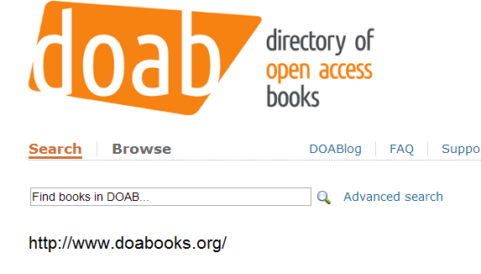



Open Access
Resources
Directory of Open Access Journals (DOAJ): http://www.doaj.org/
Open Access
Library Guide
libguides.asu.edu/openaccess

Slide 24









Open Educational Resources
Open Education
Library Guide
libguides.asu.edu/OpenEducation

Slide 25
Teaching & Learning
How can content & teaching research skills be integrated within courses/programs?

Slide 26

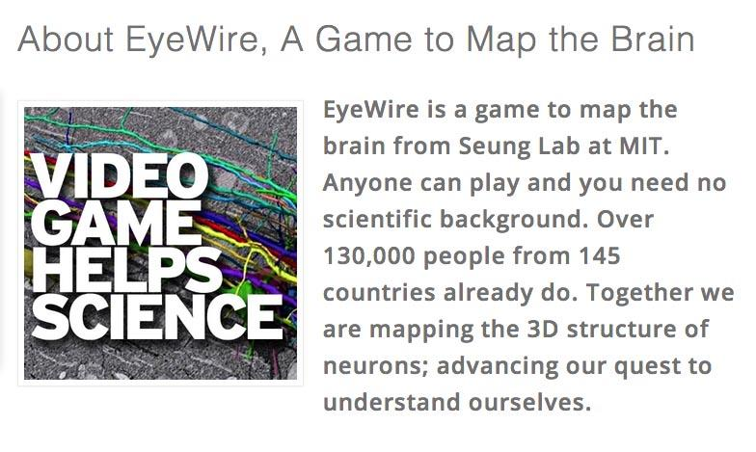
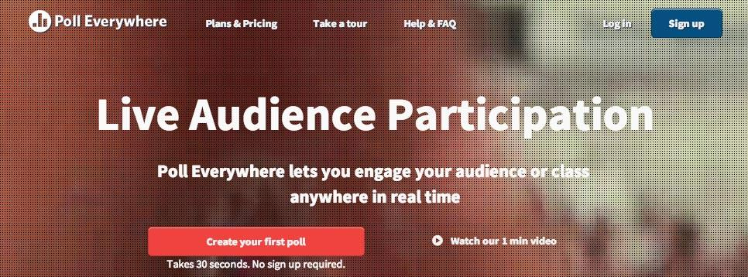
Ed Tech &
Emerging Interactive Ed Techniques
Notes:
Libraries are often in the know regarding many types of emerging technologies, including those useful for education. This is an area where you might explore how you can play a role in trying out emerging or known ed technologies, sharing best practices and examples of their use, hosting fora or showcase days to share gadgets, tech, and uses, or even provide sofware (conferencing systems), online tools (poll everywhere), or devices (ipads, etc.).

Slide 27
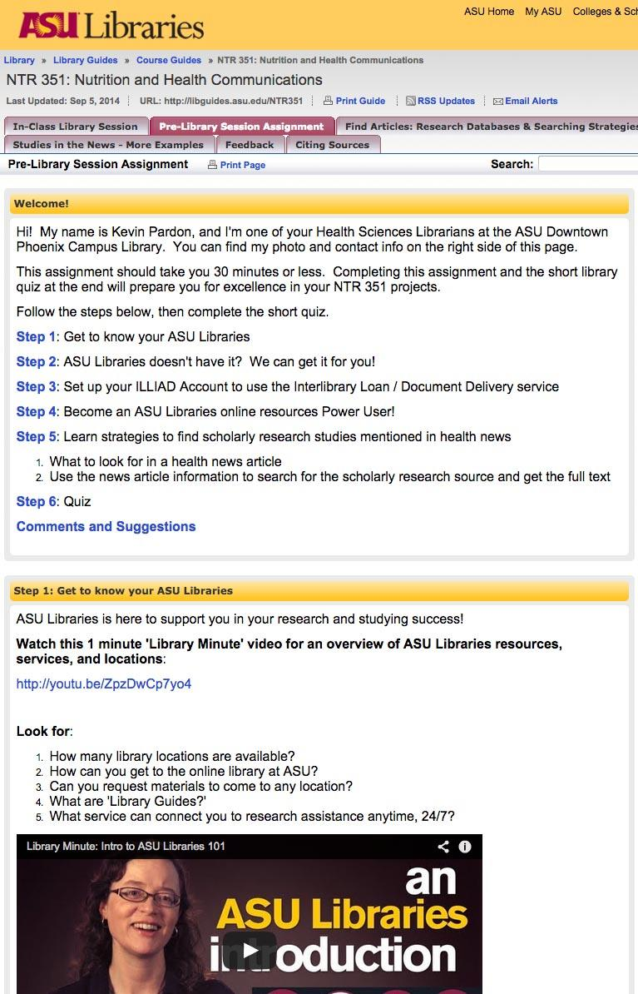
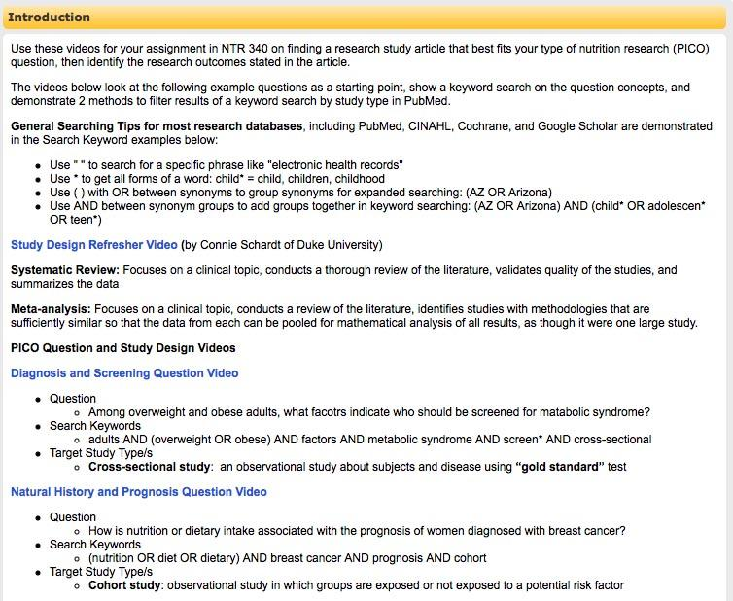
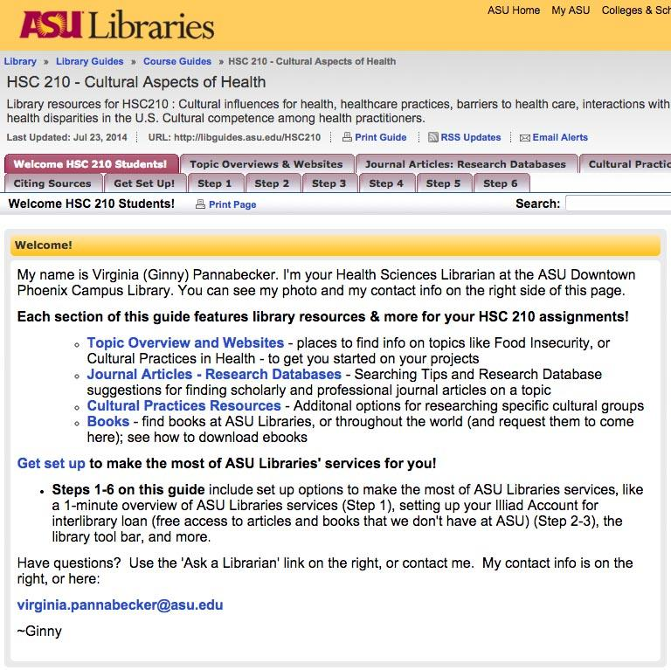
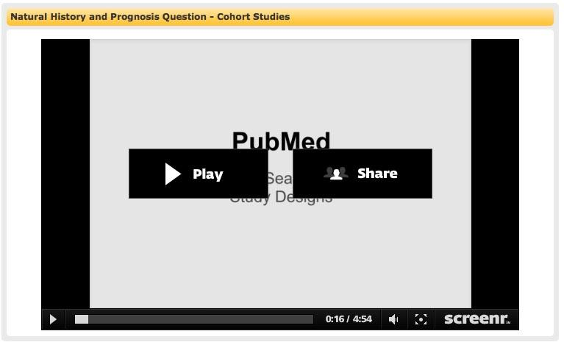
Integration with Courses
Course-Specific
Interactive
Library
Assignments or Tutorials
Instructor
Support:
Assignment
Design
Course
Guides
Discussion
Boards
Notes:
Instructor support
Library Guides
Assignments
Discussion Boards

Slide 28
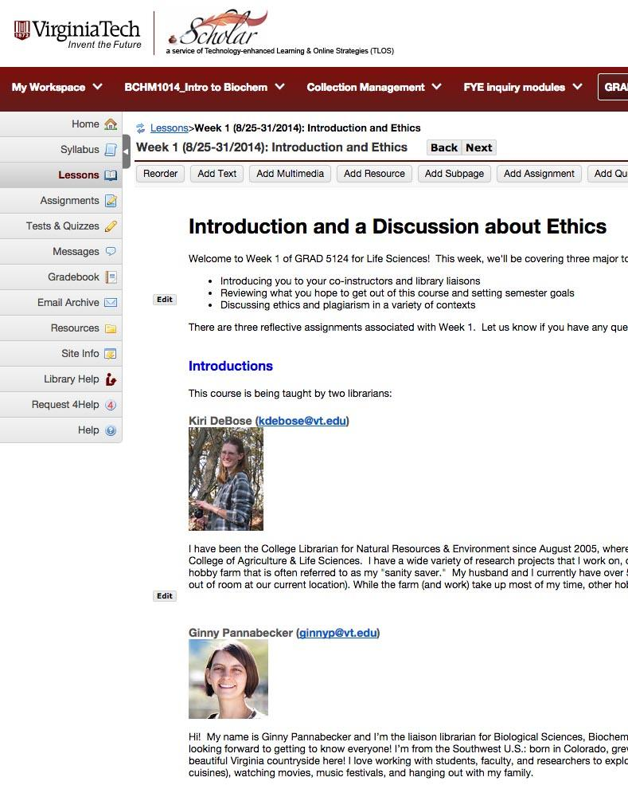
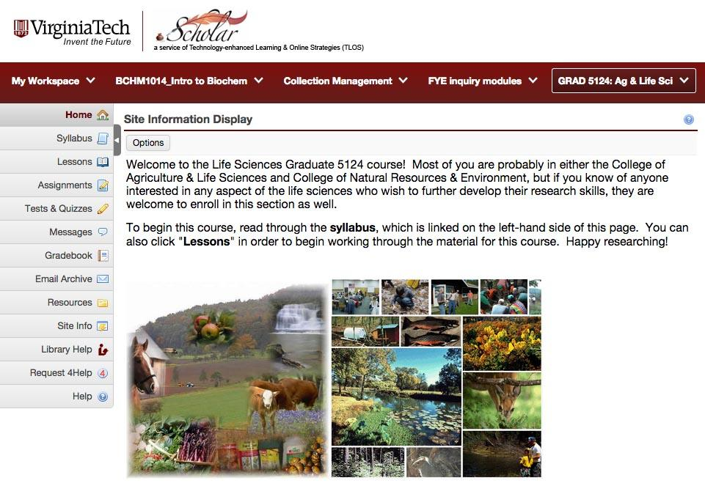
Library Course / Modules
Notes:
scheduled, direct and individualized feedback

Slide 29
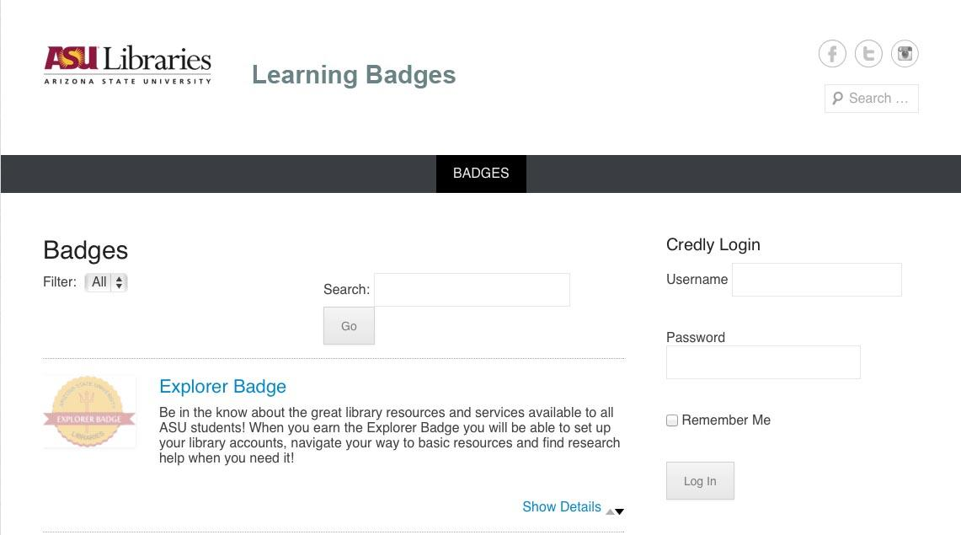
Library Course / Modules

Slide 30

Assessments & Feedback
Quizzes
Surveys
Comments
Course-specific assignments
Online forms with embeddable options
Quiz tools in tutorial software or course sites
Course site dropbox for lengthier assignments
Notes:
Assess whether learning occured
Gather feedback for constant improvement

Slide 31
Image Sources
All screenshots taken by Ginny Pannabecker using the Mac Grab utility application.
Additional photo and image sources*
  http://pixabay.com/en/boston-public-library-boston-85885/
  http://pixabay.com/en/monitor-isolated-display-white-313011/
  http://pixabay.com/en/book-books-circle-curly-education-2869/
  http://pixabay.com/en/library-formal-pattern-librarian-431445/
  http://pixabay.com/en/copyright-sign-symbol-icon-98570/
  http://pixabay.com/en/ipad-tablet-apple-android-os-153155/
  http://pixabay.com/en/checklist-check-marketing-project-154274/
  http://pixabay.com/en/question-mark-question-characters-452707/
*All photos and images are public domain. They are linked here as examples of openly licensed online materials.

Slide 32

Ginny Pannabecker
Life Science & Scholarly Communication Librarian
Virginia Tech, University Librarires
GinnyP@vt.edu

Slide 33
References
Distance-Learner Oriented Library page examples
Virginia Tech University Libraries - http://www.lib.vt.edu/index.html
Info for Distance Learners: http://www.lib.vt.edu/info/distance.html
Tutorials & other resources for course integration: http://www.lib.vt.edu/help/scholar/suggested-links.html
Creating Persistent Links for course integration: http://www.lib.vt.edu/help/scholar/persistentlinks.html
ASU Libraries - https://lib.asu.edu/
Resources for Online Students library guide: http://libguides.asu.edu/online
Tutorials page: https://lib.asu.edu/tutorials
Library Minute video series: https://lib.asu.edu/librarychannel/library-minute
Streaming Video library guide: http://libguides.asu.edu/StreamingVideo
Open Access resources library guide: http://libguides.asu.edu/openaccess
Open Educational Resources - General and for Health Sciences
Open Educational resources for health sciences (previous MLA 2014 presentation w/5 min video and reference list): http://hdl.handle.net/2286/R.I.24440
Course Supporting and Integrated Assignments and Library Course Guide examples
NTR 340 library course guide - nutrition EBP videos and overview: http://libguides.asu.edu/content.php?pid=512302&sid=4215451
HSC 210 library course guide - all online course resources for research: http://libguides.asu.edu/HSC210
NTR 351 library course guide - self-paced step by step online assignment for research skills and library overview: http://libguides.asu.edu/content.php?pid=371168&sid=4572666
Tutorial webinar recommendation
Would you watch it? Creating effective and engaging video tutorials
Prezi: http://prezi.com/inilxzumbha-/would-you-watch-it-creating-effective-and-engaging-video-tutorials/
Recording soon to be posted at: http://blendedlibrarian.learningtimes.net/

Slide 34
References
Copyright
Interactive tool - Exceptions for Instructors in U.S. Copyright Law: http://www.librarycopyright.net/resources/exemptions/
Fair Use Evaluator: http://www.librarycopyright.net/resources/fairuse/howitworks.php
Basics of Getting Permission: http://fairuse.stanford.edu/overview/getting-permission
Networking, Training, and Discussion Resources
EMTS (Educational Media and Technology Section) of MLA: http://emts.mlanet.org/
Blended librarians: http://blendedlibrarian.learningtimes.net/
EDUCAUSE: http://www.educause.edu/
7 Things You Should Know (or ask) (when trying a new technology): http://www.educause.edu/research-and-publications/7-things-you-should-know-about
Blended and Online Learning Constituent Group: http://www.educause.edu/discuss/teaching-and-learning/blended-and-online-learning-constituent-group
ACRL Distance Learning Section: http://distancelearningsection.wordpress.com/
Online and Distance Learning Standards
Quality Matters Rubric
Online course design guidelines: https://www.qualitymatters.org/rubric
ACRL Standards for Distance Learning Services
Current: http://www.ala.org/acrl/standards/guidelinesdistancelearning
Draft: http://distancelearningsection.wordpress.com/new-standards-for-distance-learning-library-services/
This Presentation is licensed with a CC-BY 4.0 open license:
http://creativecommons.org/licenses/by/4.0/

Slide 35
Tools
Screenshots
  Grab, Snippy, Snagit
Image editor
  Photoshop, Paint, Awesomescreenshot
Tutorial creation
  Screenr: https://www.screenr.com/
  Guide on the Side: http://code.library.arizona.edu/
  LessonPaths: http://www.lessonpaths.com/
Surveys
  Google Forms, SurveyMonkey, LibGuides tools
Platform
  Library Guide, Course Management system, Wiki

Slide 36
Images for use in online settings
General image search options that will lead to creative commons licensed / public domain images for use in online courses, presentations, websites, and other online environments.
Pixabay
http://pixabay.com/en/
-- Per Pixabay's FAQ, "On Pixabay you may find and share images free of copyrights. All pictures are published under Creative Commons public domain deed CC0<http://creativecommons.org/publicdomain/zero/1.0/>."http://pixabay.com/en/service/faq/
--Images from this site often come up in a Creative Commons Search (next option) since they are licensed for free re-use by anyone. Sometimes you can't use the largest file size unless you sign up, but that's not usually a problem for me.
--Pixabay images do not even require attribution as they are made available under the most free version of Creative Commons licensing.
Creative Commons Search
http://search.creativecommons.org/
--Search any topic you like and click on the provider you prefer - the results are filtered to include all or mostly items that have a creative commons license for re-use (usually just with attribution - such as a link to the image file in small print at the bottom right of the image, or in a credit note)
a. I prefer using this search with Flickr or Wikimedia Commons first because they include explicit rights on eachimage file and they use creative commons licensing so that you know the images are okay to reuse
b. Google Images is often good as well (and better via this Creative Commons filter), but occasionally takes a little time to find an image that is definitely licensed for re-use

Slide 37
Medical Images
Free and online, but check for usage restrictions/statements on each site - (most images offered by government agencies are public domain unless special circumstances apply and are stated)
More Medical Image Sources in Shared Google Doc:
http://tinyurl.com/MedImagesOnline-MLAEMTS-Sep14
http://www.photoshare.org/ - Photoshare, "Thousands of International Health and Development Images, Free for nonprofit and educational use." - supported by Johns Hopkins University
https://imagebank.nih.gov/ - NIH Image Bank, "The NIH Image Bank contains images from the collections of the 27 Institutes and Centers that comprise the National Institutes of Health<http://www.nih.gov/>. Contents include general biomedical and science-related images, clinicians, computers, patient care-related images, microscopyimages, and various exterior images."
Copyright Statement (Public Domain for most/all): "No fee is charged for using the images. However, credit MUST be given to the National Institutes of Health/Department of Health and Human Services unless otherwise instructed to give credit to the photographer or other source. NIH images are in the public domain and CANNOT be copyrighted. Images may be used, linked, or reproduced without further permission from NIH."
http://library.med.utah.edu/heal/ - HEAL - Health Education Assets Library - "The Health Education Assets Library (HEAL) is a collection of over 22,000 freely available digital materials for health sciences education. The collection is now housed at the University of Utah J. Willard Marriott Digital Library."
Copyright: Unrestricted use for educational purposes
http://phil.cdc.gov/Phil/home.asp - Public Health Image Library - images from the CDC
Copyright: Public Domain
http://lifeinthefastlane.com/ - FOAMed (Free Open Access Meducation) resources - ***TIP*** Use the site search to search for something you want an image of, like: heart - Then, a page of results will come up with a tab for 'Image.'
Creative Commons Attribution ShareAlike licensed:
"LITFL is free and open to all — we invite you to use our content in anyway to help others learn, all we ask is that you spread the word about the FOAM<http://lifeinthefastlane.com/foam/> (Free Open Access Meducation) revolution...and get #FOAMed<https://twitter.com/#!/search/%23foamed>!"

