Slide 1


Strategic Management
Chapter 10
Executing Strategy and Organizational Design
Unless otherwise noted, this slide deck is (c) Virginia Polytechnic Institute and State University. It is released under a Creative Commons Attribution NonCommercial ShareAlike 3.0 license (CC BY NC-SA 3.0)
Instructor Name | Name of Institution
http://hdl.handle.net/10919/102735
Photo by Jon Sailer on Unsplash

Slide 2
Four Ways to Structure an Organization
  Line Organizations
  Line-and-Staff Organizations
  Matrix-Style Organizations
  Cross-Functional Self-Managed Teams (Boundaryless)
http://hdl.handle.net/10919/102735

Slide 3
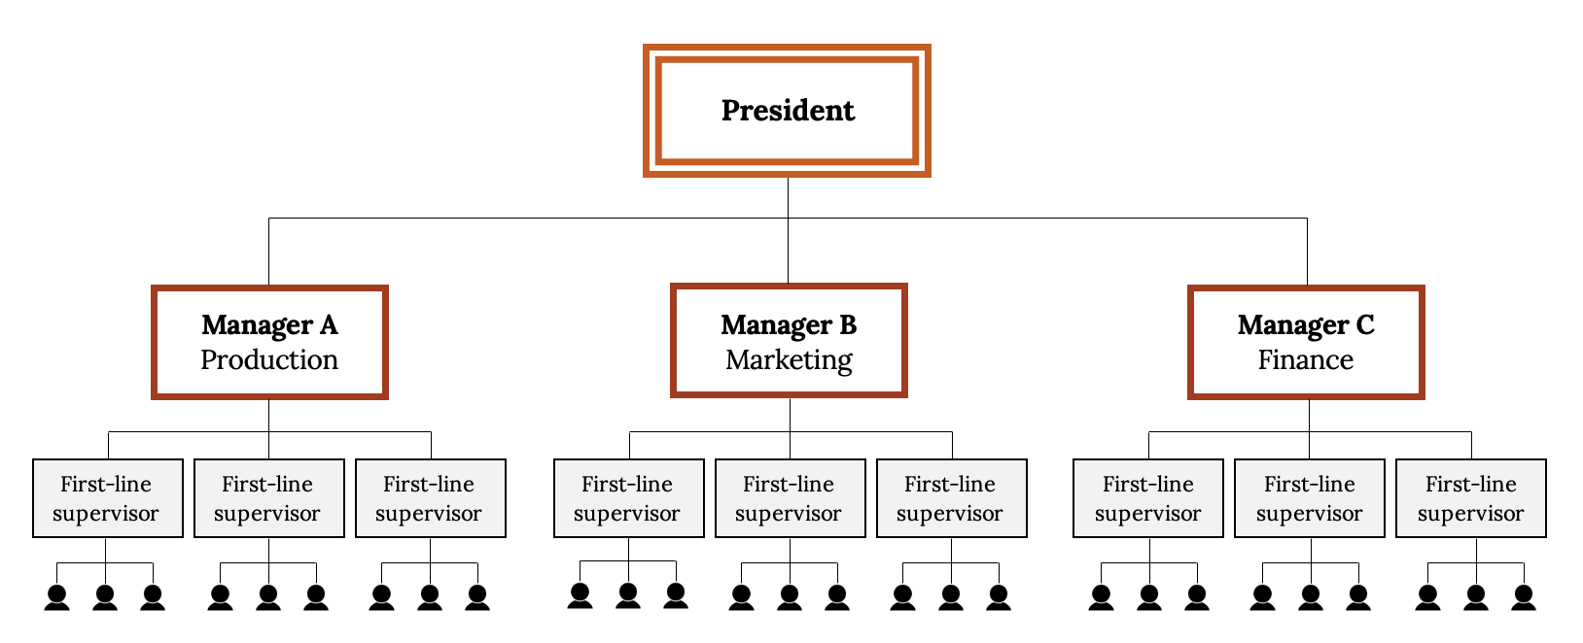
Typical Organization Chart Functional
Span of Control, Flat vs. Tall, Departmentalization
Kindred Grey (2021). “Typical Organization Chart Functional.” CC BY SA 4.0. Icons are ‘person’ by Guilherme Furtado from the Noun Project. Retrieved from https://commons.wikimedia.org/wiki/File:Typical_Organization_Chart_Functional.svg
Notes:
Hyundai 5 VPs

Slide 4
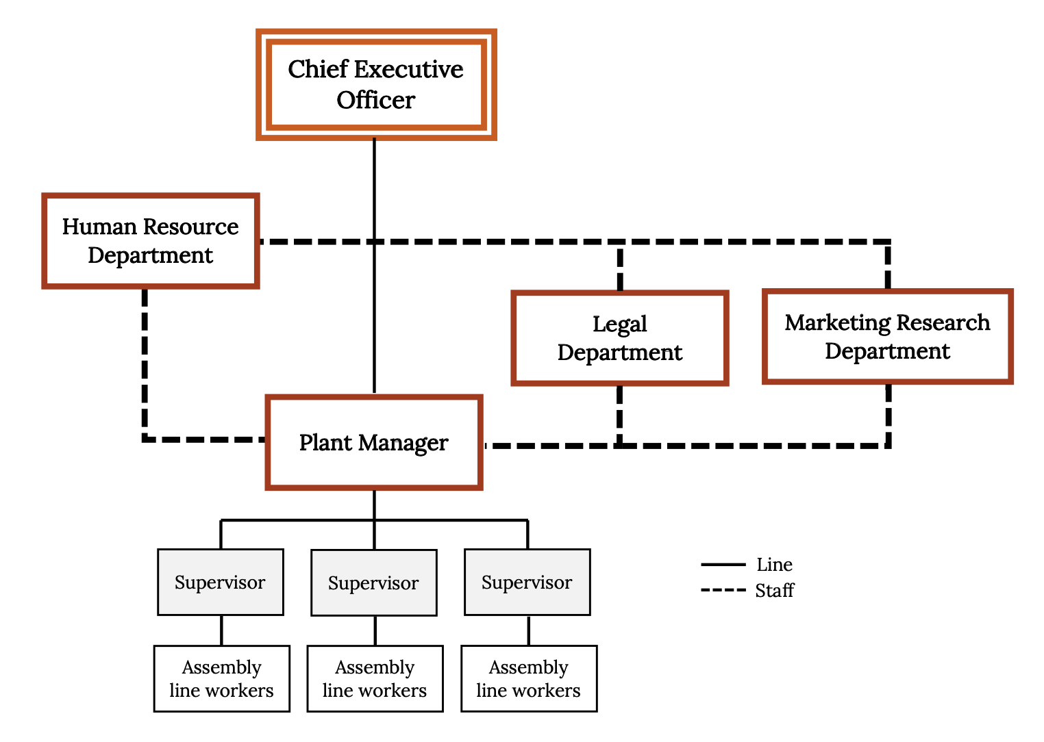
Sample Line-and-Staff Organization
Kindred Grey (2021). “Sample Line-and-Staff Organization.” CC BY SA 4.0. Retrieved from https://commons.wikimedia.org/wiki/File:Sample_Line-and-Staff_Organization.svg

Slide 5
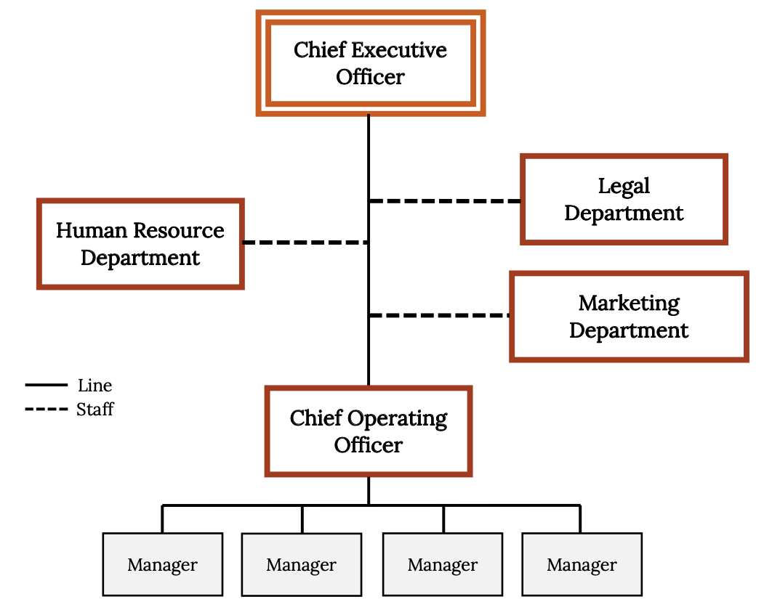
Sample Line-and-Staff Organization Simplified
Kindred Grey (2021). “Sample Line-and-Staff Organization Simplified.” CC BY SA 4.0. Retrieved from https://commons.wikimedia.org/wiki/File:Sample_Line-and-Staff_Organization_Simplified.svg

Slide 6
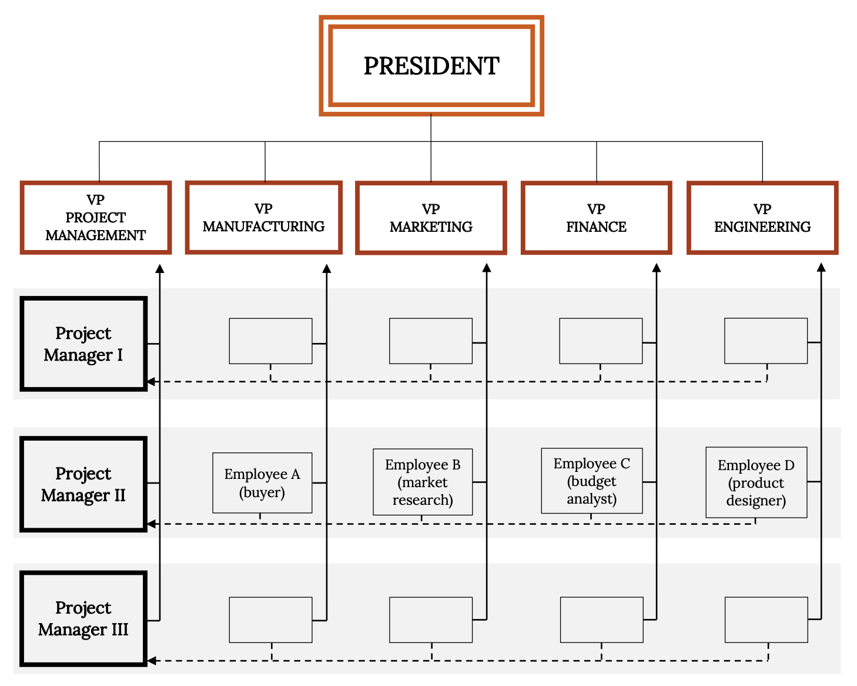
Sample Matrix Organization
Kindred Grey (2021). “Sample Matrix Organization.” CC BY SA 4.0. Retrieved from https://commons.wikimedia.org/wiki/File:Sample_Matrix_Organization.svg

Slide 7
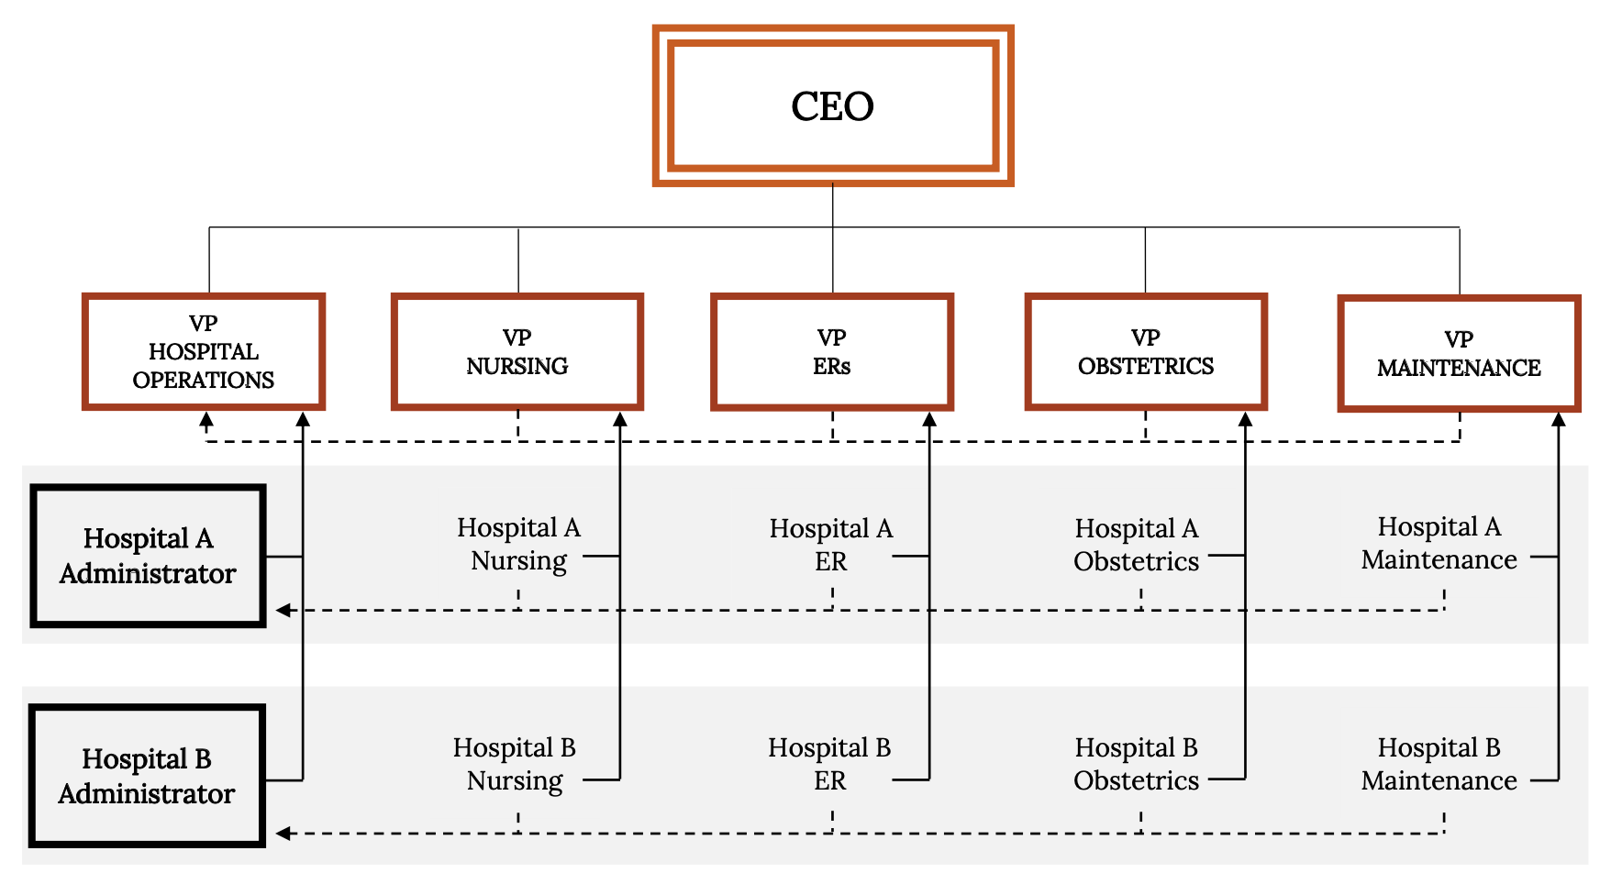
Example Matrix Organization Sentara Hospital System
Kindred Grey (2021). “Example Matrix Organization Sentara Hospital System.” CC BY SA 4.0. Retrieved from https://commons.wikimedia.org/wiki/File:Example_Matrix_Organization_Sentara_Hospital_System.svg

Slide 8
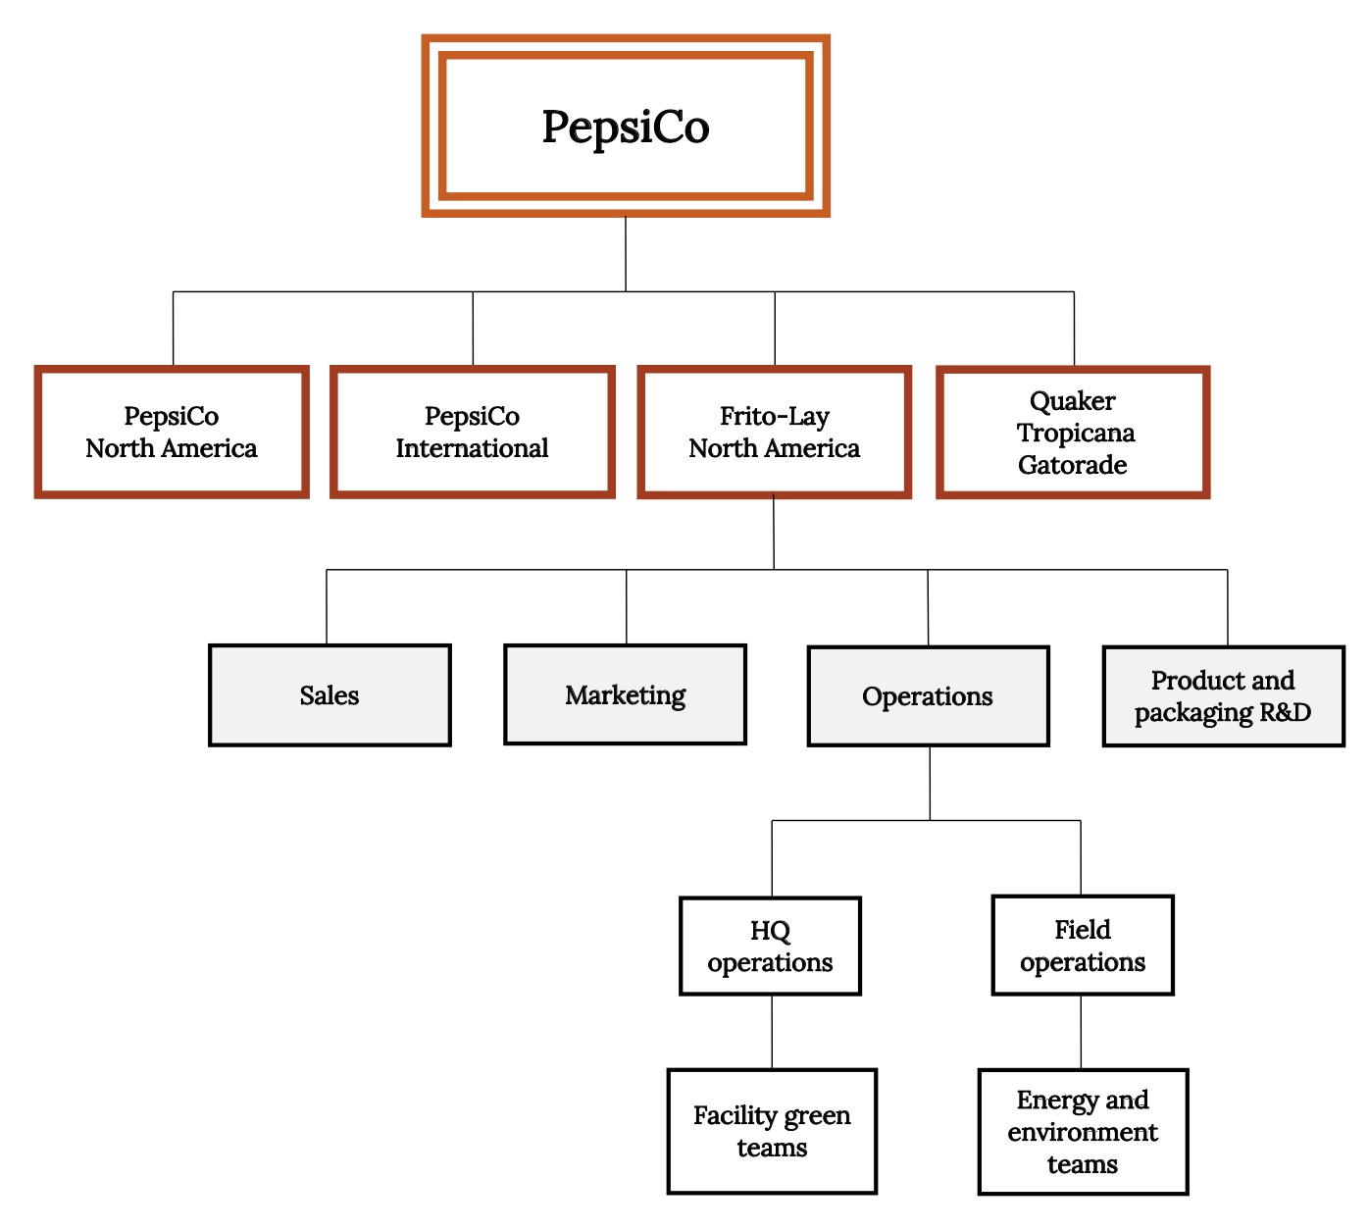
Divisional Structure
Kindred Grey (2021). “Divisional Structure.” CC BY SA 4.0. Retrieved from https://commons.wikimedia.org/wiki/File:Divisional_Structure.svg

Slide 9

Class Exercise
In groups of 2-3, design a divisional organization for Whole Foods
Now design a matrix organizational structure for Whole Foods
Now 2 come up to the board
  One draw the divisional structure
  One draw the matrix structure
Which structure would best suit Whole Foods
for executing its strategy?
  Divisional, Matrix, or Boundaryless???
Source: https://unsplash.com/photos/VLjIWo_Kmao
http://hdl.handle.net/10919/102735

Slide 10
Legal Forms of Business
Sole Proprietor
Partnership
Limited partnership
LLC
S Corporation
C Corporation
http://hdl.handle.net/10919/102735

Slide 11
Strategy for Deciding Which Form of Business?
Capital?
Taxes?
Liability?
Ease of Operation
http://hdl.handle.net/10919/102735
Notes:
Capital – what is the best source of start-up capital and additional capital needs? Owner investment, partners, other investors, bank loans, stock sales
Taxes – which form best for minimizing taxes?
Liability - which form best protects owners from liability?

