Slide 1
Parquet Containers
Matthew Coscia and Andrew Weber
CS 4624 Multimedia, Hypertext, and Information Access, Dr. Fox, Virginia Tech, Blacksburg VA, 24061, 5/4/2022

Slide 2
Outline
Background
Goals
Timeline
Work Completed/Challenges
Future Work
Lessons Learned
Acknowledgements and References

Slide 3
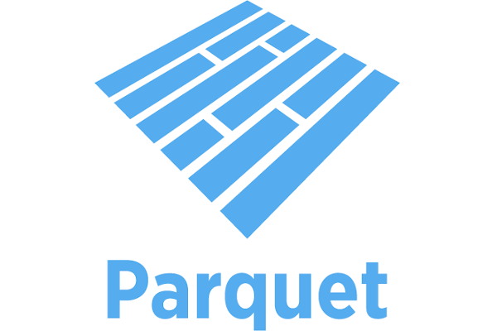
Background
Digital Library Research Laboratory currently stores Web Archive (WARC) data
WARC is a row based file format
New Twitter collections in JSON format
Apache Parquet format
Column-based data storage

Slide 4
Advantages of Parquet format
Efficient data querying
Storage optimizations

Slide 5
File | Conversion Time (s) | Original Size (Kb) | Parquet Size (Kb)
ARCHIVEIT.archive.org-8090.warc.gz | 35.3616448 | 106,921 | 124,967
table_z_1.json | 14.614174 | 436,446 | 14,989
table_z_10.json | 1.452997 | 37,203 | 1,164
table_z_11.json | 0.647998 | 435 | 31
table_z_12.json | 0.995338 | 26,642 | 919
table_z_13.json | 0.622997 | 1,513 | 69
table_z_14.json | 3.243972 | 181,387 | 8,390
table_z_15.json | 0.569603 | 5 | 12

Slide 6
Goals
Web Archive (WARC)
JSON
Parquet
Parquet

Slide 7
Timeline
1. Convert WARC to Parquet Locally
M2 Sub-tasks (Mid-April)
Build an image
Deploy Container
Run conversion code
3. JSON to Parquet working in container
M1 Sub-tasks (Mid-March)
Install dependencies
Practice Apache Spark
Run conversion code
M3 Sub-tasks (May)
Receive JSON schema
Develop code
Build an image
Deploy Container
2. WARC to Parquet working in container

Slide 8
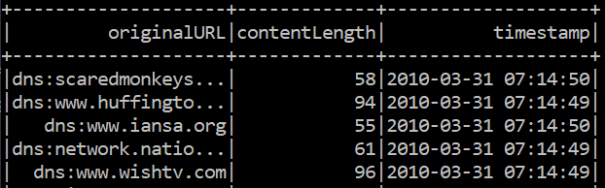
WARC -> Parquet
Reading formatted WARC files
Adding timestamp using value from content header
Convert each file in given directory

Slide 9
Work Completed: JSON -> Parquet
Determine schema using sample files
Reading formatted JSON files
Adding new columns to dataframe
Confirm Directory Exists
Collect all JSON files
Convert each file
This program takes a directory as an argument.
Program collects all files ending in .json to get ready for conversion.
Individually convert each JSON file to Parquet format.

Slide 10
Interacting with Container
First Iteration:
Second Iteration:
Third Iteration:
Final Version:
Dockerfile CMD
Command Line Interface
Interactive Mode
Dockerfile CMD + Mounted Volume

Slide 11
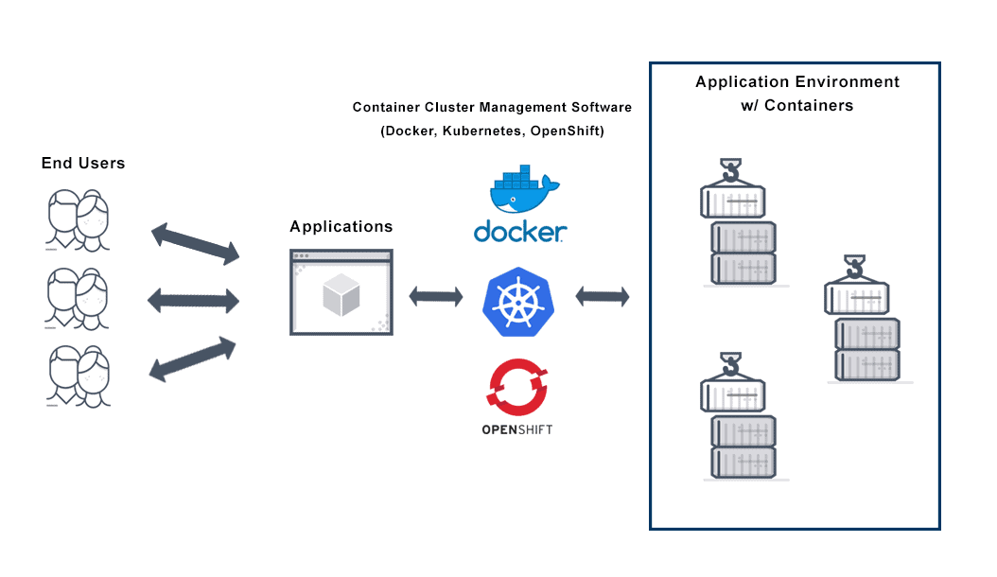
Deploying to VT Cloud

Slide 12
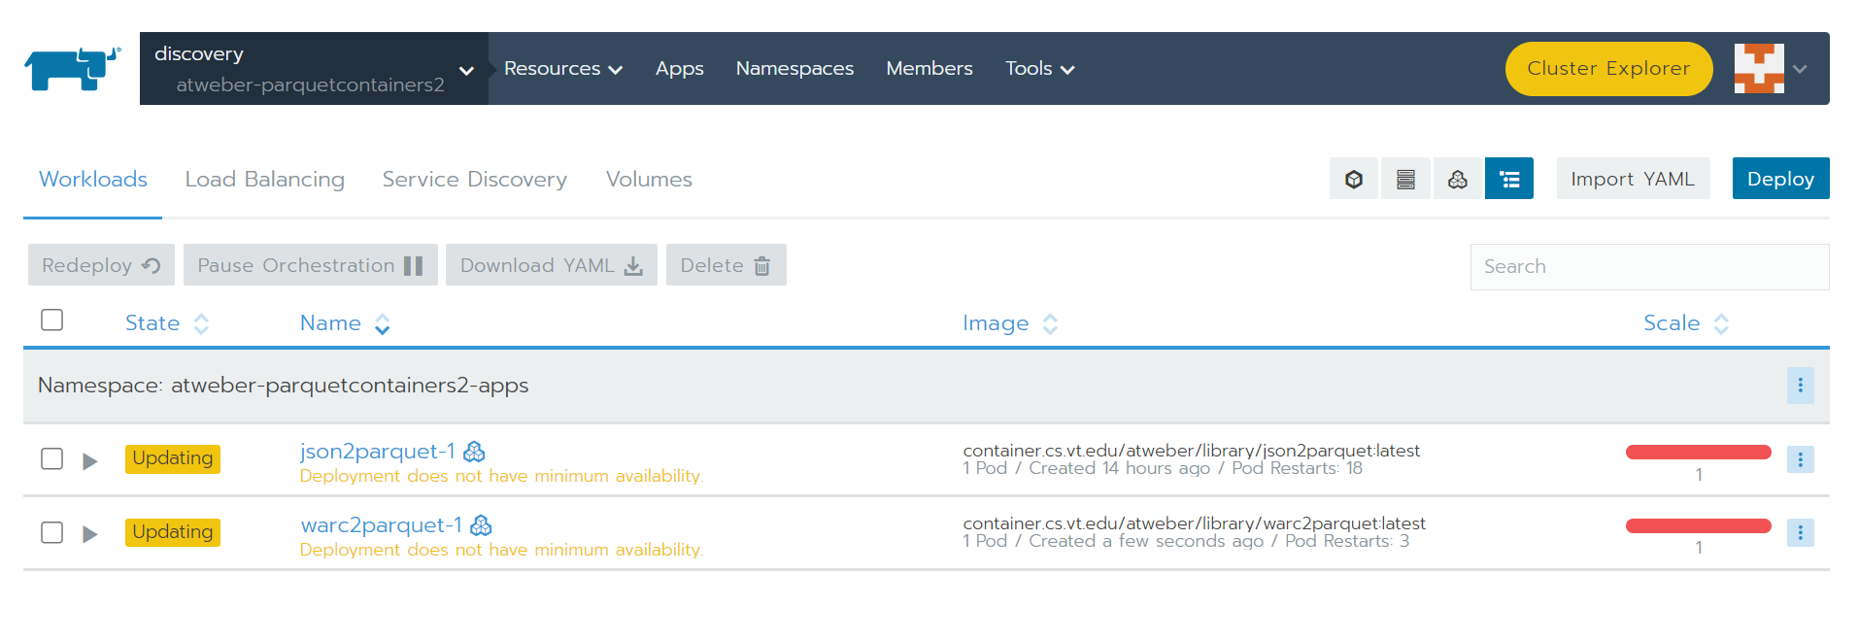
Deploying to VT Cloud
Two containers running in “discovery” cluster

Slide 13
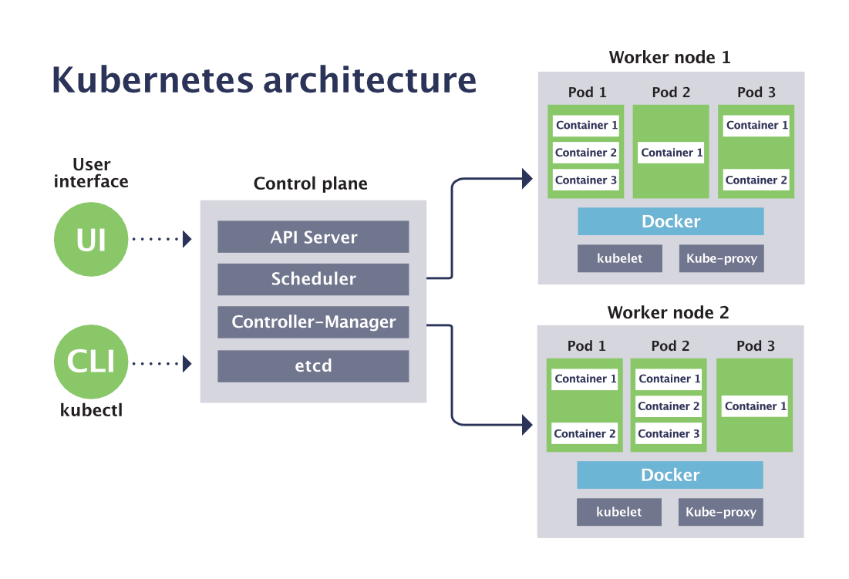

Future Work
Create a separate Kubernetes Cluster to hold our containers
Use Ceph for persistent storage
Containers continuously spun up and down, need reliable storage

Slide 14

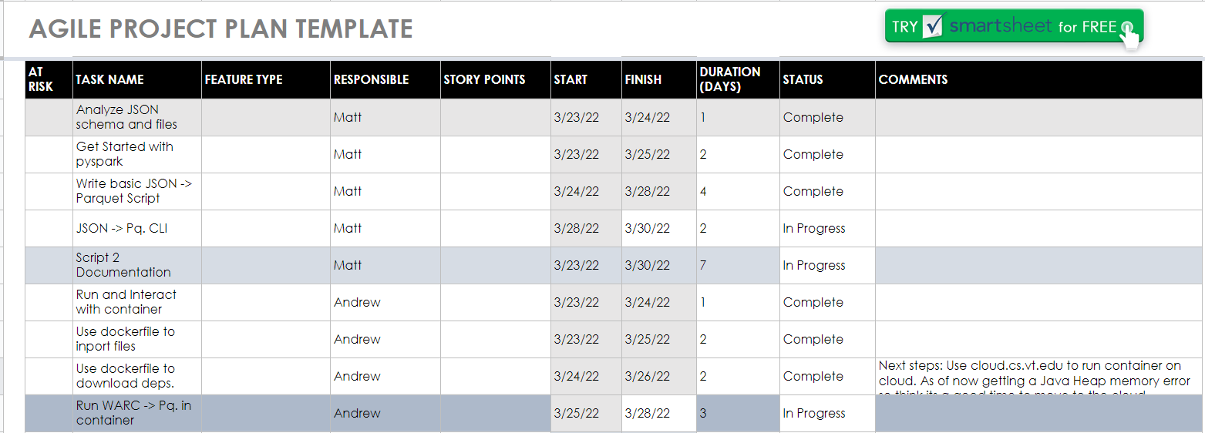
Lessons Learned
Experienced a lull in productivity
Started to follow agile sprint process
Bi-weekly work sessions, daily scrum meetings, etc
Notes:
Talk about dealing with production

Slide 15

Acknowledgements
Xinyue Wang, Client
Dr. Edward Fox
GTA Ryan Wood

Slide 16
References
[1] Apache Parquet. 2022. URL: https://parquet.apache.org/.
[2] Archives Unleashed Toolkit. 2019. URL: https://archivesunleashed.org/aut/.
[3] bitnami/spark - Docker Image | Docker Hub. 2022. URL: https://hub.docker.com/r/bitnami/spark.
[4] Ceph The Future of Storage. 2020. URL: https://ceph.com/en/.
[5] Container Images: Architecture and Best Practices - Aqua. 2022. URL: https://www.aquasec.com/
cloud-native-academy/container-security/container-images/.
[6] Pranav Dhakal et al. Library Tweets Conversion. Tech. rep. Virginia Polytechnic and State University, Dec. 2021. URL: https://vtechworks.lib.vt.edu/handle/10919/107086.
[7] Alex Gamela and Rute Figueiredo. Podman vs Docker: What are the differences?
Dec. 2021. URL: https://www.imaginarycloud.com/blog/podman-vs-docker/.
[8] IA Web Commons. 2021. URL: https://github.com/commoncrawl/ia-web-commons.
[9] Image Details - Container Registry - Google Cloud Platform. 2022. URL: https://console.cloud.
google.com/gcr/images/datamechanics/GLOBAL/spark@sha256:a54be21302b381cb74232fcb1eb5ab94a54details?tag=platform-3.1-latest.
[10] Eran Levy. What is the Parquet File Format and Why You Should Use It. Feb. 2022. URL: https://www.
upsolver.com/blog/apache-parquet-why-use.

