Slide 1
Tobacco Testimonies
Team Members: Nick Onofrio, Nick Sorkin, Campbell Johnson, Michael DiFrancisco, and Devin Venetsanos
Multimedia, Hypertext, and Information Accessx - Professor Fox
Virginia Tech, Blacksburg VA 24061, 2/14/2019

Slide 2
Outline
Background
Menu
Document Gathering
Doc2Vec
Similarities
Clustering
Lessons Learned
Acknowledgements
References
Questions

Slide 3
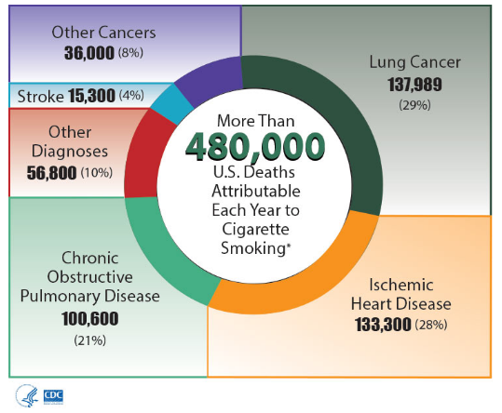
Background
How can we identify ways of combating Big Tobaccos strategies

Slide 4
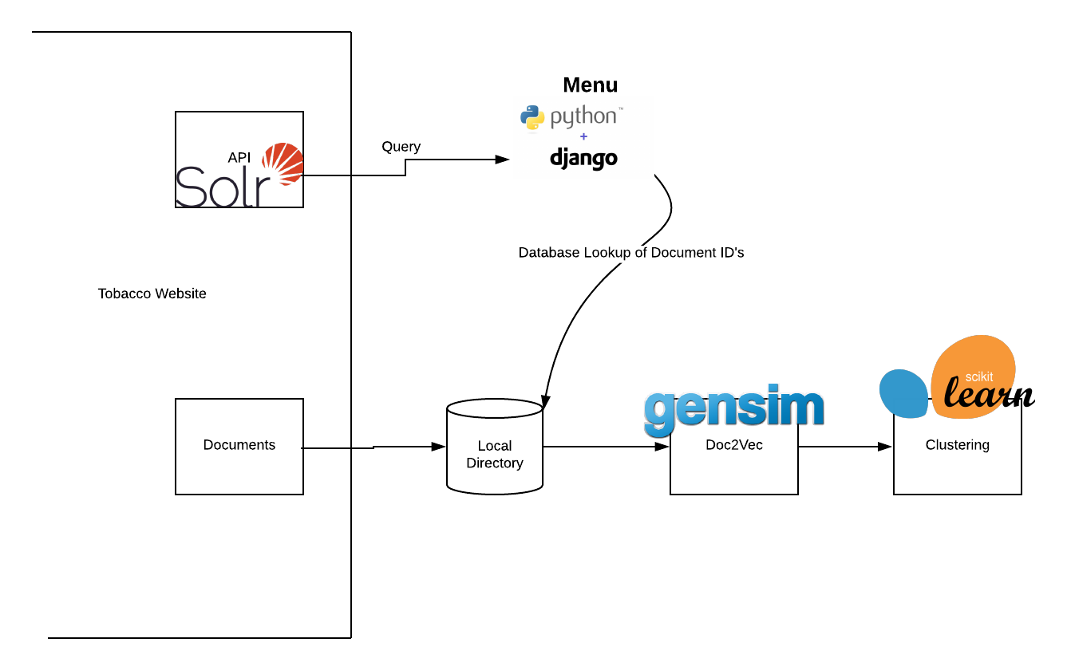

Slide 5
Menu
We stopped work on this portion of the project.
As it stands, users can select a topic to query the API.
Working well with storing and finding documents.

Slide 6
Document Gathering
Downloading Documents
Organization
Feeding into the Model

Slide 7
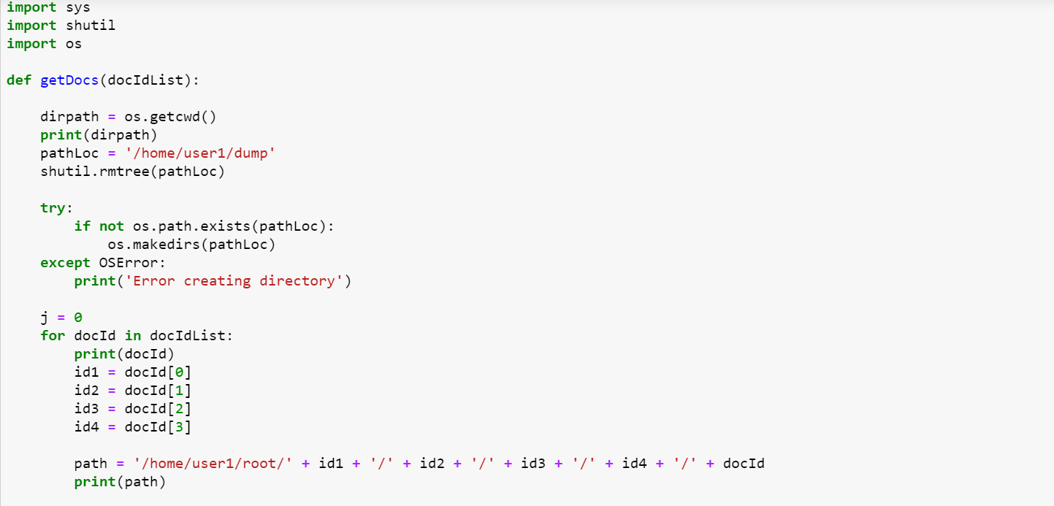
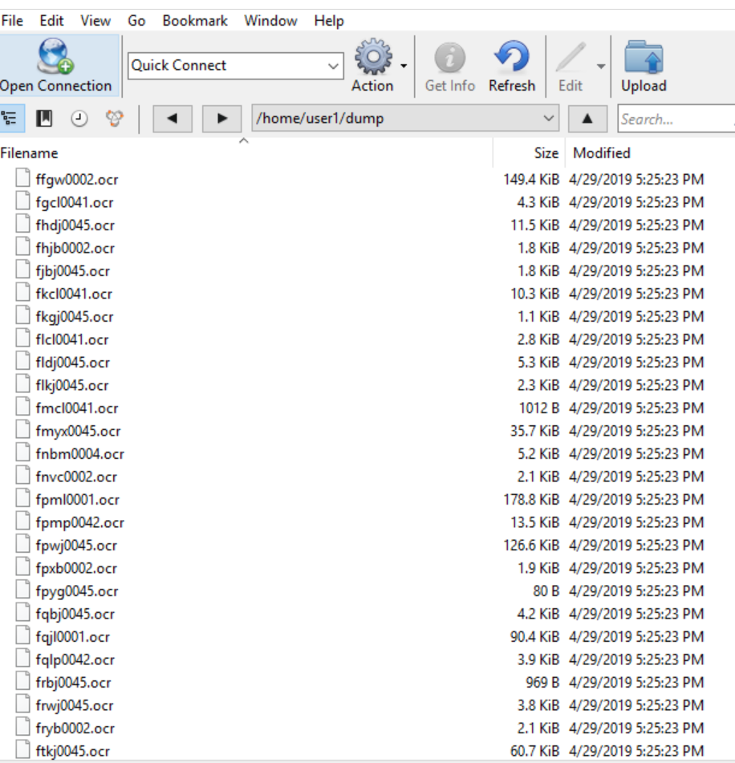
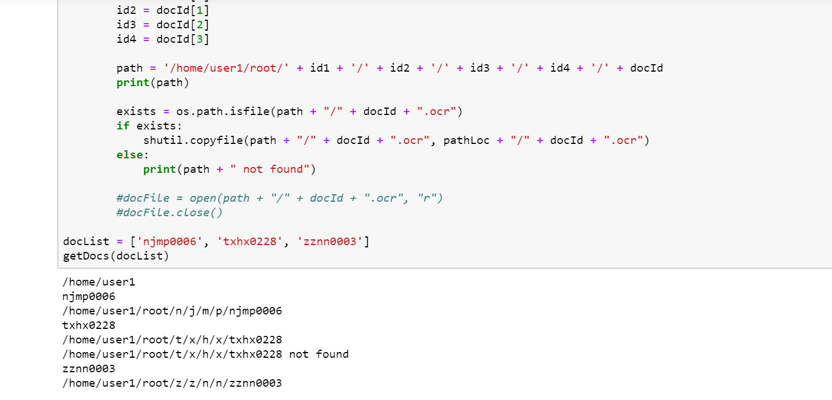

Slide 8
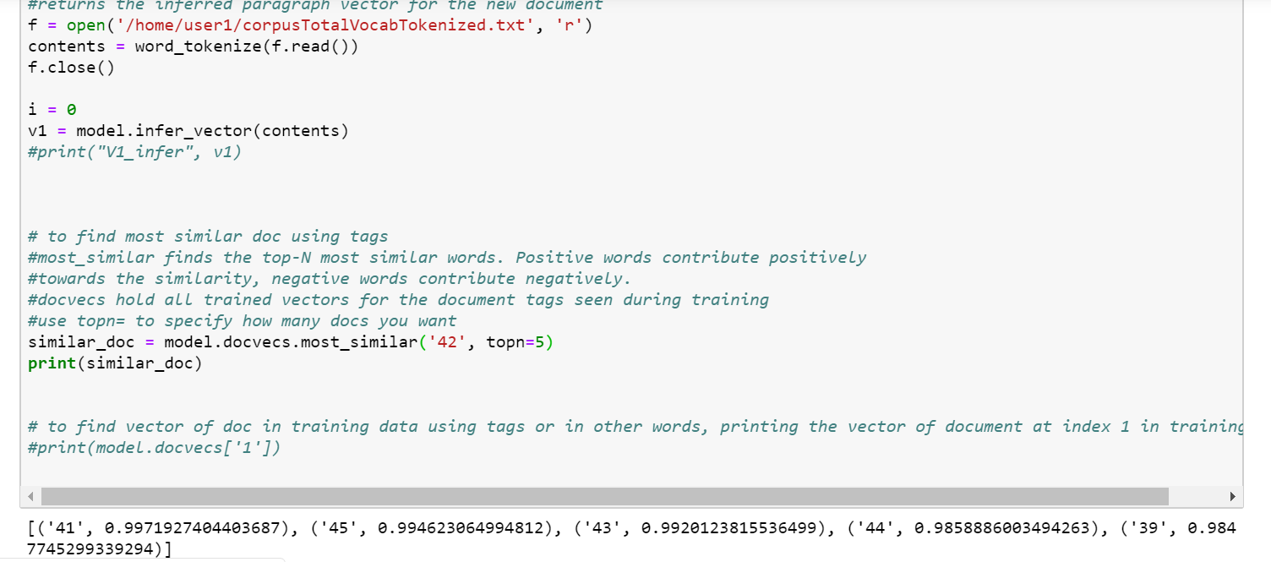
Doc2Vec

Slide 9
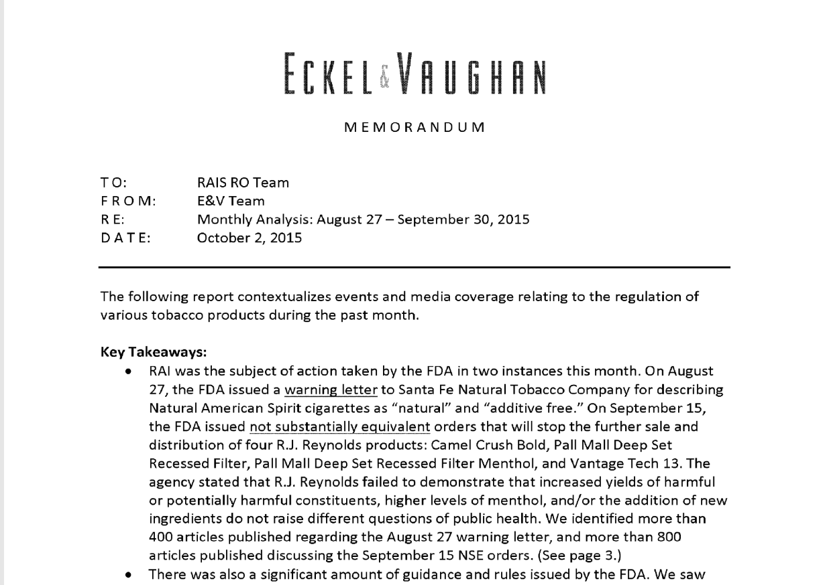
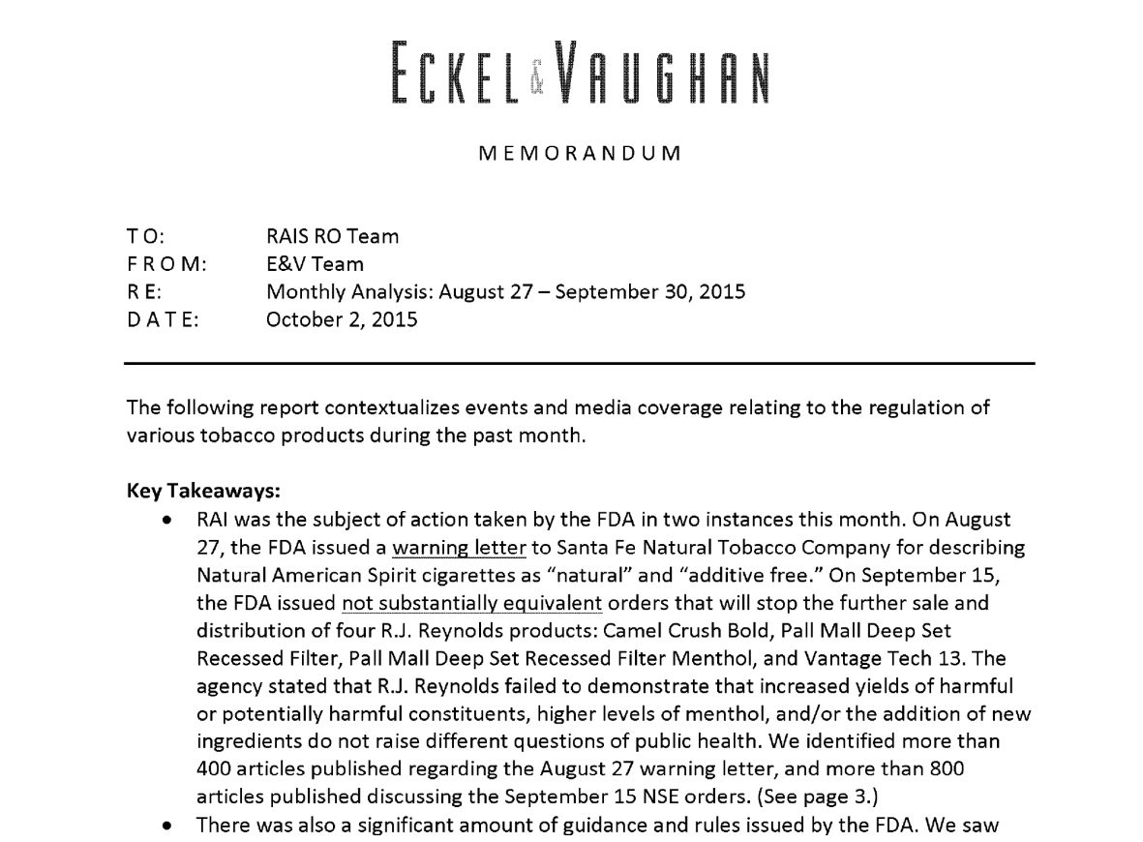
Doc2Vec Continued

Slide 10
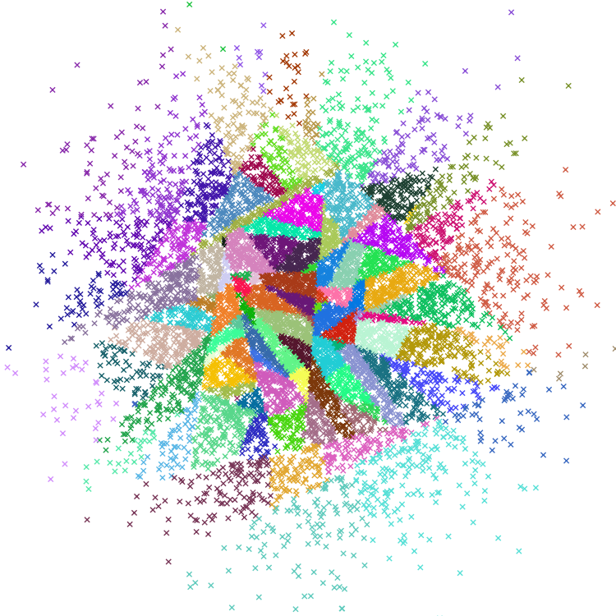
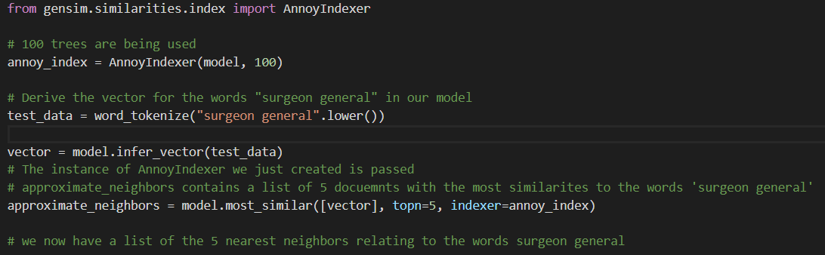
Similarities
Using the gensim similarities.index package
This package uses Annoy (Approximate Nearest Neighbors Oh Yeah)
Finds nearest neighbors in vector tree from Doc2Vec model

Slide 11

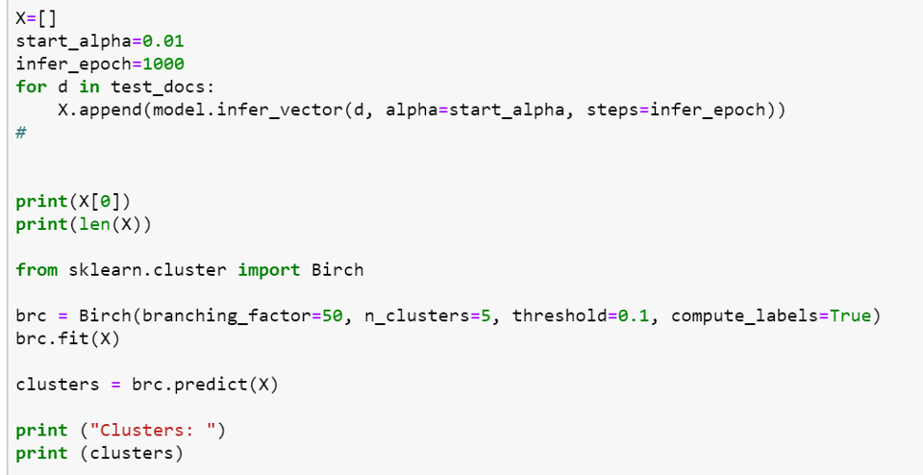
Clustering
We can cluster our document vectors using the Scikit-learn Birch clustering algorithm
Using the Doc2Vec model, we create a list of vectors with each corresponding to a document
We are returned in order the cluster that each corresponding document is in

Slide 12
Lessons Learned
Planning is ESSENTIAL and can help the project run much smoother
Seek advice from the resources that are available
Working face to face with group members was more productive

Slide 13
Acknowledgements
Client: David M. Townsend, Ph.D
Technical Assistance Contacts: Saurabh Chakravarty and Professor Fox

Slide 14
References
Glantz, Stanton. Industry Documents Library, 2002, www.industrydocumentslibrary.ucsf.edu/tobacco/.
“Google Code Archive - Long-Term Storage for Google Code Project Hosting.” Google, Google, 29 July 2013, code.google.com/archive/p/word2vec/.
“Text Data Management and Analysis: A Practical Introduction to Information Retrieval and Text Mining.” ACM Digital Library, Association for Computing Machinery and Morgan & Claypool, 2016, dl.acm.org/citation.cfm?id=2915031.
Gensim: Topic modelling for humans. (n.d.). Retrieved April 25, 2019, from https://radimrehurek.com/gensim/models/doc2vec.html
KDnuggets. (n.d.). Retrieved April 25, 2019, from https://www.kdnuggets.com/2018/04/implementing-deep-learning-methods-feature-engineering-text-data-cbow.html
Doc2Vec Document Vectorization and clustering. (n.d.). Retrieved April 25, 2019, from http://techscouter.blogspot.com/2018/08/doc2vec-document-vectorization-and.html
Text Clustering with doc2vec Word Embedding Machine Learning Model. (2018, October 04). Retrieved April 25, 2019, from http://ai.intelligentonlinetools.com/ml/text-clustering-doc2vec-word-embedding-machine-learning/
Qaiser, R. (2017, May 12). How to Extract Words from PDFs with Python. Retrieved April 25, 2019, from https://medium.com/@rqaiserr/how-to-convert-pdfs-into-searchable-key-words-with-python-85aab86c544f
Mishra, D. (2018, March 17). DOC2VEC gensim tutorial. Retrieved April 25, 2019, from https://medium.com/mishra.thedeepak/doc2vec-simple-implementation-example-df2afbbfbad5
Used this source in the creation of the Doc2Vec Model
Doc2vec tutorial. (n.d.). Retrieved April 25, 2019, from https://rare-technologies.com/doc2vec-tutorial/

Slide 15
Questions?

