Slide 1

Chapter 3
Economics and Business
(c) Virginia Tech, Department of Management, Pamplin College of Business. CC BY NC SA 4.0.
Available from: http://hdl.handle.net/10919/105157

Slide 2
Objectives
Describe the foundational philosophies of capitalism and socialism.
Discuss private property rights and why they are key to economic development.
Discuss the concept of GDP (gross domestic product).
Explain the difference between fiscal and monetary policy.
Discuss the concept of the unemployment rate measurement.
Discuss the concepts of inflation and deflation.
Explain other key terms related to this chapter including supply; demand; equilibrium price; monopoly; recession; depre

Slide 3
Economics– Creating Wealth
Economics is the study of the production, distribution, and consumption of goods and services.
Resources are the inputs used to produce outputs.
Resources may include any or all of the following:
Land
Labor (physical and mental) Capital –including buildings and equipment
Entrepreneurship
Knowledge

Slide 4
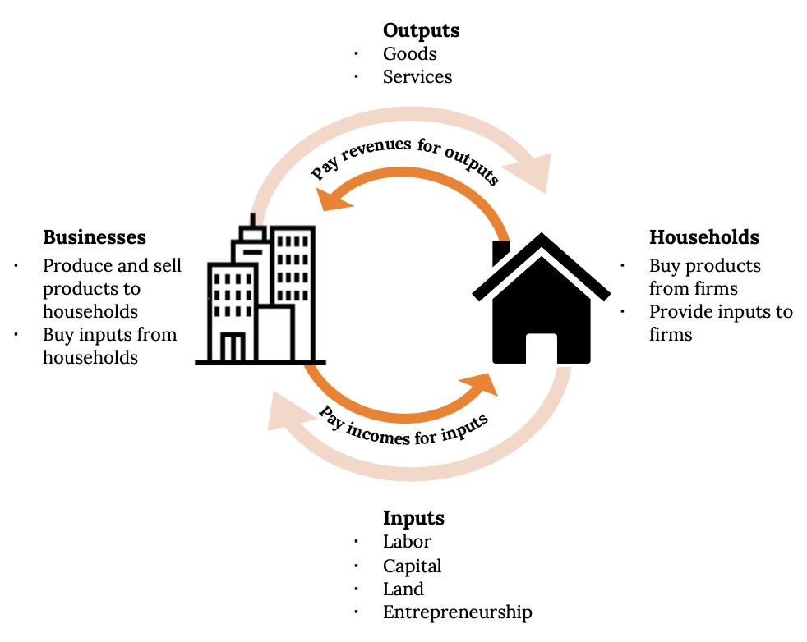
Input and Output Markets

Slide 5
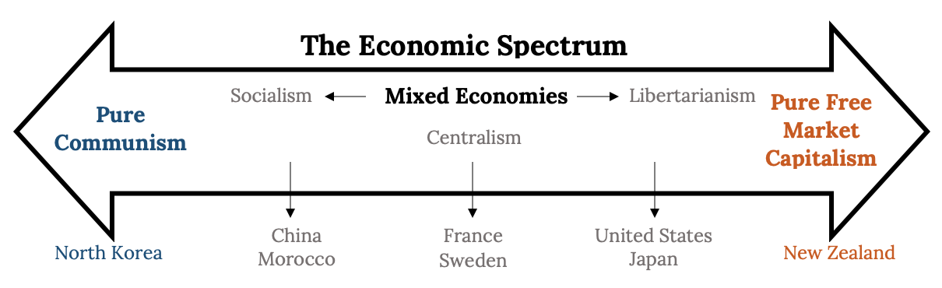
A Continuum of Economic Systems

Slide 6
The Father of Economics
Adam Smith believed that:
Freedom was vital to any economy’s survival.
Freedom to own land or property and the right to keep the profits of a business is essential.
People will work hard if they believe they will be rewarded

Slide 7
Government’s Role in Business
A government can promote business by…
1.Minimizing spending and keeping taxes and regulations to a minimum.
2.Allowing private ownership of businesses.
3.Minimizing interference with the free exchange of goods and services.
4.Passing laws that enable businesspeople to write enforceable contracts.
5.Establishing a currency that’s tradable in world markets.
6.Minimizing corruption

Slide 8
3 Economic Systems
The economic system in which most businesses are owned and operated by individuals is the free market system, also known as capitalism.
1.Capitalism
2.Socialism
3.Communism
<------------------------------------------------------------->
Communism Socialism Capitalism
<------------------->

Slide 9
Capitalism
Capitalism --All or most of the land, factories and stores are owned by individuals, not the government, and operated for profit.
Countries with capitalist foundations
United States
England
Australia
Canada

Slide 10
Capitalism’s Four Basic Rights
1.The right to own private property.
2.The right to own a business and keep all that business’ profits.
3.The right to freedom of competition
4.The right to freedom of choice

Slide 11
Free Markets
Free Market --Decisions about what and how much to produce are made by the market.
Consumers send signals about what they like and how they like it.•
Example: Formation of Redbox, Growth of Apple, Inc.
Price tells companies how much of a product they should produce. If something is wanted but hard to get, the price will rise until more products are available

Slide 12
Socialism
Socialism --An economic system based on the premise that some basic businesses, like utilities, should be owned by the government in order to more evenly distribute profits among the people
Entrepreneurs run smaller businesses
Citizens are highly taxed
Government is more involved in protecting the environment and the poor

Slide 13
Communism
Communism --An economic and political system in which the government makes almost all economic decisions and owns almost all the major factors of production.
Prices don’t reflect demand which may lead to shortages of items, including food and clothing.
Some communist countries today suffer severe economic depression and citizens fear the government

Slide 14
Two Major Economic Systems
Free-Market Economies --The market largely determines what goods and services are produced, who gets them, and how the economy grows.
Command Economies --The government largely determines what goods and services are produced, who gets them, and how the economy will grow

Slide 15
Important Changes to Global Environment
Growth of global competition
Increase of free trade among nations
More efficient distribution systems and communication advances

Slide 16
Mixed Economies
Mixed Economies --Some allocation of resources is made by the market and some by the government.
Neither free-market nor command economies have created sound economic conditions, so countries use a mix of the two economic systems

Slide 17
Treading Towards Mixed Economies
Communist governments are disappearing.
Mostly socialist governments are cutting back on social programs, lowering taxes and moving toward capitalism.
Mostly capitalist countries are increasing social programs and moving toward more socialism

Slide 18
Perfect Competition
When the market is characterized by Perfect Competition:
Many small companies sell identical products.
The price is determined by supply and demand.
Commodities like corn and soybeans are excellent examples.

Slide 19
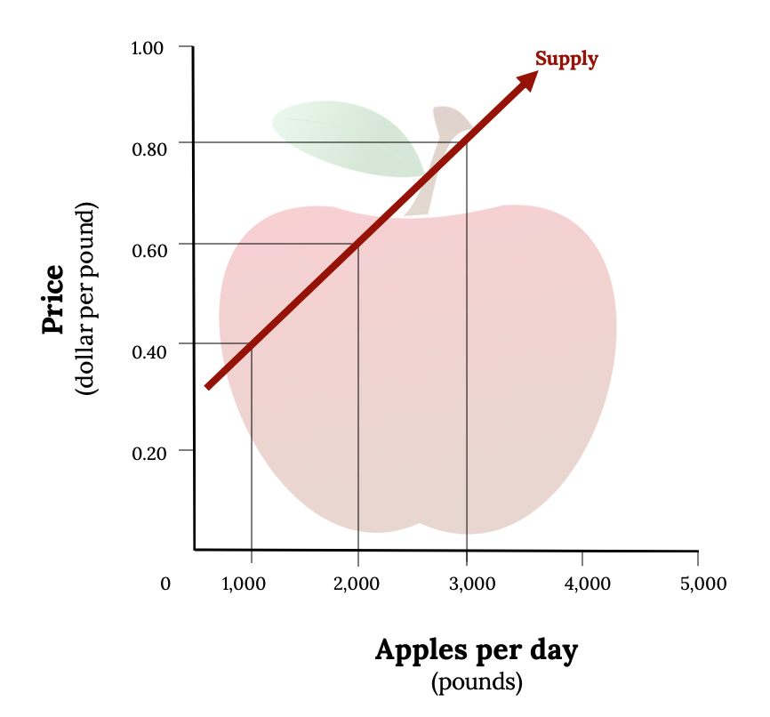
Basics of Supply and Demand
Demand and the Demand Curve
Demand is the quantity of a product that buyers are willing to purchase at various prices.
Prices Rise ----People Buy Less
Prices Spring ----People Buy More
Supply and the Supply Curve
Supply is the quantity of a product that sellers are willing to sell at various prices. The quantity of a product that a business is willing to sell depends on its price.
Sell More ----Prices Rise
Sell Less ----Prices Fall

Slide 20
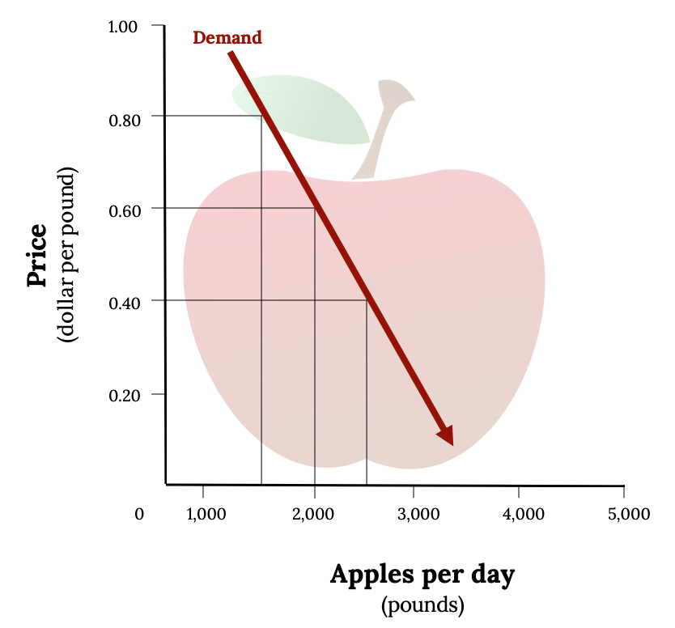
The Demand Curve

Slide 21
The Supply Curve

Slide 22
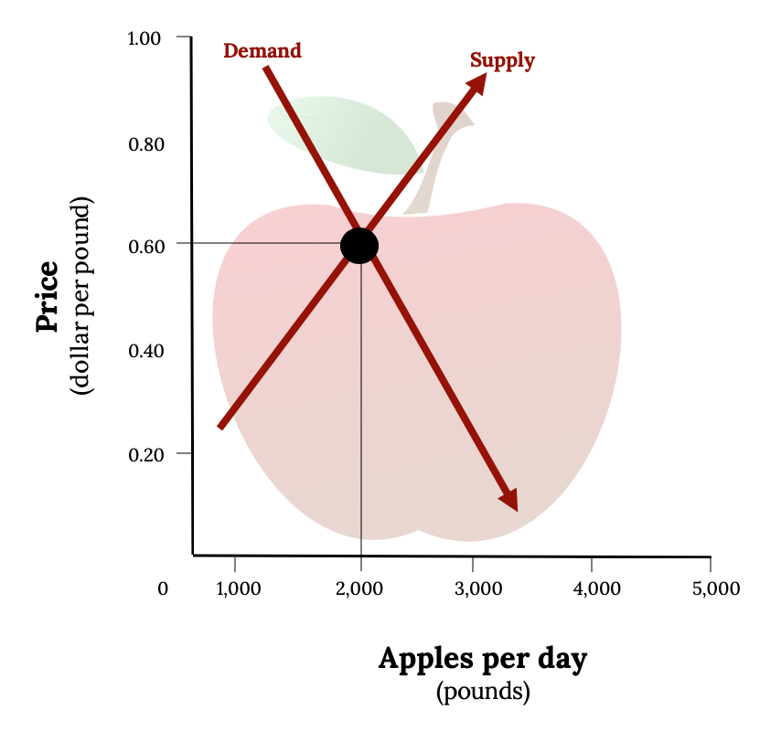
Equilibrium Price
Plotting both the supply curve and the demand curve on one graph, as we’ve done in Figure 3.5 “The Equilibrium Price”. The point at which the two curves intersect is the equilibrium price

Slide 23
U.S. Economic Systems
Key terms / Indicators
GDP Unemployment rate
Inflation,
Deflation Consumer
  Price Index (CPI)
  Producer Price Index
Monopoly, Monopolistic Competition, Oligopoly, Perfect Competition
Business Cycle

Slide 24
Understanding the U.S. Economy
Key terms
In an oligopoly, a few sellers supply a sizable portion of products in the market. They exert some control over price, but because their products are similar, when one company lowers prices, the others follow. \
Example: Automobile and Airline companies.
In a monopoly, there is only one seller in the market. The “market” could be a specific geographical area, such as a city. The single seller is able to control prices.
Example: There are few monopolies in the United States because the government limits them. Most Spring into one of two categories: natural and legal. Natural monopolies include public utilities, such as electricity and gas suppliers. Legal- patent holders

Slide 25
Understanding the U.S. Economy
Key terms / Indicators
Gross Domestic Product
The market value of all goods and services produced by the economy each year. The GDP includes only those goods and services produced domestically; goods produced outside the country are excluded

Slide 26
Understanding the U.S. Economy
Key terms / Indicators Recession and GDP
Eventually, however, things slow down. GDP decreases, unemployment rises, and because people have less money to spend, business revenues decline. This slowdown in economic activity is called a recession.
Economists often say that we’re entering a recession when GDP goes down for two consecutive quarters

Slide 27
Consumer Price Index
The most widely publicized measure of inflation is the consumer price index (CPI), which is reported monthly by the Bureau of Labor Statistics.
The CPI measures the rate of inflation by determining price changes of a hypothetical basket of goods, such as food, housing, clothing, medical care, appliances, automobiles, and so forth, bought by a typical household

Slide 28
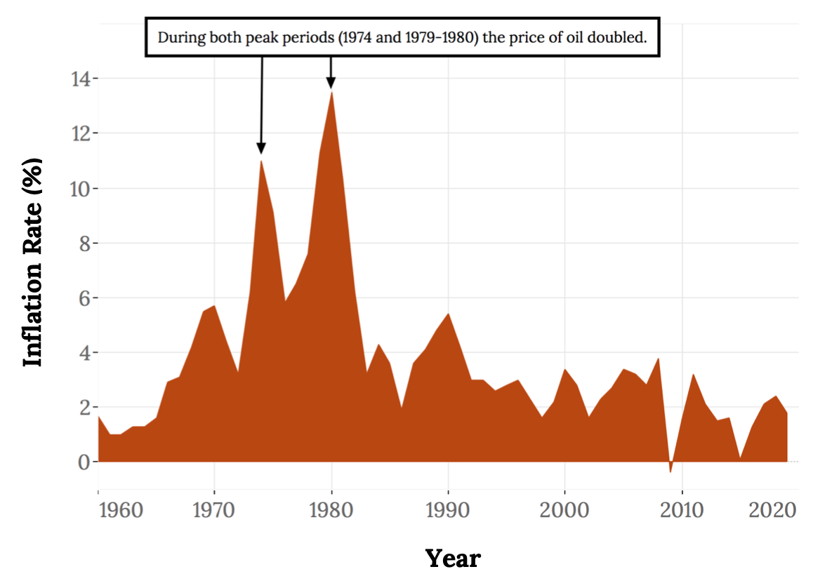
Consumer Price Index
The Inflation Rate that the US Government had tried to keep us to is 2%

Slide 29
Economic Indicators
To get a sense of where the economy is headed in the future, we use statistics called Economic Indicators.
Indicators that report the status of the economy a few months in the past are lagging indicators.
Example: Avg. length of Unemployment
Those that predict the status of the economy 3 to 12 months in the future are called leading indicators
Example: The New Residential Housing Construction Report, commonly referred to as "housing starts“
Building Permits Issued

Slide 30
Economic Health
The world's economies share three main goals:
Growth
High employment
Price stability

Slide 31
Government’s Role In Business
A government can promote business by…
1.Minimizing spending and keeping taxes and regulations to a minimum.
2.Allowing private ownership of businesses.
3.Minimizing interference with the free exchange of goods and services.
4.Passing laws that enable businesspeople to write enforceable contracts.
5.Establishing a currency that’s tradable in world markets.
6.Minimizing corrupt

Slide 32
Fiscal Policy
Fiscal Policy --The federal government’s efforts to keep the economy stable by increasing or decreasing taxes or government spending.
Tools of Fiscal Policy:
Taxation
Government Spending

Slide 33
Monetary Policy
Monetary Policy–The management of the money supply and interest rates by the Federal Reserve Board.
Tools of Monetary Policy
Interest Rates
Money Supply

Slide 34
Takeaways
Economics is the study of the production, distribution, and consumption of goods and services
In a planned system, such as communism and socialism, the government exerts control over the production and distribution of all or some goods and services.
In a free-market system, also known as capitalism, business is conducted with limited government involvement. Competition determines what goods and services are produced, how they are produced, and for whom.
When the market is characterized by perfect competition, many small companies sell identical products. The price is determined by supply and demand. Commodities like corn are an excellent example.
.
Supply is the quantity of a product that sellers are willing to sell at various prices. Producers will supply more of a product when prices are high and less when they’re low.
Demand is the quantity of a product that buyers are willing to purchase at various prices; they’ll buy more when the price is low and less when it’s high.

Slide 35
Chapter 3
Q&A
(c) Virginia Tech, Department of Management, Pamplin College of Business. CC BY NC SA 4.0.
Available from: http://hdl.handle.net/10919/105157

