Slide 1

THE DIVERSITY ALLIANCE:
BEGINNINGS, PERSONAL STORIES, AND FUTURE DIRECTIONS
June 7, 2017
2017 VLACRL Spring Program: Diversity in Our Libraries
Tarida Anantachai, Chanelle Pickens, and Anthony Wright de Hernandez, Charla Gilbert

Slide 2
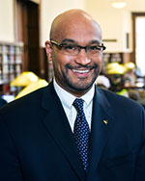
But First, a Thanks!
Dr. Jon E. Cawthorne, PhD
Dean of Libraries
West Virginia University

Slide 3
Diversity (Counts) in Our Libraries

Slide 4
Library Residency Programs
Post-degree work experience designed as an entry-level program for recent graduates of an MLS program

Slide 5
Diversity (and Inclusion) in Our Libraries
Recruitment is one thing,
retention is another.
i.e. the pipeline issue

Slide 6
“The challenges we face are both fundamental and substantial. We have moved from an area of equilibrium to a new normal, an era of constant disequilibrium. Our ways of working, ways of creating value, and ways of innovating must be reframed.” John Seely Brown

Slide 7
The Diversity Alliance: Origins
Founding members
  American University
  University of Iowa
  Virginia Tech
  West Virginia University
Program elements
  3-year residency program
  Professional development funds
  Annual institute, online seminars, cohort network, etc.

Slide 8
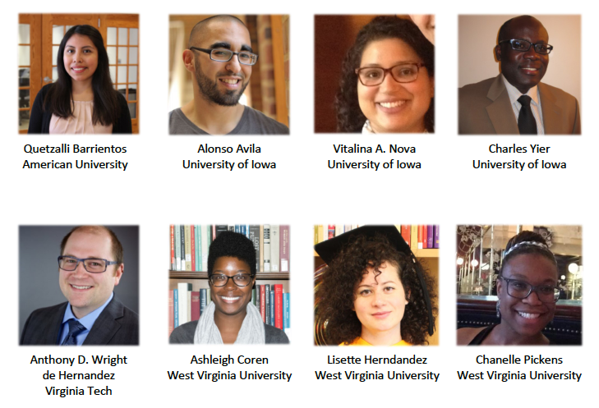
The Diversity Alliance:
The First Cohort
“A collaborative effort…that represents a commitment to mentoring under-represented populations and establishing a networked cohort of early-career librarians.”

Slide 9
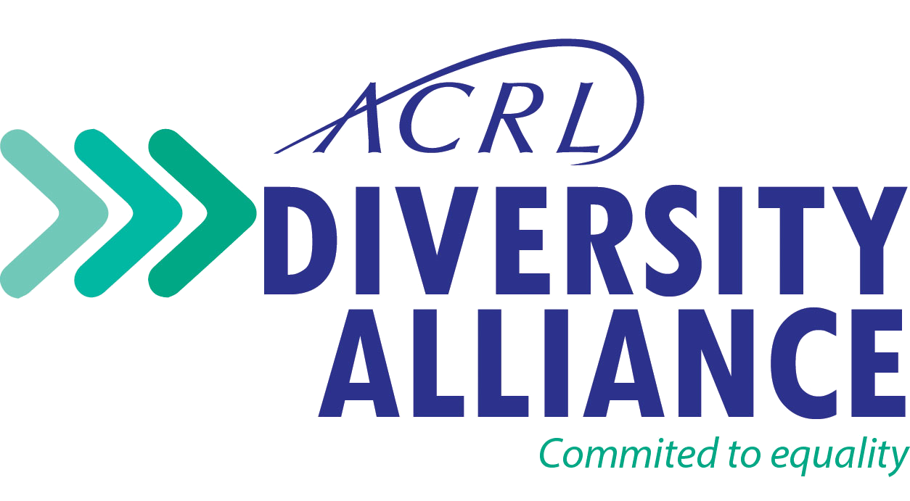
A New Administrative Home

Slide 10
Goals
To instill a passion for academic and research librarianship.
To create more opportunities in academic and research librarianship for individuals from underrepresented racial and ethnic groups to gain the knowledge, skills and competencies to thrive in an academic context through the creation of residency positions.
To open doors, share networks, connect people, and facilitate a deeper understanding of the profession. To prepare residents to participate in the wider higher education community and for success in scholarship, professional service, and leadership.
To increase the hiring pipeline of qualified, talented individuals from underrepresented racial and ethnic groups.
To enrich the profession by introducing new perspectives and encouraging dialogue among librarians from diverse backgrounds.

Slide 11
Principles
Establish a residency program for at least one individual that lasts a minimum of two years (three years preferred).
Commit to designing experiences at the local level to expand the residents’ interests and skills, e.g., mentorships, rotation through other library units, etc.
Agree to serve as a resource, i.e., advisors and guides, to those institutions participating in the ACRL Diversity Alliance.
Provide at a minimum the same level of professional development support provided other library faculty/staff/employees.
Provide a salary for the resident commensurate with the salaries of equivalent entry-level library professionals.

Slide 12
Task Force
Charge: Oversee the Diversity Alliance, serve as advocates of the program, build relationships and investigate partnerships with appropriate ACRL and ALA groups, and propose future directions, including governance, to the ACRL Board of Directors.
Composition: Chair, and representatives from:
  ACRL Diversity Committee
  ACRL Residency Interest Group
  ALA Office for Diversity, Literacy, and Outreach Services
  (Other additional appointments as needed)

Slide 13
2016-2017
Members
American University
Arizona State University
Bowling Green State University
Clemson University
Emory University
Gulf Coast State College
Harvard University
Iowa State University
Louisiana State University
Massachusetts Institute of Technology
Michigan State University
North Carolina State University
The Ohio State University
Pennsylvania State University
Swarthmore College
Syracuse University
Temple University
Texas A&M University
Towson University
University of Alberta
University of California, Riverside
University of Delaware
University of Illinois at Urbana-Champaign
University of Iowa
University of Michigan
University of Tennessee - Knoxville
University of Utah
University of Wisconsin - Madison
Virginia Tech
West Virginia University

Slide 14
Coming Down the Pipeline
Recent developments
  Information session at ACRL 2017
  Mountain Plains Library Association and other partnerships
Future directions
  Needs assessment (e.g. value, benchmarks, best practices)
  Increased support for residency coordinators
  Face-to-face learning experiences (e.g. institutes)

Slide 15
Additional
Resources
ACRL Diversity Alliance
  http://www.ala.org/acrl/issues/diversityalliance
ACRL Diversity Alliance Task Force
  http://www.ala.org/acrl/aboutacrl
  /directoryofleadership/taskforces/acr-tfda
ACRL Residency Interest Group
  http://acrl.ala.org/residency

Slide 16
Chanelle Pickens
Visiting Instructional Librarian
West Virginia University
My Journey: Identity & Inclusivity
in the Diversity Resident Experience
Notes:
I am excited for this opportunity to speak with you about my experiences thus far as a resident librarian at West Virginia University and to explore these topics of diversity and inclusion. While I intend to tell you about myself, the work I’m pursuing and my career goals, I hope to spend more time highlighting the realities of the diversity resident experience and how these experiences play out in our profession. To be sure, my experiences are my own and are, quite naturally, different from the experiences of each and every other diversity resident. I have found, however, that there are some overarching themes each of us has encountered and things all of us (administration, coordinators, and residents) can learn. I offer an invitation to you, an invitation to join me on this deeply transformative, deeply rewarding, and deeply personal experience that I call my ‘journey’.

Slide 17
The Why
“We say WHAT we do, we sometimes say HOW we do it, but rarely say WHY we do WHAT we do.”
Simon Sinek
Notes:
Why do we do what we’re doing? Namely, developing and participating in residency programs.
Some reasons - to address the often cited racial and ethnic disparities in the profession; to combat the antiquated and inadequate stereotypes of libraries and librarians; because someone tells us we ‘should’.
What are the goals of a diversity program? What are the goals of YOUR diversity program? How do these goals both reflect and honor your community?
How do we address the sometimes incongruent goals and expectations of administration, coordinators, and residents?

Slide 18
Culture, Conformity, & Authenticity
“Here's to the crazy ones. The misfits. The rebels.
The troublemakers. The round pegs in the square holes. The ones who see things differently. They're not fond of rules. And they have no respect for the status quo. You can quote them, disagree with them, glorify or vilify them. About the only thing you can't do is ignore them. Because they change things. They push the human race forward. And while some may see them as the crazy ones, we see genius. Because the people who are crazy enough to think they can change the world, are the ones who do.”
Rob Siltanen
Notes:
It’s necessary to take an honest look at the culture of your institution.

Slide 19
The Work
“I don't like work - no man does -
but I like what is in the work -
the chance to find yourself.”
Joseph Conrad
Notes:
Talking about diversity and inclusion is hard work! Throwing identity politics into the mix makes things even harder. But actually doing the WORK is another story entirely.

Slide 20
Identity & Inclusivity
“My identity is very clear to me now, I am a black woman, I'm not alone, I'm free. I say I'm free because I no longer have to be a credit, I don't have to be a symbol to anybody;
I don't have to be a first to anybody. I don't have to be an imitation of a white woman that Hollywood sort of hoped I'd become. I'm me, and I'm like nobody else.”
Lena Horne
Notes:
Bringing it all home!

Slide 21
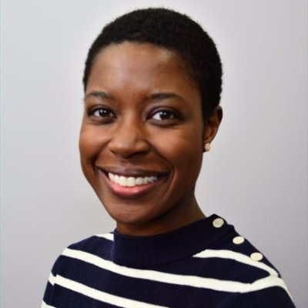
Ashleigh Coren
Visiting Librarian, Office of the Dean
West Virginia University
http://wvulresidency.weebly.com/
Notes:
Ashleigh Coren everybody!

Slide 22
Chanelle Pickens
Visiting Instructional Librarian
West Virginia University
chanelle.pickens@mail.wvu.edu
cpickensportfolio.wordpress.com
Notes:
Thank you and good night!

Slide 23
Anthony Wright de Hernandez
University of Washington iSchool
  Full-time job & commute
  Online education
Work experience outside libraries
  First job at 9
  Jobs to pay bills
Second in family to get Masters
  No family tradition of academia
  Financial barriers to higher education
Notes:
My background:
Attended the University of Washington iSchool to get my MLIS.
Worked full time while attending - commuted two hours each way.
Did my degree through the online program
Online education (even today) has a stigma of not being as good as in-person education.
Online is my preferred method. Lets me engage more with the material and better formulate responses for in-class discussions.
Managed one internship with OCLC - an online internship working with CONTENTdm
My work history started with a job as a paperboy at 9. I worked in retail during high school. I waited tables and worked in fast food during undergrad. Before pursuing a career in libraries, I had only considered jobs as a means to pay the bills. Personal interests were something to be done in my off hours. I had never dreamed of a job I could actually enjoy doing.
My Dad had two years of college. My Mom, none. My grandparents were farmers. My older brother has a bachelor’s degree. My younger brother is just beginning to explore higher ed thanks to the GI bill. Most of my aunts and uncles have no higher ed at all. There was no familial experience of higher ed for anyone to pass on to me. It was all a new and unfamiliar experience -- and it cost a lot of money. Going back for a masters was supported by my family but it was also scary - it meant adding tons more debt. That made it doubly important that I keep working full time through school.

Slide 24
Diversity Alliance
Finding out about residencies
  ALA Mid-Winter
  ACRL Residency Interest Group
Applying
  Job postings
  Interviews
Leaving Minnesota
  Social differences
  Distance from family
Notes:
I first found out about the Diversity Alliance at ALA Mid-Winter in Chicago. I paid to attend even though I wasn’t working in libraries. I spent most of my time at the career center (which I later found out I could have done without paying).
I met Charla and Lori Hostuttler from WVU there. They were one of many displaying materials but the Diversity Alliance sounded interesting. The idea of a residency was especially interesting since one of my big barriers to getting a job in libraries was my lack of experience.
After Mid-Winter, I looked into residencies as possible opportunities. I found the ACRL Residency Interest Group and started applying to residencies that appealed.
Applying for residencies happened while I was working full time and applying to other positions. I applied to 3 of the 4 Diversity Alliance residency postings. The one at American University was more targeted toward areas of librarianship I wasn’t interested in.
I managed to get interviews with VT and WVU - I had to take off work for the phone interviews. I also had to arrange a fake vacation to do my on campus interview. I wasn’t able to let my employer know I was seeking other employment. I needed the job and couldn’t hint I might be leaving.
I had one experience of an academic interview prior to these: at a small regional university in the Bible belt. That experience included preparing an instruction session - and teaching it, and preparing a technology proposal. It was a two day interview. It also included some unwelcome comments about gays once I got there.
Applying to the DA was stressful because I really had no experience applying for academic jobs. I had no real experience with the day-long interview or with doing a presentation based on a prompt as part of an interview. Most of my interviews were an hour long prior to this.
On top of that, I worried about moving somewhere more socially conservative. My experience in Oklahoma didn’t make me feel too great about SouthWest Virginia or West Virginia. I worried about whether I could be open about my sexuality at work. I worried about whether Virginia or West Virginia would recognise my marriage - the Obergefell decision happened in late June after my on campus interview.
Despite those worries, I had grown up in Virginia and still had family in the DC area. Taking either of the jobs I was interviewing for would require me to live apart from my husband for at least 3 years (he’s still in Minnesota attending law school) but it would be easier since I’d be within a few hours of family.

Slide 25
Barriers for Diverse Groups
Financial
  Working through school
  Supporting self (especially GSM)
Familial obligations
  Harder to travel
  Less free time
Systemic barriers
  Educational system design
  Experience requirements
Notes:
The challenges I faced are not uncommon for members of underrepresented populations.
Many members of diverse groups face financial barriers, have familial obligations to fulfil, and face systemic barriers to success.
Like me, many members of diverse groups begin working at an early age - for spending money or to help their family survive. Many rely on financial aid to go to school and still have to work while in school. They often can’t let their revenue stream die to pursue educational opportunities like internships. By the time they are in grad school, they are often supporting themselves. For Gender and Sexual Minorities, it is still common for them to have no familial support - having been disowned when they came out.
Financial barriers affect how much experience these candidates can bring to the job search. Paid internships in our industry are virtually non-existent and many internships are only available during business hours. Many, like me, can’t give up a paying job to do an unpaid internship leaving them without as much experience entering the job market.
Other members of diverse groups face barriers because of familial obligations. Whether the obligations are prompted by an economic situation or by cultural heritage, many members of diverse groups need to remain in proximity to family or their family will suffer. This makes traveling across the country to take a position harder. It can also affect the amount of free time available for taking internships and gaining experience to improve their employability.
There are also systemic barriers to success for members of diverse groups. The educational system itself was designed around the needs of white upperclass families. There have been attempts to change its structure but the system still assumes that the only concern of students is learning. For members of diverse groups, this is often not the case. When it comes to employment, the experience requirements on many job postings do something similar. They assume that people can devote time to gaining experience in low-paying staff positions or in unpaid internships. As I explained, this is simply not possible for many people.

Slide 26
Creating Opportunities
Helping diverse candidates gain experience
  MLIS/MLS as barrier
  Internships
Filling vacated positions
  Consider incumbent’s incoming experience
  Intentionally reimagine position
Job market in 2010s
  The job-hopping opportunity
Notes:
So how do we create opportunities for people who face these barriers?
If you are at an institution that can create a residency, great! The residency programs out there are wonderful opportunities for people who have faced these types of challenges.
If you are at an institution where creating a residency just isn’t a realistic possibility, don’t fret - there are other things you can do.
Consider how the MLIS/MLS can actually cause a barrier to candidates. If a candidate has little to no library experience but has their MLIS, consider hiring them for a position that doesn’t require the MLIS - even though they will probably leave once they’ve gained enough experience to apply for positions that do require it. You gain someone with extra knowledge and they gain the experience they need.
If you can create an internship, do it. Paid would be best - but unpaid is also good. Think about making internships available online - there are a lot of online students now and online internships can teach a lot. Also consider offering internships during 2nd or 3rd shift and on weekends.
When filling a vacated position, it’s tempting to advertise asking for someone who can take over everything the previous incumbent could do. Instead, consider how much that incumbent grew over the course of their tenure in the position. Think about what they came in with. Are there any responsibilities you can shift to someone else to make the position more entry-level? What does someone coming in really need to have? What can they develop over time as they grow in the position?
Can the position be repurposed to specifically develop talent? Despite the experience I had in the Bible belt, the position structure there was great. They knew they were in an extremely rural location that most people would not want to move to. They presented the position as a development opportunity for the incumbent. It wasn’t a formal residency but it had a similar structure. During the interview, they explained that new hires were asked to stay for three years (non-binding). After three years, the Dean would work hard to get them a position somewhere they wanted to be. The dean at that school saw it as an opportunity to get fresh perspectives every few years by hiring people straight out of grad school.
Finally, think about what today’s job market is like. Job Hopping has become more common. Undergrads are advised to expect to work many jobs over the course of their career. The Society for Human Resource Management said in an article last August that job hopping presents a recruitment opportunity. Let candidates know what their development and advancement will look like over the course of a few years and they are more likely to take a position. Repositioning positions as development opportunities helps you to think about what the minimum qualifications really are. If you can look for a candidate with the foundational knowledge and let them learn more while on the job, you’ll get more diverse candidates and more innovation as they grow and develop new techniques to solve old problems.

Slide 27
Charla Gilbert
Director of Planning and Branch Operations - Virginia Tech
Steering Committee Representative for the Diversity Alliance
Search Committee Chair for the Resident Position
Resident Supervisor - First Year

Slide 28
The Search
Writing the job ad
Job descriptions
Competitiveness of the position
What skill level was needed
Lessons Learned

Slide 29
The Steering Committee (Coordinators) - Challenges
Communication
Ownership of the work
Focus for the future

Slide 30
The Steering Committee (Coordinators) - Successes
Timing
Support
Institutes

Slide 31
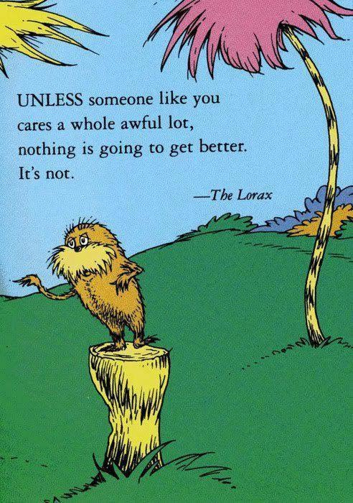

QUESTIONS?

Slide 32
Thank You!
Tarida Anantachai, tanantac@syr.edu
Chanelle Pickens, chanelle.pickens@mail.wvu.edu
Anthony Wright de Hernandez, antwri@vt.edu
Charla Gilbert, charla70@vt.edu

