Slide 1
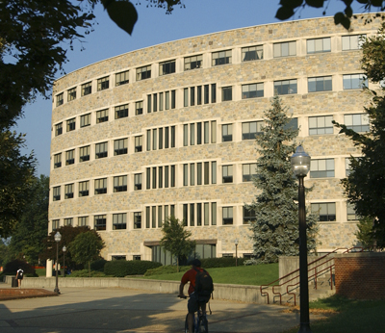
concept review
thought starter ideas for Newman Library, Virginia Tech
June 19, 2012

Slide 2
thank you
Thank you for the opportunity to explore a range of thought starter concepts for the Newman Library. We look forward to your feedback on the ideas and applications presented.
our intent
Within this document, our application design team has interpreted your requirements and your vision, into various thought starter concepts. Our intent is to further our on-going dialogue regarding existing and emerging needs for students, faculty and staff, and the opportunities to support active learning in the library.
We have expressed our concepts using a range of Steelcase Inc. products and applications. These applications are designed to support emerging trends in higher education, and to help create the vision you have for new behaviors and experiences in the library.

Slide 3
contents
our understanding
The Newman Library is evolving from a destination for individual reading and research, to a social destination which supports active learning. Your objective is to create inspiring learning spaces which evoke the feelings and experiences of settings not currently offered in the Newman Library. Our goal is to help create spaces which incorporate the feelings and experiences of these social spaces not traditionally found in libraries, such as a marketplace, hotel lobby or village.
The images and solutions provided are designed to create these types of social environments which support active learning, and, foster the skill sets desired by 21st Century learners.
contents include
Learning environment issues
Floorplan overview
Social and work settings
I/owned spaces
I/shared spaces
we/owned spaces
we/shared spaces
Product highlights
Kit of parts
Next steps

Slide 4
learning environment issues

Slide 5
Shifting purpose of university libraries
Is your library ready?
Why would we ask this question? The answer is that Steelcase is passionate about bringing human insights to higher education and helping universities perform better through the places where their people come together to work and learn.
A fundamental shift has occurred in university libraries and it’s one that has profound impact on how we support and utilize library spaces. We believe that the library is more important than ever before in how it supports changing pedagogy, the needs of the millennial student and the requirements for 21st Century skills.
21st Century Library issues
stacks are greatly reduced
Increased need for digital access to content
changing role and skill sets for librarians
demands for technology related services and environments
Notes:
b

Slide 6
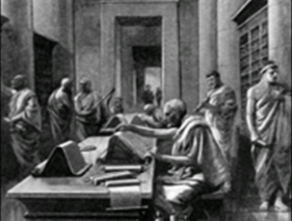
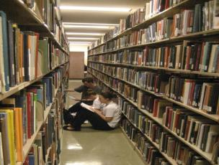
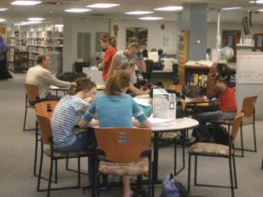
reading centered
storage centered
learning centered
the shift

Slide 7
supporting the change from informational to social
social
social
spatial
informational
spatial
informational
20th century library
21st century library

Slide 8
library issues
reduced stacks
As stacks have been reduced over recent years, opportunities arise to re-purpose library spaces and to create environments which support active learning
digital access to technology
The explosion in technology has greatly impacted the overall use of the library. Libraries continue to purchase and develop digital collections which are affected by advances in search technology, creation of tools allowing scholarly use of digital content, and broader changes in the scholarly communication environment.
changing role of librarians
The convergence of demographic changes, technological advances, and broader social trends compels librarians to accelerate their acquisition of new skills and knowledge. In particular, they must understand and embrace the application of new technologies to instructional programs, as well as to other service programs.
demand for services
The expanding capabilities of mobile or “smart” devices, such as phones and other handheld devices,
are increasing student expectations for services. There is increased use and expectation of distributed or diffused content, in addition to opportunities to create and share content. Students, staff, faculty, and departments will increase their use of social networking tools.

Slide 9
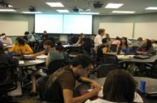
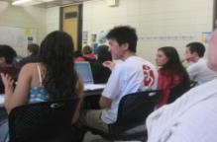
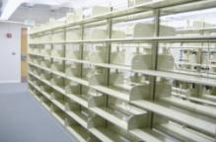
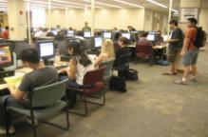
drivers for change
diverse student population
explosion in technology
pedagogical shift

Slide 10
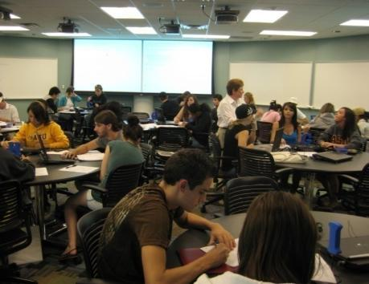
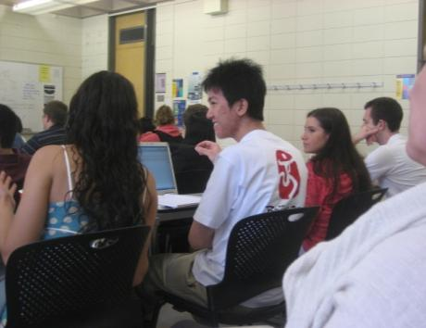
drivers for change
Diverse Student Population
increase in first generation college attendees
“digital natives” lack information literacy
adult learners expect immediate relevance to their work and bring a foundation of experience

Slide 11

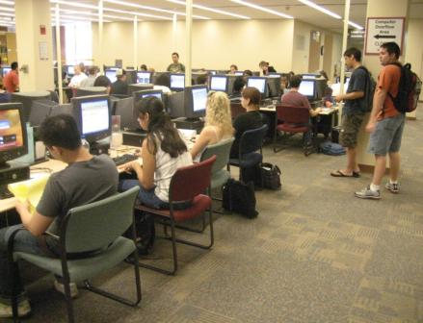
drivers for change
digital access to content
stacks are going away
changing skill set for librarians
growing demand for library computer labs
demands for technology related services and environments
Explosion in Technology

Slide 12
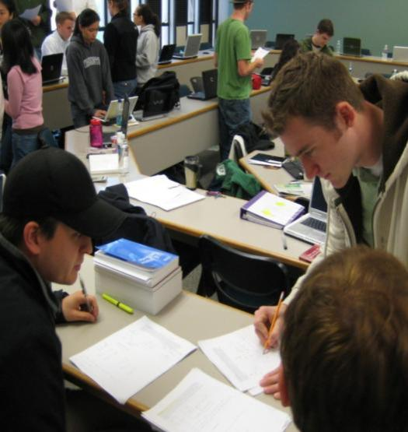
drivers for change
21st Century Pedagogy
constructivism … learning is social
learning by doing
driving teamwork

Slide 13
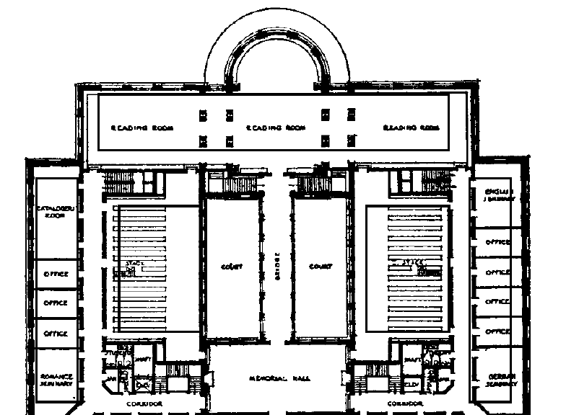
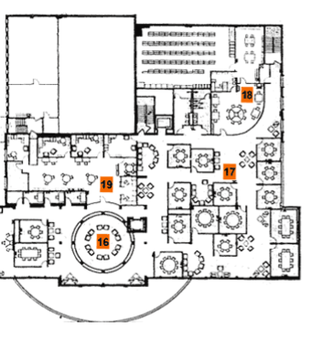
Solutions to change from informational to social at the Newman Library – The library as an ecosystem.
20th century library
21st century library

Slide 14
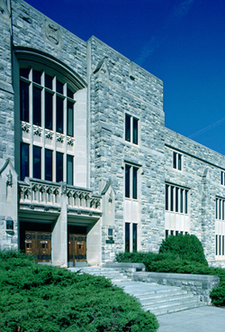
Helping VT transition to make a great
library….Better!

Slide 15
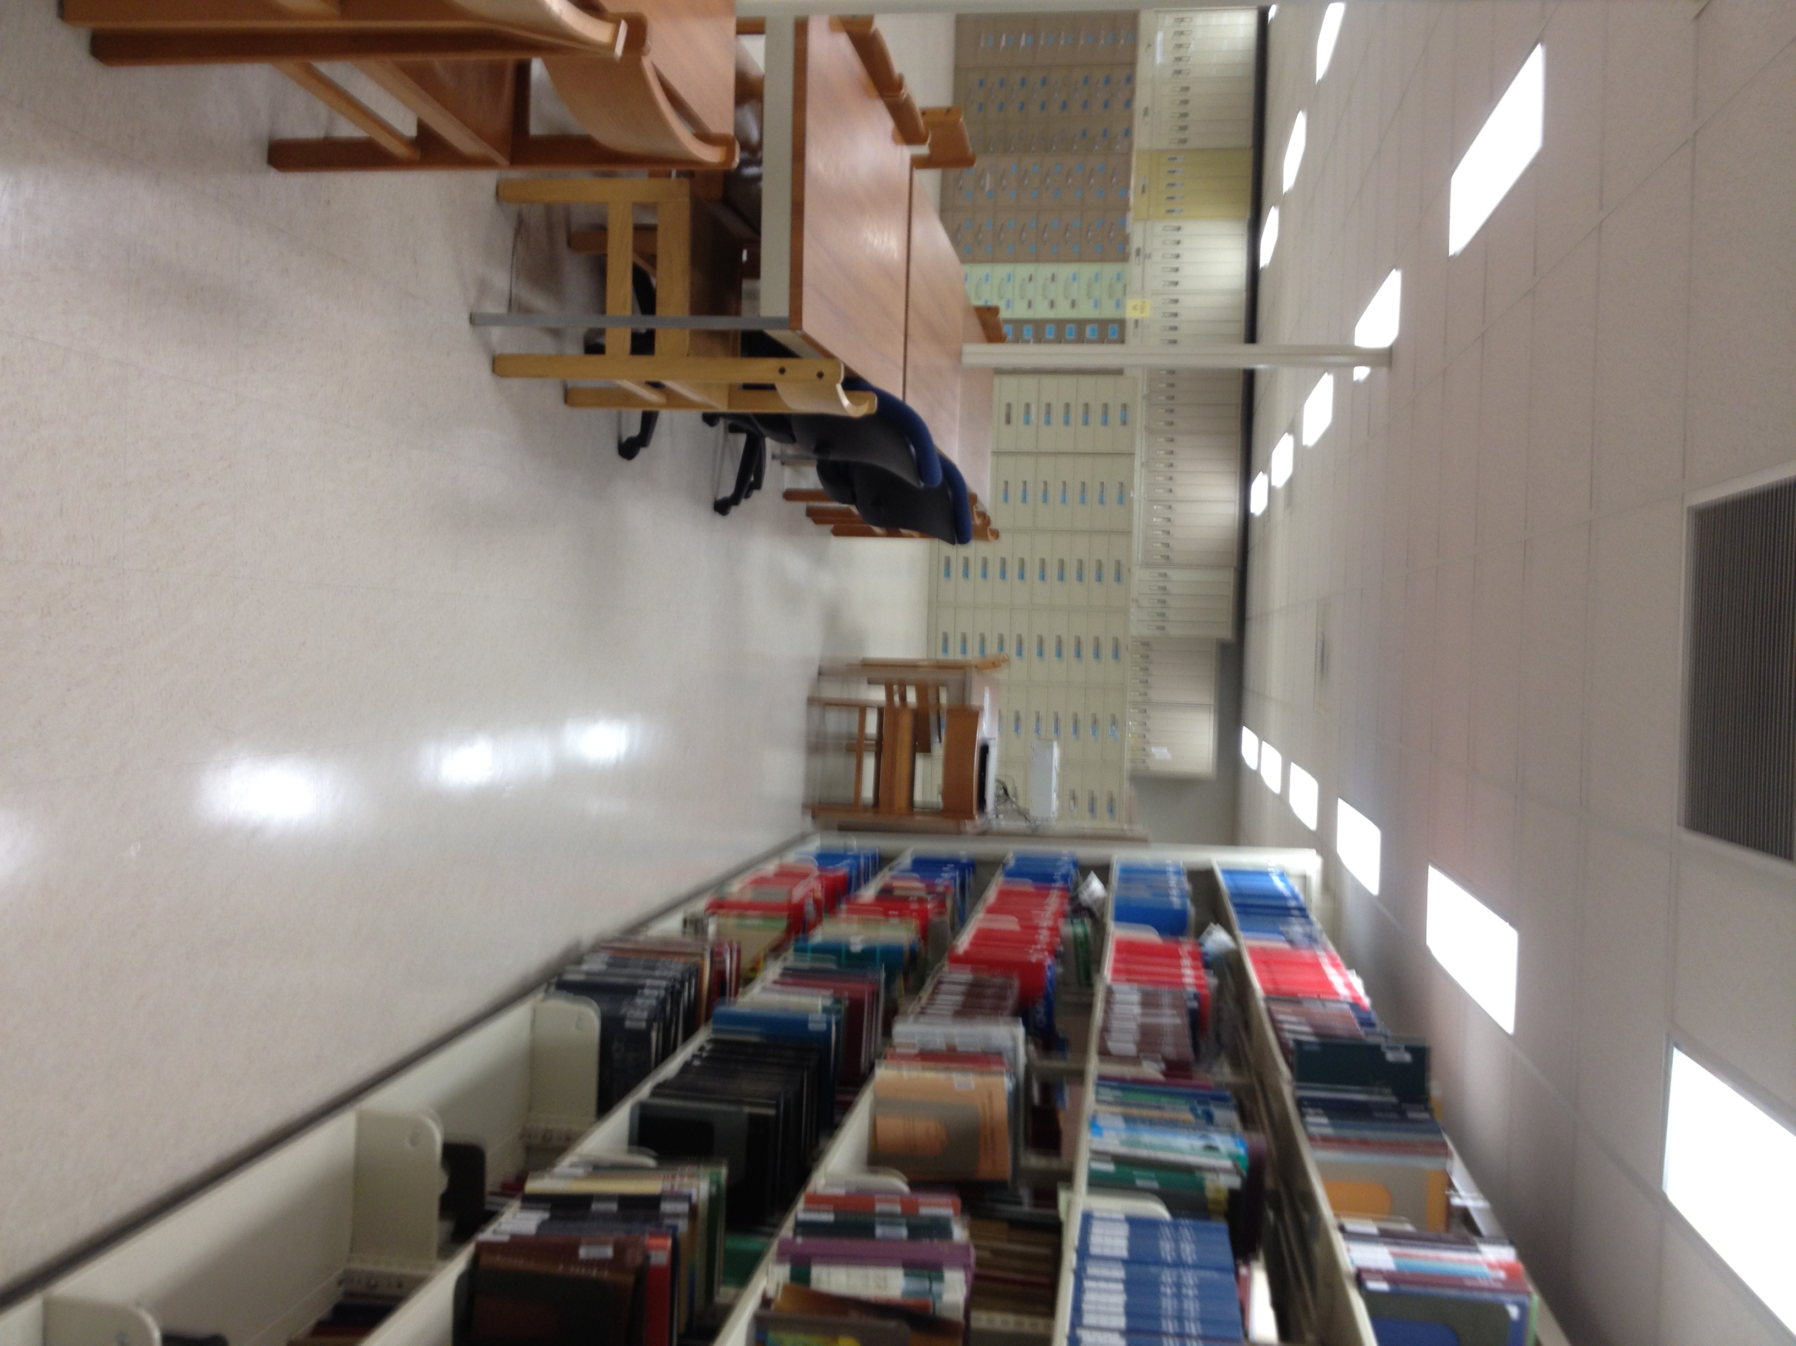
As physical storage needs stabilize and stacks reduce, opportunities and challenges arise to repurpose libraries to support emerging needs of students, faculty and staff.

Slide 16
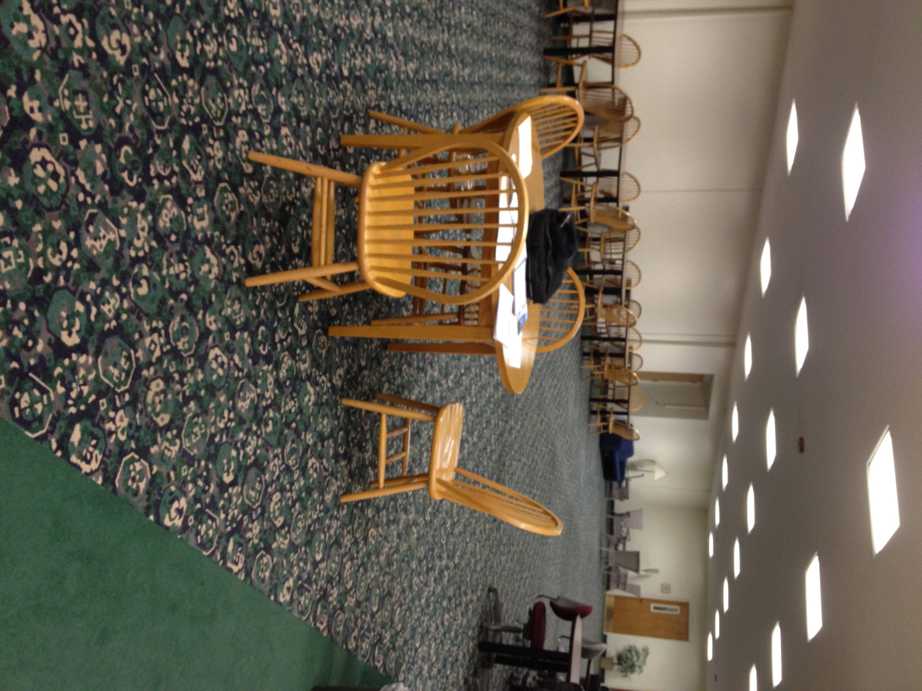
Providing inspiring and effective spaces for individual study, as well as group learning and collaboration.

Slide 17
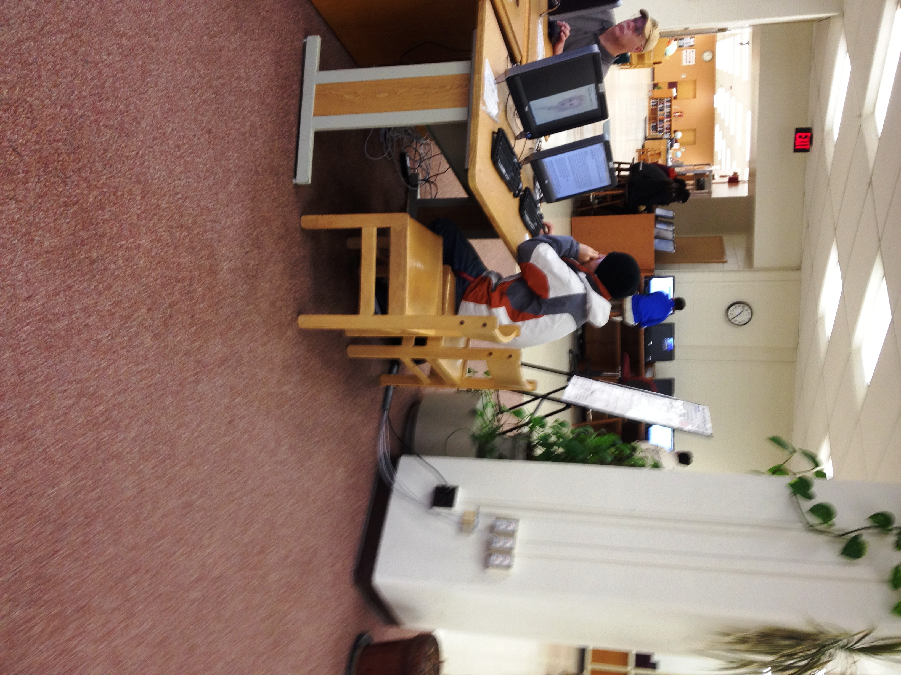
Providing settings and tools to access technology, and to generate and share digital content.

Slide 18
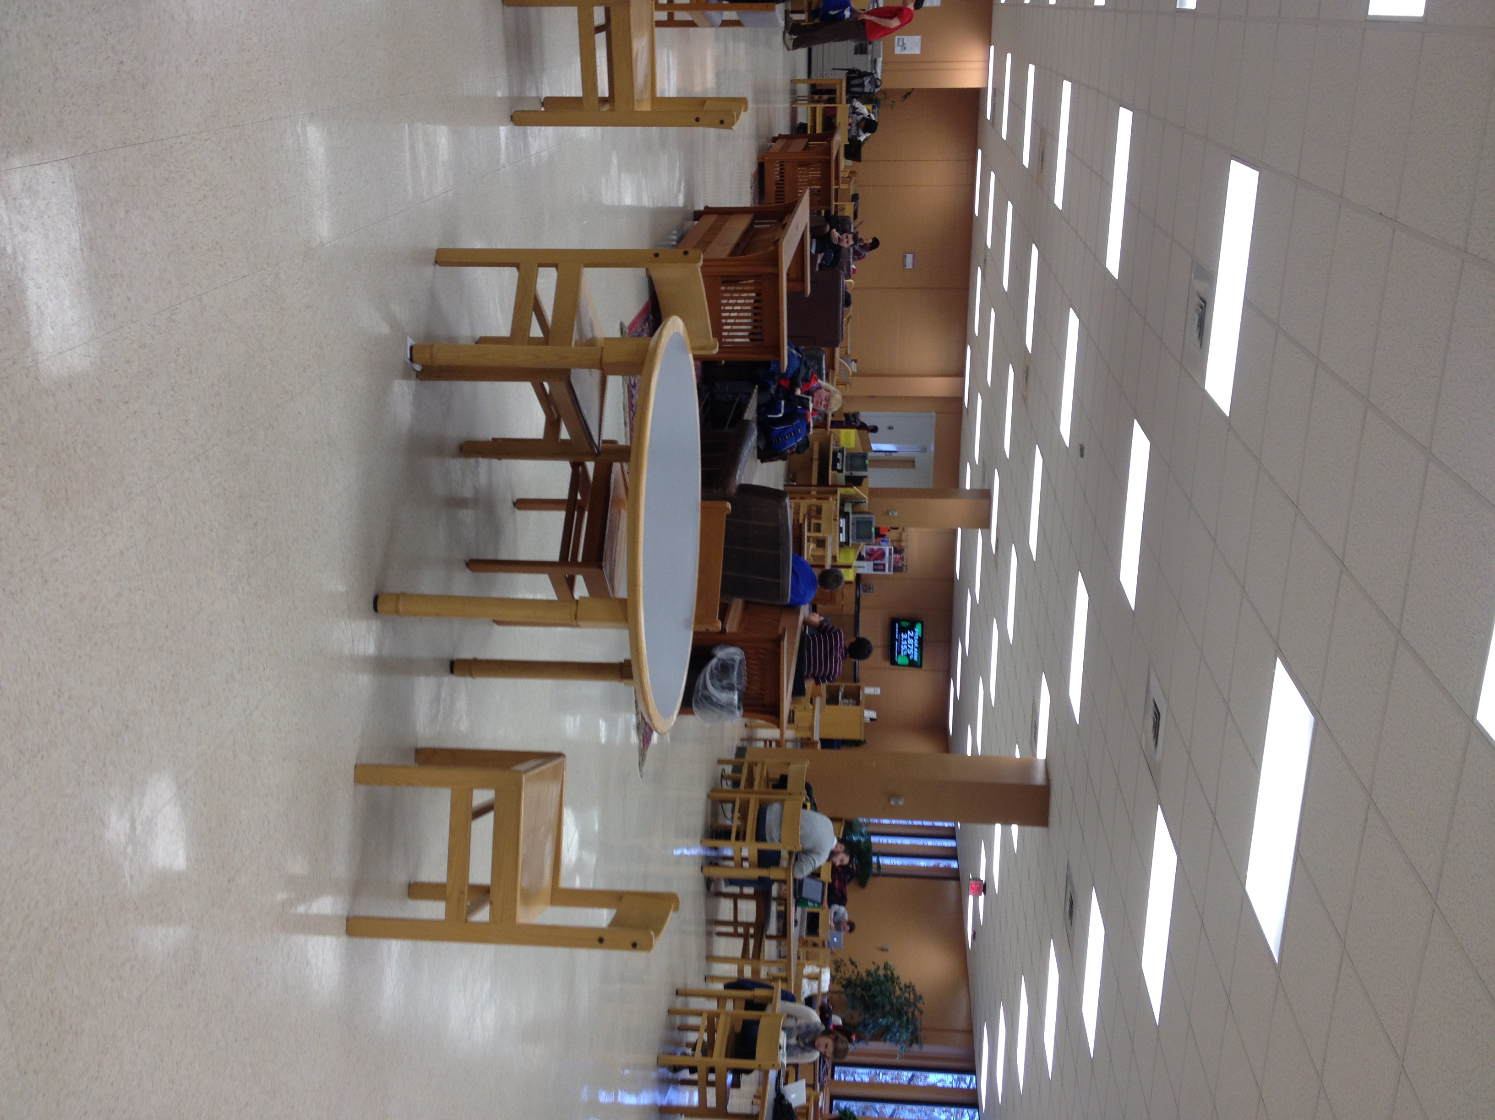
Creating spaces which allow for multiple kinds of individual and social activities, postures and modes of learning.

Slide 19
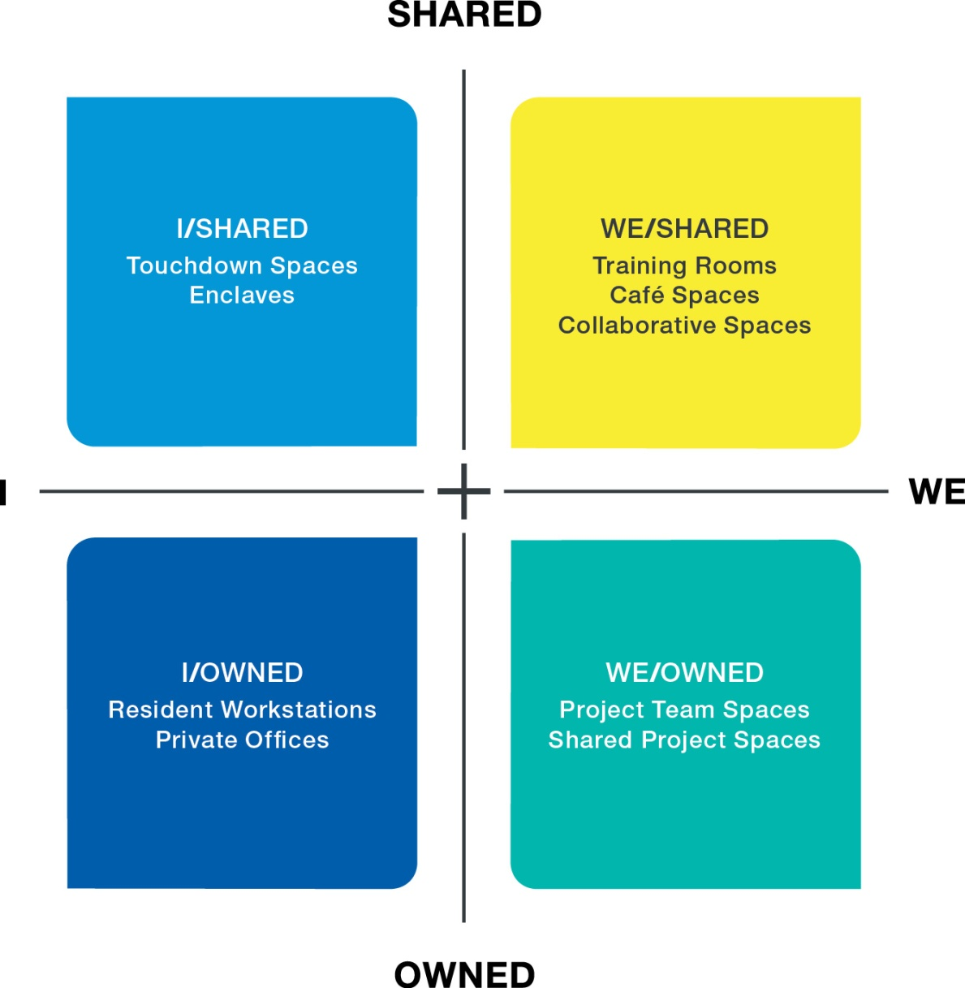
solutions framework
solutions framework
This framework provides a methodology for creating and assessing a workplace designed for an interconnected world. It recognizes that people need to do both individual “I” work and group “We” work. And it also breaks the paradigm that all individual spaces should be assigned or “owned” or that all group spaces should be shared.
palette of place
Workstyles, mobility, and job requirements all differ, so an interconnected workplace needs to provide spaces for both residents and mobile workers and a variety of places for individual and group work that anyone can use.
palette of posture
Changing postures is physically energizing and mentally stimulating, and supports different work modes. Workplace designs that allow people to vary postures
help keep people refreshed and engaged, and
support overall wellbeing.

Slide 20
floor plan overview

Slide 21
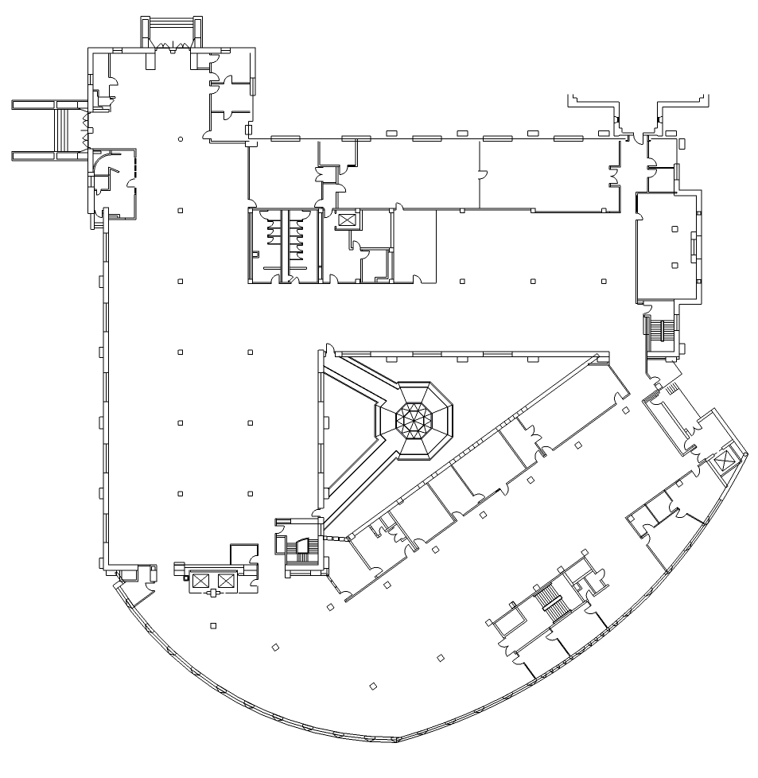
floor plan overview | current
metrics
square feet | 43,886 s.f.
workers supported | 13,706 s.f.
resident | 2,194 s.f.
distributed | 11,512
square feet per person | 41 s.f.
ratio
workstation:worker | #:#
I/Owned spaces
individual settings | 2,194 s.f. | 16%
private offices | 0 | %
I/Shared spaces | 0 | %
We/Owned spaces | 0 | %
We/Shared spaces | 11,512 s.f. | 84%
I/Owned spaces
We/Shared spaces

Slide 22
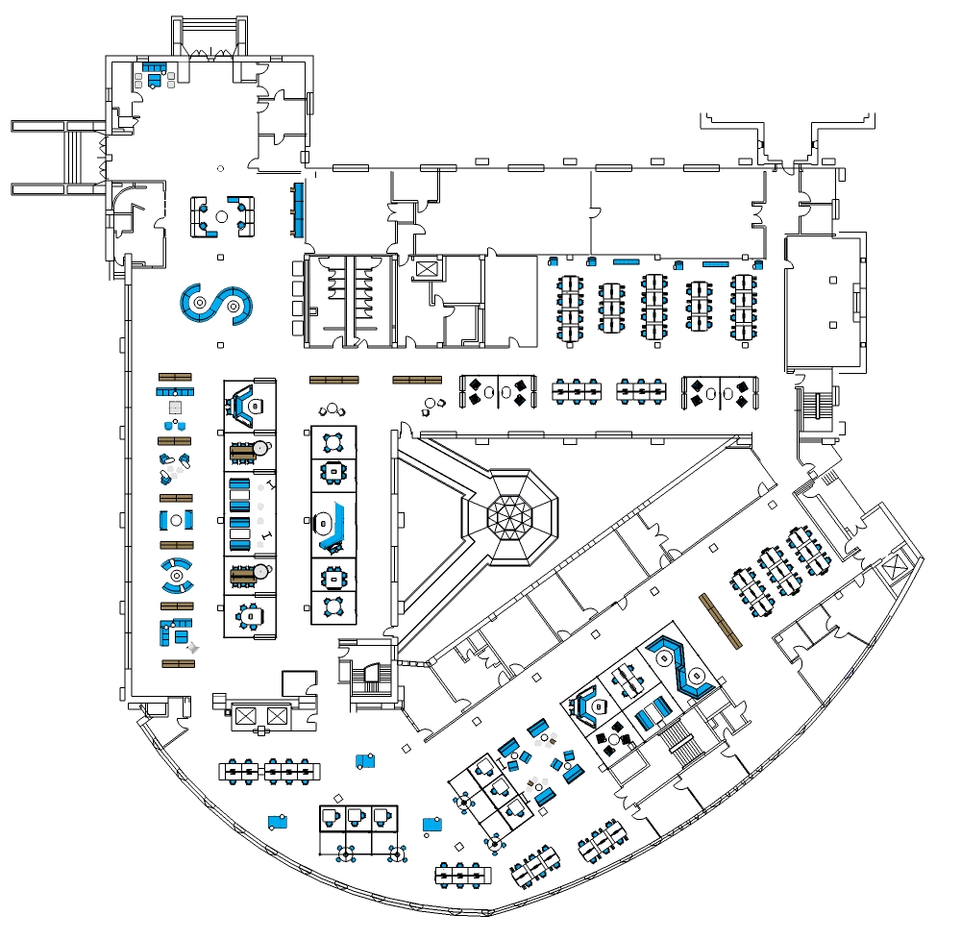
floor plan overview | concept
metrics
square feet | 43,886 s.f.
workers supported | 14,080 s.f.
resident | 965 s.f.
distributed | 13,115 s.f.
square feet per person | 40 s.f.
ratio
workstation:worker | 102:334
I/Owned spaces
individual settings | 965 s.f. | 7%
private offices | 0 | 0%
I/Shared spaces | 2,531 s.f. | 18%
We/Owned spaces | 1,695 s.f. | 12%
We/Shared spaces | 8,889 s.f. | 63%
I/Owned spaces
I/Shared spaces
We/Owned spaces
We/Shared spaces

Slide 23
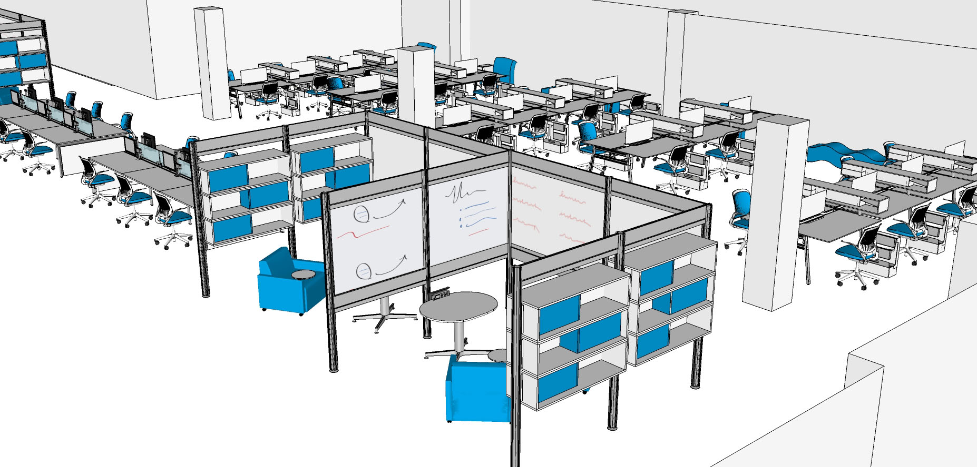
floor plan view | concept
view 1
design intent
Students are offered touch down benches where they can study/work promoting different learning experiences. It inspires individual or group work with their different study/work modes.

Slide 24
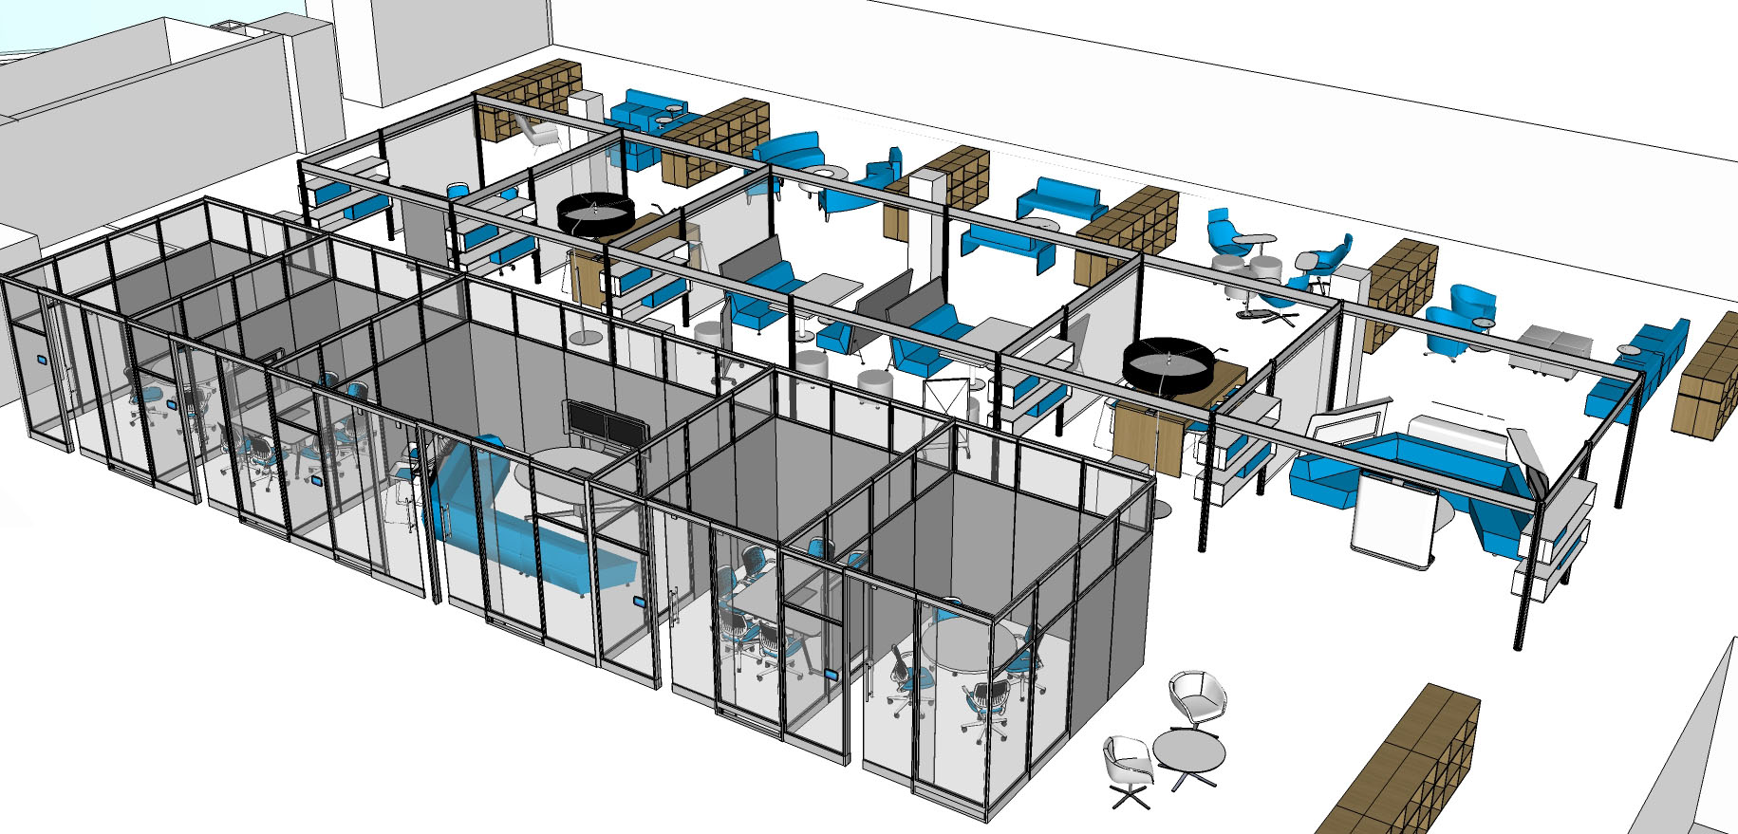
floor plan view | concept
view 1
design intent
Students are offered a dynamic mixture of areas ranging from very open to totally enclosed. It supports productivity and technology, inspiring individual and group work.

Slide 25
work settings

Slide 26
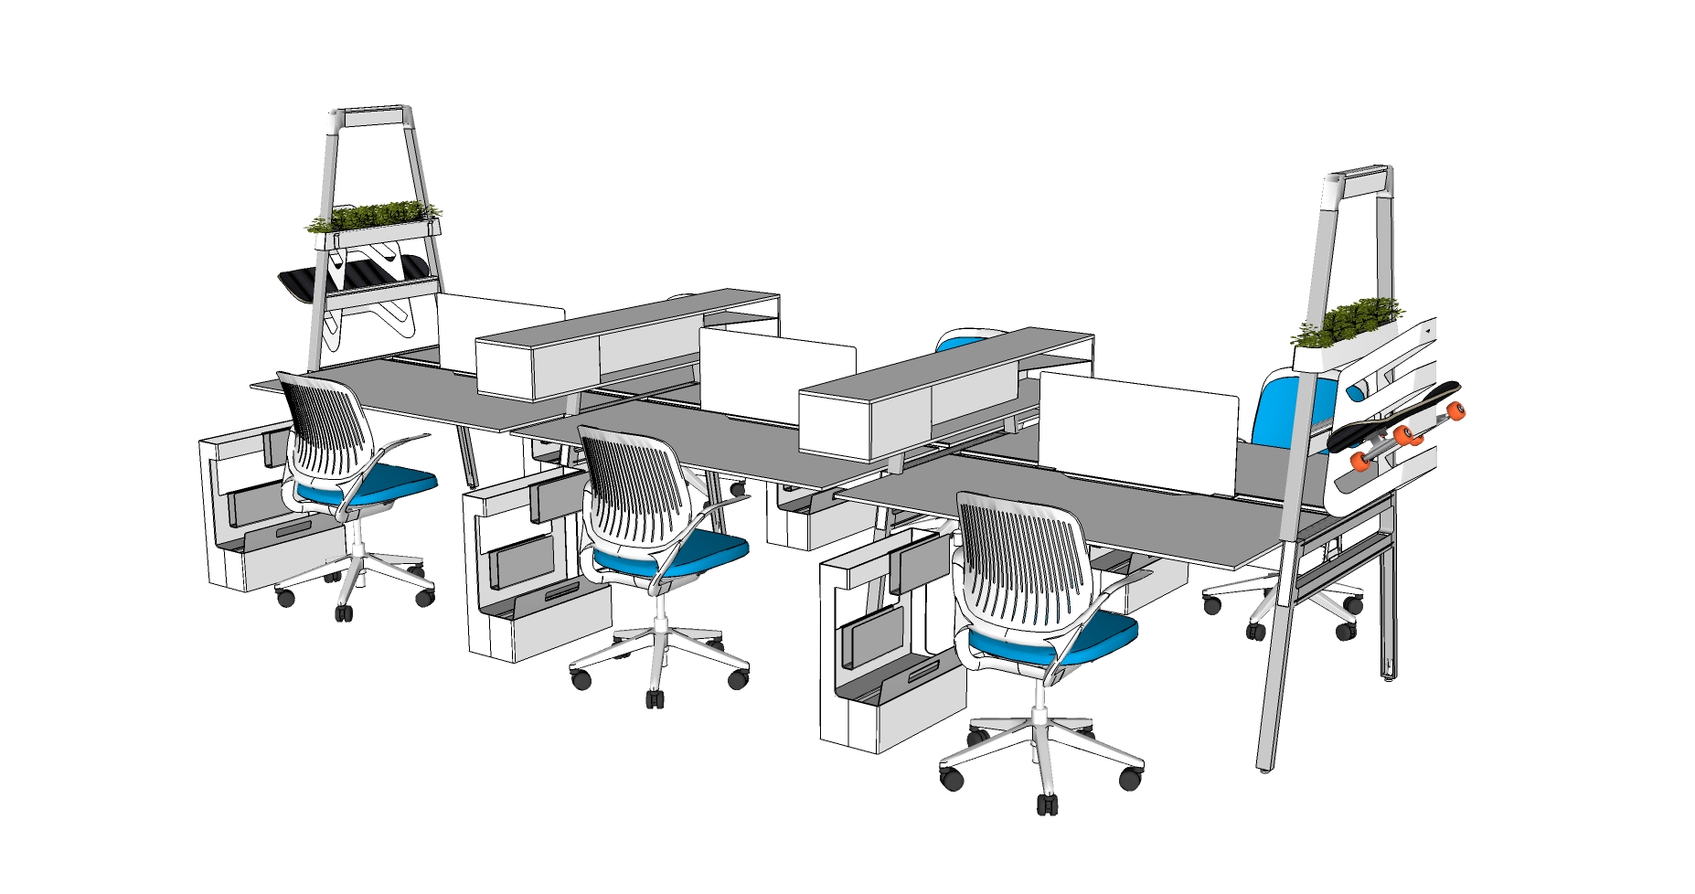
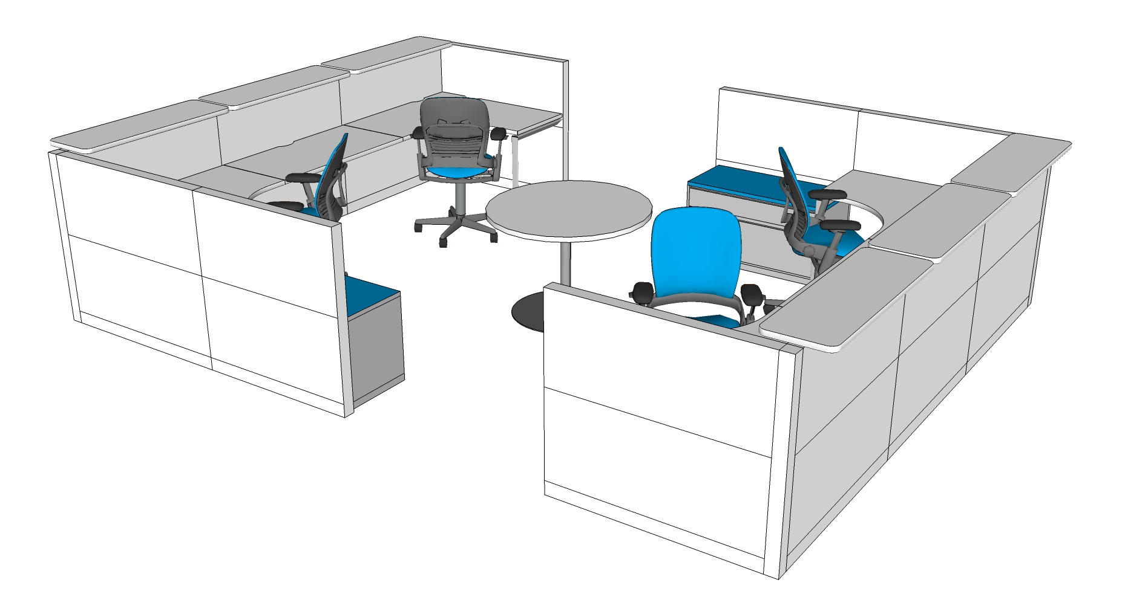
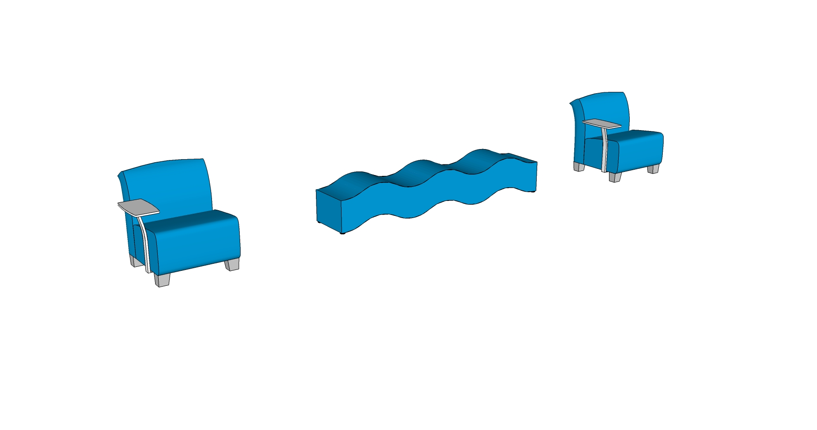
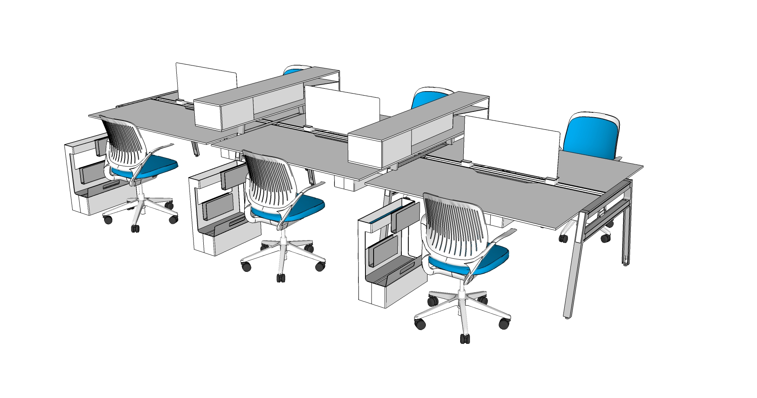
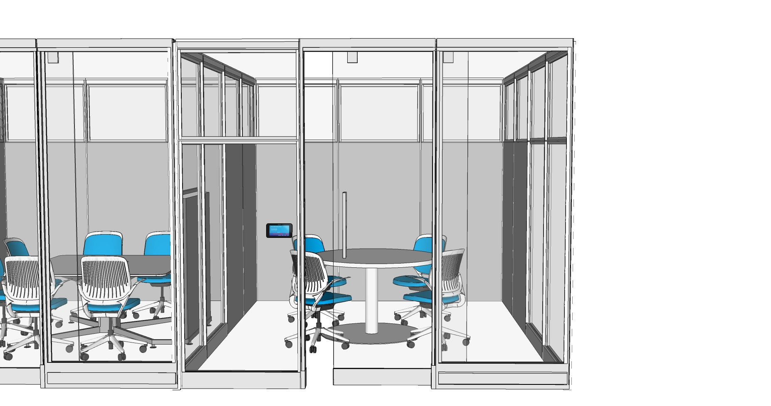
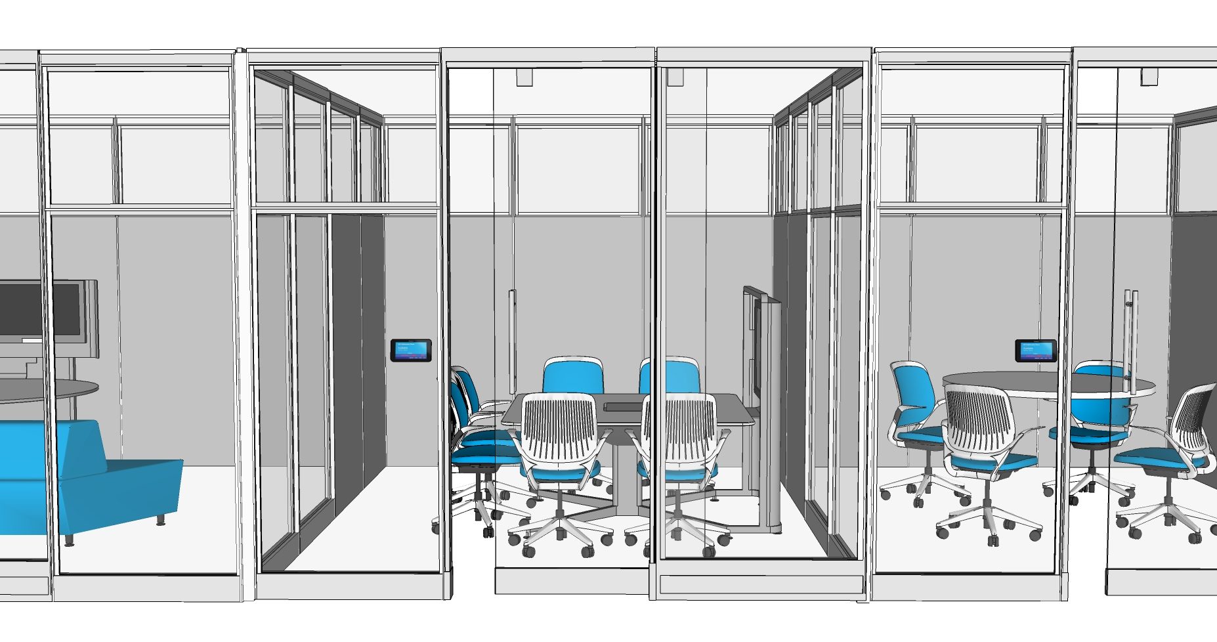
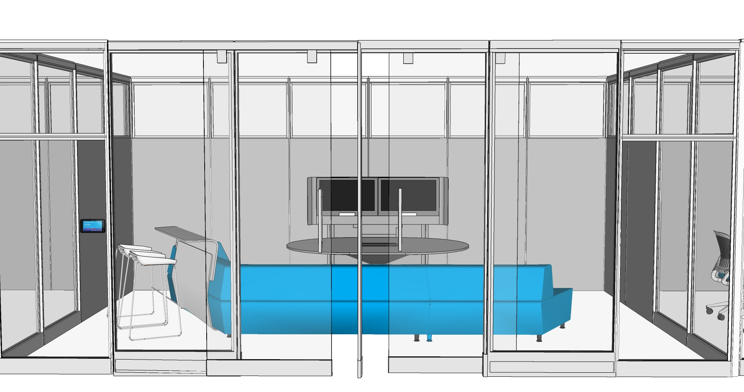
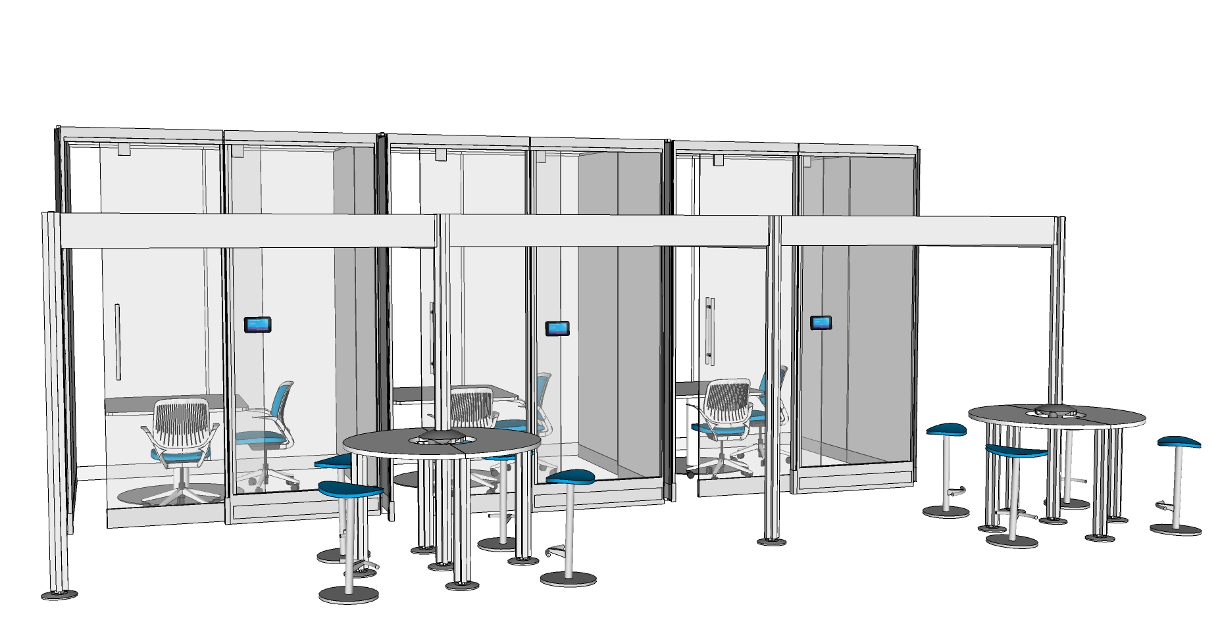
work settings
I/Owned spaces
B1
W1
I/Shared spaces
A1
B2
We/Owned spaces
C1
C2
C3
C4

Slide 27
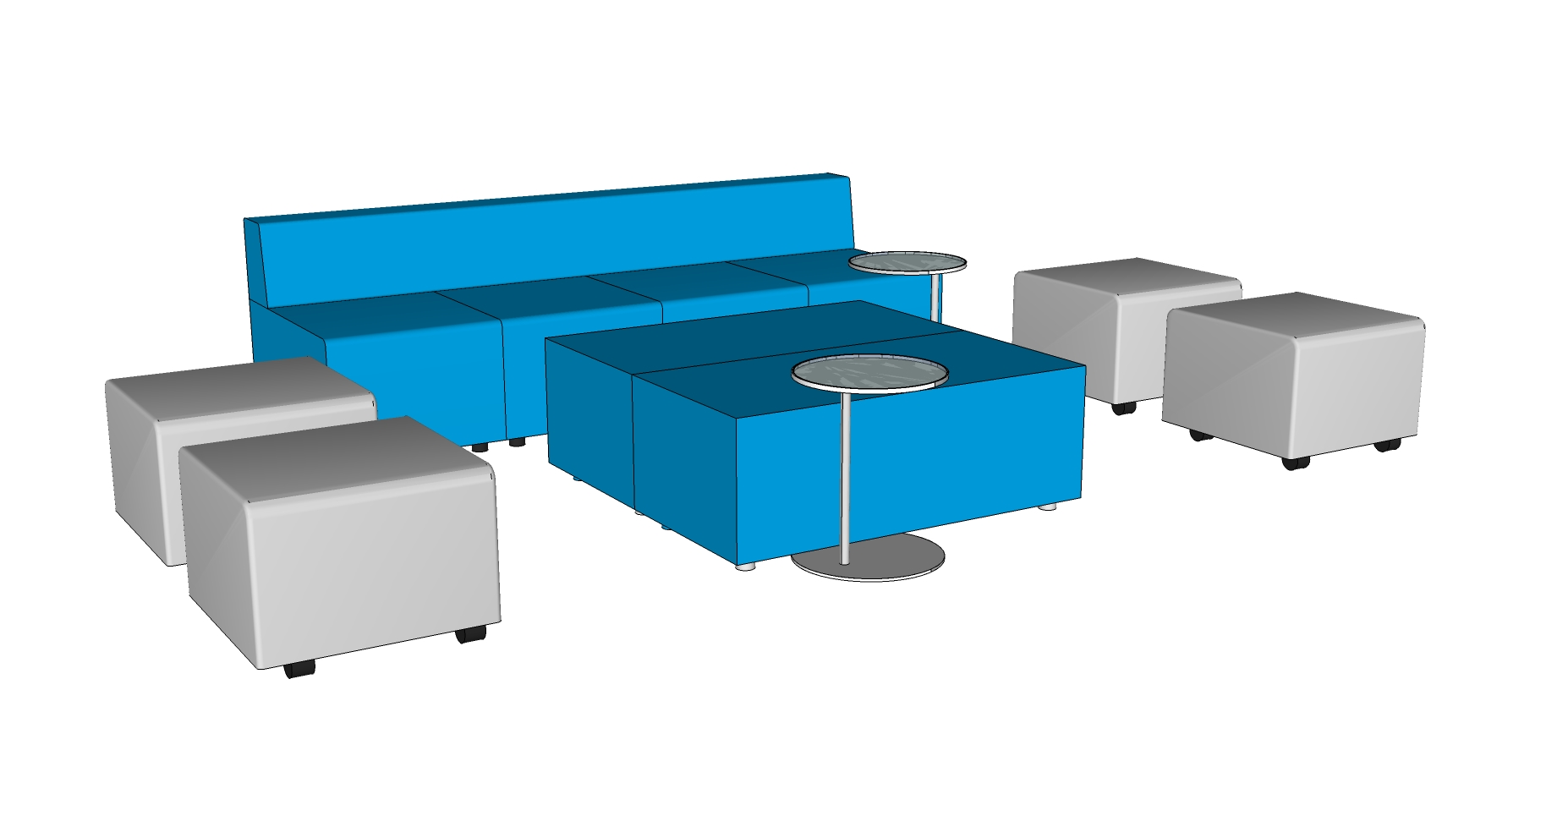
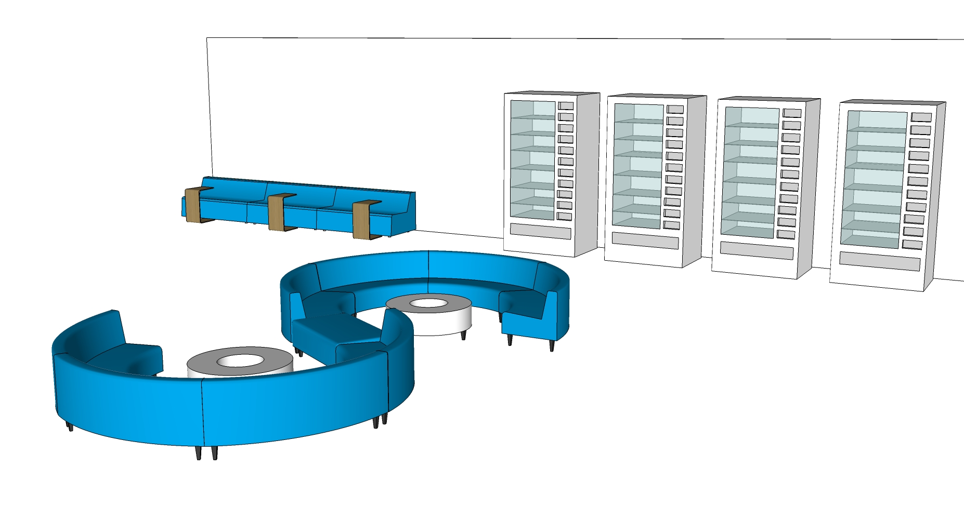
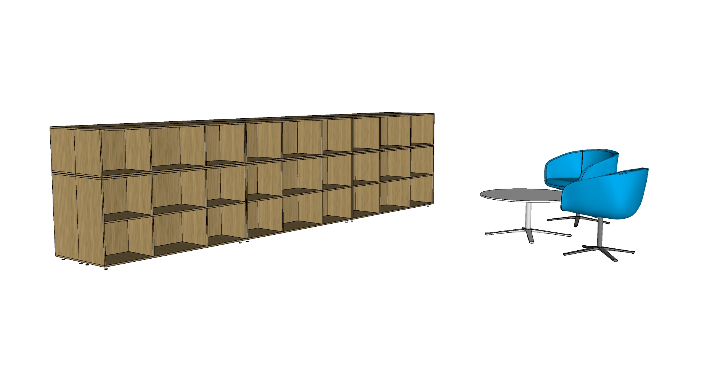
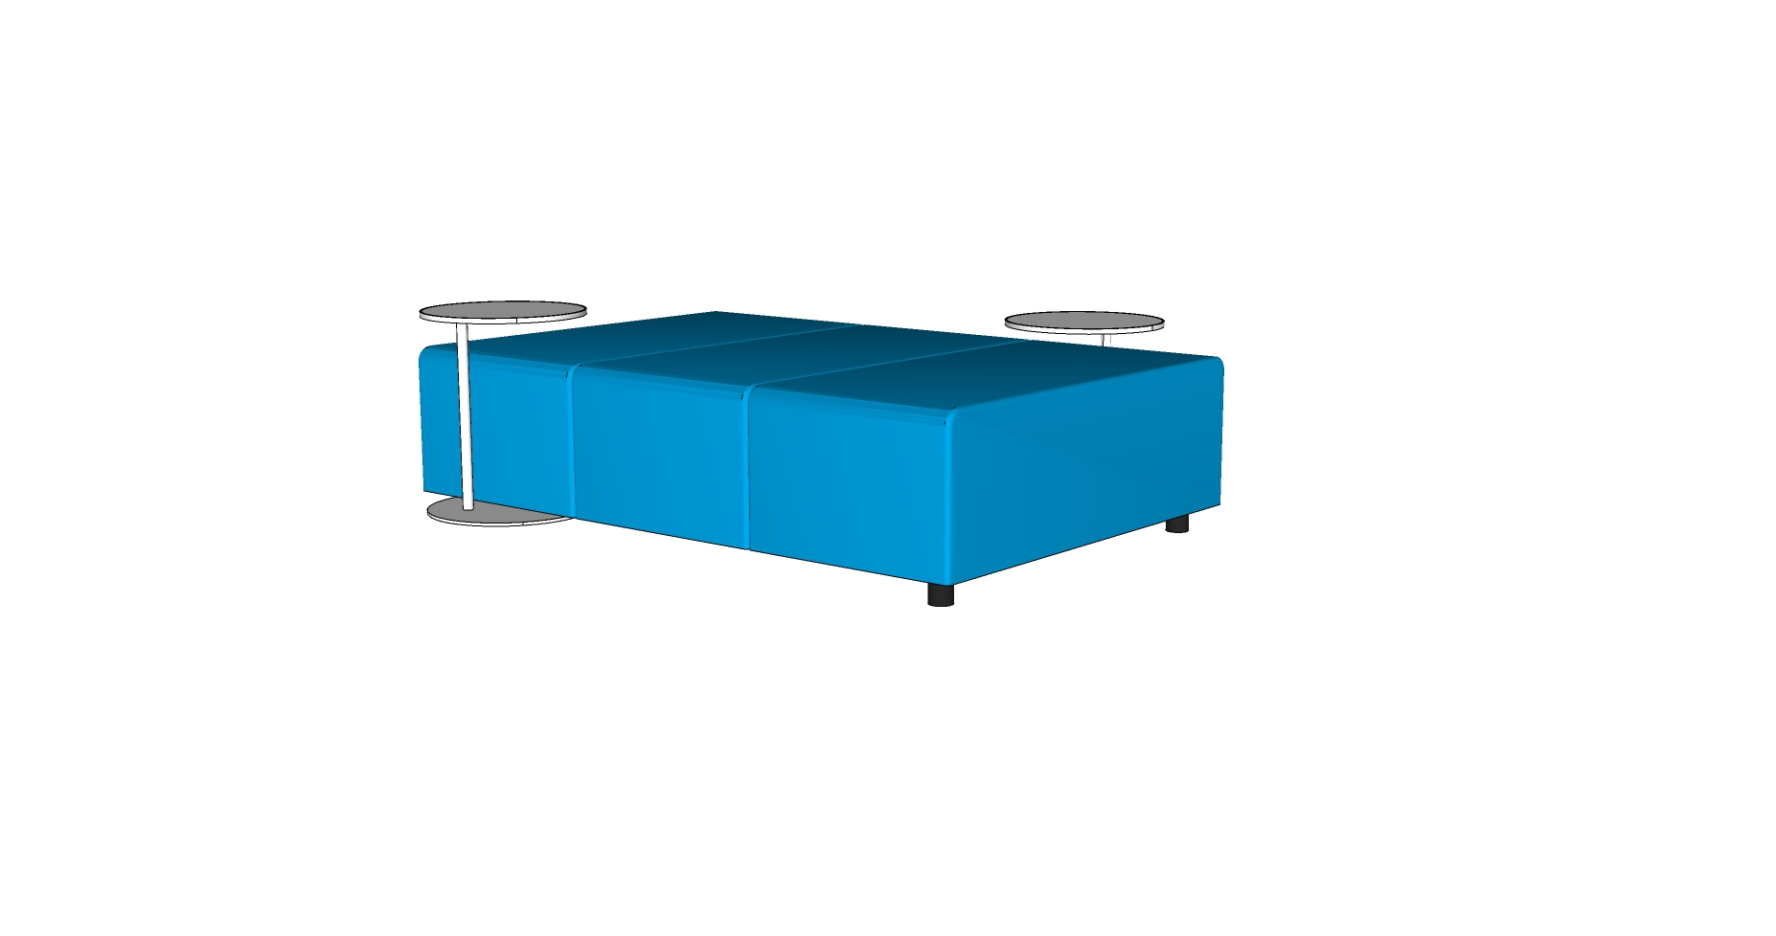
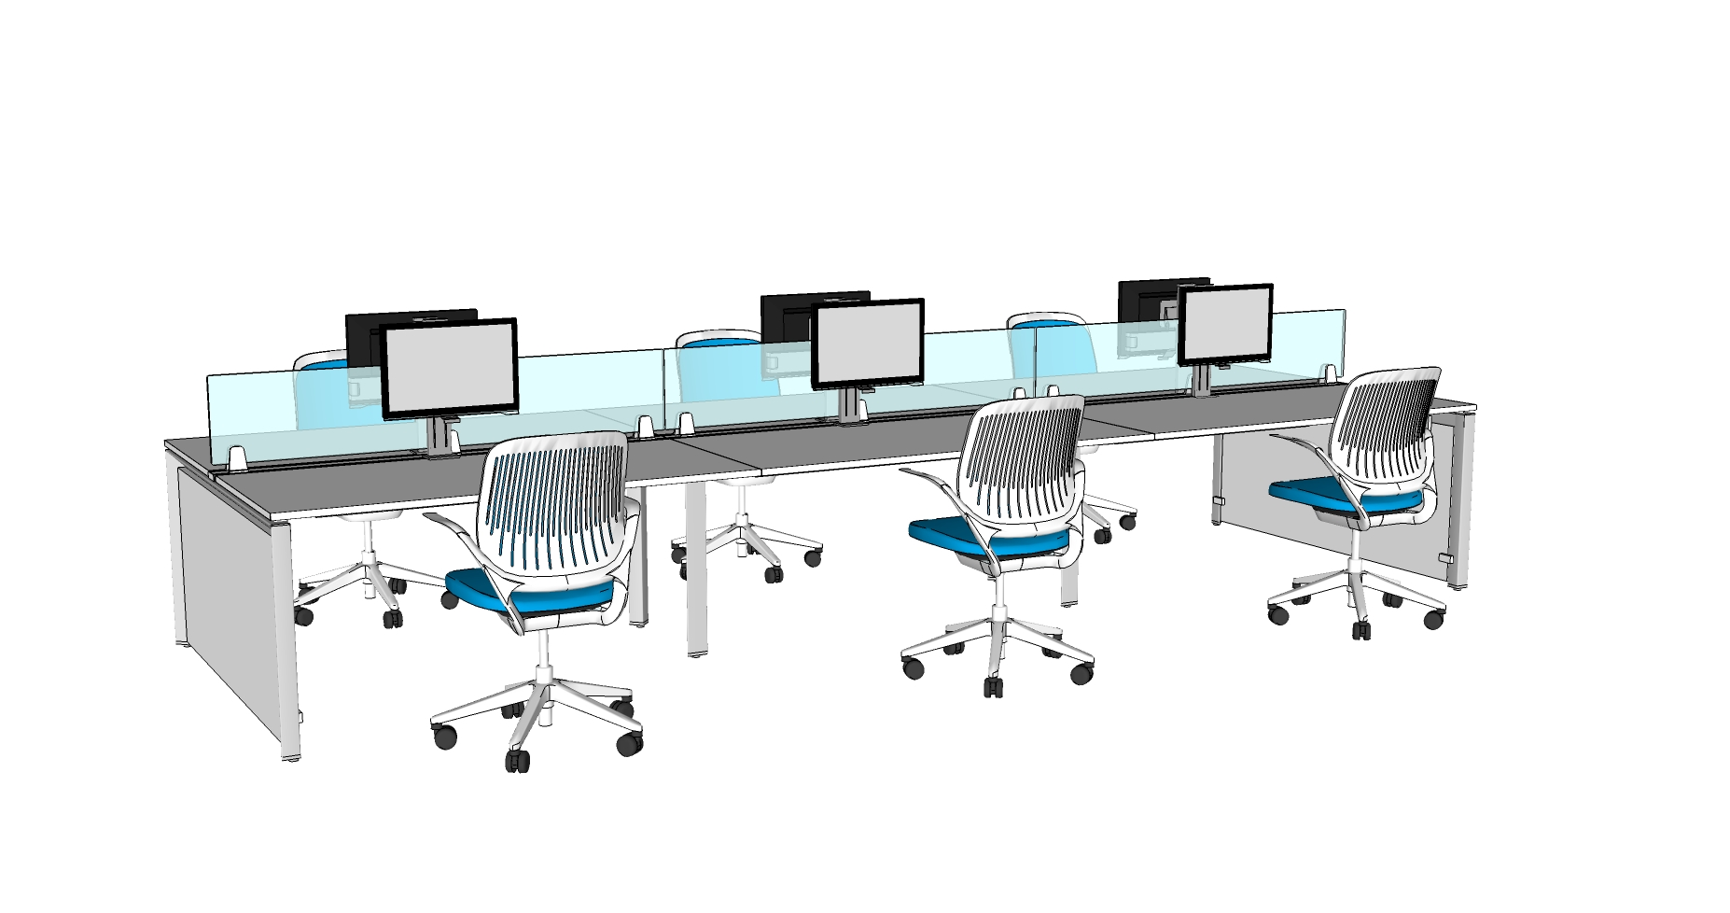
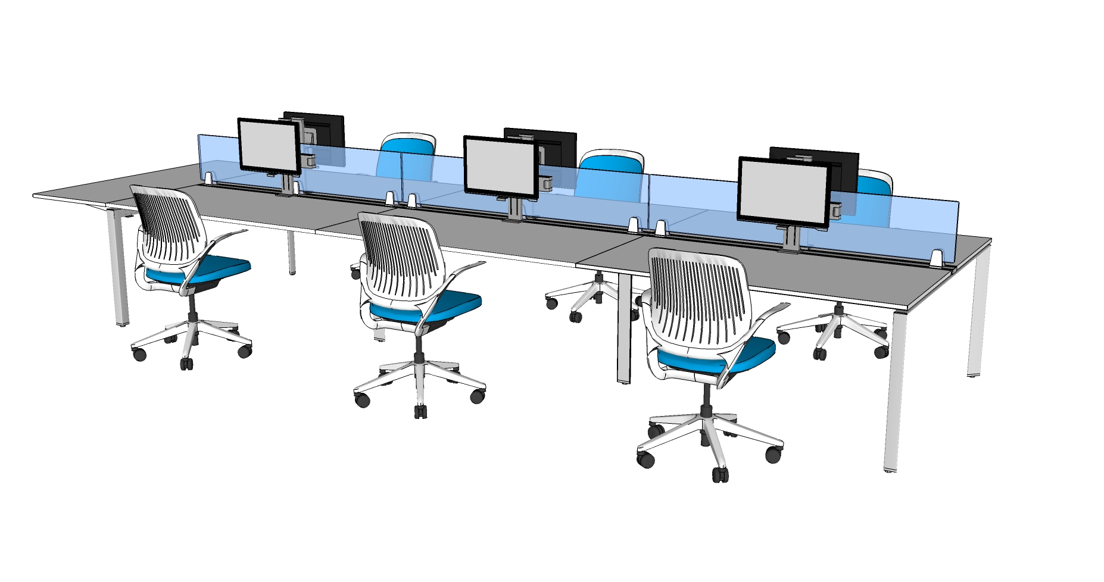
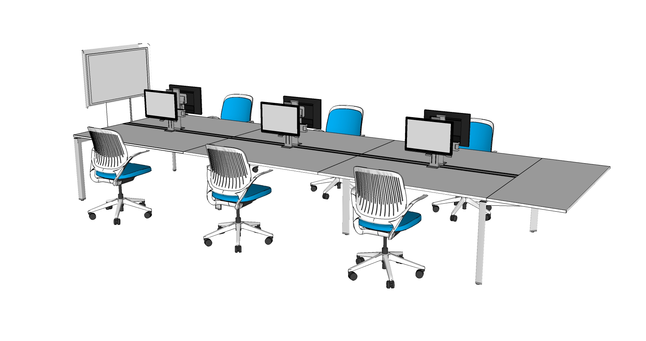
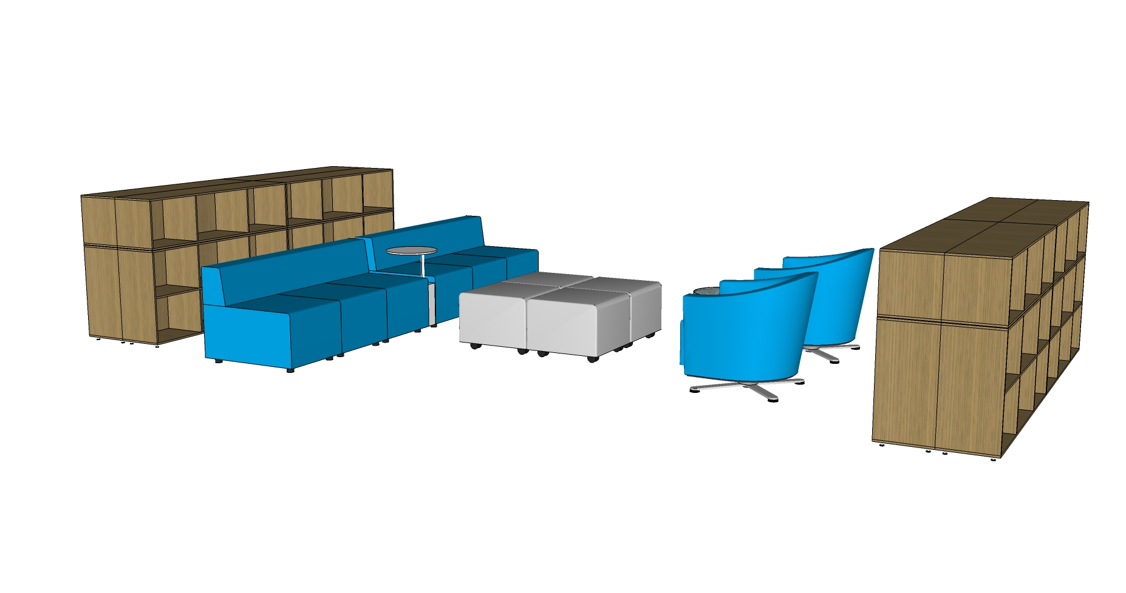
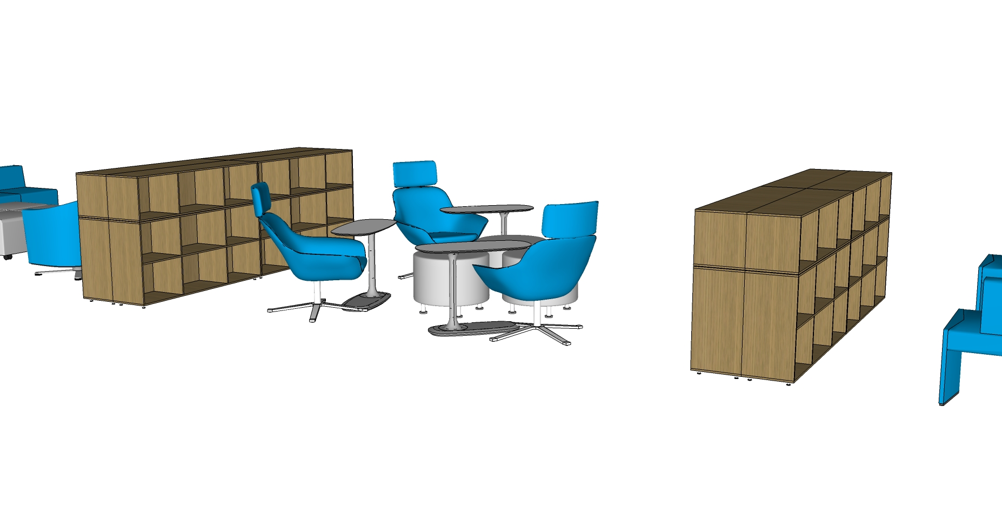
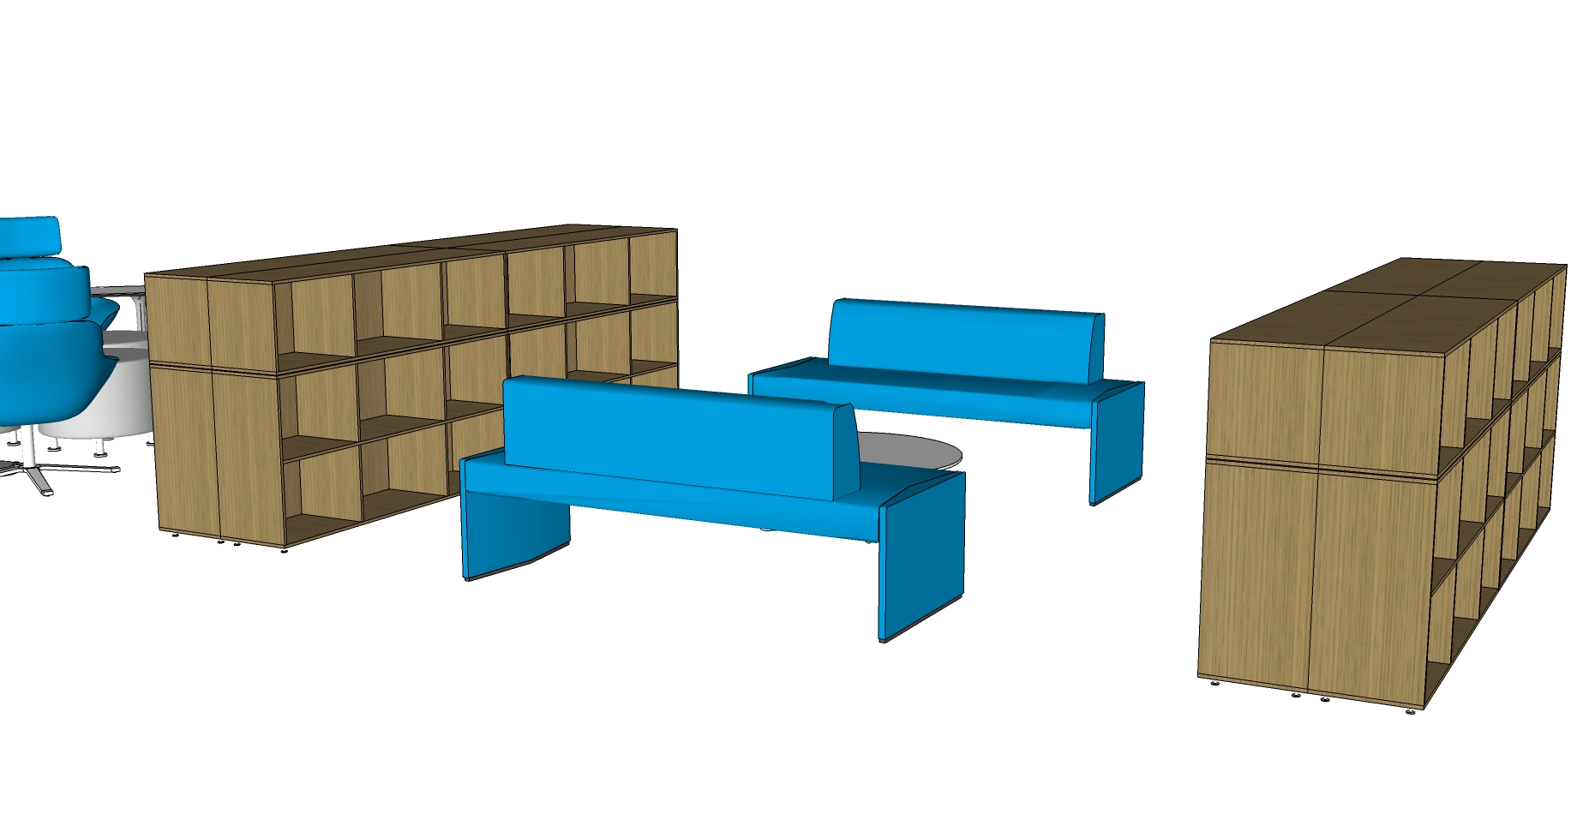
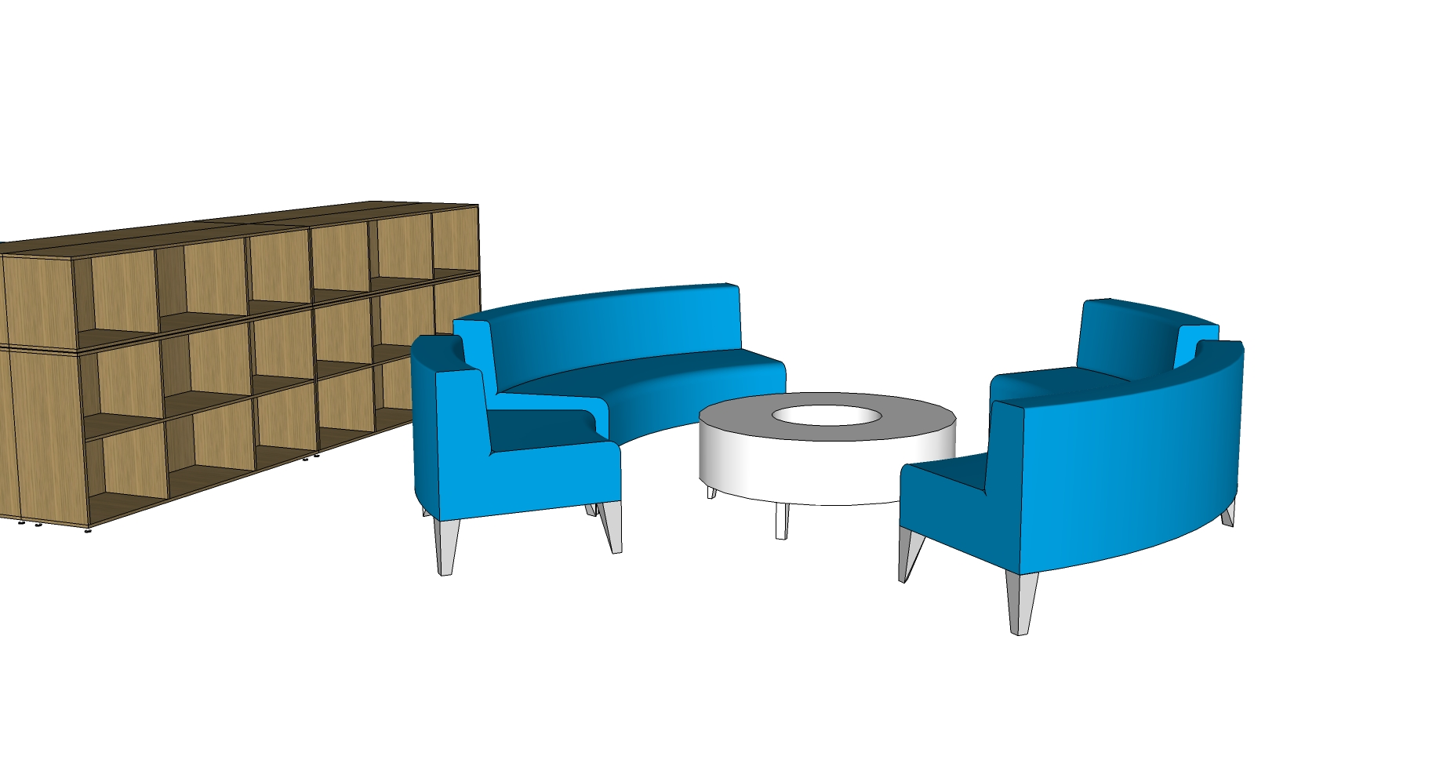
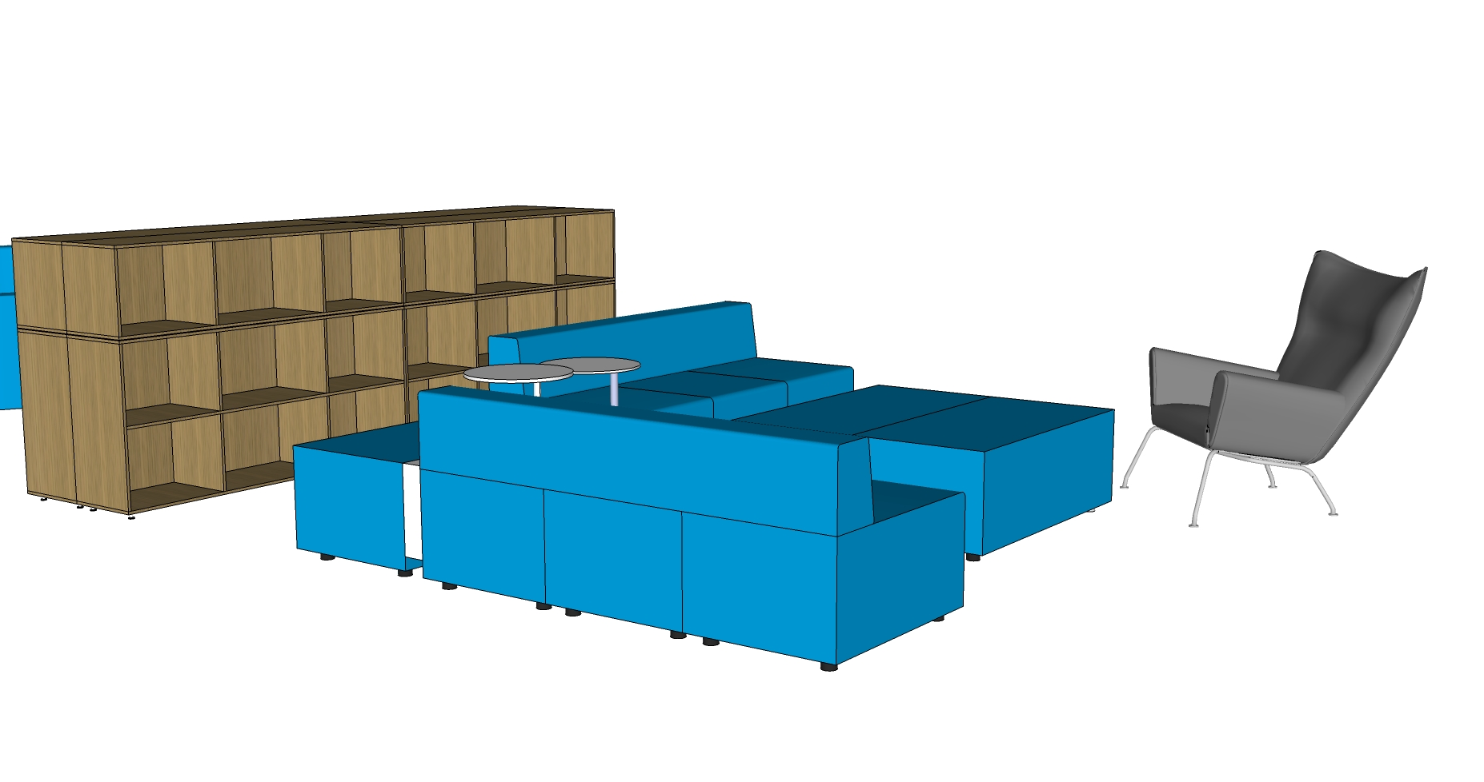
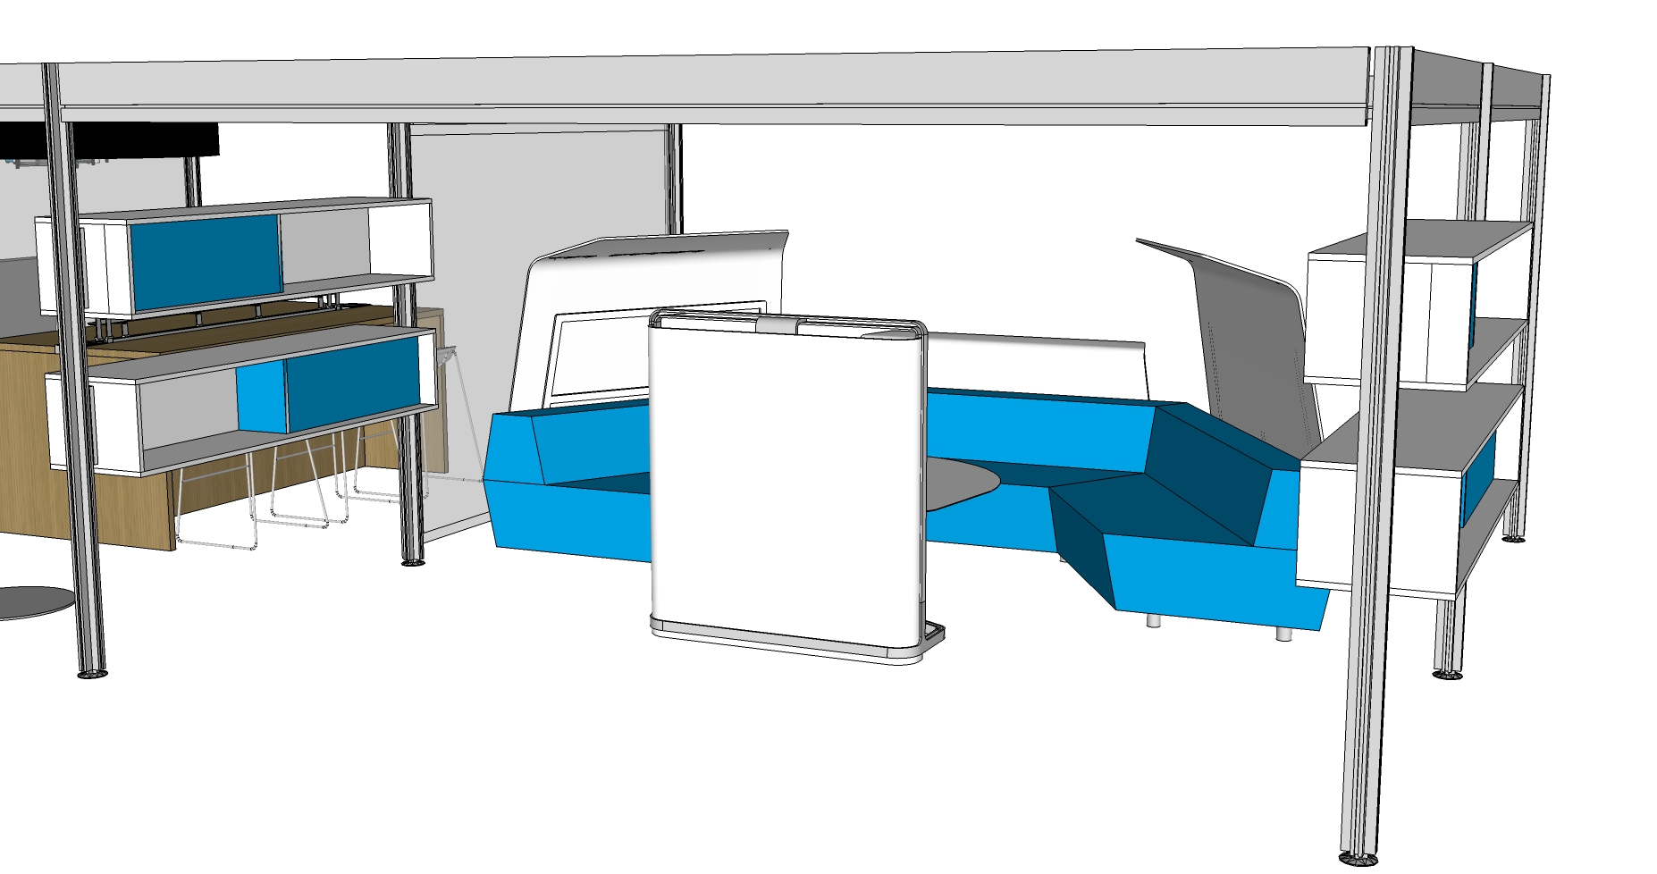
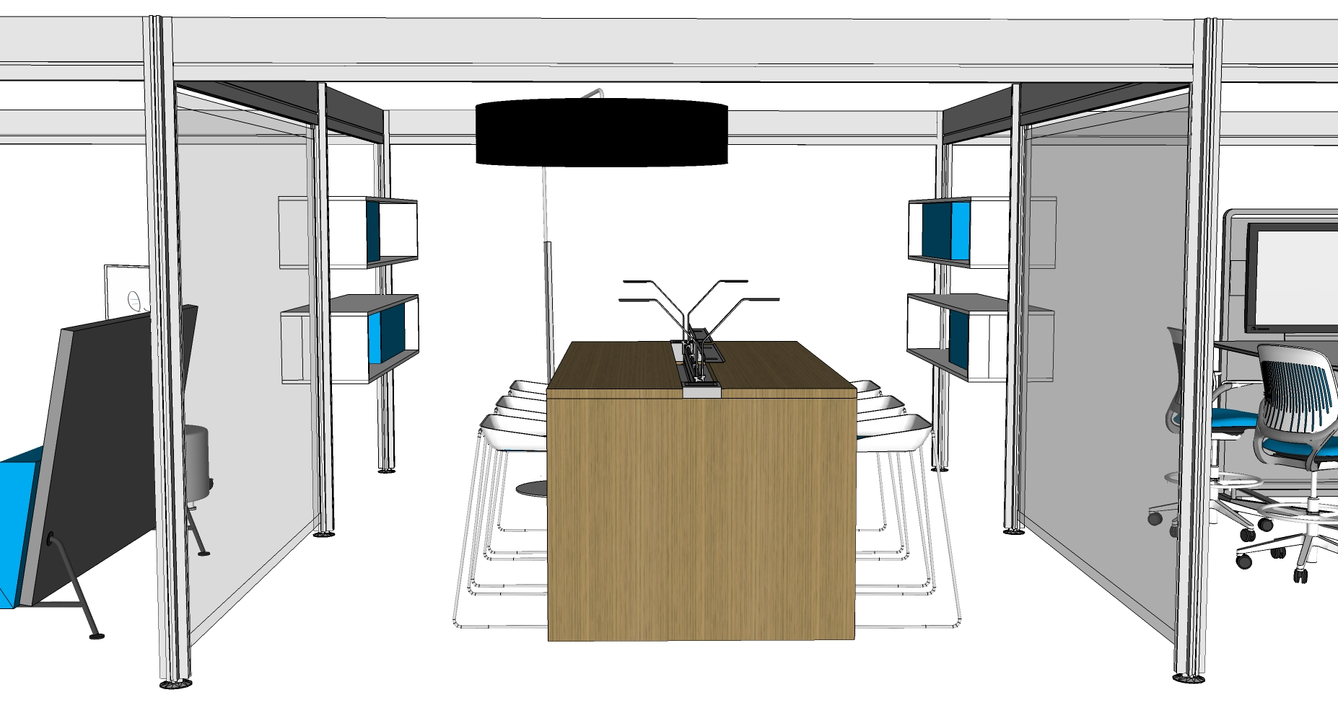
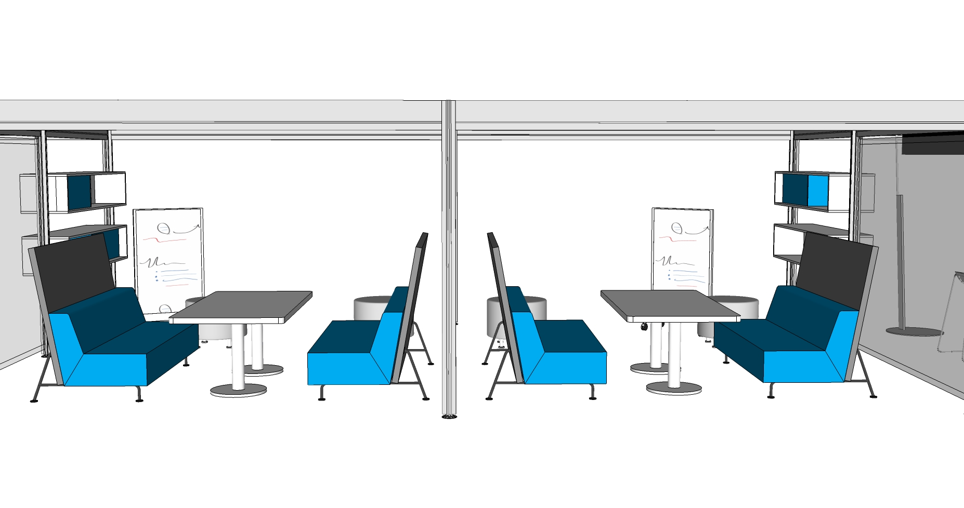
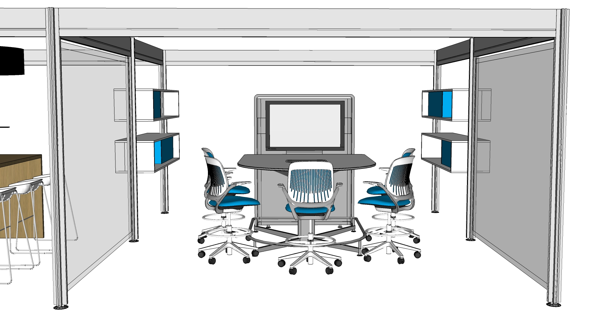
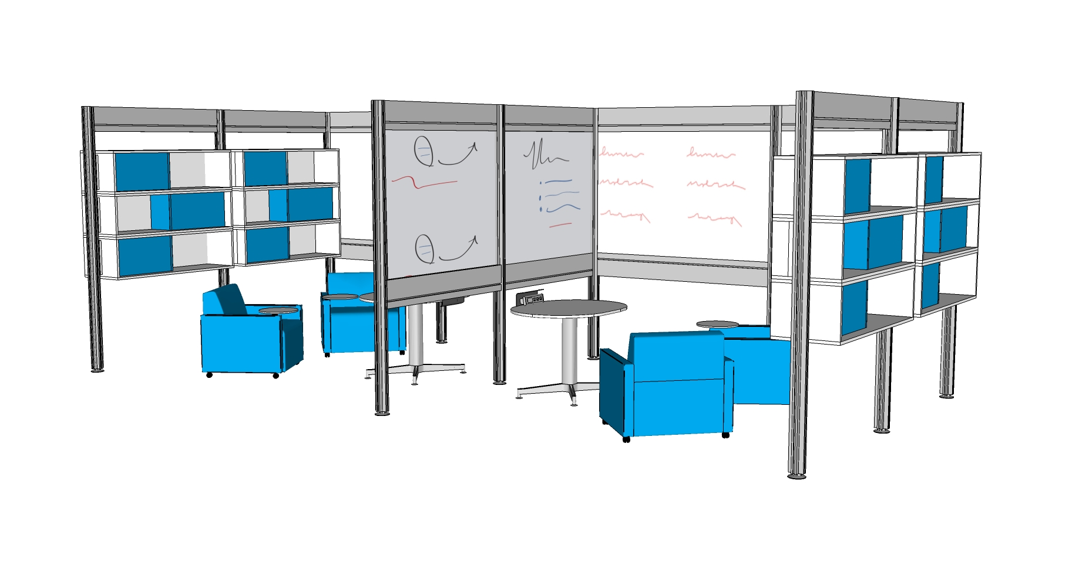
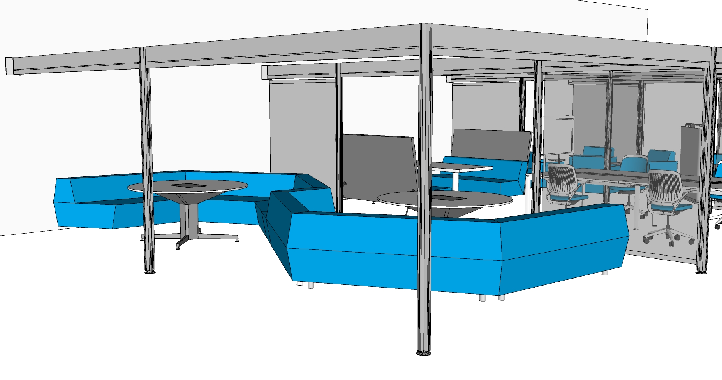




work settings
We/Shared spaces
A2
A3
A4
A5
B3
B4
B5
C5
C6
C7
C8
C9
C10
C11
C12
C13
C14
C15
C16
C17
C18
C19

Slide 28



HOTEL LOBBY
VIBE: Meet & Greet; waiting to get started
MOOD: Welcomed, Excited, Anticipation
Individuals and Small Groups
Comfortable temporary location. Digital Kiosk to plan destination

Slide 29


work settings | I/Owned | Hotel Lobby
W1
concept
This easy access workstation supports individual work; but at the same time, it offers a space to share information between co-workers and with students.
Montage panels help define territory and maintain privacy.
Provide units to store personal belongings and reference materials. Cushion top serves as extra seating.
footprint: 20’ x 12’ 6”
application includes
Montage panels
Universal worksurfaces
Leap seating
A shared table in the center encourages co-workers to collaborate and share information.
Transaction tops on the sides facilitate interaction between employee and students.
key plan
plan view
Notes:
Option 1

Slide 30


NEXT GEN OFFICE
VIBE: team, open, modern, cooperative, sharing, support-the-idea
MOOD: inspiring, future-oriented, progress-making, startup
Space that support individuals & cooperation; collision space
Supports mixture of librarians & staff; different units/ideas united

Slide 31

work settings | I/Owned | Open Office
W2
concept
Open and accessible storage is layered to aid in workspace compression
This modern open office solution is used by employees. It is divided into individual workstations with low-height screens and storage so co-workers can stay connected and promote interaction.
Provide end of run tall-archs to define space and store skateboards or bicycles
footprint: 15’ x 8’
application includes
Bivi bench
Cobi seating
This caddy offers a mobile space to store personal belongings.
Helps define personal territory and maintain focus.
key plan
plan view
Notes:
Option 1

Slide 32




CONDOS
VIBE: meeting space, intense effort, making progress.
MOOD: special, focused, determined.
Well-defined group rooms, glass windows, necessary tools.
Reservable, tech provided, prime location, rehearsal.

Slide 33

work settings | We/Owned | Condos
C1
concept
Glass openings allow natural daylight to flow.
Offers a space to share ideas and information in a more focused environment.
This setting supports collaboration work. Students can reserve the space and have a private meeting and a more concentrated work. Full height walls and doors are included.
footprint: 14’ x 10’
application includes
Privacy wall
Groupwork table
Cobi chair
Room wizard
key plan
Room Wizard lets students schedule spaces in-advance or on-the-spot, via a simple touch-screen interface or network access.
plan view
Notes:
Option 1

Slide 34

work settings | We/Owned | Condos
C2
concept
Sliding door offers real estate efficiencies.
Media Scape settings promote interactive technology by sharing digital information.
This enclosed setting offers a space with full-technology where students can schedule group meetings to study and share information.
footprint: 14’ x 10’
application includes
Privacy wall
Cobi seating
Media Scape
Room wizard
Room Wizard used for scheduling and sending content to participants.
key plan
plan view
Notes:
Option 1

Slide 35

work settings | We/Owned | Condos
C3
concept
media scape tables allow users to generate, capture, retrieve and share information.
Walls help maintain privacy and focus in the meeting.
This area offers a collaborative space full of technology. Users in the front row can easily share digital information with team members in the room and those working remotely. Ledges accommodate a second row of seating, enabling others to easily join the meeting and participate.
footprint: 14’ x 20’
application includes
Privacy wall
Media Scape table and lounge
Scoop stool seating
Room wizard
Stool height provides a higher level of viewing for the back row.
media scape lounge offers comfortable seating for casual interactions.
key plan
plan view
Notes:
Option 1

Slide 36





MARKETPLACE
VIBE: energizing, active, synergy, open, guidance
MOOD: helpful, mind-expanding, inspiring, accomplishment
Individual or group and an intersection of expertise and tools
Place to get support from a variety of vendors

Slide 37

work settings | We/Owned | Marketplace
C4
concept
This setting supports enclosed enclaves for 1:1 conversations or a more concentrated work. This space can be reserved in-advance or on-the-spot. It also offers a collaborative area where students can plug in and work for a while.
Privacy walls offer an enclosed space for a more focused individual or group work.
Post & Beam enables meeting spaces to be created in the open plan.
footprint: 15’6”x 26’6”
application includes
Privacy wall
Post & Beam
Groupwork tables
Universal worksurface
Enea seating
Cobi seating
Room wizard
Table tops at stool height provide an extra working area. Technology hubs are included to offer easy access to power and data.
Room Wizard provides an easy way to reserve the space for the required time
key plan
plan view
Notes:
Option 1

Slide 38

work settings | We/Shared | Marketplace
A5
concept
This setting connects different areas in the floor plan. It serves as a space where students can meet and organize agendas.
Low technology open meeting space gives users a place to informally meet.
footprint: 5’6” x 5’
application includes
Await bench
Await table
Comfortable seating and tables.
key plan
plan view
Notes:
Option 1

Slide 39


CONCEPT ASSEMBLY LINE
THOUGHT FACTORY
VIBE: productivity, advancing, task-oriented, building the idea
MOOD: quiet-focus, accomplished, formulating, hands-on
Individual or small groups, defined
space & tools, close proximity
High-Tech, goal oriented, transform concept to product/idea
VIBE: production, concentration, absorbing the concept
MOOD: extreme focus, getting-things-done, accomplished
Well-defined personal workspace; quiet; individualistic
Thought-oriented. Your own tools & supplies, leave with something

Slide 40

work settings | I/Shared | Assembly Line
B2
concept
This well-defined space supports individual work. Screens and storage define personal territory, shield distractions and help maintain visual privacy and focus. Power and data access makes connections easy for mobile technology.
Screens offer definition of space and help maintain focus..
Cobi seating offers comfort and ease of adjustment.
footprint: 15’ x 8’
application includes
Bivi bench
Cobi seating
“Bring your own technology” spaces require a place to plug in portable devices. This bench provides quick access to power and data.
Provides free address bench for students.
key plan
plan view
Notes:
Option 1

Slide 41

work settings | We/Shared | Thought Factory
B4
concept
Provides appropriate tools to support usage of new technological devices such as adjustable monitor screens, laptops, etc.
Frame One benching supports individual and collaborative groups. It helps students interact with other students and share ideas.
Low height front screen for a sense of boundary.
footprint: 17’ x 8’
application includes
Frame One bench
Cobi seating
Details monitor arm
Provides a worksurface to accommodate multiple devices or equipment like printers, scanners, etc.
Frame One supports both collaborative and individual work integrating work tools to support the users.
key plan
plan view
Notes:
Option 1

Slide 42





ZEN GARDEN
VIBE: reflection, semi-quiet, subdued, absorbing the concept.
MOOD: very focused, getting things done, accomplished.
Well-defined personal workspace for individual work.
Thought-oriented. Bring your own technology/tools.

Slide 43
work settings | I/Shared | Zen
B2
concept
This well-defined space supports individual work. Screens and storage define personal territory, shield distractions and help maintain visual privacy and focus. Power and data access makes connections easy for mobile technology.
Screens offer definition of space and help maintain focus..
Cobi seating offers comfort and ease of adjustment.
footprint: 15’ x 8’
application includes
Bivi bench
Cobi seating
“Bring your own technology” spaces require a place to plug in portable devices. This bench provides quick access to power and data.
Provides free address bench for students.
key plan
plan view
Notes:
Option 1

Slide 44

work settings | I/Shared | Zen
A1
Concept
This alternate work area supports the focused bench seating area, allowing users to change postures and collaborate causally.
Jenny seating promotes individual work. The included tablet offers a space to put books or laptops making it more comfortable to work.
footprint: 26’ x 3’
application includes
Jenny seating
Ripple seating
Ripple seating offers great ergonomics.
key plan
plan view
Notes:
Option 1

Slide 45




TOOL SHOP
VIBE: creativity, task-oriented, building.
MOOD: focused, connected, expressive.
Individuals or pairs (with experts nearby).
High-end computers and software for media, ideas into products.

Slide 46

work settings | We/Shared | Tool Shop
B5
concept
Provides appropriate tools to support usage of new technological devices such as adjustable monitor screens, laptops, etc.
Individual work space supports ready to use technologies supported by the University. Benching application promotes interaction between individuals.
Provides a worksurface to accommodate multiple devices or equipment like printers, scanners, etc.
footprint: 17’ x 8’
application includes
Frame One bench with Media Scape
Cobi seating
Details monitor arm
Includes a media scape monitor enabling peer to peer teaching.
key plan
plan view
Notes:
Option 1

Slide 47
HOTEL LOBBY
VIBE: Meet & Greet; waiting to get started
MOOD: Welcomed, Excited, Anticipation
Individuals and Small Groups
Comfortable temporarily location. Digital Kiosk to plan destination

Slide 48

work settings | We/Shared | Hotel Lobby
A2
concept
Meet and greet space where students can take a seat and wait for their teammates. Its an open and accessible space before the library's entrance.
Provides comfortable sofa near the main entrance.
Provides small personal tables that can be used in different locations.
footprint: 12’ x 8’
application includes
Await sofa, ottoman and bench
Await table
Offers mobile seating that can be arranged differently depending on users needs.
key plan
plan view
Notes:
Option 1

Slide 49

work settings | We/Shared | Hotel Lobby
A3
concept
Comfortable space for individuals or small groups. This space serves as a temporary location, while they discuss their agenda. In this area users have access to digital kiosks.
Comfortable seating with movable personal tables.
footprint: 21’6” x 13’6” / 4’6” x 16’6”
application includes
Big Lounge seating
Circa modular seating and table
Campfire personal table.
Digital Kiosks (not by steelcase)
This dynamic seating creates a sense of enclosure.
key plan
plan view
Notes:
Option 1

Slide 50



VILLAGE
VIBE: Nomadic, decompress, what’s next?
MOOD: recharging, refreshing, rebooting
Groups or individuals; brainstorming
Soft-seating, flexible, customizable, bring your own tech/tools

Slide 51

work settings | We/Shared | Villages
C5
concept
This area offers flexibility for the users. It can accommodate individuals or small groups. The shelves provide boundary and storage creating a sense of enclosure.
Offers mobile seating that can be arranged differently depending on users needs.
footprint: 11’ x 17’
application includes
Bivi Bigger Depot
Await sofa and ottoman
Await table
Jenny round seating
Comfortable seating for individuals or small groups.
Open shelving that offers a space for books, magazines and newspapers.
key plan
plan view
Notes:
Option 1

Slide 52

work settings | We/Shared | Villages
C6
concept
This shared area provides a space where students can research different topics and have access to reference materials.
Open shelving that offers a space for books, magazines and newspapers
footprint: 11’ x 17’
application includes
Bivi Bigger Depot
Bob seating
Alight-ottoman round
Denizen tablet
Personal tables where students can put their laptop or take notes.
Individual soft-seating
key plan
plan view
Notes:
Option 1

Slide 53

work settings | We/Shared | Villages
C7
concept
This open space provides a gathering space where small groups can meet and do some research for their projects. The shelves provide boundary and storage creating a sense of enclosure.
Provides a table where students can put the books and reference materials they are using.
Open shelving that offers a space for books, magazines and newspapers.
footprint: 11’ x 17’
application includes
Bivi Bigger Depot
Together bench
Holy Day table
Comfortable seating for small group meetings.
key plan
plan view
Notes:
Option 1

Slide 54

work settings | We/Shared | Villages
C8
concept
This open area offers a gathering space where students can brainstorm and do some research. The shelves provide boundary and storage creating a sense of enclosure.
This semi circular sofa supports individual or small group interaction.
This table offers a space for books, laptops and other supplies.
footprint: 11’ x 17’
application includes
Bivi Bigger Depot
Circa modular seating
Circa table
Open shelving that offers a space for books, magazines and newspapers
key plan
plan view
Notes:
Option 1

Slide 55

work settings | We/Shared | Villages
C9
concept
This setting offers a comfortable space for individuals or small groups. Provides an easy access to reference materials.
Open shelving that offers a space for books, magazines and newspapers
Comfortable seating for individuals or small groups.
footprint: 11’ x 17’
application includes
Bivi Bigger Depot
Await sofa and bench
Await table
Carl Hansen seating
key plan
plan view
Notes:
Option 1

Slide 56



NEIGHBORHOODS
VIBE: sharing, community, growing
MOOD: focused but open, stimulated
Defined group space but open to conversation / stimuli
Personal space w/ some awareness & collaboration w/ neighbors

Slide 57

work settings | We/Shared | Neighborhood
C10
concept
This semi open area offers a space for small groups where team members can brainstorm freely without disrupting others.
Totem with canopy on media scape table integrates technology and provides an intense collaboration tool.
Stool height ledge provides a higher level of viewing for the back row.
footprint: 16’ x 16’
application includes
Post & Beam
Media Scape table and lounge
Duo storage
Duo Storage provides boundary and space for groups. It also provides a place to set personal belongings.
Post & Beam helps define the space creating a sense of enclosure.
key plan
plan view
Notes:
Option 1

Slide 58

work settings | We/Shared | Neighborhood
C11
concept
Integrated power and data at desk makes connections easy for mobile technology
Post & Beam helps define the space creating a sense of enclosure.
This area provides stool height seating and desk with integrated power. It’s a comfortable place for a social gathering and short meetings.
footprint: 16’ x 12’
application includes
Post & Beam
Campfire Big Table
Campfire Big Lamp
Scoop Stool seating
Duo storage
Soto accessories
User comfort supported with a choice of seated or standing postures.
key plan
plan view
Notes:
Option 1

Slide 59

work settings | We/Shared | Neighborhood
C12
concept
This area supports a space for small groups where some awareness and collaboration with neighbors may occur.
Markerboard screens help to visualize and conceptualize ideas.
footprint: 16’ x 26’
application includes
Post & Beam
Bix seating and table
Alight-ottoman round
Groupwork markerboard screens
Duo storage
Comfortable seating that supports small group meetings.
Post & Beam Transparency Infills and storage help define the space and creates a sense of privacy.
key plan
plan view
Notes:
Option 1

Slide 60

work settings | We/Shared | Neighborhood
C13
concept
Post & Beam enables meeting spaces to be created in the open plan with components such as duo storage and infills.
This area provides a space for defined groups and it supports collaboration between 5 people. It promotes users to evaluate, generate, capture, retrieve and share information.
Monitor on shroud connected to media: scape table enables intense generative and evaluative sessions.
footprint: 16’ x 13’
application includes
Post & Beam
Media Scape table
Cobi Stool seating
Duo storage
User comfort supported with a choice of seated or standing postures.
key plan
plan view
Notes:
Option 1

Slide 61



KNOWLEDGE PARK
VIBE: productivity, advancing, task-oriented, building the idea.
MOOD: semi-quiet, focused, accomplished, formulating, hands-on.
Individual or pairs, defined space & tools, close proximity.
High-tech, goal oriented, transforming concepts to ideas.

Slide 62

work settings | We/Shared | Knowledge Park
C14
concept
This setting area supports individual or pair work. It’s a defined space where students can brainstorm and work in a semi-quiet environment.
Markerboards integrated into Post & Beam create a meeting space out of the open plan, add boundary and provide a surface to capture ideas.
Duo storage offers a space to place personal belongings and it also helps define the space creating a sense of enclosure.
footprint: 22’ x 10’
application includes
Post & Beam
Eno Markerboard Infill
Duo storage
Coupe seating with tablet
Scape Series table
Tablets on the Coupe seating provide a comfortable place to support laptops in an open, informal collaborative setting.
Scape series table provides an extra place to support laptops with technology outlets.
key plan
plan view
Notes:
Option 1

Slide 63

work settings | We/Shared | Knowledge Park
B3
concept
This area supports both collaborative and individual work in a small space. It integrates work tools and technology to support the users.
Low height front screen for a sense of boundary.
Provides appropriate tools to support usage of new technological devices such as adjustable monitor screens, laptops, etc.
footprint: 15’ x 8'
application includes
Frame One bench
Cobi seating
Details monitor arm
Frame One supports both collaborative and individual work.
Infills to hide power in-feeds and harnesses.
key plan
plan view
Notes:
Option 1

Slide 64

work settings | We/Shared | Buffer Zone
A4
concept
This area serves as a connector between different spaces. It supports short-term individual seating and shelving for displays of arts, reference materials and collections.
Individual soft seating
footprint: 15’ x 13’
application includes
Bivi Bigger Depot
Bob seating and table
Open shelving that offers a space for books, magazines and newspapers
key plan
plan view
Notes:
Option 1

Slide 65




LODGE
VIBE: togetherness, sharing, extending
MOOD: focused yet not constricted, encouraged, intentional
Well-defined group space; mobility and activity-oriented alt space
Extension of classroom, TA’s, or special projects room; retreat

Slide 66

work settings | We/Shared | Lodges
C15
concept
This space promotes togetherness and collaboration. Students can gather in small study groups and share ideas. The post and beam helps define the space and create the sense of enclosure.
Media scape table integrates technology.
Post & Beam helps define the space creating a sense of enclosure.
footprint: 25’ x 14’
application includes
Post & Beam
Media Scape lounge and table
Comfortable seating that encourages team work and collaboration.
key plan
plan view
Notes:
Option 1

Slide 67

work settings | We/Shared | Lodges
C16
concept
Integrated power and data at desk height makes connections easy for mobile technology
This setting supports group work activities. Students can bring their laptops and share ideas. Technology eases interaction and togetherness.
Comfortable seating that supports small group meetings.
footprint: 25’ x 14’
application includes
Post & Beam
Frame One bench with media scape
Bix seating and table
Cobi seating
Face-to-face seating arrangement between students is more conducive to discussions and provides team collaboration zones.
Includes a media scape monitor enabling peer to peer teaching.
key plan
plan view
Notes:
Option 1

Slide 68
work settings | We/Shared | Lodges
C17
concept
Post & Beam and Transparency Infills helps delfine the space and creates a sense of privacy.
Tablets on the Coupe seating provide a comfortable place to support laptops in an open, informal collaborative setting.
This setting promotes collaboration and sharing ideas. The media scape helps users generate, capture, retrieve and share information with all team members.
footprint: 25’ x 14’
application includes
Post & Beam
Media Scape lounge and table
Scoop stool
Coupe seating with tablet
Privacy canopies surround team members creating a sense of enclosure and allow them to brainstorm freely, without disrupting others.
Ledges accommodate a second row of seating enabling others to easily join the meeting, participate and leave when desired.
key plan
plan view
Notes:
Option 1

Slide 69

work settings | We/Shared | Lodges
C18
concept
This open area supports collaboration of small groups. It is flexible and it offers soft seating sofas. You can bring your own devices and work in there.
Screens help define a meeting space in the open plan while providing some boundary for a sense of enclosure.
Paper Table helps with sharing ideas and concepts.
footprint: 7’6” x 9”
application includes
Campfire Screens
Campfire Big Lounge
Campfire Paper Table
Campfire Personal Table
Alight-Ottoman Round
Personal table is flexible and can be used in different locations.
Lounge seating allows a comfortable alternative.
key plan
plan view
Notes:
Option 1

Slide 70

work settings | We/Shared | Lodges
C19
concept
This open area supports small meeting groups and collaboration. Adjacency to private spaces supports the team and visitor to the space.
Markerboard screen helps to visualize and conceptualize ideas.
Screens help define a meeting space in the open plan while providing some boundary for a sense of enclosure.
footprint: 7’6” x 9’
application includes
Campfire Screens
Campfire Big Lounge
Campfire Half Lounge
Campfire Personal Table
Groupwork Markerboard Screen
Lounge setting supports small and mid sized groups conversation and idea sharing.
key plan
plan view
Notes:
Option 1

Slide 71
next steps
May we suggest:
Make modifications or editions
Present to larger audience and stakeholders
Develop collage or expression exercises for select audience
Implement survey for additional insights
Identify internal approval process
Explore specific product solutions

