Slide 1

Pesticide Safety Update/Review
Charlotte Maxwell, Associate ANR Extension Agent

Slide 2

Objectives for Today
PPE requirements of commonly used pesticides.
Re-entry periods for commonly used pesticides.

Slide 3

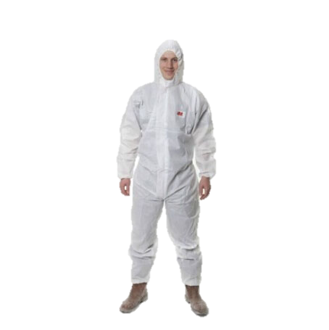
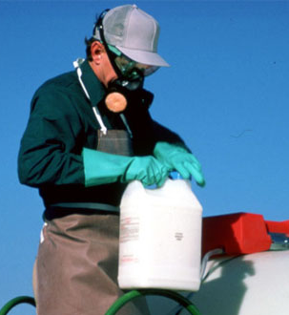
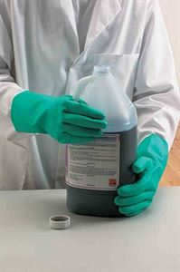

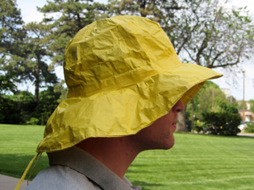
Halex®GT Herbicide
Post-emergence herbicide for weed control in glyphosate tolerant (GT) corn.
Do not enter or allow worker entry into treated areas during the REI of 24 hours.
PPE:
Apron
Chemical Resistant Gloves
Chemical Resistant Boots
Chemical Resistant Headgear
Coveralls

Slide 4

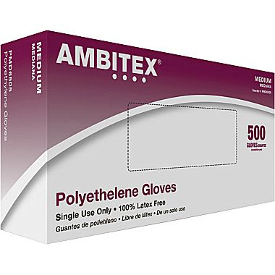

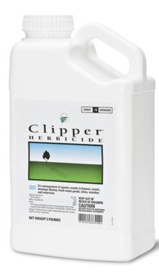
Clipper ™ Herbicide
This is a water dispersible granule product used to manage aquatic weeds.
There is no post-application holding restriction against use of treated water for drinking or recreational purposes.
PPE:
Long Sleeve Shirt and Pants
Waterproof Gloves
Shoes and Socks

Slide 5
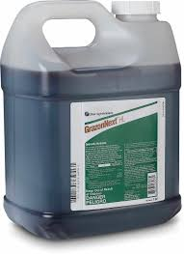


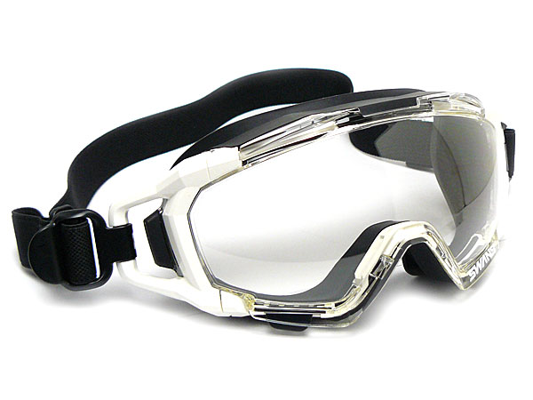
GrazonNext® HL Specialty Herbicide
Used for control of broadleaf weeds and certain woody plants on pasture.
Grass that is being grown for hay that is treated with this product within the preceding 18 months can only be used on that farm unless allowed by supplemental labeling.
Do not transfer animals grazing or feeding hay to areas where sensitive broadleaf crop occur without first allowing 3 days of grazing on untreated pasture.
PPE:
Protective Eyewear
Chemical Resistant Gloves

Slide 6
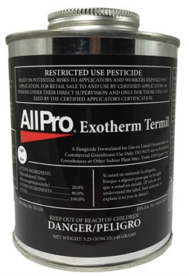
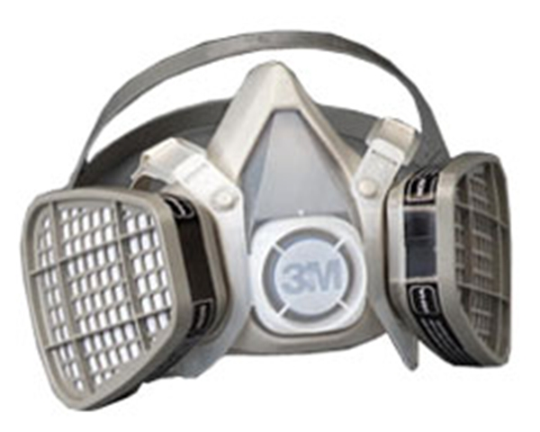
Exotherm Termil
A fungicide formulated for use on certain ornamentals. This product is for commercial greenhouse use only.
Use only if the greenhouse being treated is completely sealed off from another structure.
12 hour REI- see label for specific WPS for re-entry during REI.
PPE:
Organic Vapor Respirator*
Chemical Resistant Gloves

Slide 7
Dicamba + 2,4-D DMA
For use on fallow systems, general farmstead, sorghum, grass, pastures, wheat and more.
48 hour REI
PPE:
Chemical Resistant Gloves
Apron

Slide 8
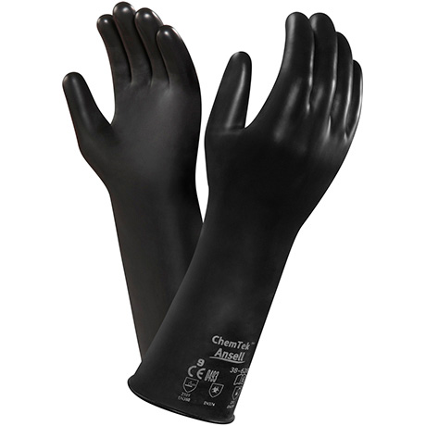
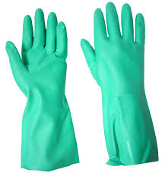
Know Your Gloves
Butyl
Nitrile

Slide 9


More Gloves
Neoprene
Natural Rubber

Slide 10

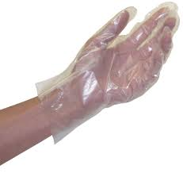
Just a Few More…
Polyethylene
PVC

Slide 11

Last one!
Viton

Slide 12
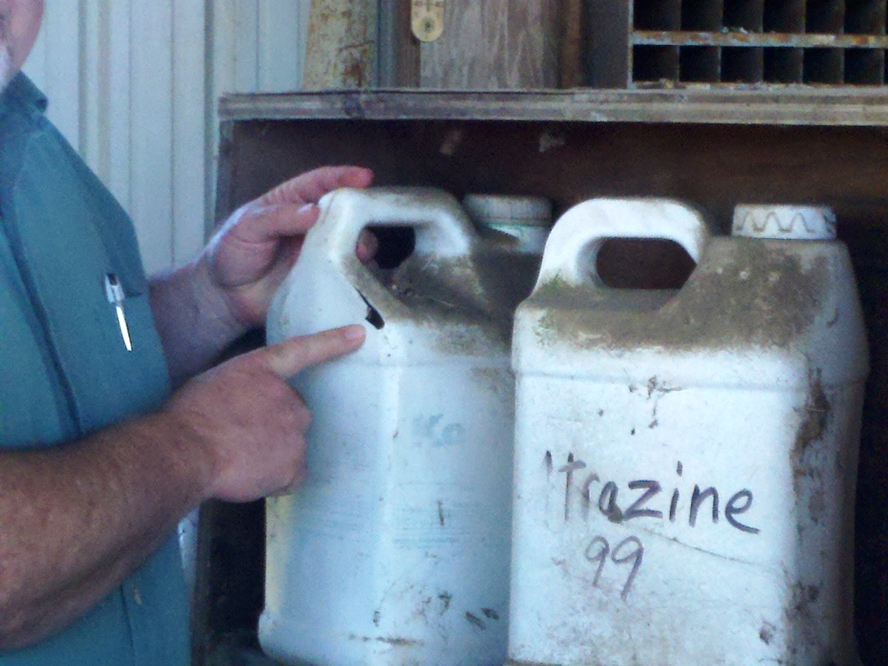
Other Safety Reminders
Don’t let someone borrow your pesticides if you aren’t sure of their training/experience.
Make sure all of your pesticide containers are clearly labeled.
Ensure your pesticide storage area is secure.

Slide 13

Take Home Thoughts
Not all pesticides are the same, they have different PPE requirements and REI.
The label is the law.
If you aren’t sure, ask before you use.
Always store your pesticides in a safe place.

Slide 14
Questions?

Slide 15
Thank you!
Charlotte Maxwell mcharley@vt.edu
540-223-3837

