Slide 1
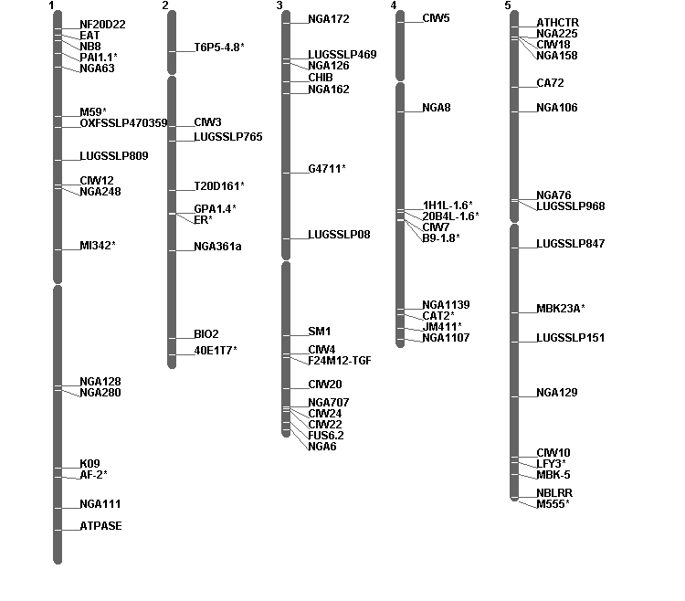
Additional file 1
Notes:
Additional file 1: Arabidopsis molecular genome map generated based on SSLP and CAPS markers that are polymorphic between Col-0 and Nd-0 ecotypes. CAPS markers shown with asterisks.

