Slide 1
PLN Members and the ARL Digital Preservation Survey
Preliminary Findings
Gail McMillan
Director, Digital Library and Archives
Virginia Tech
Matt Schultz, Katherine Skinner
MetaArchive
Notes:
Relatively little information gathered or reported about digital preservation practices and policies. So we proposed and conducted the
1st ARL SPEC survey on digital preservation (Systems and Procedures Exchange Center). While they specifically survey only ARL members, the publications are resource guides for any academic library researching management issues.
The survey sought to identify the strategies that institutions use to protect their digital collections and to describe the roles and responsibilities of stakeholders. We specifically noted digital preservation includes the policies, strategies, and actions that ensure access to digital content over time.
Today I’m going to share some of the survey data about (1) digital content, (2) strategies for preserving that content, (3) and about staff, time, and funding they currently devote to digital preservation and 3 yr projection of these into the future. We covered other issues too about responsibilities and stakeholders, but 15 minutes isn’t enough time to go into too much depth. Read the report!
March 14 – April 18, 2011. 64 responses (51%)
I thought since this meeting of PLN members was planned that perhaps you’d be interested in looking at this data from the point of view of PLN vs. non-PLN members. 28 PLN members, 34 not PLN members

Slide 2
What types of digital content is your library currently licensing or managing on behalf of your institution?
Notes:
Slide 2 Q1
All the libraries are responsible for much of the same types of digital content.
More PLNs have ETDs, art or visual materials with a database or digital component, the output of mass digitizing projects, and Computer games.
None are managing many
Administrative records (e.g., Word documents, spreadsheets, databases, e-mails, etc.)
Applications, operating systems, or other software
Web-harvested materials (e.g., externally hosted websites, discussion lists, scholarly portals, etc.)

Slide 3
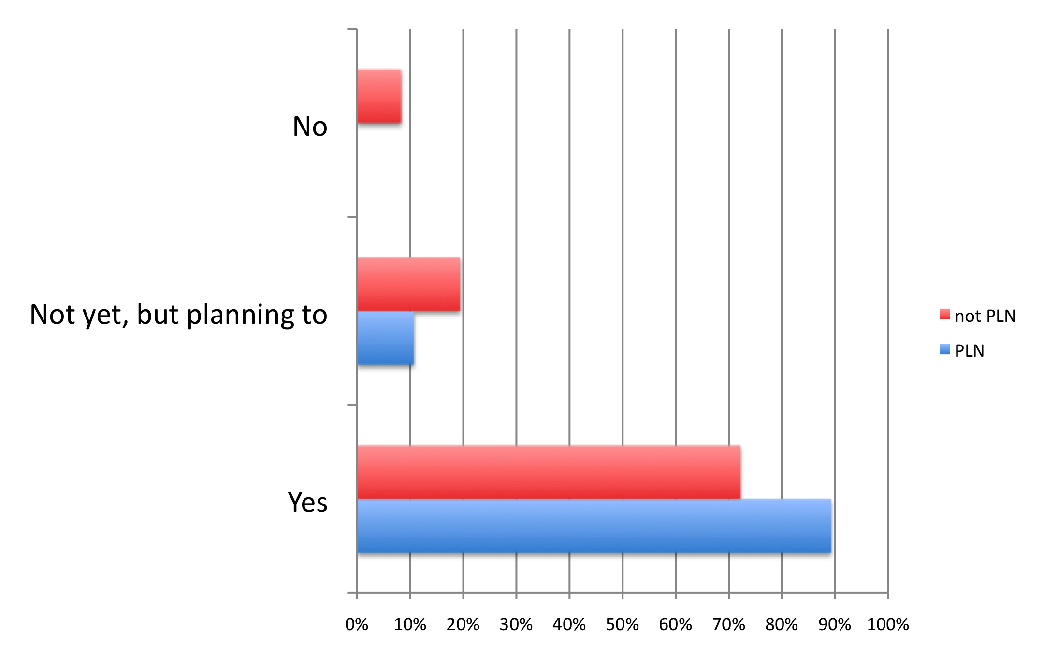
Is your library actively investing in the preservation of any of this digital content, either alone or with other entities?
Notes:
Slide 3 Q2
For the most part we’re preserving what we manage. But to my surprise not every library with digital content is also preserving it.
3 libraries that are not PLN members are not planning to preserve digital content they license or manage. They cited the lack of experienced staff, funding for hardware and software, and institution-wide policies and strategies for digital preservation as significant barriers to preservation.

Slide 4
Which types of content your library is investing in (planning to invest in) for the purpose of digital preservation?
Notes:
Slide 4 Q3
Libraries are very likely to preserve the digital content that they have with one major exception: licensed materials such as e-journals and databases, which only about half are planning to preserve.
The most-likely-to-be-preserved collections can be described as the unique digital resources of the universities, i.e., graduate student research and digitized special collections. Respondents referred to these as core to their identity and as the “unique output by the university community” and “part of the university’s official record.”
Ranking at the bottom of the preservation priorities are Applications/operating systems/ and
other software, along w/computer games.

Slide 5
What level(s) of preservation metadata does your library (plan to) have and/or create for digital content?
 | PLN | not PLN
Item-level | 89% | 100%
Collection-level | 74% | 92%
Other level(s) | 11% | 8%
Notes:
Slide 5 Q33
Now that you have a sense of the digital content and their intention to preserve it, we’ll look at their strategies and policies. First METADATA
Nearly all reported that they create some item-level metadata (48 or 94%), and many also create some collection-level metadata (42 or 82%). Though PLN members tend to have less preservation metadata in both categories.
Other: PLNs
Granularity varies for research data projects, but could actually be at the sub-item level depending on how data sets are defined.
Series level for archival items.
Series or folder level
Other: not PLNs
Archival series-level metadata for university archives & for special collections manuscript collections
Some folder level

Slide 6
Preservation metadata libraries (plan to) have and/or create for digital content.
Notes:
Slide 6 Q34
All reported collecting administrative metadata (e.g., access privileges, rights, ownership of material),
all but one also collect technical metadata (e.g., information describing the production process or digital attributes of the work).
Slightly fewer (approximately 84%) report collecting metadata about structure or provenance at this time.

Slide 7
Preservation metadata schemas libraries (plan to) have and/or create for digital content.
Notes:
Slide 7 Q34
Fifty respondents reported using multiple schemas to describe their digital collections.
The most popular metadata formats are
Dublin Core (40 or 80%),
Qualified Dublin Core (35 or 70%),
and METS (35 or 70%).
Slightly more than half (26 or 52%) also reported using PREMIS.
Others EAD, NLM, FGDC, IPTC, MIX, TEI, RDF, MARC, VRA Core, PBCore, AESS, and Darwin Core.

Slide 8
At what stage of development are your library’s digital preservation policies?
Notes:
Slide 8 Q4
Preservation policies are in some state of development at all but 2 PLNs and 4 non-PLNs. Of those libraries that are in discussion and draft stages, the majority are approaching policy development as a campus-wide initiative, inclusive of stakeholders beyond the library such as campus IT, university archives, offices of scholarly communication, offices of strategic initiatives, and digital services, among others.
PLNs at Other Stages of Development reported:
Digital preservation policy for local digital repository has been approved.
I am making ad hoc decisions about what to formally preserve at this time.
Of course, this is only true of the highest level digital preservation policies, not the policy surrounding the technical specifications of the proposed program.
Repository dependent. Some are more far along than others. There is no library-wide digipres policy as of now.
Written and approved at a broad level as part of a general preservation policy. Due to be reviewed and updated.
Non-PLNs at Other Stages of Development reported:
It is selective, i.e. to a relatively high stage in a digital asset agreement form for digital projects, but still in discussion for all digital assets needing preservation.
Local digital projects in discussion; licensed materials preserved via protocols also in discussion; ETD pr
Nothing exists locally at York.
The Digital Preservation Decision Tool has been approved, but we are in the process of moving to a new digital preservation system, Rosetta, and a new records management program, Filenet

Slide 9
How does your library (plan to) fund its investments in digital preservation?
Notes:
Slide 9 Q11
Now a quick look at resources and funding.
Most of the respondents report they are now funding digital preservation through a mixed revenue model that includes a range of internal and external funding sources. The good news is the # that fund at least part of their digital preservation activities through their general library operating budgets. Some already have a dedicated digital preservation budget. Many also report that other internal funding lines, including their IT budgets and their materials budgets cover a portion of their digital preservation work. Grants and awards continue to provide a hefty percentage of funding and some institutions report that gifts and endowments are a growing funding source for digital preservation.

Slide 10
Compared to 3years ago, are staff, time, and funding currently deployed for digital preservation more, less, or about the same?
 | PLN | not PLN
 | Staff | Staff
More | 71% | 64%
About the same | 25% | 32%
Less | 4% | 4%
 | PLN | not PLN
 | Time | Time
More | 71% | 76%
About the same | 21% | 20%
Less | 8% | 4%
 | PLN | not PLN
 | Funding | Funding
More | 50% | 71%
About the same | 29% | 21%
Less | 21% | 8%
Notes:
Not shown in this slide but we asked (Q9) how many staff are (or will be) charged with digital preservation responsibility at your library. Include both the number of FTEs and number of individuals.
There are about the same FTE doing Digital Preservation work at PLNs and non-PLNs: 2.5. But the PLNs split the FTE over 5 staff while the non-PLNs have an FTE of Digital Preservation work spread over about nearly 8 people.
Average # of FTE Average # of Individuals
not PLNs 2.6 7.6
PLNs 2.4 4.8
Slide 10 Q13
When asked to compare today’s levels of investment in staff, time, and funding to the investment levels of their libraries three years ago, the majority of respondents reported that they are investing more staff and time. We see a significant difference in funding between PLNs and non-PLNs compared to 3 years ago.

Slide 11
In the next 3 years, do you expect staff, time, and funding in digital preservation to increase, decrease, or stay the same?
 | PLN | not PLN
 | Staff | Staff
Increase | 63% | 60%
Stay about the same | 38% | 36%
Decrease | 0% | 4%
 | PLN | not PLN
 | Time | Time
Increase | 67% | 80%
Stay about the same | 29% | 20%
Decrease | 4% | 0%
 | PLN | not PLN
 | Funding | Funding
Increase | 63% | 76%
Stay about the same | 33% | 12%
Decrease | 4% | 12%
Notes:
Slide 11 Q14
Compared to three years ago, most of the responding libraries are currently investing more staff, time, and funding in their digital preservation activities. The majority anticipates that this trend will continue over the next three years.
A few libraries expect their investment to decrease. As one respondent stated, “It’s hard to predict an increase in our funding/budget situation going forward given the current climate. As a result, we can only be pessimistic for purposes of this survey and expect the worse: further budget cuts or at best, level funding. We do continue to actively pursue research grant opportunities, however.”

Slide 12
Barriers to Digital Preservation
Staffing needs
  Dedicated to digital preservation
  Fostering expertise to keep pace with technical challenges
    Technical infrastructures
    Best practices
Funding for technical development
  Equipment purchases
  Transition from grants to institutional funding
Lack clear institutional policies and/or strategies
Notes:
Slide 12 Q12 Barriers to Digital Preservation
The survey sought to gauge both the willingness and capacity of libraries to keep pace with the growth of their digital content. Not surprisingly, almost all of the respondents, and slightly more PLNs (46 or 94%: 96% PLNs/92% non-PLNs) stated that their libraries want to invest in preserving more digital content than they currently do.
The most frequently reported barriers to preservation were staffing and expertise. The responding libraries are struggling to dedicate staff to digital preservation and to foster staff expertise to keep pace with the technical challenges inherent in digital content, technical infrastructures, and digital preservation best practices.
Funding and resources for technical development, equipment purchases, and support for on-going operations were also frequently cited barriers. Several institutions reported having difficulty making the transition from grant-funded support to dedicated institutional funding for sustained operations.
Finally, several libraries reported that their institutions lack clear institutional policies and/or strategies for guiding investments. Other less-cited, but still significant barriers include legal issues regarding deposit, lack of trustworthy repository status, and the absence of reliable standards for complex digital data.

Slide 13
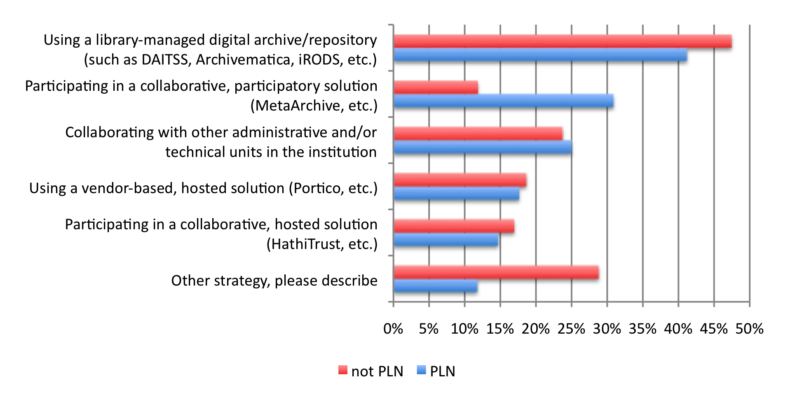
Strategies your library currently uses to ensure the preservation of its digital assets.
Notes:
Slide 13 Q16, 21, 26 Text below is from Exec Sum. Is it still true?
Libraries use a range of strategies for preserving most digital resources. Their first choice solution is using a library-managed digital archive/ repository. This strategy is followed by collaborative solutions, either with other administrative and/or technical units in the institution, in a participatory solution such as the MetaArchive, or in a hosted solution such as the HathiTrust.
other PLN
We not only participate in HathiTrust, we are essential for its fundamental operations and development.
Partnership with non-profits, e.g. Internet Archive
Data generated out of research projects funded through specific programs.
Homegrown software and repository architecture.
Using ArchiveIt
3 Local back-up of servers where digital copy is stored
other not pln
2 Using Rosetta and FileNet with other entities in our consortium
Developing new infrastructure through NSF award for Data Conservancy.
6 Storing processed and raw files on a locally-hosted, backed -up server.
2 Development in-house of our own repository software, which is open source and available to others.
The master PDFs are duplicated in ContentDM as part of our normal delivery workflow. They are also stored on long lasting physical storage.
3 Texas Digital Library PresNet
UC systemwide digital Repository
Images are stored on the library's servers, in a preservation file format (TIFF). Bit-preservation assured through library systems administration & backup. Metadata is managed in Special Collections databases

Slide 14
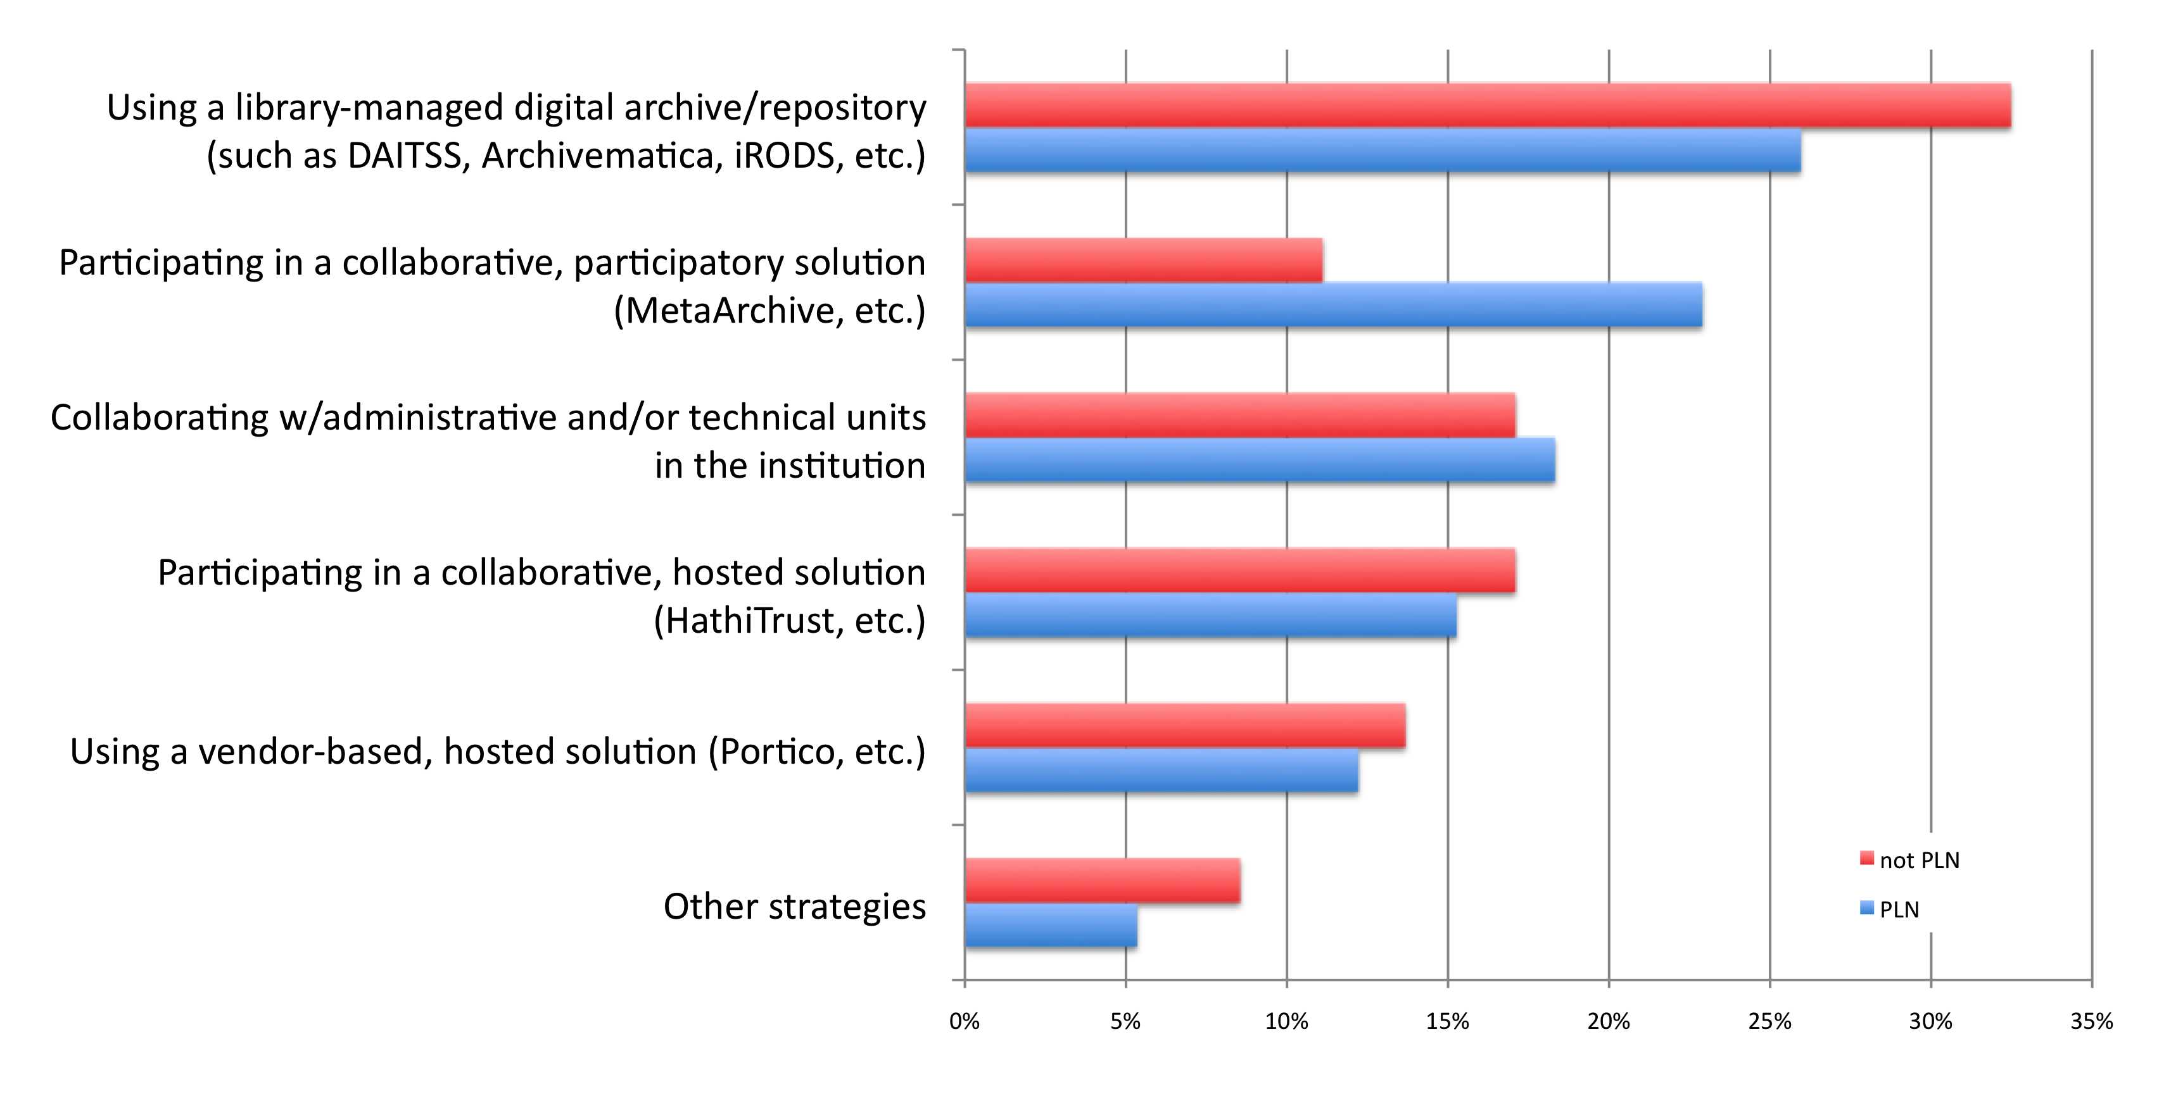
Strategies you anticipate the library will use in 3 years to ensure the preservation its digital assets.
Notes:
Slide 14 Q18, 23, 28
While the majority of respondents predict that using a library-managed digital archive/repository will remain their primary strategy, an increasing number anticipate that participating in collaborative solutions will be part of their future strategy. Nearly 25% of those that expect to collaborate are not currently collaborating as part of their preservation strategy. A vendor-based solution is the least likely future preservation strategy. Among the “other” anticipated strategies, respondents mentioned homegrown solutions and institutional and statewide repositories.
The 3 most frequent reasons to explain why future strategies might be different from their current preservation strategies, were:
They are not now, but they plan to collaborate.
Their repositories will develop further.
They will take advantage of third-party or remotely hosted solutions (HathiTrust usually).
Also mentioned, but less often, were changes due to centralization of efforts within their institutions.

Slide 15
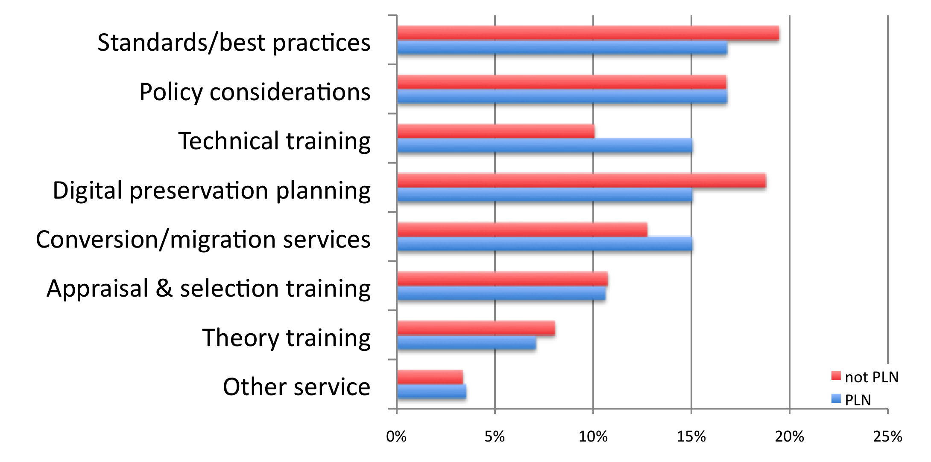
What types of services would your library find valuable for improving its role in preserving digital content?
Notes:
Slide 15 Q39
There’s not really much difference between the 2 group’s responses to this question.
Non-PLN members see a little more need for standards and best practices and digi preservation planning.
Interestingly, PLN members would like more technical training and conversion/migration services.
Neither group wants theory training so we could say that these library are ready to move past conceptual decision-making and are beginning to make practical progress towards digital preservation.
Other service, PLNs
Affordable and practical external audit
Clear benchmarks/articulated metrics to evaluate our progress
Many of our digital resources lack good (or often any) metadata. While it is important to create and preserve not only the digital objects but their descriptive, technical, administrative, rights, etc. metadata, we have hundreds of thousands of digital resources. We need help in strategizing how to overcome this daunting amount of work.
Models enabling us to estimate resource requirements so we can weigh them against the benefits.
not PLN
Clarification of role of libraries in preserving 3rd party data
External services to provide ongoing, realtime format validation, transformation and migration.
Grant Writing
it would be very helpful, if institutions that have preservation policies would share them

Slide 16
Identify the perceived willingness of various groups within your institution to deposit their content with your library’s digital repository solution(s) for preservation purposes.
 | PLN | not PLN | PLN | not PLN | PLN | not PLN | PLN | not PLN | PLN | not PLN
 | Very Willing | Very Willing | Mostly Willing | Mostly Willing | Indifferent | Indifferent | Mostly Un- willing | Mostly Un- willing | Very Un- willing | Very Un- willing
Academic units |  | 19% | 50% | 31% | 44% | 44% | 6% | 6%
Administrative units | 19% | 7% | 38% | 20% | 44% | 53% | 0% | 13% |  | 7%
Data Centers |  |  | 27% | 40% | 67% | 40% | 7% | 7% |  | 13%
Other unit(s) | 25% | 33% | 25% | 50% | 50% | 17%
Notes:
Slide 16 Q35/36
34 libraries reported they plan to manage a digital archive/repository that is intended to support preservation functions. Findings for PLNs and non-PLNs was 88% and 90%, respectively. The majority reported that some institutional units, including academic units, administrative units, and data centers, are “indifferent” to deposit, or are “not actively seeking deposit.” They cited several commonly perceived and expressed barriers to deposit, such as awareness, library capacity (real or perceived), complicated submission workflows, and concerns about future access to their content.
They are actively expanding their policies, workflows, and technical capacity for preservation.
This expansion is, in itself, challenging. It requires a paradigm shift in thinking about the library’s mission as an active caretaker of non-physical content; it also requires heavy resource allocations to establish a solid infrastructure for digital life-cycle curation. However, there is a second challenge that ARL libraries cite and must respond to at the campus level. Respondents report that other campus entities (e.g., research data centers, administrative units) are often both unaware of the library’s growing capacity for digital curation and ambivalent at best about engaging the library’s services for their own data collections. If libraries are to maintain their core role as the campus’s source for collecting, providing access to, and preserving not just analog but also digital collections, they must find new ways of engaging with their campus constituents, including through advertising these services and engaging directly with the content producers. Doing so will help to ensure that the campus turns to a central entity—the library—to maintain its scholarly communications channels and materials in the increasingly digital age, rather than distributing this responsibility across other campus units or outsourcing it altogether.

Slide 17
ARL DIGITAL PRESERVATION SURVEY RESULTS: PLN MEMBERS
Thanks!
Gail McMillan
Digital Library and Archives, Virginia Tech gailmac@vt.edu
Notes:
Slide 17 CONCLUSION
Despite real and perceived barriers to digital preservation progress, the libraries are moving forward—planning to preserve more content, improve their strategies, and develop policies that will better ensure the long-term viability of their digital assets.
Methods for preserving digital content are becoming standardized and digital preservation models like the MetaArchive, DAITSS, and HathiTrust are available. This survey revealed, as the digital preservation field is maturing, that most ARL libraries are rising to the challenge of establishing policies, workflows, and infrastructures to systematically preserve their rapidly expanding bodies of digital content. The survey also revealed that most ARL libraries are actively engaging in in-house digital preservation rather than outsourcing it to external parties, thus maintaining their control and ownership over the digital content that they curate. Survey respondents also predicted that they would continue turning to library-managed and collaborative solutions over vendor-based, hosted solutions for their core collections.
Tempering our excitement at the unprecedented levels of reported preservation activity are some of the comments made throughout the survey that demonstrate that the definition of “digital preservation” is still murky for some librarians. A number of respondents confused “back ups” with “preservation.”
Access-oriented repository services are not necessarily preservation solutions.

