Slide 1

ScrapingGenAI
James Do, Heewoon Bae, Julius Colby
CS 4624 Multimedia, Hypertext, and Information Access
Dr. Fox
Virginia Tech, Blacksburg 24061, 4/30/2024

Slide 2
Outline
Project Design
Implementations
  MarketBeat
  Reddit
Challenges
Future Work
Acknowledgements
References

Slide 3
Project Design
Data Collection
Data Processing/Analysis
Data Visualization
Create MarketBeat Scraper to scrape earning calls
Create Reddit Scraper to scrape posts and comments
Develop a parser to analyze and process data of both MarketBeat and Reddit
Utilize a Sentiment Intensity Analyzer to better process the collected data
Utilize Matplotlib and Pandas libraries to create visualizations
Visualize processed data through various graphs and charts to effectively discern trends and perform numerical analyses of specific keywords
Used Tkinter Python library for user GUI

Slide 4
MarketBeat Implementation
Scraped an online earning call database (MarketBeat) for links to company earning call transcripts
  Earning call transcripts:
    Quarterly reports about the financial state of a company
Parsed individual web pages to pull and store the transcripts
Applied a keyword search to find relevant sections of the transcript and fed them into a natural language processor to decide positivity
Created a visualization showcasing positivity and relativity

Slide 5
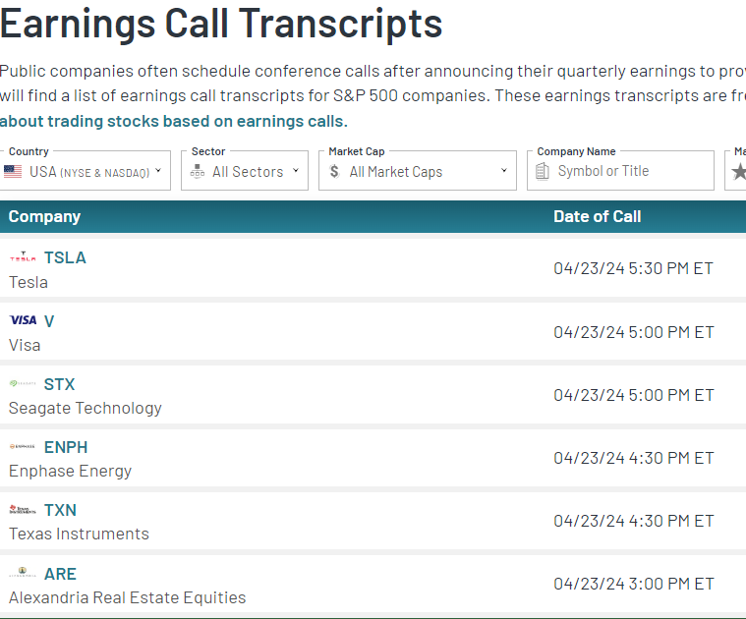
MarketBeat Scraper
Scraped root of MarketBeat.com to gather links to separate earning call transcripts
Used BeautifulSoup
Fed each link to transcript into parser
MarketBeat Website

Slide 6
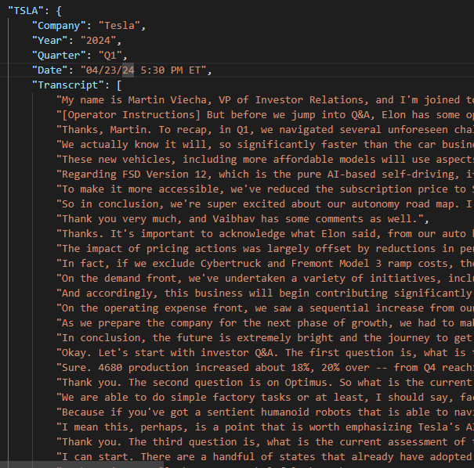
MarketBeat Parser
Parsed each company transcript to provide specified output
Used BeautifulSoup
Requested output: Stock Ticker, Company Name, Date of Transcript, and the Transcript itself
Outputs CSV and JSON
JSON output of parser

Slide 7
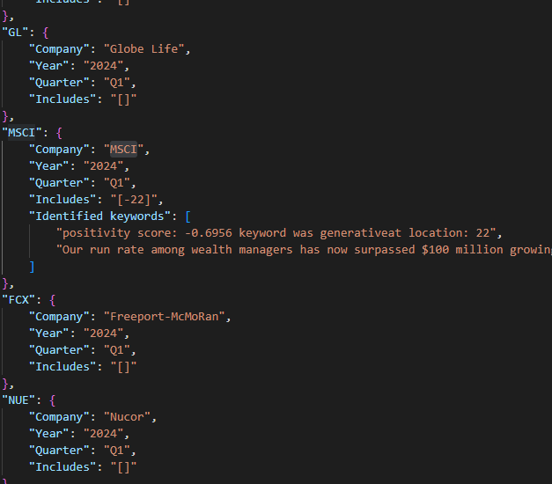
MarketBeat Analyzer
Prompts user to input search keywords and returns sections of the transcript that included them
Returns relevant keywords to output file
Runs sentiment analyzer on section and returns a positivity rating
JSON output of analyzer

Slide 8
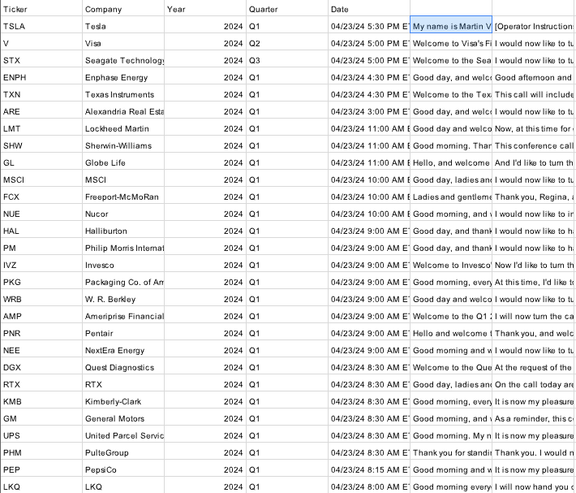
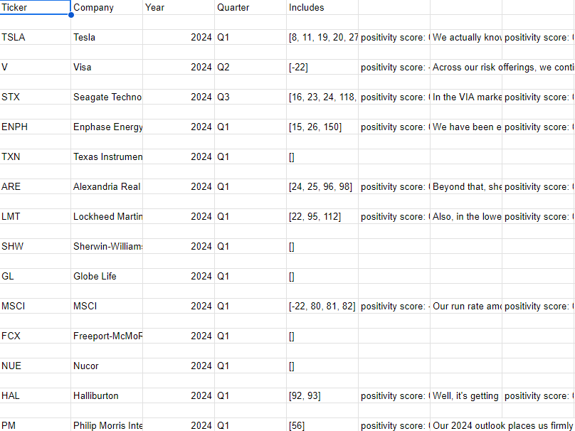
MarketBeat Output
CSV output of both parser and analyzer

Slide 9
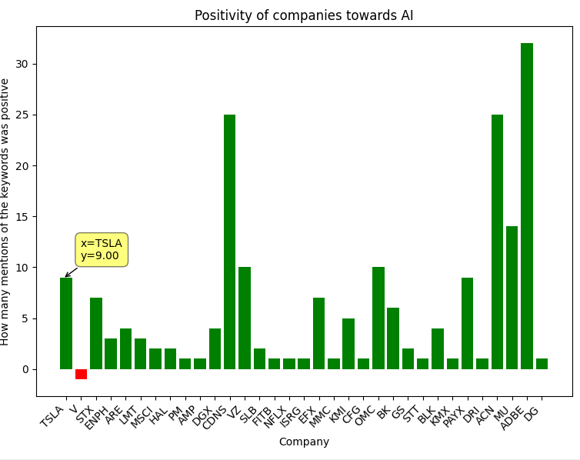
MarketBeat Visualizer
Takes data returned by the analyzer and formats a graph showcasing which companies are relevant
Uses Matplotlib
Shows positivity rating
Visualizer output

Slide 10
Reddit Implementation
Scraped Reddit app to collect posts and comments of certain subreddits
Utilized a Reddit API to be able to scrape posts and comments
Implemented a keyword search through the posts and comments for users to specify what to scrape
Added Sentiment Intensity Analyzer to determine the positivity score of posts and comments
Created visualization that shows the positivity of posts/comments and through a monthly basis and analyze trends on certain keywords

Slide 11
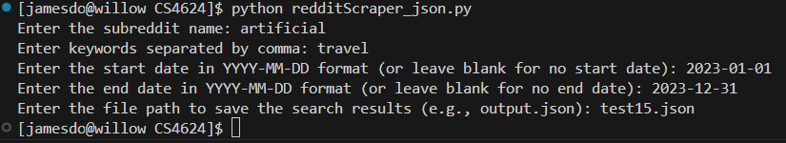
Reddit Scraper
Scraped Reddit to obtain posts and comments that include one of the keywords from the user
Utilized Reddit’s API to be able to pull content from the app

Slide 12
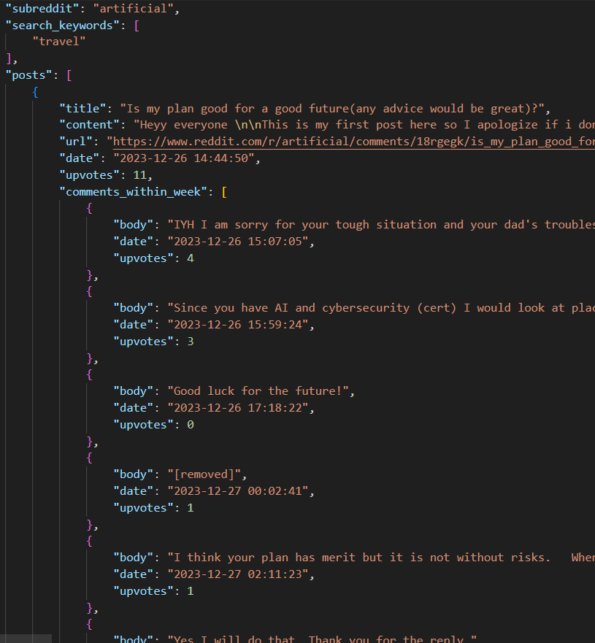
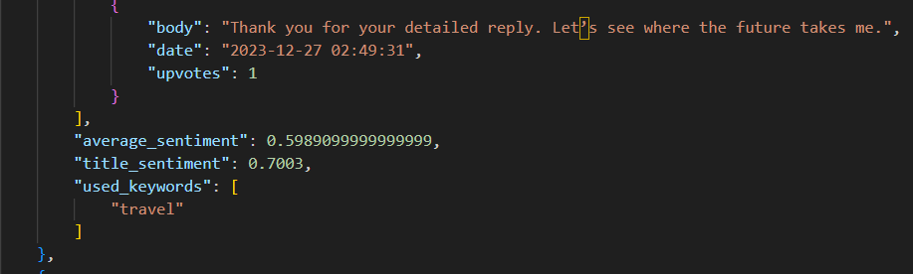
Reddit Parser
Parses each post and their comments to get the data of the positivity score and the keywords used when scraping
Utilizes the NLTK library for the positivity score
Outputs a JSON file

Slide 13
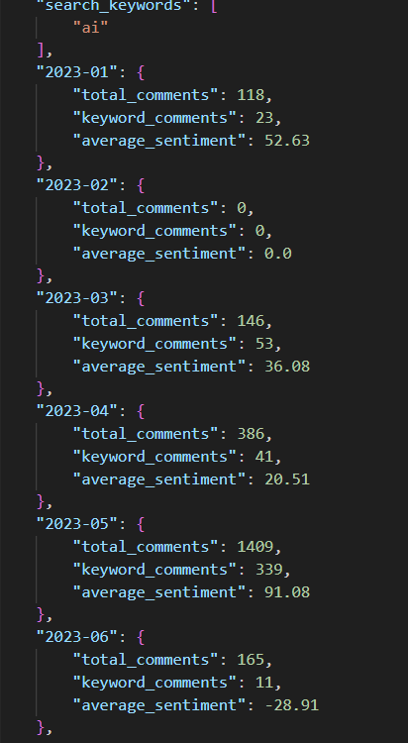
Reddit Analyzer
User will be prompted to put in a subreddit, specific keywords and timeframe of how long the scraper should scrape
Output will be the total number of comments scraped per month, keywords comments, and average positivity score

Slide 14
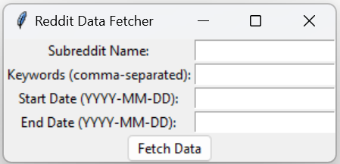
Reddit Visualization
Takes in Reddit scraper user input format to then create a pie and line graph. The pie graph shows the total number of comments with pieces being the months. The line graph shows the change in the number of comments that contain the keywords.
Combined web scraper and data visualizer into a single script for user
Used Tkinter Python library for user GUI
Used Matplotlib and Pandas for data visualization

Slide 15
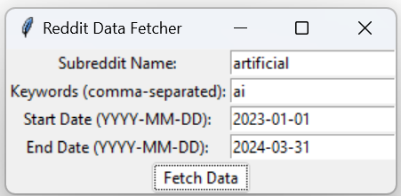
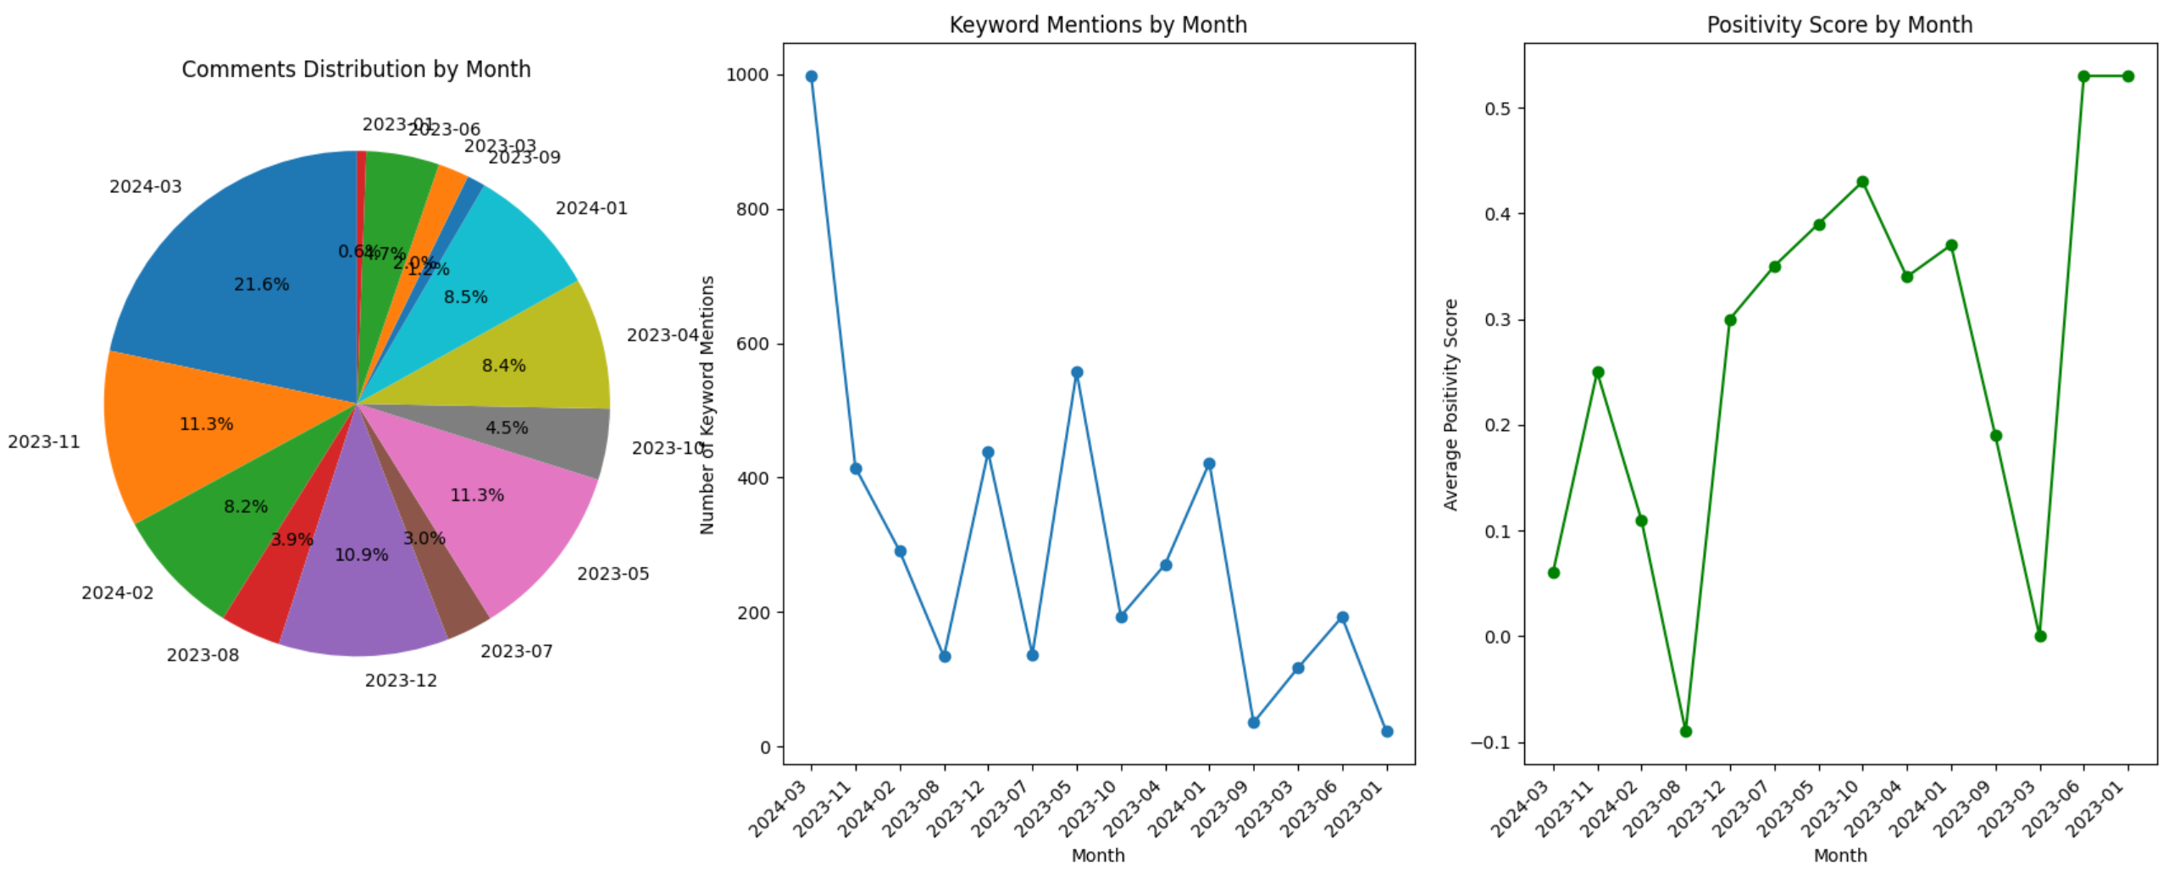
Reddit Visualization

Slide 16
Challenges
Reddit API issues
User input issues
Reddit API rate limits
Ensuring data consistency

Slide 17
Future Work
Implement a scraper to pull transcripts from individual sectors
Implement a scraper to pull transcripts from specific companies and their history
Implement a front end to the Reddit scraper
Improve upon the functionality of the Reddit scraper

Slide 18


Acknowledgements
Florian Zach
Edward Fox

Slide 19
References
[1] Reddit (2005). " Reddit Data API Wiki.” [Application] support.reddithelp.com.
https://support.reddithelp.com/hc/en-us/articles/16160319875092-Reddit-Data-API-Wiki [accessed May 1, 2024].
[2] Bryce Boe (2023). “PRAW: The Python Reddit API Wrapper.” praw.readthedocs.io.
https://praw.readthedocs.io/en/stable/ [accessed May 1,2024].
[3] Reddit (2024). “reddit API DOCUMENTATION.” https://www.reddit.com/dev/api/. [accessed May 1, 2024].
[4] James Briggs (2020). “How to Use the Reddit API in Python.” towardsdatascience.com. https://towardsdatascience.com/how-to-use-the-reddit-api-in-python-5e05ddfd1e5c [accessed May 1, 2024].
[5] Reddit (2024). “r/artificial/” reddit.com. https://www.reddit.com/r/artificial/ [accessed May 1, 2024]
[6] Simplescraper docs (2024). “How to scrape and save recipes with the extension.” simplescraper.io. https://simplescraper.io/docs/how-scrape-save-recipes/?source=install [accessed May 1, 2024].
[7] MarketBeat (2024). “Earning Call Transcripts.” marketbeat.com. https://www.marketbeat.com/earnings/transcripts/ [accessed May 1, 2024].
[8] Tripadvisor (2024). “Build a trip.” www.tripadvisor.com/
https://www.tripadvisor.com/ [accessed May 3, 2024].
[9] Google Maps (2024). “Maps” www.google.com/maps/
https://www.google.com/maps/@37.2241513,-80.4215138,14z?entry=ttu [accessed May 3, 2024]
[10] McKinsey & Company (2024). “What is generative AI?” www.mckinsey.com/
https://www.mckinsey.com/featured-insights/mckinsey-explainers/what-is-generative-ai [accessed May 4, 2024]

Slide 20
References
[11] BeautifulSoup (2024). “BeautifulSoup4.” www.pypi.org/ [Software]
https://pypi.org/project/beautifulsoup4/ [accessed May 4, 2024]
[12] Pandas (2024). “Panda Library.” www.pandas.pydata.org/ [Software]
https://pandas.pydata.org/ [access May 4, 2024]
[13] Matplotlib (2023). “Matplotlib: Visualization with Python.” [Software]www.matplotlib.org/
https://matplotlib.org/ [accessed May 4. 2024]
[14] NLTK (2023). “Natural Language Toolkit.” [Software] www.nltk.org/
https://www.nltk.org/ [accessed May 4, 2024]
[15] mplcursors (2016). “Interactive data selection cursors for Matplotlib.” [Software] www.mplcursors.readthedocs.io
https://mplcursors.readthedocs.io/en/stable/ [accessed May 4, 2024]
[16] Pattern Python (2023). “Explain Pattern Python Library.” www.medium.com/ [Software]
https://medium.com/@sujathamudadla1213/explain-pattern-python-library-5bb4c530956b [accessed May 4, 2024]
[17] Microsoft (2024). Visual Studio Code. 2024. [Software] https://code.visualstudio.com/, [accessed May 3, 2024]

