Slide 1
Anti-Poaching
Multimedia, Hypertext, and Information Access
Instructor: Edward Fox, fox@vt.edu
Client: Dr. Francesco Ferretti
Virginia Tech
Blacksburg VA, 24061
April 19, 2023
By Zachary Hutcherson

Slide 2
Outline
Client
History of AUVs in conservation
Why are drones so valuable to conservation?
Aerial vs. submersible drones
Which is better for surveilling surface ships?
Overall review of the sources
Acknowledgements
References

Slide 3

Client
Dr. Francesco Ferretti
Professor in VT Fish and Wildlife Conservation
Manages research projects relating to marine conservation
Requested a literature review of sources in regards to drones and their uses in marine conservation

Slide 4
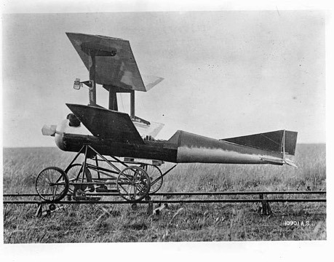
History of AUVs in Conservation
Drones for Conservation in Protected Areas:
First saw civilian use in the 1980s
Primarily used for agriculture (Crop pollination, pesticides, and fertilizer)
Conservation use of drones began in 2011
Conservationists required a cheap and safe way to monitor wildlife without disturbing the area
Replacement for helicopters
Used by Sea Shepherd Organization to catch whalers in Japanese waters
Valuable proof of concept for marine use

Slide 5
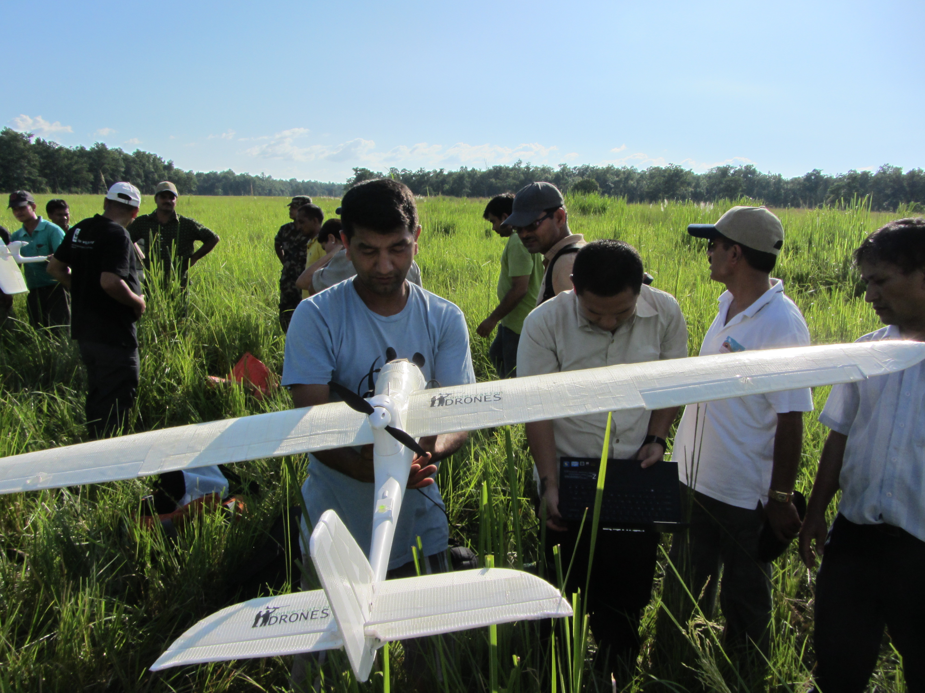
Why are drones so valuable to conservation?
Drones for Conservation in Protected Areas:
Study shows that drones have far more value to surveillance than manually controlled vehicles
The cost of a drone is generally far cheaper
More accurate with the use of machine learning algorithms
Provide a larger scale of monitoring capabilities with the use of a swarm for consistent use
Describes an increase in drone usage over time

Slide 6
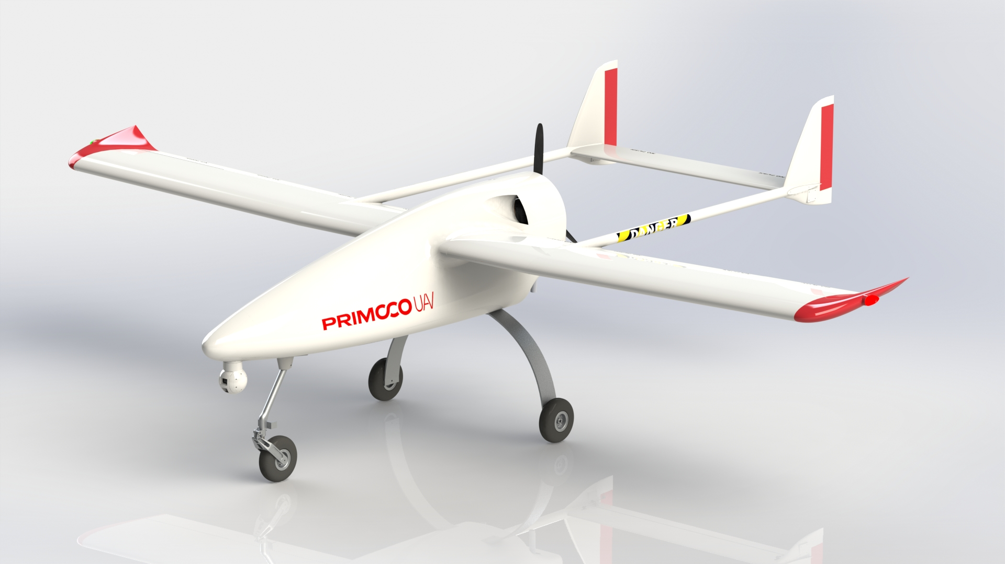
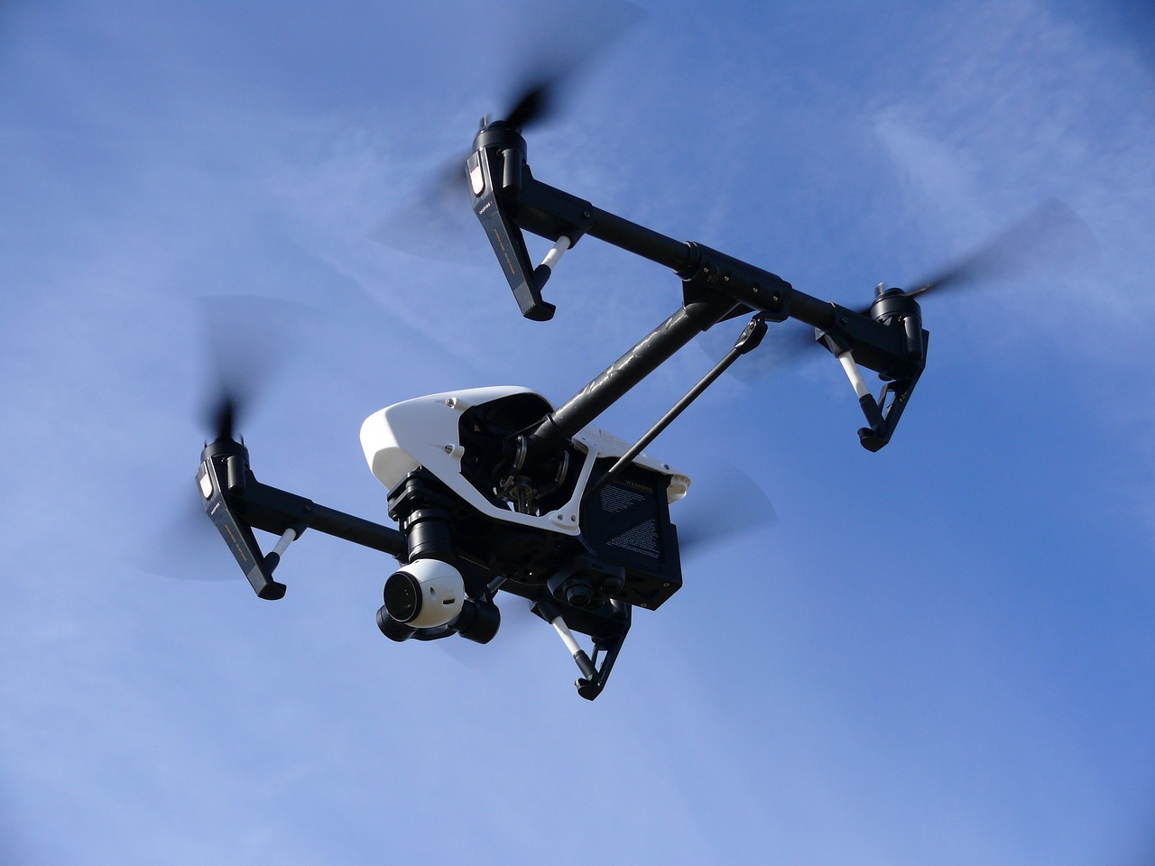
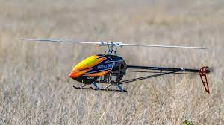
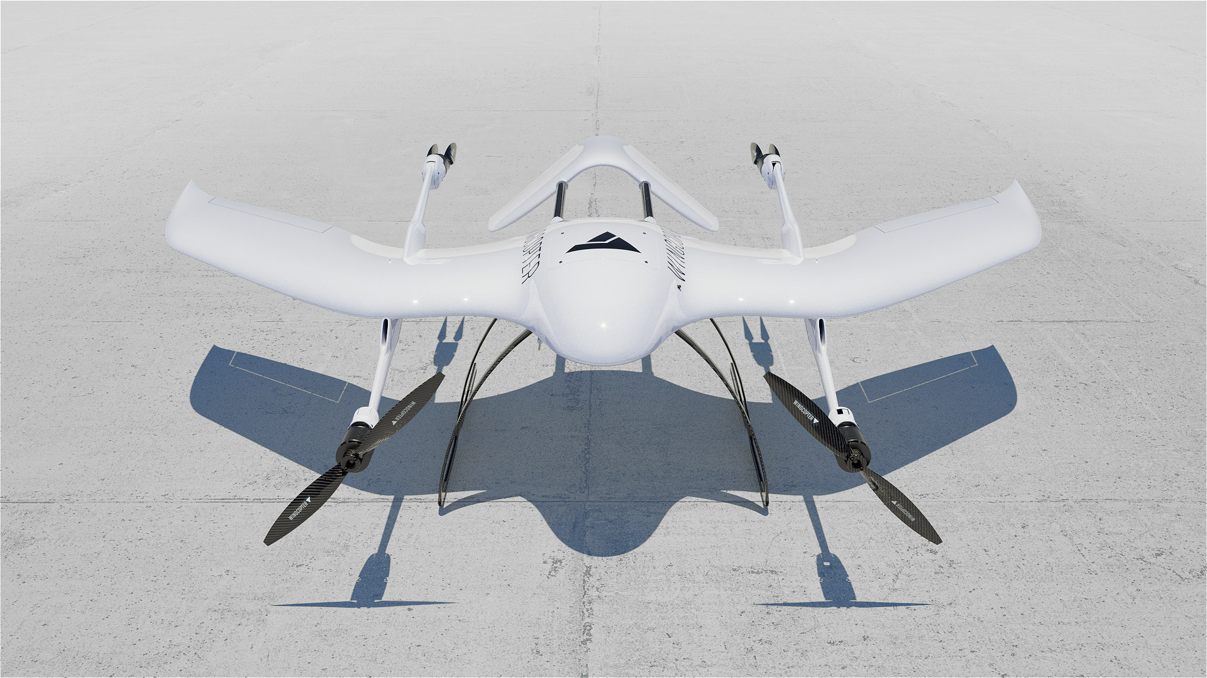
Aerial vs. Submersible Drones (Aerial)
Unmanned Aerial Vehicles:
Fixed -
Multi rotor
Single rotor
Hybrid
Types of Aerial drones
Fixed wing (like a standard plane)
Longer range, durable, stable
Multi rotor (like a quadcopter)
Cheapest, easy to use, maneuverable
Single rotor (like a helicopter)
Slow, difficult to use, expensive, not worth it
Hybrid (VTOL)
Vertical take off, fixed wings, expensive, difficult

Slide 7
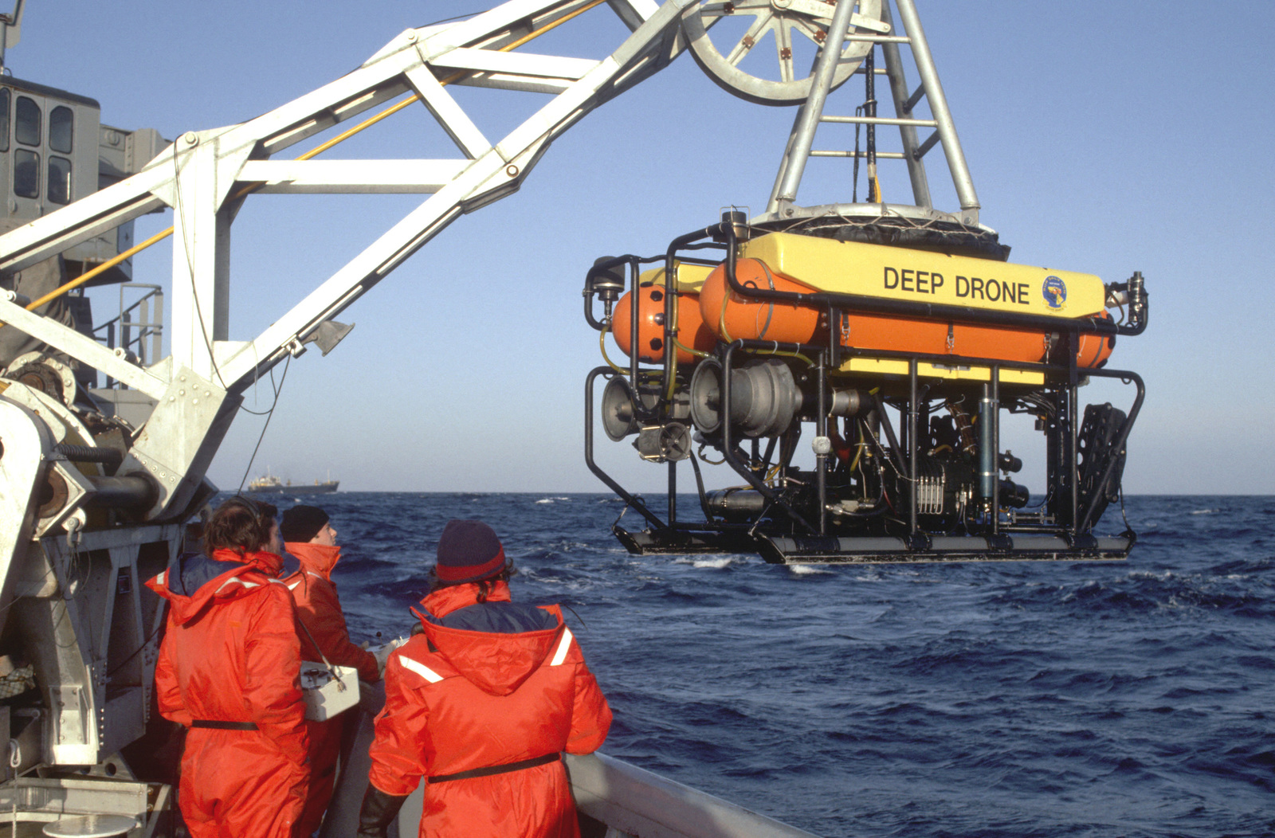
Aerial vs. Submersible Drones (Submersible)
The Drone Revolution of Shark Science:
Travel very slowly compared to aerial drones
More expensive
Can be tethered to a control center
Power and communications provided by the tether
Bounded by the length of the tether
Non-tethered submersibles
Communication difficulties in rough weather
Longer range
Offer unprecedented knowledge on behaviors and status of marine species like sharks

Slide 8
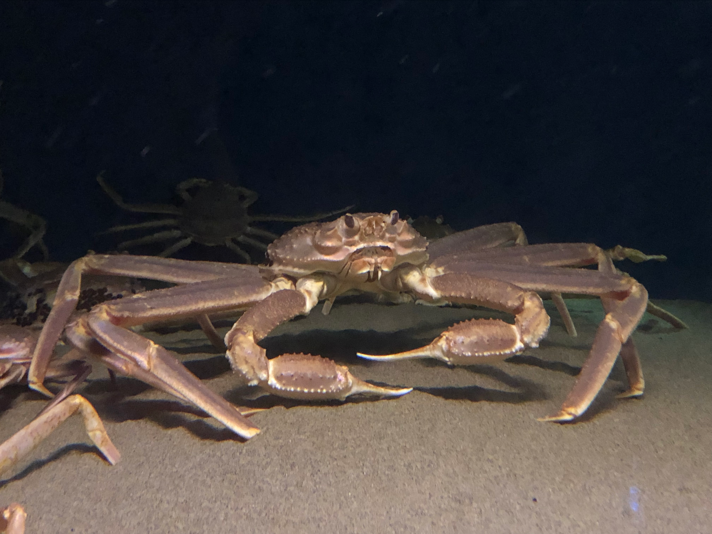
Aerial vs. Submersible Drones (Submersible)
Tracking Crabs in Real Time to Improve Fisheries Management:
Tether operated underwater vehicle was found to be very effective in documenting the populations of snow crabs in Nova Scotia
Helped fisherman and conservationists ensure healthy numbers of snow crabs
Far cheaper than a deep sea mooring
The study wasn’t the most useful as it didn’t give many details or statistics

Slide 9
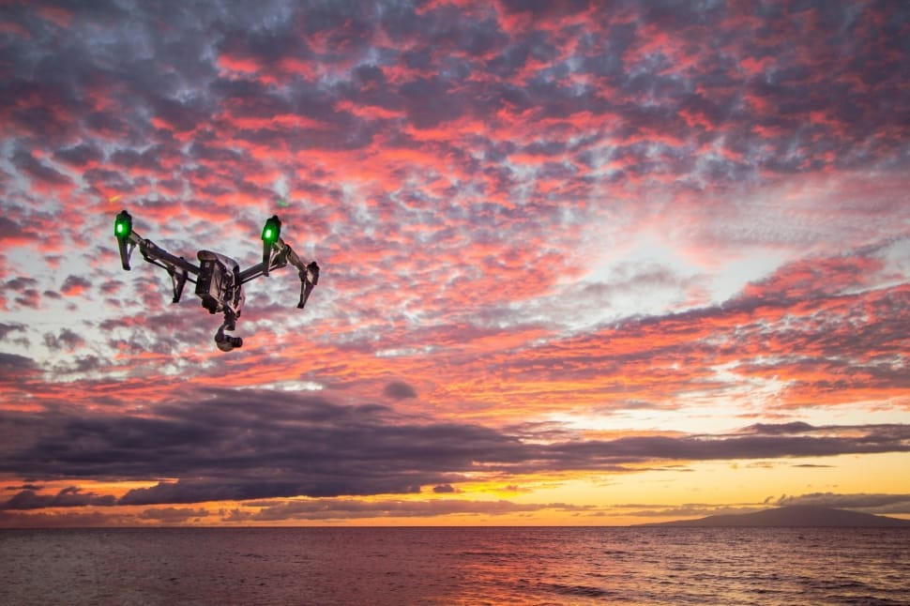
Which is better for surveilling surface ships?
Aerial and Underwater drones for Marine Litter Monitoring in Shallow Coastal Waters
Study shows that for identifying marine litter, aerial drones are more effective
Implies that aerial drones are more efficient than underwater drones for most surveillance cases
Underwater drones are able to detect litter that aerial drones struggle with and vice versa
Both types of drones together are far more likely to detect something than any manned vehicle

Slide 10
Overall Review of the Sources
These studies are critical for informing the public on the use of drones for marine conservation
The study by Liquid Robotics Tracking Crabs in Real Time to Improve Fisheries Management was not very useful however
Far too vague about the benefits of their drones for wildlife and local fisherman

Slide 11

Acknowledgements
Dr. Francesco Ferretti
Jeremy Jenrette
Dr. Edward Fox

Slide 12
References
https://btstu.researchcommons.org/journal/vol2020/iss3/5/
https://www.sciencemuseumgroup.org.uk/blog/conservation-up-in-the-clouds/
https://maritime-executive.com/article/sea-shepherd-activists-using-drones-to-track-japanese-whalers
https://link.springer.com/article/10.1007/s10661-022-10519-5#Sec29
https://geonadir.com/fixed-wing-vs-multirotor-drones-which-is-better/
https://www.mdpi.com/2504-446X/5/1/8
https://www.ncbi.nlm.nih.gov/pmc/articles/PMC9841964/
Images
Wiki commons

