Slide 1


Elements and Altmetric at Virginia Tech
A Client Case Study
Lily Troia, Altmetric and Virginia Pannabecker, University Libraries, Virginia Tech
August 2, 2018
This presentation is licensed CC BY SA 4.0 for reuse with attribution, ShareAlike..

Slide 2

What we’ll cover
Introductions and background
Wrangling your institution’s publications: Elements at Virginia Tech
Integrating with the Altmetric Explorer: multi-tiered roll-out approach
Developing a sustainable Altmetric Strategy
What’s next at VT
Elements and Altmetric: two systems working in tandem
Questions and Discussion

Slide 3
Who we are
Ginny Pannabecker | Associate Director, Research Collaboration and Engagement | Virginia Tech University
Lily Troia | Engagement Manager Altmetric, Digital Science | DS Data and Analytics
develops and supports services to assist the VT community in collaborative, open research practices; and in discovering and sharing the impact of their work
Previous positions at Arizona State University
digital scholarship librarian + communications & copyright specialist
Previous positions at William & Mary
Virginia Institute of Marine Science, Harvard University Office of Scholarly Communication

Slide 4
Digital Science and Virginia Tech University
Long standing commitment at VT to support researchers by supporting and elevating research impact
VT and DS relationship started with Elements over four years ago
Integrate enterprise data systems with Elements for internal reporting and feed public facing web profiles through CollabVT, Virginia Tech’s in-development implementation of VIVO.
Soft launch of Altmetric and the Explorer in October 2017
Integrated with Elements Summer 2018 for full roll-out autumn 2018
View Elements and Altmetric as vital to evidencing reach and influence of scholarship that extends beyond the academy -- key to meeting academic mission as a Land Grant institution

Slide 5
Quick Elements Recap
At VT, Elements is part of a larger research ecosystem
“RIS as Part of a Larger Environment of Systems” (2017). Ogier, A., Pannabecker, V., Layne, M.
Automated data feeds, data privacy, systems integrations
Inst Repository VTechWorks
Provost’s Office and University Libraries partnership
College and departmental uptake of Elements
Annual Faculty activity reporting
Departmental custom reports
Custom use of data to feed departmental websites
Training and Support
VT Elements - FAQ, Getting Started, College-specific info
Regular workshops, liaisons, additional support on request

Slide 6
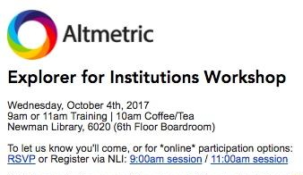

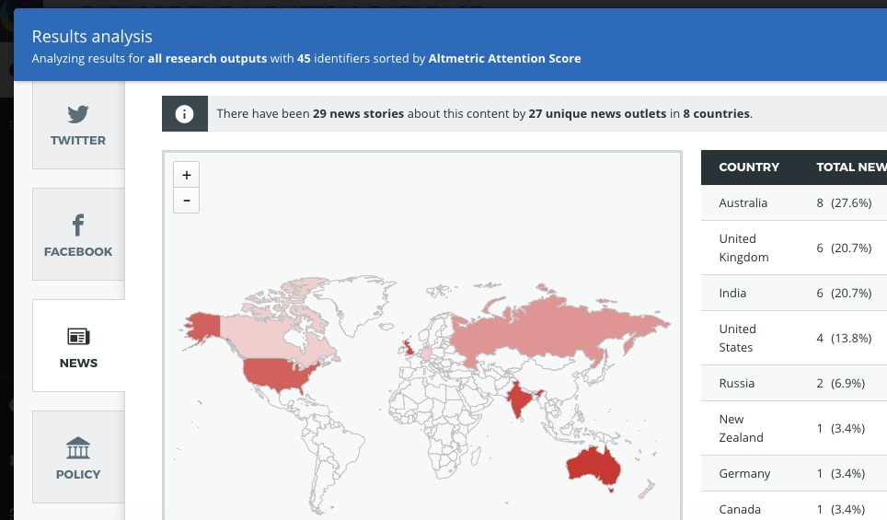
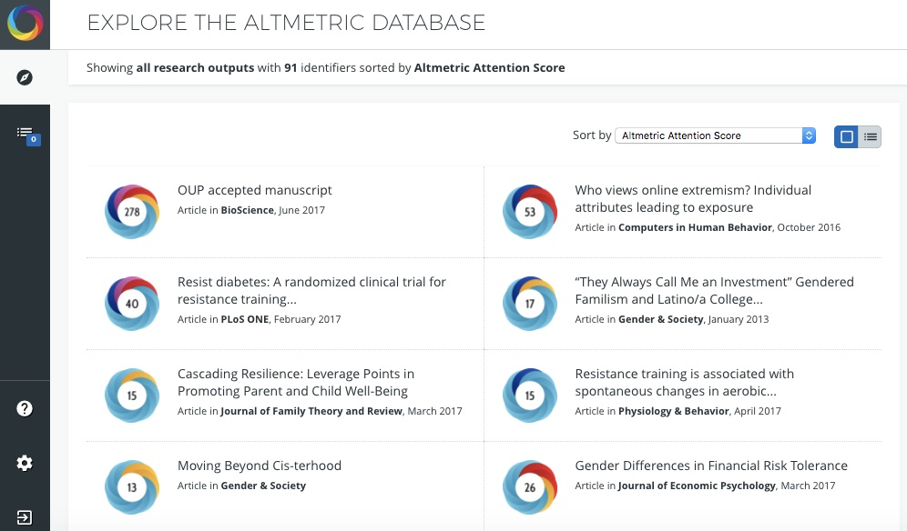
Launching Altmetric at Virginia Tech
Initial set up
Soft launch
Liaison collaboration
Department workshops & reports
Consultations & Open workshops
Notes:
Initial set up
Soft launch w/training
Department and open workshops
Article level metrics overall, including citations, altmetrics, web analytics
Delving into all these metrics to ‘tell your story’ by crafting qualitative summaries of metrics for specific publications or groups of items.
Examples from AE, bookmarklet, Report
Individual Consultations and AE Reports

Slide 7
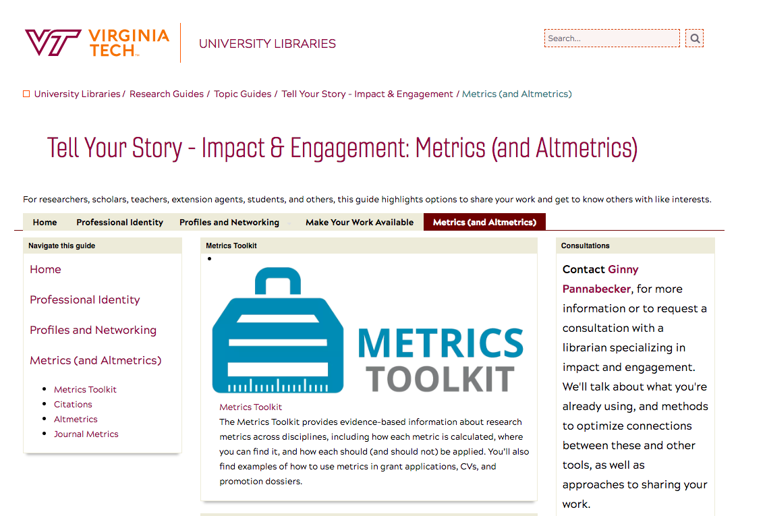
Developing a strategic Altmetric approach
Help researchers and faculty tell their story
Altmetric as part of broader impact & engagement services
Encourage responsible use of complementary, diverse metrics
Elevate visibility and impact of all research outputs
Targeted user training coordinated through VT Libraries
Specialized, collaborative research projects

Slide 8
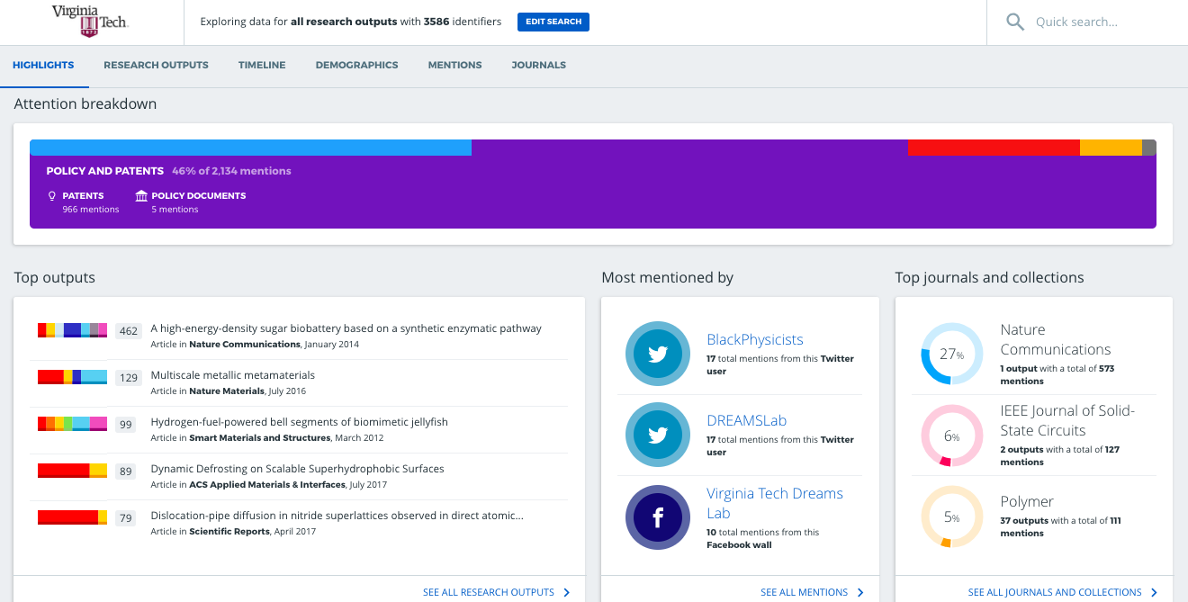
The Altmetric Explorer at Virginia Tech: Phase 1
Soft launch of Altmetric in Fall 2018
Goal: provide staff and faculty immediate access to full Altmetric database prior to Elements
Initial onsite train-the-trainer sessions
Ability to search for outputs en masse via identifier
Example: Materials Engineering

Slide 9
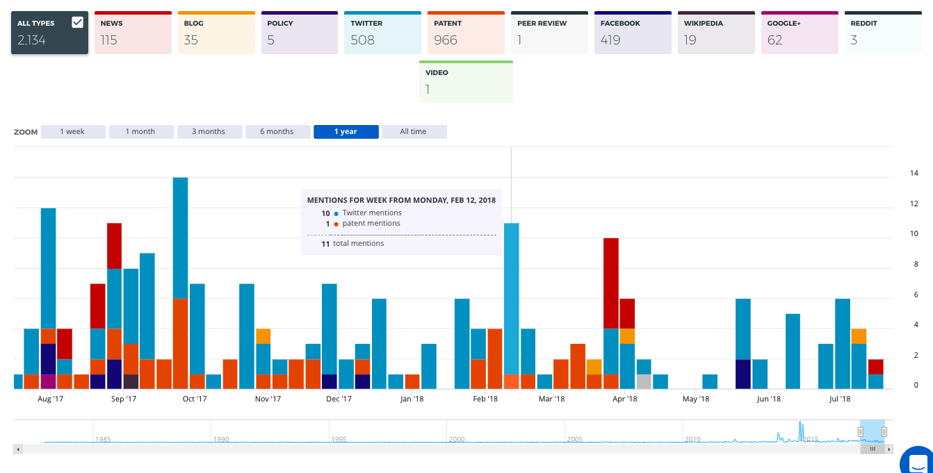
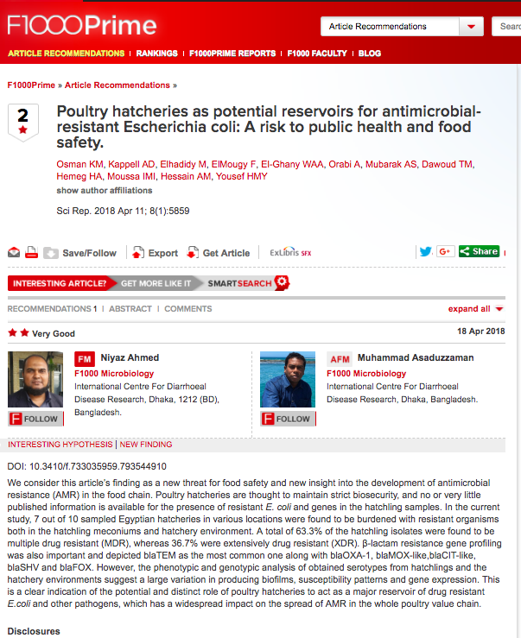
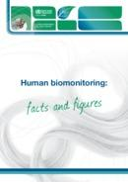
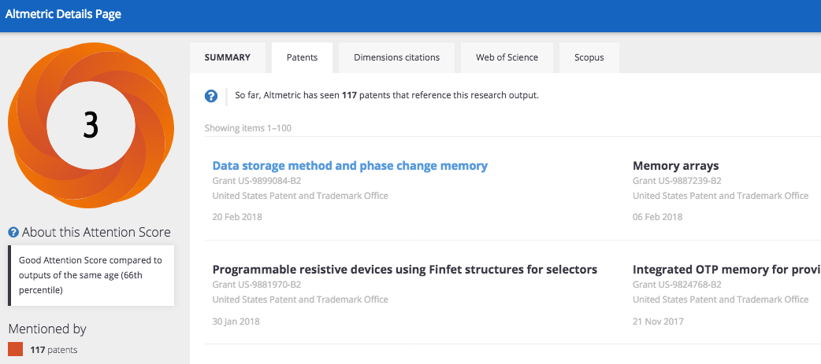
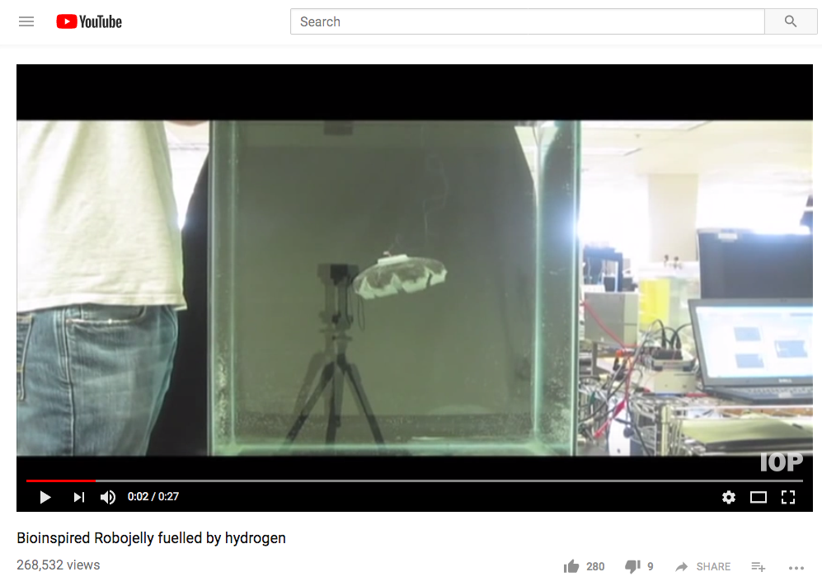

Slide 10
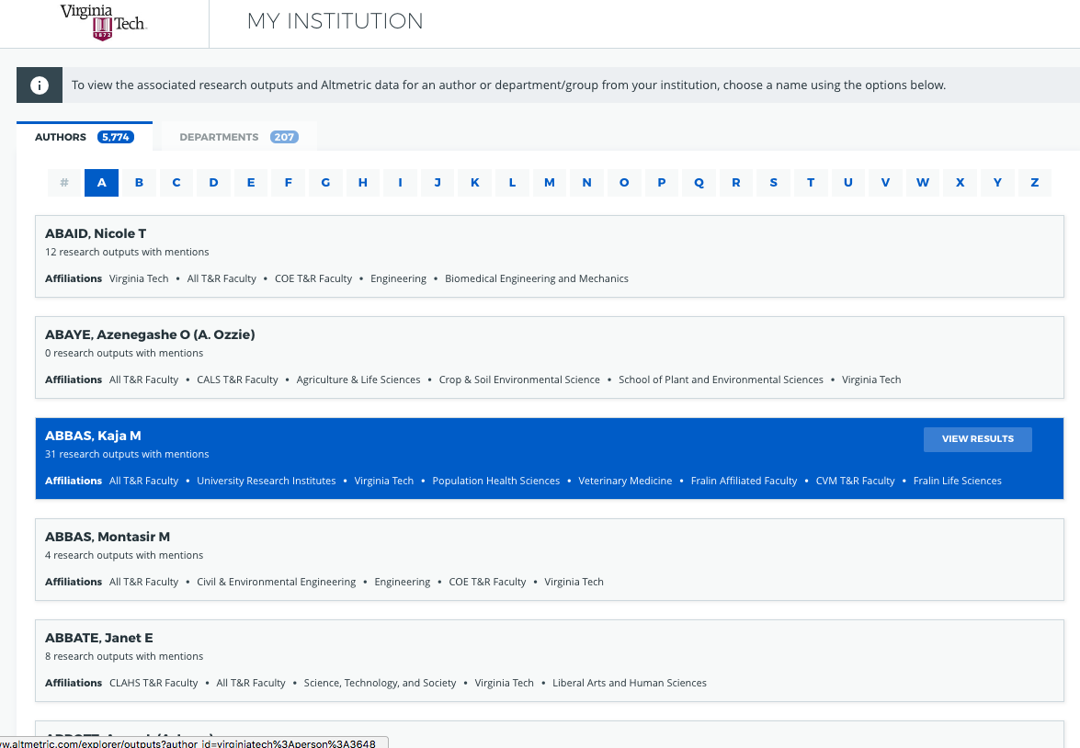
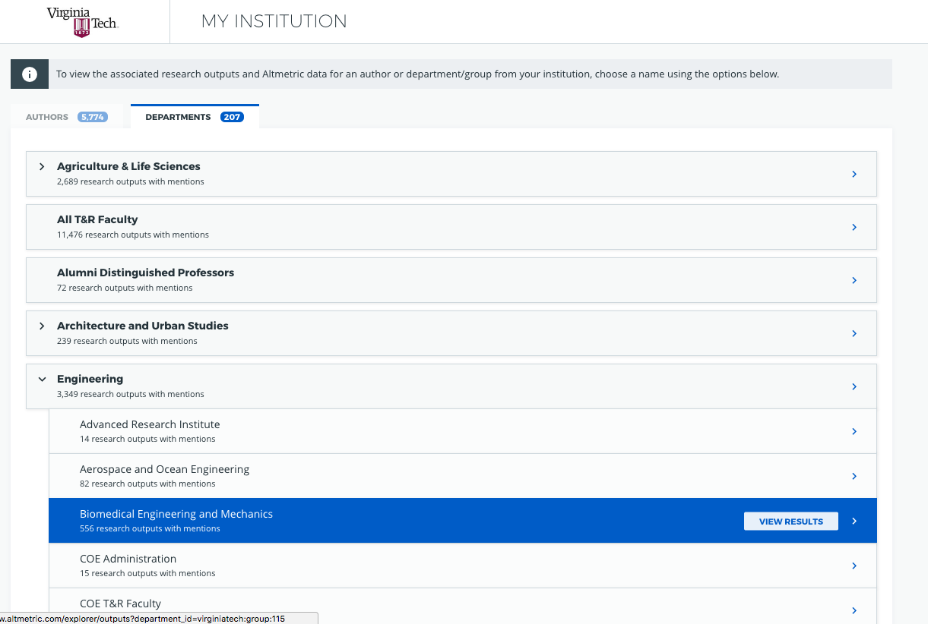
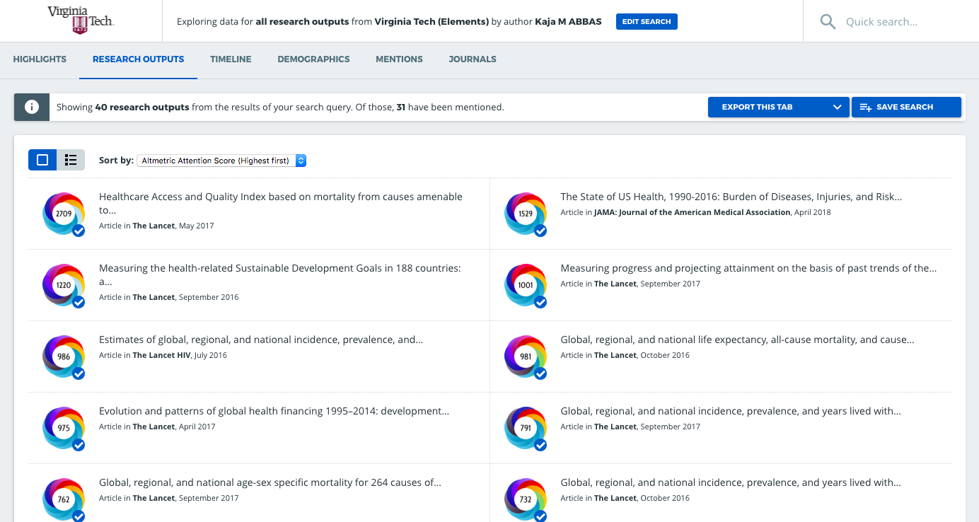
Altmetric Phase 2: Custom institutional instance via Elements integration

Slide 11

Highlight: custom Altmetric user persona research
Develop User Personas for ag/life sci researches, faculty, and extension agents in collaboration with Inga Haugen, Agriculture, Life Sciences, and Scholarly Communication Librarian + Texas A&M Libraries
Approach process with a critical lens, keeping mission and values at center
Meet needs of extension program workflows and behavioral patterns
Personas crafted in the context of engagement scholarship/non-traditional research outputs
Identify and align with communication methods and associated with each user
Treat personas be living, iterative documents
Ensure personas are openly available, shared broadly, and repurposable

Slide 12
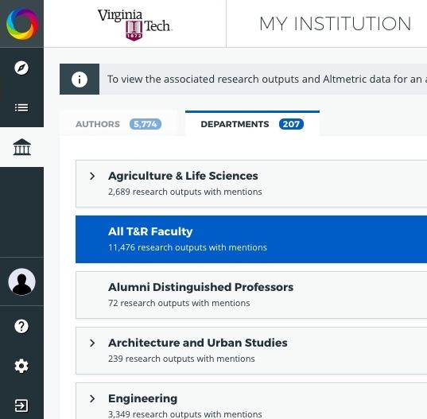
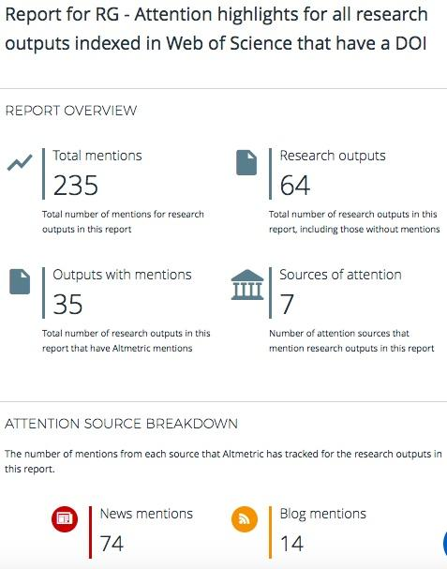
What’s next
Integration = easier
Repository records & pubs
Outreach
Institutional news stories
Outreach to institutional communications staff
Optimizing for altmetrics
College and departmental
Individual consultations
Custom group reports
Altmetrics across platforms
Notes:
Integration means ease of item grouping by individuals or university groups, including repository items that are input into Elements
An issue of note: if not all faculty are in elements, or if their publications records are not complete, this will be something to address
Elements is one source option for integration; can also use Institutional Repository as the data source
Further integration with Elements when Elements data was more complete
Related investigation of how to connect altmetrics across platforms (IR, Elements, AE)
Outreach plans - institutional news stories; outreach to institutional communications staff

Slide 13
Maximizing the potential of Elements + the Explorer
Ease of implementation, coordinated DS team
Updates to Elements → updates in The Explorer
Department/Author columns in data export
Support of two unique teams working together
Fosters development of research assessment workflows
Helps elevate and surface diverse, current attention for all research outputs at your institution
Promote clearer pathways to research visibility and impact

Slide 14
Question? Discussion!

Slide 15
THANK YOU!

