Slide 1
Embargo Support for DSpace
Midterm Presentation
Jeb Schiefer and Paul Sharma
Clients: Keith Gilbertson and Zhiwu Xie
CS 4624
Virginia Tech

Slide 2
What is DSpace ?
Digital Repository
Open Source and Customizable
Started in 2002
Support for all types of digital content
Supports efficient search and retrieval

Slide 3
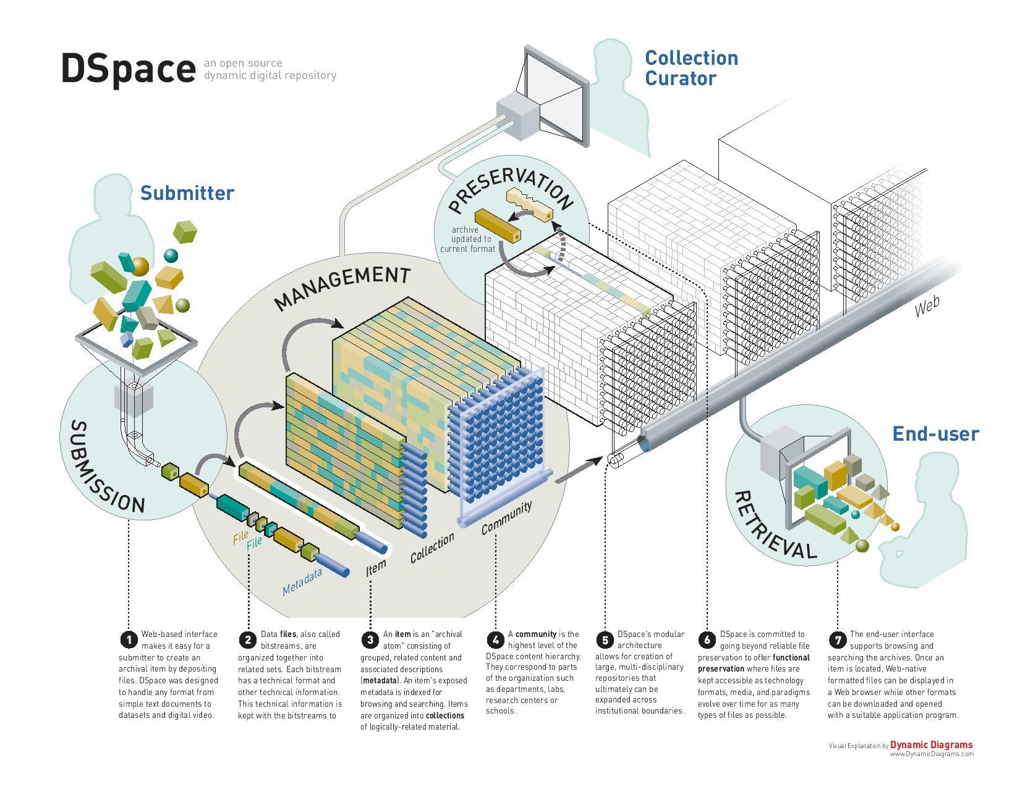
How does it work ?

Slide 4
Ways to submit
Submission Workflow
Item import via Command Line Tools

Slide 5
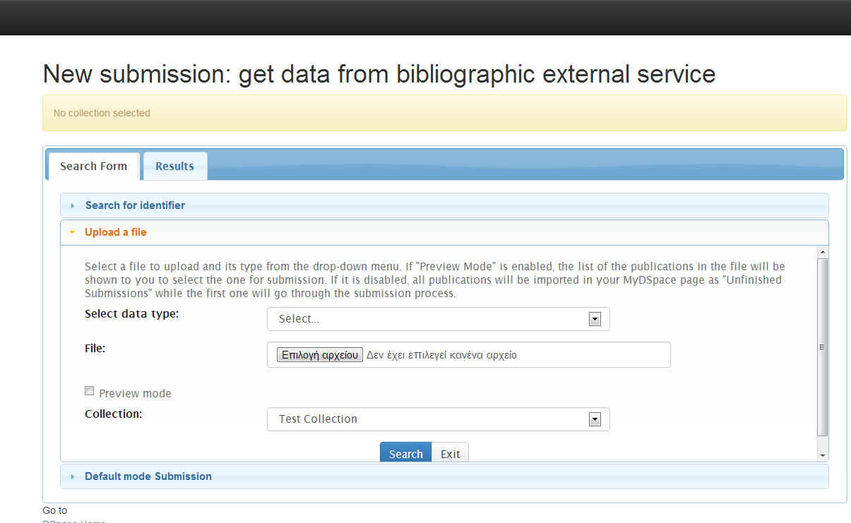
Submission Workflow Snapshot

Slide 6
Embargo
Special type of content restriction
Item level or bitstream level embargo
Bitstream level embargo only for Submission workflow

Slide 7
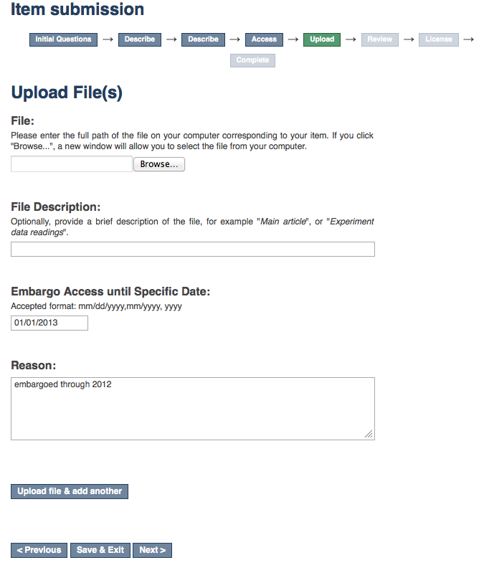
Embargo Snapshot

Slide 8
Item Import
$ ./dspace import -a -e joe@user.com -c CollectionID -s items_dir -m mapfile
New flag: -E for embargo

Slide 9
Contents File
One file (item) per line
Each item is called a bitstream
Specific actions per bitstream (embargo)

Slide 10
Contents file structure
file_1.doc
file_2.pdf embargo:[start],[end]
license

Slide 11
Date format
ISO 8061
[YYYY]-[MM]-[DD]

Slide 12
Final Goal
Pull request with main branch on GitHub

