Slide 1
CS 3604 Case Study Library
Team Members:
Elizah Fields
Hamza Jaldi
Joseph O’Such
Jonathan Woodbury
CS 4624: Multimedia, Hypertext, & Information Access
Instructor: Prof. Fox
Virginia Tech, Blacksburg VA 24061, May 6, 2024
Notes:
Joseph O’Such

Slide 2
Outline
Project Recap
Problem Recap
Changed Approach
Tools Used
Presentation Layer
Application Layer
Authentication
Database Layer
Future work
Notes:
Joseph

Slide 3
Project Recap
Client: Dr. Dunlap, CS 3604
Digital Library Program (DLP) held students’ case studies from CS 3604
  Reports & Presentations
  Used by students to see examples of past projects
Notes:
Joseph

Slide 4
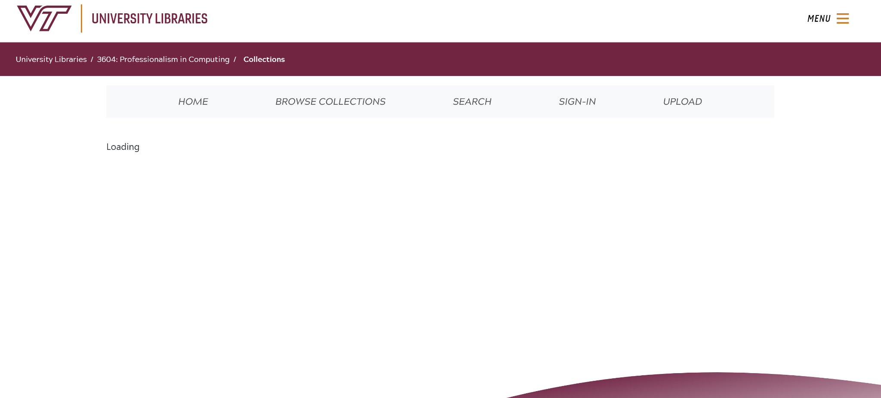
Problem Recap
Had no student authentication
Became harder to maintain over time
  AWS Amplify build errors
  DLP root repository now private
  1.5 years out of sync
Notes:
Joseph

Slide 5

Changed Approach
Met with a DLP team developer
Developed 3 possible plans
  Pull DLP updates and continue
  Host on DLP managed instance
  Build custom site
Decided to build custom site
Notes:
Joseph

Slide 6

Tools Used
Microsoft Azure
  Python: CSV module
MERN Stack
  React: Presentation Layer
  Express & Node: Application Layer
  MongoDB: Database Layer
Notes:
Elizah

Slide 7
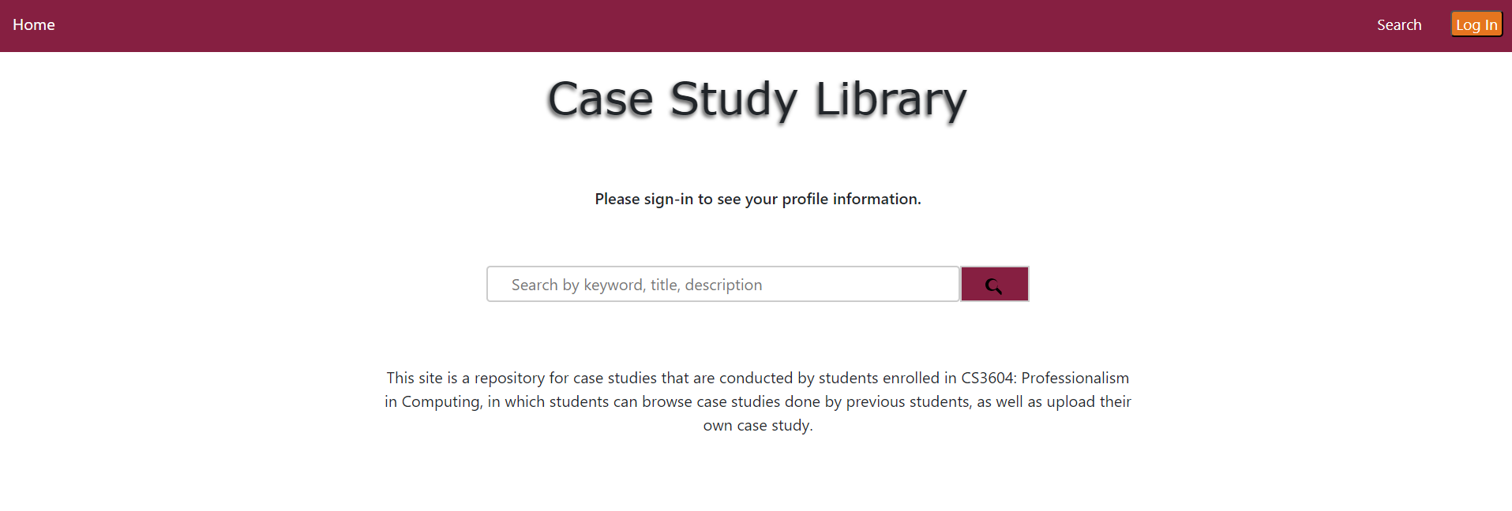
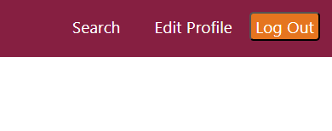
Presentation Layer
Notes:
Elizah

Slide 8
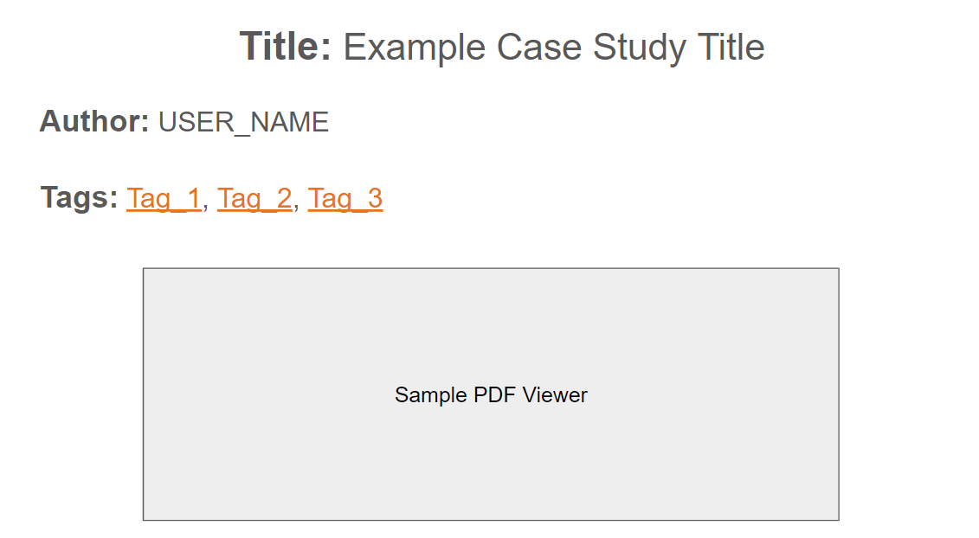
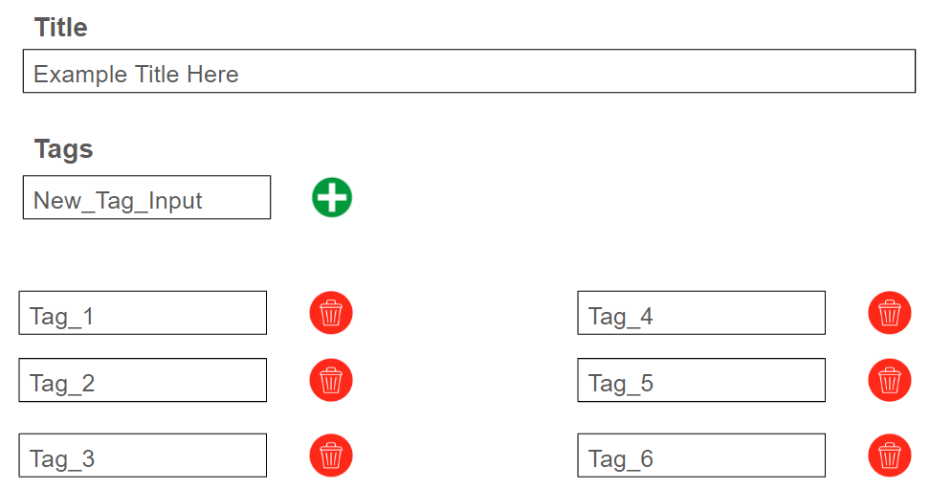
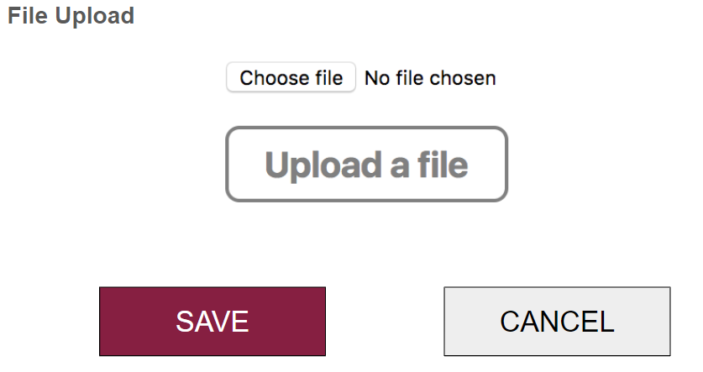
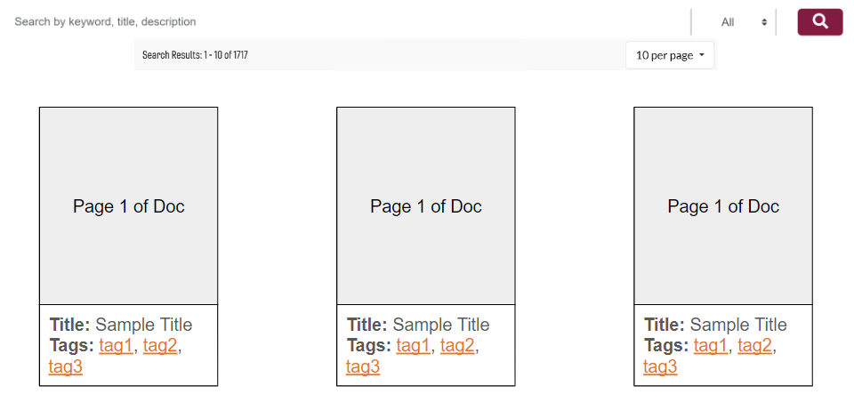
Notes:
Elizah

Slide 9

Presentation Layer Status
Work Completed
Homepage
Navigation bar
Search page
Profile page
Notes:
Elizah

Slide 10



Application Layer
End User
Profile API
Search API
File API
MongoDB
File System
Notes:
Joseph

Slide 11

Application Layer Status
Work Completed
Layer set up with controllers and routes
Profile, Search, and File API completed and tested with Postman
Notes:
Joseph

Slide 12
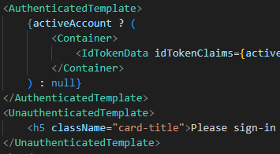
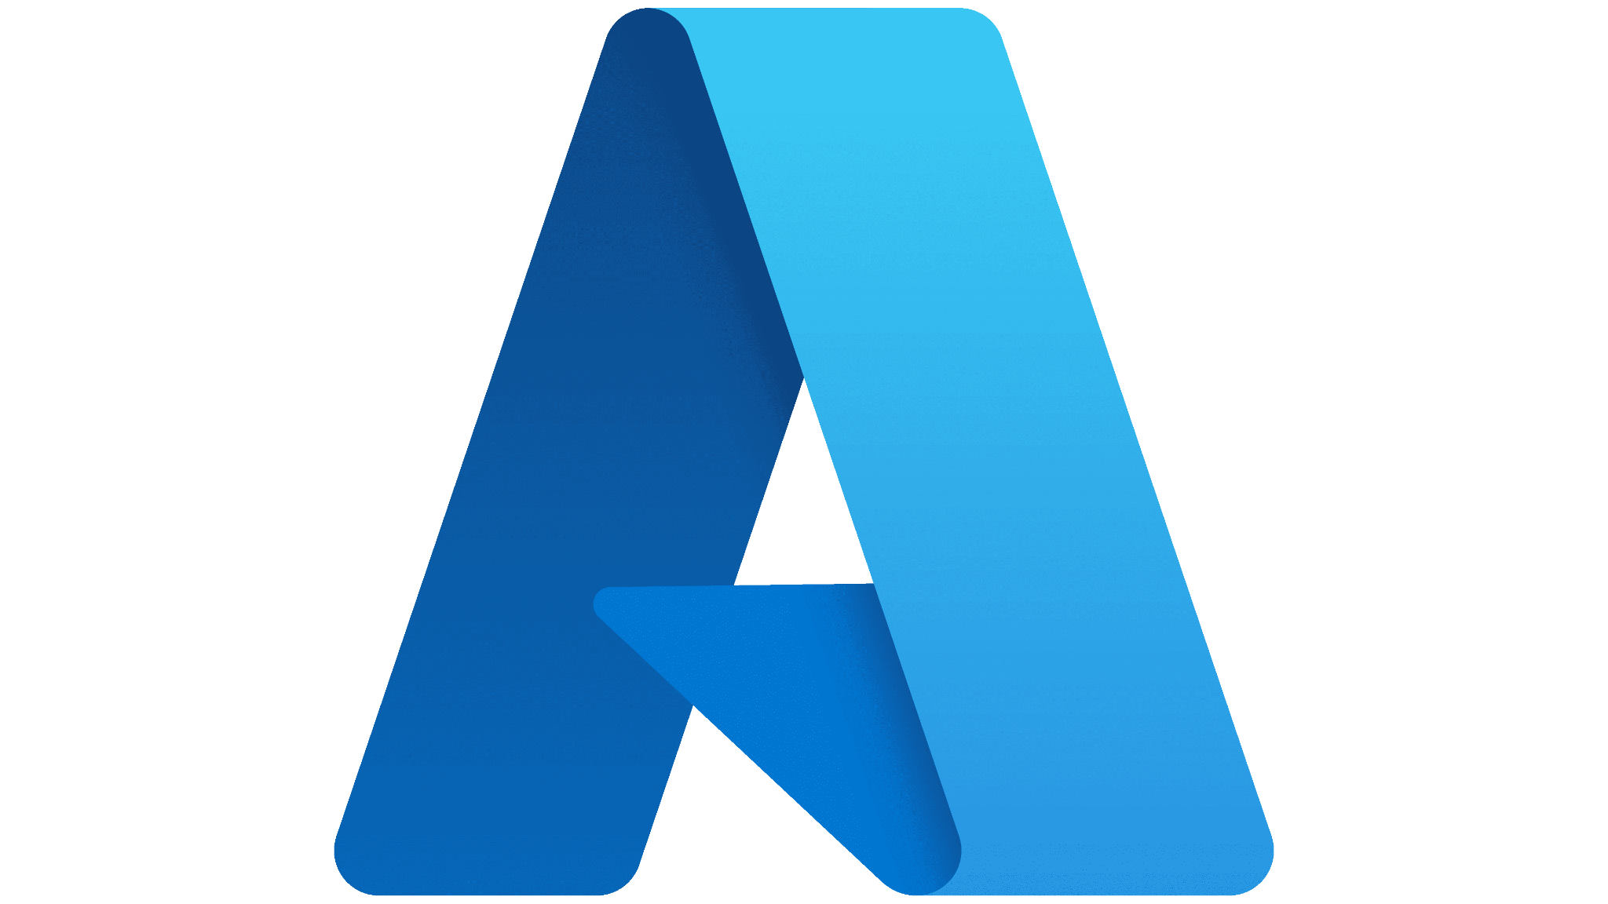
Work Authentication
Microsoft Azure
  Invite students as external users
  Ues app registration to grant authentication
JavaScript library: msal-react
  Uses auth templates to display webpages
  Determined by whether user is authenticated

Slide 13
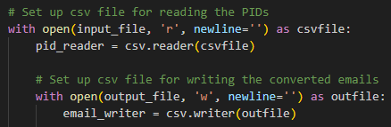
Automation
Must invite 100s of students a semester
Python script for 3604 instructors
  CSV module: Makes CSV file of students’ emails
Microsoft AD: imports file as a batch invite

Slide 14

Authentication Progress
Work Completed
Authentication for students inside Microsoft AD tenant
Restricting web pages based on authentication
Automation of Microsoft AD’s batch invite process

Slide 15
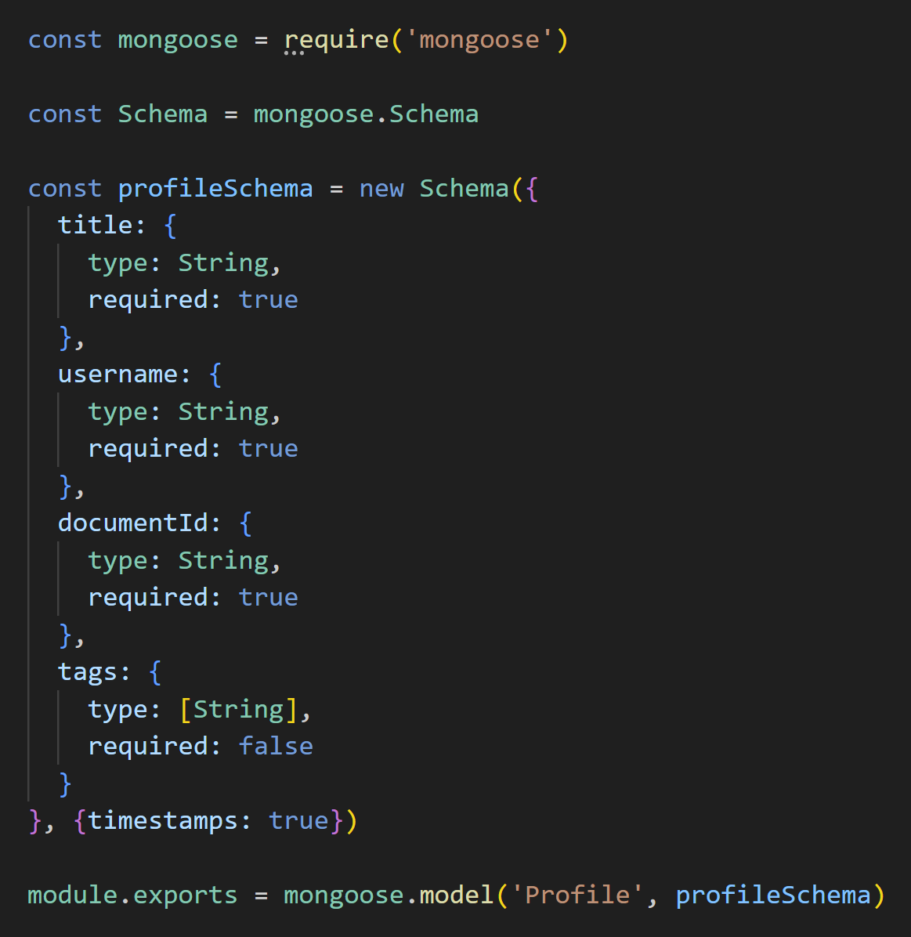
Database Layer
MongoDB is a NoSQL database
  Using schema to enforce formatting
  NoSQL is flexible for future changes
File data stored on disk
  Simple, easy to access

Slide 16


Database Layer Progress
Work Completed
MongoDB schema created
API updates to DB tested
File system structure created

Slide 17
Future Work
Finish the edit profile page (current capstone group will complete)
Extensive automated testing
Add levels of authentication, including administrative access
Create in depth data backup plan with AWS S3 or other remote storage

Slide 18
Acknowledgements
Professor Dunlap
Professor Fox
Satvik Chekuri
Dr. Chen and Mr. Lee from VT DLP
The previous capstone groups
  Theo Ouzhinski, William Denman, Katie Geibel, and Thrilok Shivaraman
  Trevor Bagbey, Matthew Betsill, Omar Elgeoushy, Daniel Setareh

Slide 19
References
[1] “CS 3604 Case Study Library.” University Libraries, https://casestudies.cs.vt.edu/, Accessed 17 April 2024
[2] “Microsoft Identity Platform Documentation.” Microsoft Learn, https://learn.microsoft.com/en-us/entra/identity-platform/. Accessed 17 April 2024
[3] “MERN Stack Crash Course Tutorial.” Youtube, https://www.youtube.com/playlist?list=PL4cUxeGkcC9iJ_KkrkBZWZRHVwnzLIoUE. Accessed 13 April 2024

Slide 20
Questions?

