Slide 1




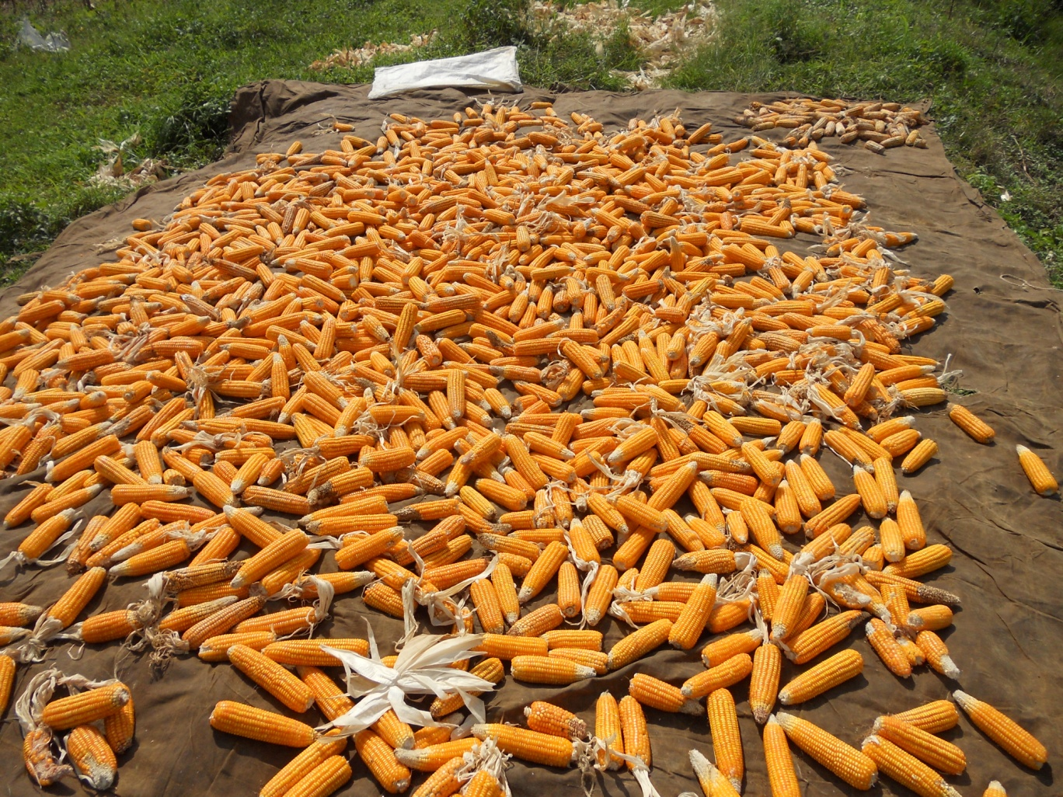
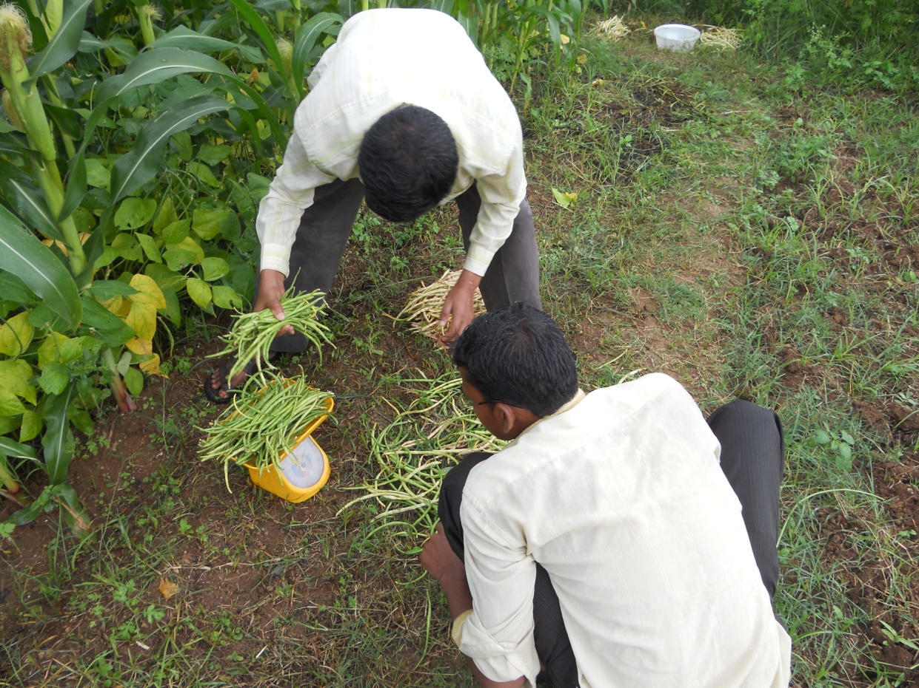
A comparative study of Conservation Agriculture Production Systems (CAPS)
for tribal people of Odisha, India
Aliza Pradhan*¹, J. Halbrendt¹, C. Lai¹, T. Idol¹, C. Chan-Halbrendt¹, C. Evensen¹, C. Ray², P.K. Roul³, and K.N. Mishra³ ¹Dept. of Natural Resources & Environmental Management, ²Dept. Of Civil & Environmental Engineering, ³Odisha University of Agriculture & Technology
Introduction
Materials and methods
Results and Discussion
Rainfed-shifting cultivation common in tribal districts
of Odisha.
Issue of unsustainability due to loss of forest cover,
intense mining activities, high tillage practices on hill
slopes, and accelerated soil and water erosion.
Experiencing degradation of soil and water resources, lower land productivity, increased poverty and loss of livelihood options.
Location-specific conservation agriculture production systems (CAPS) recommended.
An on-station experiment was conducted at Regional
Research and Technology Transfer Station,
Kendujhar, Odisha from June 2011 to March 2012.
The experiment was laid in a strip plot design with 2
factors; each at 2 levels and with 3 replications.
Table 1. Treatment combinations
Plot size was 4.8x7.2 m.
Improved varieties of maize (Nilesh) and cowpea
(Hariyali bush) were grown.
Conventional tillage included ploughing the field thrice
while it was done only once in case of minimum tillage.
Maize seed yield in maize+cowpea under
minimum tillage (5610 kg/ha) was the highest
and statistically similar to that of only maize
under conventional tillage (5210 kg/ha).
Sole maize cropping produced comparable seed
yield (4440 kg/ha) to that of maize+cowpea
intercropping (4443 kg/ha).
Cowpea pod yield in maize+cowpea
under minimum tillage (1240kg/ha) was 24.4%
less than that under conventional tillage.
Practice of minimum tillage stabilizes the available
indices of the soil and when integrated with
maize+ cowpea, tends to improve them.
Maize+cowpea intercropping under minimum
tillage recorded a highest net profit of $ 655/ha
with a benefit-cost ratio of 2.13.
Fig. 1 Effect of CAPS on maize and cowpea yield
Factors | Levels
Tillage | Conventional (CT) | Minimum (MT)
Intercropping | Only maize (M) | Maize+cowpea (Vigna unguiculata) (M+C)
Objectives
Estimate and compare the effects of CAPS on crop yield, soil health and economics of production.
Recommend and incorporate the locally preferred CAPS into farmer’s practice.
Local agricultural and socio-economic scenario
(Market value of cowpea pod :maize seed = 1.14 :1 )
Kendujhar is one of the tribal dominated districts of
Odisha, with small villages of 30-100 households.
Farming is the major source of income, average farm
size < 1 ha.
Upland (48%), Shallow soil with high pH and low
fertility.
Common system is maize (zea mays) followed by
mustard (Brassica juncea), both local, low-yielding
varieties.
Fertilization primarily farm yard manure,
uncomposted.
Most crop sold in local market or exchanged for
rice.
Average household size is 7 across 2-3 generations,
average household annual income < $ 40.
Maize yield
Cowpea yield
Cowpea yield
Conclusion
Table 2. Yield and economics of CAPS
Minimum tillage is as good as conventional
tillage in terms of maize yield.
In case of maize+cowpea intercropping, farmers
can get an additional income for cowpea without
having any reduction in maize yield.
The effect of CAPS treatments on soil physical
and nutrient status should be assessed over
multiple years.
Treatment | Yield (kg/ha) |  | Gross return ($/ha) |  | Net return ($/ha) | B:C
 | Maize | Cowpea | Maize | Cowpea
CT-M | 5210 |  | 917 |  | 347 | 1.61
CT- M+C | 4440 | 1640 | 781 | 328 | 461 | 1.71
MT-M | 4300 |  | 773 |  | 253 | 1.49
MT-M+C | 5610 | 1240 | 987 | 248 | 655 | 2.13
Project funded by: USAID SANREM-CRSP

