Slide 1

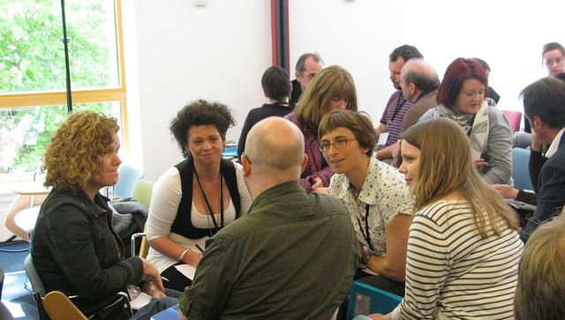
Wherever You Are
Engaging Learning Experiences for
Distance and Online Learners
Small Group Discussion by Culture Republic. CC BY-ND 2.0, https://flic.kr/p/8anLVV
This presentation is licensed CC BY 4.0 - for linked or cited content, please refer to that content’s copyright status.
Virginia Pannabecker
Health Sciences Research Support Coordinator, Virginia Tech, University Libraries
Presented as part of a panel session: Engaging Strategies to Teach Information Literacy to Distance Learners, sponsored by EMTS and PSS, Medical Library Association Annual Meeting 2017
:

Slide 2
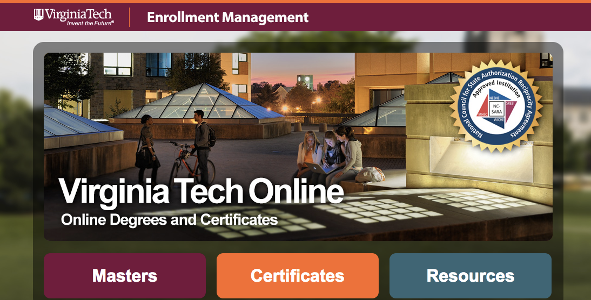
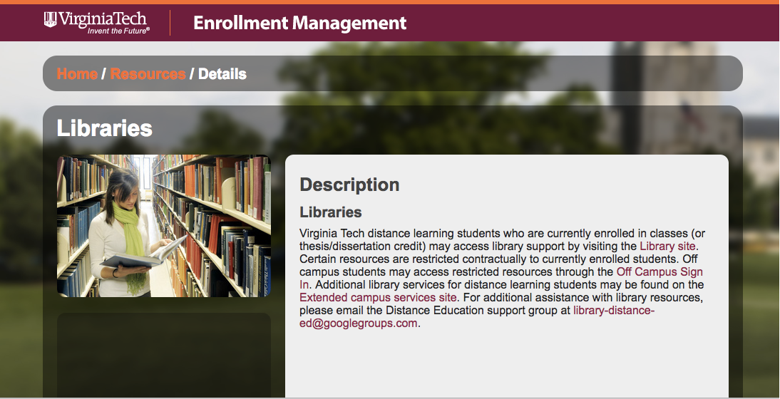
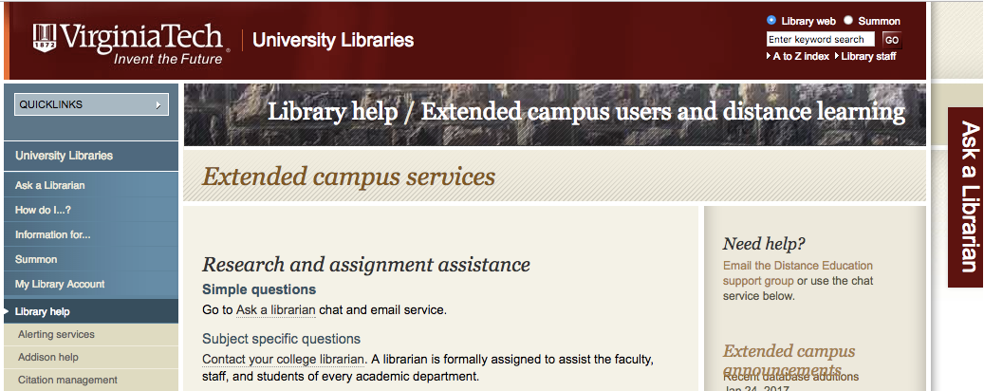
Online and Distance Education at VT
Notes:
Intro: VT has few fully online programs, but many distance students for a variety of reasons (multiple locations, growing Roanoke and Northern Virginia locations; graduate students conducting research or internships elsewhere; true online students in online courses)
[Images - Screenshots of: 1) VT Online / 2) VT Online library resources / 3) VT University Libraries Extended Campus Services pages]

Slide 3
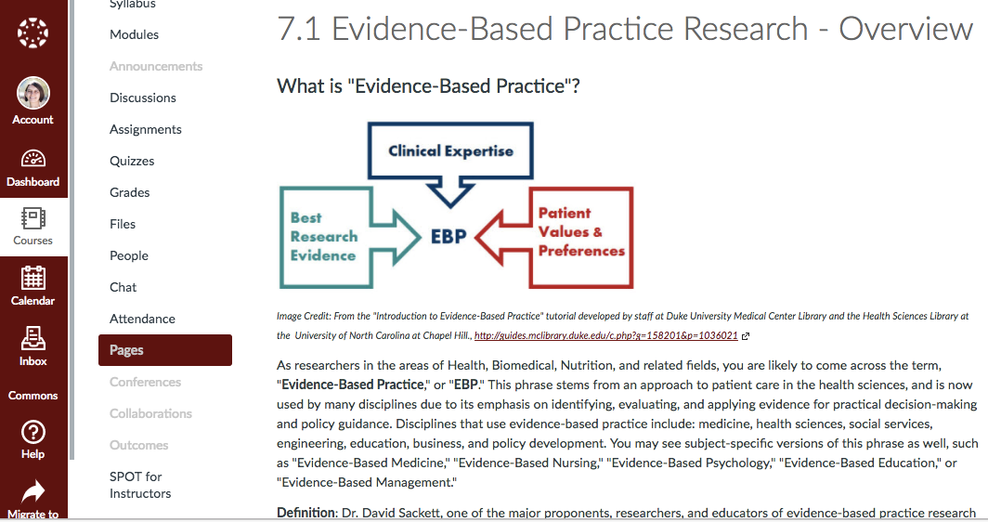
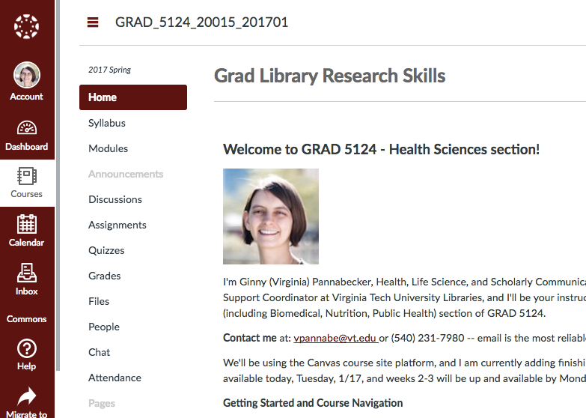
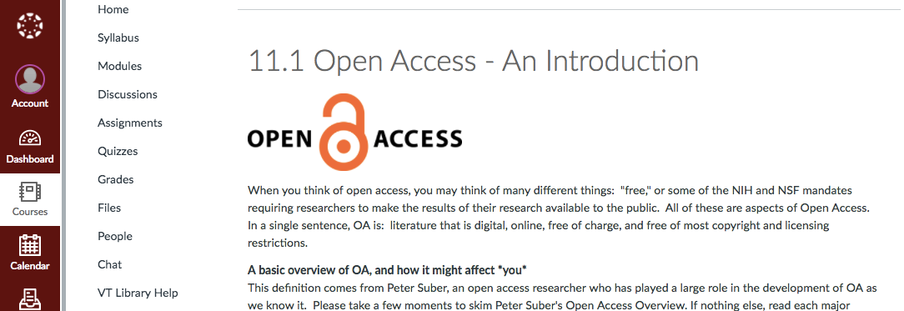
Graduate Library Research Skills
- Online Course by VT Librarians
Intro and Professional Identity
Ethics (Research & Writing)
Literature Reviews & Library Services
Data Collection & Grants - Basics
Organizing Your Digital LIfe
Citation Managers
Effective Searches
Core Research Databases
Additional Databases & Critical Appraisal
Dissertations & Theses
Authorship, Copyright, Open Access
Measuring Scholarly Impact
Notes:
[Image - Screen shot of example page from each Canvas course/module]
GRAD 5124 - Graduate Library Research Skills
Engagement: Full semester Canvas course
Positives: Once put together, works well for each semester; modules can also be used separately for other instruction; international students and students returning to school after time in a career particularly appreciate this course, as well as students working on a thorough literature review; usually market to all grads; my section to health/life sciences
Challenges: Does need to be updated at least annually, this can take 1-2 hours per module for minimal updates (dates, links, etc.); 1-2+ days for bigger updates like changing to another topic for a module or to other activities; Quite a bit of work and time are involved for the instructor to stay up to date on responding to assignments, etc. Average: 1+ hours per week for every 4 students in the class.

Slide 4
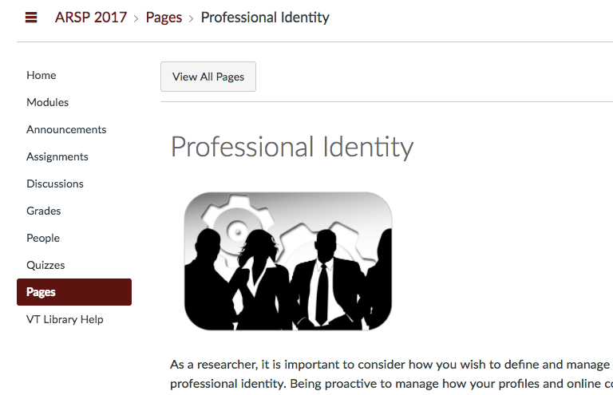
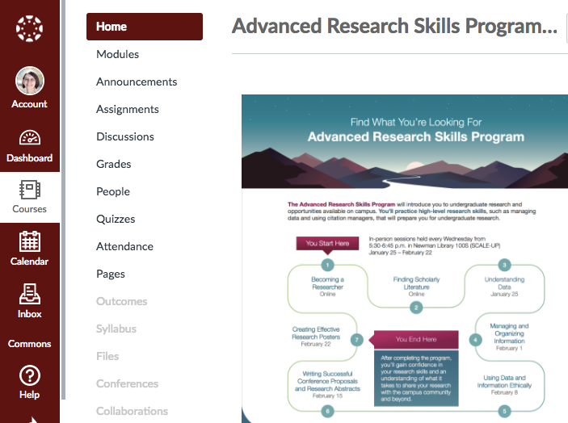
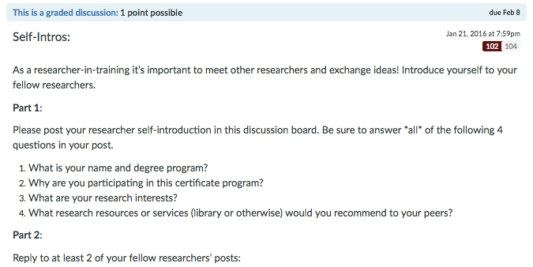
Advanced Research Skills Certificate Program for Undergraduate Researchers
Notes:
[Image - Screen shot of example page from each Canvas course/module]
ARSC - Undergraduate Research Skills
Engagement: Canvas module with readings / videos and activities → Quiz to check knowledge and include reflection; Discussion post with requirement to engage with 2 peers → to check learning and apply concepts / skills
Positive points - once set up runs fairly well, not too long of content, etc.; interactive components, mix of materials
Challenges - Open ended reflection questions = take longer to grade; Allocating points for discussion post and checking for 2 comments = also can take longer (but worth it)

Slide 5
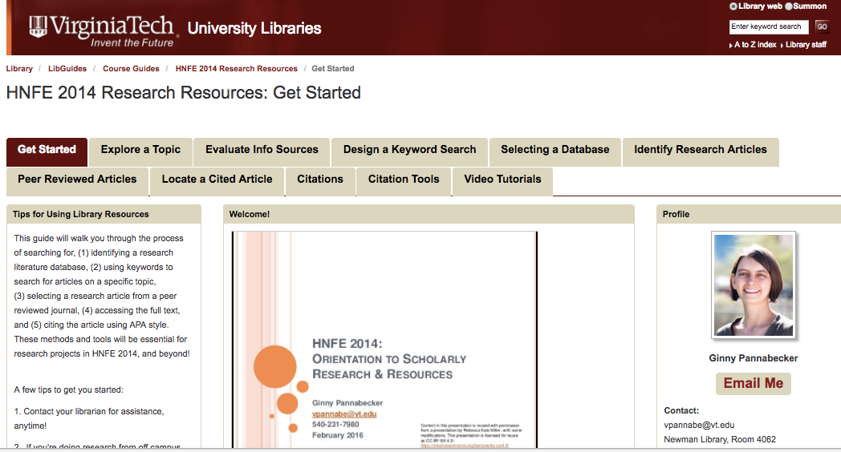
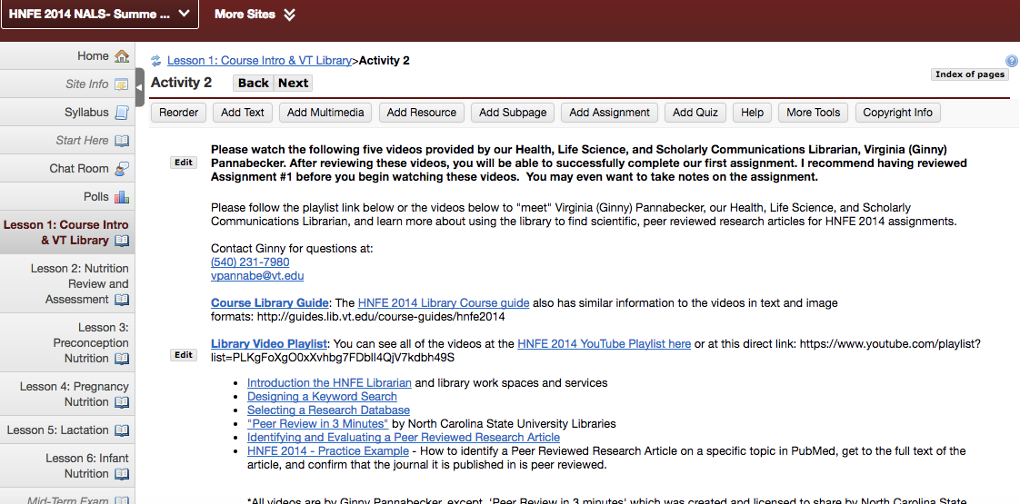
Online Nutrition Course
- Library Module
Notes:
Library Guide and Videos with brief in-course announcement (undergraduate fully online Nutrition course)
[Image - screen shot of Library Guide and possibly of assignment/announcement in course]
Engagement methods – students read welcome message by librarian; watch video tutorials (optional) and/or review the library guide pages related to their assignment; students complete their assignment for credit and contact the librarian for assistance if needed (usually about 2-4 individual contacts per class)
Positives – Once put together, requires brief updates each semester; can be used to support in person courses and other related sessions as well; text libguide and video tutorials provide multiple methods for students to access content to learn on their own; contact with librarian supports additional learning needs or questions
Challenges – videos would be better to be re-done to be shorter, currently between 3-7 minutes, so the 7 minute ones are long; some videos may still need transcripts; bigger updates like this take quite a bit of time – about 1-3 days per video

Slide 6
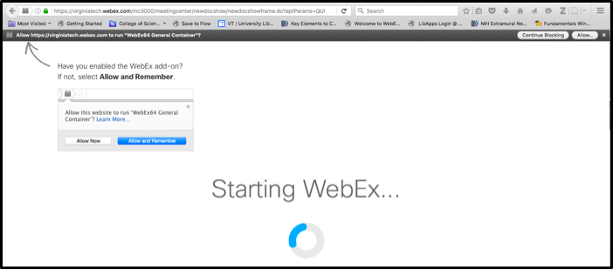
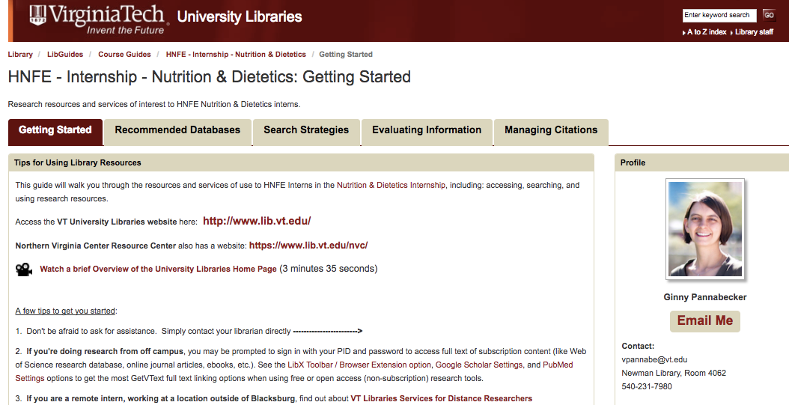
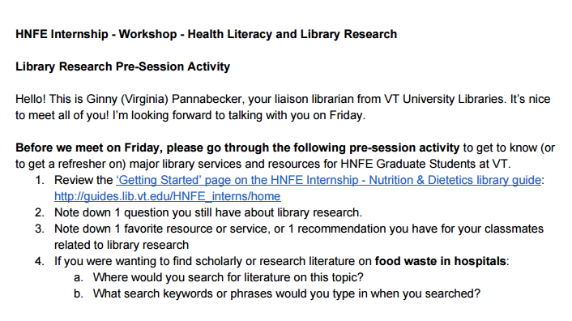
Dietetics Internship
- Graduate / Professional Flipped Webinar
Notes:
Library Guide and flipped webinar (via WebEx) for Dietetics Interns
[Image - Screen shot of library guide / assignment (?) / WebEx screen (?)]
Engagement methods – pre-webinar / in-person assignment requires exploration of the library guide and thinking about where to search for information about how to structure a keyword search - all for the same specific topic to aid in comparative discussion at in-person/webinar follow up; in-person and at the same time online webinar session (or webinar session on its own separately) allow time to go over results of pre-assignment, questions from students, and review further tools / methods together
Positives – multiple modes of communication – pre-session assignment of open ended questions works well to prepare students to have comments ready for all group discussion and ensures most students are familiar with some resources ahead of time; text and in-person session via online webinar or in-person mean all students (distance and otherwise) get a similar experience; pre-assignment doesn’t take much time, or can if desired by student, but could be done in as little as about 10-15 minutes, some might take 20-40 minutes if they went through the guide thoroughly – allows for independently differentiated learning ahead of session; having all students consider the same topic allows for comparative discussion about search sources and keyword methods, etc. at in-person / webinar follow up session;
Challenges – usually at least some technical challenges, but those get resolved pretty easily; might plan for a back up if you have never done it before, or try the online webinar set up out in advance with the locations/equipment/method you’ll use at the session, if possible; sometimes not enough time to get to each person’s individual topic questions after group discussion, but those can then be covered by follow up with individual students as needed

Slide 7
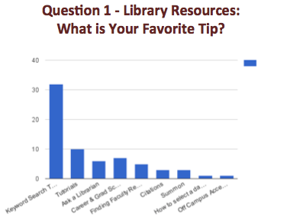
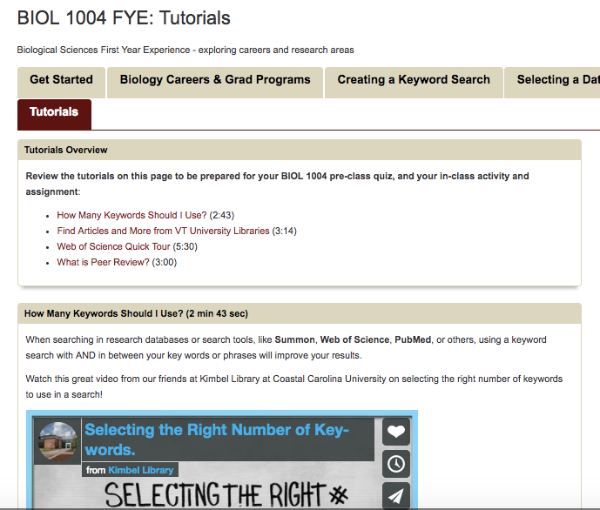
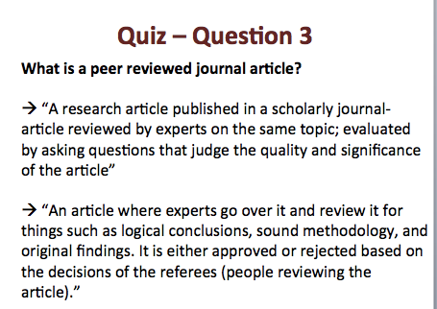
Biological Sciences
-Flipped Freshmen Seminar
Notes:
BIOL First Year Experience – freshman seminar class
Images: BIOL FYE 1004 library guide tutorials page; review slide for question 1 – your favorite library tip, and review slide for quiz question 3 – open ended: what is a peer reviewed journal article?
Engagement methods: Course announcement of pre-assignment by librarian with requirements to read through library guide and complete a short quiz (5-6 questions); quiz done in Canvas, but can also be done with Google forms if no class credit attached) out of a 250+ class, received about 100-150 responses for a decent sample of student skill levels and thoughts; followed by in-person session where we all reviewed summaries of the question responses and student thoughts / correct answers
Positives: Guide set up and quiz do not take a lot of time, especially if you already have a guide set up and just need to make some edits / updates and create a quiz that encourages reviewing guide content; Including open ended questions like ‘What is a peer reviewed journal article’ gets authentic student thoughts and reflection about topics beyond just correctly identifying a definition or multiple choice; Easy open ended questions like ‘your favorite library tip’ allows them to use their experiences and helps you get through review of services, resources via student-generated top tips
Challenges: Not entire class response rate, but that’s not necessarily critical – could be helped by some points for completing the quiz; This was done as a flipped in person class so for distance only students, could follow up with a video recording summarizing responses, or with a webinar, or both, or with a text summary, or some other follow up → For an online / distance class the quiz responses could perhaps also be done via discussion posts, such as assigning one or two questions to groups of students

Slide 8
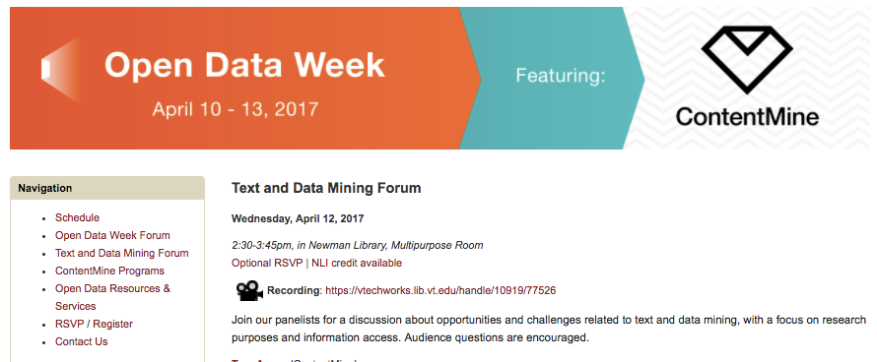
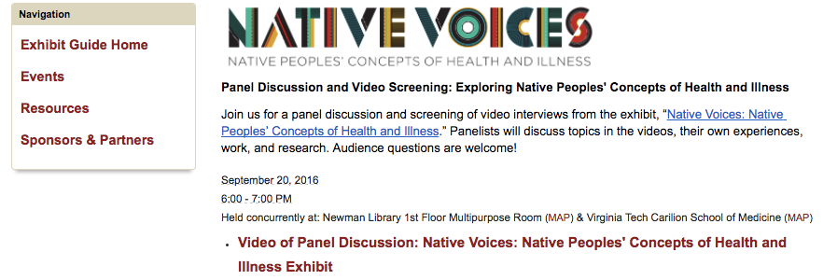
Dreaming Big: Engaging Online & Distance Learners in Events & Special Programming
Notes:
[Image - screen shot of event guide page for TDM and Native Voices]
Examples: Native Voices panel, TDM panel
Engagement methods: Used a library guide for event websites; partnered with multiple campus groups / departments to arrange and publicize events; brought in one or more speakers for at least one event; included at least 1 program that had a real-time participation option for distance and/or online participants, via WebEx, and/or via a satellite location; recorded at least one program for later viewing by those who couldn’t make program scheduled options, and had links to related services, resources, follow up options
Positives: online / distance participation options are very welcome, as are recordings and access to session materials (slides, handouts, etc.) for viewing at any time; allows distance / online students to participate / have access to some of the ‘extra’ content that on campus students get regularly
Challenges; technical challenges increase when trying to record and allow online access to an event, due to microphone set up, etc. multiple sites add a challenging point too; however these are worth trying and overcoming the challenges.
Special note on Open Con – for events relate to ‘open topics – OA, OER, Open data, etc. – Open Con satellite events are a great way to get additional support, including an event website with a registration function, and more. *Open Con also has a set up for allowing video access to events (possibly with recording) that I haven’t tried, but looks worth looking into.

Slide 9
Resources
This presentation and related example information literacy session activities and assessments are archived in the VTechWorks institutional repository:
http://hdl.handle.net/10919/77595
References:
Virginia Tech Online: http://www.vto.vt.edu/
Virginia Tech Online - Library Resources: http://www.vto.vt.edu/details.php?view=resources&show=resources&page=libraries
Virginia Tech, University Libraries - Extended Campus Services: http://www.lib.vt.edu/help/extended/services.html
GRAD 5124: Graduate Library Research Skills online course offered as a 1-credit pass/fail course at Virginia Tech - created by VT librarians
Advanced Research Certificate Program: 6-week workshop series for undergraduate students interested in research; partnership between VT librarians and VT Office for Undergraduate Research
HNFE 2014 - Nutrition Across the Life Span - Library Guide with tutorials and course support - used in in-person and online course information literacy sessions: http://guides.lib.vt.edu/course-guides/hnfe2014/GetStarted
HNFE Dietetics Internship Library Guide - used in in-person and online / distance information literacy sessions: http://guides.lib.vt.edu/HNFE_interns
BIOL FYE - Biiological Sciences First Year Experience seminar course - library guide used in information literacy session pre-class online assignment and in-person session: http://guides.lib.vt.edu/BIOL1004
Open Data Week event guide with recordings and materials: http://guides.lib.vt.edu/OpenDataWeek
Native Voices exhibit event guide with recording: http://guides.lib.vt.edu/NativeVoices/PanelDiscussion
Open Con satellite event information for event support on open topics: http://www.opencon2017.org/satellite
Canvas open course by Virginia Pannabecker and Margaret Hoogland, taught as an MLA CE in 2015, 2016, “Expand Your Library Instruction Toolkit”: https://canvas.instructure.com/courses/1029482 *Includes several examples of online instructional materials and activities, including Canvas modules

