Slide 1
MPEG-4
By: Kevin Brunner, Evan Spillane, Jack Cobb, Harjas Ahuja, and David Shapiro
Department of Computer Science, Virginia Tech, Blacksburg, VA
CS 4624, Multimedia, Hypertext, and Information Access
February 19, 2015

Slide 2
Introduction
Increasing number of mobile users and increasing need for mobile communication
The need for data, images, video, and other multimedia to be sent to our phones continues to expand
Multimedia, especially video, is highly bandwidth intensive
In order to make mobile multimedia realistically possible, we must efficiently compress it
  Difficult since its goal is to reduce redundancy of signals, while robust delivery requirements require redundancy

Slide 3
Quick MPEG History
This need to compress multimedia videos introduces the need for MPEG
MPEG is a popular audio and video compression method
MPEG-4 is the third MPEG standard, coming after MPEG-1 and MPEG-2
MPEG standards are decoding standards which specify the semantics of the decoding process and the bitstream representation

Slide 4
Quick MPEG History
The original purpose of the creation of the third standard (MPEG-4) was:
  High efficiency
  Limited complexity audio-visual videophone scenes
  Very low bit-rates
The scope was expanded in 1994 since there was only a moderate likely increase in compression and a need for greater functionality within certain bit ranges not supported by past standards
This was due to three important trends:
  Wireless communications
  Interactive computer applications
  Integration of audio-visual data into a number of applications
Working draft (November 1996) to international standard (January 1999)

Slide 5
Improvements of MPEG-4
In comparison, MPEG-4 video standard provides universal accessibility, including robustness in error prone environments
Provides solutions for coding of natural or synthetic video and video
Provides system for multiplex/demultiplex and description of scenes in a adjustable manner
Multiple versions for ongoing specification revisions and work
Designed to be a true encompassing multimedia standard
Mobile indoor applications vs mobile outdoor applications
  Indoor - lower mobility and higher bandwidth (1 megabit/second or more)
  Outdoor - higher mobility and lower bandwidth (1-10 kilobits/second)
  MPEG-4 is optimized for both, with bit-rates ranging from about 10 kilobits/second to around 1.5 megabits/second or higher

Slide 6
ITU-T Standards
ITU-T developed standards for video coding, audio coding, and multiplex
The related ITU-T standard for MPEG-4 is H.263
H.263 uses motion compensated discrete cosine transform (DCT) framework, with accuracy of half-pixel
Partitions each picture into macroblocks, consisting of 16 x 16 luminance block and the corresponding 8 x 8 chrominance blocks
DCT coding reduces spatial redundancy and motion compensation reduces temporal redundancy, allowing for compression

Slide 7
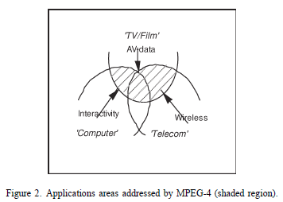
Overview
MPEG-4 covers the intersection of telecommunications, computer, and TV/film
These types of media had been previously completely separated
Geared towards:
  Internet and intranet video
  Wireless video
  Video databases
  Interactive home shopping
  Video e-mail
  Home movies
  Virtual reality games
  Simulation and training

Slide 8
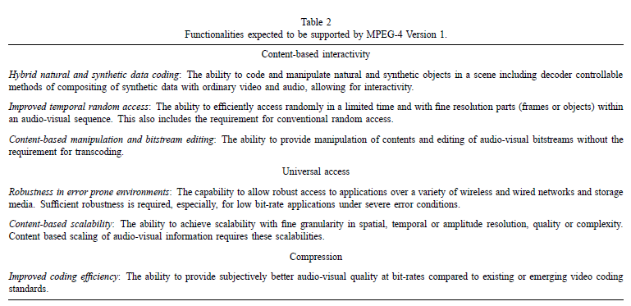
Requirements

Slide 9
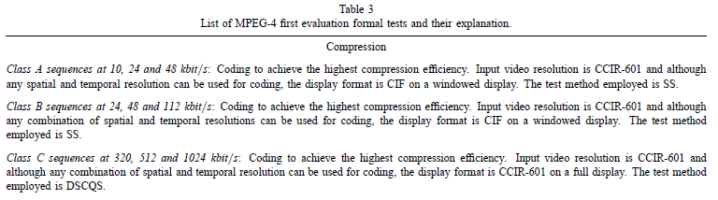
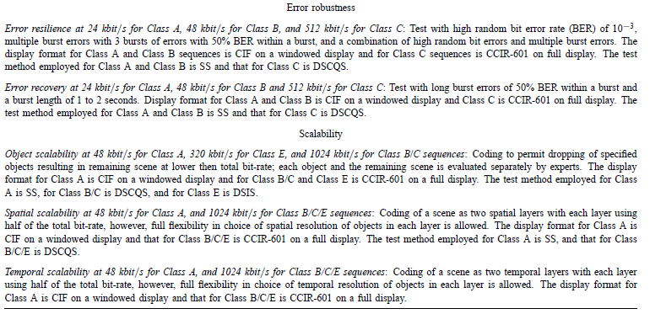
Video Tests

Slide 10
Audio Tests
Three classes of audio test sequences, Class A, B and C were identified:
• Class A: Single source sequences consisting of a clean recording of a solo instrument.
• Class B: Single source with background sequences consisting of a person speaking with background noise.
• Class C: Complex sequences consisting of an orchestral recording.
A number of bit-rates such as 2, 6, 16, 24, 40 and 64 kbit/s were selected for testing of audio/speech.
For specific bit-rates, some candidates outperformed the reference coding schemes, although for all combinations tested, no single scheme was the clear winner.

Slide 11
SNHC Tests
• The SNHC group started its work much later than the video group.
• Its focus was primarily on coding for storage and communication of 2D and 3D scenes involving synthetic images, sounds, and animated geometry and its integration into scenes that contain coded natural images/video and sound.

Slide 12
Video Development
Video development was started by identifying a number of needed tools and the options available for each tool as well as a reference framework.
40 experiments were defined and categorized into the following groups:
• Coding efficiency
• Shape and object texture coding
• Robust coding
• Multifunctional coding
A reference coding framework known as the first Verification Model (VM1) was released

Slide 13
SNHC Development
There have been a total of four iterations of SNHC VM, from VM1 to VM4.
More mature tools of SNHC VM3 have been accepted for the visual part of the MPEG-4 Version 1 standard.
The remaining tools have been left in VM4 for consideration for the next version of MPEG-4.

Slide 14
Systems Development
The Systems layer in MPEG has been traditionally responsible for integrating media components into a single system, providing multiplexing and synchronization services for audio and video streams.
A key requirement from the System part is the capability to combine individual audiovisual objects in scenes.
This was accomplished by using Java but performance and compliance issues soon arose.
A three-step approach was adopted:
  In level 0, no programmability was allowed.
  In level 1, facilities were provided to combine different tools into algorithms.
  In level 2 even individual tools were considered as targets for programmable behavior.

Slide 15
DMIF Development
The significance of the DMIF activity has been recognized and DMIF has been given the status of a new group.
The charter of the DMIF group is to develop standards for interfaces between Digital Storage Media (DSM), networks, servers and clients for the purpose of managing DSM resources and controlling the delivery of MPEG bitstreams and associated data.
The ongoing work of this group is expected to result in part 6 of the MPEG-4 standard.

Slide 16
MPEG-4 Video Coding Basics
Ongoing work consists of two major areas – coding of (natural) video and coding of synthetic video
From a top-down perspective, the organization of coded MPEG-4 Video data can be described by the following class hierarchy:
• VideoSession: Represents the highest level in the class hierarchy and simply consists of an ordered collection of Video Objects.
• VideoObject: represents a complete scene or a portion of a scene with a semantic meaning.
• VideoObjectLayer (VOL): represents various instantiations of a Video Object.
• GroupOfVideoObjectPlanes (GOV): Optional access units for editing, tune-in or synchronization.
• VideoObjectPlane (VOP): represents snapshot in time of a Video Object.

Slide 17
Motion Coder
Predicted from previous frames (p frames) or bidirectionally from previous and future frames (b frames)
  B frames are more complex
After prediction, coder finds the residual
Estimation and compensation is performed on 16x16 luminance block of a macroblock
  Motion vector is specified to half pixel accuracy
  Often not enough; individual 8x8 block for motion vectors

Slide 18
Scalable Video Coding
Allows simple decoder to produce basic quality while an enhanced decoder may produce enhanced quality
Ensures that input video data is coded into two or more layers
  Independently coded base layer
  One or more enhancement layers
Supports both Temporal and Spatial scalabilities
  Temporal: offers decoders a means to increase temporal resolution
  Spatial: offers decoders a means to display base or enhancement layer output

Slide 19
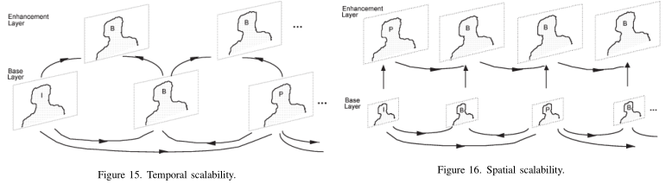
Scalable Video Coding
Temporal: ½ temporal resolution at base layer
Spatial: ¼ resolution at base layer
In reality, some flexibility is allowed in the prediction structures, so they do not always result like the ones above

Slide 20
Robust Video Coding
Helps to increase error robustness
Variety of tools available to encoder in error resilient mode
  Resynchronization
  Data Partitioning
  Reversible VLCs

Slide 21
Data Partitioning
Increases error resilience
  Separates normal motion and texture blocks of a macroblock
  Sends motion data followed by motion marker then texture data
    Marker is unique 17 bit block not emulated by codewords
Motion data sent for each macroblock, then texture data
Texture data for each macro block is divided into 2 parts
  Coded block information for luminance
  Coded discrete cosine transform (DCT) coefficients

Slide 22
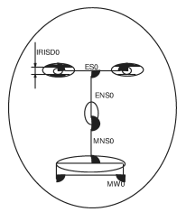
Facial Animation Coding
FAPs and FDPs are set of parameters that allow animation of faces to reproduce expressions, emotions and definition of facial shape.
The FAP set contains two high level parameters:
Visemes: The facial expression while making any sound
Expressions: Described by textual definitions such as joy, sadness, anger etc.
FAPU: Units defined in order to interpret facial models and
produce accurate results in terms of expressions and speech
pronunciation
  Eg. IRISD0, ES0, ENS0, MNS0 etc.

Slide 23
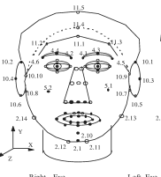
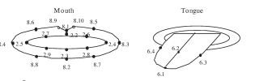
Facial Animation Coding
FDPs customize the proprietary face model to a particular face. The FDP set is specified using the FDP node and supports two options:
  Calibration info so the face can be configured using facial feature points
  A face model is downloaded with the animation definition of the FAPs

Slide 24
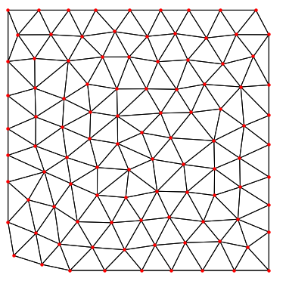
Object Mesh Coding
Mesh based representation is useful for natural or synthetic visual objects
MPEG-4 includes a tool for 2D triangular mesh based representation.
The vertices of the triangular patches are called nodes
A uniform mesh can be specified by horizontal and vertical
node points
Delaunay mesh utilizes the boundary node points and then
the interior node points of the mesh
Generally, the total number of nodes and boundary nodes is
encoded. The top left node is encoded, then the next clockwise boundary node is found and the difference between them is encoded. All the boundary and interior nodes are encoded in a similar fashion

Slide 25
Still Texture Coding
Discrete Wavelet Transform (DWT) is used to code still image data for texture mapping as it ensures coding efficiency and continuous scalability.
Basic modules of a zero-tree wavelet based coding scheme:
  Decomposition of texture using DWT
  Quantization of wavelength coefficients
  Coding of lowest frequency subband using a predictive scheme
  Zero-tree scanning of higher order subband wavelet coefficients
Lowest band coefficients are quantized using a uniform mid rise quantizer, higher bands use multilevel quantization having different step sizes for each level of scalability.
After quantization, each wavelet coefficient is zero or non-zero, the coefficients are scanned by zero-tree scanning.

Slide 26
MPEG-4 Audio
Natural Audio
  Parametric coder: Lowest bit range between 2 and 6 kbit/s
  CELP coder: Medium bit rates between 6 and 24 kbit/s
  Time/frequency coder: Higher bit rates starting at about 16 kbit/s
Text to Speech
  Changes text into a string of phonetic symbols
  Applications: Artificial storyteller, voice newspaper, voice internet etc.
  Can be used for many languages, adopts concept of language code.
Structured Audio
  Use ultra low bit rate algorithmic sound models in the range 0.01-10 kbit/s
  SAOL: signal processing language effects post production in MPEG-4

Slide 27
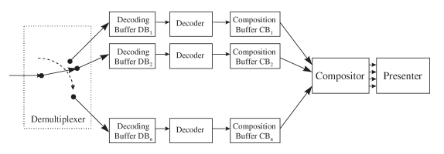
MPEG-4 System Decoder Model
Composed of a set of decoders for various audio and video types
Two types of buffers
  Decoding
  Composition

Slide 28
MPEG-4 System Decoder Model
Keeping time is very important
  Serves to ensure that “Events” happen when content creator intended
  So sender can control behavior of receiver
    So receivers resources are not exhausted
    Sender timestamps data, receiver uses timestamps to adjust clock speed

Slide 29
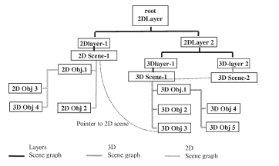
Scene Description
New with MPEG-4
Refers to the spatial positioning and behavior of individual objects
Transmitted in a different scene from the audiovisual objects

Slide 30
Scene Description
Architecture is based on Virtual Reality Modeling Language (VRML)
Scenes are described as a hierarchy of nodes, forming a tree
Leafs correspond to media objects (audio or visual components)
Intermediate nodes perform operations on children (grouping / transformations)

Slide 31
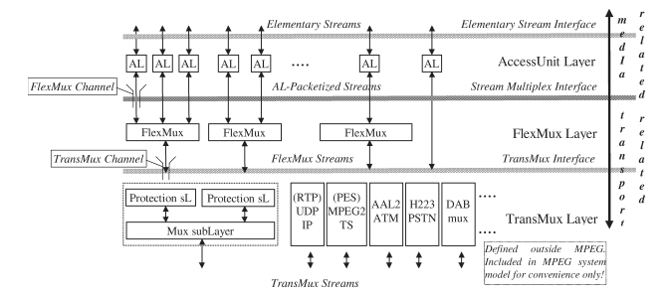
Multiplexing
MPEG-4 can be delivered across a variety of channels
Slow wireless streams or fast dvds
Top most level is the Access Level Unit or AL
  This is where the timestamping happens for receiver control
  can be configured to include frame information, sequence numbering (useful for error prone environments)

Slide 32
Multiplexing cont.
Next is the “FlexMux” layer
  Use is optional (as seen in right side of picture)
  Can be used as a data channel for information about objects on screen
Finally the “TransMux” layer
  Not specified by MPEG 4
  Can be used as a transport layer facility

Slide 33
Beyond Current MPEG-4 Work
MPEG committee has begun work on the next MPEG standard.
It will be called MPEG 7
Will specify a set of descriptors that will be associated with the content itself.
Allows fast searching for material
All content will be indexed and searchable

Slide 34
Questions?

Slide 35
References
Atul Puri and Alexandros Eleftheriadis. 1998. MPEG-4: an object-based multimedia coding standard supporting mobile applications. Mob. Netw. Appl. 3, 1 (June 1998), 5-32. DOI=10.1023/A:1019160312366 http://dx.doi.org/10.1023/A:1019160312366

