Slide 1
Obstacles to widespread diffusion of IPM in developing countries: Lessons from the field
Jeffrey Alwang
9th International IPM Symposium
March 19-22, Baltimore, MD
Notes:
Study was conducted as part of IPM crps project in Ecuador
Randomized farmers into T& C. Treated received text messages about IPM
We found that text messages increase adoption of and knowledge about IPM
We investigate channels using the psychology literature through which SMS can induce behavior change

Slide 2
Objectives
Discuss evidence related to IPM adoption in developing countries
Identify economic obstacles to more widespread adoption
Introduce behavioral obstacles to wider adoption
Present evidence on use of ICT (text messages) as an extension tool to overcome behavioral obstacles

Slide 3
IPM adoption in developing countries
Good information on pesticide use: Global pesticide use has grown to 3.5 billion kg/year (a global market worth $45 billion)—growth rate has been around 3% per year since early 2000s
  Substantial evidence of external costs (range of $4 to $20 per kg of active ingredients)
In comparison…Evidence on adoption (never mind impact) of IPM is spotty
  No global consensus on what is IPM
  Nationally representative surveys or censuses of agriculture do not generally contain information on IPM use (e.g. the World Bank’s ISA)
  IPM is usually attached to projects, so project-related data are sometimes used to report adoption, but…inconsistent definitions, unclear surveying techniques, single-shot surveys
Notes:
World Bank’s Integrated Survey of Agriculture—could be used to get some nationally representative information, but do not have adequate detail to identify IPM adopters/users. E.g. the Tanzania ISA—asks about organic fertilizer, pesticide/herbicide use, type and why use? But not enough detail to tease out IPM use.

Slide 4
What is known about IPM adoption in developing countries?
Evidence tied to projects likely underestimates use of IPM
Evidence shows that farmers adopt IPM in a piecewise fashion
  Similar to many agricultural technologies
  Pest pressure is not uniform, farmers experiment
  Very little evidence of adoption of complete “packages”
When commercial applications exist, adoption is more widespread
  Grafted fruits & vegetables (eggplant in Bangladesh; naranjilla in Ecuador)
  Pheromone traps in Bangladesh
  Biological controls (e.g. Trichoderma in India and Indonesia)
Most “IPM projects” in developing countries contain the built-in assumption that diffusion mechanisms are needed
  Farmer field schools, field days, mass media, extension training
  2014 PNAS assessment: “insufficient training and technical support to farmers”
Notes:
E.g. recent baseline survey in Ethiopia shows 70% of farmers are using one or more of practices defined as IPM—prior to project inception

Slide 5
Economic explanations for slow adoption in developing countries
Farmer awareness and knowledge
  Problems with agricultural extension in many LDCs
  Limited opportunities for private sector involvement
  Heterogeneity and dynamics of pest pressure
Low and variable profitability
  Attribute of technology?
  Policy? Example: pesticide subsidies in Asian countries
  External costs of IPM alternatives are often invisible
Risk and uncertainty
  Perceptions of lower risk with chemical controls
  Uncertainty about “believability” of message
  Heterogeneity in pest pressure and effectiveness of controls
Access to inputs
  Low-impact pesticides, biologicals, pheromones
  Labor

Slide 6
Behavioral economic explanations
Non-standard preferences
  Present bias—lure of dead insects
  Procrastination—delay decisions until damage is evident
  Loss aversion—less likely to adopt when downside risk is important
  Endowment effect—sprayers are everywhere
  Reference dependence—costs and benefits relative to current controls
Non-standard beliefs
  Overconfidence—ability to manage toxic pesticides, avoid many damages
Non-standard decision making
  Limited attention—to external costs, to health costs
  Menu effects

Slide 7
Behavioral economics: Menu effects
When faced with numerous, complex choices, decision makers:
  Show preference for familiar—do what they always do
  Show preference for salient—e.g. chemicals stand out as a pest management option
  Avoid choices—select the default option
Complexity leads to perverse choices
  Stick with what is known and most visible
  Continue with business as usual

Slide 8
Solutions to complexity problem
Intensive training of farmers
  FFS effective at increasing farmer knowledge…but, selectivity
  Evidence shows that they are less effective when brought to scale (3ie evaluation)
  Spillovers to other farmers have not been well documented
  Cost and scale of FFS limit their effectiveness in promoting wide diffusion
Simple messages
  Don’t spray before 40 days
  Use specific inputs (e.g. low-toxicity pesticides; grafted varieties; pheromone traps)

Slide 9
Information & Communication Technology (ICT)
Capable of delivering information at low cost
Previous studies find that increase in cellular coverage increases producer and consumer welfare (Jensen, 2007; Aker, 2011; Aker and Fafchamps, 2014)
Cell phone ownership
Cost of SMS
Makes using SMS to deliver info appealing
Easy to randomize
Notes:
Rapid changes in ICT in developing countries
But: Is use of ICT-based delivery effective?

Slide 10
ICTs and IPM
Pull information—crowd-sourcing for pest and disease forecasting
Push information
  SAWBO—Scientific Animations without Borders (limited evidence of effectiveness in changing post-harvest management of cowpea bruchids)
  EN_English_USA_BiocontrolMaruca_Final.mp4
  FON_Fon_Benin_BiocontrolMaruca_Final.mp4
Text messages
  Reminders for time-sensitive operations
  Knowledge transfer for more complex messages

Slide 11
Evidence about impacts of SMS
In agricultural sector
  In India, not effective in increasing prices received in markets (Fafchamps and Minten, 2012).
  In India, increased use of appropriate and less hazardous pesticides but no impact on knowledge (Cole and Fernando, 2012)
  Treated farmers in Peru received higher market prices, especially for perishable crops (Nakasone, 2013)
In other sectors
  SMS increase savings (Karlan et al. 2016)
  Used in the health sector for adherence to drug regimens, smoking cessation, increased physical activity, dengue prevention, etc. (e.g. Rodgers et al. 2005; Da Costa et al. 2010; Dammert et al. 2014)
  Often used as reminders
Notes:
RCT to determine the effective of text message to effect behavior changes

Slide 12
Recent study objectives
Determine if text messages affect adoption of IPM practices among potato farmers in Carchi, Ecuador
Determine if text messages affect knowledge about IPM
Identify mechanisms by which text messages induce behavior changes
  Reminder effect?
  Knowledge building effect?
Notes:
limited evidence about SMS to increase adoption of IPM
Not reminder effects => need to tailor message to correct timing
Knowledge building effects => substitute or complement extension services and message content could be adapt to farmers skills/knowledge to max impact.

Slide 13
Background
Carchi is the largest potato producing region in Ecuador
  90,000 potato producers
  Heavy use of pesticides-health, environment, and cost of production issues
IPM program (INIAP/CIP/IPM CRSP—supported by USAID) since 1999
  Late blight, Andean potato weevil, tuber moth, leaf miner, and rhizoctonia are the major pests and diseases
IPM diffusion methods under IPM CRSP
    FFS (1998-2003)
    Farmer field days
    Written materials & mass media
    Farmer-to-Farmer transfer

Slide 14
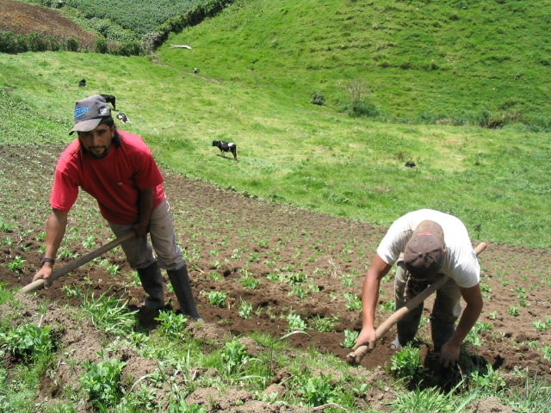

Slide 15
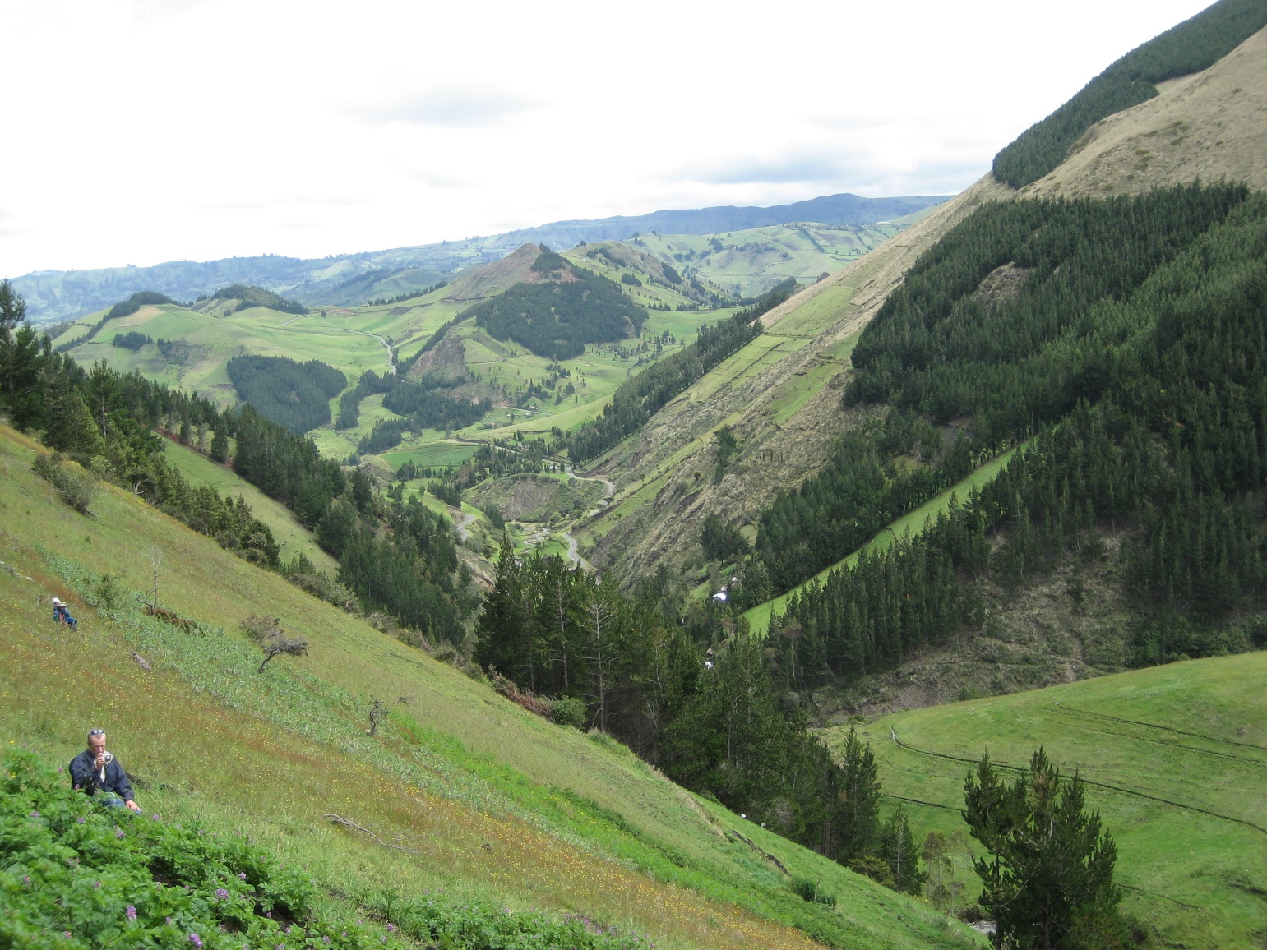

Slide 16
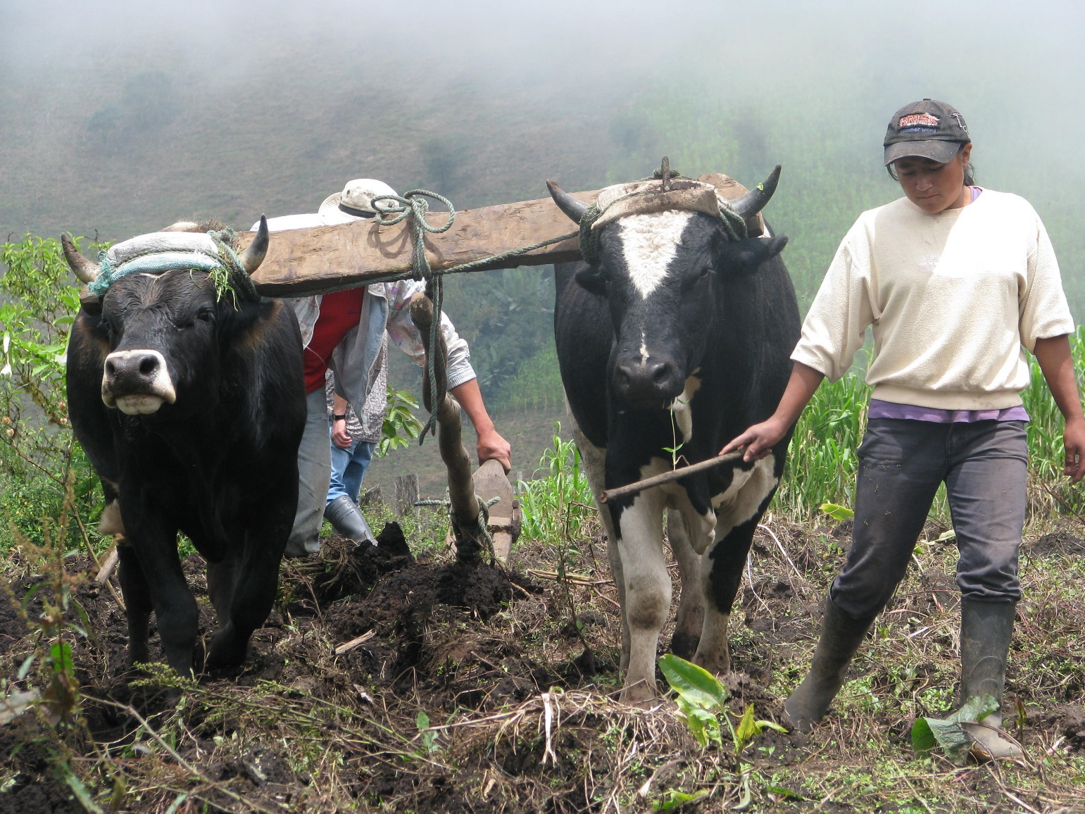

Slide 17
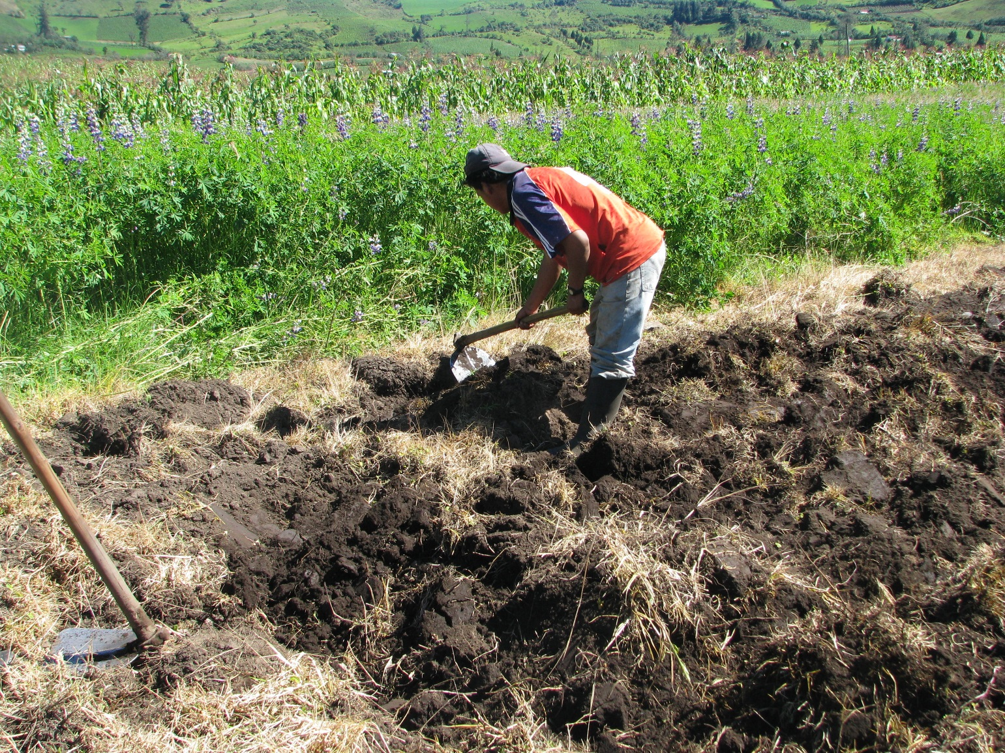

Slide 18
Conceptual framework
Sub-optimal heuristics
  Situation where the decision maker faces a large menu of options
    Preference for the familiar to sort out complexities
  The IPM package includes numerous and complex choices
    Knowledgeable farmers are less likely to be overwhelmed by the complex choice sets and less likely to choose the default option
    Impact of text messages:
      Greater for complex compared to simple IPM practices
      Smaller for already knowledgeable farmers
Notes:
Experiment was designed to tease out different behavioral constructs via testable hypotheses

Slide 19
Experiment
Invitation for potato producers to attend a day-long farmer field day (FFD) on IPM training
FFDs were conducted in 3 locations:
  Teaching stations on IPM practices
  Booklet
  Informed about experiment
  Gathered basic household demographics for eligible participants
  Also information on stage of the potato plant
Randomized participants into control and treatment groups
Notes:
Advertised by employees ministry of agriculture, local government, NGOS
Eligibility: own cell phone, can read, and interested in participating in the experiment
RCT at village level

Slide 20
Experiment
Treatment group
  Received 2-3 text messages per week over 10 weeks for free
  Texts tailored towards stage of the potato production cycle
  Texts could be reminders, informative, or both
Follow-up questionnaire
  Adoption of and knowledge about IPM practices
  353 farmers (196 treated and 157 control) (treatment was applied at the village level)

Slide 21
Data
12 IPM practices, grouped into 7 adoption scores:
  All 12 IPM practices
  Simple vs. complex IPM practices
  Purchase vs. non-purchase reliant IPM practices
  Time sensitive vs. insensitive IPM practices
23 IPM knowledge questions and 8 knowledge scores
  Overall knowledge
  Knowledge related to each of the 7 adoption scores
Notes:
All expressed in %

Slide 22
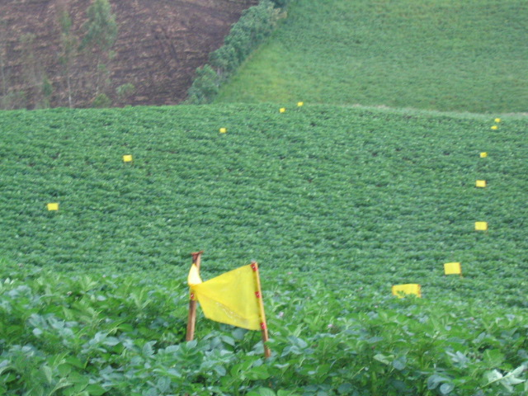

Slide 23
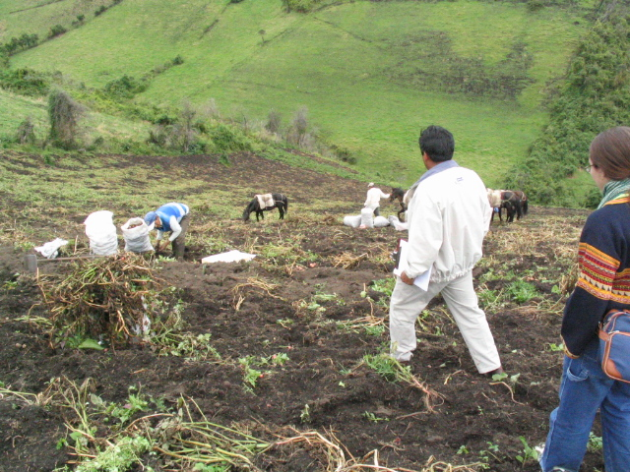

Slide 24
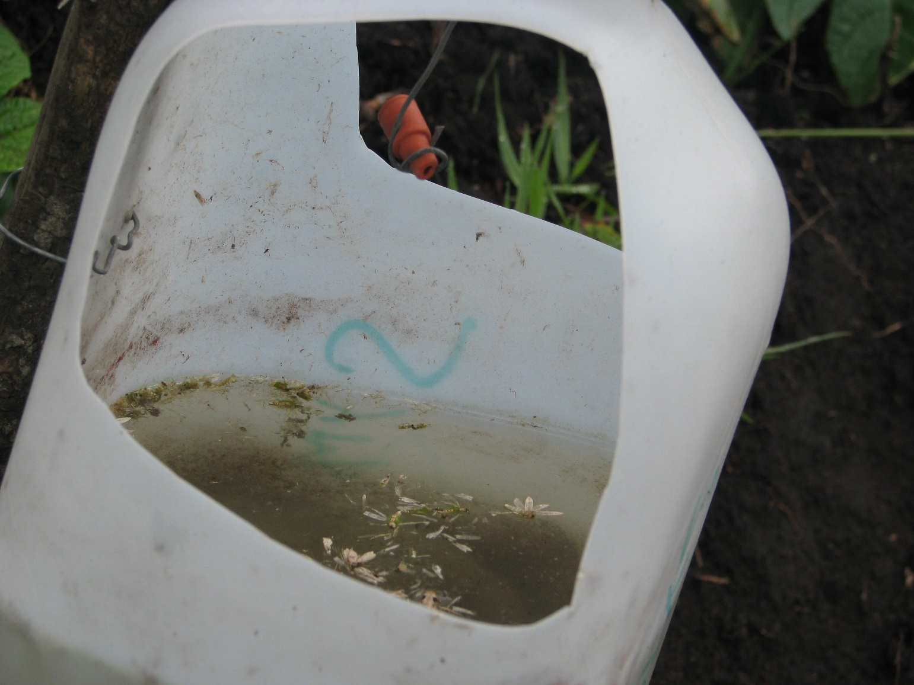

Slide 25
Table 1: Descriptive statistics of IPM adoption practices and scores
 | Sample |  | Control | Treatment | ∆ C & T
Description |  | Mean (%) | Mean (%) | Mean (%) | p-value
Adoption of IPM practices
Use of traps for weevil |  | 16.71 | 12.74 | 19.90 | 0.068
Use of bait plants for weevil |  | 17.56 | 8.28 | 25.00 | 0.000
Use of IPM chemical control for weevil |  | 48.71 | 52.94 | 45.41 | 0.163
Solarize seeds to prevent tuber moth |  | 62.04 | 49.04 | 72.45 | 0.000
Apply Bacu-Turin to prevent tuber moth |  | 10.76 | 10.19 | 11.22 | 0.755
Hilling to prevent tuber moth |  | 86.97 | 81.53 | 91.33 | 0.009
Use of IPM chemical control for tuber moth |  | 65.71 | 63.40 | 67.53 | 0.424
Use of fixed traps for leaf miner |  | 8.50 | 8.92 | 8.16 | 0.802
Use of mobile traps for leaf miner |  | 6.23 | 6.37 | 6.12 | 0.924
Disinfect seeds to prevent rhizoctonia |  | 61.47 | 54.14 | 67.35 | 0.012
Use of IPM chemical to control for rhizoctonia |  | 38.81 | 31.85 | 44.39 | 0.015
Remove yellow plants to maintain seed quality |  | 52.97 | 50.32 | 55.10 | 0.373
Adoption scores (see table A1 for definition of adoption scores)
Overall |  | 39.60 | 35.61 | 42.79 | 0.000
Simple practices |  | 59.04 | 54.55 | 62.64 | 0.001
Complex practices |  | 20.21 | 16.77 | 22.96 | 0.004
Purchase-reliant practices |  | 32.03 | 29.16 | 34.32 | 0.011
Non-purchase reliant practices |  | 54.67 | 48.41 | 59.69 | 0.000
Time sensitive practices |  | 36.20 | 31.34 | 40.10 | 0.000
Non-time sensitive practices |  | 56.68 | 57.37 | 56.12 | 0.759
Number of observations | 353 |  | 157 | 196
Note: ∆ C & T means difference between control and treatment group.

Slide 26
Descriptive analysis
Table 2: Descriptive statistics of IPM adoption scores
 | Sample |  | Control | Treatment | ∆ C & T
Description | Mean (%) |  | Mean (%) | Mean (%) | p-value
Adoption scores in percentage of IPM practices adopted
Any practice (12) |  | 39.6 | 35.61 | 42.79 | 0
Simple practices (6) |  | 59.04 | 54.55 | 62.64 | 0.001
Complex practices (6) |  | 20.21 | 16.77 | 22.96 | 0.004
Purchase-reliant practices (8) |  | 32.03 | 29.16 | 34.32 | 0.011
Non-purchase reliant practices (4) |  | 54.67 | 48.41 | 59.69 | 0
Time sensitive practices (10) |  | 36.2 | 31.34 | 40.1 | 0
Time insensitive practices (2) |  | 56.68 | 57.37 | 56.12 | 0.759
Number of observations |  | 353 | 157 | 196

Slide 27
Regression results
Table 5: impact of treatment on knowledge and adoption
 | Overall Knowledge |  | Overall adoption
 | dy/dx | z | dy/dx | z
Treatment | 0.184*** | 5.33 | 0.063*** | 2.62
Secondary education (1=Yes) | 0.073** | 2.14 | 0.031 | 1.52
Age | -0.001 | -0.99 | 0 | -0.41
Nb of HH members 15 years & + | 0.023*** | 2.68 | -0.003 | -0.51
Land owned (ha) | 0 | -0.03 | -0.002* | -1.7
Nb of cows owned | 0.004** | 1.97 | 0.002* | 1.68
Altitude (m) |  |  | 0.000** | 2.07
Observed weevil (1=Yes) |  |  | 0.064** | 2.15
Observed tuber moth (1=Yes) |  |  | 0.082 | 1.62
Observed leaf miner (1=Yes) |  |  | -0.012 | -0.26
Observed late blight (1=Yes) |  |  | 0.063 | 1.58
Observed Rhizoctonia (1=Yes) |  |  | 0.070*** | 3.54
Notes:
Impact of treatment on knowledge = between 18 to 23 percentage points-depending on the knowledge score

Slide 28
Regression results
Theory of limited attention is supported
 | Adoption of purchase reliant practices |  | Adoption of non-purchase reliant practices
 | dy/dT | z | dy/dT | z
Treatment | 0.053** | 2.07 | 0.086*** | 2.97
<
 | Adoption of time sensitive practices |  | Adoption of time insensitive practices
 | dy/dT | z | dy/dT | z
Treatment | 0.071*** | 3.08 | 0.022 | 0.5
>

Slide 29
Regression results
Theory of sub-optimal heuristics is supported
 | Adoption of simple practices |  | Adoption of complex practices
 | dy/dT | z | dy/dT | z
Treatment | 0.047* | 1.83 | 0.075*** | 2.71
<
Overall adoption | dy/dx | z
Treatment
@
PTK p10 | 0.073*** | 2.92
PTK p25 | 0.068*** | 2.99
PTK p50 | 0.061*** | 2.58
PTK p75 | 0.054*** | 2.02
PTK p90 | 0.043 | 1.26
Notes:
Effect of treatment of adoption of simple practices at differennt knowledge score percentiles

Slide 30
Conclusions
Global evidence on IPM adoption is limited (adoption is necessary for impact)
Major challenge to extension/education (FFS is expensive and does not induce spread beyond participants)
Use of ICT to promote IPM technology adoption lags behind its potential
Findings from our study are promising
Timing, message content, farmer ability are important determinants of its effectiveness
Limitations to external validity of the study
  RCT preceded with formal training session
  IPM training has occurred for several years in Carchi

Slide 31
Questions?
Thank you

