Slide 1
Changes in Fluvial Erosion with Stream Chemistry
of Cohesive Streambank Soils
Tess Wynn-Thompson, akinrotimi akinola, siavash Hoomehr, Waverly Garnand, Matt Eick

Slide 2
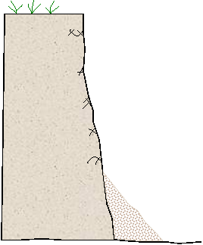
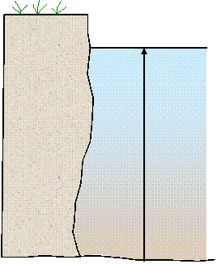
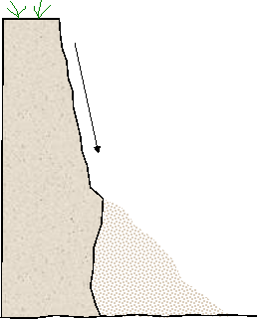
How does bank retreat (typically) occur?
Subaerial Processes/ Erosion
Fluvial Entrainment
Bank Failure
Freeze-thaw and wet-dry cycling weaken soil
Soil entrained during high flows
Mass failure from slope instability

Slide 3
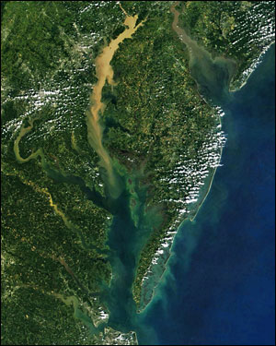
Why is bank retreat important?
Required for channel meandering
Critical part of evolution of incised channels
Net bank sediment yields constitute 70% of Piedmont watershed sediment yields in Chesapeake Bay watershed*
Chesapeake Bay, USA (NASA)
* Donovan M, A Miller, M Baker, A Gellis. 2015. Sediment contributions from floodplains and legacy sediments to Piedmont streams of Baltimore County, Maryland. Geomorphology 235: 88-105.

Slide 4
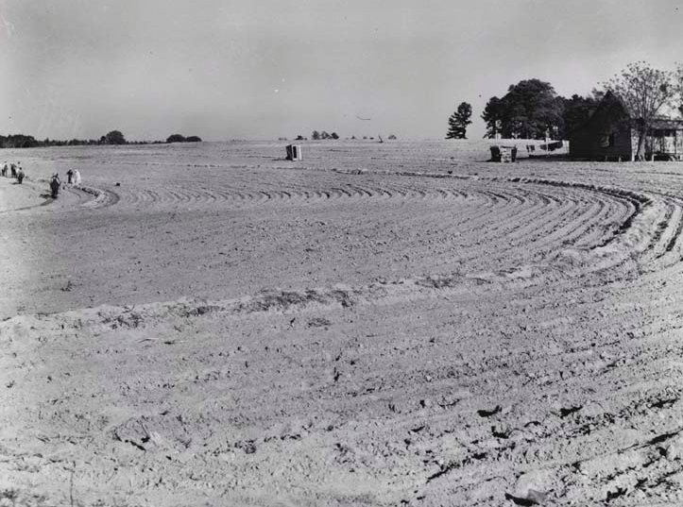
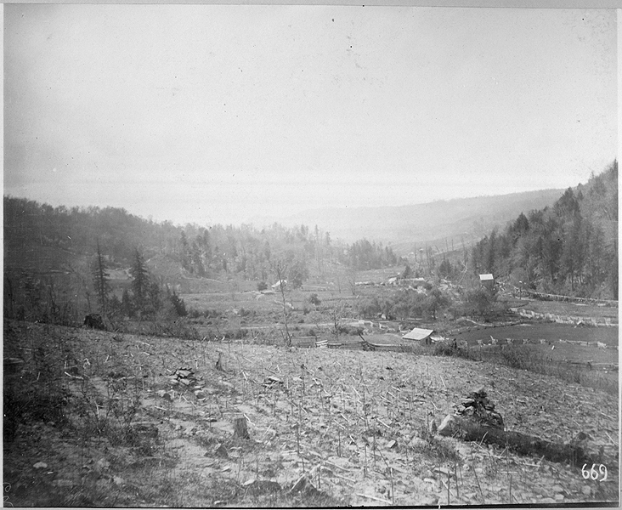
Eastern US streams have a history of human impacts
Agriculture
Logging
1600-early 1900s – Hillslopes denuded

Slide 5
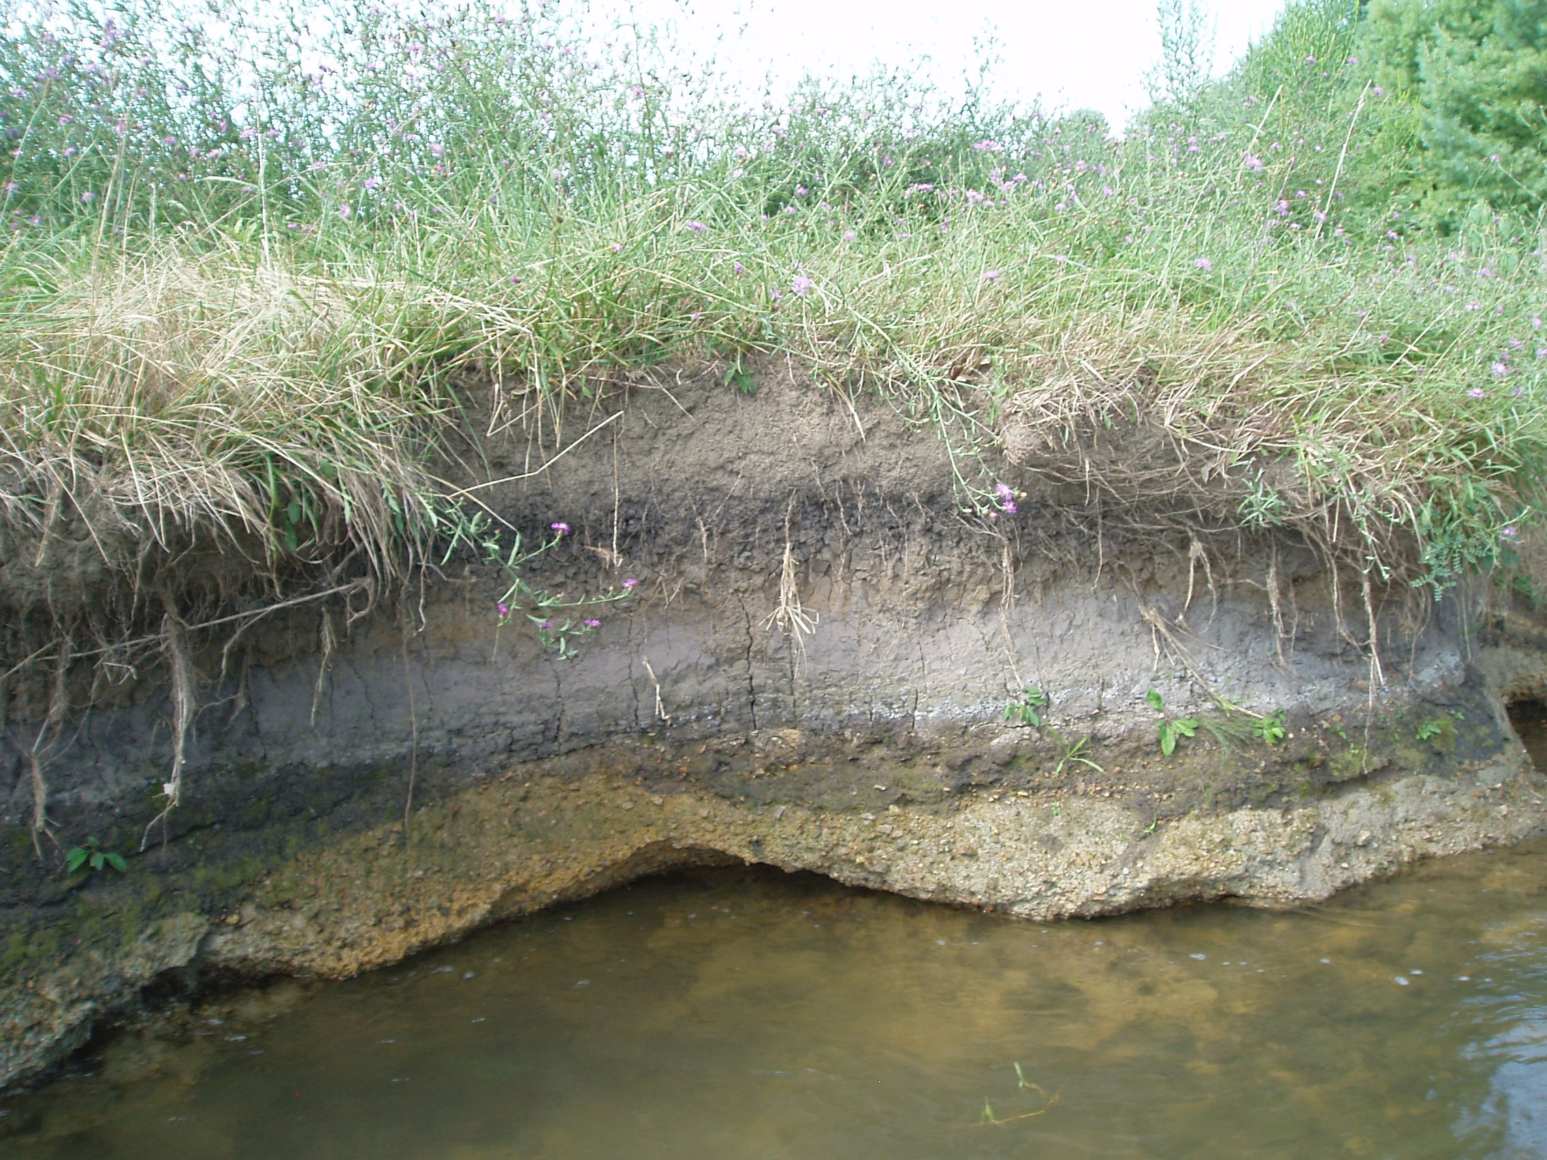
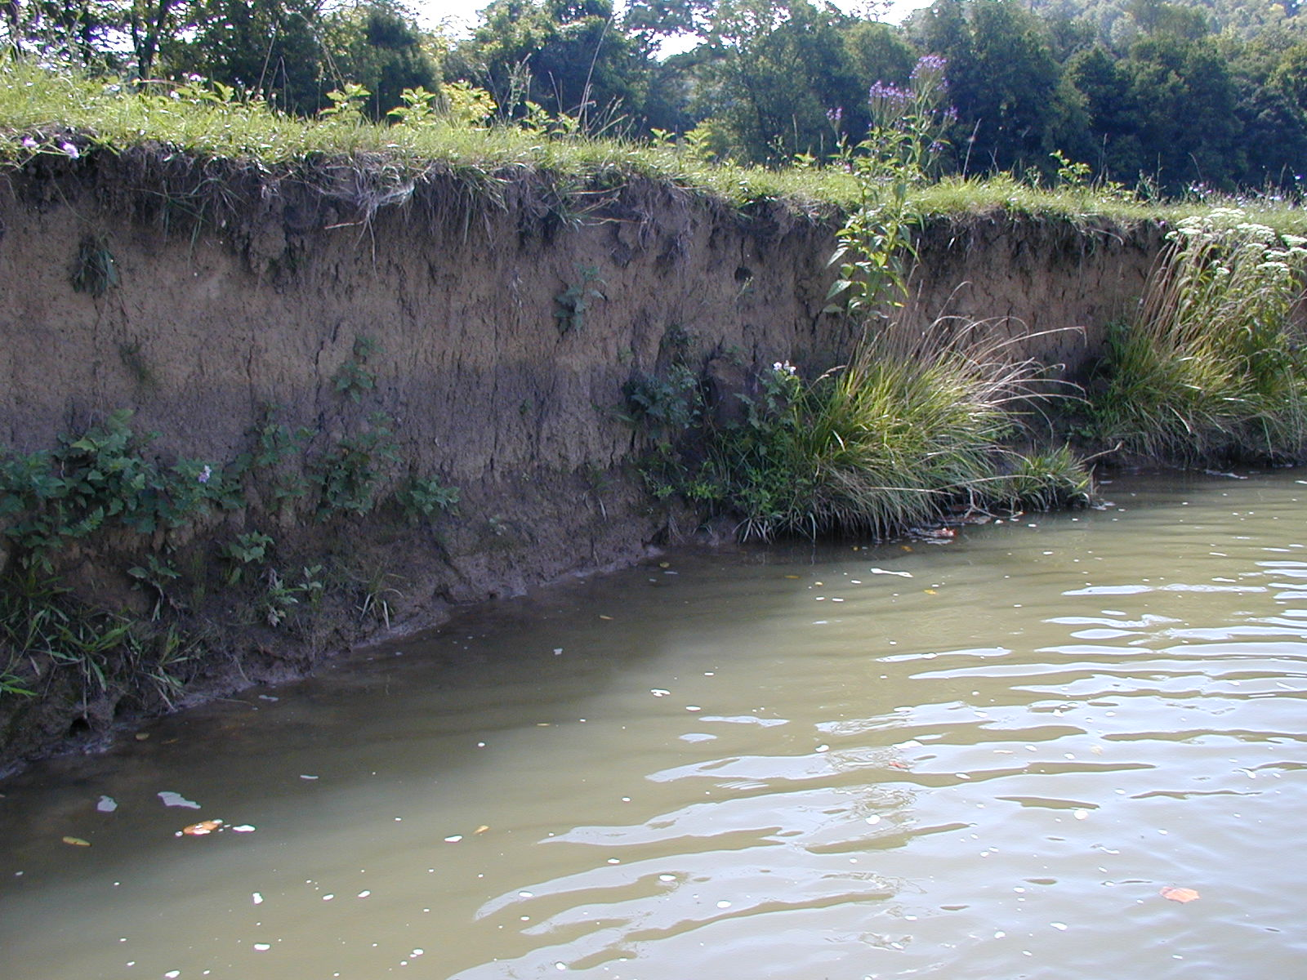
These sediments are now stored in the floodplains of headwater streams

Slide 6
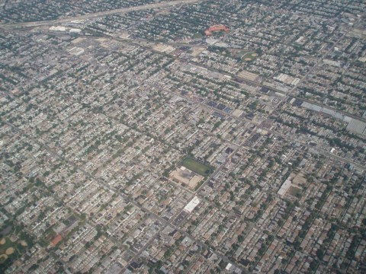

Slide 7
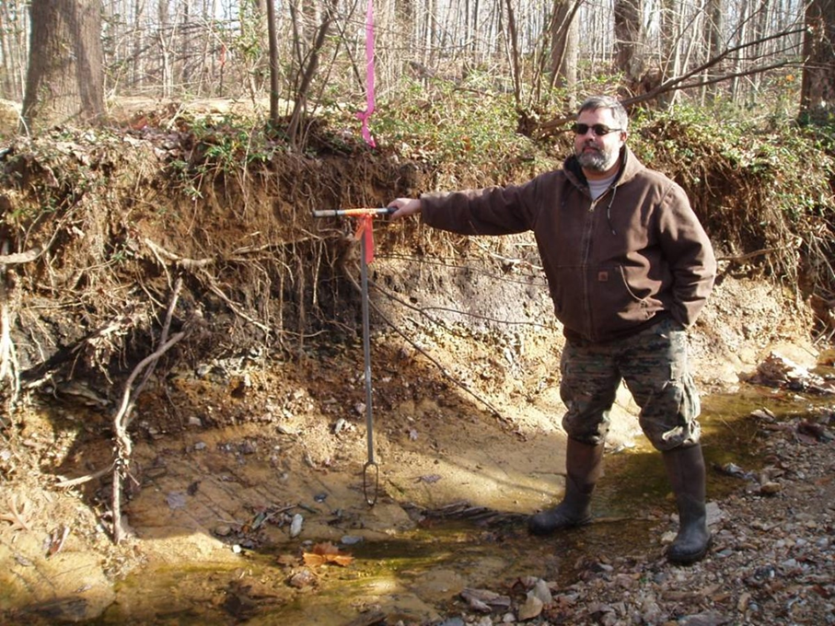
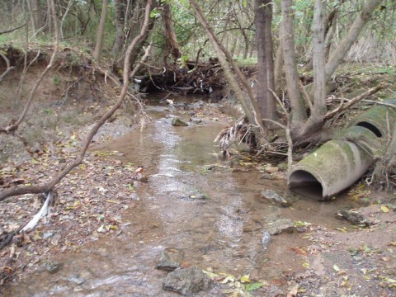
In eastern US streams, channel incision is frequently limited by bedrock and/or culverts
…so channel widening is common

Slide 8
The goal of this study was to quantify changes in fluvial erosion rates with changes in stream chemistry
Temperature
pH
Deicing salt

Slide 9
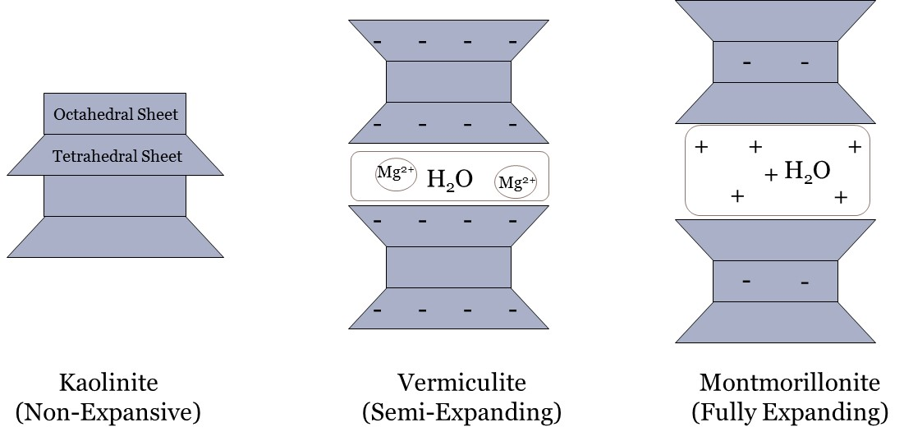
Cohesive soils are dominated by inter-particle attraction
Notes:
Cohesive soil “grains” are very small
Cohesive soils requently erode as aggregates
Crystal structure strongly influences soil behavior
Pore water and eroding fluid chemistry are important

Slide 10
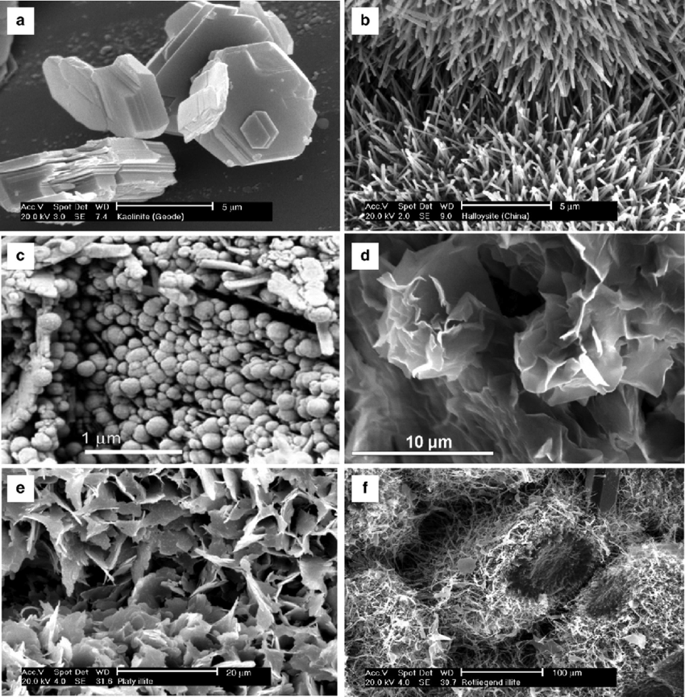
The type of clay in a soil plays a major role in erosion
Kaolinite
Tubular crystals of halloysite
spheroidal crystals of halloysite
Montmorillonite
Flaky illite
Fibrous illite
Industrial Clays - Scientific Figure on ResearchGate. Available from: https://www.researchgate.net/SEM-images-of-clay-minerals-a-pseudohexagonal-crystals-of-kaolinite-b-tubular_fig4_311583515 [accessed 30 May, 2018]
Images courtesy of The Clay Minerals Society and the Clay Minerals Group of the Mineralogical Society (Images of Clay Gallery, available at www.minersoc.org/pages/gallery/claypix/index.html).

Slide 11
Remolded, 5-cm diameter cores of two natural soils were tested in an 8-m recirculating hydraulic flume

Slide 12
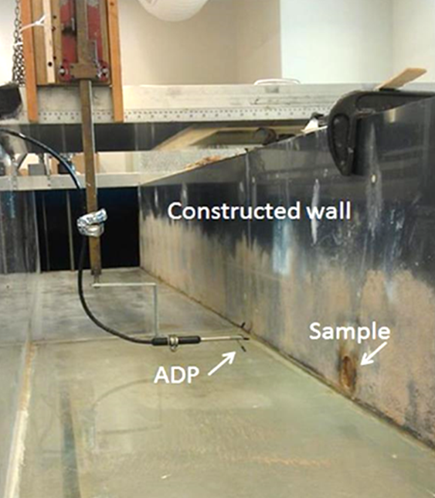
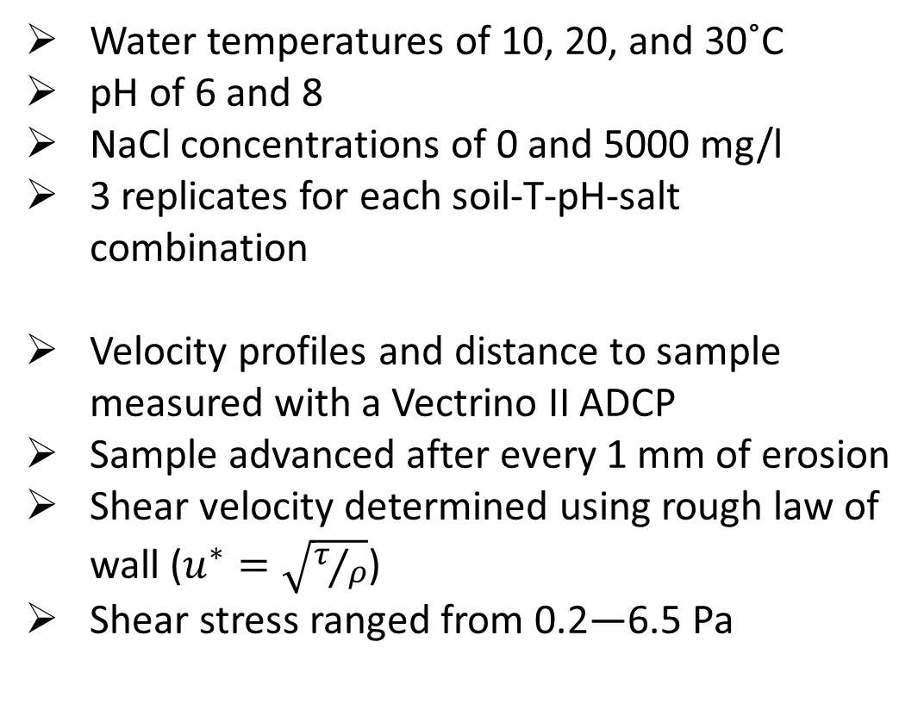
Water temperature, pH, and salt concentration were varied
Water temperatures of 10, 20, and 30˚C
pH of 6 and 8
NaCl concentrations of 0 and 5000 mg/l
3 replicates for each soil-T-pH-salt combination
Velocity profiles and distance to sample measured with a Vectrino II ADCP
Sample advanced after every 1 mm of erosion
Shear velocity determined using rough law of wall ($u^{∗}=\sqrt{τ/ρ}$)
Shear stress ranged from 0.2—6.5 Pa

Slide 13
Two natural soils were tested
Vermiculite-dominated
Montmorillonite-dominated
40% sand, 40% silt, 20% clay
  35% hydroxyl interlayered vermiculite
  10% vermiculite
  10% mica
  15% kaolinite
  13% quartz
  10% chlorite
  6% smectite
47% sand, 42% silt, 11% clay
  35% kaolinite
  25% montmorillonite
  20% mica/illite
  15% hydroxyl-interlayered vermiculite
  3% chlorite
  2% quartz

Slide 14
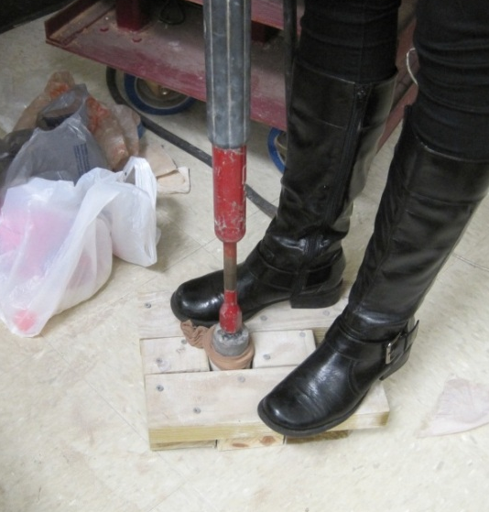
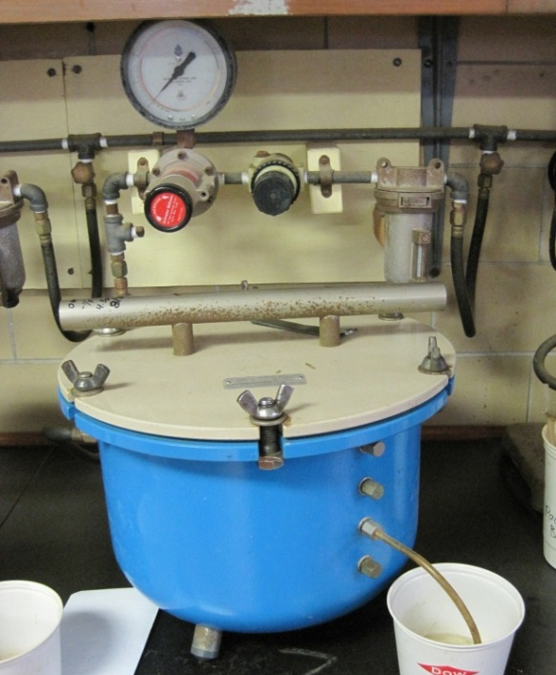
Soil sample preparation
Air-dried soils crushed and sieved (2-mm)
Dionized water added to bring to test moisture content
Compacted into 5-cm x 5 cm aluminum cylinders with a slide hammer
Saturated overnight
Placed in a pressure plate chamber to bring samples to field capacity (-1/3 bar)
Tested within 8 hours of removing from pressure chamber

Slide 15
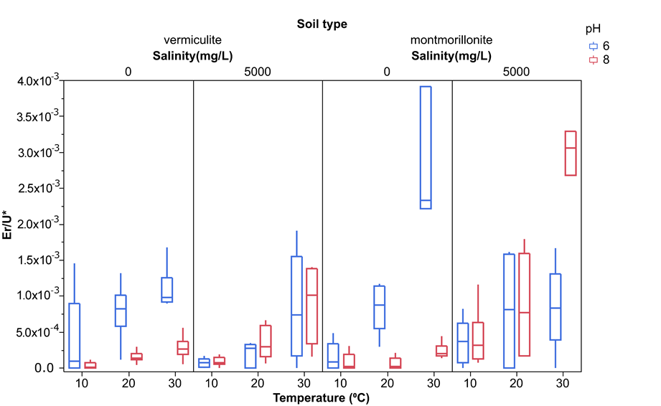

Slide 16
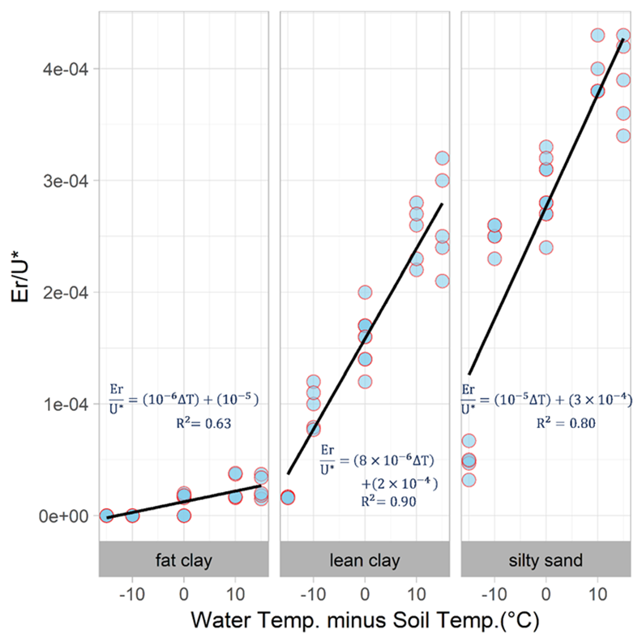
Actually, the heat exchange between the water and the soil affects erosion rates
New research by Akin Akinola

Slide 17
Wrapping it up…
Clay type and stream chemistry play a significant role in the fluvial erosion of cohesive streambanks
Stormwater regulations should require temperature control in addition to peak flow and volume control to maintain channel stability
The change in erosion rate with temperature is directly related to the change in enthalpy of the streambank soils

Slide 18
Questions??
https://en.wikipedia.org/wiki/Carnac_the_Magnificent

