Slide 1
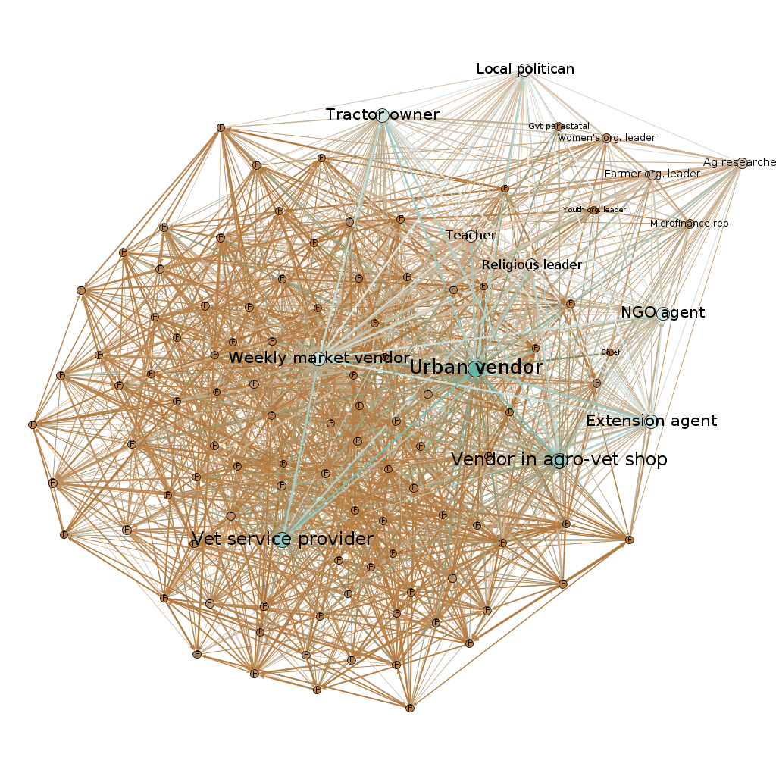
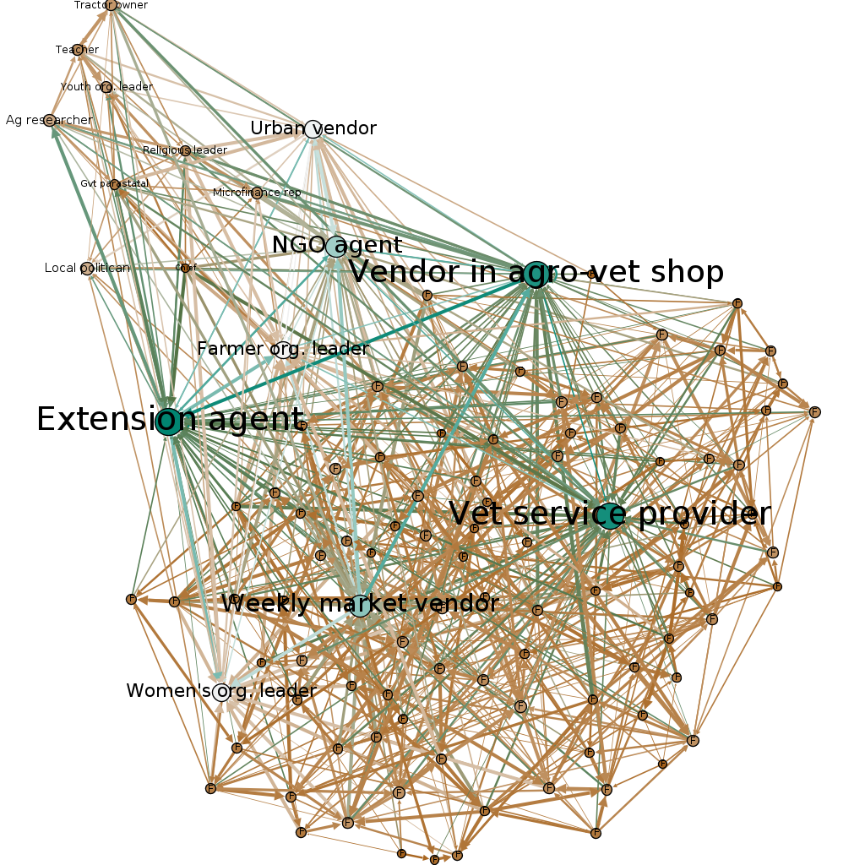
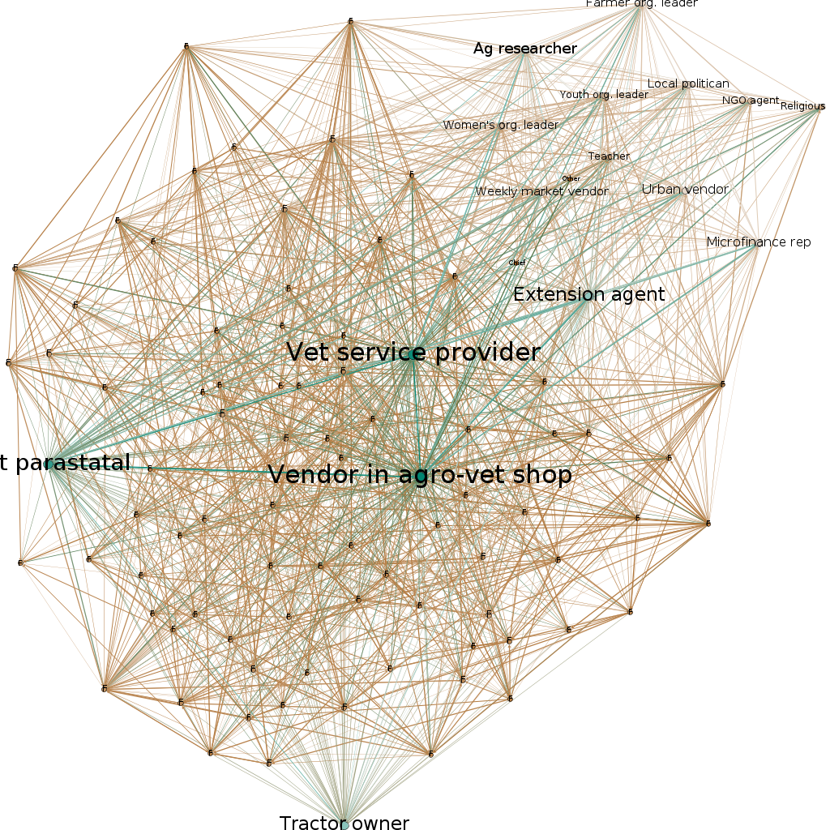
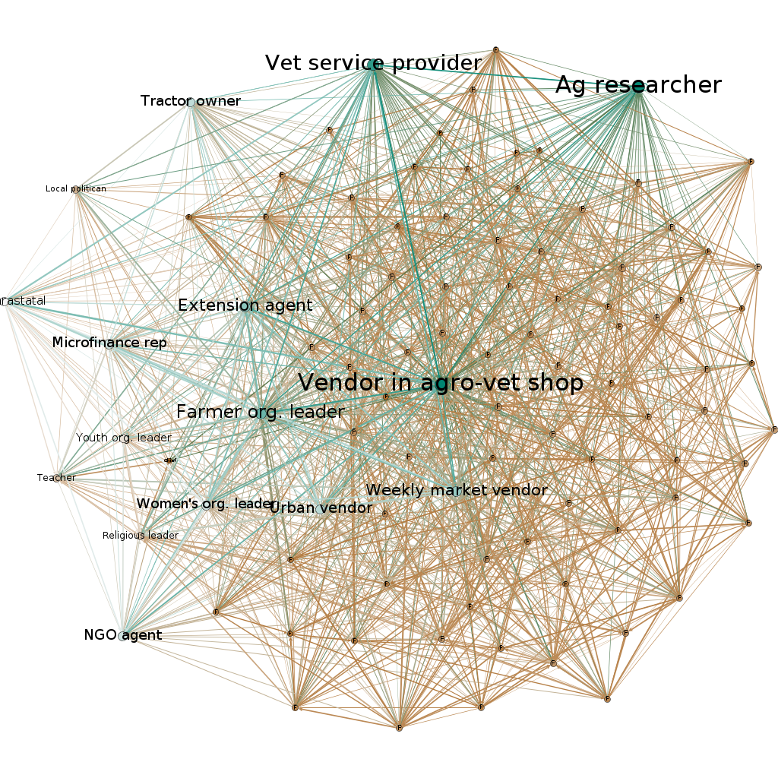
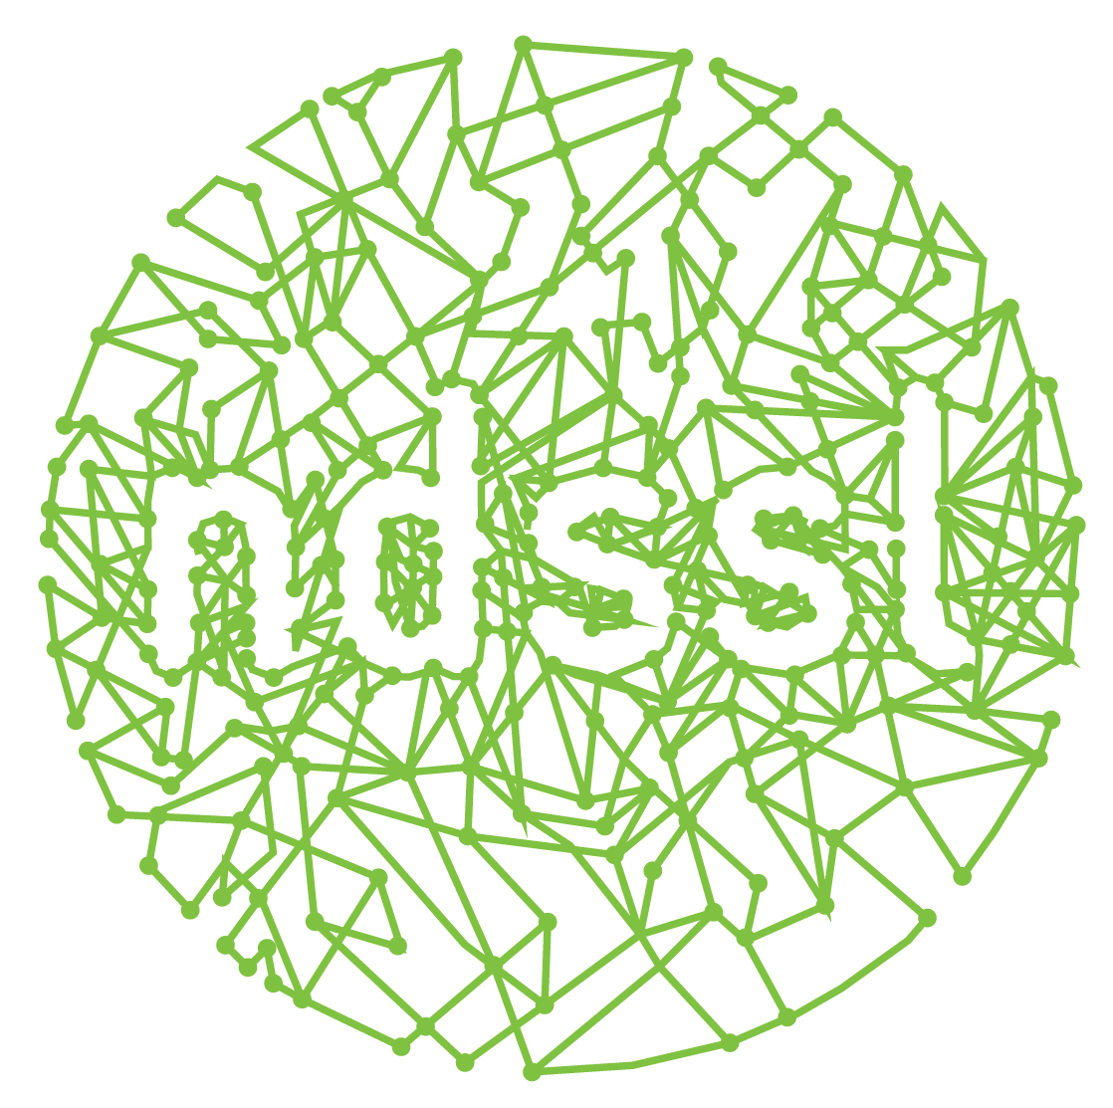





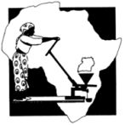

Innovation Networks and Social Contagion in East Africa
Jessie Gunter¹, Caitlin Rivers¹, Stephen Eubank¹, Keith M. Moore¹, Christopher Kuhlman¹, Jennifer N. Lamb¹, Jay Norton², Emmanuel Omondi², Rita-Laker Ojok³, Dominic Ngosia Sikuku⁴, Dennis Ashilenje⁵, and Johnstone Odera⁶
¹ Virginia Tech, ² University of Wyoming,³ Appropriate Technology-Uganda, ⁴ SEATEC Community Development, Kitale, Kenya,⁵ Manor House Agricultural Center, Kitale, Kenya, ⁶SACRED Africa Training Institute , Bungoma, Kenya
Abstract
Disease Model
This study seeks to understand the pathway by which new technology and the associated knowledge passes through community networks in western Kenya and eastern Uganda. Previous research in the region emphasizes the importance of community support to promote widespread adoption of Conservation Agriculture practices. We will simulate complex contagions of information in these networks using the simulation platform EpiSimdemics. This work complements and expands on the growing body of research that uses network analysis to study the effects of network structure and social contagion on complex health and social systems.
In the simulations, we will use an SI adaptation of the SIR disease model, which is a compartmental model in epidemiology.
Individuals who become “infected” with the information experience a mindset change towards Conservation Agriculture practices, which is represented numerically by a change in node state from 0 to 1.
SIR
SI
Susceptible
Infectious
Recovered
Susceptible
Infectious
time, t
time, t
Dataset
Research Locations
node state 0 1 2
node state 0 1
The data was collected in each of the four research sites using egocentric methods in which individuals reported their direct contacts in social networks from a locally adapted list of ~20 agricultural sector and community actors. Individuals and institutions also answered questions about their beliefs about farming practices.
Eastern Uganda and Western Kenya
Research Districts: Tororo, Kapchorwa, Bungoma, Trans-Nzoia
Network graphs
Kapchorwa
Future Research Questions
Tororo
What trends do the results of the simulations reveal about the flow of information through the networks?
How do the details in network structure affect the outcome of contagion?
Seed node adjustment
Thresholds assigned uniformly at random vs. according to survey responses about agricultural beliefs
Removal of key nodes
What are the optimal network intervention points to ensure the spread of information about Conservation Agriculture?
 | Tororo | Kapchorwa | Bungoma | Kitale
Number of nodes | 106 | 111 | 97 | 98
Average degree | 6.689 | 14.342 | 14.052 | 14.694
Complex Contagions
Bungoma
Kitale
Complex contagions require reinforcement from multiple sources in order to be transmitted.
Unaffected node: node that does not possess information.
Affected node: node that possesses information.
Threshold-t diffusion: a node becomes affected when at least t of its neighbors are affected.
Simple contagion: information transfer with t = 1.
Complex contagion: information transfer with t > 1 [Centola & Macy, AJS, Vol. 113, 2007].
unaffected
unaffected
affected
v₁
v₄
For t = 2, v₄ becomes affected.
v₂
node state transition model
v₃
affected

