Slide 1
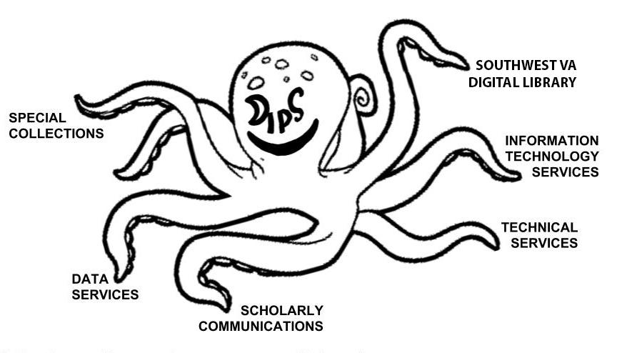
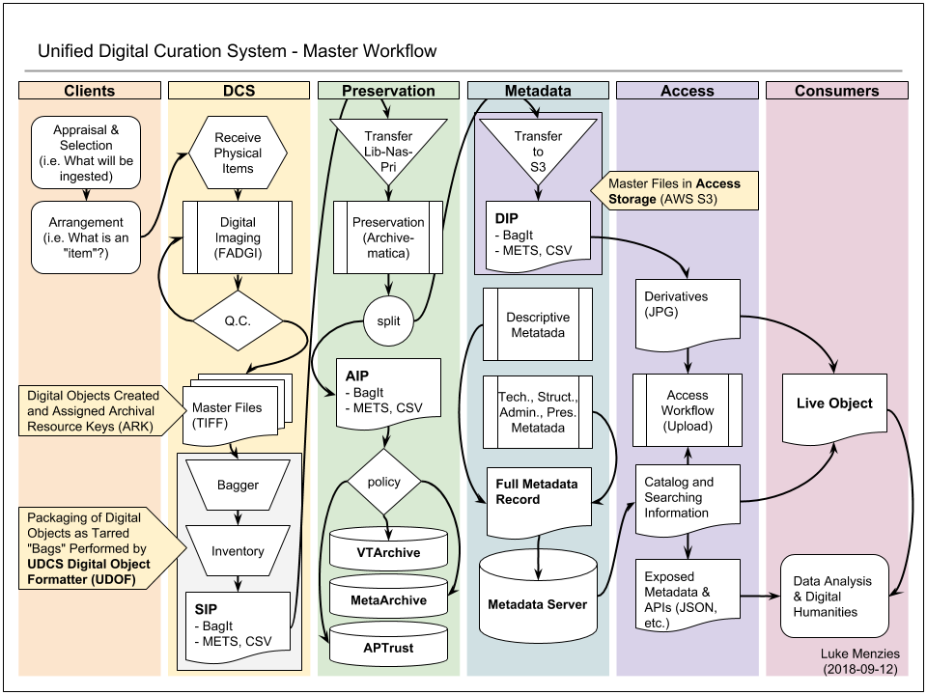



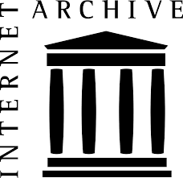



Middle-Where?
Preservation as Negotiation for Workflow Integration
Alex Kinnaman & Luke Menzies, Virginia Tech
P20
P20
Goal: use digital preservation “middleware” as a method for integrating our University Libraries’ current workflows and create a model for others to use for combining local infrastructure with external tools
Virginia Tech University Libraries:
Over 80,000 digital objects (and counting!)
5 distinct content repositories
2 external storage memberships (APTrust and MetaArchive)
2 faculty members hired for digital preservation
A mess of tools
Our Poster includes:
Timeline of our digital preservation decisions
Analysis of challenges and mediation techniques
Investigation of other universities’ initiatives
Next steps for VTUL
Take all of our tools, repositories, personnel, and workflows….
...and create a Unified Digital Curation System for the entire library

