Slide 1

Albatross: rolling on a sea of data
Annette Bailey
Tracy Gilmore
Leslie O’Brien
Anthony Wright de Hernandez

Slide 2
Background
Evolution of usage stats management:
BUD, SUSHI, Scholarly Stats, 360 COUNTER, Foster
Considerations:
Normalizing data
Subscription costs vs personnel costs
Flexibility of reporting
Notes:
LESLIE
Since 2002 (the inception of Project Counter) we’ve had at least 4 different methods of compiling and evaluating electronic resources usage data. We’ve used vendor products, spreadsheets, and MS Access databases. Today we will talk about our most recent initiative: a database to pull together journal usage data and cost data in a central environment where the data can then be queried to use in return on investment analysis. This project is a collaboration between Tracy Gilmore, assessment librarian, Annette Bailey, assistant director for electronic resources and emerging technologies, and Anthony Wright de Hernandez, a resident librarian at Virginia Tech who did a rotation in Collections and Technical Services in 2015.
ADVANCE TO NEXT SLIDE TO SHOW BUD

Slide 3
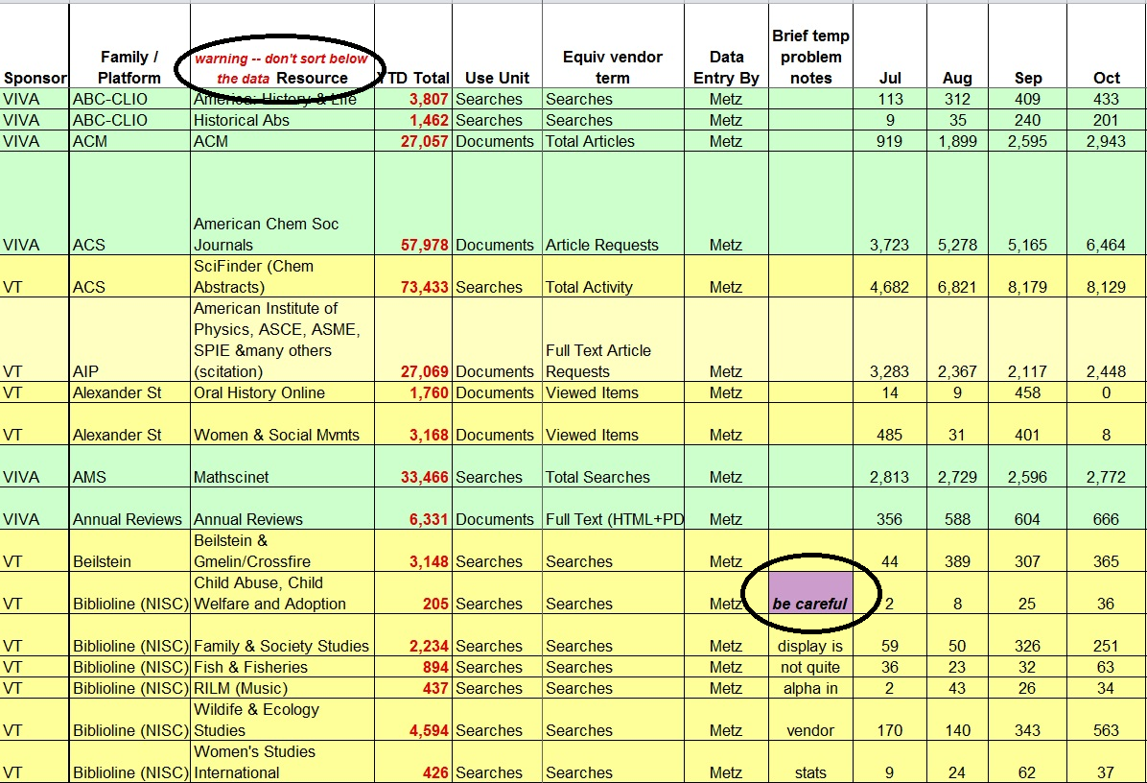
Big Ugly Database
Notes:
From 2002 to 2006 we kept track of usage data on a spreadsheet which was called the Big Ugly Database, or BUD for short.
This approach worked pretty well for tracking usage at the package level, but doesn’t allow for analysis at the individual journal. It doesn’t have any cost data, so cost per use and cost trends have to be calculated separately. You can see that different metrics are combined into one spreadsheet. There are warning messages reminding the collections staff about anomalies or special calculation instructions. And it contained fewer than 200 lines of data. By 2008 we were collecting over 150 different COUNTER reports with over 40,000 lines of data.

Slide 4
Background
Evolution of usage stats management:
BUD, SUSHI, Scholarly Stats, 360 COUNTER, Foster
Considerations:
Normalizing data
Subscription costs vs personnel costs
Flexibility of reporting
Notes:
We made some attempts to use SUSHI import into our Innovative electronic resources management module, but there were problems with that. We briefly used 3rd party solutions. With those products we had issues with non-normalized data that caused journal titles to either be duplicated in reports, or omitted entirely from reports. We also had to do a lot of work to supply cost data to those products in order to do cost per use analysis. The subscription costs for those solutions came out of the collections budget, which in the late 2000s was not very stable.
A former staff member designed a Microsoft Excel database which he called Foster, in honor of the original database, BUD. This will only make sense if you are a Virginia Tech football fan.
At that point we had a functional Access database that used COUNTER reports in combination with bibliographic data from our catalog. We could analyze a journal’s use across multiple platforms, cost per use by subject, cost per title by subject. We had control over our raw data, and we could create complex queries and data relationships.
For various technical and administrative reasons, we discontinued the MS Access database after a few years and we’ve been watching out for a new solution. We’ve thought about business intelligence systems licensed by our university, and new products like Springshare’s LibInsight. After careful consideration, it seemed like a locally developed relational database was the best solution for us to manage the rising sea of electronic resources data.
Anthony is going to talk about this approach.

Slide 5
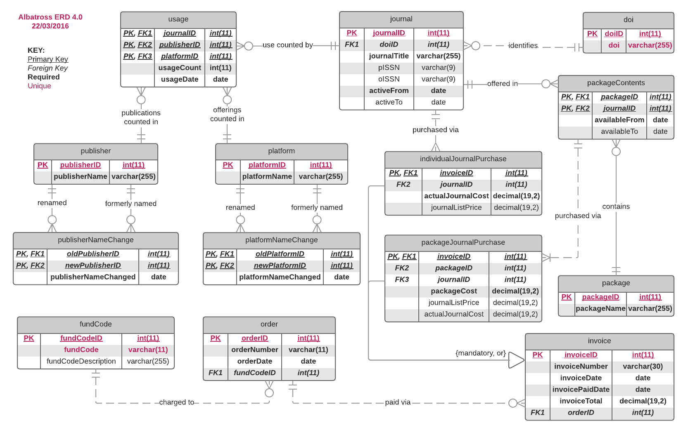
Navigating the Data: Entity Relationship Diagram
Notes:
Our first step in creating this new database was consideration of the data we wanted to be able to analyze and the tools we wanted to use to do that analysis.
I started with reviewing the data points and worked on developing an Entity Relationship Diagram (ERD) to reflect how the data are all related. Our main concern for this database is electronic journals, so much of the focus was on how everything ultimately connects back to the Journal and how we uniquely identify each journal over time through name and publisher changes or when more than one platform offers access. The main data points include information about the Journal, Package, Publisher, Platform, and Order.
Some challenges with the data were:
Rebranding - Journals, Publishers, and Platforms all have variabley names making it difficult to track usage over time. We chose to use the Digital Object Identifier (DOI) as a static identifier for each journal because it is the only data point that once assigned should never change. It is also required in the current COUNTER standard.
Reflecting Individual purchase vs. purchase as part of a package was another challenge. In the database, this is a decision point with subtables to enter the relevant data. Calculating costs is more complicated because we don’t always have a neat individual price paid for each journal. Because of this problem, we had to incorporate the vendor’s published list prices to use as part of the cost analysis.
NEXT SLIDE: Visual Paradigm vs. LucidChart

Slide 6

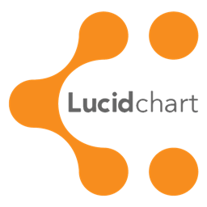
Navigating the Data: Entity Relationship Diagram
Positives
Great automation
Helpful for beginners
Multiple platforms
Negatives
User helps aren’t that great
Desktop software only
License fees ≈ $100 / 3 mos.
Positives
Free for Education
Google Drive integration
Web based
Negatives
No automation
Requires experience
Requires Internet connection
Notes:
Our initial ERD development was made easier by using a paid software: Visual Paradigm. This software helped get our ERD development off the ground. It’s easy to use and provides some support for new designers such as drop-down lists for data types and help with crow’s-feet notation and assigning primary and secondary keys. Another key plus is that it isn’t limited to Windows only. For someone who hasn’t done a lot of ERD design, it was a good tool. We used it during the heavy development phase.
After the initial ERD was created, we migrated to LucidChart which allows collaborative editing of diagrams at no charge for education, so it’s free for us. Since the ERD will be undergoing less frequent edits, a free option made more sense going forward. It’s cross-platform since it’s web based and integrates with Google Drive. It wouldn’t have been a great choice for our initial development since there aren’t any drop-downs or helps built in. You have to know what you’re doing to use this tool for ERD design.
NEXT SLIDE: Gathering the data

Slide 7
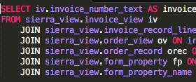
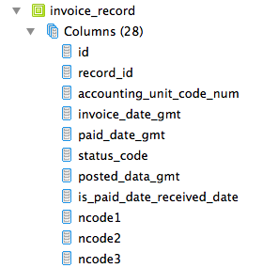
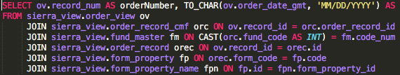
Building the Database: Gathering Cost Data
Two types of cost data:
List Price
  Obtained from vendor lists
Actual Cost
  Obtained from the Sierra Database Navigator tool (SierraDNA).
Data Gathered
2,389 order rows
13,705 invoice rows
Allows comparison of
paid price
discounted (package) price
list price
Costs pulled from invoice and order records required joining 6 tables to connect the DOI to the cost for each journal.
Not a lot - but it was challenging to identify the table connections in SierraDNA.
Notes:
Now, just a few words on how we gathered our cost data.
List Price information was obtained from published lists put out by vendors. Tracy’s team gathered this information from the various sources they have.
I worked on getting the actual cost data using SierraDNA.
In SierraDNA, I wrote queries to pull the price paid for each journal. This is complex because each order can have multiple invoices. The images here show glimpses of the queries I wrote and a view of the invoice_record table in Sierra.
I had to locate a path through the tables that would connect the journal to the invoice that paid for it and the invoice item that reflected its cost. For anyone familiar with SQL, this isn’t a terribly difficult task except that Sierra was clearly never designed for users to interact with in this way. Sierra stores data broken out into widely separated tables and figuring out how to connect two data points within Sierra can be a challenge. I ultimately found the path and was able to pull the reports we needed by using joins to connect 6 tables together to get the related data points we needed.
My initial query pulled a total of 2,389 order rows and 13,705 invoice rows to be imported into Albatross for use in our analysis. These orders and invoices represent the paid and discounted prices for the journals we have obtained. By including them in the database, we can compare these prices to the list prices published by the vendors.
Next Tracy will talk to you about gathering our other data points

Slide 8
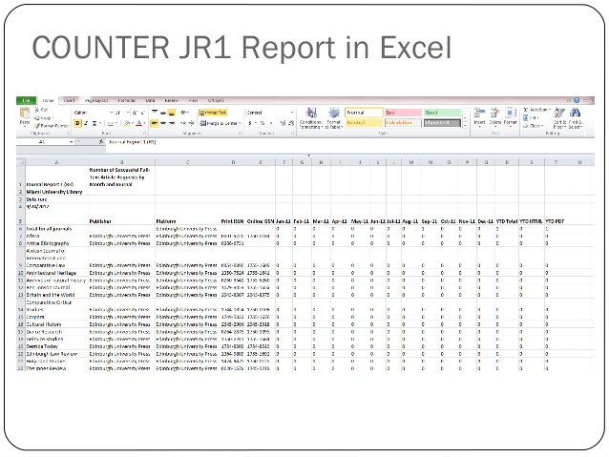
Building the Database: Cleaning up JR1 COUNTER reports
Challenges working with 5 years of usage reports:
Reports varied in structure and content
Most reports were COUNTER release 3 or 4
Many reports were non-COUNTER
All reports required some manipulation
70% of reports both COUNTER and non-COUNTER required DOI’s
Notes:
Cleaning up the JR1 reports required touching every single report from 2010 through 2015 to ensure that each report was consistently formatted. This meant moving year-to-date column totals on COUNTER 3 release reports from right to left, re-formatting non-COUNTER reports to look like COUNTER, and adding DOIs to all JR1. Consistent, Comparable, Credible, Clean

Slide 9

Building the Database: Digital Object IDs
The majority of journal titles did not have DOIs
Used CrossRef to find and add DOIs where available
Created our own schema based on:
  Journal Title initials
  ISSN
  10.9999/ISSN or 10.9999/journal initials
Identified over 100 journal packages and collections
  Adding DOIs to titles
  Identifying the list price
Notes:
70% of our records did not have DOI and these were needed in order to identify journals. To compensate for journals that lacked DOIs we created our own DOI schema to act as a temporary identifier associated with each journal title. As registered DOIs become available on current and future JR1s we will updated the previous years using vlookup.
In addition to adding DOIs to individual Journal titles we had to create a table that identified every title associated with a journal package or collection and give them specific identifiers and consistent DOIs and provide the associated list price these journals, because the cost data we had was associated with the package or collection and not at the journal title level which is what we needed for cost per use analysis.

Slide 10

Building the Database: Not so standard data
Data from vendors - not following the standard closely - i.e. lack of Journal DOIs
COUNTER JR1 reports - no longer in standard format
We wrote scripts so that we can work across the cumulative data set. These scripts generate reports.

Slide 11
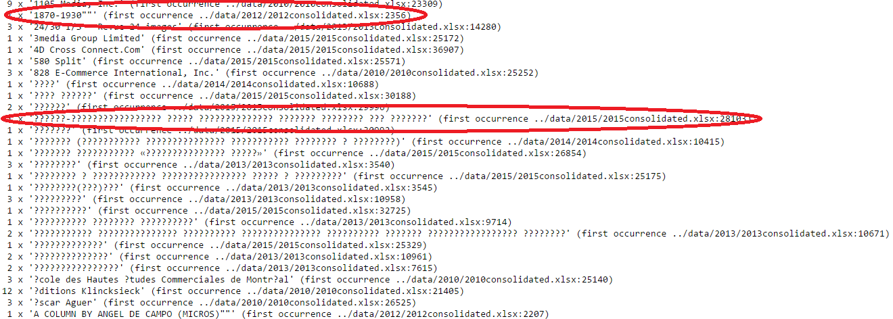
Building the Database: Publisher Data
Notes:
Data Volume (# years): why did we choose this amount of data
-talk about the COUNTER data

Slide 12
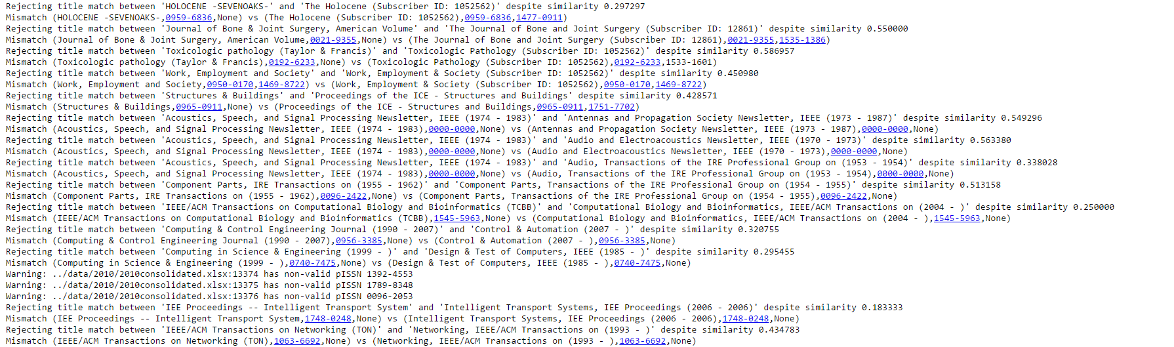
Building the Database: Journal Title Data
Notes:
Data Laundering
Diacritics
Data Cleanup (title standardization, etc.)
Scripts created

Slide 13

Using the Database: Workflows
New skills and new tools were required to work with and visualize our data.
SQL for querying the database
VLookup for updating DOIs
Pivot tables and Pivot charts
Excel Dashboards
Google Dashboards
Tableau
The purpose is to provide a more public and robust picture of our usage.
Notes:
The purpose for cleaning and creating consistent formatting for all of this data is for both internal and external reporting of our journal usage over time. We also want to analyze our journal usage by platform, publisher, discipline, department, or college. And to provide multiple viewpoints of this data in reports to our liaisons and stakeholders in a clear, concise and visually formatted way that contributes to a deeper understanding of how these resources are being used.

Slide 14
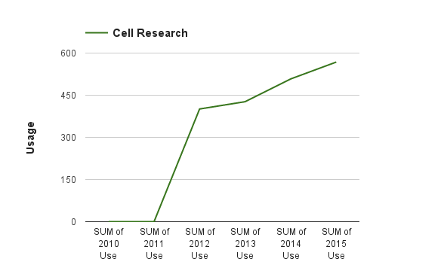
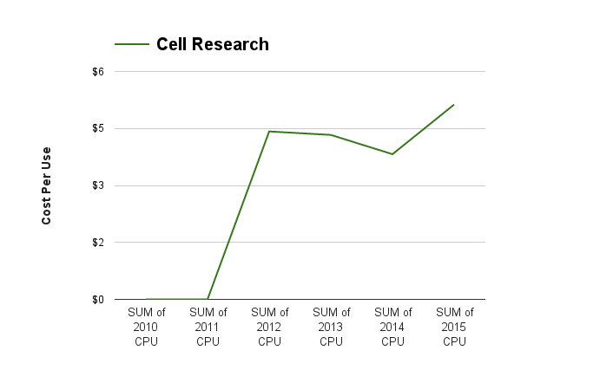
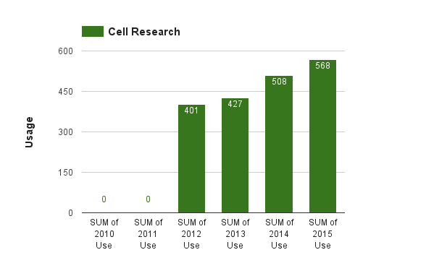
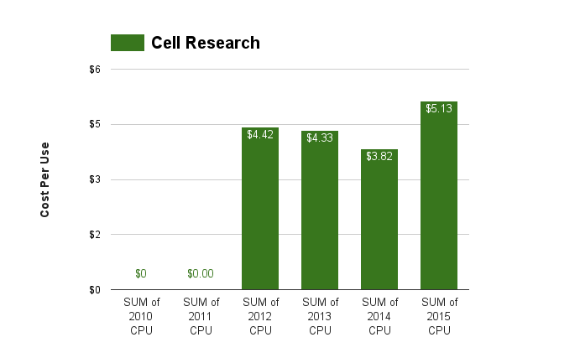
Using the Database: Reports
Notes:
This slide is a depiction of the way we are viewing our data today, creating cost per use charts and dashboards in excel. We have spent the majority of our time collecting, cleaning, and managing various COUNTER reports, but I see our role moving more into the service of regularly consulting specifically with our subject liaisons and providing them with valuable insights and actionable data.

Slide 15
Why design our own database?
Budget
Control over the data
Allows for robust reporting
  Review of journal packages
  Accommodates changes to COUNTER
Flexibility and long-term sustainability
Notes:
You might ask why we’re building our own database instead of using an 3rd party solution. We have experience with several 3rd party products, so we didn’t decide to do this on a whim. We’ve tested SUSHI with our III MIllennium system, it either didn’t import or didn’t import correctly.
An obvious reason is budget--we want to preserve as much of our collections budget as possible for content for our users, or products that add value to our collections that we cannot easily develop ourselves.
There are many free or low cost products available now that weren’t available to us when we created our previous databases. Many of our staff have acquired skills in scripting and writing queries that we used to have to rely on our IT staff for. We have more file storage space available to us than we did 10 years ago.
Another reason is to have more control over our data. We receive so many non-standard reports, even reports that claim to be up to the latest COUNTER standard don’t always conform.
When COUNTER standard changes we can adapt to normalize the data as we need to.
Our database can grow to accommodate a variety of queries for different purchasing models. We can create “what if” scenarios for journal package by comparing list prices to discounted prices. We can incorporate cost sharing with our consortia and buying groups.
Another factor that’s important to us is decentralizing the workload for our journal review database. This would be a concern with both the in-house solution or hosted solution. We have many staff involved in collecting and compiling use reports, and learning SQL. We think this solution is scalable and relatively easy to support. The data is backed up by our university IT unit.

Slide 16
Evaluating the Database: Future Plans
Expanding the data points
Demonstrating the value to the university
Evaluating package and big deals
Automated download of COUNTER reports for maximum flexibility and less manual work
Investigating data warehousing solutions and data visualization tools (in process):
  Amazon Web Services
  Google Drive
  Hiring data visualization specialists
Notes:
Our next steps are to expand the number of datapoints we include in the database. We have numerous questions we want to answer. As I mentioned just now, there’s an increasing need to evaluate package scenarios. Big Deals don’t seem to be going away. We are also seeing evidence based or usage based package offers. It’s important to know what titles in the package are being used, what’s the use of front file vs backfile articles, and calculate the inflation costs for different scenarios.
If SUSHI downloads can be incorporated into the data gathering process, that would be fantastic. but if it can’t, we need to find other ways to streamline that process.
We’re being asked, as many of you probably are, how our library collections and services add value to the university. Virginia Tech is introducing performance based budgeting in the near future, and we’ve been asked to come up with metrics to demonstrate our success and value. We need to develop skills with data visualization tools to help us present the information in meaningful ways and tell our stories.

Slide 17

Questions?
Annette Bailey: afbailey@vt.edu
Tracy Gilmore: tgilmore@vt.edu
Leslie O’Brien: lobrien@vt.edu
Anthony Wright de Hernandez: antwri@vt.edu

