Slide 1
IDEAL Spreadsheet
Tony Ardura, Austin Burnett, Rex Lacy, Shawn Neumann

Slide 2
Project Description
IDEAL is utilized to provide visualization aids for researchers making use of large web archive files.
This information will be processed through Hadoop with a spreadsheet like interface.
Why would we do things this way?

Slide 3
Interface, iteration #1
- Using,HTML / CSS, jQuery and javafx
Interface consists of selectable archives
Filter options to restrict output
Selectable list items take user directly to result

Slide 4
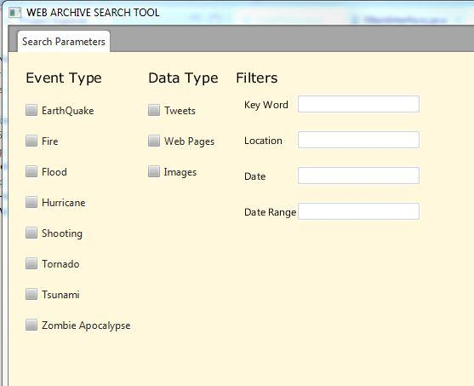
Iteration # 1
An early idea for a filter tool
Addresses filter needs
But not client specs

Slide 5
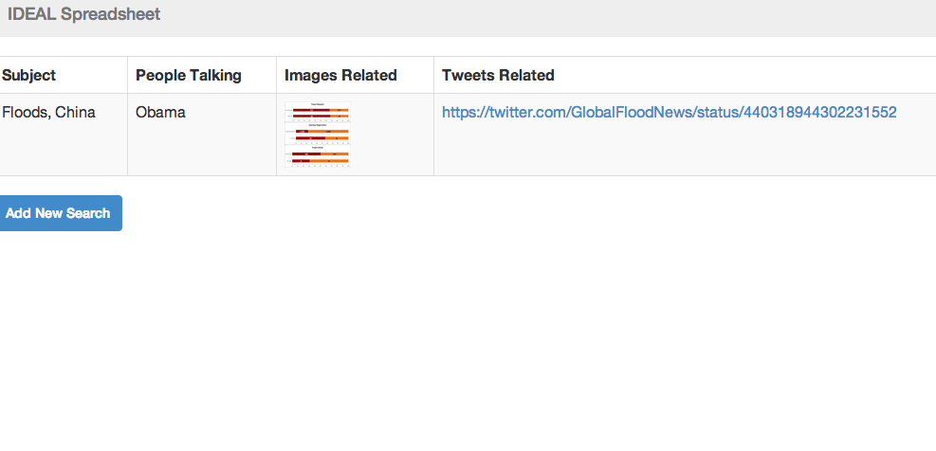
Iteration #2
More current version:
Web page of results
Ability to continue search
Ability to further refine

Slide 6
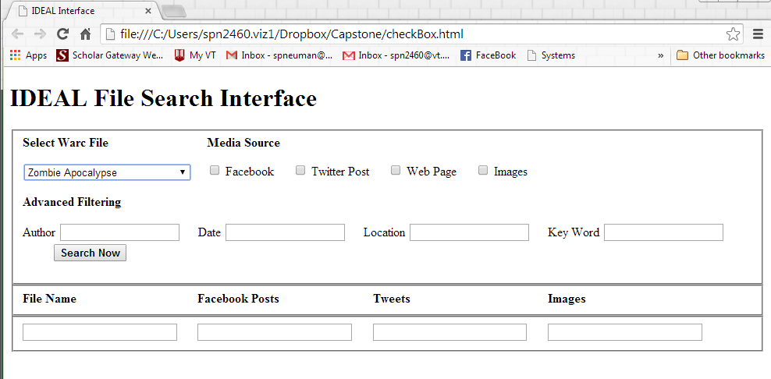
Iteration #3
Client Feedback
On the right track. Eliminate check boxes.
Add feature to apply filters by dragging through cells
(similar to excel)

Slide 7
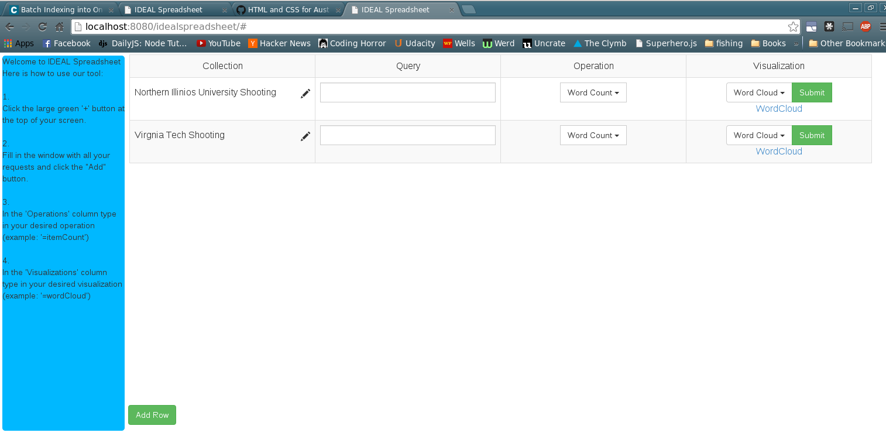
Iteration #4, Final Version
Combines spread sheet type feel with ease of use functionality.
Can be modified easily to accommodate future users.

Slide 8
Problems Faced
Requirement Ambiguity
Project Scope
UI / Backend Balance

Slide 9
Learned
Get rid of ambiguity as fast as possible
Better group organization
More research

Slide 10
Looking Ahead
Help section
SOLR integration
More operations

Slide 11
Demo Video
https://www.youtube.com/watch?v=f0gsRTUxQNs&feature=youtu.be

Slide 12
Questions?

