Slide 1
Creating a Website for Election Predictions
Team Members: Bryan Tran, Pierre Tran, Eunice Hong, Danny Pham, Danny Chung
Course: CS4624: Multimedia, Hypertext, and Information Access
Instructor: Mohamed Farag
Blacksburg VA 24061
2/6/2024
Notes:
bryan

Slide 2
TABLE OF CONTENTS
01
02
03
04
05
06
Client
System Design
Features
Implementation
Challenges
Live Demo
Notes:
bryan

Slide 3

Client
Dr. Can Dogan
  Ph.D. in Economics
  M.A. in Economics
Contact Information: cdogan@radford.edu
Specializes in data analytics and machine learning algorithms
Notes:
Pierre

Slide 4
Project Deliverables
Present the existing data in an interactive website
Present the prediction results for the 2024 election on a U.S. map showing the counties on the map with different color codes
Present the prediction results for each county along with fundamental variables when the county is clicked on the U.S. map
Notes:
Pierre

Slide 5
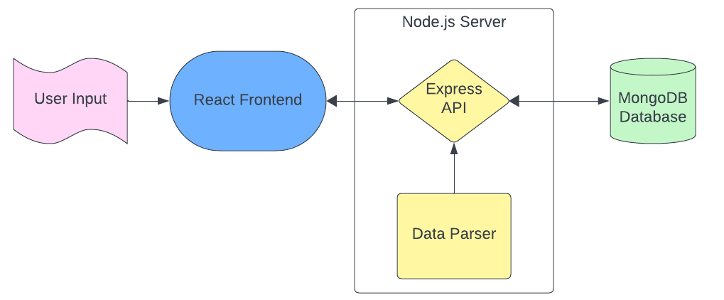
System Design
Notes:
Danny C

Slide 6

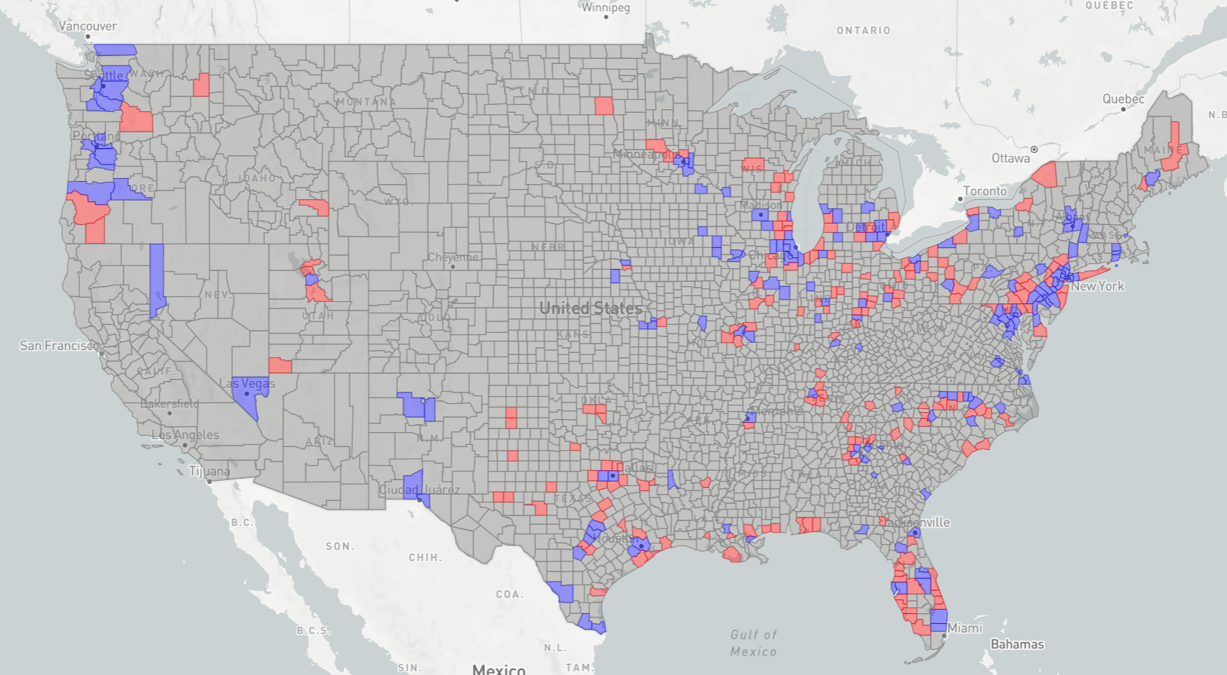


Frontend Specifications
Technologies
  React
  Mapbox
  Material UI
  Chart.js
Requirements
  Landing page
  Interactive Map to display election prediction and data
  Separate data visualization page
  Admin login page to import new data
Notes:
Danny C

Slide 7

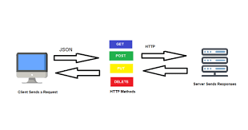


Backend Specifications
Technologies
  Node.js
  Express
  MongoDB
  Multer
Requirements
  REST API
  Custom user authentication
  Get endpoints
  Post endpoint
  Data parsers (xlsx to schema)
Notes:
pierre

Slide 8
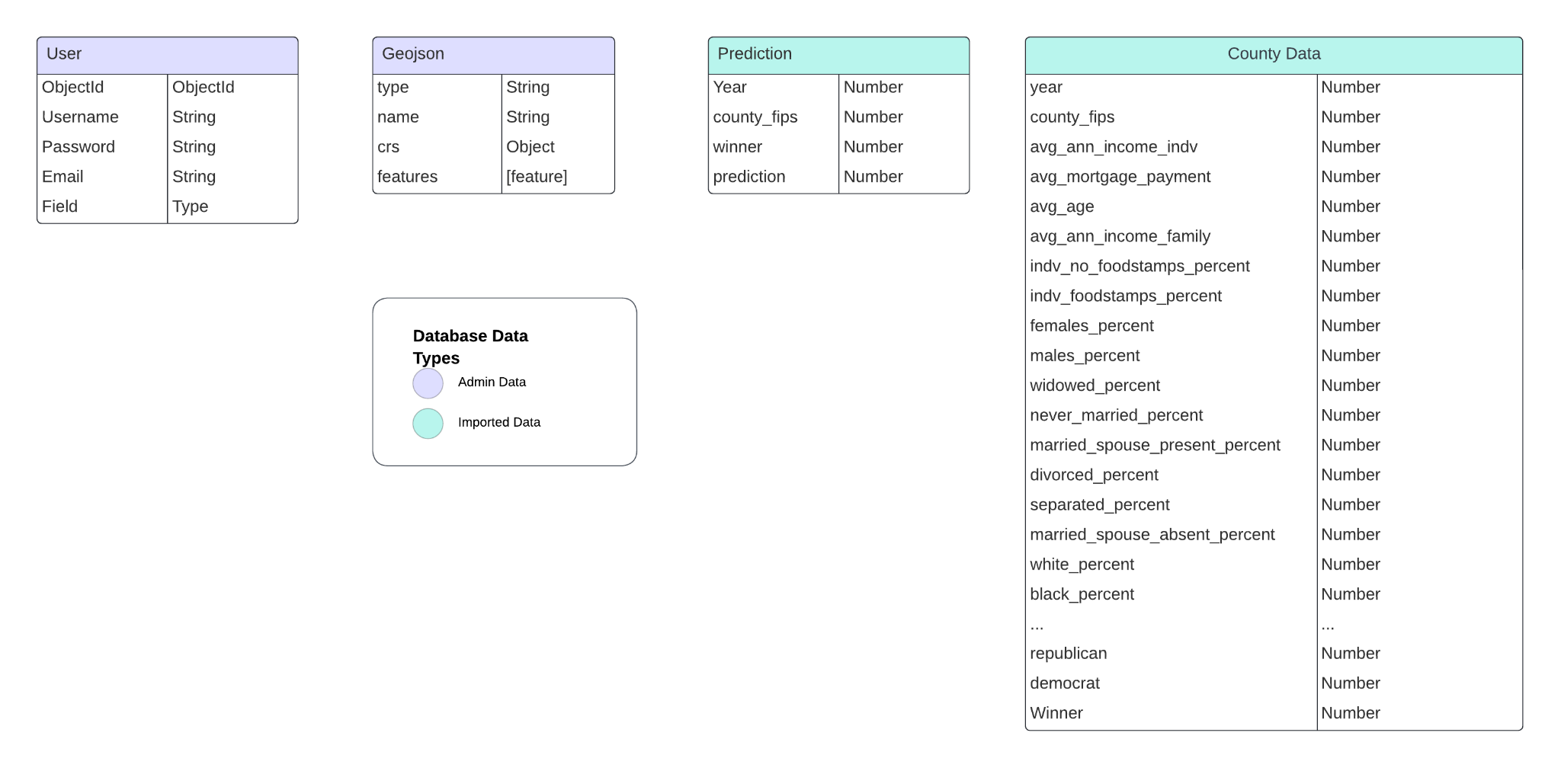
Database Design
Different collection for each year of data
4 Databases
  User
  Geojson
  Prediction
  County Data
Notes:
pierre

Slide 9
Features
Map Page
Data Trends Page
Login/Register
Import New Dataset
Interactive map to display prediction results
Show trends in data over time
Login or register new account
Add to existing dataset or import new one
Notes:
bryan

Slide 10
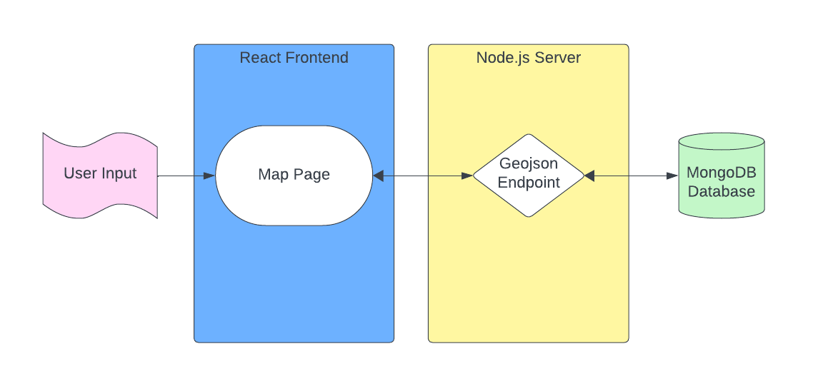
Map Page
Our map page will act as the main hub for users to explore
Map uses mapbox API to be fully interactive and dynamic to any data in the database
Map uses geojson data to display county boundaries
Each county has different colors to represent the election prediction
Notes:
bryan

Slide 11
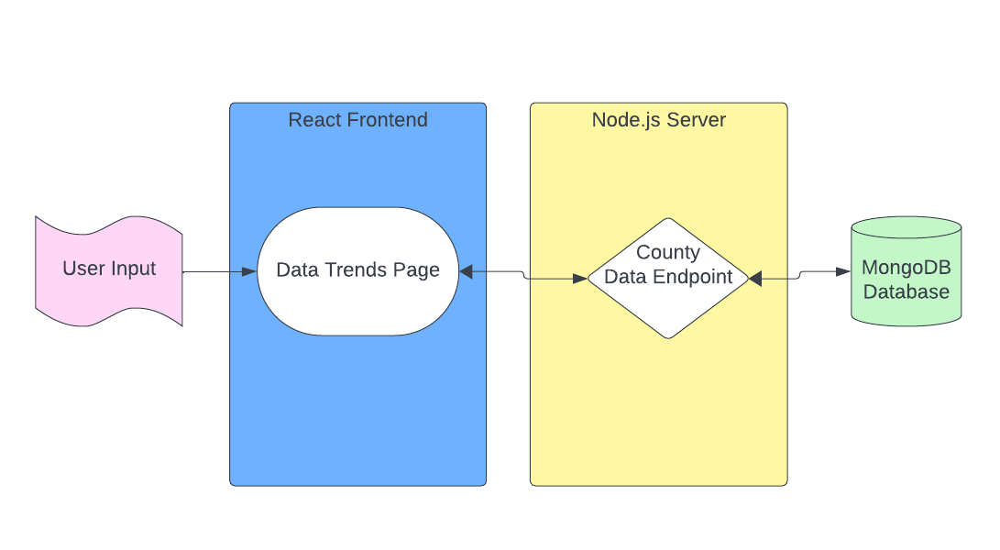
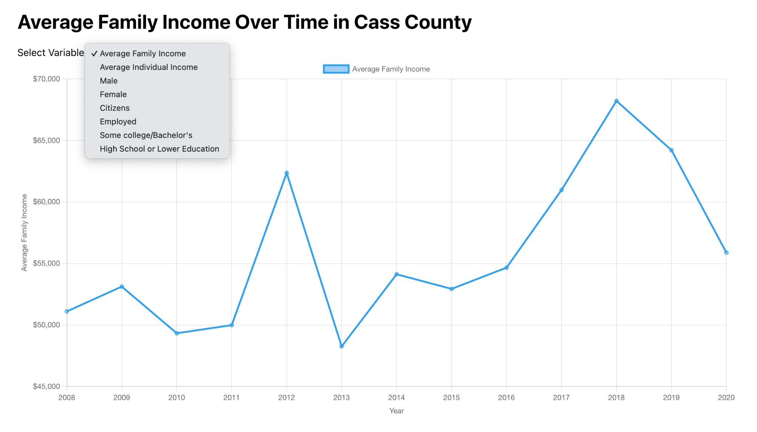
Data Trends Page
User clicks on a county from Map Page
Routes to trends page displaying in-depth data for that county
Can Choose which variable to display data for
Notes:
Danny C

Slide 12
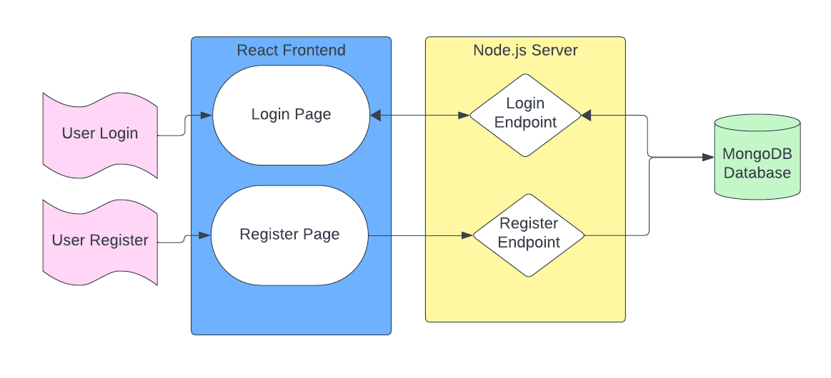
Login/Register
Allows a user to register an account into our database
Login is needed to import data
Custom authentication using bcrypt in our backend
Stores encrypted password in user collection
Notes:
Eunice

Slide 13
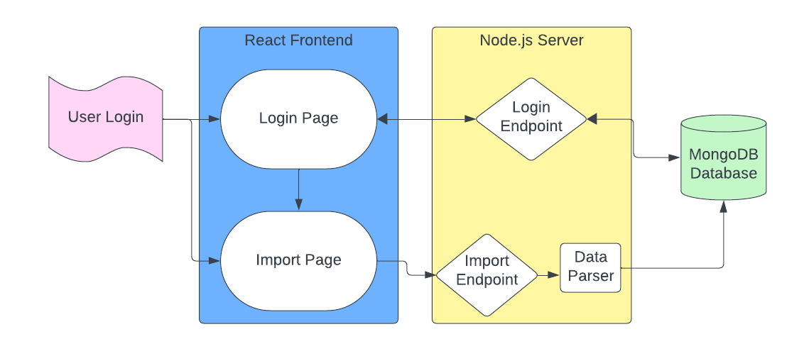
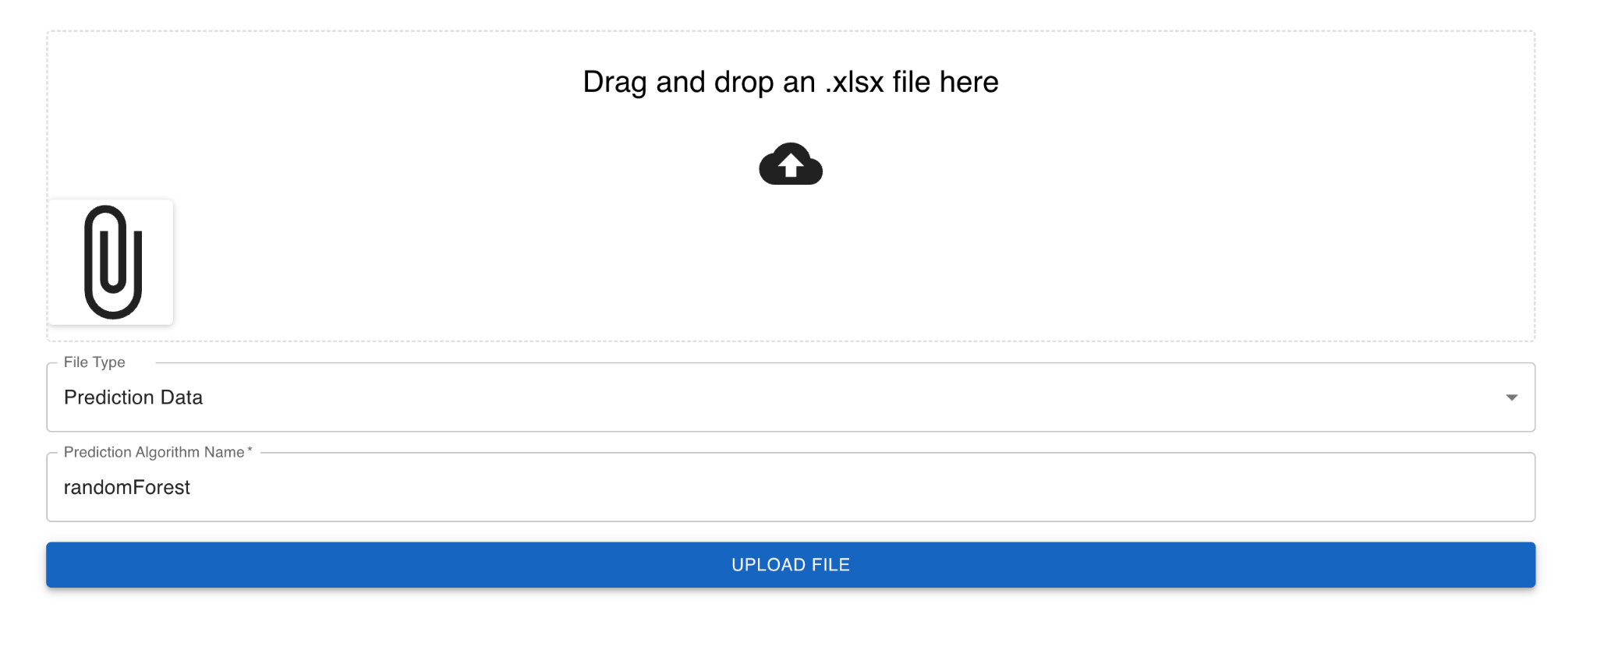
Import New Dataset
To import a new dataset user must login in
Imported datasets will either be appended onto an existing dataset or create a new one
The import endpoint will be run through a data parser/validator to add the database
Notes:
Eunice

Slide 14
Challenges
Coordinating the specifics of the revelation information to be displayed on the map and trends page
Uploading and parse files
Miscommunications between client and developers
Notes:
Danny P

Slide 15
Future work
Expanding the dataset to include more demographic variables and election cycles for deeper analysis.
Integrating machine learning model updates to refine predictions based on new data.
Exploring additional interactive features to further engage and inform users
Notes:
Danny P

Slide 16
Acknowledgement
Professor Farag
Dr. Can Dogan
Notes:
Danny P

Slide 17
References
Slide Template: https://slidesgo.com/
Sources:
https://webapps.radford.edu/eprofiles/profile/page/cdogan#details
https://www.mapbox.com/
https://www.nytimes.com/interactive/2021/upshot/2020-election-map.html
https://www.mongodb.com/
https://blog.logrocket.com/multer-nodejs-express-upload-file/
Notes:
Danny P

Slide 18
LIVE DEMO
Notes:
pierre

Slide 19
THANKS!
Do you have any questions?
Notes:
Pierre

